Slide 1
Variability in the western tropical Atlantic and its impact on air-sea interaction and coupled boundary layers
Science background:
Upper ocean stratification in region driven by barrier layer, which is greatest in winter months and affects upper ~100 m
Model results suggest that this occurs because increased mixing from air-sea fluxes deepens thermal layer, but salinity stratification persists due to advection
Processes including the submesoscale through submesoscale vorticities associated with the salinity fronts have significant effect on restratification →
Regional coupled model simulations with ocean mesoscale variability suggest that increased resolution provides:
Higher ocean SST gradients (in line with observations)
More realistic winds, particularly along equator and ATOMIC region
Improved rainfall representation
→ improved air/sea flux representation improves ocean stratification
Seo et al.

Slide 2
Approach
Observational strategy (WHOI team: Clayson, Edson, Jayne) employs fixed, ship-based, and Lagrangian and semi-Lagrangian measurements to quantify ~mesoscale variability in:
Air-sea fluxes
Upper ocean structure and mixing
Ocean advection
These data will compliment the EUREC⁴A and ATOMIC atmospheric measurements
Synthesis of observations and modeling of region (WHOI team: Clayson and Seo)
Focus on upper ocean mixing physics and coupled atmosphere-ocean interactions
Hierarchy of models:
High-resolution ocean model
Single-column coupled model
Regional high-resolution coupled model
Combining efforts with EUREC⁴A complimentary atmospheric measurements and modeling teams
Also in combination with satellite data
This approach will allow us to address questions related to impact of local versus remote forcing of upper ocean structure including barrier layer, impact of mesoscale air-sea flux variabiity on surface winds and precipitation, and resulting feedbacks between the ocean and atmosphere

Slide 3
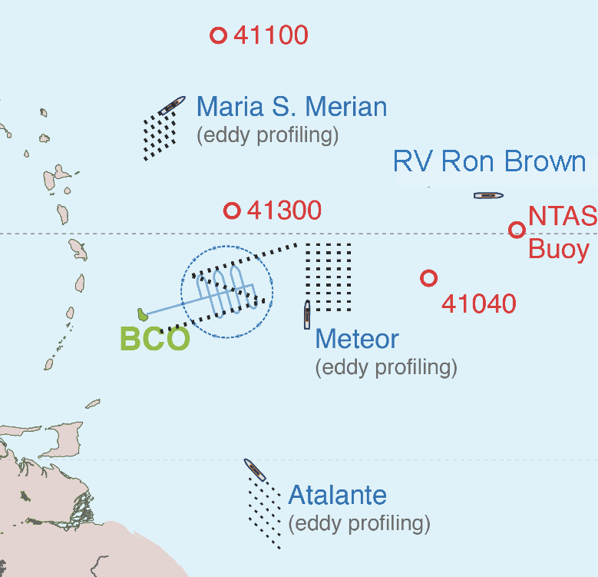
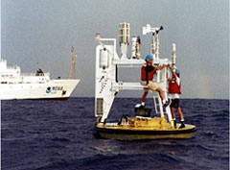
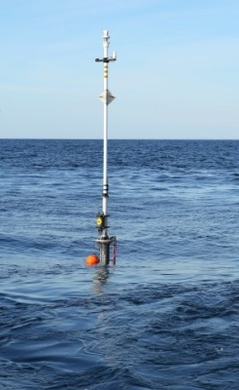
WHOI Observational Assets
NTAS Enhancements
Direct covariance fluxes package for stress and buoyancy.
Possible addition of IRGA for DC latent heat flux.
Licor
3-D Sonic
Motion
Sensors
X-Spars
Shipboard Met
As needed
ALAMO
X-SPAR
Air-Sea Fluxes:
Direct covariance fluxes package with on-board flux calculations
Air temperature, pressure, humidity, wind speed and direction
Downwelling solar and longwave radiation
Upper Ocean Structure:
Ocean temperature and salinity measurements at multiple depths
ADV and/or ADCP for currents and oceanic turbulence
Subsurface pressure sensors to characterize surface wave field
ALAMO Profilers
Temperature and Salinity Profiles
Can be programmed to sample the upper 200 m
Provide 15-18 profiles per day in this mode
Current estimates

