Slide 1
NOAA Effort
NOAA observational assets
Ship
Aircraft
Island-based systems
NOAA/OAR modeling research
Stratocumulus - Shallow convection
Data assimilation
Stochastic parameterization
Air-sea interaction
NOAA/EMC
Collaborate on advances in operational models

Slide 2
Suggested NOAA Observational Assets*
Ship-based observations
Ship Class | System | Group | PI
II (180 – 200 ft) | Air-sea flux | PSD | Blomquist
II | Sondes | PSD | Cox, Hartten
II | Ocean mixing | University Wash | Thomson/Thompson
I (250 280 ft) | Cloud Obs | PSD | Fairall/De Szoeke
I | Doppler Lidar | CSD | Brewer
I | Aerosols | PMEL | Quinn
I | C-band radar | CSU | Rutledge
I | UAS | PMEL | Quinn
I | Flux buoys | WHOI | Edson/Clayson
Aircraft-based observations
Aircraft | System | Group | PI
P-3 | TDR | AOML/PSD | C. Williams
P-3 | AXBT | NRL | Chen/Shinoda
P-3 | Cloud microphysics | PSD | Fairall
P-3 | Drop Buoy | PSD | De Boer
P-3 | Wband cloud radar | PSD | Fairall
P-3 | WSRA wave spectra | PSD | Walsh
G-4 | Dropsonde | AOML/PSD | Bariteau/Barsugli
G-4 | TDR | CSD | C. Williams
*NOAA process for requesting aircraft and ships. Have made requests for Ronald H. Brown, G-4, and P-3
Groups and PI’s are strawmen

Slide 3
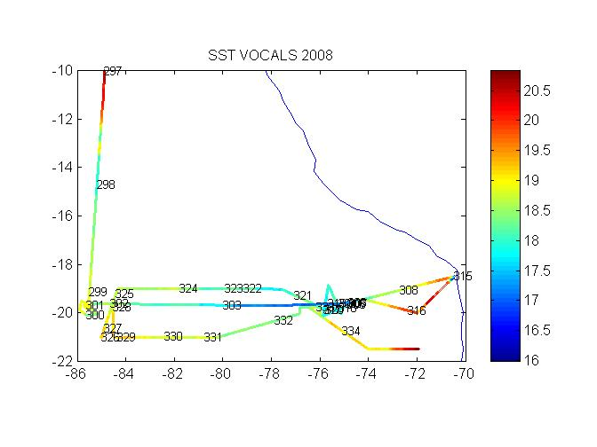
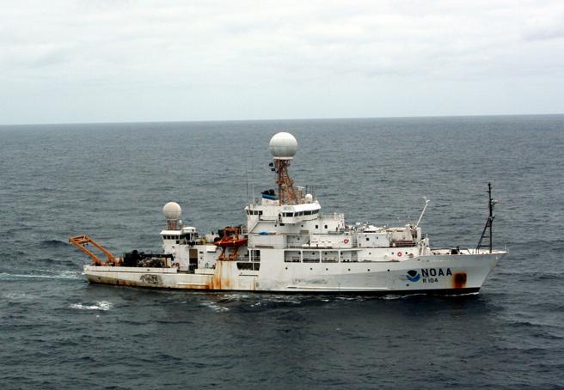
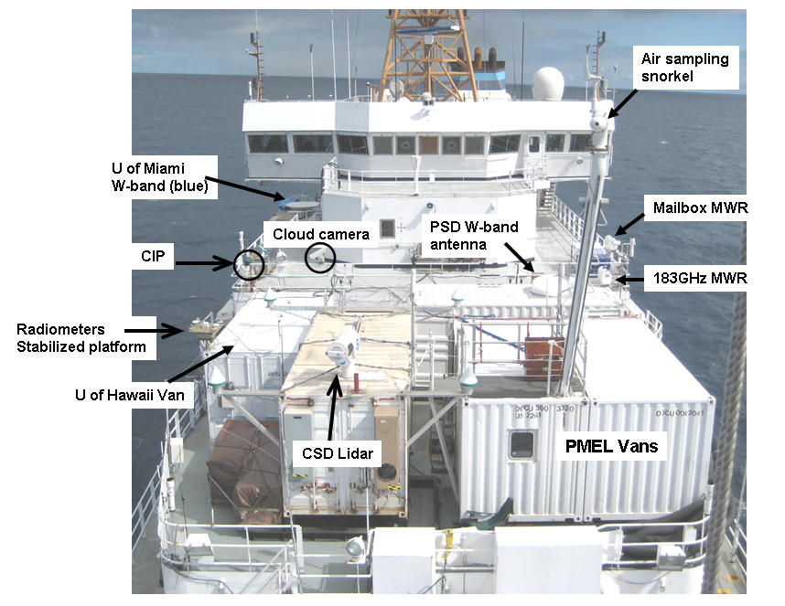
NOAA Ship Ronald H. Brown
For this study, the Brown fielded one of the most comprehensive sets of observing systems ever assembled on a research vessel. The ship is festooned with 6 seatainer laboratories and all manner of instruments including five meteorological radars, a Doppler Lidar, four different ocean profiling systems, and a variety of chemical, aerosol, and biological measurements (Fig. 1). Some 40 scientists from have participated in two deployment legs. The science party includes representatives from three NOAA labs, 13 Universities, and three research laboratories in Chile and Peru.

Slide 4
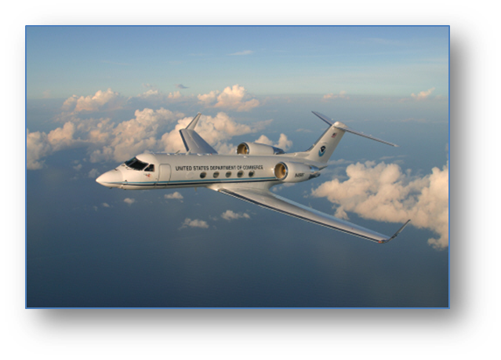
G4 Dropsonde Flight
8 hr flight, 60 degrees total

Slide 5
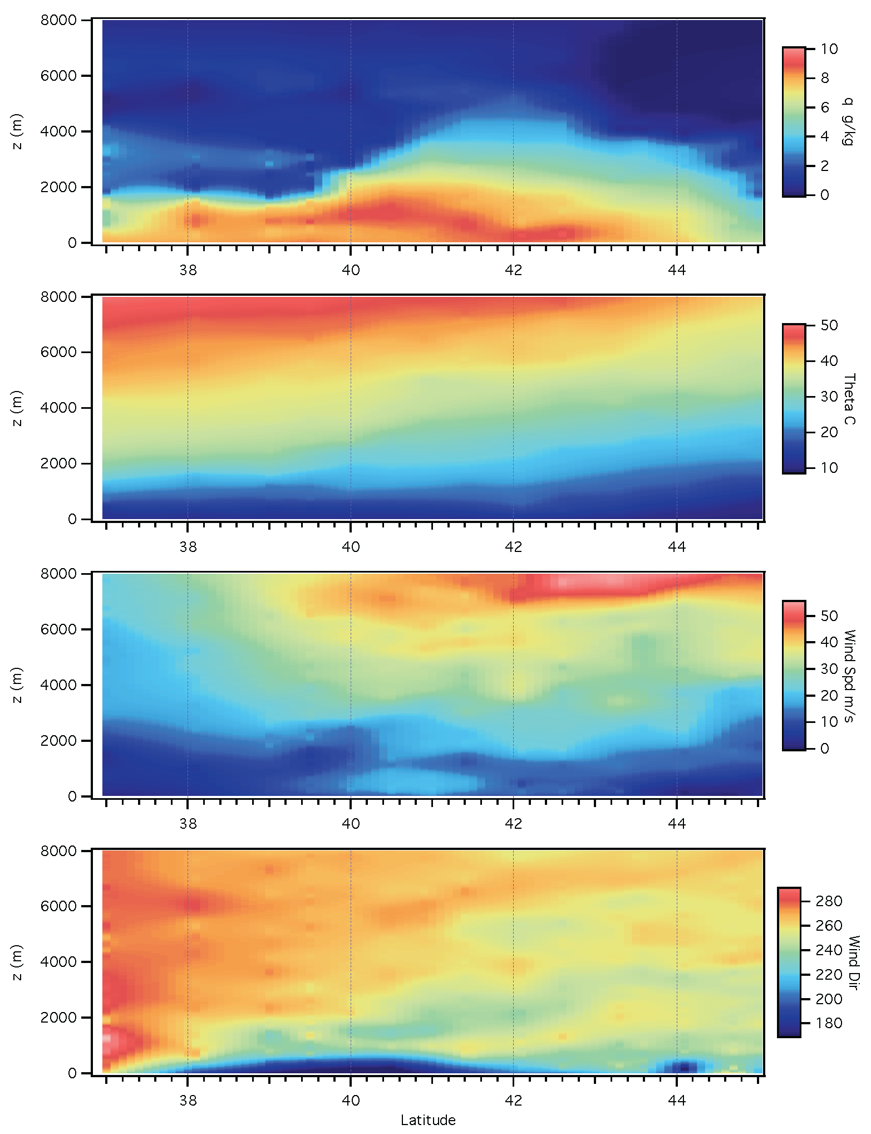
February 12 Line of 15 sondes

Slide 6
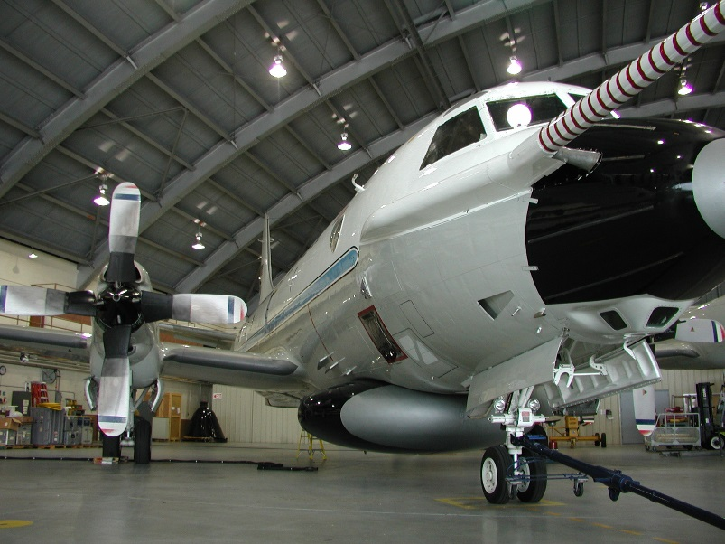
NOAA P-3
Cloud Physics probes
Tail Doppler Radar
SFMR – 10m wind speed, rainrate
WSRA – Wave properties, Mean square slope, rain rate
Aircraft data system (navigation, T, q, U, etc)
Dropsondes
AXBT, AXBuoy
PSD Wband radar

