Slide 1
NOAA ESRL PSD Briefing March 2013
Surface Processes and Coupled Modeling
Light Winds to Hurricanes
Poles to Tropics
Momentum, Heat, Moisture, Trace Gases, Aerosol Particles, Radiation, Precipitation
Christopher W. Fairall ¹ , Jian-Wen Bao¹, Andrey A. Grachev ^{1, 2} , Jeff Hare ^{1, 2}
Ludovic Bariteau ^{1, 2}, Ola Persson ^{1, 2}
¹ NOAA Earth System Research Laboratory/Physical Science Division, Boulder, Colorado, USA
² Cooperative Institute for Research in Environmental Sciences, University of Colorado, Boulder, Colorado, USA

Slide 2
Building Blocks
Direct measurements
Surface flux parameterizations
Boundary Layers
Turbulent transport
Microphysics
Coupled models
Hurricane
Sea-ice
MJO

Slide 3
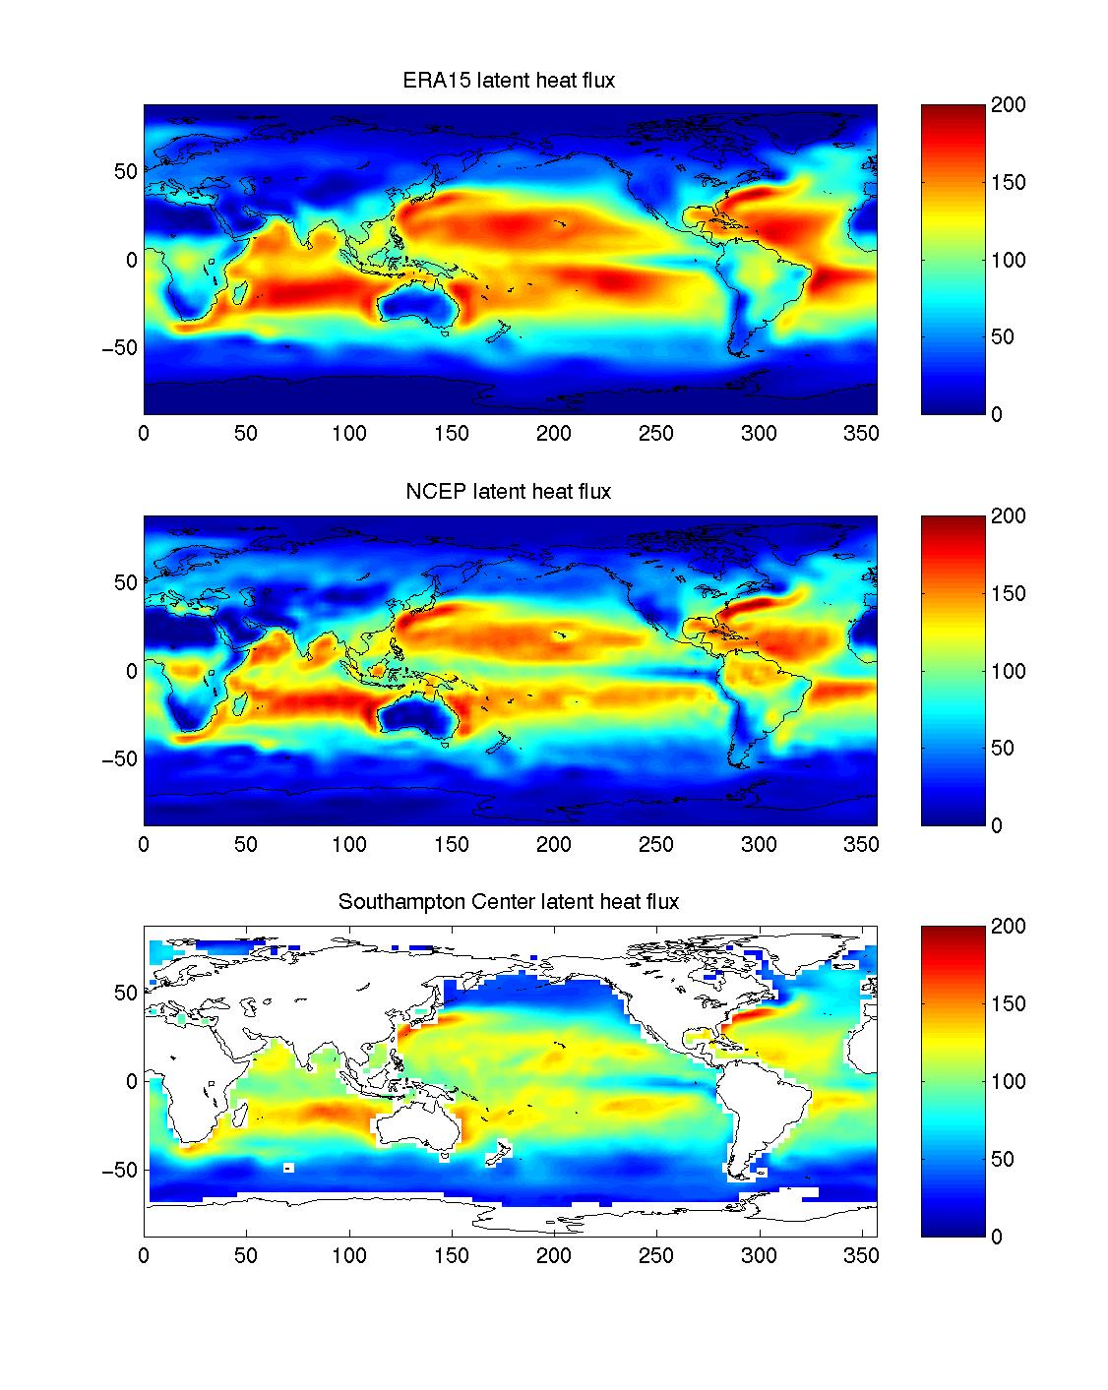
BACKSTORY
1996 Release COARE2.5 bulk flux algorithm
2002 Chris Bretherton evaluating coupled climate model asks ‘Which one of these flux maps is right?”
2003 WCRP Working Group on Surface Fluxes (CWF chair)
2005 WHOI global flux product
2011 COAREG3.1 CO2, DMS, ³He, CO, O₃, SF₆ and 73 other gases
2013 GOV/WGNE Coupled Prediction Workshop, NCEP:’So where can we get these flux data?’

Slide 4
APPROACH
Direct Flux Observations
Tech Development, Near-surface, Boundary-Layer Observations
Fundamental Physics
Navier-Stokes, Turbulent Kinetic Energy budget equations, scalar conservation
Flux Parameterization
Similarity scaling, cloud-radiative coupling, deposition velocities
Research Numerical Models
1-D Closure, Large Eddy Simulation, Mesoscale, Cloud Resolving, Regional
Ocean Flux Observing System
Research Vessels (SAMOS), Ship Opportunity (COADS), Flux Reference Buoys (OceanSites), Satellites (SEAFLUX )
NOAA Models
Operational Numerical Weather Prediction
Climate Models
Direct data used principally to develop parameterizations, improve the observing system, and ‘verify’ model results

Slide 5
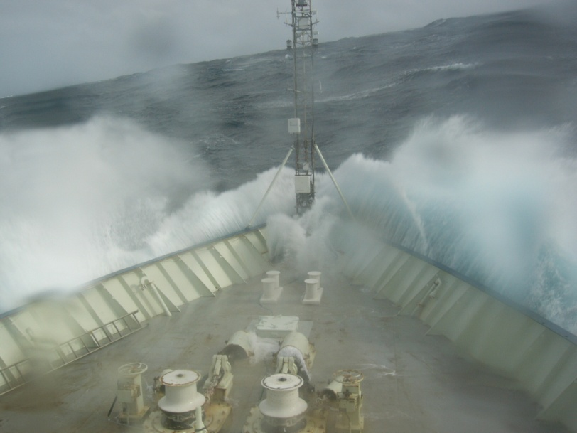
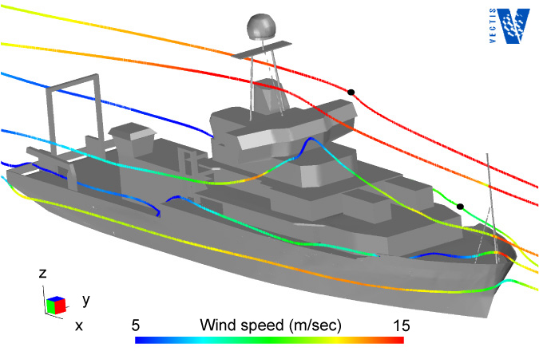
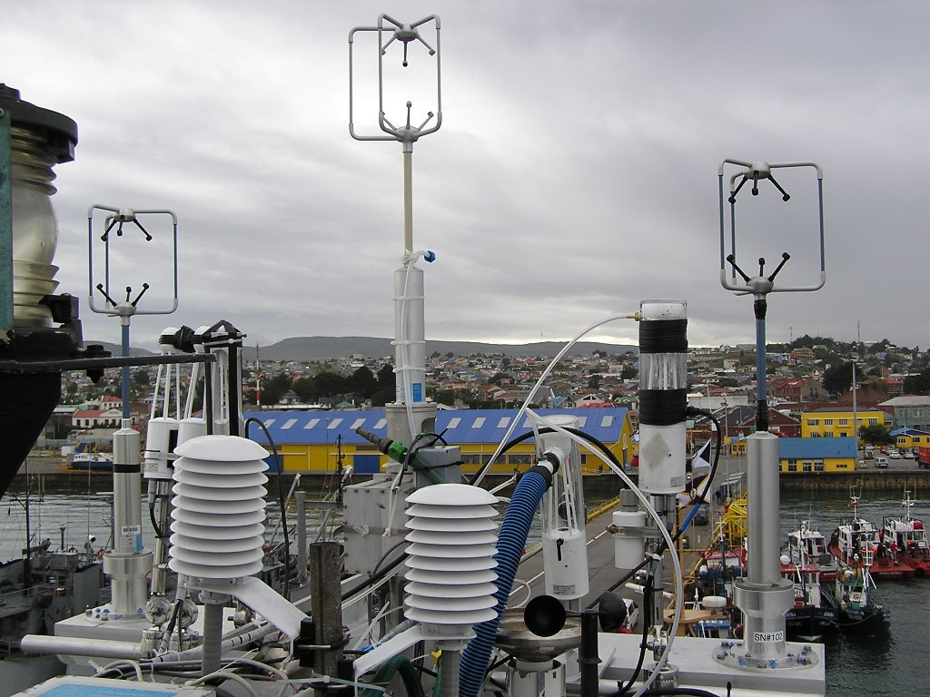
TECHNOLOGY EXAMPLE: Motion-Corrected Eddy-Covariance Turbulence Measurements from Ships

Slide 6
Surface Turbulent Flux Parameterizations
Turbulent Fluxes: Bulk Parameterization
Flux= Mean correlation of turbulent variables, <w’x’>
MetFlux – Dominated by atmospheric turbulent transfer physics
GasFlux – Dominated by oceanic molecular transfer physics;
Enhanced by whitecap bubbles
Transfer coefficients computed from direct flux measurements

Slide 7
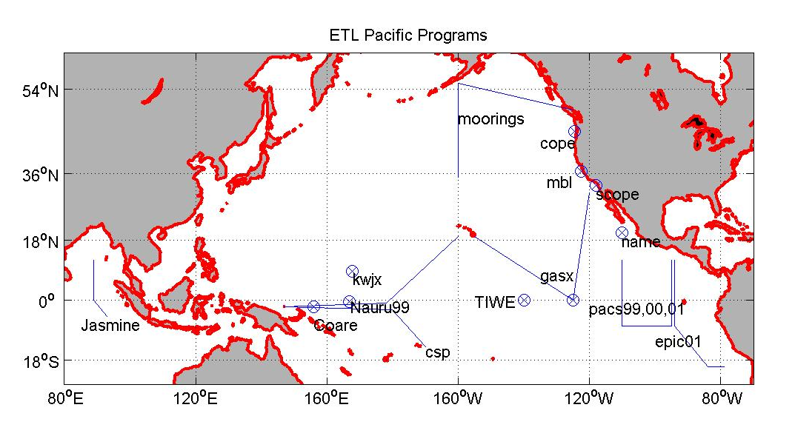
NOAA COARE AIR SEA TURBULENT FLUX MODEL
1996 Bulk Meteorological fluxes
Update 2003 (7200 covariance obs*)
Oceanic cool skin
Ocean diurnal warm layer
2000 CO₂ [U. Conn and Columbia U]
2003 Hurricane Sea Spray
2004 DMS [U. Hawaii]
2005 Snow/Ice [US Army CRREL]
2006 Ozone [U. Colorado]
2008 PCBs and PCEs [Mich. Tech. U]
2009 Hurricanes [UNSW Australia]
2010 79 Trace gases
2011 COAREG3.1 CO2, DMS, ³He, CO, O₃, SF₆
PSD cruises Pacific Ocean 1991-2001
*Complete flux data time series publically available under ‘Data Sets’ at http://www.esrl.noaa.gov/psd/psd3/wgsf/

Slide 8
Programatic View
CPO
SEARCH Arctic Observatories (T.Uttal) k$1000
Ocean Obs Flux observing system 300
Air-Sea EPIC, NAME, VOCAL,DYNAMO 150
Gas flux Gasex I, II, III, ?? (100)
Hurricanes
NOAA Base Physics, P-3observations 650
HFIP HWRF physics (Bao) 100
NASA GOES-5 fluxes 100
Renewable energy DOE (Wilczak)/GSD RUC 300
Arctic Persson, Shupe, Solomon, Grachev
NSF, DOE BL, mesoscale, microphys, WRF 600
ONR Waves-ice interactions 200

Slide 9
Surface Processes and Couple Models: Wider Contex
2009 OceanOBs09 WP Flux Observing Sys
2011 WWRP Polar Pred. Steering committee
2012 US-IOOS12 WP CoastalFlux Observing Sys
2012 GSOP/CLIVAR Ocean reanalysis and fluxes
2012 WGNE/GOV WP on Obs for coupled predictions

