Slide 1
WWRP Polar Prediction Project Thomas Jung Chair of the WWRP Polar Prediction Project Alfred Wegener Institute Helmholtz Centre for Polar and Marine Research Germany

Slide 2
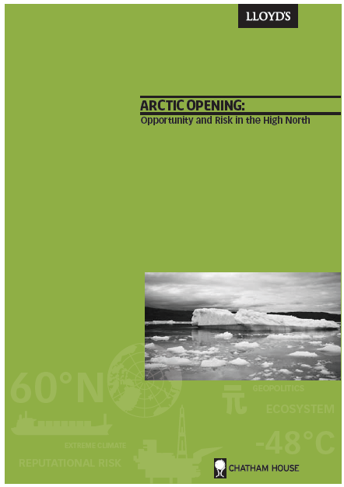
Opportunity and risk
Some statements from the report:
The Arctic is likely to attract substantial investment over the coming decade ($100 bn)
The environmental consequences of disasters in the Arctic are likely to be worse than in other regions
Significant knowledge gaps across the Arctic need to be closed urgently

Slide 3
Background
PPP constitutes the hours-to-seasonal research component of the emerging WMO Global Integrated Polar Prediction System (GIPPS). A closely related WCRP Polar Climate Predictability Initiative covers GIPPS research on seasonal-to-decadal time scales.
PPP Mission Statement
Promote cooperative international research enabling development of improved weather and environmental prediction services for the polar regions, on time scales from hourly to seasonal.

Slide 4
Progress
*Formation of Science Sterring Group (Dec 2011)
*6 meetings so far. Plans include
Montreal, Aug 2014
*Science and YOPP meeting at ECMWF June 2013
*Science Plan, Implementation Plan, Year of PP Plan (Draft)
Report of Science Symposium working groups
*Project Office (Thomas Jung, AWI)
*Funding from AWI
*Trust fund via WMO
*Web Site: http://polarprediction.net/
*Coordination with WCRP PCPI (Climate effort)
*Series of briefings at WMO/WCRP, national agencies

Slide 5
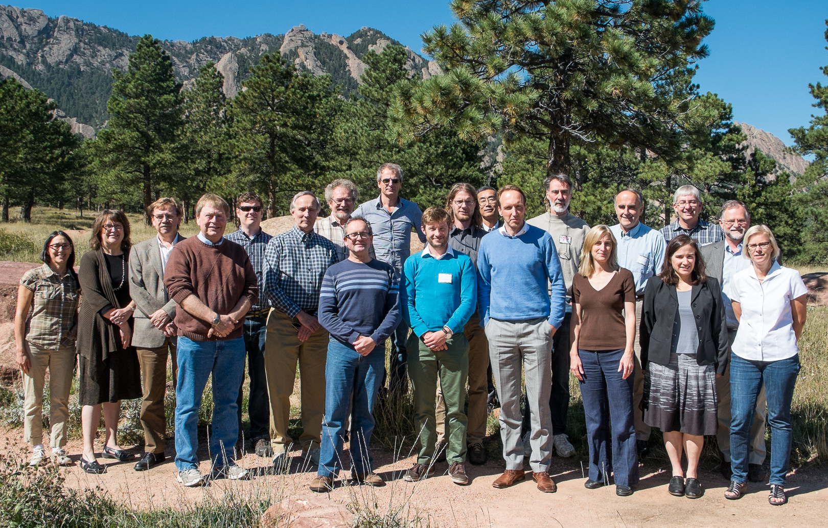
PPP Steering Group
Thomas Jung (chair)
Peter Bauer
David Bromwich
Paco Doblas-Reyes
Chris Fairall
Marika Holland
Trond Iversen
Brian Mills
Pertti Nurmi
Don Perovich
Phil Reid
Ian Renfrew
Gregory Smith
Gunilla Svensson
Mikhail Tolstykh
SG4, Boulder, 1-3 October 2013
Jonny Day (APECS liasion)
Neil Gordon (WMO consultant)

Slide 6
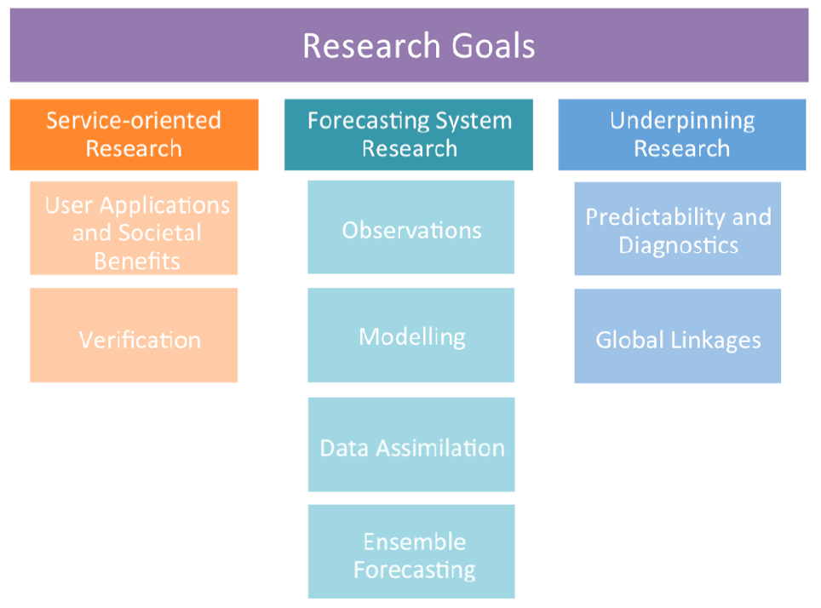
Research areas
Source: PPP Implementation Plan

Slide 7
Flagship themes
Sea ice prediction
Explore predictability
Develop of coupled prediction systems
Linkages between polar regions and lower-latitudes
Determine mechanisms and strengths
Implications for predictions in middle latitudes
Improved availability of observations from polar regions
The Year of Polar Prediction (YOPP) 2017-2019

Slide 8
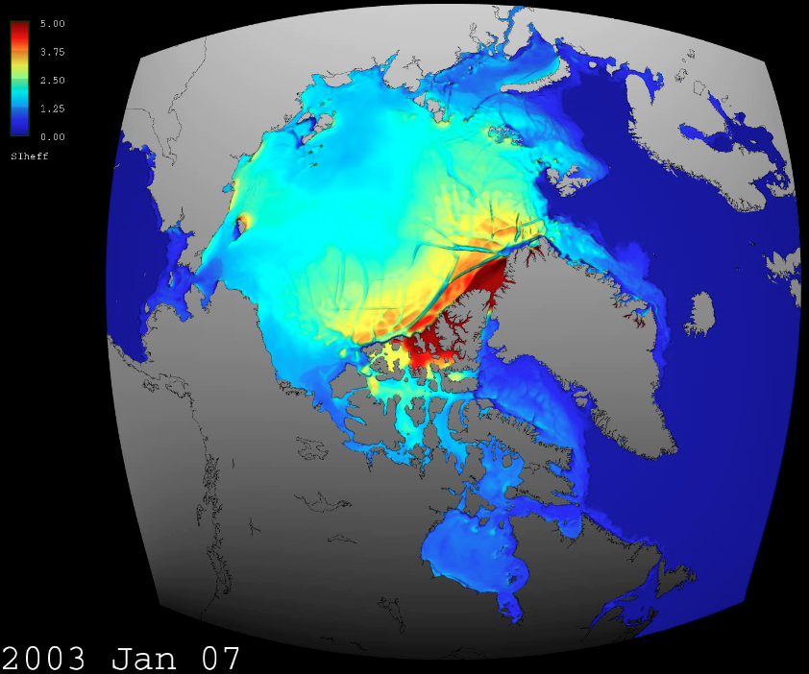
Sea ice prediction
MITgcm @ 4km resolution
Simulation described in Nguyen et al (2012) and Rignot et al. (2012)

Slide 9
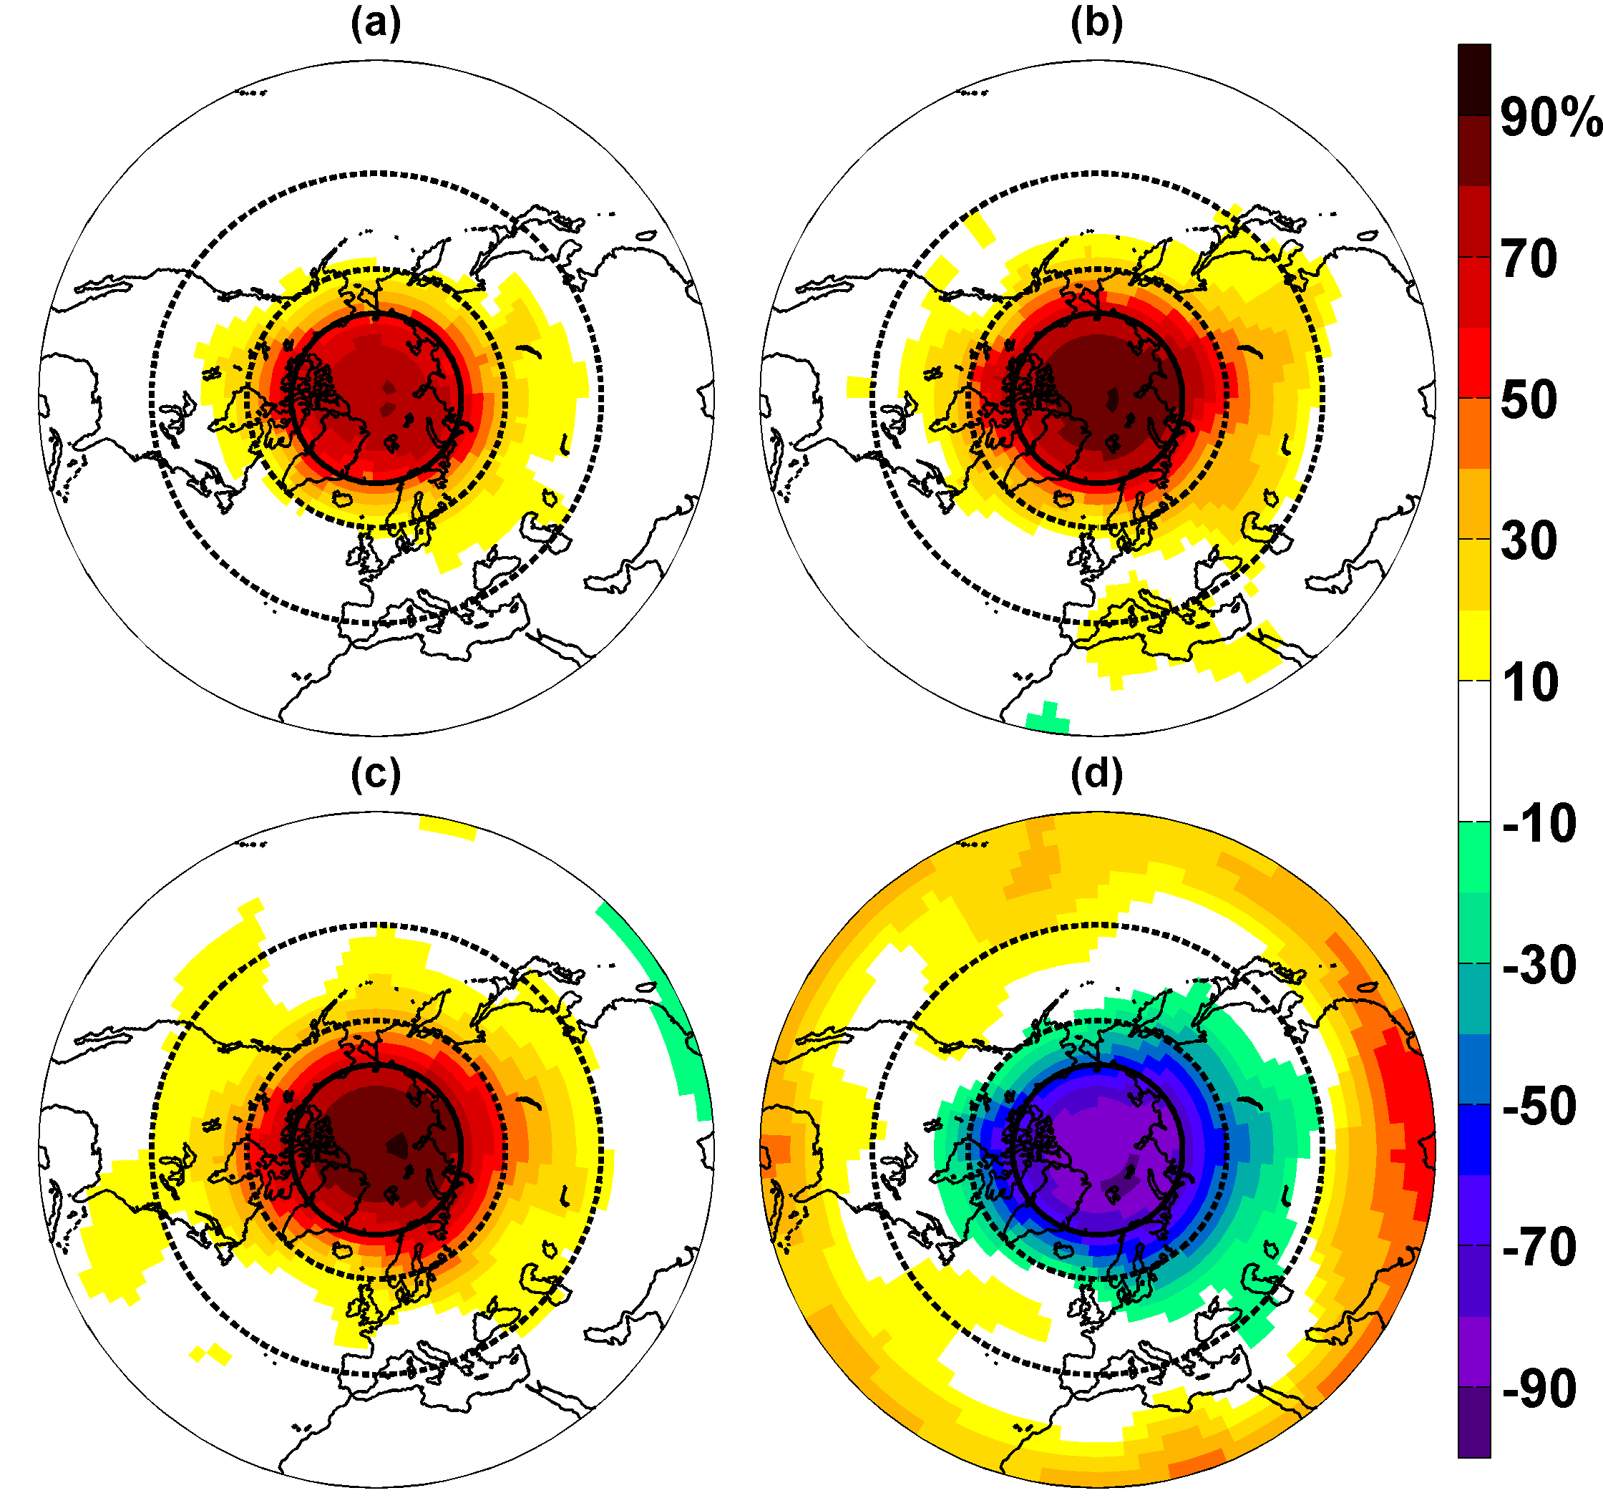
Linkages
Day 1-5
Day 6-10
Day 11-30
Day 11-30

Slide 10
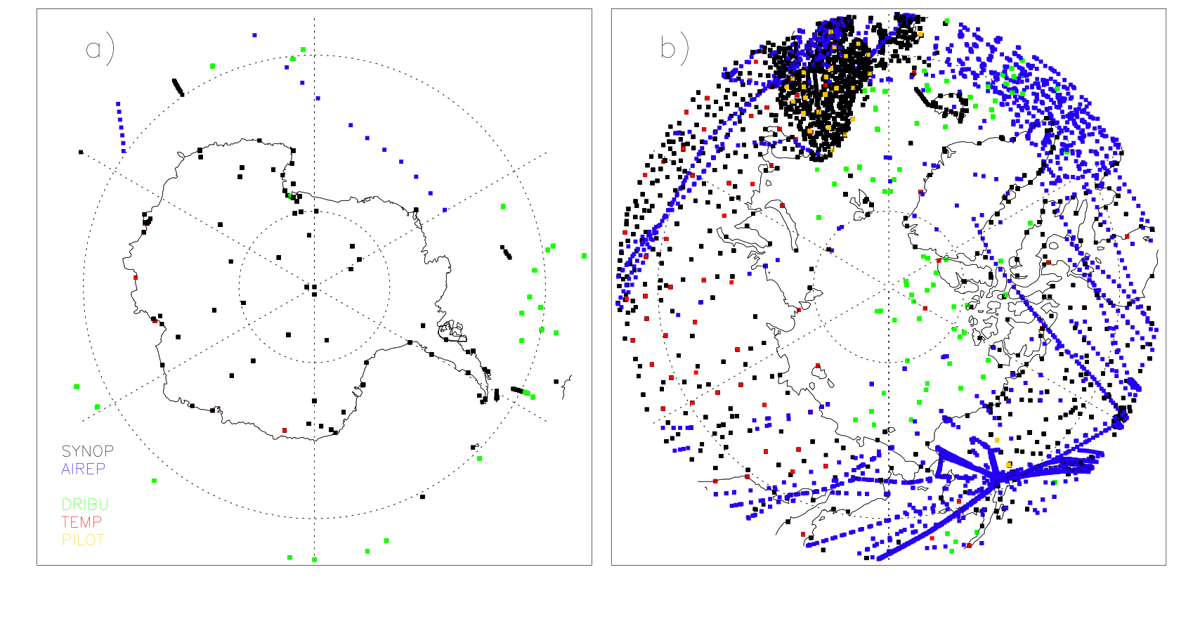
Improved observational coverage
Synop (Surface stations), AIREP (Airline), DRIBU (Drifting buoys),
TEMP (Rawindsone) and PILOT (Pilot balloons)
Polar data coverage of conventional observations in the ECMWF operational analysis on 1 January 2012.
P. Bauer (ECMWF)

Slide 11
The Year of Polar Prediction
Comprehensive observational snapshot
In situ and satellite data
Observing system design (data denial experiments)
Supersites (model grid boxes ➔ MOSAiC)
Model development (e.g. Transpose-CMIP)
Community data sets (reforecasts, special archiving etc.)
Frontier experiments (e.g. high-resolution modelling)
See draft YOPP Implementation Plan

Slide 12
The Year of Polar Prediction
Preparation Phase 2013 to mid-2017
YOPP mid- 2017 to mid-2019
Consolidation Phase mid-2019 to 2022
Preparation Phase 2013 to mid-2017
Consolidation Phase mid-2019 to 2022
Community engagement
Intensive observing periods
Data denial experiments
Align with other planned activities
Dedicated model experiments
Model developments
Develop imple- mentation plan
Research into use & value of forecasts
Dedicated reanalyses
Preparatory research
Intensive verification effort
Operational implementation
Summer school Workshops
Summer school
YOPP publications
Liaise with funders
YOPP conference

Slide 13
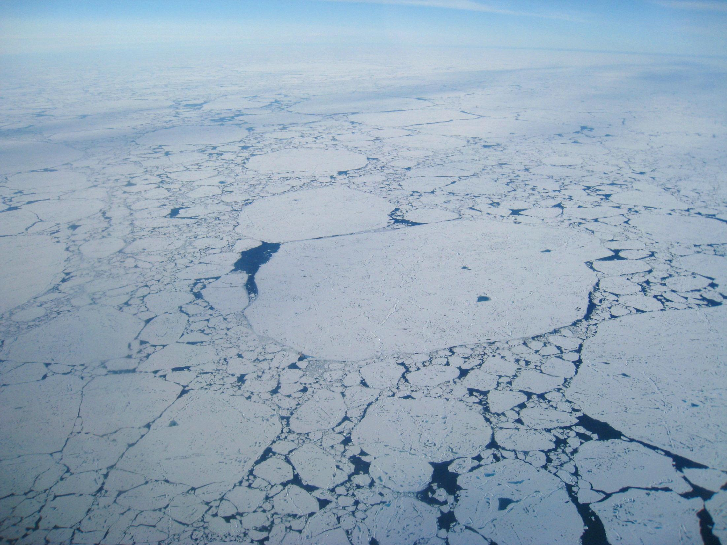
MOSAiC
Multidisciplinary drifting Observatory
for the Study of Arctic Climate
Matthew Shupe – U. of Colorado
Ola Persson – U. of Colorado
Michael Tjernström – Stockholm U.
Klaus Dethloff – Alfred Wegener Inst.
And many others

Slide 14
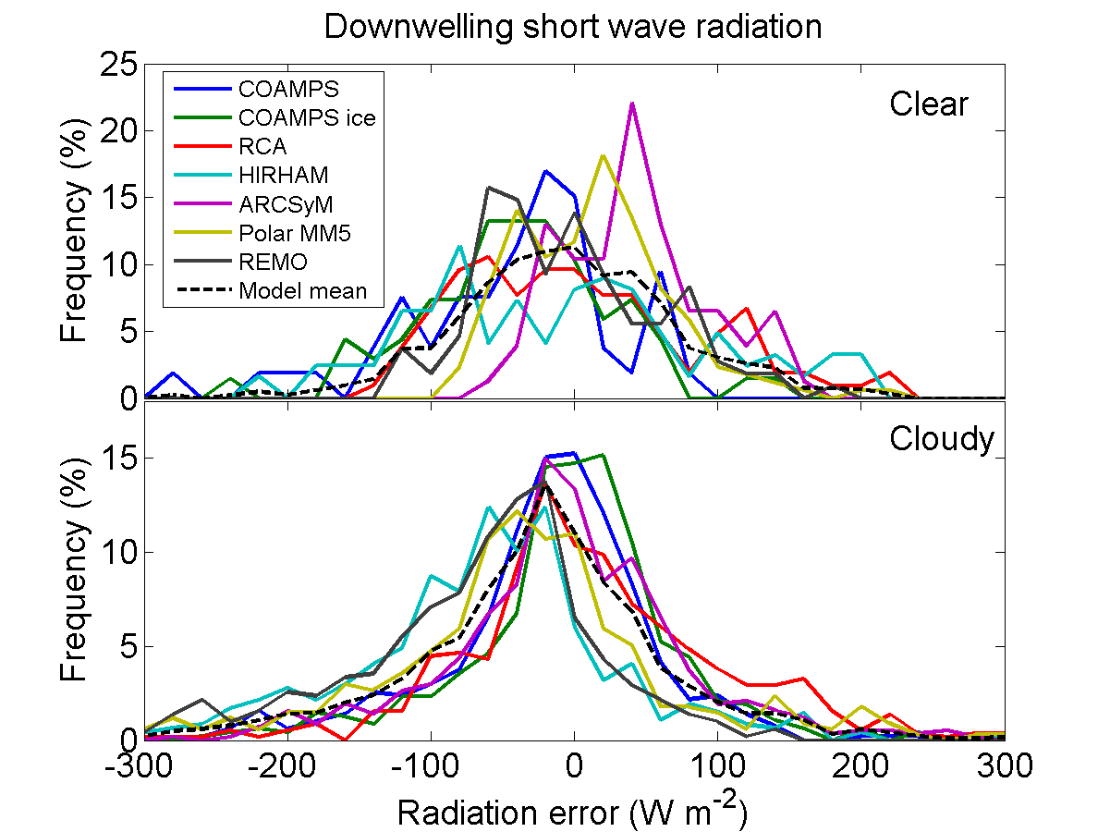
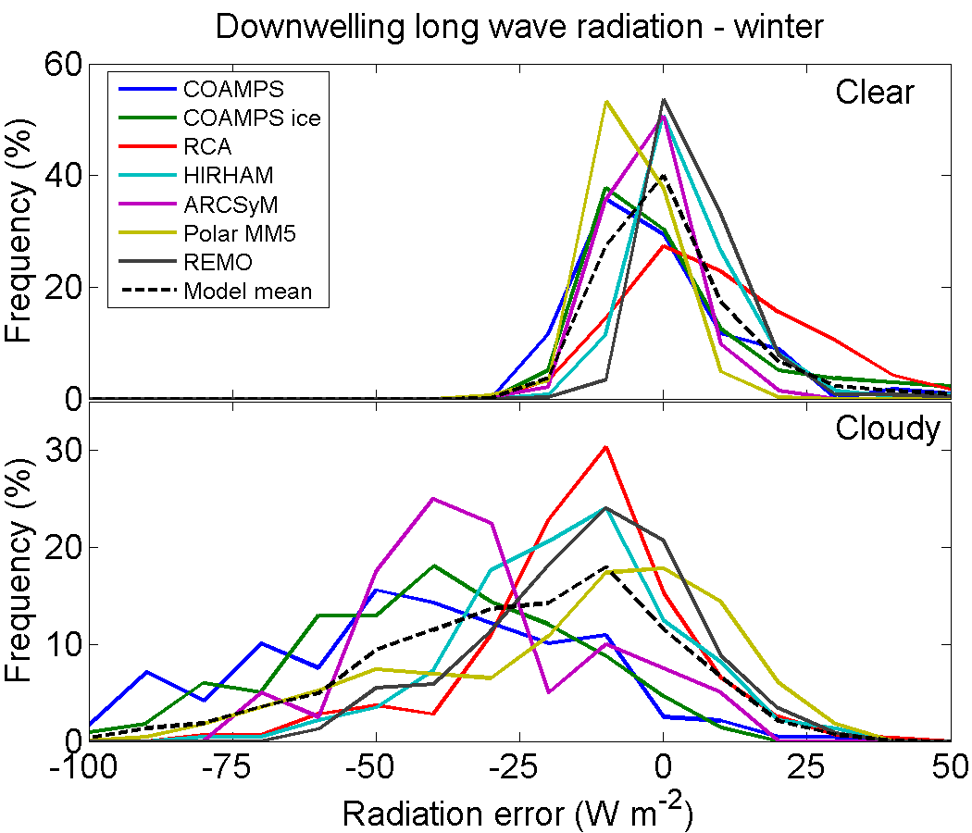
Critical Model Shortcomings
Regional Climate Models evaluated against SHEBA radiative fluxes reveal major biases and spreads, especially under clouds.
Such biases can have serious implications for sea-ice concentrations.
~ 0 W m⁻²
~ 0 W m⁻²
~-10 W m⁻²
~-25 W m⁻²
Tjernström et al. 2008

Slide 15
The MOSAiC Plan
What:
Deploy heavily instrumented, manned, ship-based, Arctic Ocean observatory for comprehensive, coordinated observations of the Arctic atmosphere, cryosphere, and ocean.
Network of spatial measurements to provide context and variability (buoys, gliders, UAVs, aircraft, ships, satellites, ice stations).
Coordinated modeling activities at many scales from process-study to regional climate models.

Slide 16
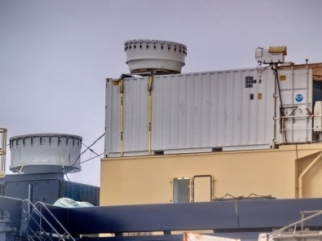
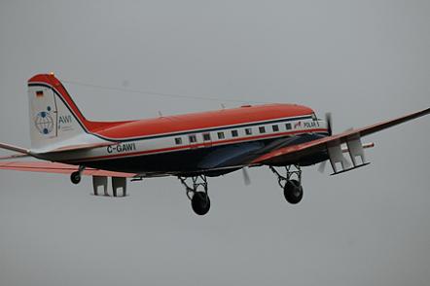
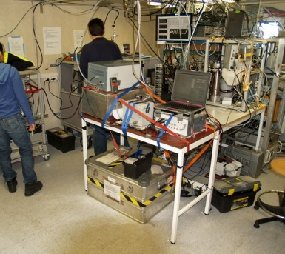
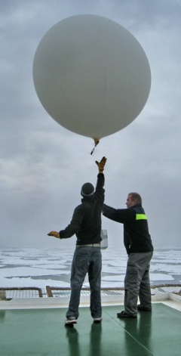
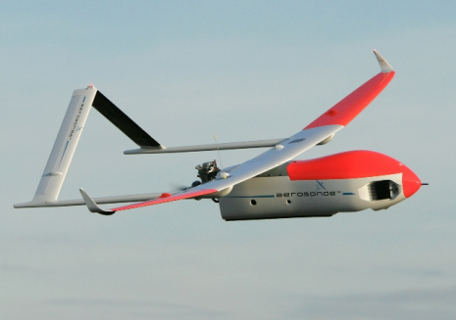
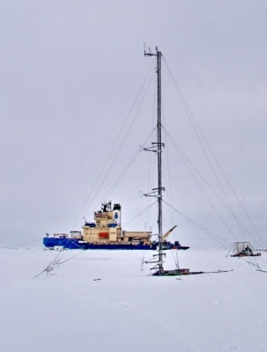
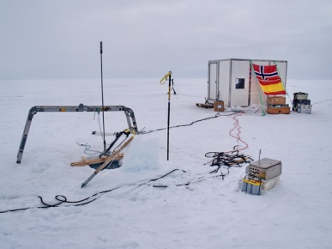
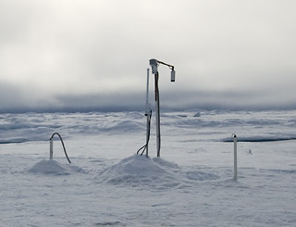
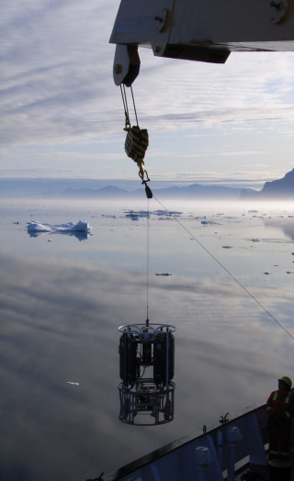
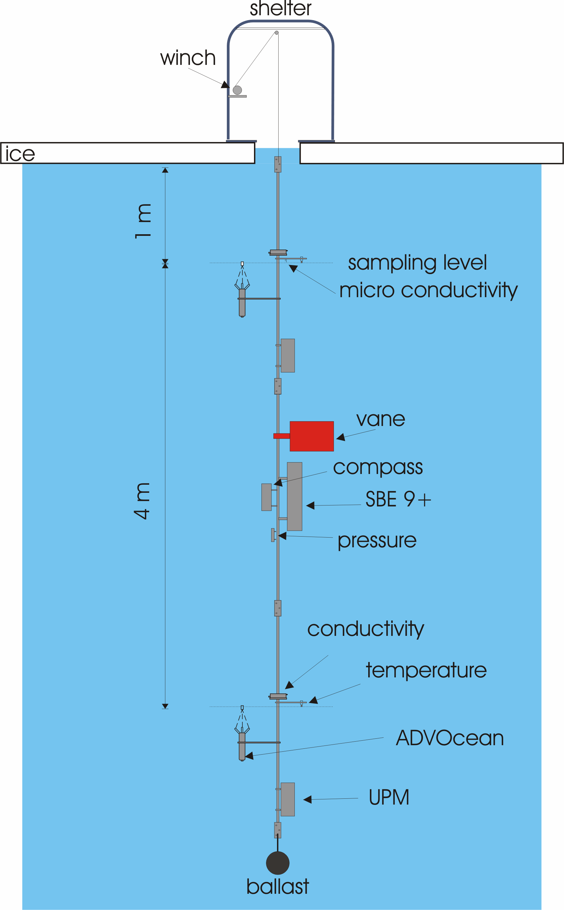
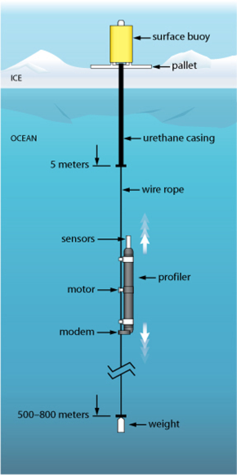
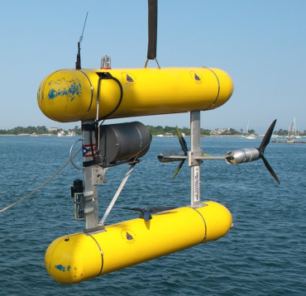
Measurements
atmospheric profiling, BL, & dynamics
gases, aerosols, clouds & precip.
aircraft + UASs
ocean and ice bio/chem
surface energy budget
buoys, AUVs, gliders
Micro-
meteorology
ice profiling, thermodynamics, mass budgets
ocean state, profiling, & dynamics
leads & ocean surface

Slide 17
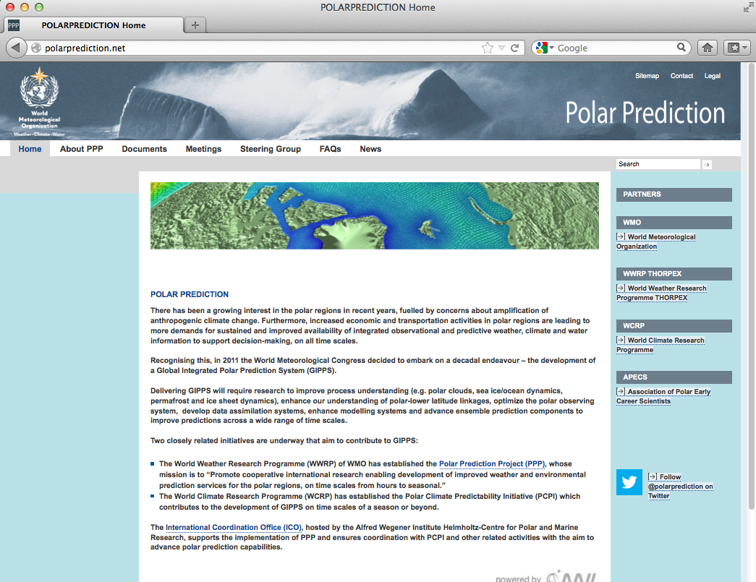
Further information
http://polarprediction.net

