Slide 1
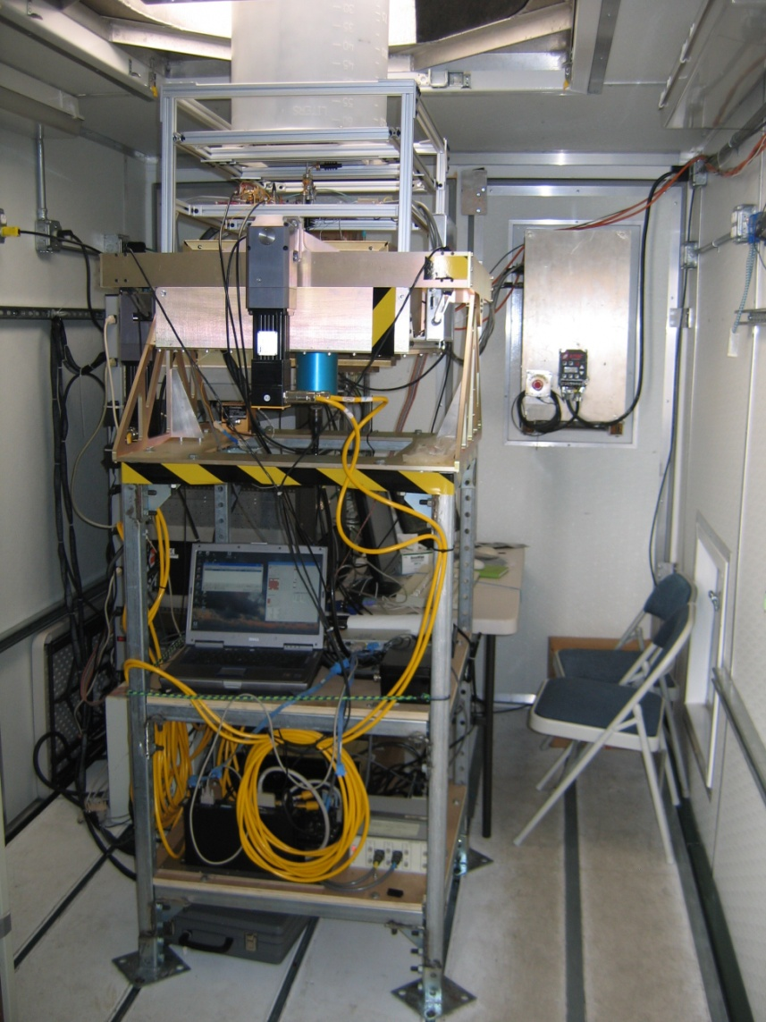
Ship-based Observations of Turbulence and Stratocumulus Cloud Microphysics in the SE Pacific Ocean from the VOCALS Field Program
C.W. Fairall¹, K. Moran¹, S. Pezoa¹, D.E. Wolfe¹, S. de Szoeke², Christopher Williams¹, Andrey A. Grachev¹, Aditya Choukulkar¹, W. Alan Brewer¹, and V. Ghate³
(1)NOAA Earth System Research Laboratory, Boulder CO, USA, (2) Oregon State University, Corvallis, OR
(3) Rutgers University, New Brunswick, NJ
The NOAA Physical Science Division has developed and recently deployed a new pitch-roll stabilized, vertically pointing W-band (94 GHz) Doppler cloud radar for research investigations of the dynamics and microphysics of marine clouds. This paper is a discussion of separating turbulent and droplet mean gravitational motions in the Doppler velocities.
Turbulence – BL mixing, fluxes, dynamics. Drop Microphysics – cloud/radiative coupling, aerosol effects, precipitation formation, dynamics.

Slide 2
What is a Cloud Radar?
Radar scattering from a distribution of droplets:
P_{t}=Transmit power, R=range, A_{e}=Antenna Area, ΔR=Range resolution, Δt=‘Dwell’ time to produce velocity estimate, λ=wavelength, q_{liq}=amount of liquid water per volume, r_{m}=drop radius
Tradeoffs:
  Portable – A_{e} small
  Affordable , safe, reliable- P_{t} small
  Resolve processes – ΔR, Δt small
  Sensitive – A_{e}, P_{t}, ΔR, Δt Large
Rain drops r_{m}=1 mm; Cloud drops r_{m}=0.01 mm. Clouds require 10⁶ more sensitivity.
Solution – λ small. Typically 3 or 8 mm (94 GHz or 35 GHz)

Slide 3
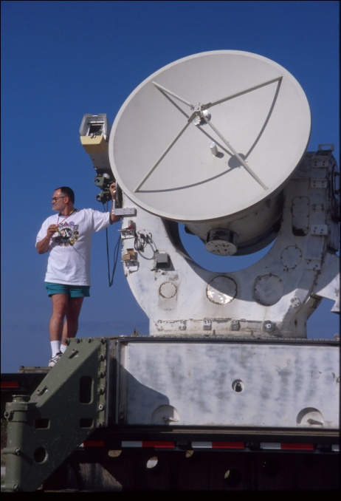
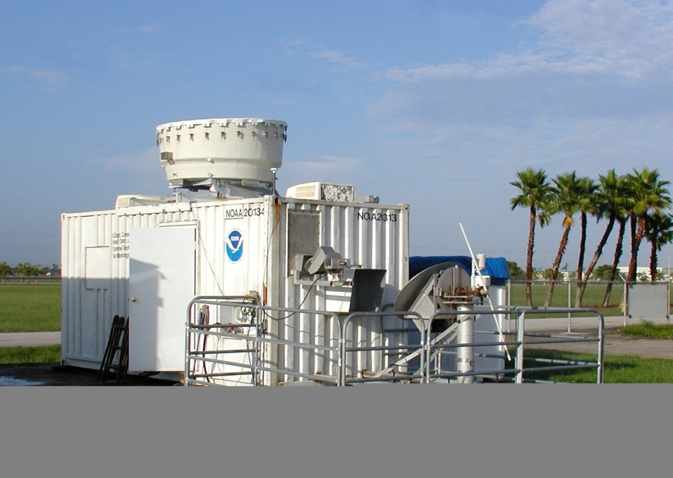

Historical Background Meteorological Cloud Radars
1950’s TPQ-11 35 GHz radar ‘ceilometer’ for airports
1983 NOAA-K 35 GHz scanning Doppler radar (100 kw, 1.2 m, 5 sec)
1987 Lhermitte 94 GHz Doppler
1995 Moran ARM/MMCR 35 GHz (continuous, spectral processing, 0.1 kw, 1m, 20 sec)
Marine deployments
  1994 Penn State 94 GHz Doppler Monterey Ship Tracks Experiment
  1999 NOAA/PSD 35 GHz MMCR JASMINE (Indian Ocean); [2000, 2001, 2004, 2008]
  2008 NOAA/PSD 94 GHz VOCALS Marine Stratus (stabilized, 1.2 kw, 0.25 m, 0.3 sec)
NOAA-K
MMCR
PSD Wband

Slide 4
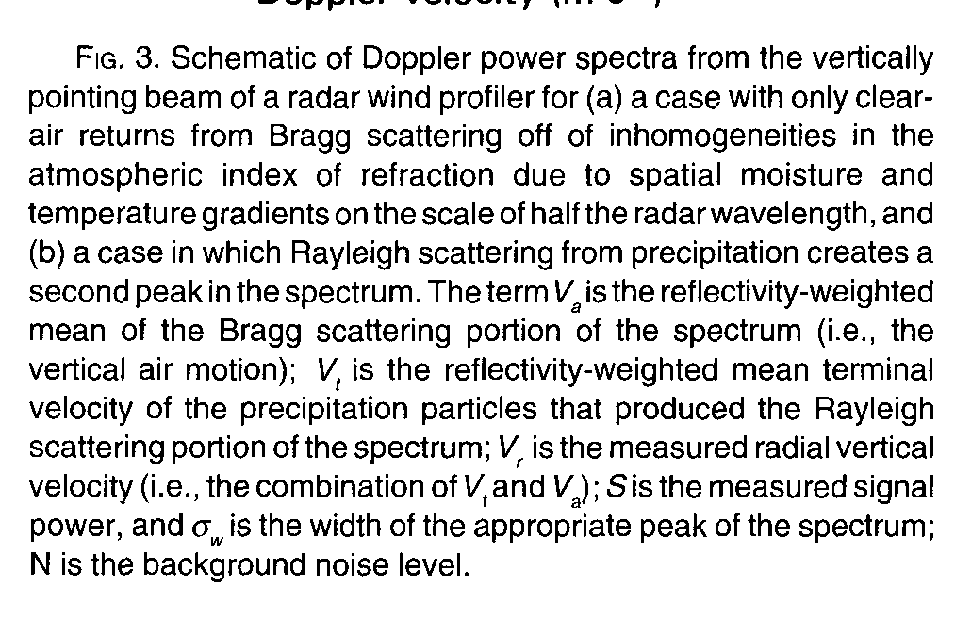
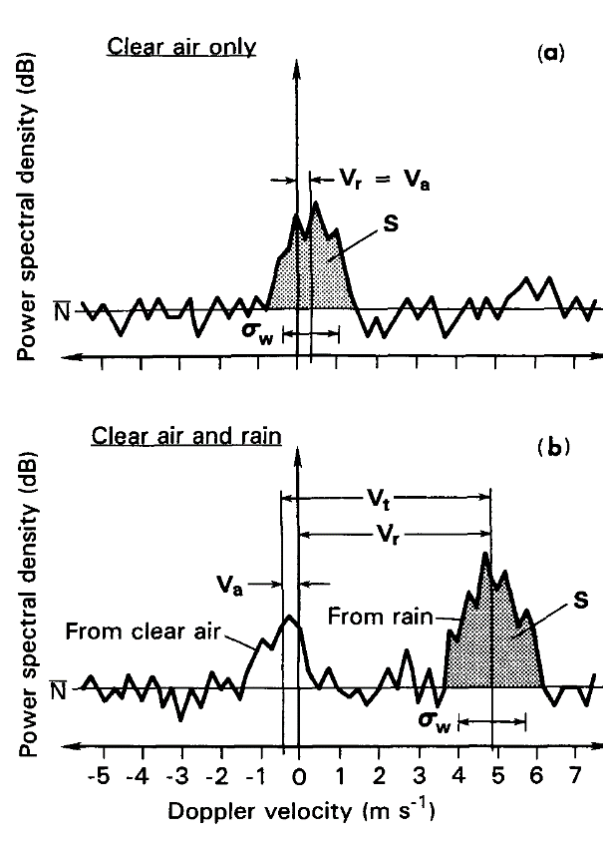
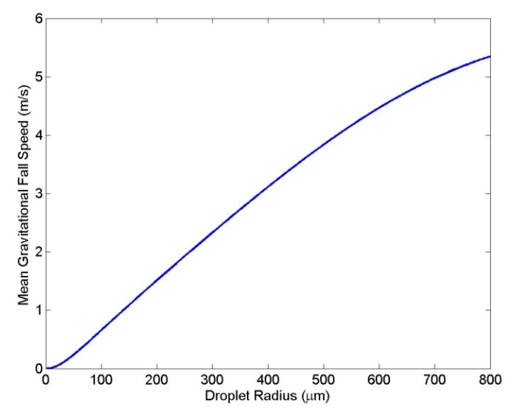
Doppler Spectrum Moment Processing
Three Basic Moments:
Mean Doppler Velocity (V_{a}=W)
Doppler width (σ_{w})
Backscatter (dBZ)

Slide 5
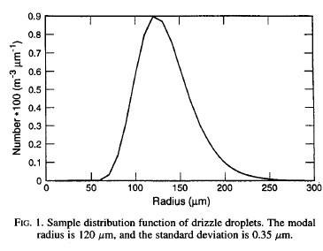
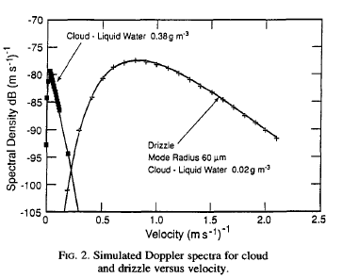
Example DropSize spectra and Doppler Spectra
Log-Normal DropSize distribution:
N_{o}=total number drops/volume
r_{m}=mode radius
σ_{x} = log width
Cloud dBZ=-18
Drizzle dBZ=-5

Slide 6
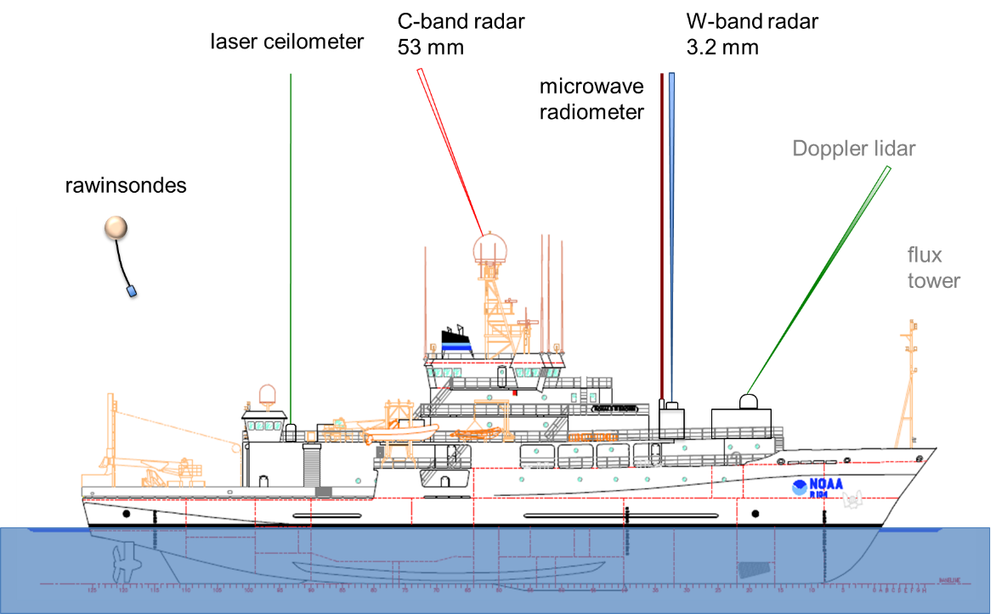
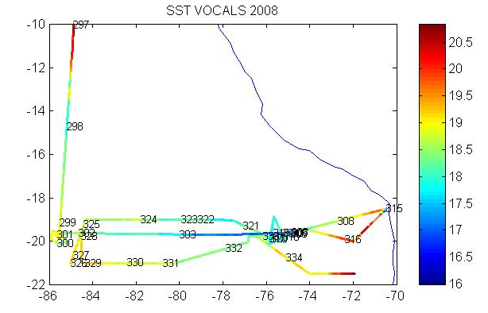
VOCALS REx Measurements
Seven years of research cruises on the southeastern tropical Pacific Ocean culminated with two cruises for the VOCALS Regional Experiment (REx) in October-December 2008. Investigators measured surface meteorology and air-sea fluxes aboard the ship. Remote sensing observations from rawinsondes, radar, lidar, and passive radiometers aboard the NOAA ship Ronald H. Brown provide statistics about the thermodynamics of the atmosphere and the distribution of clouds and rain in the marine stratocumulus deck off the coast of Chile (Fig.1).

Slide 7
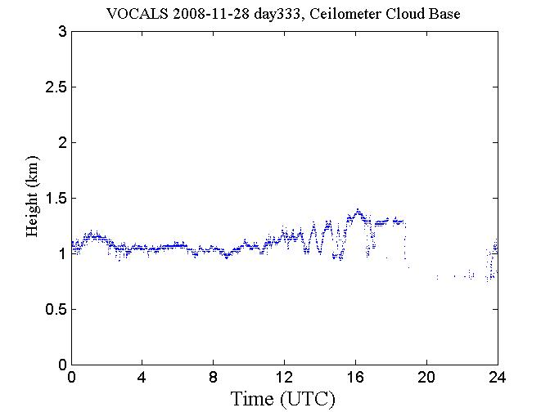
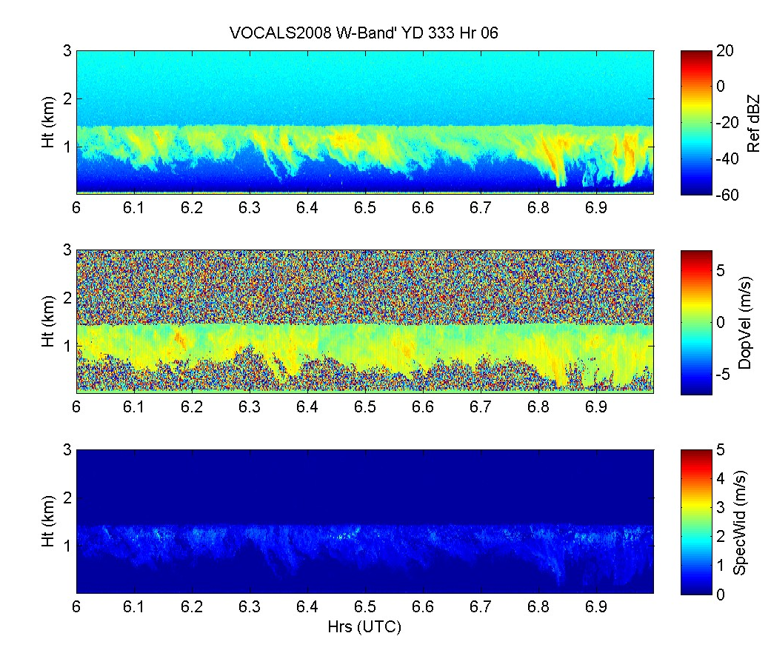
Time-Height Cross Section Cloud Views
Time series of ceilometer cloudbase height for Nov. 28.
Cloud -30<dBZ<-15 Vg<0.2 m/s
Drizzle -18<dBZ<0 0.5<Vg<3 m/s
Rain 0<dBZ<30 3<Vg<9 m/s
Time-height cross section from 1 hour of data beginning at 0600 on Nov. 28 (Day 333) from ESRL/PSD W-band cloud radar. The top panel is the radar reflectivity (dBZ); the middle panel is the mean Doppler velocity (m/s, positive down); the bottom panel is the Doppler width (m/s) of the return.

Slide 8
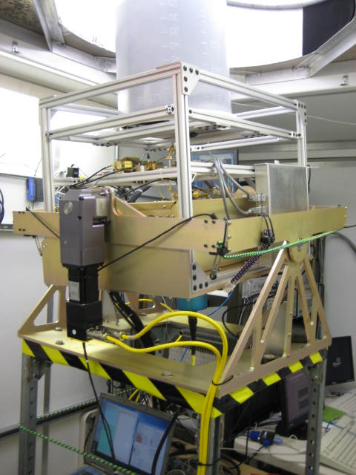
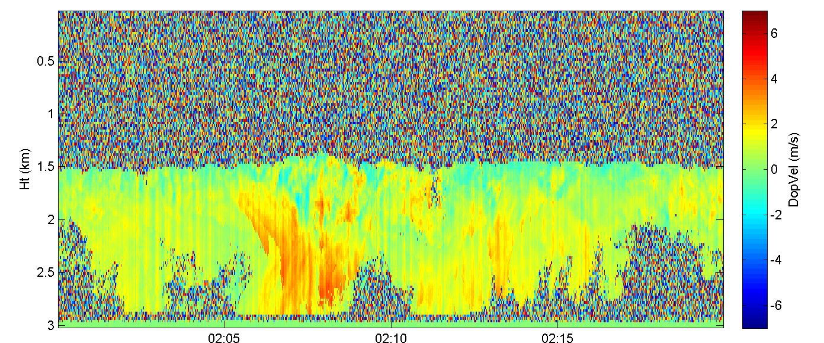

Motion Stabilization And Correction
W-band
antenna
*Pitch/Roll stabilization maintains antenna level
*Measured ship vertical motion is subtracted from Doppler
Mean Motions Before and After Vertical motion Correction

Slide 9
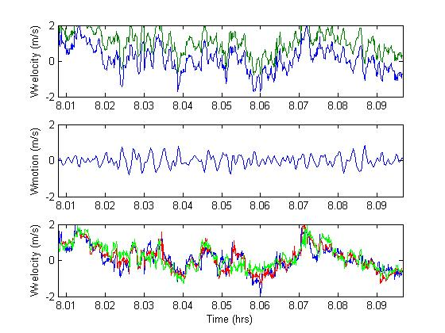
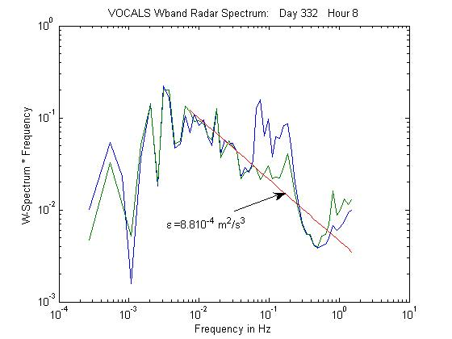
Turbulent Velocity Profile Information

Slide 10
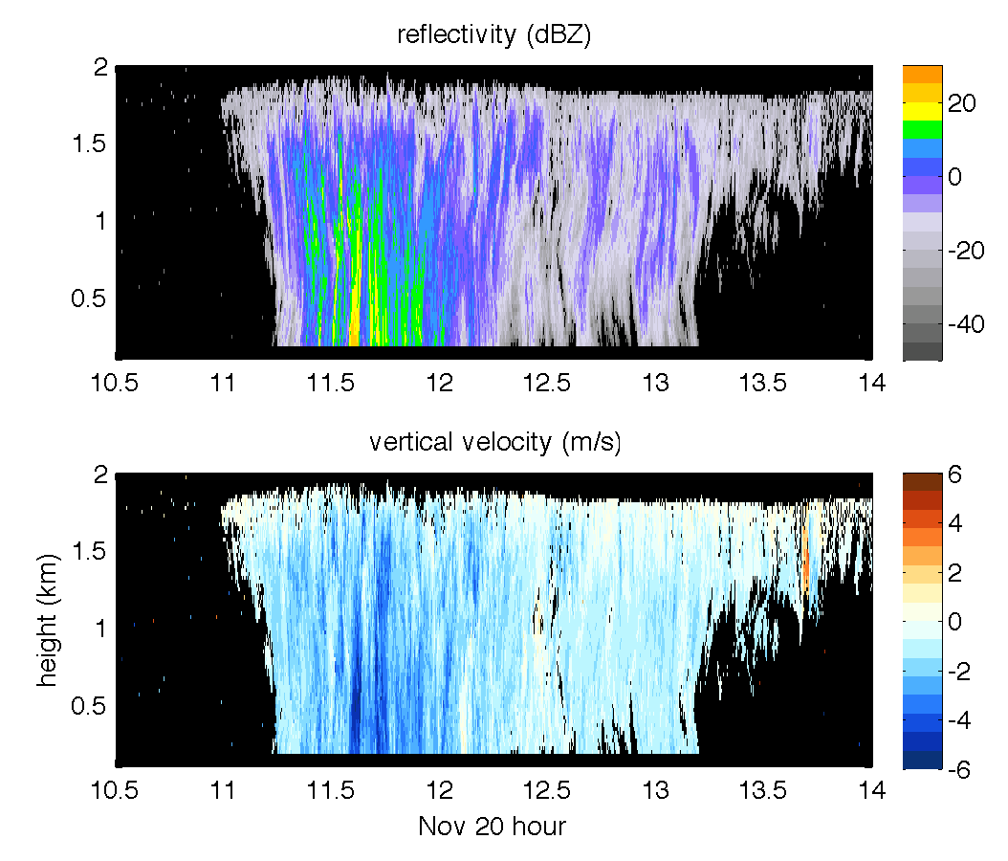
November 20, a rainy period

Slide 11
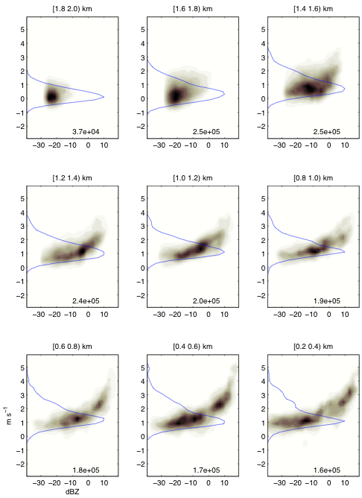
Joint dBZ-Velocity Distributions As Function of Height in the Cloud
From cloudtop down, 200 m height bins
Ztop =1.8 km
Zbase=1.3 km

Slide 12
Retrieval of Clear-air Velocities
In order to retrieve the clear-air velocities from the radar measurements, the Pinsky et al. (2010) technique is utilized.
The measured velocity, V, at height h and time t is split into:
where,
Assume,
Estimate, from the data (as shown in Figure)
Therefore,
And,
where,
Retrieval based on assumption that turbulence and microphysics are uncorrelated averaged over major time interval

Slide 13
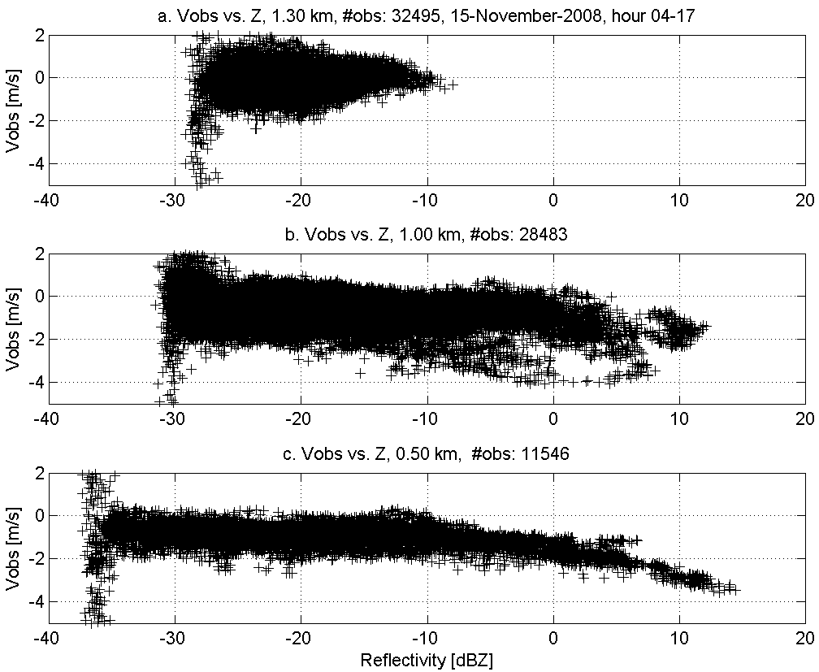
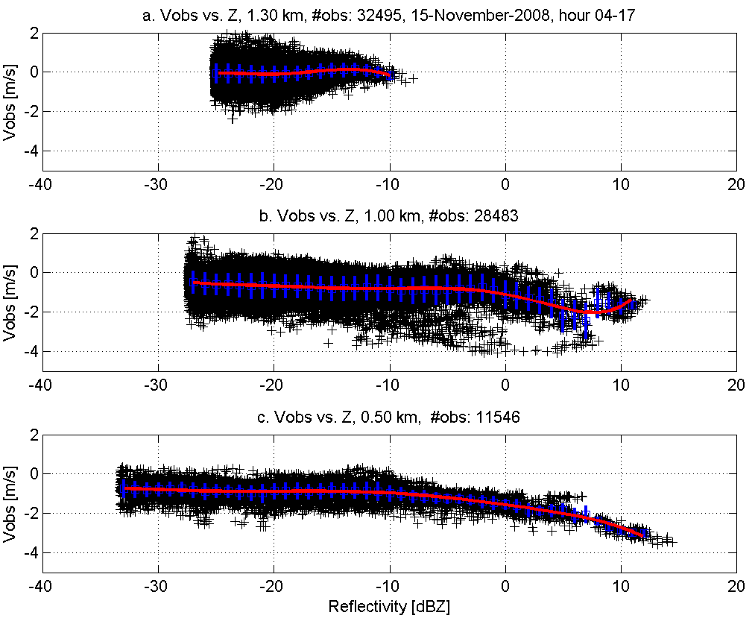
Sample Velocity vs dBZ scatter plots
Figure 2. Radar measured vertical velocity (- Doppler) as a function of height and reflectivity (Z). The function ϕ(Z) (red line) is estimated for each height.

Slide 14
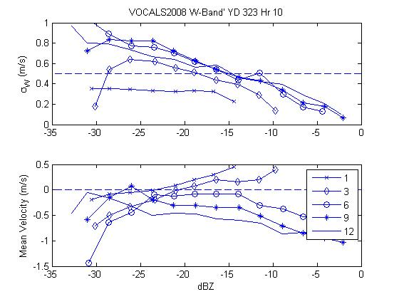
1 Hr from VOCALS: Pinsky Stats
Figure 3b. Profile of the Pinsky a0 factor.
Figure 3a. Radar measured Mean Doppler velocity and STD as a function of dBZ at different levels in the cloud: 1=cloud top, 3=third range gate down, … .
If θ=constant, a=1.0, and

Slide 15
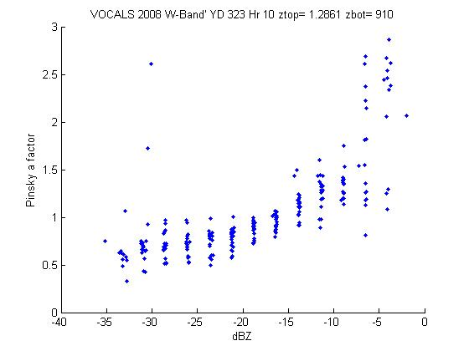
Pinksy a factor
a<1 means updraft and Vg are anticorrelated for small dBZ.
Downdrafts include entrained dry air that evaporates small drops (Vg’>0).
a>1 means updraft and Vg are correlated for large dBZ.
Large drops only present in strong updrafts near cloud top (Vg’>0).

Slide 16
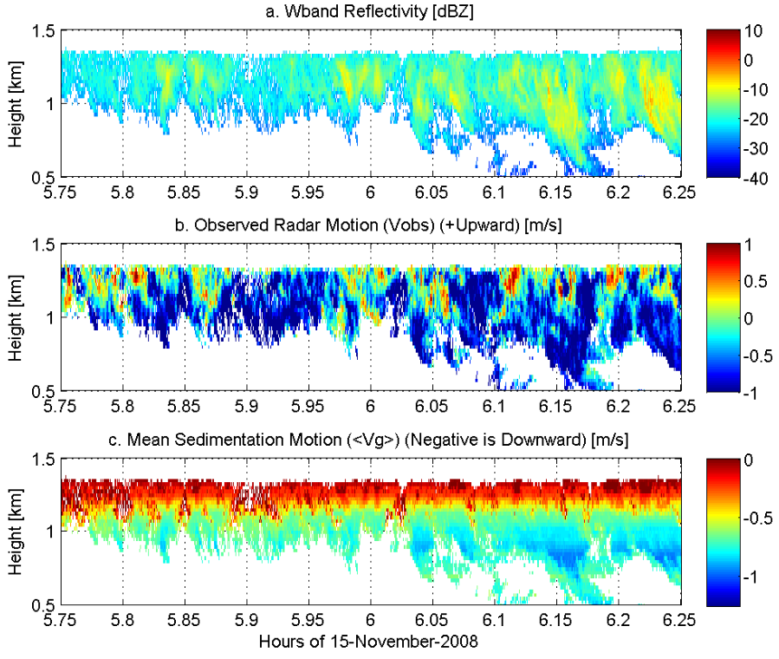
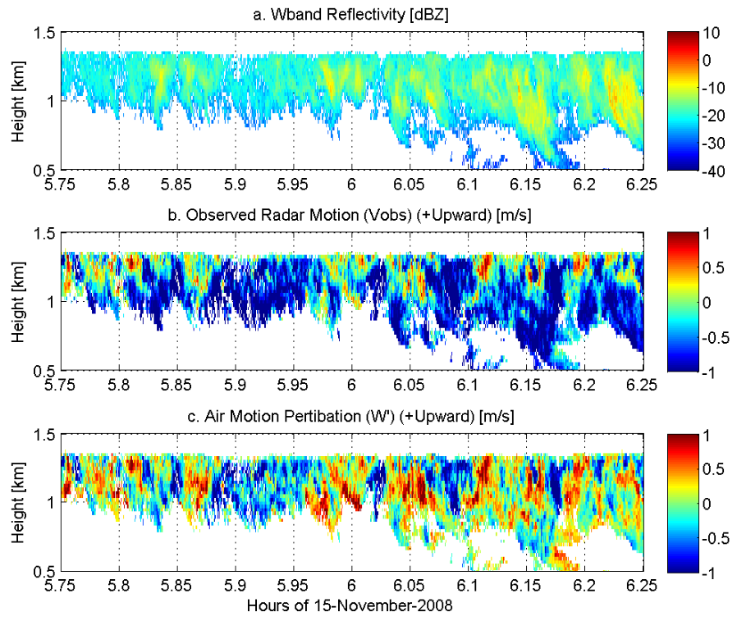
Pinsky Results for ½ hour
Mean vertical drop velocity (-Vg)
Figure 4. Clear-air velocity retrieval process. (a) Estimate of mean sedimentation velocity, (b) Estimate of turbulent air motion
Turbulence

Slide 17
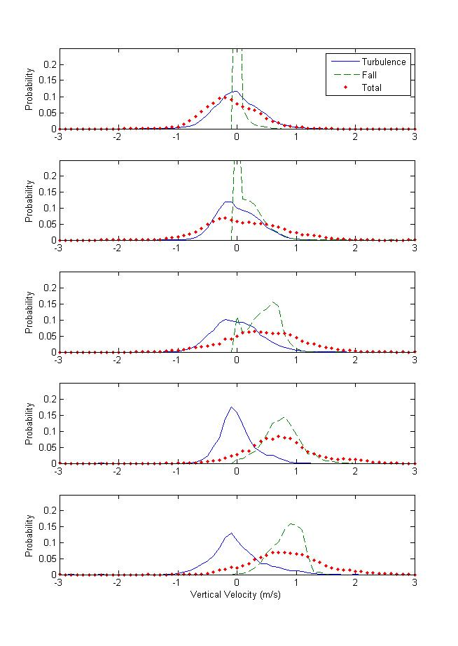
Velocity Stats: Turbulence and Microphysics
Fig. 5. Probability distributions of vertical velocity at different heights in the cloud:
Red dots=raw Doppler
Blue line=turbulence
Green line=Vg

Slide 18
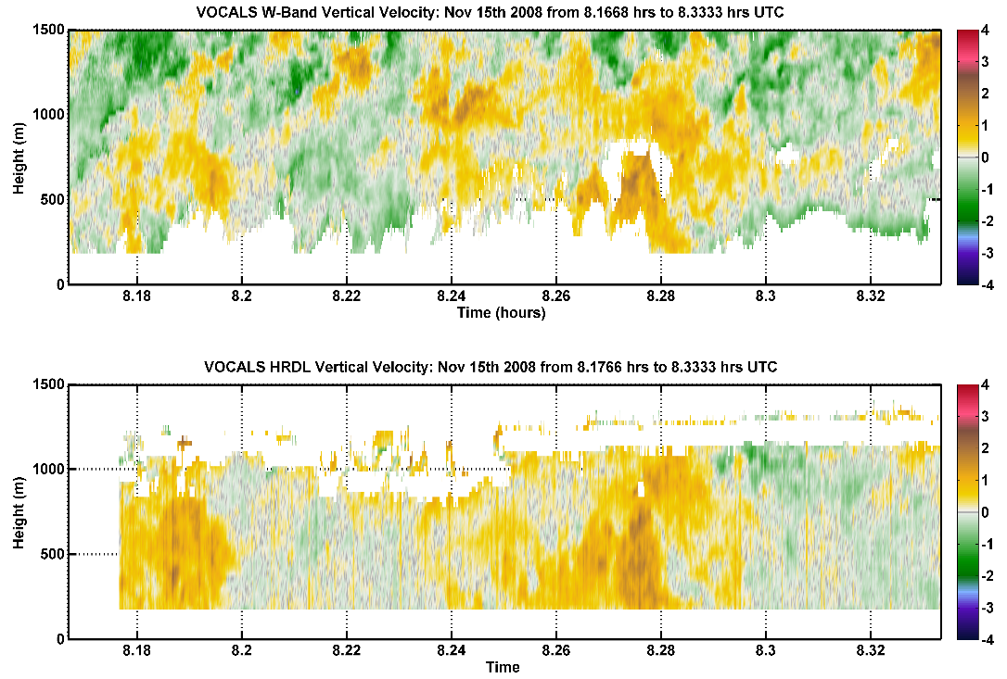
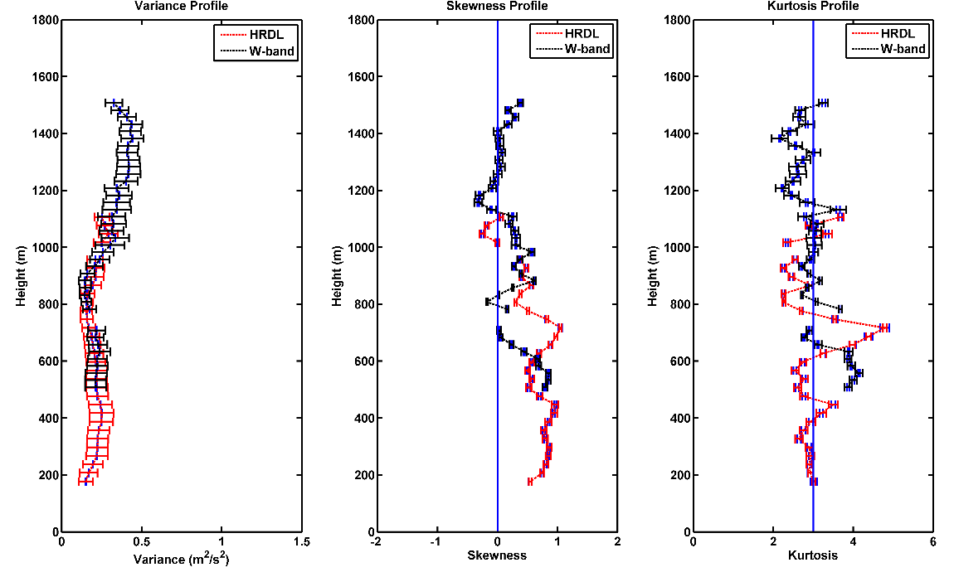
Lidar + Radar Turbulence Retrievals
Figure 6. Comparison of radar retrieved clear-air velocities and turbulence parameters with those measured by the High Resolution Doppler Lidar (HRDL). (a) Comparison of vertical velocity, (b) Comparison of turbulence parameters.

