Slide 1
Overview: CalWater Briefing
National Science Foundation
May 16, 2013
Marty Ralph (NOAA): Overview of CalWater, AR theme
Kim Prather (UCSD): Aerosol-cloud-precipitation theme
Chris Fairall (NOAA): CalWater2 Air-Sea Studies
Ruby Leung (PNNL): ACAPEX campaign

Slide 2
CalWater2:
How did we get here?
CalWater1 (2009-2011) findings and gaps
NOAA’s Hydrometeorology Testbed (HMT) - A modern mesonet in California will be complete in 2014
Global Hawk demonstration conducted- WISPAR in 2011
Increasing societal needs for water-related information and tools (flood damages averaged $10 B/yr in the 2000s, up from $5 B/yr in the 1980s)
Science white paper developed by ad hoc science team and published in GEWEX Newsletter in March 2013

Slide 3
Core Scientific Steering Group
Investigator | Affiliation
F. M. Ralph (Co-Lead) | NOAA Earth System Research Laboratory
K. A. Prather (Co-Lead) | Scripps Institution of Oceanography, University of California San Diego
D. Cayan (Co-Lead) | Scripps Institution of Oceanography, University of California San Diego US Geological Survey
M. Dettinger | Scripps Institution of Oceanography, University of California San Diego US Geological Survey
C. Fairall | NOAA Earth System Research Laboratory
L. R. Leung | Pacific Northwest National Laboratory
D. Rosenfeld | The Hebrew University of Jerusalem
S. Rutledge | Colorado State University
J. R. Spackman | NOAA Earth System Research Laboratory Science and Technology Corporation
D. E. Waliser | NASA Jet Propulsion Laboratory

Slide 4
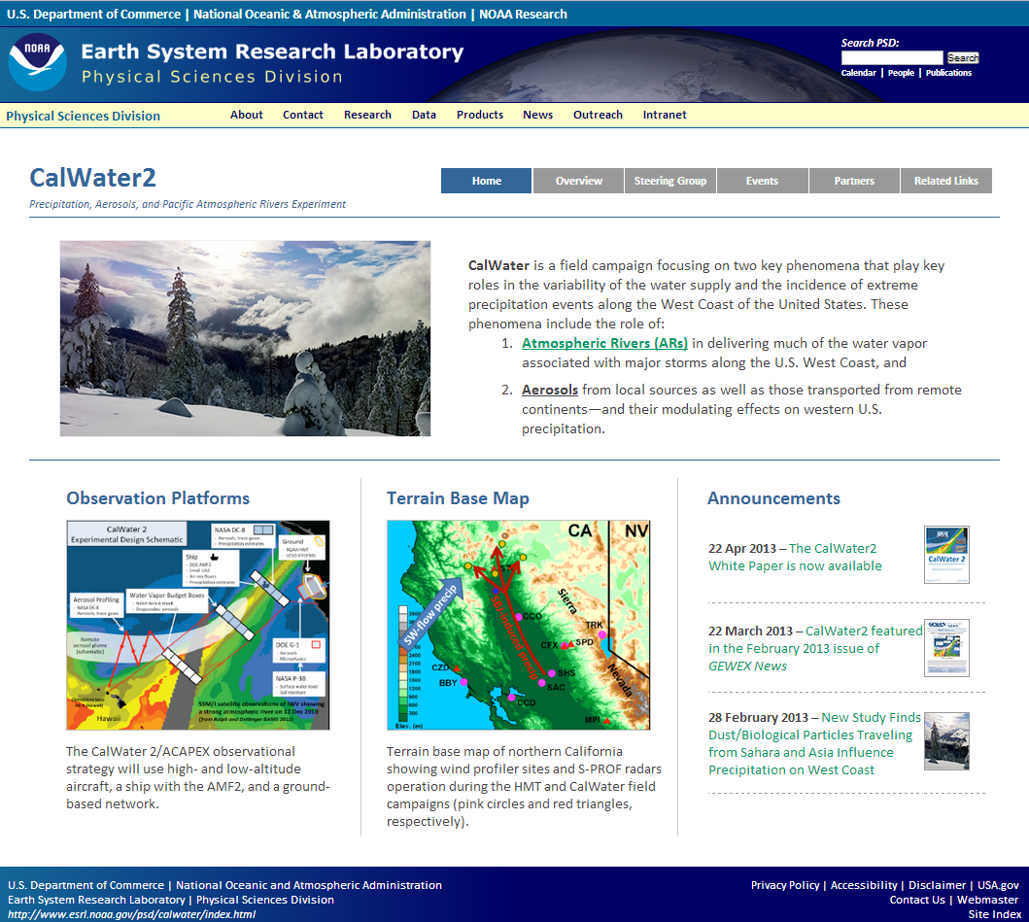
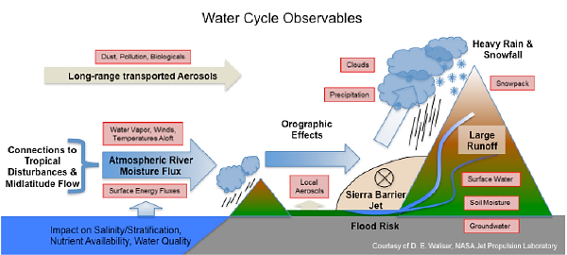
CalWater 2 Informational Webpage
Presents overview, goals, and experimental design of CalWater 2

Slide 5
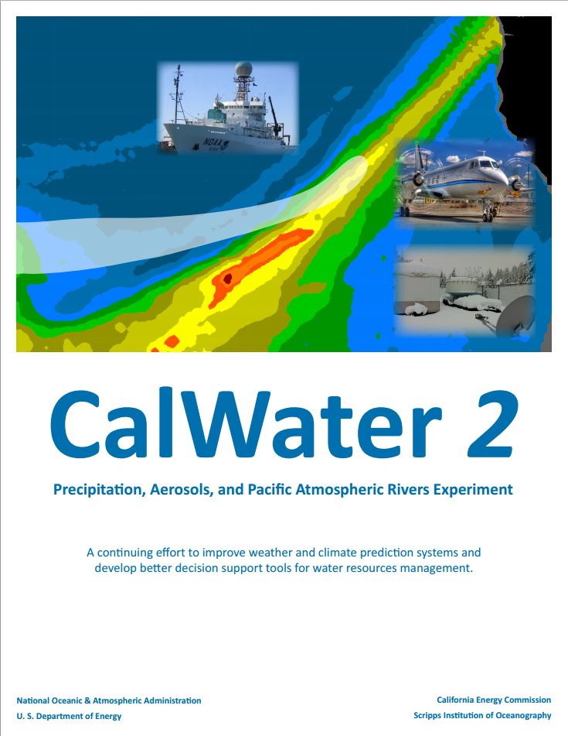
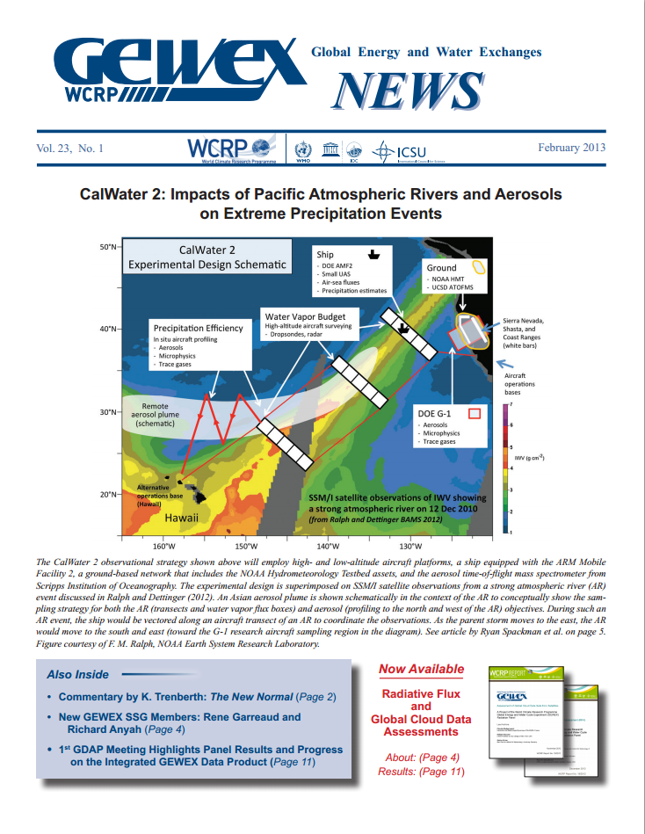
Key Documentation on CalWater 2

Slide 6
Drivers and Phenomena
Socio-economic issues
Variability of the water supply
Incidence of extreme precipitation events along the West Coast of the United States
Key phenomena addressed
Atmospheric rivers (ARs) deliver much of the water associated with major storms along the U.S. West Coast
Aerosols, from local sources as well as those transported from remote continents, can affect western U.S. precipitation.
Affects of a changing climate on these phenomena

Slide 7
Key Science Gaps
Evolution and structure of ARs, including quantifying terms in the water vapor transport budget (air-sea flux, rainout, frontal convergence, entrainment from tropics)
Prediction of aerosol burdens and properties during intercontinental transport from remote source regions to the U.S. West Coast
Aerosol interactions with ARs and the impact on precipitation, including locally generated aerosol effects on orographic precipitation along the U.S. West Coast

Slide 8
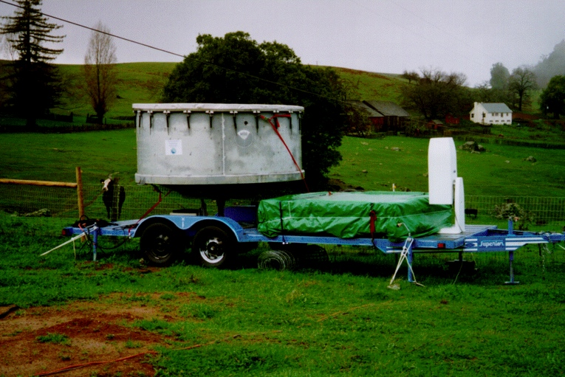
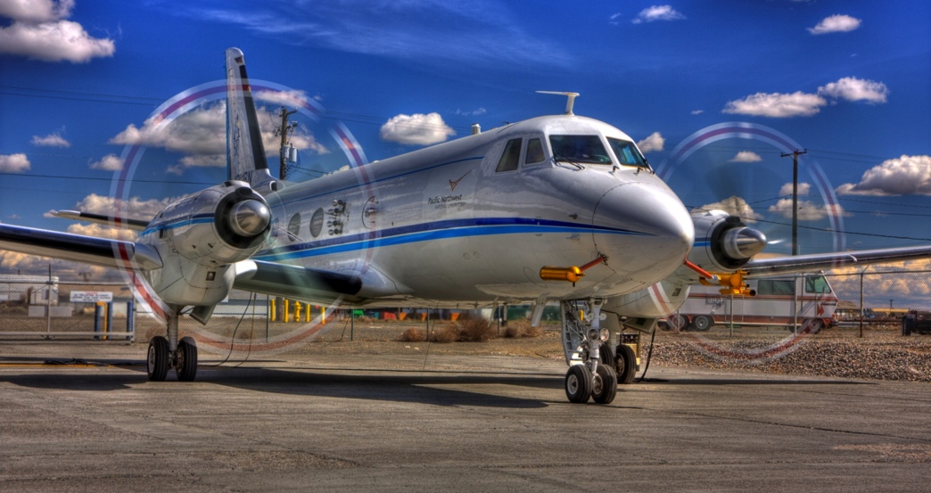
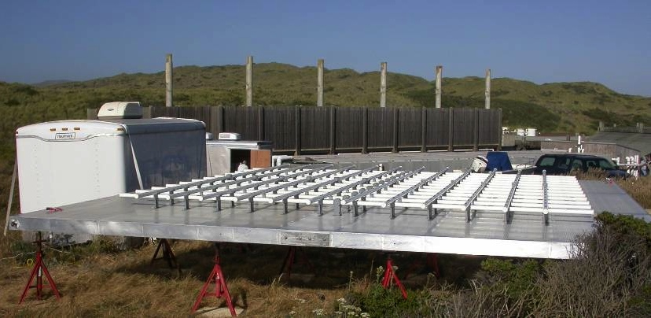
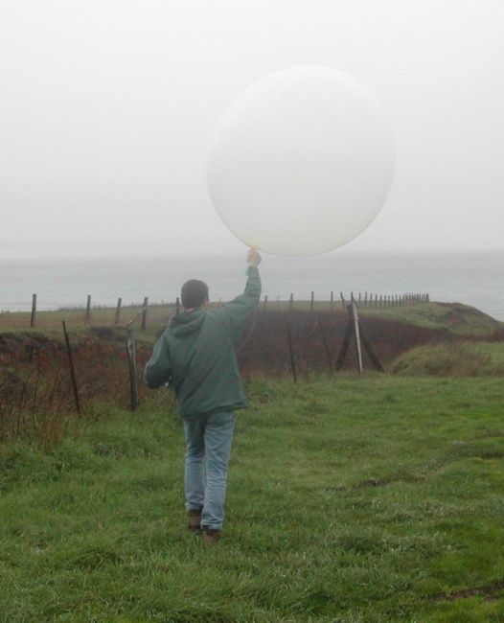

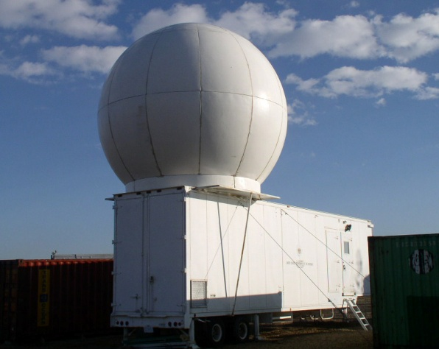
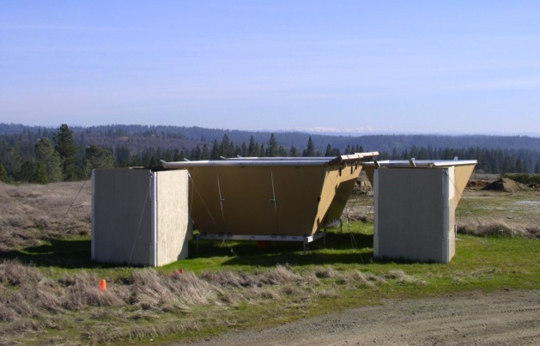
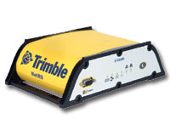
CalWater & HMT-West Observing Systems
Winter 2010/2011 in California
Experiments documenting ARs and Aerosols
Three S-Prof precipitation profilers
(NOAA/PSD)
449 MHz wind profiler
G-1 Research aircraft for CalWater (DOE/PNNL)
1 Feb – 7 mar 2010
SKYWATER
Radar
C-band
scanning
radar
(NOAA/PSD)
Seven 915 MHz wind profilers
(NOAA/PSD)
Scanning Radar
GPS IWV & balloon
Sounding Systems

Slide 9
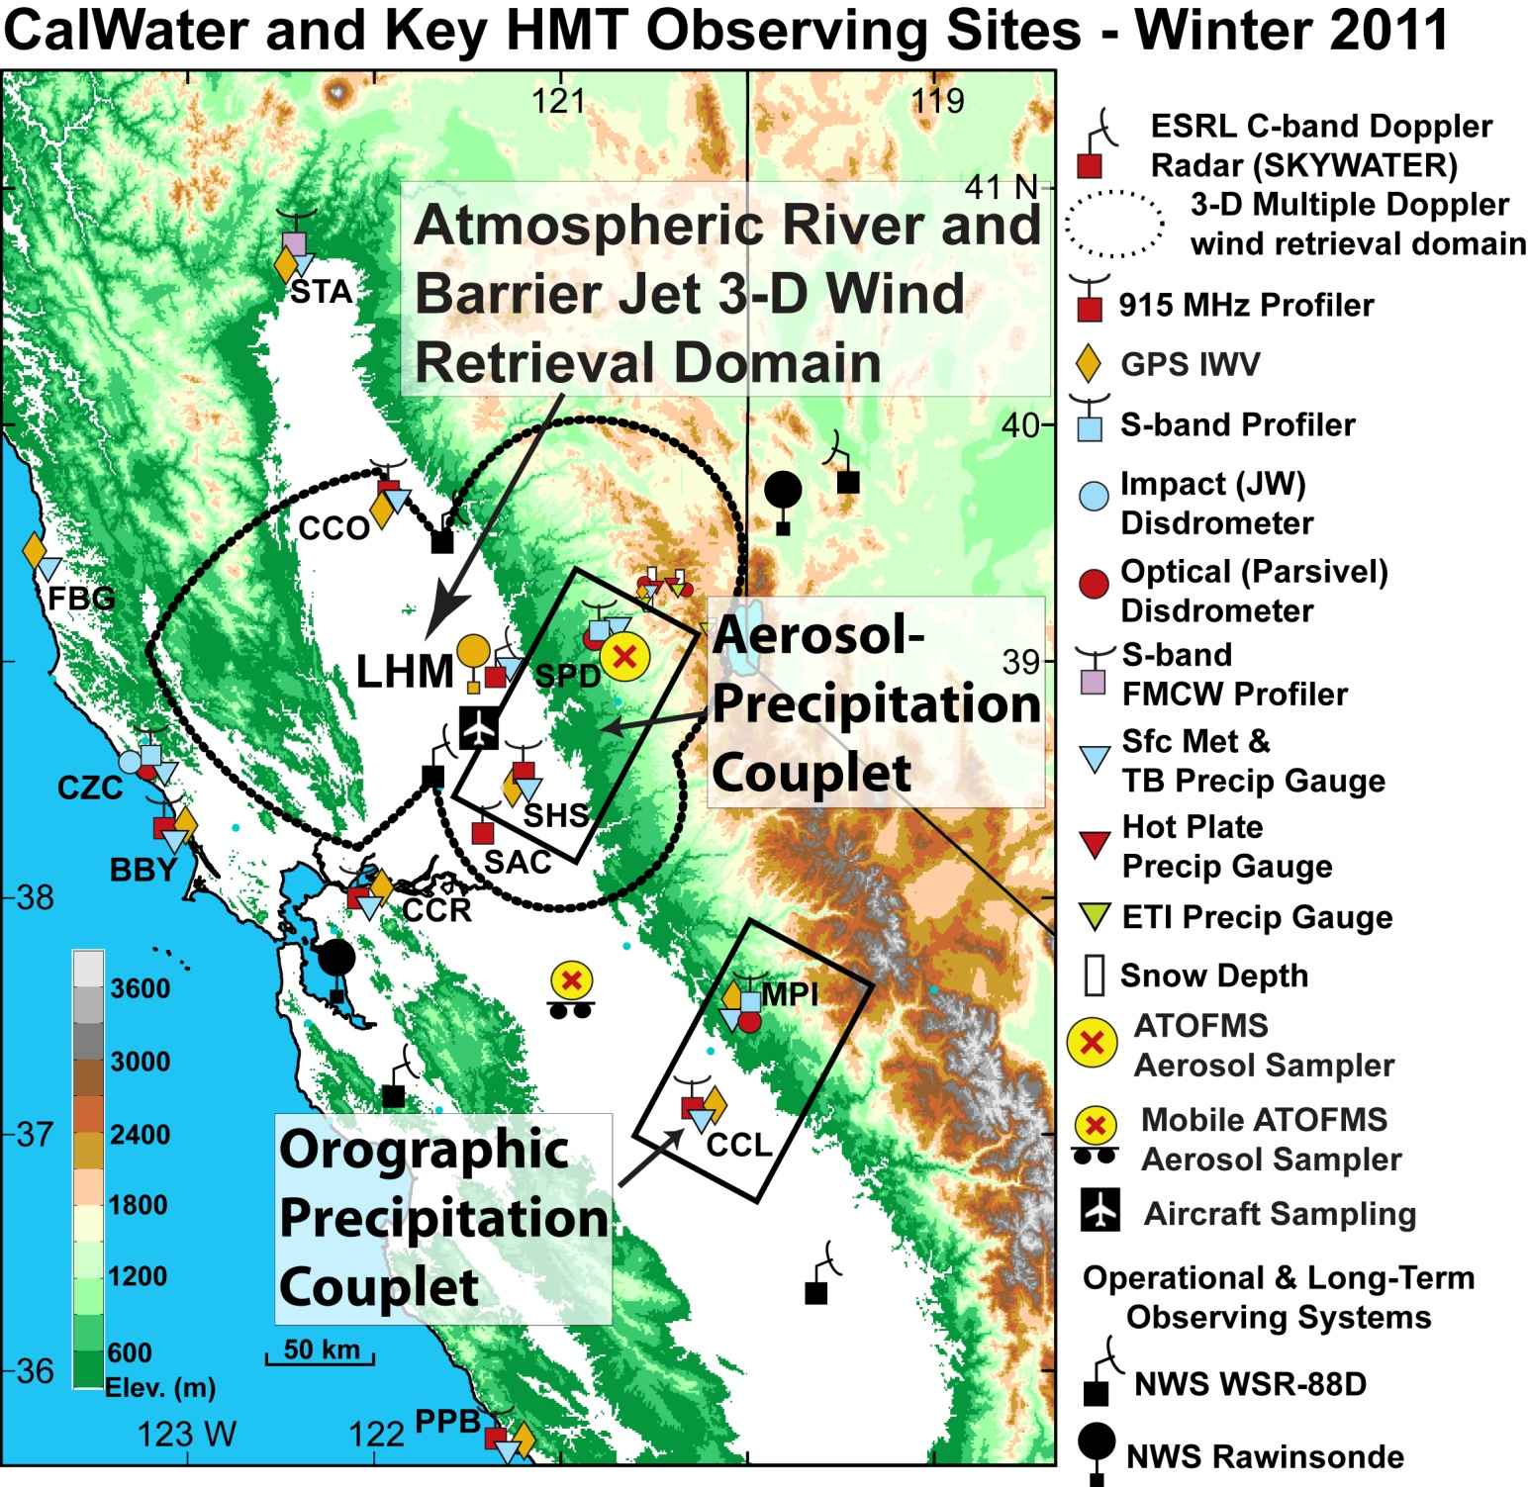
Dec 2010-
Mar 2011
Feb 2009
Feb/Mar
2010

Slide 10
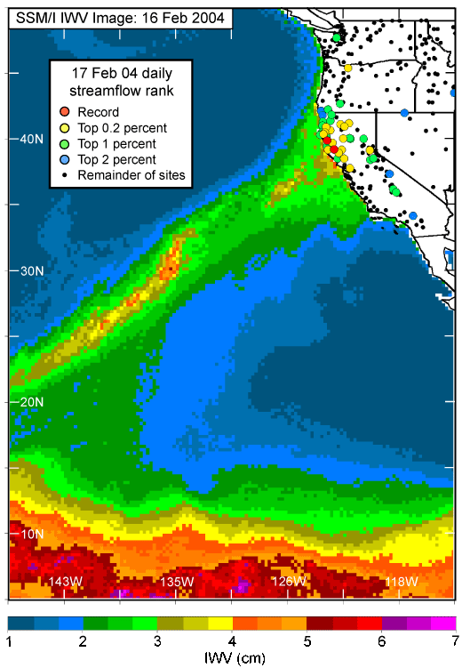
Flooding on California’s Russian River: Role of atmospheric rivers
Ralph, F.M., P. J. Neiman, G. A. Wick, S. I. Gutman, M. D. Dettinger, D. R. Cayan, A. White
Geophys. Res. Lett., 2006
Russian River floods are associated with atmospheric rivers
- all 7 floods over 8 years.
SSM/I satellite data shows atmospheric river
Stream gauge data show regional extent of high stream flow covers 500 km of coast
Flooding in Western Washington: The Connection to Atmospheric Rivers
Paul J. Neiman, Lawrence J. Schick, F. Martin Ralph, Mimi Hughes, and Gary A. Wick
J. Hydrometeorology (2011)
Of 48 annual peak daily flows on 4 watersheds, 46 were associated with the land-fall of atmospheric river conditions.

Slide 11
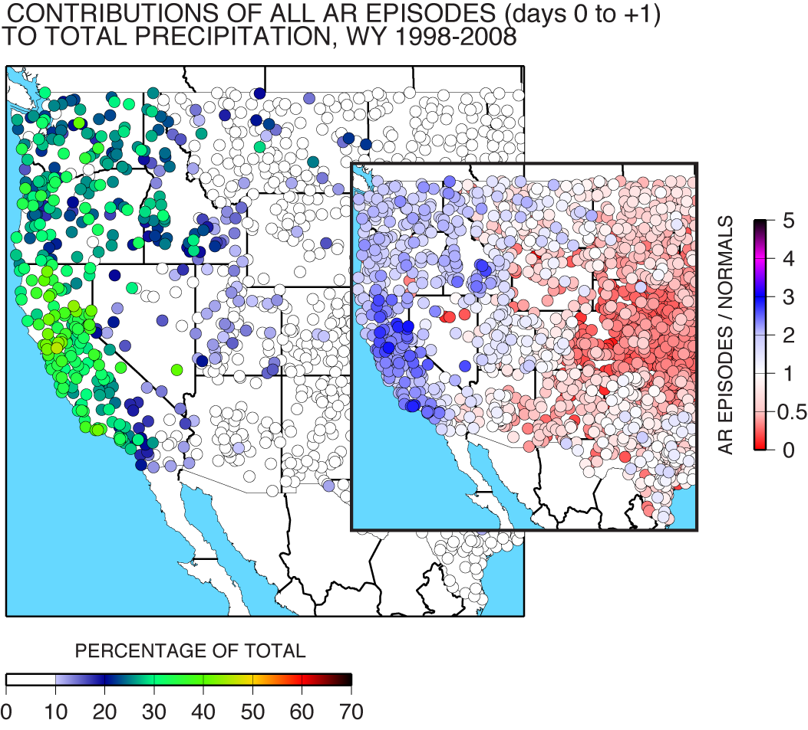
Atmospheric Rivers, Floods and the Water Resources of California
by Mike Dettinger, Marty Ralph, , Tapash Das, Paul Neiman, Dan Cayan
Water, 2011
25-35% of annual precipitation in the Pacific Northwest fell in association with atmospheric river events
An average AR transports the equivalent of 7.5 times the average discharge of the Mississippi River, or ~10 M acre feet/day
35-45% of annual precipitation in California fell in association with atmospheric river events

Slide 12


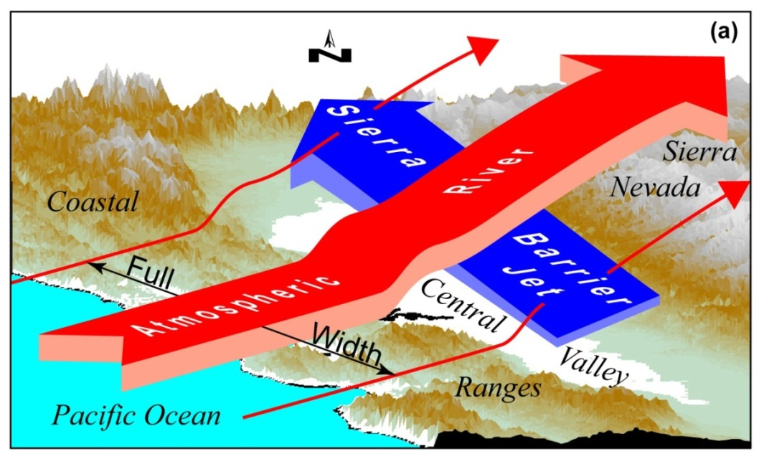
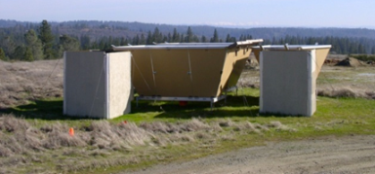

Kinematic and Thermodynamic Structures of Sierra Barrier Jets and Overrunning Atmospheric Rivers during a Land-falling Winter Storm in Northern California
Kingsmill, Neiman, Moore, Hughes, Yuter and Ralph
Journal of Hydrometeorology, 2013 In Press
Landfalling storm 14-16 February 2011
Multi-Doppler scanning-radar retrievals
Multi-wind-profiler time series diagnostics
Balloon soundings
Observing network clearly monitored both the AR and SBJ during two sub-periods within the 2-day IOP
SBJ western edge detected
SBJ deepened toward the north
AR rode up and over the SBJ

Slide 13
Representation of the Sierra Barrier Jet in 11 years of a high-resolution dynamical reanalysis downscaling compared with long-term wind profiler observations.
Hughes, M., P. J. Neiman, E. Sukovich and F. M. Ralph, 2012, J. Geophys. Res. – Atmos., 117
Method
11 years of profiler-observed SBJs (256)
Compared with reanalyses ranging from 275 km, 32 km, 10 km to 6 km grid sizes
NARR 32 km grid size
RD 6 km grid size
Results
NNRP (275 km) does not have SBJs
NARR (32 km) and CARD (10 km) SBJ is 2 times as deep as observed
WRF RD (6 km) has 80% of SBJs
SBJs in WRF RD (6 km) are best match to observed strength and depth
WRF RD misses stable layer below 500 m MSL in SBJs (compared to radiosondes)
Vapor transport in 6-km WRF-RD differs greatly from 32-km NARR
NARR 35% too much flux into Sierra
NARR 20% too little flux along Sierra

Slide 14
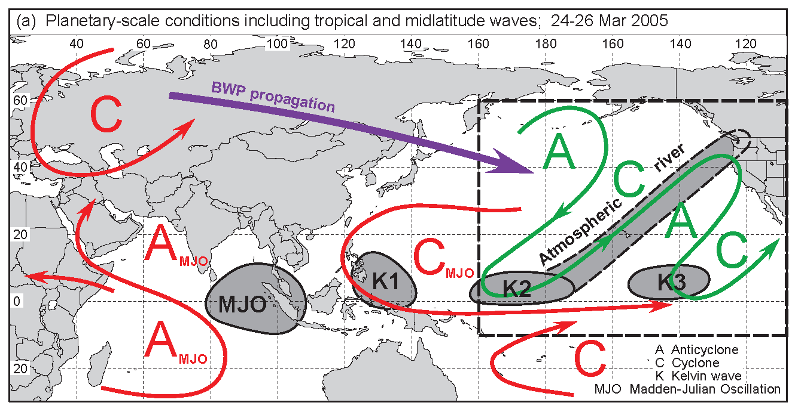
Planetary- and synoptic-scale conditions in a March 2005 case
From Ralph et al. 2011, Mon. Wea. Rev.

Slide 15
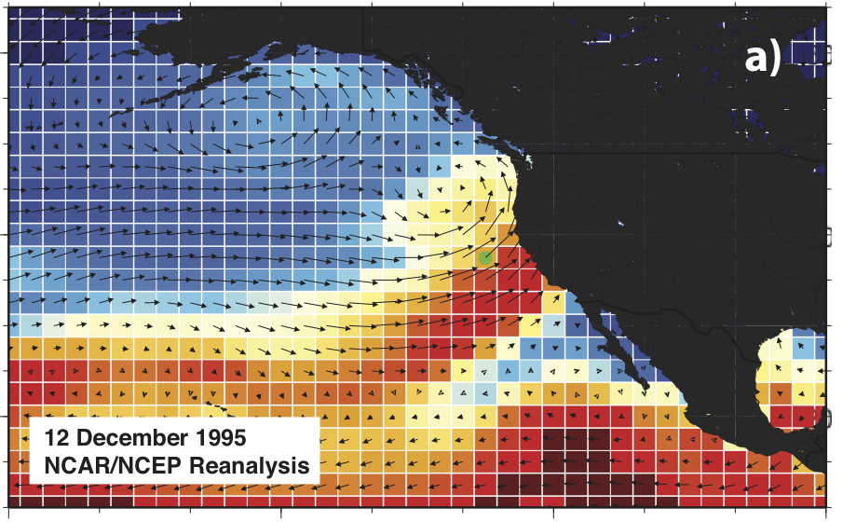
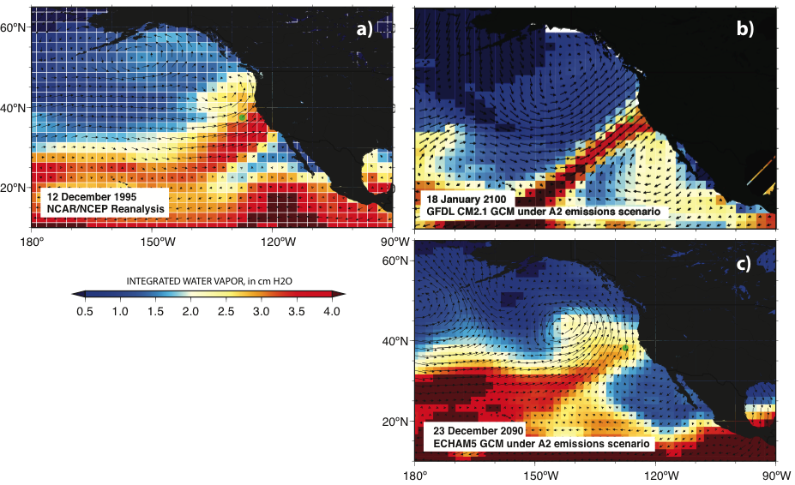
Atmospheric Rivers in IPCC-AR4 climate-change projections by 7 modern GCMs
Obs case
By end of 21st Century, most GCMs yield:
More atmospheric vapor content, but weakening westerly winds
Net increase in “intensity” of extreme AR storms
Warmer ARs (+1.8 C) → snowline raised by about 1000 feet on average
Lengthening of AR seasons (maybe?)
Water Vapor &
Low-Level Winds
Dettinger, M.D., 2011, Climate change, atmospheric rivers and floods in California—A multimodel analysis of storm frequency and magnitude changes: Journal of American Water Resources Association, 47, 514-523.

Slide 16
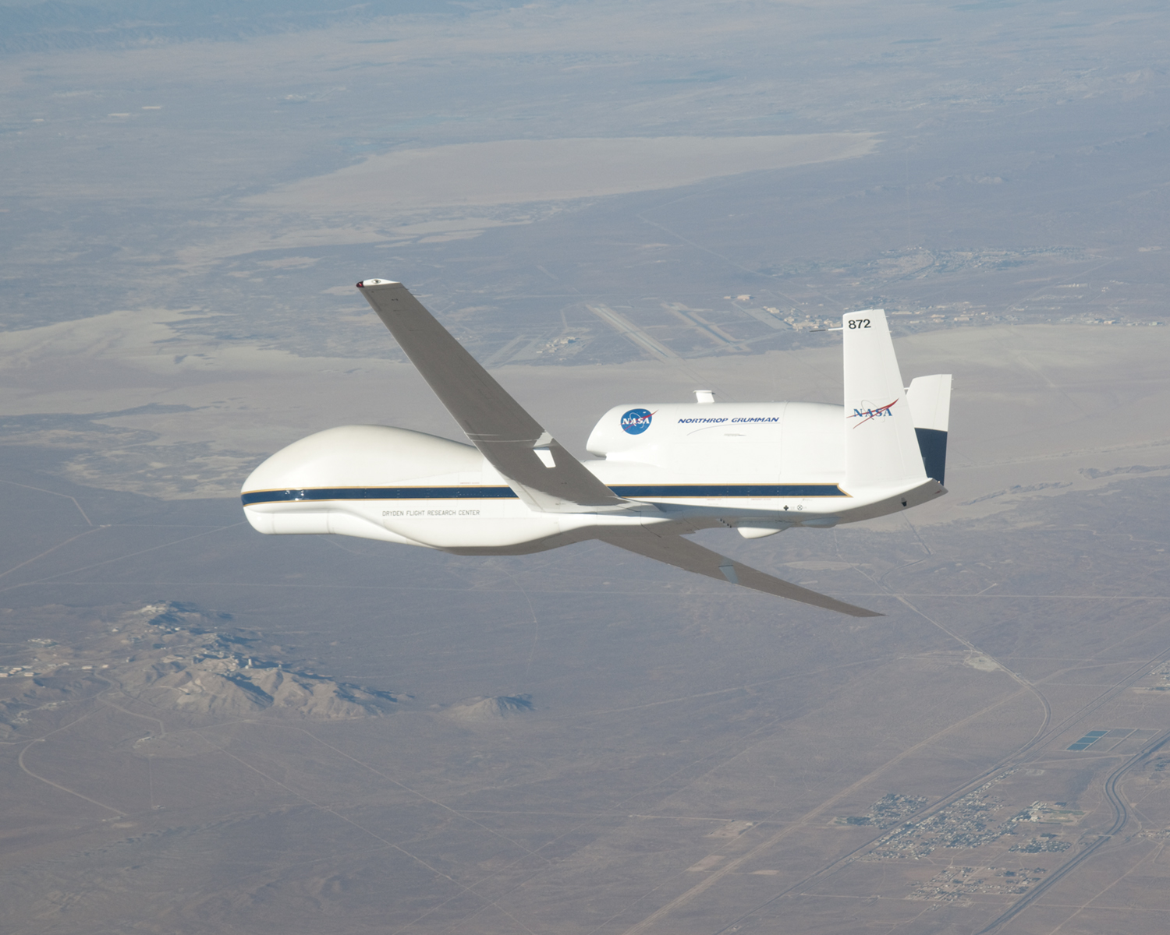
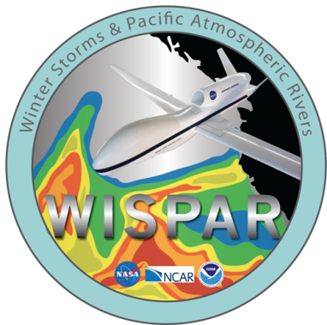
WINTER STORMS AND PACIFIC ATMOSPHERIC RIVERS (WISPAR)
J. R. Spackman^{1,2}, G. A. Wick¹, M. L. Black³, F. M. Ralph¹, Y. Song⁴, Y. Zhu⁴, P. J. Neiman¹, J. Intrieri¹, T. Hock⁵, B. H. Lambrigtsen⁶, R. E. Hood⁷
¹NOAA Earth System Research Laboratory
²Science and Technology Corporation
³NOAA AOML Hurricane Research Division
⁴NCEP Environmental Modeling Center
⁵National Center for Atmospheric Research
⁶NASA Jet Propulsion Laboratory
⁷NOAA Unmanned Aircraft Systems Program
Photo Credit: NASA
Notes:
WISPAR was a collaborative effort between NOAA-NASA-NCAR.

Slide 17
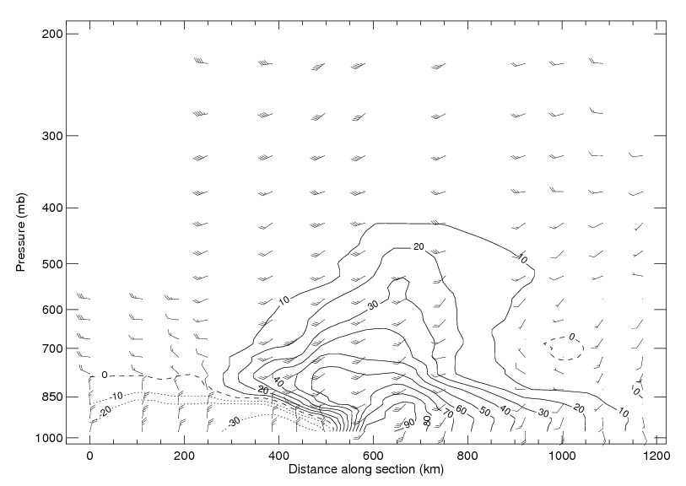
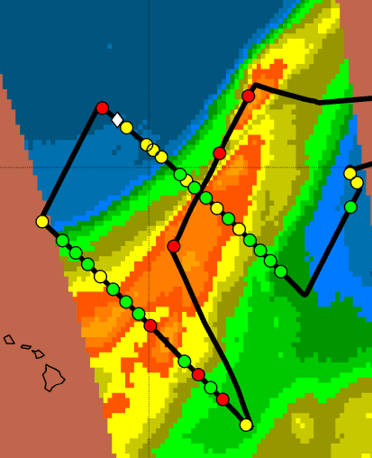
GH AR Flight,
11-12 Feb 2011, IVT
start
403 km wide
end
186x10⁶ kg/s flux
~11 “Mississippis”
10 Million Acre Feet/day

Slide 18
California has begun implementation of key land-based sensors
An Atmospheric River-focused long-term observing network is being installed in CA as part of a 5-year project between CA Dept. of Water Resources (DWR), NOAA and Scripps Inst. Of Oceanography
Installed 2008-2014
>100 field sites
Bodega Bay
Atmos. River Observatory (ARO) to be installed
Dec 2012

Slide 19
50°N
CalWater 2
Experimental Design Schematic
NASA DC-8
- Aerosols, trace gases
- Precipitation estimates
Ground
- NOAA HMT
- UCSD ATOFMS
Ship
- DOE AMF2
- Small UAS
- Air-sea fluxes
- Precipitation estimates
40°N
Sierra Nevada,
Shasta, and
Coast Ranges
(white bars)
Aerosol Profiling
- NASA DC-8
- Aerosols, trace gases
Water Vapor Budget Boxes
NASA Global Hawk
Dropsondes, aerosols
Operations bases
Global Hawk, DC-8 (NASA Dryden)
P-3B, G-1 (Monterey)
30°N
Remote aerosol plume (schematic)
DOE G-1
- Aerosols
- Microphysics
NASA P-3B
- Surface water level
- Soil moisture
20°N
Operations base
DC-8 (HawaiI)
SSM/I satellite observations of IWV showing a strong atmospheric river on 12 Dec 2010 (from Ralph and Dettinger BAMS 2012)
Hawaii
160°W
150°W
140°W
130°W
Courtesy of F. M. Ralph, NOAA Earth System Research Laboratory

Slide 20
Major Platforms | CY 2014 |  |  |  | CY 2015 |  |  |  | CY 2016 |  |  |  | CY 2017 |  |  |  | CY 2018
NOAA HMT/CADWR Network
DOE ACAPEX AMF2 + G-1
NOAA or NSF ship
NOAA P-3 Chang/Fairall
OLYMPEX NASA DC-8 & other facilities
Facility
Status
Committed
Requested

Slide 21
Major Platforms | CY 2014 |  |  |  | CY 2015 |  |  |  | CY 2016 |  |  |  | CY 2017 |  |  |  | CY 2018
NOAA HMT/CADWR Network
DOE ACAPEX AMF2 + G-1
NOAA or NSF ship
NOAA P-3 Chang/Fairall
OLYMPEX NASA DC-8 & other facilities
Global Hawk Risk Reduc. NOAA NASA
NSF other facilities (radar…)
Facility
Status
Committed
Requested
To be developed

Slide 22
Major Platforms | CY 2014 |  |  |  | CY 2015 |  |  |  | CY 2016 |  |  |  | CY 2017 |  |  |  | CY 2018
NOAA HMT/CADWR Network
DOE ACAPEX AMF2 + G-1
NOAA or NSF ship
NOAA P-3 Chang/Fairall
OLYMPEX NASA DC-8 & other facilities
Global Hawk Risk Reduc. NOAA NASA
NSF other facilities (radar…)
AREX NASA Global Hawk
AREX NASA DC-8
Facility
Status
Committed
Requested
To be developed

Slide 23
Major Platforms | CY 2014 |  |  |  | CY 2015 |  |  |  | CY 2016 |  |  |  | CY 2017 |  |  |  | CY 2018
NOAA HMT/CADWR Network
DOE ACAPEX AMF2 + G-1
NOAA or NSF ship
NOAA P-3 Chang/Fairall
OLYMPEX NASA DC-8 & other facilities
Global Hawk Risk Reduc. NOAA NASA
NSF other facilities (radar, G-V…)
AREX NASA Global Hawk
AREX NASA DC-8
Facility
Status
Committed
Requested
To be developed
Hypothetical

Slide 24
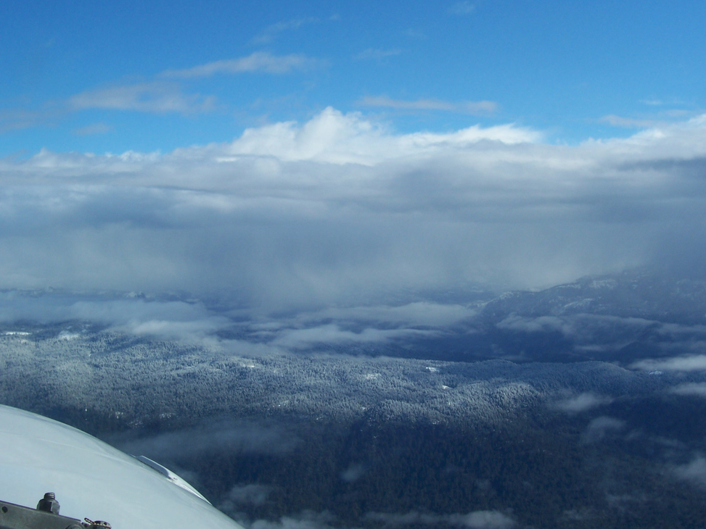
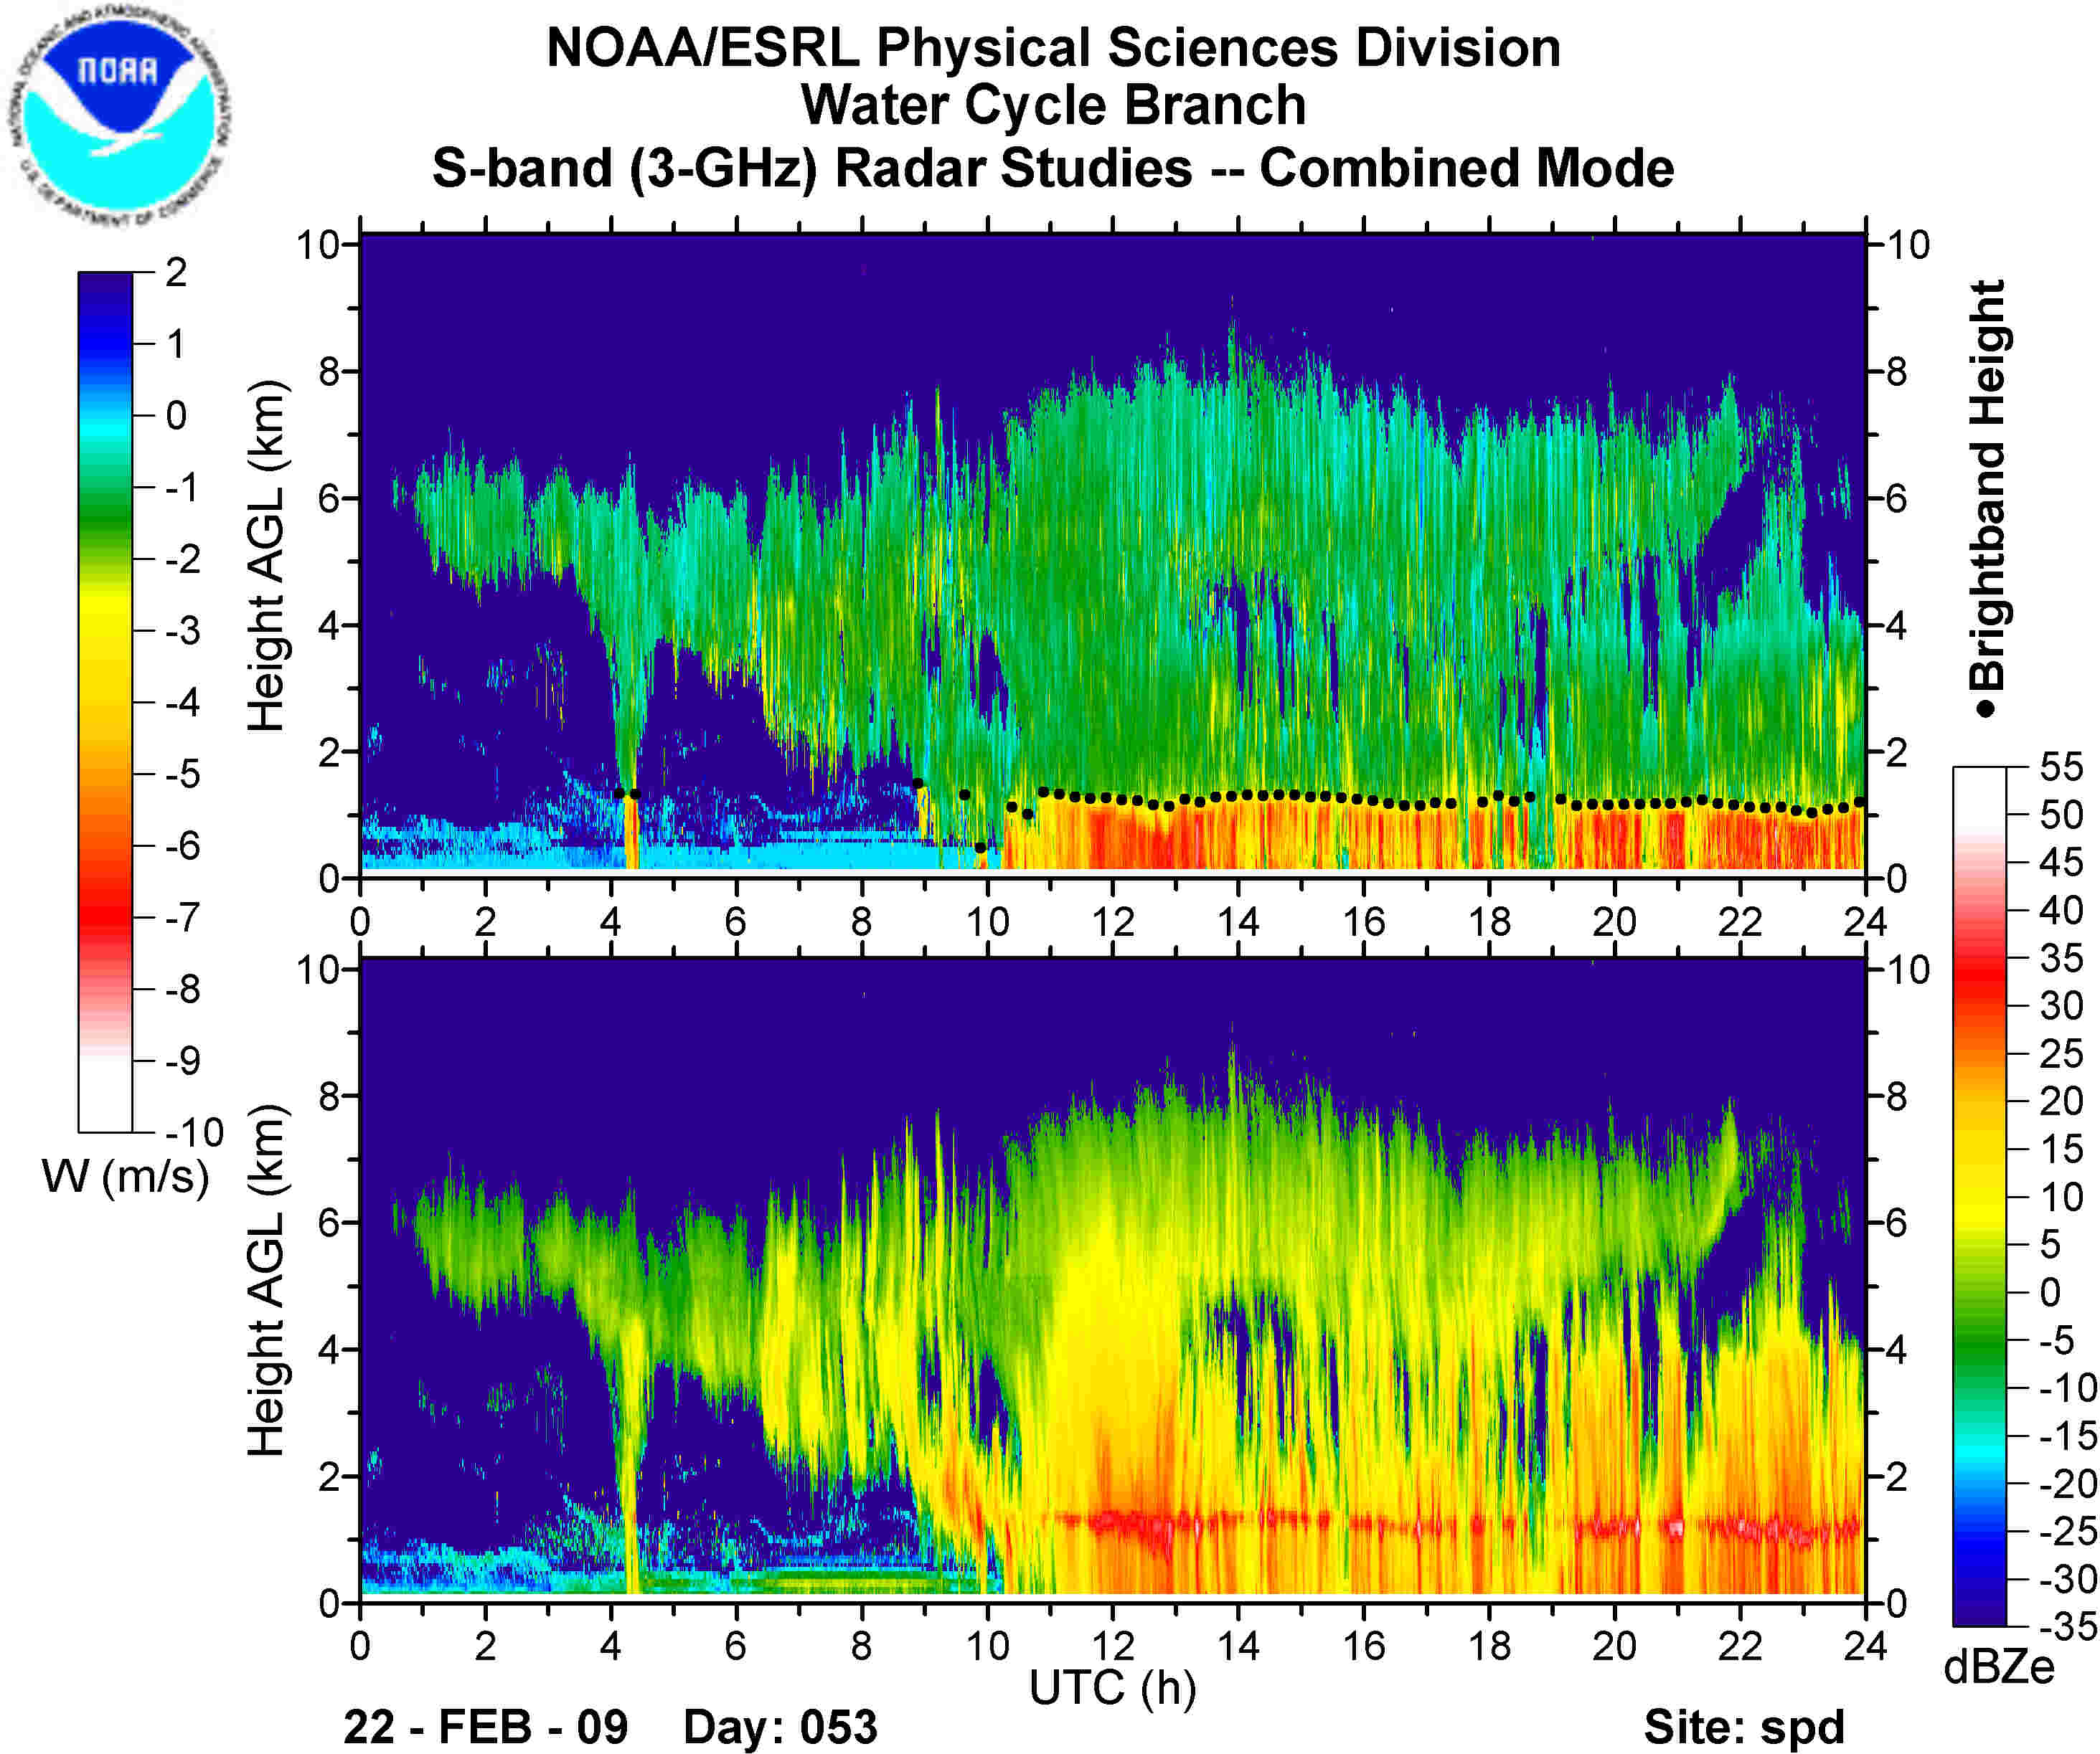
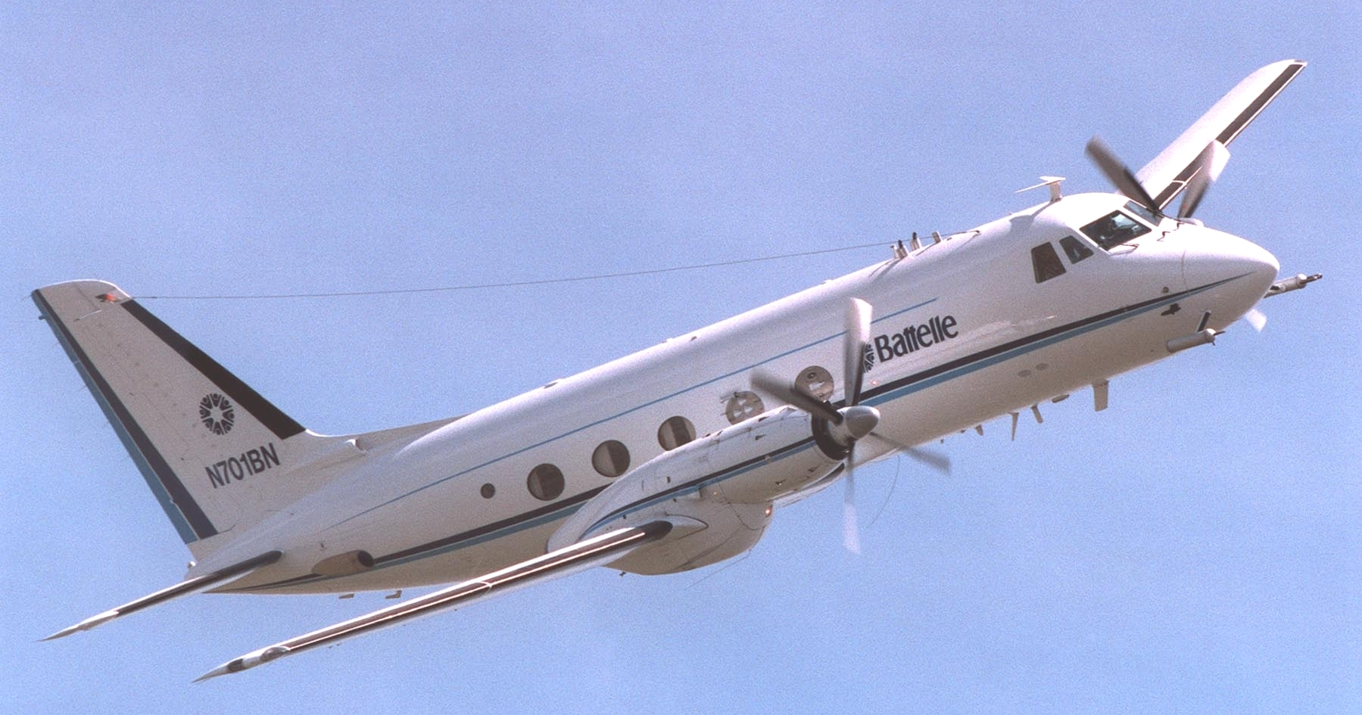
Overview of CalWater: 2009-2011
Goal: Develop a stronger understanding of aerosol sources and
processes impacting cloud properties and precipitation in California
Key questions
How do aerosols affect the formation of clouds and precipitation?
What are the sources and mixing states of aerosols that act as seeds for the formation of droplets and ice?
Under which conditions do aerosols influence precipitation processes?
S-band Radar
Satellite
In-situ measurements
2011

Slide 25
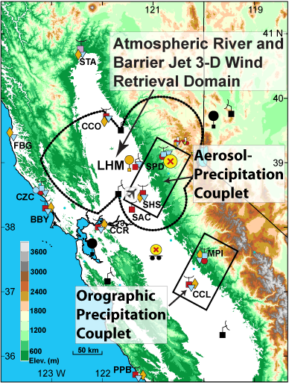
CalWater Measurements
Ground-based studies
Sugar Pine Reservoir (2009-2011) and Mariposa (2010)
  Aerosols (size, composition, source), gas phase pollutants
  NOAA meteorology, S-band radar
Precipitation analysis
Collected rain and snow for different periods of events during storms
Analyzed insoluble residues (ATOFMS) as well as soluble species (liquid chromatography)-compared mass spectra with atmospheric aerosol measurements
Aircraft (PNNL G1) studies-2011
Flights through clouds over Sierras, ocean,
and coastal ranges to investigate orographic CCN and IN in clouds
http://esrl.noaa.gov/psd/calwater

Slide 26
Orographic Precipitation in California
Possible Sources of Cloud Condensation Nuclei (CCN) and Ice Nuclei (IN)
Asia;Africa
Terrestrial Biosphere
Central Valley Pollution
Biomass
Burning
Terrestrial Biosphere
Ocean
Pollution + Long Range Transported Dust
Clean Moist Air
Biogenic Aerosol
(Nucleation)
Transportation, Agriculture
Fires
East
Pacific
Ocean
Coastal Range
Central Valley
Sierra Nevada Range
What are the important sources of CCN and IN in the Sierra Nevada?
Rosenfeld et al., JGR, 2008 (SUPRECIP-2005)
Ault, et al., JGR, 2011; Creamean et al., Environ. Sci. Technol., 2011;
Creamean, et al., Science, 2013.

Slide 27
Characterizing Aerosol Mixing State
Aerosol Time-of-Flight Mass Spectrometry (ATOFMS)
Aerodynamic Particle Size
Dual Polarity Mass Spectra
Bulk Analysis
ATOFMS
Fraction
Mass
Number
Prather et al, Anal. Chem., 1994; Gard et al, Anal. Chem., 1997; Pratt, et al. A. Chem, 2009.

Slide 28
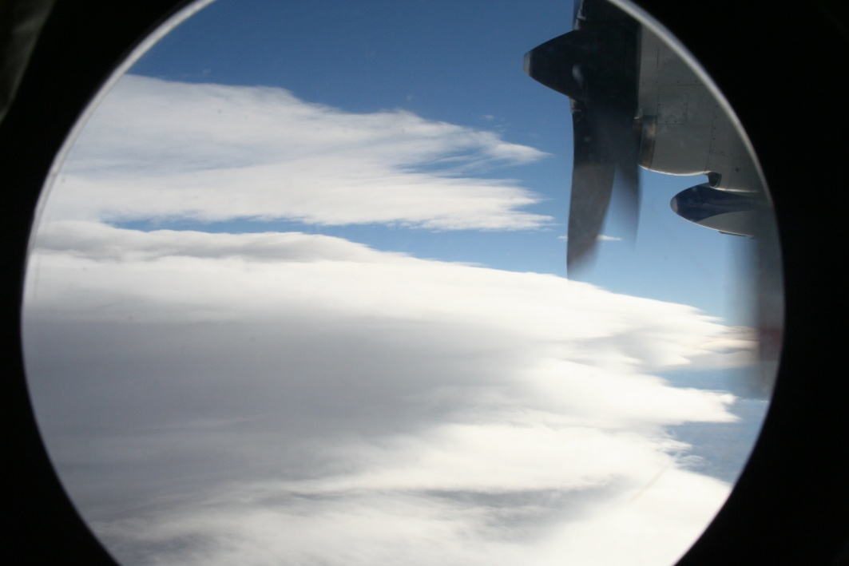
Sampling individual cloud droplets/ice crystals
Parallel measurements of aerosol chemistry & ice nuclei in real-time
Aircraft Aerosol Time-of-Flight Mass Spectrometer: Measured the size and chemical composition of individual cloud residues (non-refractory & refractory material)
Continuous Flow Diffusion Chamber (Paul DeMott, Colorado State Univ.): Measured ice nuclei concentrations
Counterflow Virtual Impactor (CVI) selected cloud particles
(>7-11 μm)
Evaporate water from cloud droplets/ ice crystals
Notes:
Twohy et al 1997

Slide 29
Single-Particle Signatures
Pratt, et al. Nature Geoscience, 2009
Notes:
29

Slide 30
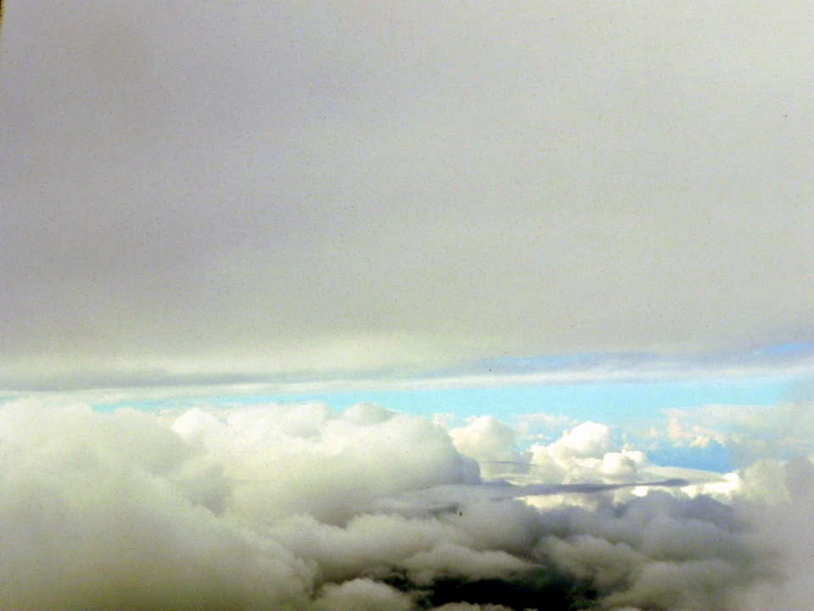
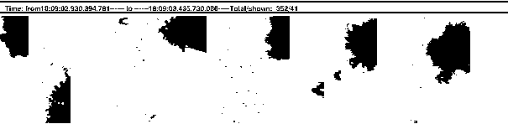
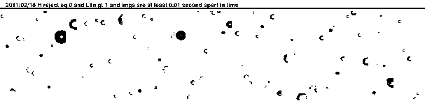
2/16/2011 17:58 UTC 3,820 m, -21.5°C
Dust
Corresponding
increase in IN on CFDC
Sea Salt

Slide 31
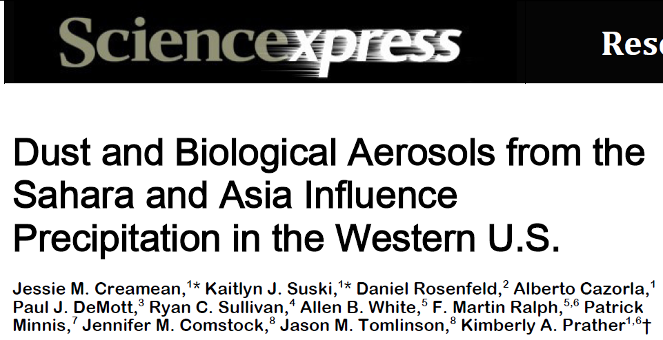
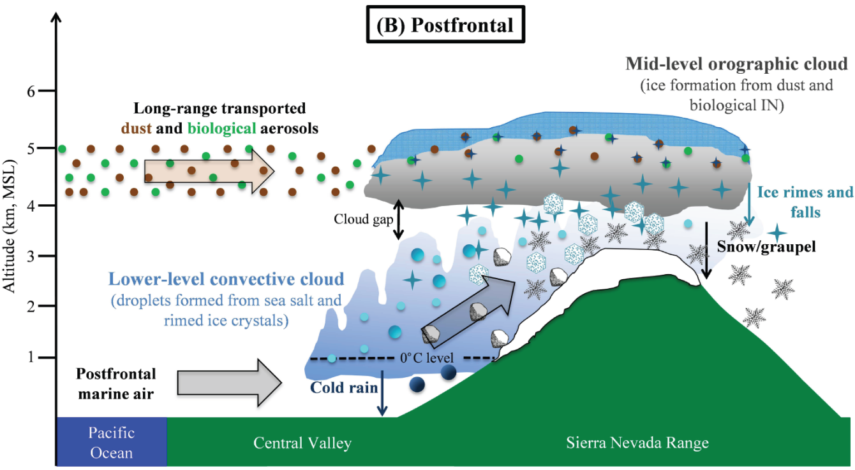
Aerosol Impacts on Regional Clouds and Climate
Creamean, et al.
Science, 2013
CalWater-2011 field observations showed days with
dust and bioparticles experienced extensive snowfall
Notes:
Aerosols impact clouds—but do they affect precip? Most people say no…Field study showed otherwise…now this research will inspire new model inputs and lab studies…demonstrates synergy between lab, field, and models

Slide 32
CalWater Findings
Dust and biological particles from as far away as African impact cloud structure over the Sierras and may enhance precipitation (modeling studies being conducted by R. Leung, PNNL and A. Martin, UCSD)
Ice formed in upper level mixed phase clouds undergoes riming as it falls through lower level marine clouds—seeder/feeder mechanism
Supercooled liquid occurs at colder temperatures above dust/bio layer
On flights w/out dust/bio, supercooled liquid observed to -35˚C (Rosenfeld)
Dust and bioparticles also observed in precipitation samples collected south in Yosemite, thus appear to impact N-S transect along Sierras
  2013-2014 Early Start CalWater2 will address:
  Are dust/bio and pollution particles affecting precipitation
  the type/amount of precip.?—QPF comparisons w/ NOAA
  How typical are trajectories and results in 2011?
  Is early transport of dust/pollution going to become the “norm” in
  in a warming climate?

Slide 33
CalWater2: Aerosol-Cloud-Precipitation Studies
Major Goal: Improve treatment of aerosols in regional climate models
Measurement Priorities:
Vertical and spatial gradients of CN and CCN concentrations
  Scanning CCN at two altitudes, PAEROS instrument package-Greg Roberts, SIO
  Biological and CCN measurements-Athanasios Nenes, GA Tech
  Satellite and sub-saturated CCN measurements (DASH)-A. Sorooshian, U. of Arizona
Sources of Ice Nuclei
  CFDC-ATOFMS-P. DeMott and K. Prather, CSU and UCSD
  Resolving oceanic vs. terrestrial biological sources, Fluorescence-ATOFMS,
  Tethered balloons; Prather, UCSD
  Time-resolved precipitation measurements (Creamean, Ralph, NOAA)
Modeling-Measurement Comparisons and Improvements
  Sonia Kreidenweis, Sue Van den Heever, P. DeMott, B. Cotton, CSU
  S. Rutledge and Spackman, CSU
  K. Prather and A. Martin, UCSD; M. Ralph, R. Spackman, J. Creamean, NOAA
  NAAPS and COAMPS coastal modeling and mobile measurements-P. Flatau (SIO) and Jerome Schmidt (NRL)

Slide 34
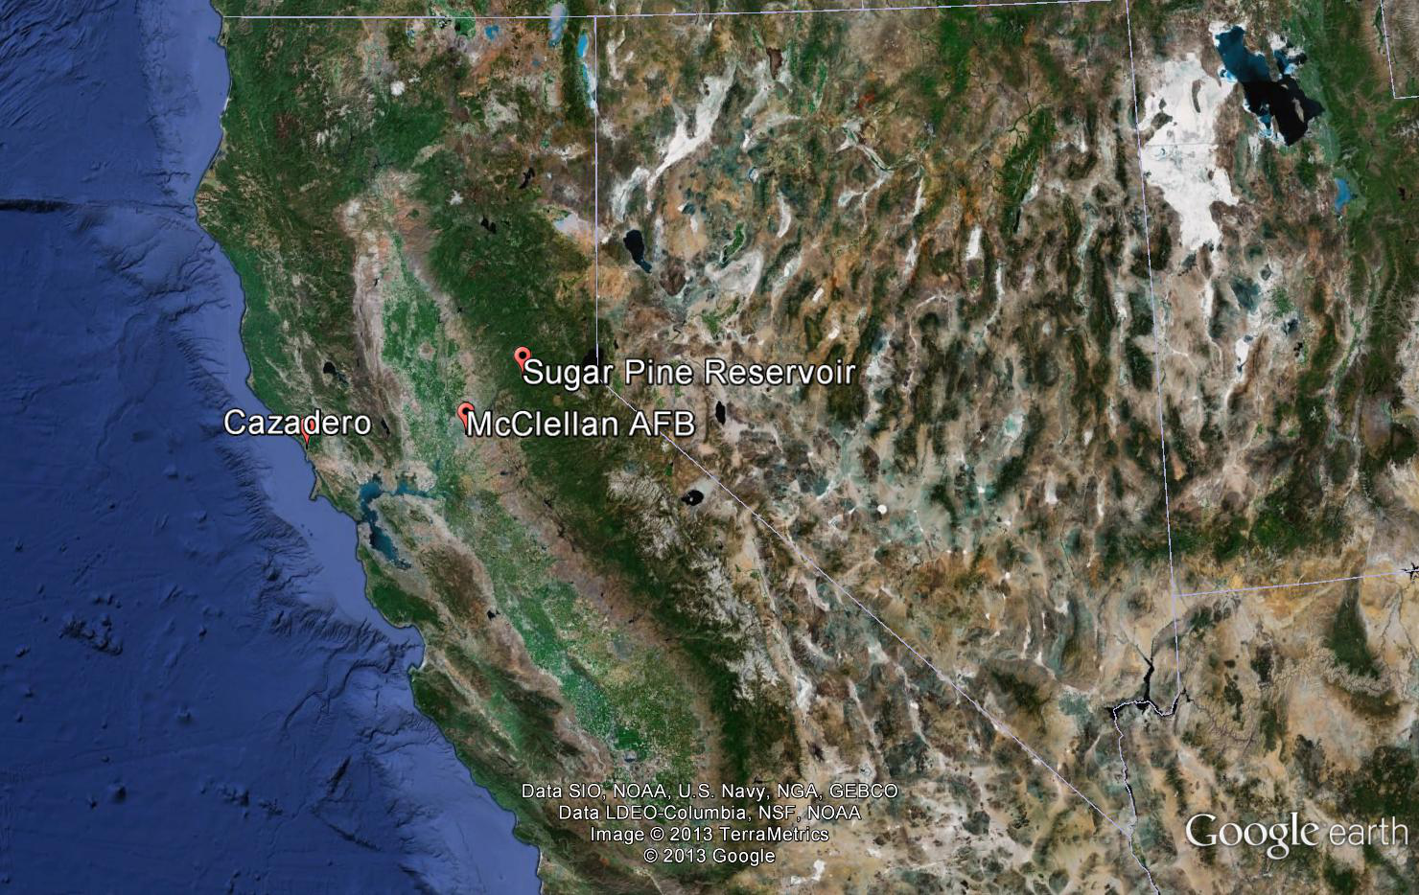
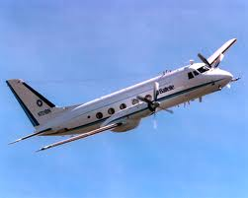
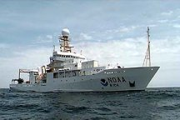
CalWater2: Planned Aerosol-Meteorology-
Microphysics-Dynamics Measurements
CalWater2 Major Focus
What are the major sources of ice nuclei and CCN (pollution vs. long range dust vs. sea spray)?
How do specific sources influence cloud microphysics and precipitation processes?
Leung
Fairall
Central
Valley
Sierra
Nevadas
Coastal
Range

Slide 35
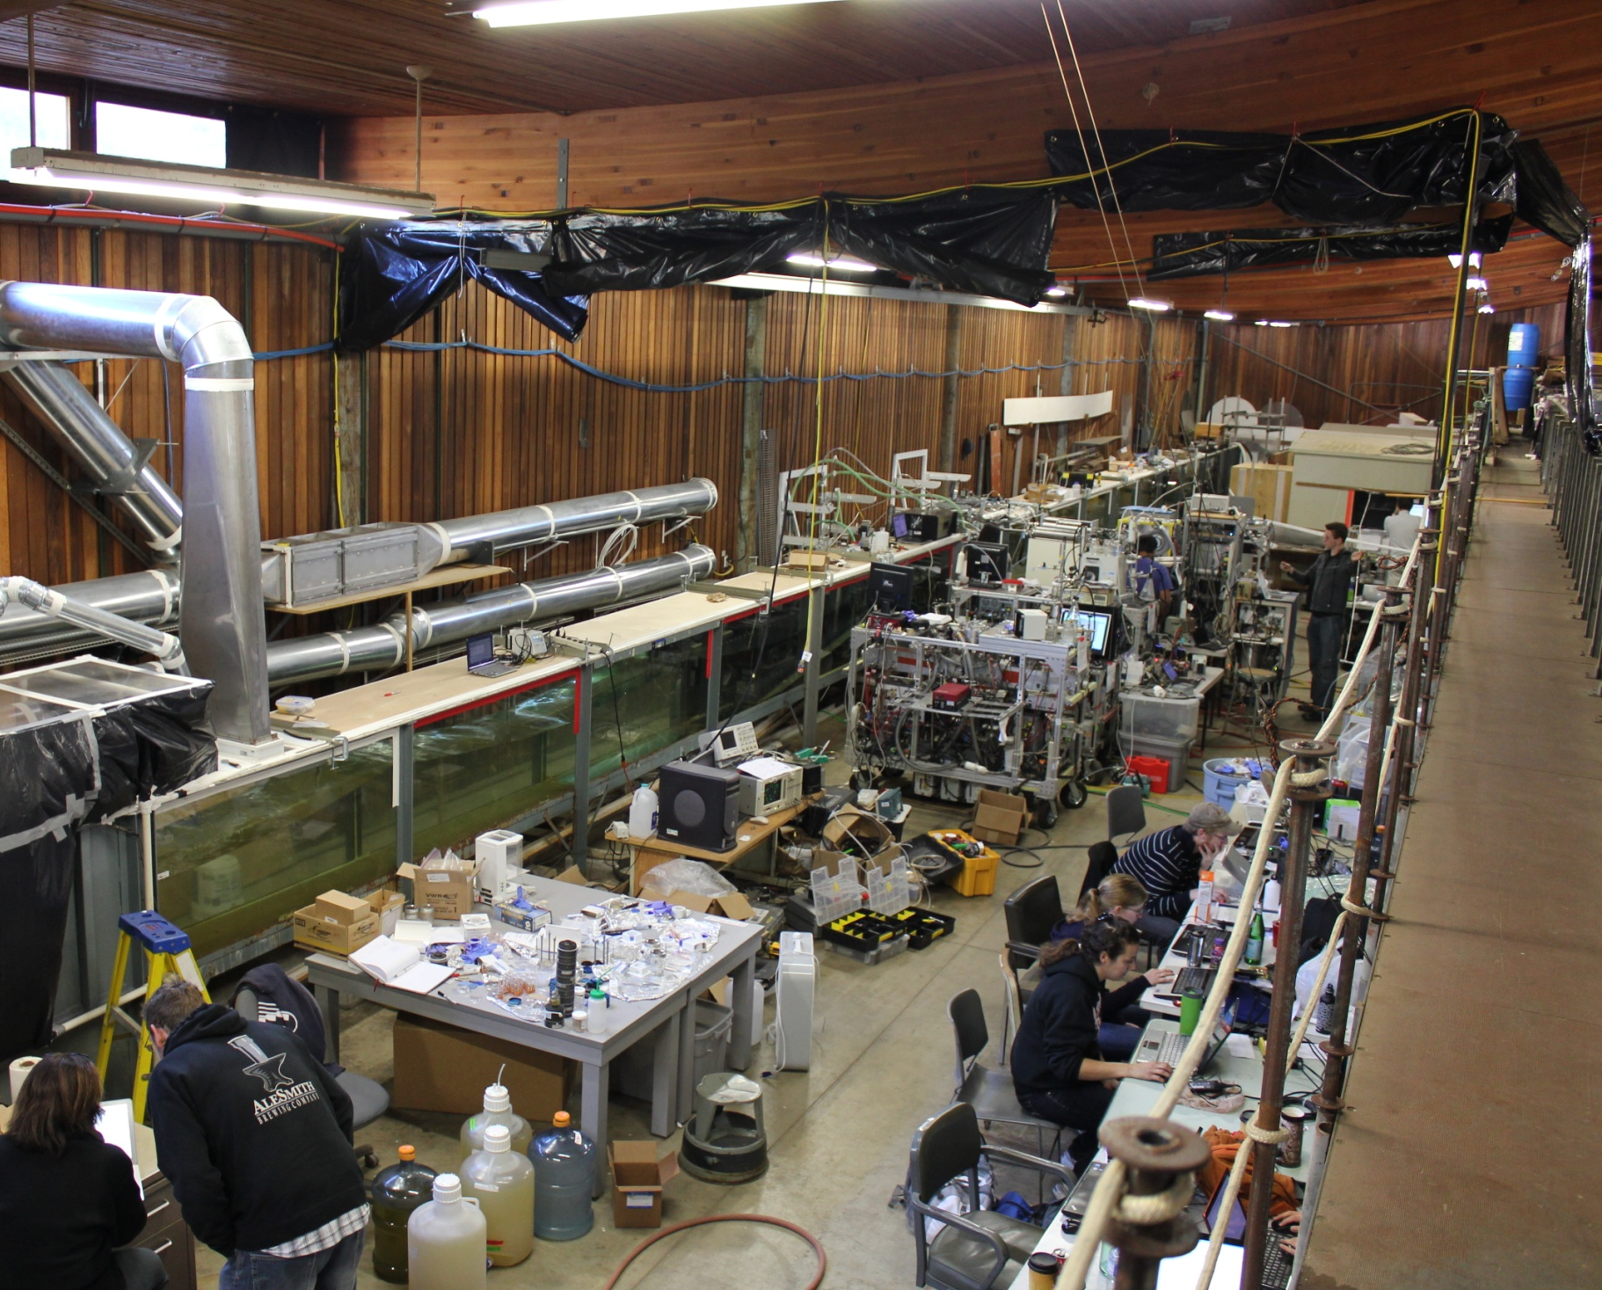
Ocean Impacts on Clouds, Climate, Precipitation
NSF CAICE: New Ocean-Atmosphere Facility
Notes:
To produce it correctly—had to move beyond standard methods (frits)-only happened because we are part of a Center which collaborates with SIO and oceanographers—forced chemists outside of the box…took over a year to get it right as you will here more about from Grant Deane

Slide 36
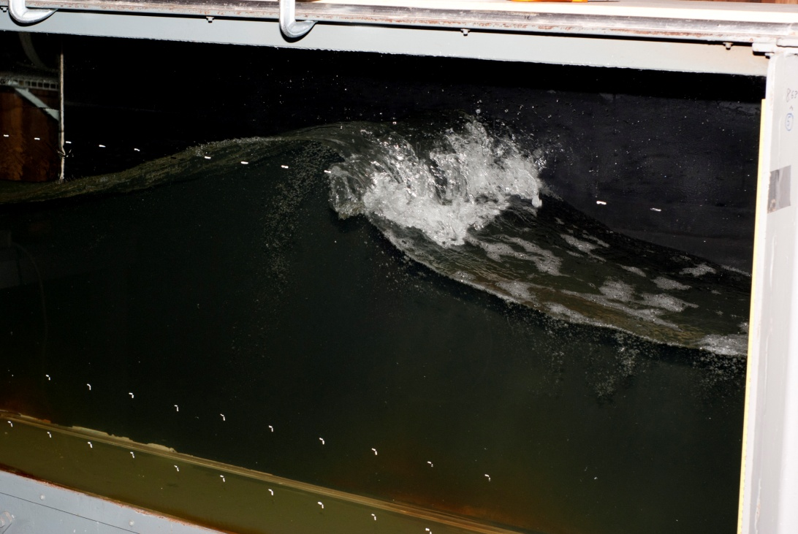
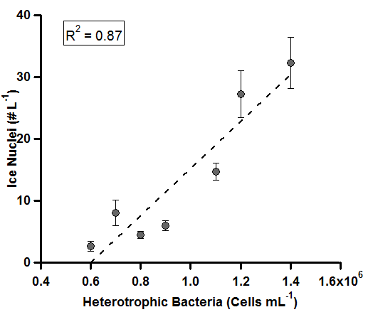
Which particles serve as ice nuclei in marine environments?
Ice Nuclei vs.
[Bacteria]_{seawater}
Field vs. Wave Flume
CalWater 2011
Single Particle
Bacteria Mass Spectra
Wave flume bacteria
signatures match ice cloud
residues in mixed phase clouds
during CalWater and ICE-T
CalWater2 IN Studies:
Prather, DeMott, Nenes, Moffet

Slide 37
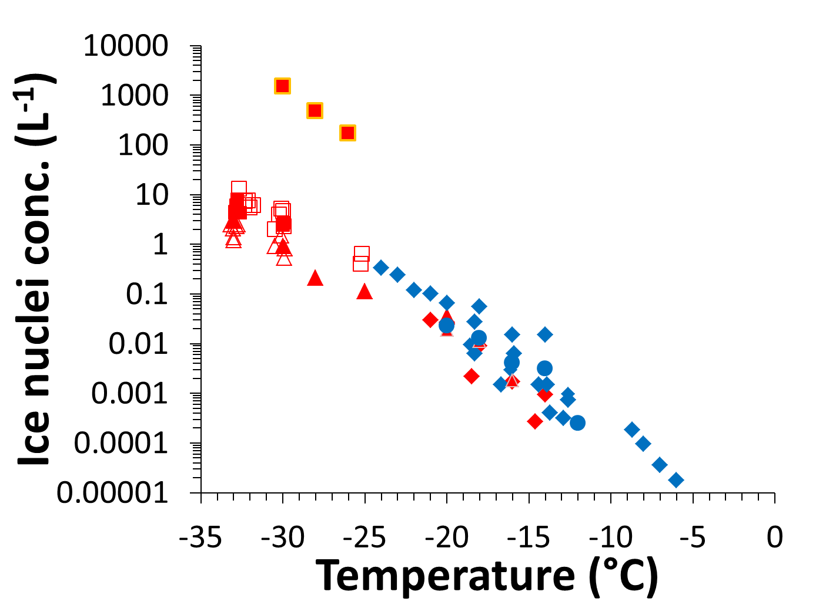
Sources of Ice Nuclei in Marine Environments
Wave Flume Sea Spray Aerosol = Marine Sea Spray Aerosol
Phytoplankton Bloom
Goal: Develop parameterizations for IN in marine-influenced clouds
FIELD
LAB (CAICE)

Slide 38
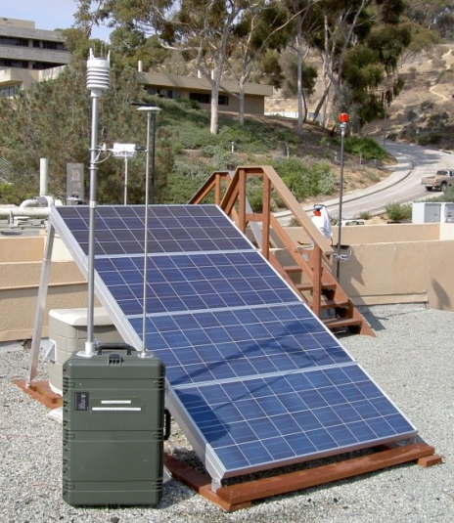
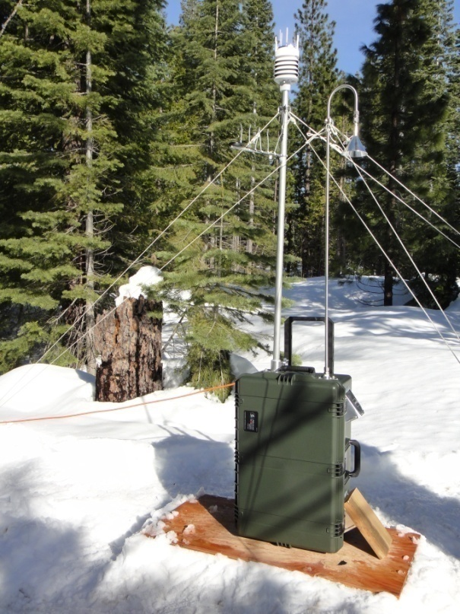
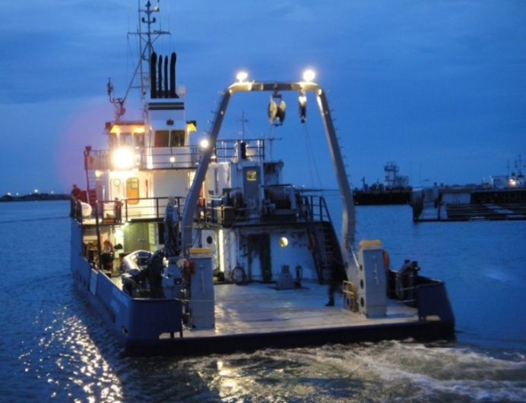
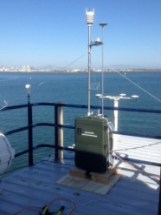
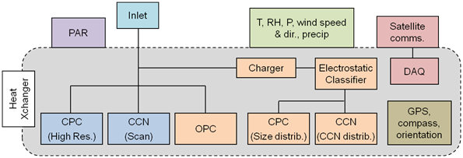
Scripps PAEROS-G. Roberts (SIO)
(Portable Aerosol Observing System)
Aerosol, CCN and meteorological observations in a single package. See instrument table.
Portable (~35 kg), with a small footprint (< 0.5 m²) and low power (< 120 W). Facilitates deployment at remote stations.
Weatherproof case for deployment under a broad range of environmental conditions.
Solar or wind power possible for operation in remote locations.
PAEROS

Slide 39
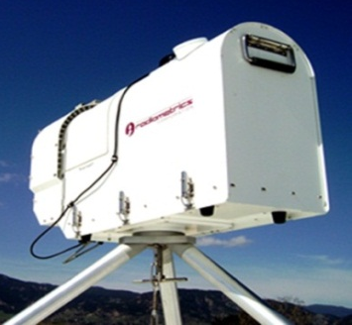
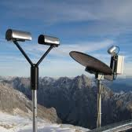
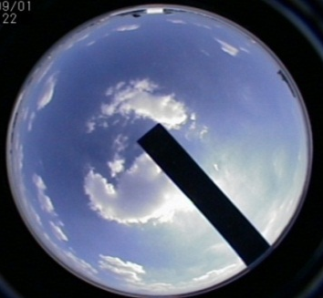
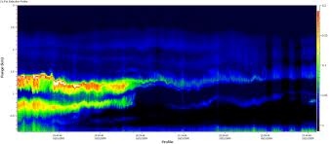
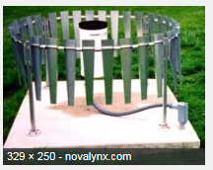

Piotr Flatau (Scripps Institution of Oceanography, UCSD)
Jerome Schmidt (Naval Research Laboratory, Monterey)
Coastal Cloud and Precipitations Observations: Aerosol and Cloud Microphysics Improvements in Regional Models
A) Radiometrics 35 Channel Microwave Profiler:
- Vertical Profiles of Temperature, Humidity & Cloud Water (to 10km)
- Cloud Base height and temperature
- Surface Pressure, Temp, Humidity
B) OTT2 Parsivel Laser Disdrometer:
- Surface Particle size distribution and fall speeds (32 bins)
- Liquid (D = 0.2 mm to 5 mm), Solid (D = 0.2 to 25 mm)
C) METEK Micro Rain Radar: Precipitation-sized particles (0-6 km), LWC rain rate, Reflectivity, Doppler
D) Prede All-Sky Camera: Cloud type and fractional coverage
E) Sigma Space MicroPulse dual Polarization Lidar: aerosol & cloud profiles with mixed-phase detection
F) Novalynx Professional 12” Tipping Bucket rain gauge
G) Sun tracker for precise radiation measurements
F
A
B
D
E
F
G
C

Slide 40
Timeline for aerosol-cloud-precip studies
CalWater2 Early Start (Feb 24-March 10, 2014)
  Sugar Pine Site spin-up and testing of new select measurements
  Anticipate several NSF proposals in early summer-June 2013)
  Precipitation sampling
  Meteorology
  Aerosol + gas phase pollutants
  Satellite + LIDAR
  Testing of new measurements
    Tethered cloud microphysics and aerosol measurements
    Bio-ATOFMS measurements
    Ground-based CFDC-ATOFMS
CalWater2 Winter 2014-2015
  Ship, G1, Cazadero, and Sugar Pine
  Anticipate NSF proposals in ~9 months (AGS, EAR, Oceanography)
CalWater2 Phase II Winters 2015-2018
  Coordinate with DOE and NASA studies
  Timing for anticipated proposals (work in progress)

Slide 41
CALWATER2 Field Study of Air-Sea Interaction and AR dynamics in Midlatitude Pacific Storms
Ships (Brown and/Or UNOLS Class I)
Aircraft (NOAA P-3, NOAA G-IV?)
Land Network (HMT West +) – Landfalling aspects
Field Duration – 30 days
Time Window – Dec 1, 2014 – Mar 31, 2015
Ship location – Nominally 35-40 N 130 W
Modeled after DYNAMO Revelle field program – joint atmospheric-oceanic observations

Slide 42

DYNAMO Field Study of Madden Julian Oscillation
Equatorial Indian Ocean
Two ships (Mirai, Revelle)
Two Aircraft (NOAA P-3, French jet)
Two Islands (Gan, Maldives; Diego Garcia)
Buoys (RAMA; UW/APL)
Dates – Sept 1, 2011 – Feb 5, 2012
Science Objectives
  Interface processes
  Ocean mixing
  Diurnal cycle
  Atmospheric convection
  Predictability

Slide 43

0.05 m sea snake
5 m sea chest
net

Slide 44

Ocean Mixed Layer (Moum/OSU)

Slide 45
CALWATER2 Air-Sea Science Objectives
Interface, near-surface
  Strong emphasis on aerosol/gas fluxes
  Fluxes in strong wind forcing with varying heat flux
    Warm sector vs post frontal
  Wave aspects – breaking, aerosol production, wave-pressure, high frequency wave slope (saturation spectrum)
Boundary layer and Frontal dynamics
  BL coupling to surface properties – updrafts/downdraft, precipitation effects on aerosol/chemistry
  Links to mesoscale, Low-level jet effects
  Synoptic – mostly aerosol/chemistry
Ocean mixing processes
  Mixing/entrainment strong forcing with deep ML
  Possible feedback to air-sea fluxes?

Slide 46
50°N
CalWater 2
Experimental Design Schematic
NASA DC-8
- Aerosols, trace gases
- Precipitation estimates
Ground
- NOAA HMT
- UCSD ATOFMS
Ship
- DOE AMF2
- Small UAS
- Air-sea fluxes
- Precipitation estimates
40°N
Sierra Nevada,
Shasta, and
Coast Ranges
(white bars)
Aerosol Profiling
- NASA DC-8
- Aerosols, trace gases
Water Vapor Budget Boxes
NASA Global Hawk
Dropsondes, aerosols
Operations bases
Global Hawk, DC-8 (NASA Dryden)
P-3B, G-1 (Monterey)
30°N
Remote aerosol plume (schematic)
DOE G-1
- Aerosols
- Microphysics
NASA P-3B
- Surface water level
- Soil moisture
20°N
Operations base
DC-8 (HawaiI)
SSM/I satellite observations of IWV showing a strong atmospheric river on 12 Dec 2010 (from Ralph and Dettinger BAMS 2012)
Hawaii
160°W
150°W
140°W
130°W
Courtesy of F. M. Ralph, NOAA Earth System Research Laboratory

Slide 47

Contrast DYNAMO and CALWATER2
DYNAMO
Undisturbed U=4, Net heat 100 W/m^2
Storm U=7 (Max=17) m/s, Net heat -75 W/m^2
Biggest effect on Solar flux
CALWATER2
Undisturbed U=7, Net heat -50 W/m^2
Storm U=13 (Max U=20) m/s, Net heat -250 W/m^2
Biggest effect on Latent heat flux
Storms will have strong stress with buoyancy forcing changing from small negative (warm sector) to very large positive (cold air, post frontal)

Slide 48
CALWATER2
Ship-based Sensors
C-band Radar – CSU (Rutledge)
DOE AMF2 - PNNL (Leung)
  Aerosols, microwaves, lidars, wind profilers, …
Fluxes and Near-Surface Meteorology-ESRL/PSD (Fairall)
Marine aerosol production - PMEL (Bates/Quinn)
Surface waves (IR/polarization imaging)– LDEO (Zappa)
Wave dissipation (SWIFT buoys) – Thompson (UW/APL)
Ocean mixing (AMP array) – UW/APL (Sanford, Kunze)
Bubble/aerosol dynamics – SIO (Deane, Stokes)
Gliders – SIO (Rudnick)

Slide 49

DYNAMO Outflow boundary Using TOGA radar Oct 24 5:00 UTC
reflectivity (dBZ)
Doppler velocity (m s⁻¹)
Steve Rutledge, Colorado State U.

Slide 50

Shipboard radar operations for CALWATER II (S. Rutledge, PI)
Quantitative ship radar operations are proposed for CALWATER II
Science contributed to CALWATER II includes documenting ocean rainfall associated with AR’s and their mesocale structures. The radar will play a key role for studying precipitation and cloud physics and the influence of aerosols on precipitation, for example the presence of Asian/African dust vs. sea spray aerosol
Having this offshore radar “laboratory” will allow a means to contrast offshore extratropical cyclones with land falling cyclones impinging on the Sierra Nevada barrier, where aerosol and S-band profiler measurements will me made
We propose to upgrade the R/V Ronald
Brown C-band radar to dual-polarimetric,
significantly increasing its current capabilities
The radar is currently located at CSU. NOAA
is in the process of donating the radar to CSU

Slide 51
Shipboard radar operations for CALWATER II (S. Rutledge, PI)
Dual-polarimetric radars are in common use today. Dual-polarization data are improve rainfall estimation, allow the diagnose of cloud and precipitation processes through the use of hydrometeor identification algorithms, and improve data quality (removal of clutter and non-meteorological echo)
The radar would be upgraded to dual-polarization by using the current transmitter split into H,V components. A new antenna and feedhorn would be acquired, along with a state of the art signal processor and other hardware to implement the upgrade
The cost for upgrade hardware is estimated to be $600,000. A vendor would be selected to supply the hardware and carry out the upgrade. The upgrade is viewed as a very low risk project—the engineering needed for the upgrade is straightforward
We would propose that NSF maintain the radar after CALWATER II as a National Facility, made available for future ocean based, or land based experiments.
This radar would provide a significant scientific advancement over previous ship radars such as those used in TOGA COARE, EPIC, DYNAMO, etc.

Slide 52



CALWATER2 : P-3 based Sensors
Microwave, IWRAP radar, Dropsondes – NESDIS (P Chang)
Tail Doppler Radar – ESRL/PSD (Kingsmill)
Wband Doppler radar (spray) – ESRL/PSD (Fairall)
Chemistry/Aerosols - TBD (Prather)
Whitecap video – LDEO (Zappa)
AXBT ?
AXBT Grid Pattern
AXBT Linear Transect
Air Drop Linear Transect

Slide 53
Table 1. Status of CALWATER2 Marine Platforms and PIs
 | Thompson² | Ron Brown¹ | P-3³ | G-I¹ | G-IV⁴
Agency | UNOLS | NOAA | NOAA | DOE | NOAA
Request | Thomson UW | Fairall PSD | Chang NESDIS | Leung PNNL | Winter storms
Schedule | Winter 2015 | Jan 2015 | Winter 2015 | Winter 2015 | Winter 2015
OCE | NSF | NSF
AR | NSF/NOAA | NSF/NOAA | NOAA/NSF |  | (NOAA)
Aerosol | DOE | DOE | NSF | DOE

Slide 54
The ARM Cloud Aerosol Precipitation Experiment (ACAPEX): Science questions
Modeling of multiscale water cycle processes and climate extremes: What influences the evolution and structure of AR and its associated cloud and precipitation?
  To what extent does water vapor in ARs originate from the tropics? What role does tropical convection play in this?
  What are the roles of air-sea fluxes and ocean mixed layer processes in AR evolution?
  What are the key dynamical processes that modulate cloud and precipitation from landfalling ARs?
Improving and evaluating parameterizations of cloud, aerosol, and their interactions: How do aerosols affect the amount and phase of precipitation?
  How frequent are aerosols transported across the Pacific and what characteristics make them effective CCN and/or IN?
  How do aerosols from long-range transport and local sources influence cloud and precipitation over California, in both AR and non-AR conditions?
  How do aerosols influence cyclogenesis and the thermodynamic development of extratropical cyclones and the coupled atmospheric rivers associated with these storms?

Slide 55


ACAPEX will deploy AMF2 and AAF G-1 to:

Slide 56



Instruments on AMF2
Aerosol Observing System (AOS)
Radar Wind Profiler (RWP)
Vertically pointing W-band cloud radar (WACR)
Microwave radiometer (MWR)
Ceilometer, micropulse lidar (MPL), and high spectral resolution lidar (HSRL)
3-channel microwave radiometer (MWR3C)
Portable Radiation Measurement Package (PRP2) and sun pyranometer (SPN)
Atmospheric Sounder by Infrared Spectral Technology (ASSIST) [newer version of the atmospheric emitted radiance interferometer (AERI)]
Meteorological instruments (MET) and atmospheric profiling (SONDE)
Bulk aerodynamics fluxes (BAF)
AOS
WACR
MWR

Slide 57

Instruments on G-1
Aerosols (total aerosol number and size distributions, BC mass, dust, scattering/absorption, single particle mass spectrometer) and chemical pollution tracers (CO, O3)
Microphysics (CCN, IN, cloud drop size distribution, cloud water/ice content)
Atmospheric state (T, P, RH, wind, turbulence)

Slide 58



Science investigations
AR dynamics, structures, and sources of moisture
  Model intercomparison: TAMIP – comparison of GCMs (including variable resolution models such as CAM-SE/CAM-MPAS) in weather forecast mode
  Use data to diagnose the moisture tendencies from different processes
  Evaluate the structures and sources of moisture associated with ARs simulated by models
  Apply divergent moisture flux analysis to the simulations to quantify the relative contributions from various regions to the moisture carried by the ARs
aqua-planet

Slide 59


Science investigations
Aerosol effects on clouds and precipitation
  Evaluate and comparison of model parameterizations of aerosol-cloud interactions using data
  Perform sensitivity experiments to compare the role of aerosols as CCN vs IN on clouds and precipitation for coastal vs orographic clouds
  Simulate long range transport of aerosols and study how AR regulates aerosol effects from long range transported aerosols
A modified bulk microphysics scheme based on insights from a spectral bin microphysics scheme produces more realistic simulations than the original scheme
Dust enhances snowfall and overall precipitation amount in CA
SBM
Bulk-2M
Bulk-OR

Slide 60


Next phase proposed: AREX/OLYMPEX/ACAPEX2
We requested AMF and G1 for ACAPEX2 to be deployed in November 2015 – March 2016 in conjunction with AREX and OLYMPEX that are being proposed
ACAPEX2 will further advance the objectives of ACAPEX, but with an added element of contrasting AR and aerosol effects in the more pristine WA coast compared to central CA
Proposed AREX/OLYMPEX/ACAPEX2 observing strategy
OLYMPEX observing strategy

