Slide 1
Synthesis
NOAA Webinar
"Evaluation and Improvement of Climate GCM Air-Sea Interaction Physics:
An EPIC/VOCALS Synthesis Project"
Chris Fairall
Yuqing Wang
Simon de Szoeke
X.P. Xie

Slide 2
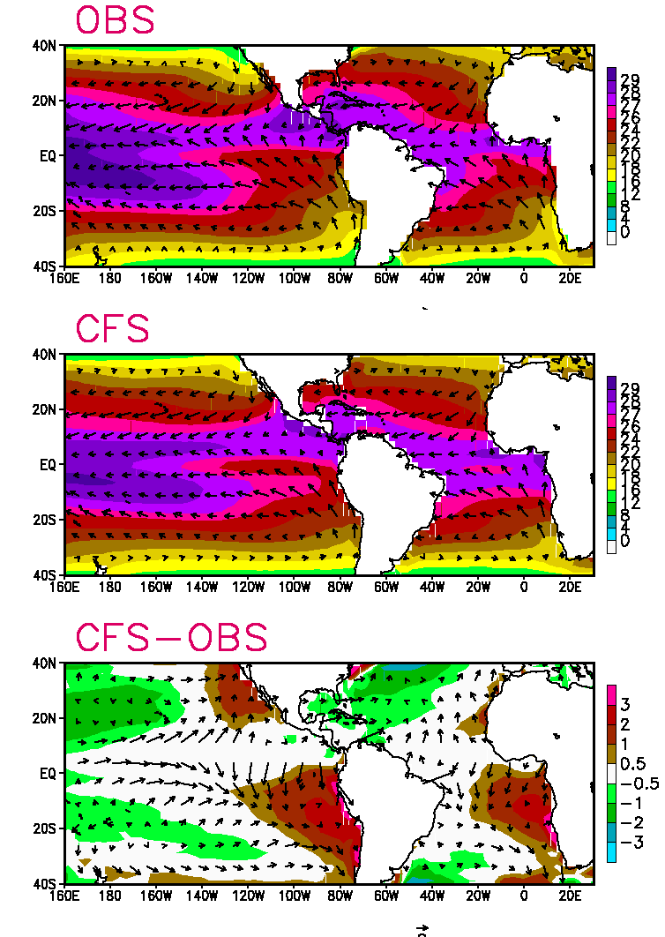
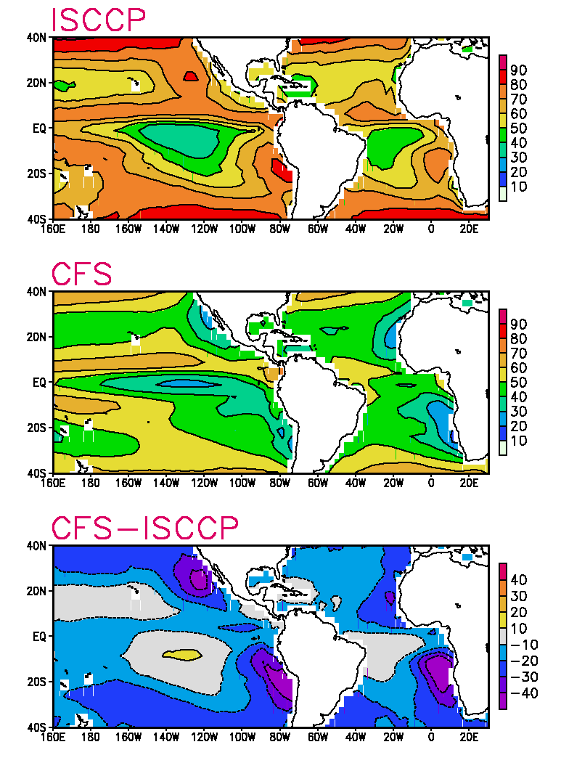
Annual Mean Total Cloud (%)
Annual Mean SST / Surf. Wind
Provided by P.P. Xie

Slide 3
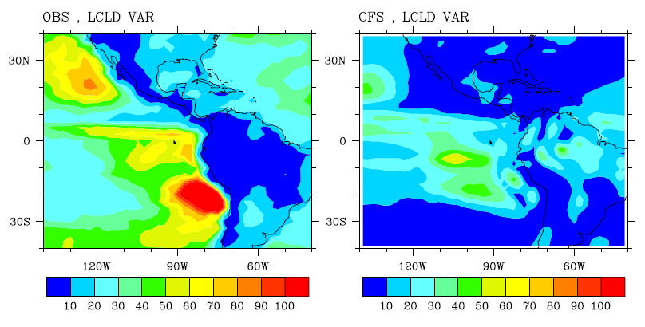
Variability

Slide 4
Background
Approach: focus on clouds and surface fluxes
Observations: Statistical in nature
  EPIC monitoring: 8 cruises, equatorial 95 and 110 W
  STRATUS monitoring: 8 cruises, 20 S 70 to 85 W
  Intensive field programs: EPIC2001, VOCALS 2008
  Buoys (TAO equatorial; WHOI surface reference stratus)
  Global ocean surface flux products
High resolution regional model:
  U Hawaii IRAM (atmosphere)
  U Hawaii IROAM (couple ocean-atmosphere)
Global climate models: IPCC AR4 archive
Data and Publications at:
http://www.esrl.noaa.gov/psd/psd3/synthesis/

Slide 5
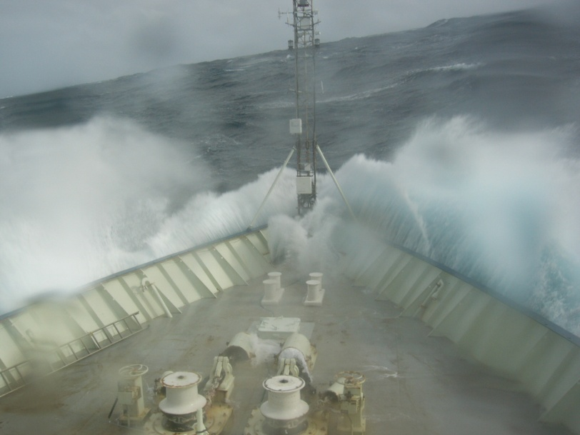
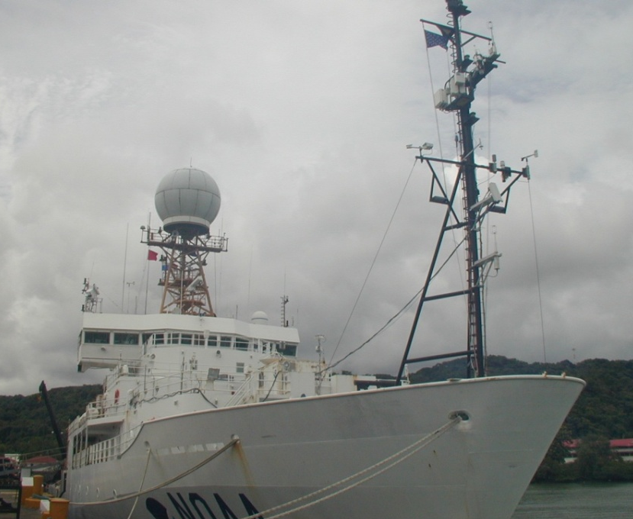
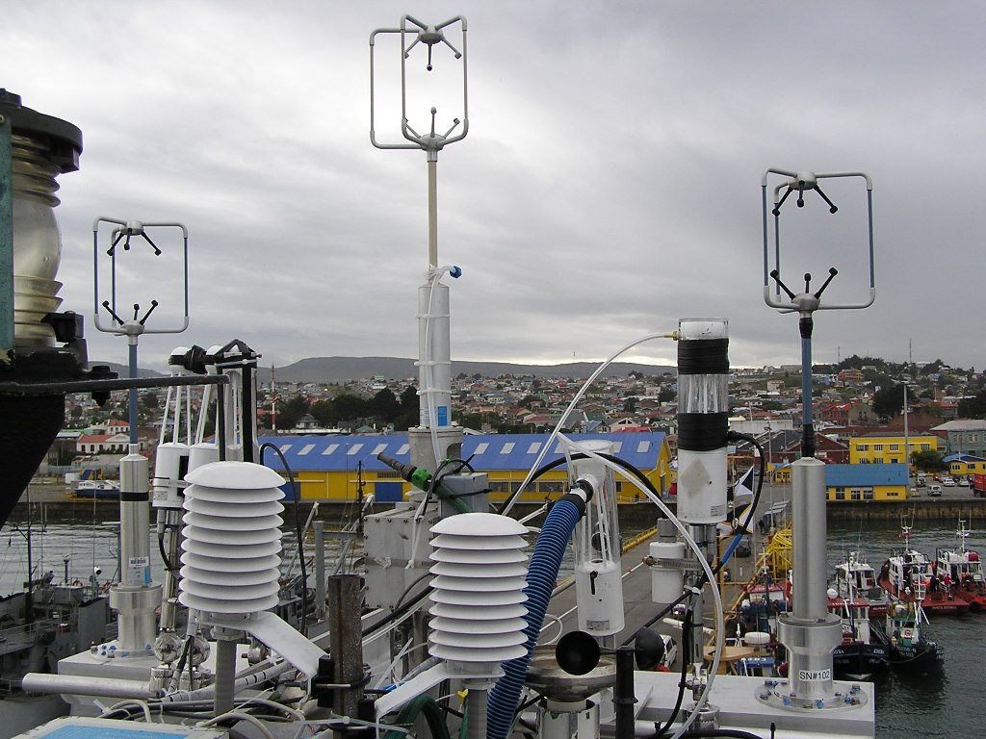
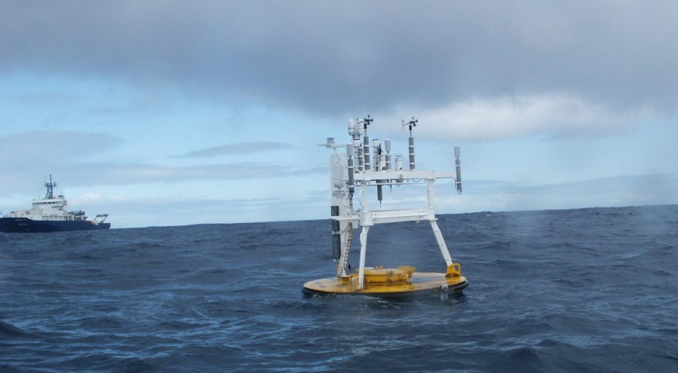
Surface Flux and Cloud/Boundary-Layer Measurements from Ships and Buoys

Slide 6
IPRC Regional Ocean-Atmosphere Model (iROAM) on ES
Atmosphere: IPRC-RAM
0.5°×0.5°, L 28
GFDL Modular Ocean Model 2
0.5°×0.5°, L 30
Forced by
NCEP reanalysis
Interactive
Ocean spin-up
Coupled
‘90 – ‘95
96 – 03

Slide 7
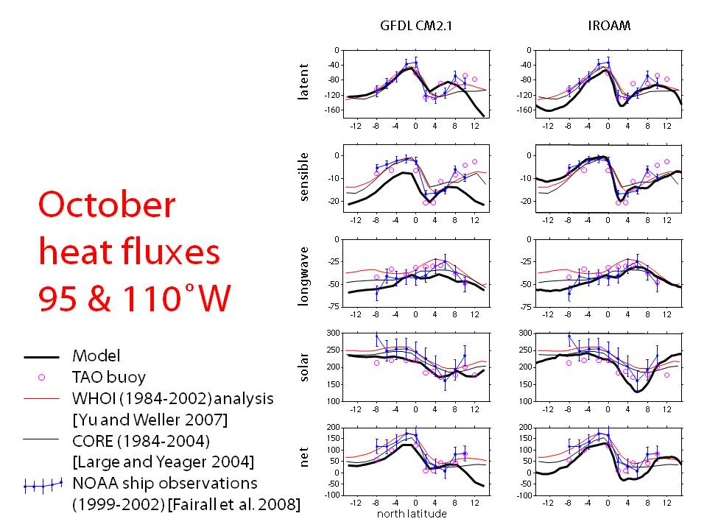
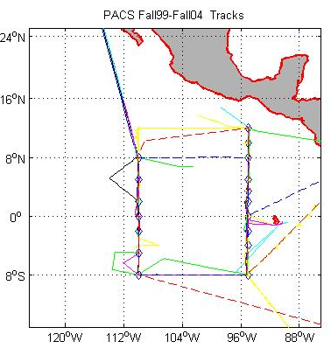
Models Vs Data ‘Climatology’: Equatorial Cruises
ESRL-PSD Tao Buoy Maintenance Cruises, 6 October and 3 April deployments: flux, boundary-layer, cloud systems
GFDL Coupled Model - IPCC
U. Hawaii Regional
N. Latitude
N. Latitude

Slide 8
Eastern Pacific surface fluxes observed and simulated by coupled GCMs
de Szoeke et al. 2010: Surface Flux Observations on the Southeastern Tropical Pacific Ocean and Attribution of SST Errors in Coupled Ocean–Atmosphere Models, J. Climate.

Slide 9
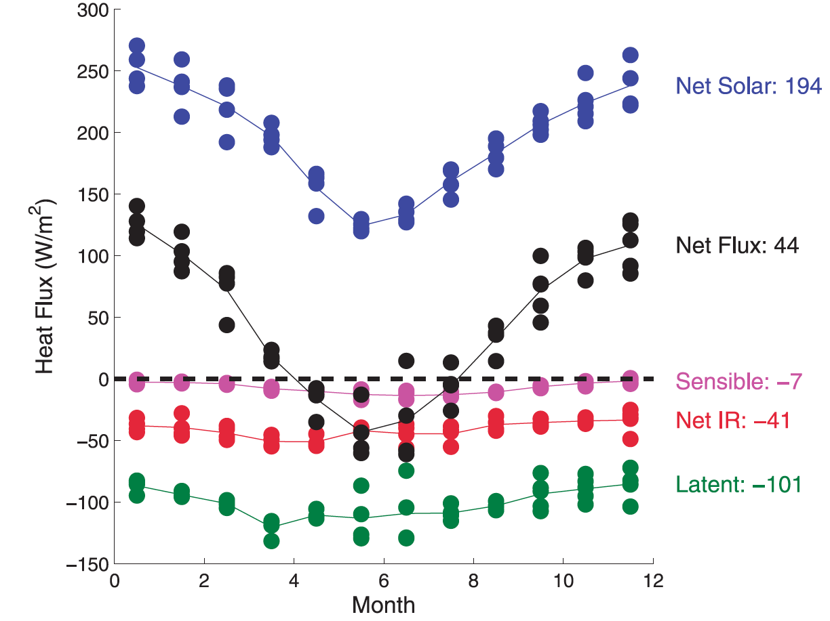
Surface ocean heat budget at 20 S 85 W
WHOI Buoy Annual Cycle
October
Colbo and Weller 2007

Slide 10
Ship-observed heat fluxes
20°S, October

Slide 11
Model heat fluxes
20˚S, October
GFDL CM2.1
IROAM
-40
-40
latent
-80
-80
-120
-120
100
85
70
100
85
70
0
0
sensible
-10
-10
-20
-20
-30
-30
-40
-40
100
85
70
100
85
70
0
0
-25
-25
longwave
-50
-50
-75
-75
-100
-100
100
85
70
100
85
70
300
300
solar
250
250
200
200
150
150
Model
WHOI ORS buoy
OAFlux (1984-2002)
CORE (1984-2004)
NOAA ship observations
100
85
70
100
85
70
160
160
120
120
net
80
80
40
40
0
0
100
85
70
100
85
70
west longitude
Notes:
analyses (WHOI and CORE) do well, even where models are worst
NOAA ship observations are available 75-85W, where model errors are largest
C:\Data\SEPflux\flux_iroam_20s_oct.emf
compare_flux_iroam_20s_oct.m

Slide 12
Surface Heat Budget
0 =
–∂/∂t SST*h
turbulent evaporation and sensible flux
net radiation
ocean residual

Slide 13
October Surface Heat Budget
ΔS > 40 W m⁻²
obs.

Slide 14
October Surface Heat Budget Errors
obs.

Slide 15
annual average heat budget
+
+
= 0

Slide 16
Ocean residual flux
“observed”
coupled GCM simulations

Slide 17
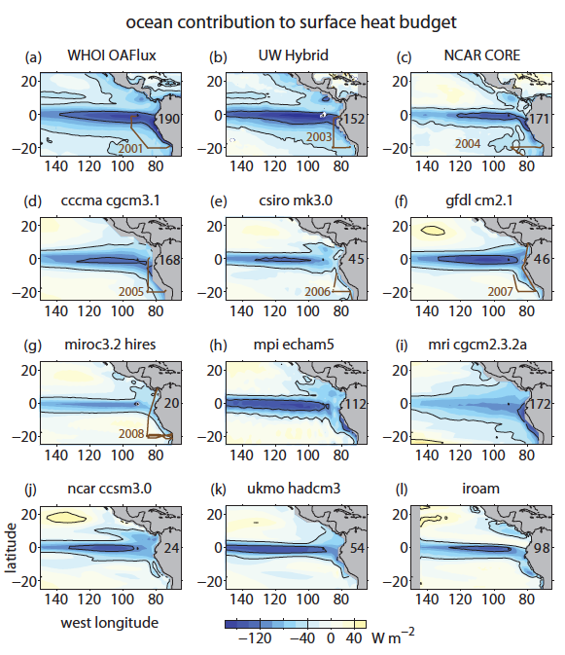

Slide 18
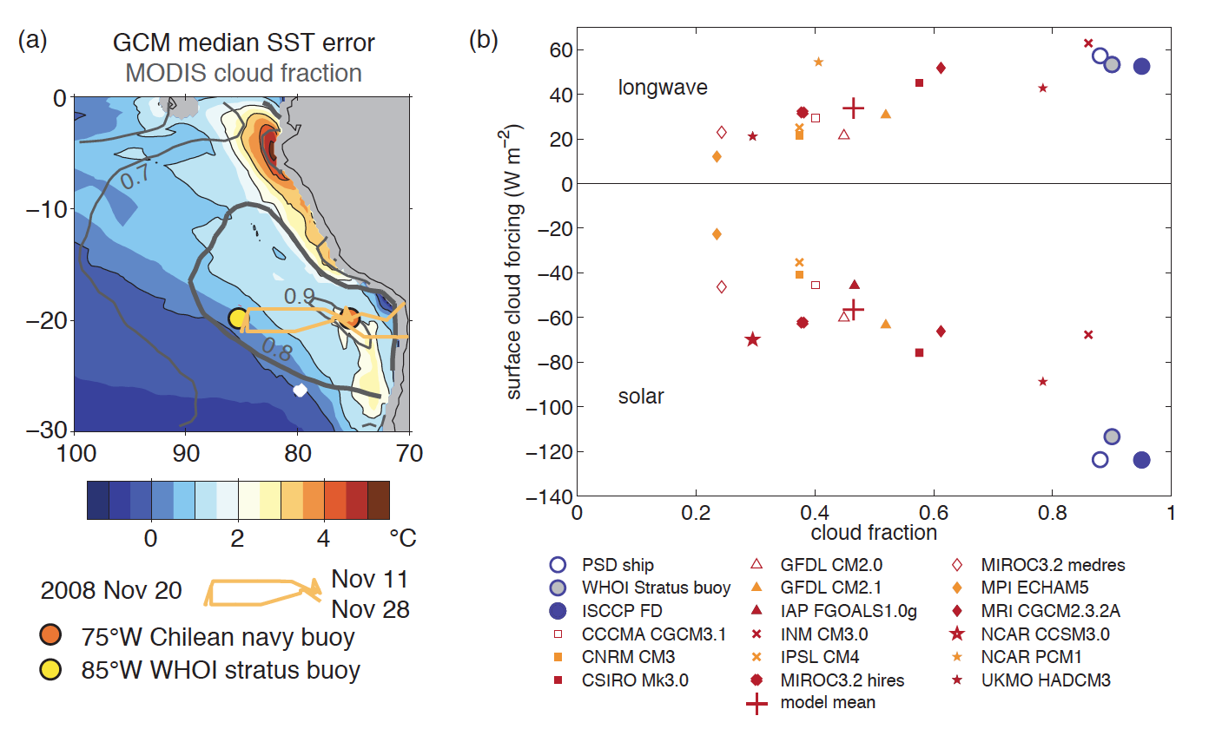
Cloud Forcing of Surface Radiative Fluxes:
CF=<Observed Flux>-Clear Sky Flux
de Szoeke et al. 2012
Notes:
cloud fraction pattern overlaid on median SST error implies there might be problems with model clouds
Too low cloud fraction explains cloud forcing error. Clouds that are present seem OK.

Slide 19
Simple Cloud Property:
Cloud top height and/or Boundary Layer height from in situ, satellite, and model
October 2006 model boundary layer depth (m) compared with observations of boundary layer depth and cloud-top height. Model mean (solid black line), 25–75 percentile range (dark gray), and model range (light gray) are plotted. COSMIC October 2006 boundary layer depth sampled over 15–25_ S is plotted in green. CALIPSO cloud-top height is plotted in magenta. MODIS cloud top heights are plotted in red from Zuidema et al. (2009). The mean depth (blue x) is an October climatology estimated from NOAA/ESRL soundings taken near the stratus buoy, with standard deviation plotted.

Slide 20
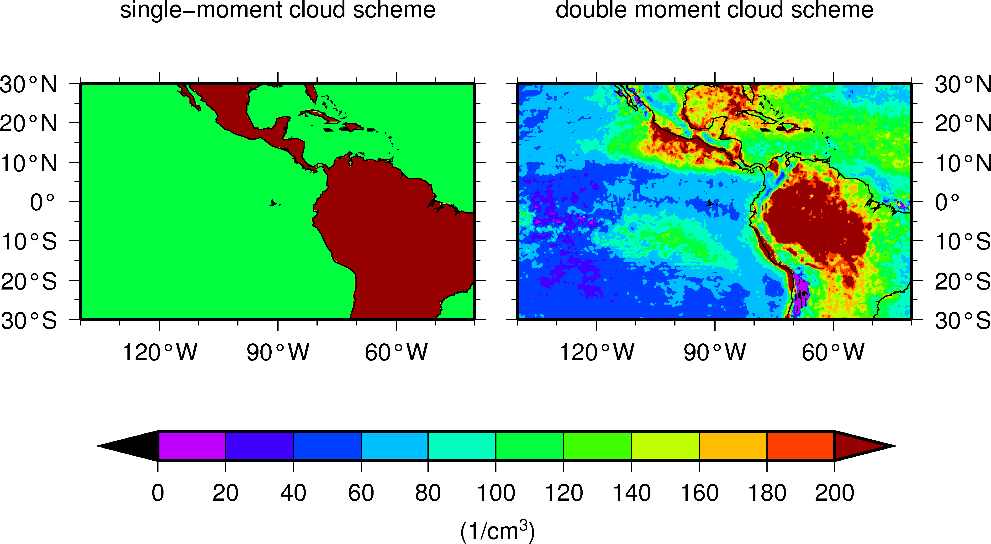
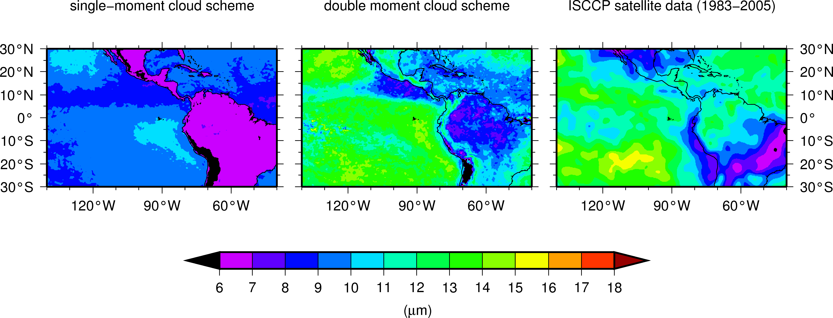
Cloud Microphysics Complexity in IRAM
Cloud droplet number concentration:
Single moment = cloud water/ice
Double moment = cloud water/ice linked to aerosols
Cloud effective radius: A balance of droplet number and total water

Slide 21
Conclusions
Good accuracy for flux products
IPCC models: radiation errors roughly cancelled by sensible+latent heat errors
Some IPCC models have significant ocean heat flux errors
Radiation errors principally caused by underestimate of cloud amount
Cloud-aerosol coupling and improved shallow convection schemes required

