Slide 1
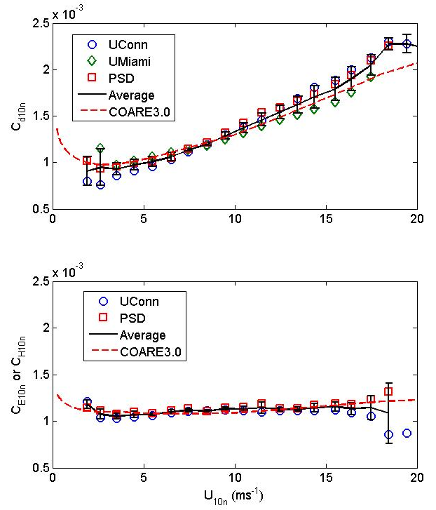
Synthesis of Air-Sea Flux Observations: Comparisons with the NOAA COARE3.0 Bulk Flux Algorithm are Pretty Astounding
Sea-air fluxes are represented by simple bulk relationships
Cx=Transfer Coefficient
S=Wind speed
ΔX=Sea-air difference in mean value of X
NOAA COARE Community Bulk Flux Algorithms
Used in models, analyses, etc. 1,300 citations.
ftp://ftp.etl.noaa.gov/users/cfairall/bulkalg/
A comparison with direct turbulent covariance observations of meteorological fluxes was based on a compilation of flux data obtained from the ESRL/PSD series of cruises, the University of Connecticut database (principally the Martha’s Vineyard offshore platform and buoys deployed as part of the CLIMODE project), and the University of Miami spar buoy flux data base. Each group provided the mean and standard deviation of the 10-m neutral transfer coefficient in wind speed bins from 1 to 25 ms⁻¹: ESRL/PSD – C_{d10n} and C_{E10n} (5,290 1-hr values between 2 and 19 ms⁻¹), UConn – C_{d10n} and C_{H10n} (14,900 30-min values between 2 and 24 ms⁻¹); UMiami – C_{d10n} (6,500 30-min values between 3 and 17 ms⁻¹). The COARE3.0 values are found to agree very closely with the mean of the measurements for U_{10n}<19 ms⁻¹: 5.5% for C_{d10n} and 4.2% C_{E10n} .
Version COARE4.0 including a new wave age parameterization will be released August 2011. The gas transfer velocity algorithm will be expanded to 79 gases.
C. Fairall, J. Hare, D. Wolfe, L. Bariteau, S. Pezoa. NOAA ESRL/PSD
Transfer coefficient vs wind speed. Upper panel: momentum-C_{d10n}; Lower panel: moisture-C_{E10n} (ESRL/PSD) and heat-C_{H10n} (U. Connecticut). The black line is the mean of the data sets; the error bars are statistical estimates of the uncertainty in the mean.

