Slide 1
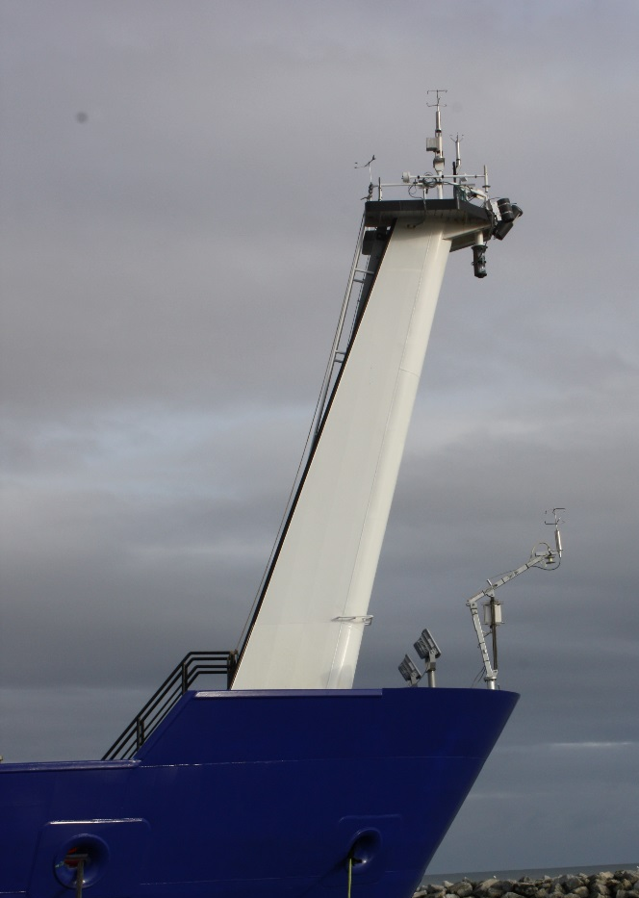
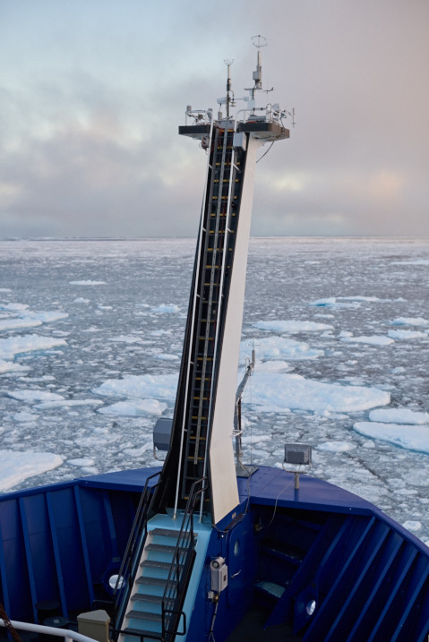
New Measurements of Air-Sea Fluxes in the Arctic
PSD turbulence sensors mounted on the R/V Sikuliaq foremast in Nome, AK (left) and in the field N. of Prudhoe Bay, AK (right). PSD installed a second mast on the bow with duplicate sensors. The sensors include two sonic anemometer/thermometers, a ship motion system, fast humidity and fast pressure sensors, mean temperature and relative humidity, rain/snow rate, and a scanning lidar wave sensor. Radiative flux and IR sea surface sensors are mounted elsewhere.
Notes:
The Arctic is warming faster than any of region of the globe. Several recent NOAA documents have called for a new emphasis on research in polar processes, e.g., NOAA’s Arctic Action Plan (AAP, 2014). The majority of the deployments of PSD’s flux system have been south of the Arctic Circle. Given the rapid increase in planned cruises to the Arctic, we have hardened one flux system for deployment in sea-ice environments. The changes principally consist of replacing previous sensor technology with heated models to combat freezing sea spray, fog, or rime-ice growth plus the ability to operate at near-saturation relative humidity and very low temperatures.

Slide 2
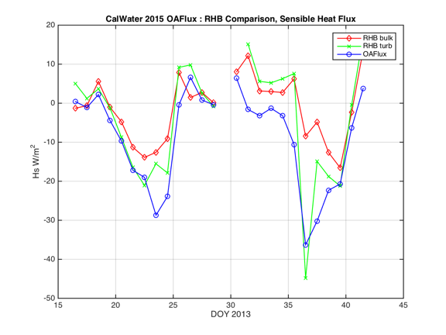
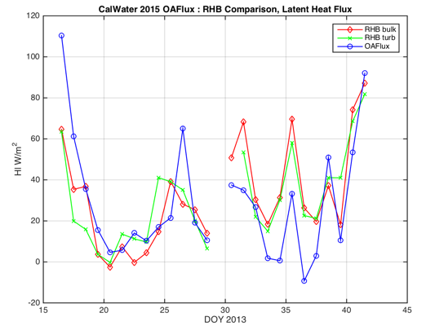
Evaluation of Gridded Flux Products with Direct Ship Observations
OAFLux gridded flux product was compared with ship observations from the R/V Ronald H. Brown for CALWATER2 2015 (Ralph et al. 2016). The figure on the right compares daily-averaged time series for sensible and latent heat fluxes.
Ralph, F. M., K. A. Prather, D. Cayan, J.R. Spackman, P. DeMott, M. Dettinger, C. Fairall, R. Leung, D. Rosenfeld, S. Rutledge, D. Waliser, A. B. White, J. Cordeira, A. Martin, J. Helly, and J. Intrieri, 2016: CalWater Field Studies Designed to Quantify the Roles of Atmospheric Rivers and Aerosols in Modulating U.S. West Coast Precipitation in a Changing Climate. Bull. Amer. Meteor. Soc., in press.
Notes:
NOAA COD invests heavily in gridded flux products including the WHOI OAFlux dataset and the SURFA database of operational NWP flux outputs. These products are critical to evaluating coupled climate model performance. PSD has conducted a series of evaluations of the accuracy of these products: the tropical Eastern Equatorial Pacific and the subtropical Eastern South Pacific. Last year we completed an analysis of two products for the Equatorial Indian Ocean (DYNAMO) and the tropical Western Equatorial Pacific Ocean (TOGA COARE). This year we compared OAFLux with direct measurements from the Ronald H. Brown made during the CALWATER2 study in January and February between Hawaii and California. The flux product does a good job of capturing the predominantly stable conditions (negative sensible heat flux); there appears to be a low bias in the product for latent heat flux in the core of the atmospheric river.

