Slide 1
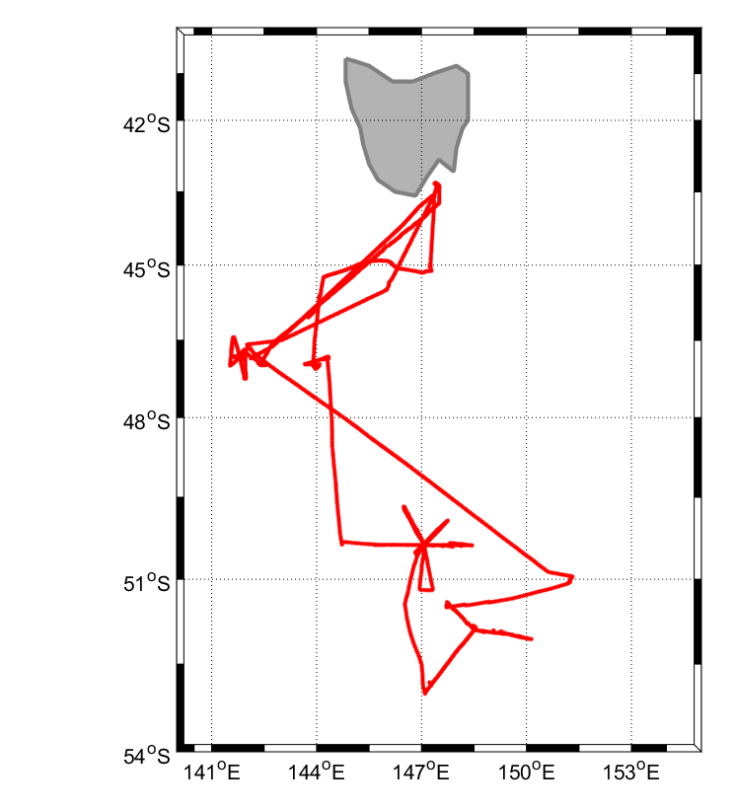
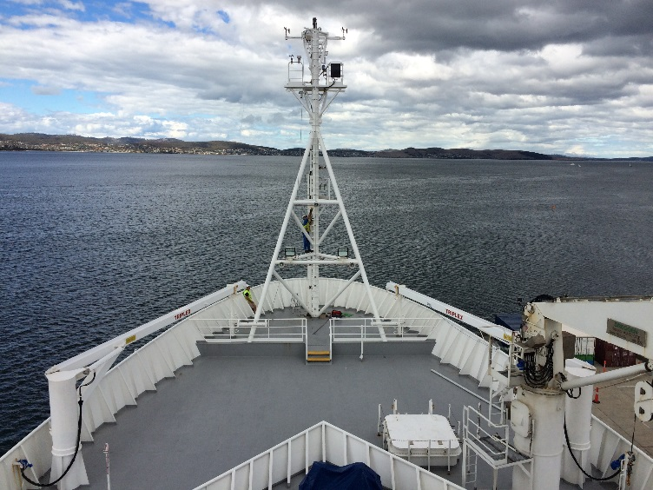
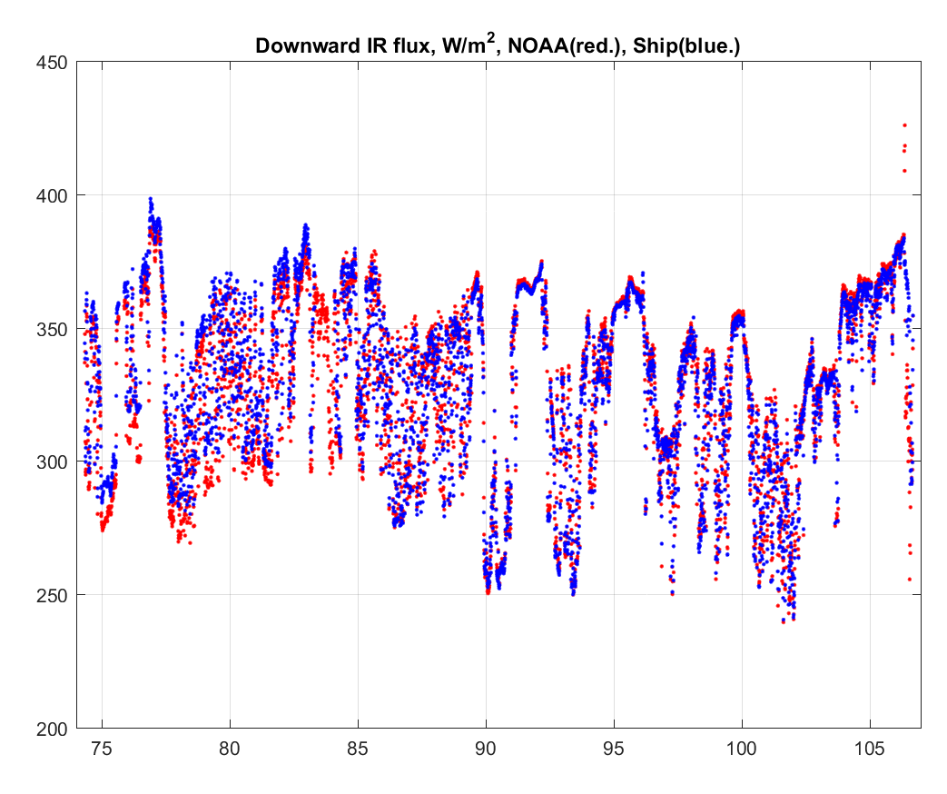
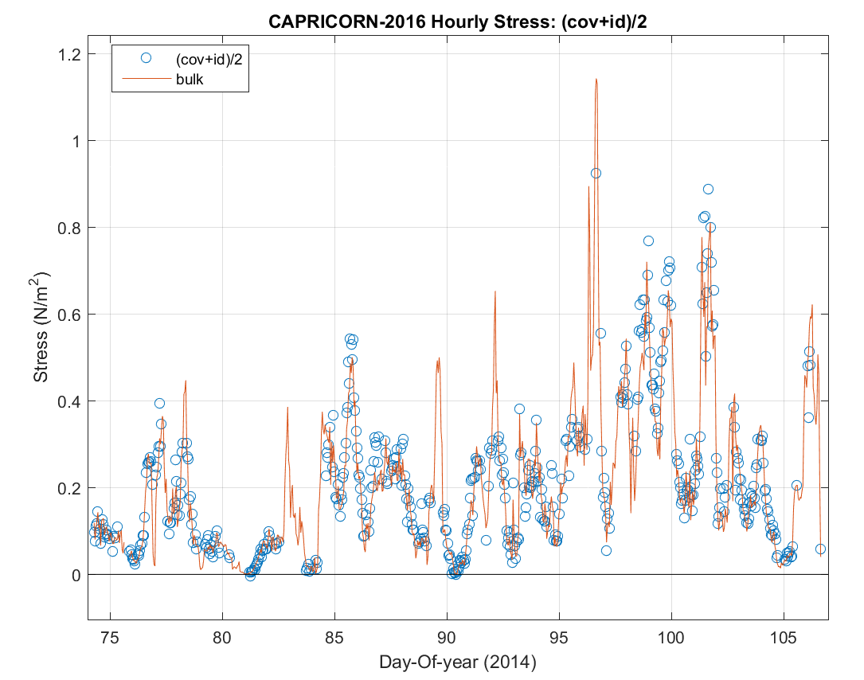
PSD Roving Ship Calibration Standard for Air-Sea Fluxes: Example R/V Investigator
PSD turbulence sensors mounted on the R/V Investigator foremast south of Tasmania (upper left). Cruise track (upper right). Comparison of NOAA PSD and the ship observations of downward IR flux (lower left) – the comparison is excellent. Comparison of direct and bulk estimates of turbulent surface stress (lower right)
Notes:
PSD maintains two complete roving air-sea flux and mean meteorology standards that are placed on research vessels to provide data quality assurance for the vessel sensors and for Flux Reference Buoys that are serviced by the ships. PSD normally does 2-3 of the ‘calibration’ cruises a year, principally for R/V’s are archive their data at the SAMOS site. The direct flux data are added to the PSD flux archive for research purposes: advancing the NOAA COARE suite of bulk flux algorithms and comparisons with satellite, NWP, and climate model flux fields.

Slide 2
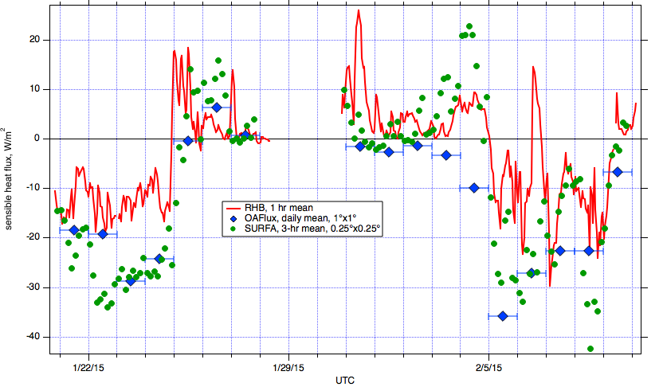
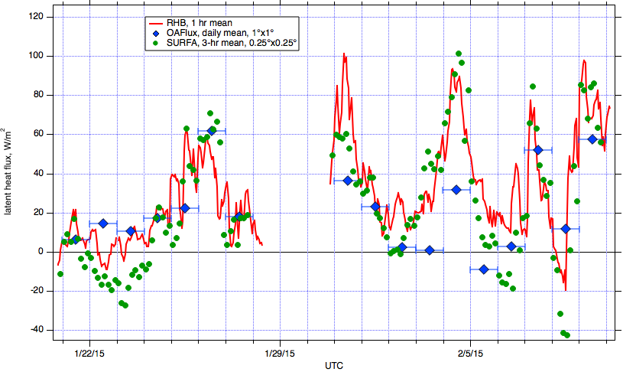
Evaluation of Gridded Flux Products with Direct Ship Observations
OAFLux and SURFA ECMWF gridded flux products compared with ship observations from the R/V Ronald H. Brown for CALWATER2 2015 (Ralph et al. 2016). The figure on the right compares daily-averaged time series for sensible and latent heat fluxes. OAFlux is biased low in the dry, high wind cold sectors. Both products are biased high in the core of the atmospheric river.
Ralph, F. M., K. A. Prather, D. Cayan, J.R. Spackman, P. DeMott, M. Dettinger, C. Fairall, R. Leung, D. Rosenfeld, S. Rutledge, D. Waliser, A. B. White, J. Cordeira, A. Martin, J. Helly, and J. Intrieri, 2016: CalWater Field Studies Designed to Quantify the Roles of Atmospheric Rivers and Aerosols in Modulating U.S. West Coast Precipitation in a Changing Climate. Bull. Amer. Meteor. Soc., 97, 1209-1228, DOI: http://dx.doi.org/10.1175/BAMS-D-14-00043.1.
.
Notes:
NOAA COD invests heavily in gridded flux products including the WHOI OAFlux dataset and the SURFA database of operational NWP flux outputs. These products are critical to evaluating coupled climate model performance. PSD has conducted a series of evaluations of the accuracy of these products: the tropical Eastern and Western Equatorial Pacific and the subtropical Eastern South Pacific. Last year we completed an analysis of two products for the Equatorial Indian Ocean (DYNAMO) and the tropical Western Equatorial Pacific Ocean (TOGA COARE). This year we compared OAFLux (daily average) and ECMWF (4-hr time resolution) with direct measurements from the Ronald H. Brown made during the CALWATER2 study in January and February 2015 between Hawaii and California. The flux products do a good job of capturing the predominantly stable conditions (negative sensible heat flux). There appears to be a low bias in the products for sensible heat flux in the core of the atmospheric river; ECMWF also has a low bias in latent heat flux .

Slide 3
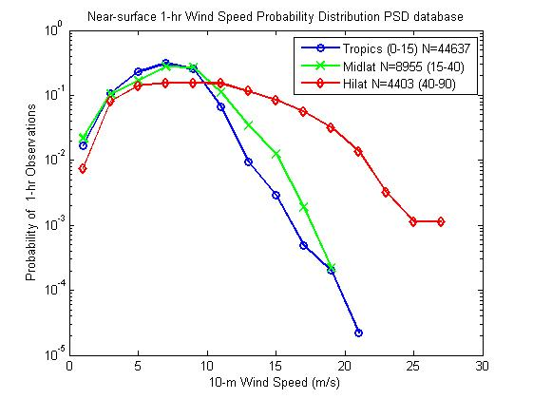
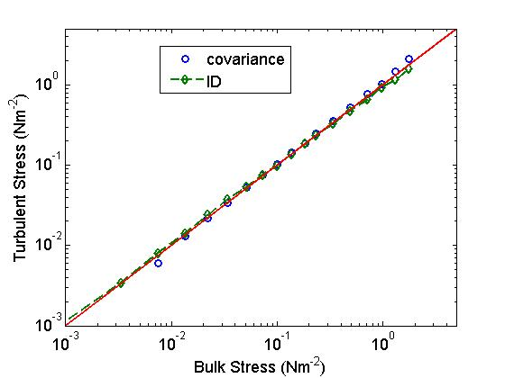
The PSD Air-Sea Flux Database Version 2.0
Some preliminary results for the new PSD flux data base combining observations from 30 cruises (a total of 60,000 1-hr observations). Map of cruise tracks (upper left), wind speed probability distributions in three latitude bands (upper right). Surprisingly the tropics and subtropics have similar PDF’s; the high latitude distributions is broader and has a higher mean wind speed. Grand comparison of direct covariance and inertial dissipation (ID) vs the NOAA COARE bulk algorithm surface stress (momentum flux) estimates (lower right).
Notes:
PSD originally produced a flux database for public consumption in 2002; that datebase had 6,000 1-hr observations. Two other synthesis databases have been created: one for 9 PACS cruises on the equatorial east Pacific and one for the 9 STRATUS cruises in the subtropical southeast Pacific. The new database combines all three into one (plus a few other cruises not part of these programs) file with almost 60,000 hours of observations (of which about 25,000 have direct covariance flux observations). We have analyzed the data to validate its quality in terms of a number of surface layer similarity relationships – it looks good. Two examples are shown above: wind speed distributions and comparison of turbulent observations and bulk calculations for surface stress. The later illustrates the accuracy of the COARE algorithm and the dynamic range of the direct flux observations. The plan is to add another flux dataset (U. Connecticut, J. Edson) and publish a ‘grand’ surface flux dataset.

