Slide 1
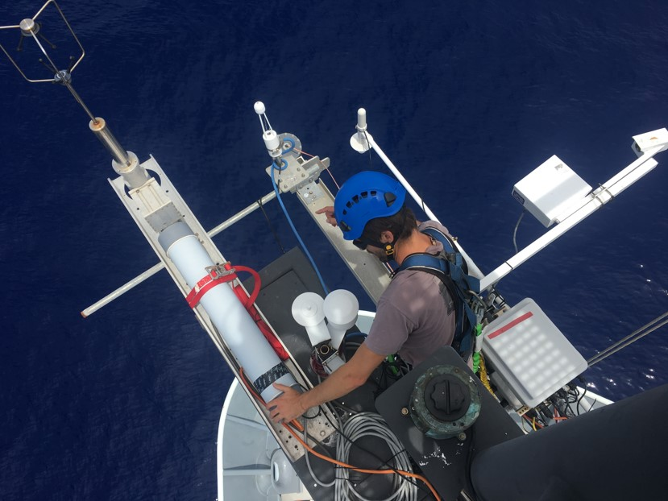
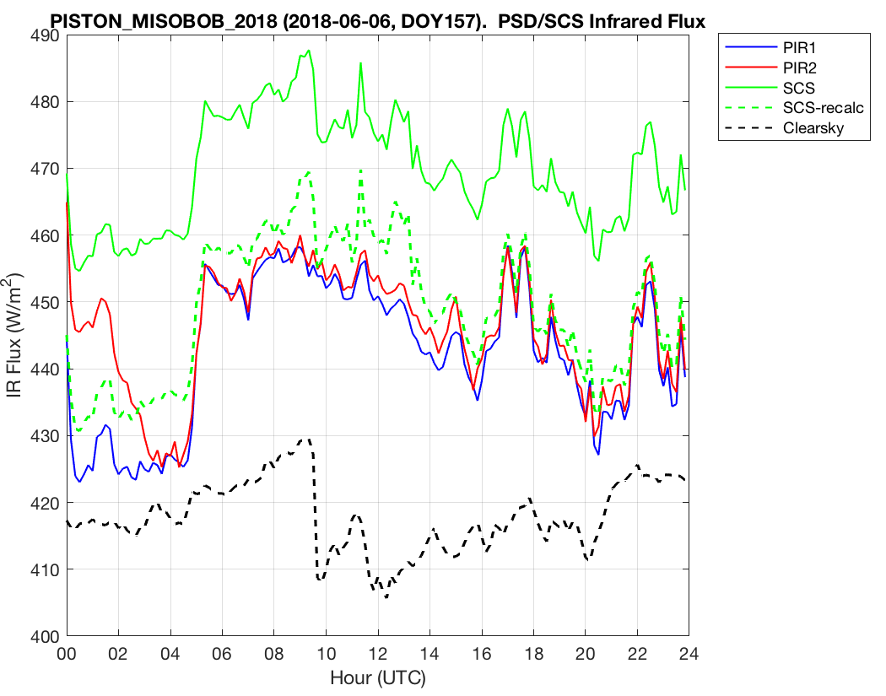
PSD Roving Ship Calibration Standard for Air-Sea Fluxes: Example Thomas Thompson
PSD sensors mounted on the R/V Thompson foremast for PISTON (left). Comparison of PSD (red and blue lines) and the ship observations (green line - SCS) of downward IR flux (right). IR flux should be accurate to 5 W/m². The ship IR flux shows a bias of 30 W/m² caused by a biased dome temperature sensor. Correction of the temperature bias (green dashed line) gives better values (dashed green line). The PSD flux team advised the ship about this problem and it has been fixed. We also diagnosed a problem with the ship’s solar flux sensor that they corrected by installing the spare.
Notes:
PSD maintains two complete roving air-sea flux and mean meteorology standards that are placed on research vessels to provide data quality assurance for the vessel sensors and for Flux Reference Buoys that are serviced by the ships. PSD normally does 2-3 of the ‘calibration’ cruises a year, principally for R/V’s are archive their data at the SAMOS site. The direct flux data are added to the PSD flux archive for research purposes: advancing the NOAA COARE suite of bulk flux algorithms and comparisons with satellite, NWP, and climate model flux fields. The example shown here illustrates a case where the research vessel has a bias in its down IR flux sensor. Comparison with the PSD system allowed us to diagnose their cause (a faulty radiometer dome temperature sensor) and correct the data. With this diagnosis, the ship can repair the problem. Later in the cruise, the ship’s solar flux sensor developed a problem because of water condensation which was solved the ship replaced it with a spare.

Slide 2
Evaluation of Gridded Flux Products with Direct Ship Observations
OAFLux and ERA-Interim gridded flux products compared with PSD ship observations from the R/V Investigator for CAPRICORN 2016. Time series at daily scale compares PSD with WHOI OAFlux for (a) Sensible heat flux, SHF (b) Latent heat flux, LHF; (c&d) same as a&b but with ERA-Interim at 3-hourly scale.
Notes:
NOAA OOMD invests heavily in gridded flux products including the WHOI OAFlux dataset and the SURFA database of operational NWP flux outputs. These products are critical to evaluating coupled climate model performance. PSD has conducted a series of evaluations of the accuracy of these products: the tropical Eastern and Western Equatorial Pacific and the subtropical Eastern South Pacific. Last year we completed an analysis of two products for the Equatorial Indian Ocean (DYNAMO), the tropical Western Equatorial Pacific Ocean (TOGA COARE), and the west coast of California (CALWATER2). This year we compared OAFLux (daily average) and ECMWF ERA-Interim (3-hr time resolution) with direct measurements from the R/V Investigator made during the CAPRICORN study in March and April 2016 south of Tasmania in the Southern Ocean. The flux products do a good job of capturing the strong variations associated with storms.. There appears to be some bias issues associated with ocean eddies.

Slide 3
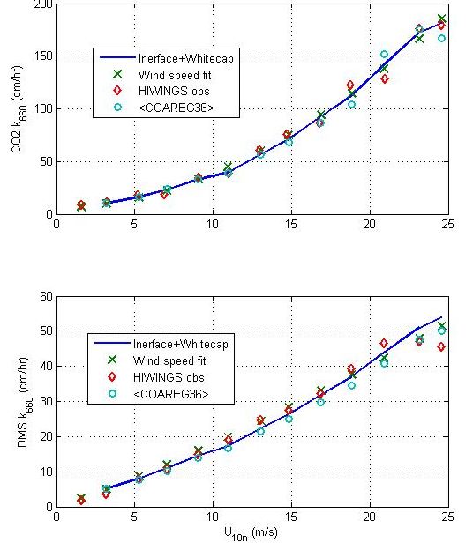
The PSD COARE Gas Flux Parameterization
The COARE gas transfer parameterization is a physically-based scaling approach where the total transfer velocity of some gas, X, is represented as the sum of a viscous transfer at the air-ocean interface plus a bubble-mediated component.
Here S_{cw} is the Schmidt number on the water side, α_{x} is the solubility of the gas, u_{*υ} the viscous friction velocity, F is a function, and f_{W} the fraction of ocean surface covered by whitecaps. The constants A and B are adjusted to fit covariance measurements of the air-sea fluxes of trace gases. In this formalism, one set of A and B values should fit all gases described by (1).
We have recently made a major step forward in generalizing the COARE met and gas versions using numerical simulations from the UNSW (Australia) wave model that has been run at selected wind speeds from 1 to 60 m/s.
The figure on the right shows the results from the HiWinGs field program conducted near Greenland in 2013. The transfer coefficient is much higher for CO2 than for DMS because of enhancement by whitecap generated bubbles. This sensitivity is driven by the solubility of the gas – the less soluble the greater the bubble enhancement. Thus, parameterization of f_{w} is critical.
Average transfer velocity k₆₆₀ (upper panel, CO₂; lower panel, DMS) from HiWinGS vs 10-m neutral wind speed. Red diamonds are observed values, x’s are from wind speed power-law fits to the data, the blue line the simplified sum (1), circles are means of values computed using COAREG36G using meteorological and wave data inputs.
Notes:
The COARE stable of physically-based bulk air-sea flux algorithms. OOMD projects do not make direct covariance turbulent flux observations, but use COARE to compute flux estimates from near-surface bulk meteorological variables. In FY18 we will release three new versions of the algorithm: COARE3.6 (basic meteorological fluxes), COARE3.6G (trace gas fluxes), and COARE3.6I (air-sea-ice fluxes). The three versions all use the same theoretical/scaling structure to give consistent results. The new versions will be backed by 20,000 hrs of direct observations. Scaling from the UNSW wave model will allow the algorithms to be used at wind speeds over 30 m/s.
See ftp://ftp1.esrl.noaa.gov/../BLO/Air-Sea/bulkalg/cor3_6/ for codes and documentation.

