Slide 1
Ship-based atmospheric reference data for satellite remote sensing retrievals and global modeling in the coastal zone C.W. Fairall NOAA Physical Science Division, Boulder, CO USA
WMO Conference on Enhancing ocean observations and research, and the free exchange of data, to foster services for the safety of life and property.
Geneva, Feb 5-6, 2019

Slide 2
Outline
Background of PSD work
Research air-sea interaction
Ocean observing system
Issues in ship observations
Accuracy requirements
Sampling, sensors, ship effects, contamination
Meteorology
Radiative flux
Aerosol
EEZ and Law of the Sea issues

Slide 3
PSD Air-sea Research
Direct observations of air-sea fluxes and associated bulk variables: stress, turbulent heat, trace gases, aerosols, radiative fluxes
Characterization of interactions
Bulk flux algorithms – COARE
State-of-the-art accuracy
Parameterization variables: waves, whitecaps, clouds, …
X_{s} ocean value
X_{r} air value
S wind speed
C_{x} transfer coefficient

Slide 4
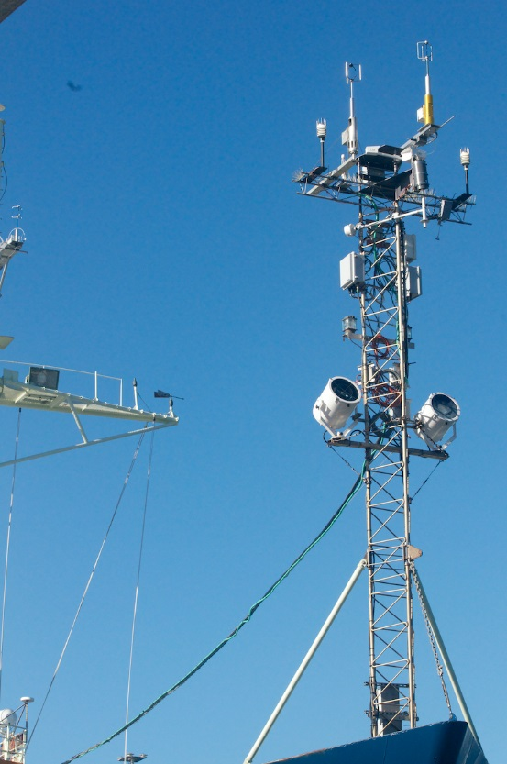
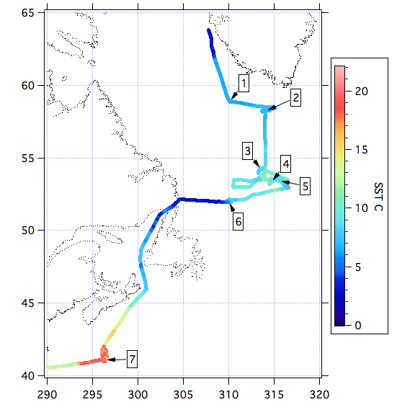
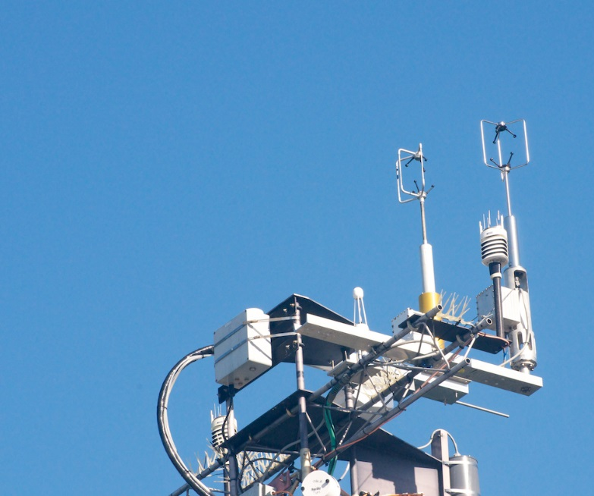
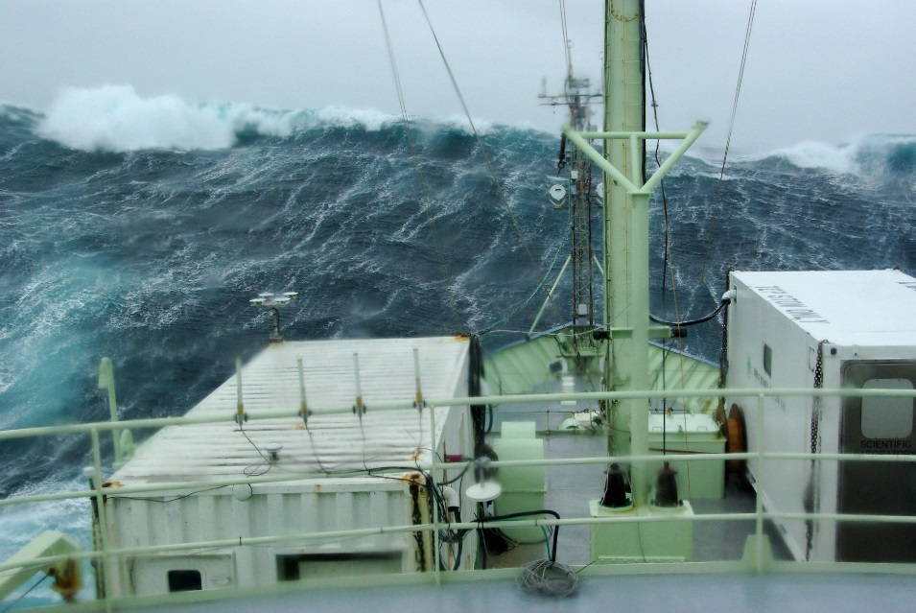
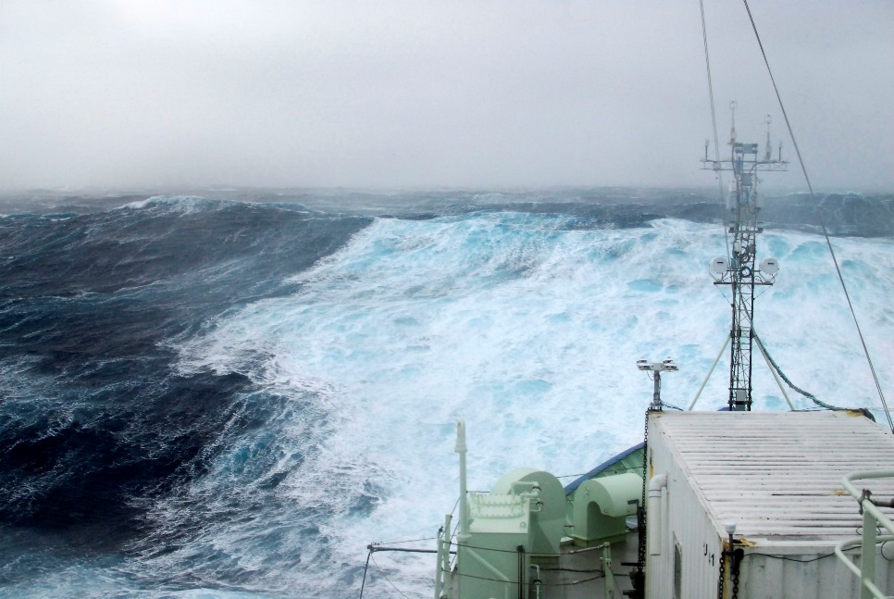
HIWINGS 2015

Slide 5
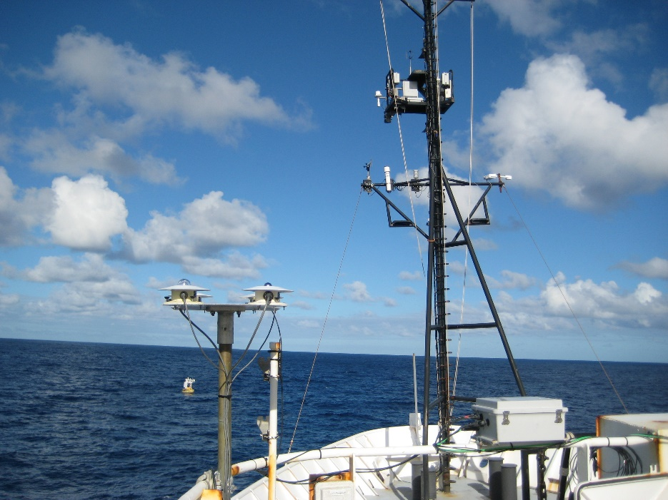
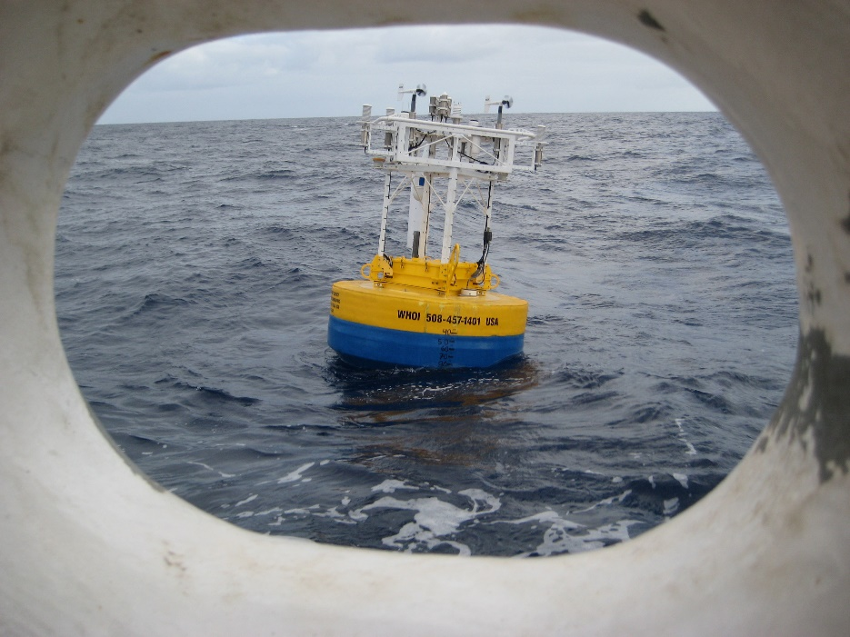
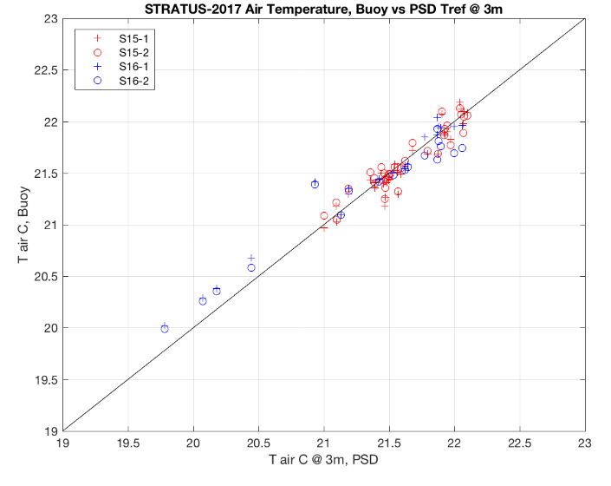
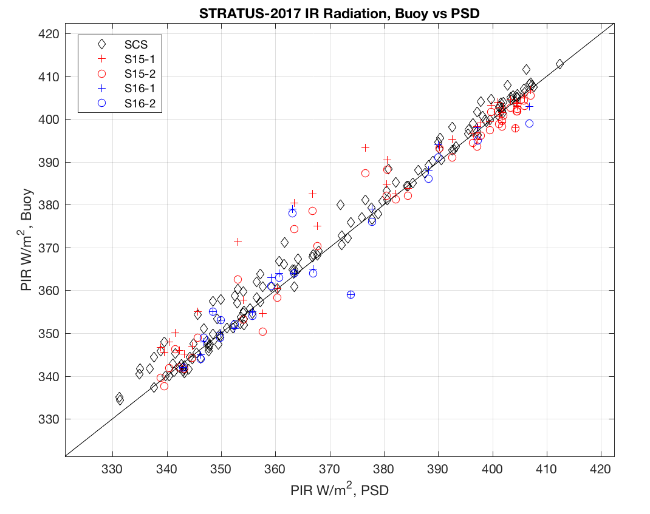
PSD Roving Ship Calibration Standard for Air-Sea Fluxes: Example STRATUS 2017
Accuracy for 10 W/m² net guideline
wind speed 2% or 0.2 m/s
SST, Ta 0.1 C
RH 2%
Solar, IR 5 W/m²

Slide 6
Guidebook for Climate Quality Ship Obs

Slide 7
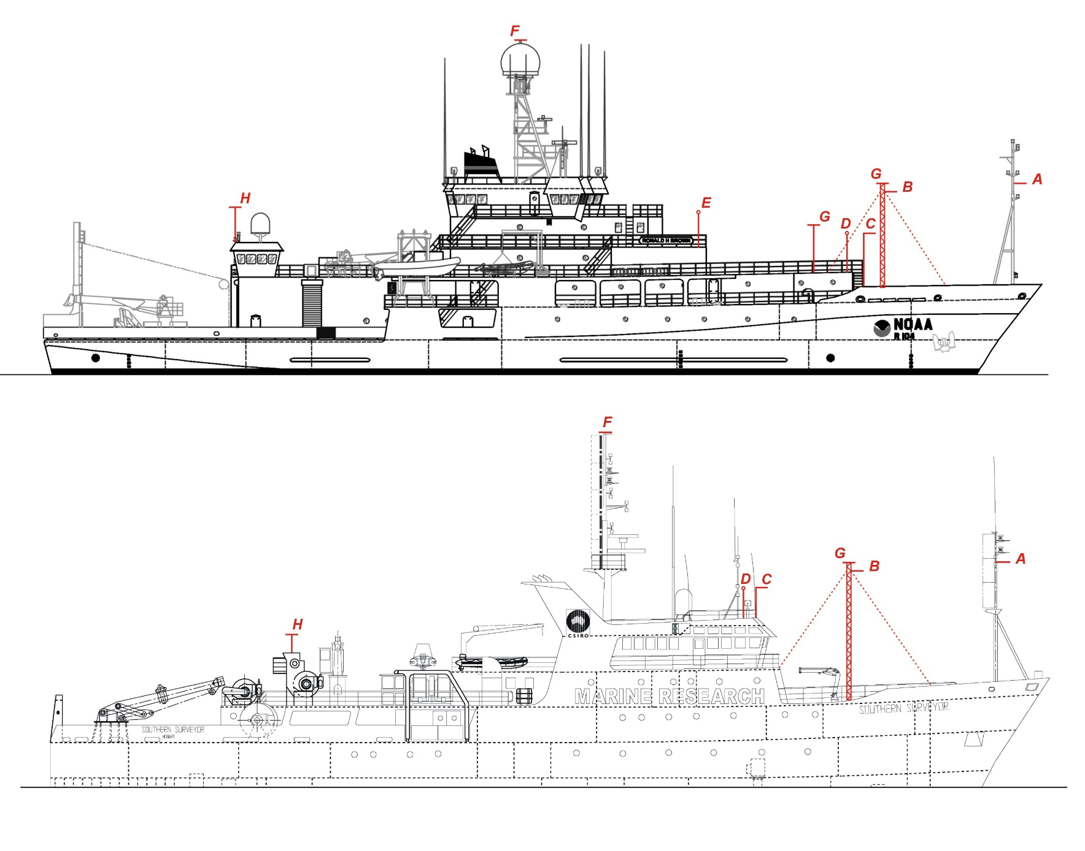
Sensor Placement to Minimize Interference
Flow distortion
Ship plume
Radiative FOV
Tradeoffs:
Maintenance
Cables
Physics

Slide 8
PSD Measurements: Flux Hardware
Wind speed: 3-D sonic anemometer
Motion corrected, flow distortion corrected
Air T, RH, P: Vaisala system
Ventilated radiation shield
SST: PSD sea snake
Floating thermistor
Radiative flux: Eppley/Kipp-Zonen radiometers
Calibrated at GMD Boulder
Rain rate: Long path optical scintillometer
No wind speed-induced error
Fast Humidity/CO2: IR absorption

Slide 9
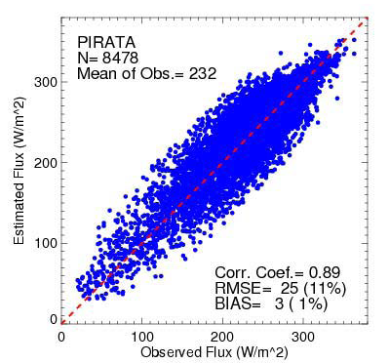
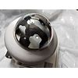
Radiative Flux
Pyranometer & Pyrgeometer: Eppley or K&Z
SPN-1 Pyranometer: direct/diffuse
Corrections for solar shadowing or IR FOV
Pitch/roll stabilization
Pinker, R. T., Zhang, B. Z., Weller, R. A. &
Chen, W. (2018). Evaluating surface
radiation fluxes observed from satellites
in the southeastern Pacific Ocean.
Geophysical Research Letters, 45. https://
doi.org/10.1002/2017GL076805

Slide 10
Aerosols
Total optical depth (wavelength)
Microtops (hand held) MFRSR (multi freq rotating shadow band)
Ceilometer/lidar profiles aerosol backscatter (also cloud information)
Commercial ceilometer may be poorly calibrated for good backscatter.
In situ aerosol concentrations
CN – total particles/cc r>0.03 micron
Optical spectrometers – size resolved r>.1 micron
Mobility – size resolved r<0.1 micron
Chemical
Bulk, filterpacks (ship effluent)
Size-resolved chemical
Many systems are laboratory instruments not suitable for out deployment. Issue of piping aerosols to instrument without compromising the measurement

Slide 11
AEROSOL Systems

Slide 12
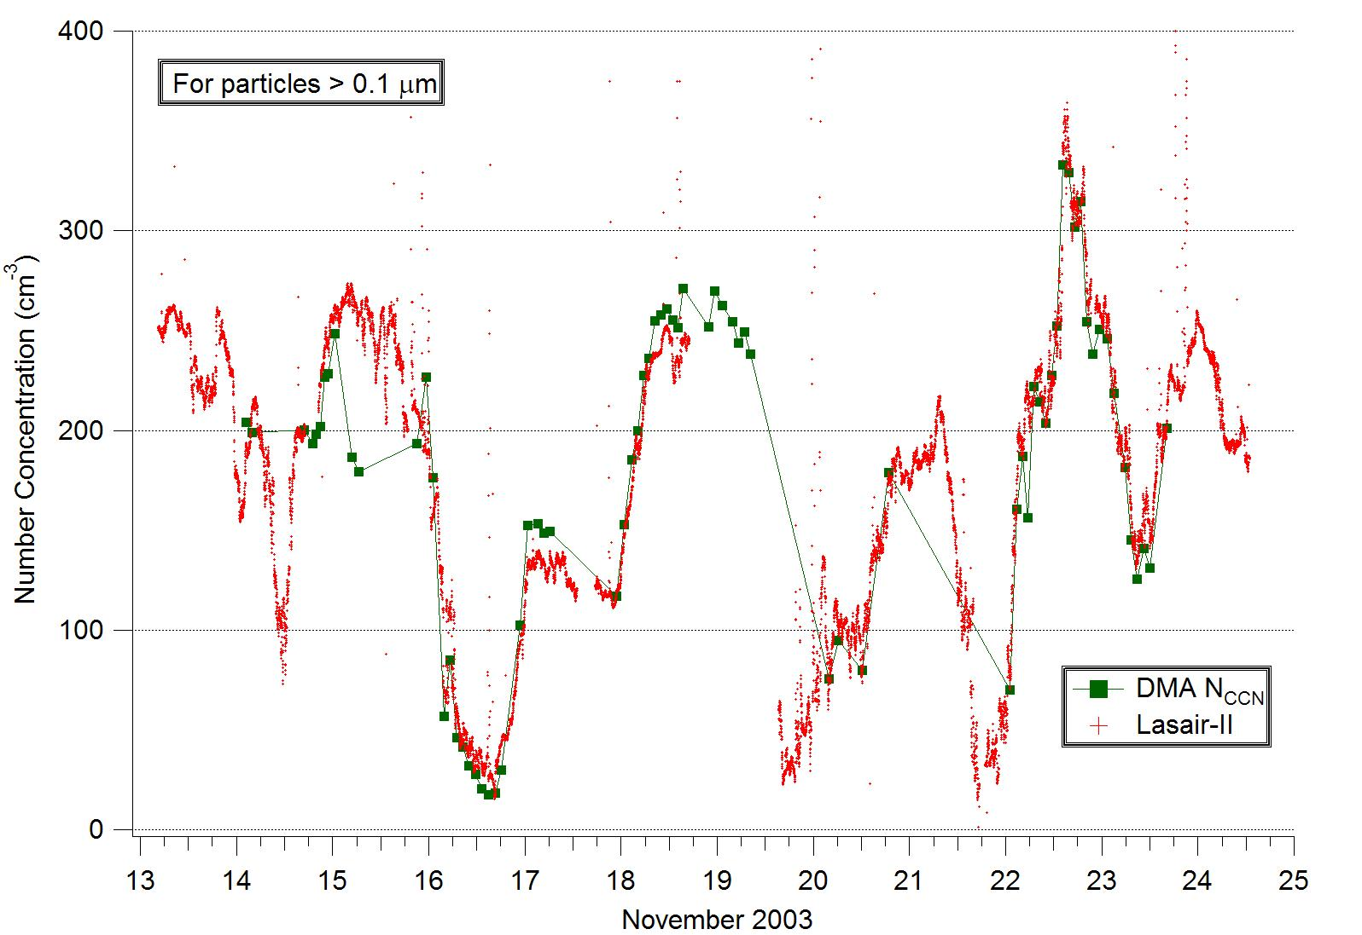
Example Concentration from E. Pacific Comparison of Optical and Mobility Analyzers
Contamination of intakes by ship plume may ruin the observations. Particularly for chemical aspects.

Slide 13
Conclusion
Fully automated bulk meteorology climate system can be built for about 25 K$ hardware. Issues are well understood.
High quality solar/IR flux quite feasible. Sensors are cheap (3k$ ea).
Combination of pyranometer and SPN-1 would be good for solar
Pitch/roll stabilization would likely reduce biases (poorly explored)
A lot of diversity in aerosol observations
Simple optical depth and CN counts straightforward.
Size spectra are expensive and not well suited to unattended operation.
Aerosol chemistry principally research grade
More subject to contamination by ship’s plume

Slide 14
EEZ and International Restrictions
WMO resolution 40
Parameters in the standard ship report (air temp, humidity, pressure, SST, winds, cloud parameters, waves etc.) don’t need special permission.
An official process to get permission to take data in EEZ
Handled thru departments of state
Many months lead time
Yes answer may come the day before the cruise. Or, not at all. Little feedback.
Agreement to share data
Two observers on board (at your expense)
Official process is cumbersome and note suitable for routine/monitoring activities.
https://www.wmo.int/pages/prog/www/ois/Operational_Information/Publications/Congress/Cg_XII/res40_en.html

