Slide 1
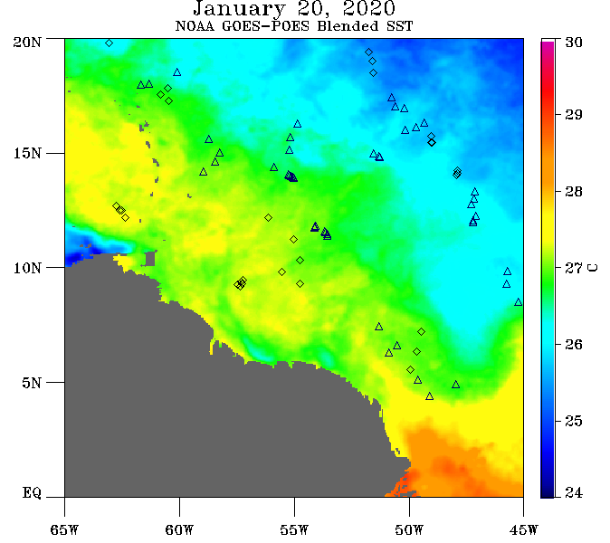
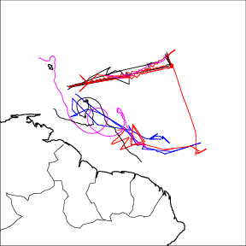
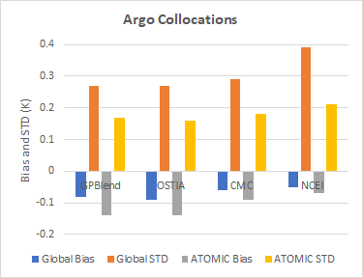
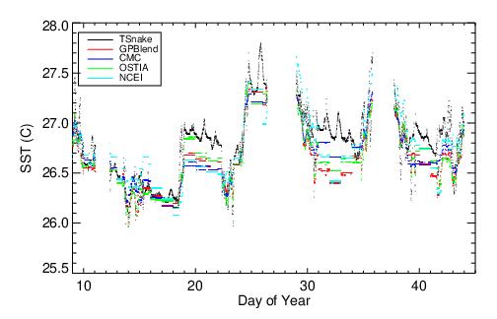
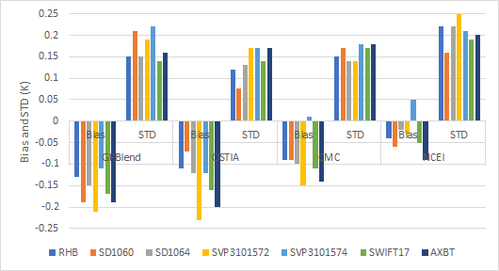
Consolidation and Assessment of ATOMIC SST Data: Satellites vs ships, saildrones, drifters, AXBT
Objectives
Evaluation of 4 satellite data SST products: GPBlend, OSTIA, CMC, NCEI
Use of satellite data to intercompare in situ data
Findings thus far
Satellites 0.12 C cooler in ATOMIC region
In situ observations in good agreement
Satellite vs RHB, Saildrone, SVP, SWIFT, and AXBT
Time series at Ron Brown with 4 satellite SST products
Notes:
Fairall and Thompson. Synthesis of SST observations from ATOMIC NW Atlantic field program to evaluation gridded SST products.

Slide 2
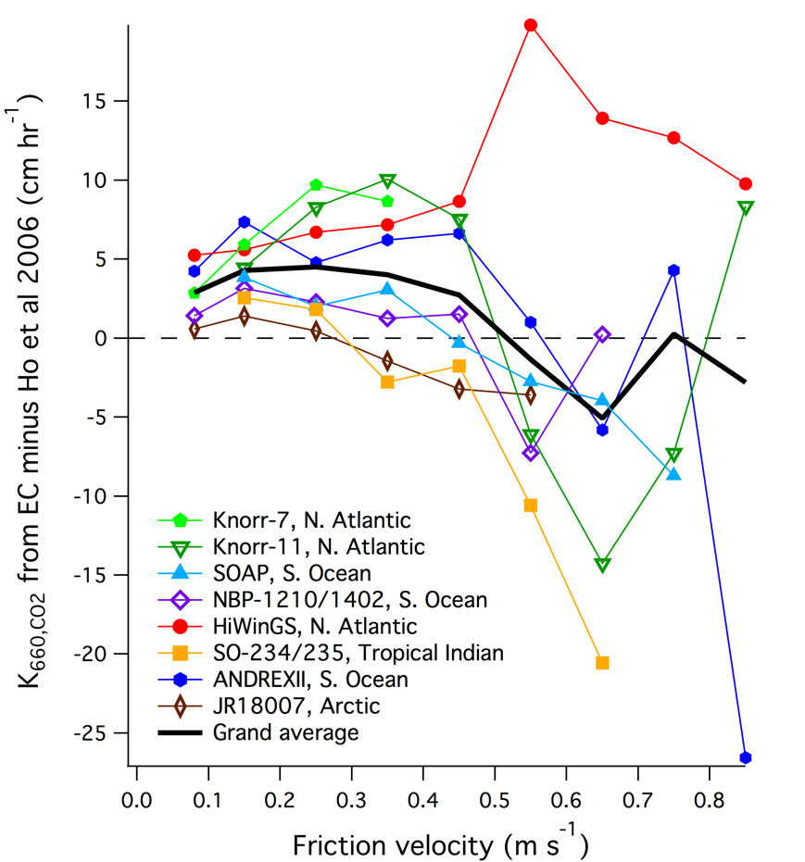
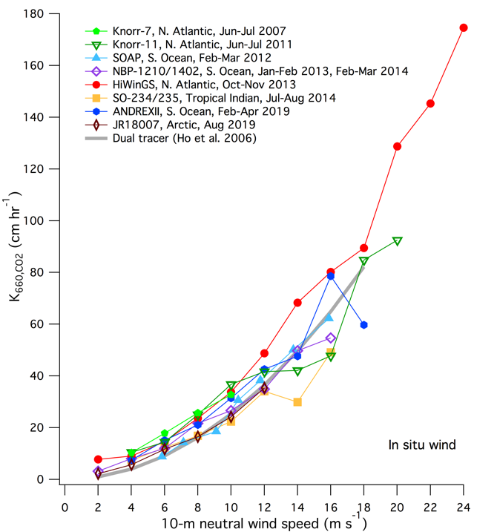
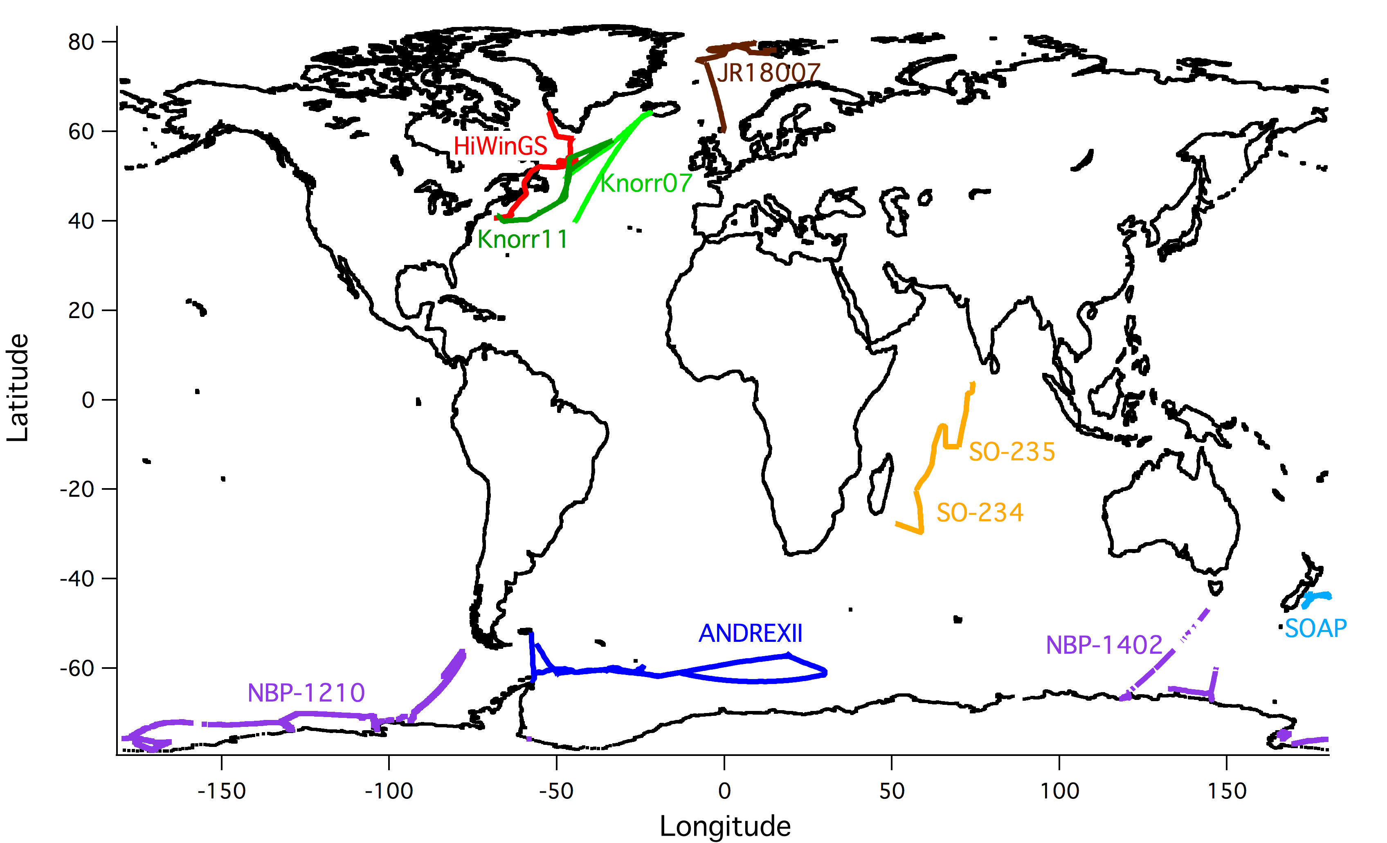
Synthesis of CO2 transfer velocity measurements from eight recent field programs shows evidence of chemical enhancement of CO2 transfer: Yang et al. 2021
Flux CO2 = solubility*k*dPCO2, k is the transfer velocity. Flux measured with eddy correlation, k computed
Field program distribution shown in map (lower panel)
k vs 10-m wind speed shown in middle panel; grey thick line is tracer consensus from Ho et al. 2006
Right panel shows difference of EC and tracer values. The tracers are He3 and SF6, which are not chemically active. The larger values for EC for CO2 indicate chemical enhancement of CO2 flux
Notes:
Fairall and Thompson. Synthesis of recent direct measurements of CO2 fluxes and transfer velocity.

