Slide 1
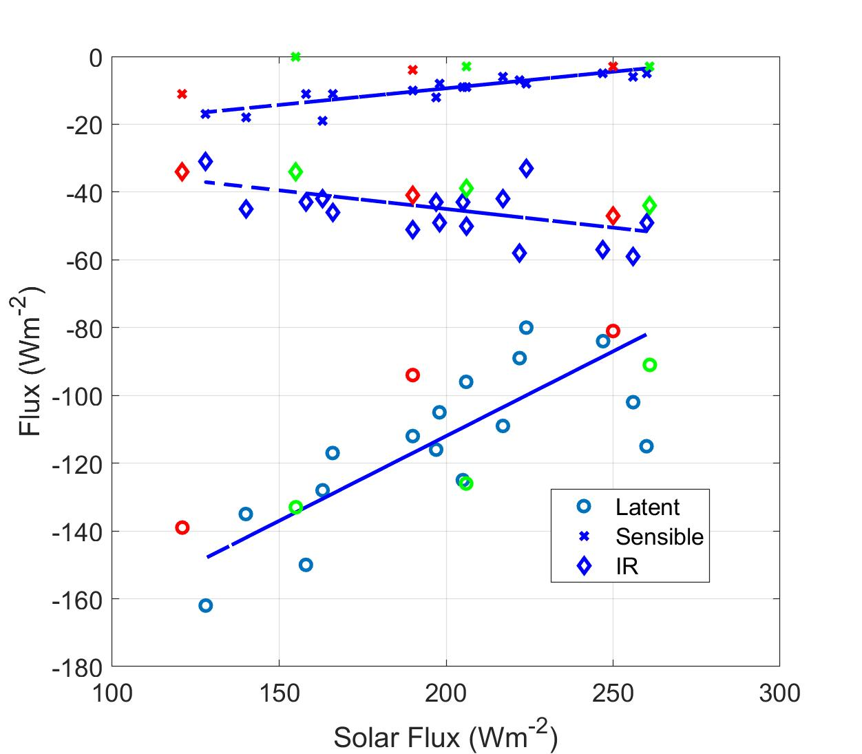
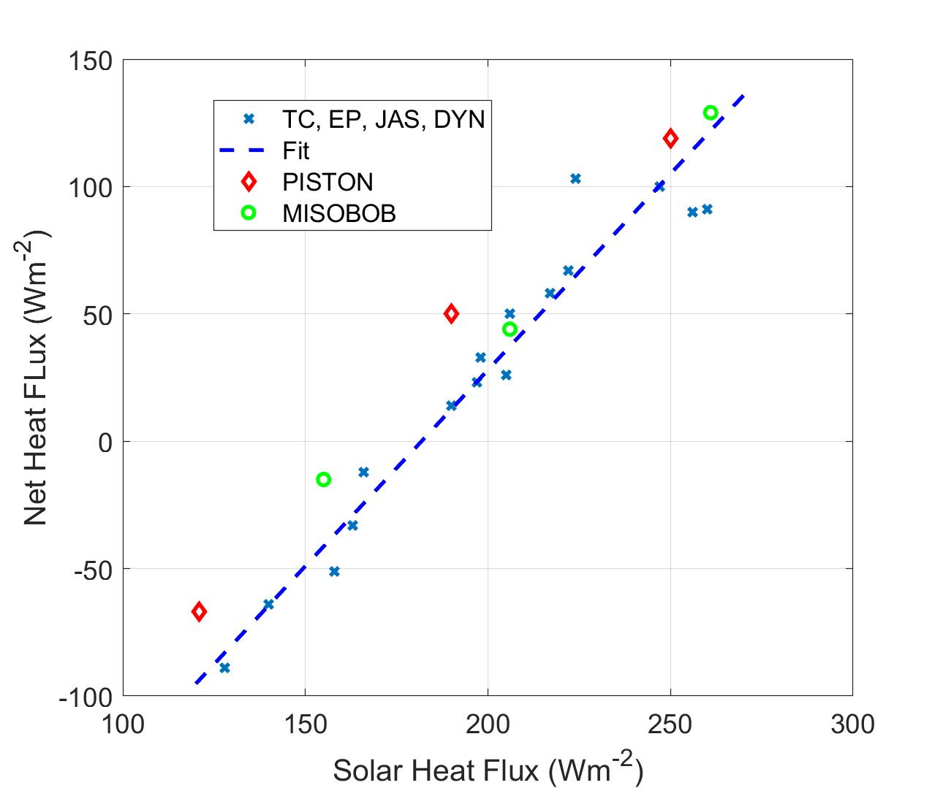
Surface Energy Budgets in Tropical Organized Convection
Analysis of ship-based observations of surface fluxes obtained in six tropic air-sea interaction field programs (TOGA COARE, EPIC, JASMINE, DYNAMO, MISOBoB, and PISTON).
Partition into suppressed, disturbed, and MJO convective forcing. Strong forcing = strong cloud induced reduction in solar flux
Find strong correlation of sensible, latent, and net IR flux components and Net surface energy flux with Solar radiative flux with Solar radiative flux
Surface heat flux components vs net solar flux
Net surface heat flux vs net solar flux
Notes:
Fairall and Thompson. Synthesis of flux observations from six tropical field programs reveal correlations between flux components associated with strong convective disturbances such as MJO.

Slide 2
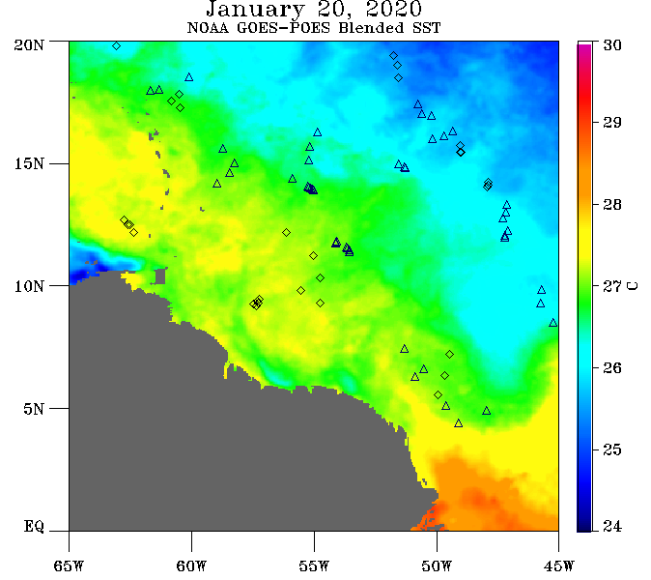
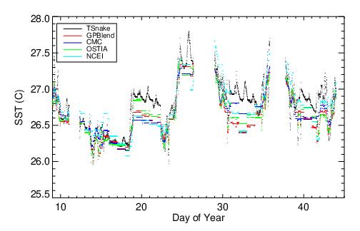
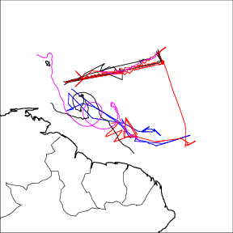
SST
Consolidation of SST Data: Satellites vs ships, saildrones, drifters, AXBT
Observational period
Buoys have been sampling for decades; ships visit moorings for service since early 1990’s
PSL Instruments deployed on ship to evaluate moorings and satellites
surface and near-surface meteorology, oceanography, fluxes, and physics
Recent Results
Factors controlling radiative fluxes, clouds, and latent heat are revealed
We regularly provide calibrations to the ships and moorings
A comprehensive study of SST variability captured by multiple satellites was just completed in the Tropical N. Atlantic
Time series SST from Ron Brown with 4 satellite products
Notes:
Fairall and Thompson. Synthesis of SST observations from various in situ sources are used to create a high-reolution blended, gridded SST product with specified accuracy. This work requires knowledge of the accuracy of in situ sensing technology and the physics driving near-surface temperature profiles.

