Slide 1
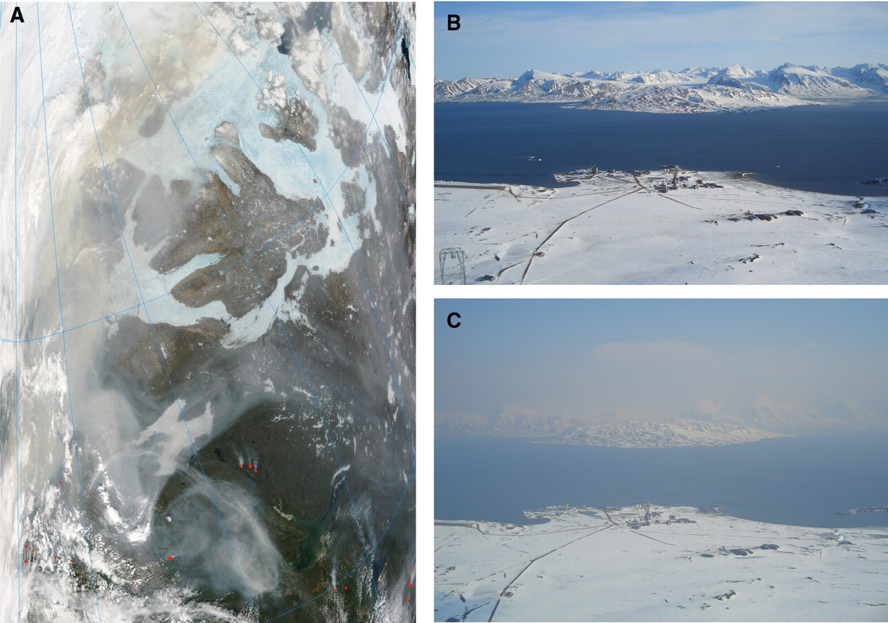
Arctic Air Pollution Workshop Theme 1 – What are the top 5 science areas we should focus on in the next 10 years?
Arctic pollution from Fires
Arctic haze

Slide 2
Questions to be prepared for:
Which within-Arctic science areas require special attention? Are they missing from the survey results?
Which science areas related to long-range pollution transport require special attention? Are they missing from the survey results?
Which issues are driven by societal needs/benefits?
Which issues would benefit from a collaborative approach ?
You have the survey results, use them during the discussions!

Slide 3
Theme 1: Key Science Questions
Session Aim: To establish major scientific issues over next 10 years that would benefit from collaborative efforts
Session Chairs: Kathy Law/ Jennie Thomas (LATMOS-CNRS, Paris)
10:35 Survey results – Jennie Thomas/Kathy Law (LATMOS/CNRS)
10:40 Long-range transport of pollution to the Arctic - Louisa Emmons (NCAR)
11:00 Local Arctic air pollution – Jennie Thomas (LATMOS/CNRS)
11:20 Interactions of pollutants with natural cycles – Greg Huey (Georgia Tech.)
11:50 Introduction/Training to the World Café Process - Sandy Starkweather (CIRES/NOAA)
Lunch

Slide 4
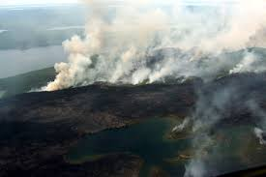
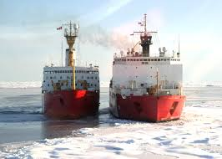
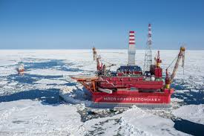
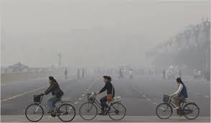
Theme 1: Science Questions
Survey Results Kathy Law/ Jennie Thomas & organizing committee
photo: NY Times
photo: NASA
photo: USGS
photo: Gazprom

Slide 5
Anthropogenic emissions – influence on Arctic pollution
Emissions
Uncertain Asian (Eurasian/Russian) emissions
Future scenario development (policy support)
Globally consistent ship emissions inventory
Natural emissions (ocean, fires, biogenics)
photo: NY Times
photo: NASA
photo: USGS
photo: Gazprom

Slide 6
Anthropogenic emissions – influence on Arctic pollution
Long Range Transport
Changing transport patterns – natural variability
Understanding past trends (observations & models) + future changes
Changing emissions (LRT vs local, present/future)
Contribution of Asia vs. North America vs. Europe
photo: NY Times
photo: NASA
photo: USGS
photo: Gazprom

Slide 7
Anthropogenic emissions – influence on Arctic pollution
Local pollution
Emissions – shipping, oil/gas extraction, metal smelting, domestic combustion (local monitoring) – present + future
Increasing local sources (socio-economic + climate drivers)
Impacts of industrialization on climate, air quality (health) & ecosystems (other contaminants)
Urbanization
Active role for local communities
photo: NY Times
photo: NASA
photo: USGS
photo: Gazprom

Slide 8
Pollutant Distributions (Processes) (aerosols & trace gases)
Common themes:
Vertical distributions (poor model performance)
Transport (residence times) (dynamics, processing)
Seasonal and inter-annual cycles
Surface vs free troposphere
Wet and dry deposition
photo: NY Times
photo: NASA
photo: USGS
photo: Gazprom

Slide 9
Pollutant Distributions (Processes) (aerosols & trace gases)
Aerosols:
Scavenging processes (esp. BC – also others!)
Deposition of BC on snow/ice
Aerosols <-> clouds & radiative effects (microphysics)
Decreasing sulfate <-> climate?
Trace Gases (ozone + others)
Chemical processing (oxidising capacity)
Poor predictions (e.g. OVOCs, PAN)
Roles of halogens (ozone destruction, chlorine, climate feedbacks)
Biosphere interactions (deposition)
photo: NY Times
photo: NASA
photo: USGS
photo: Gazprom

Slide 10
Climate Change & Pollution
Feedbacks between natural background and changing climate & anthropogenic perturbations
Emissions and climate change (e.g. fires, biogenics, ocean/ice/snow emissions)
Methane – climate-biosphere-atmosphere interactions
photo: NY Times
photo: NASA
photo: USGS
photo: Gazprom

Slide 11
Policy, local communities, and interfacing with stakeholders
Communities
Acting with/ informing/finding solutions
Quantifying pollution impacts
Policy
How to pass clear messages to policy makers?
What policies will govern emissions in the Arctic?
Interfacing with stakeholders
How can we engage with social scientists, policy makers, industry, etc. while doing sound physical science?
A major challenge now and in the future!

Slide 12
The how – coming in Theme 2
Do we need more routine measurements (ship based & aircraft) to adequately characterize pollution?
Do we need large scale field studies to improve models?
New partnerships (e.g. Russia, Asia, ….)
photo: NY Times
photo: NASA
photo: USGS
photo: Gazprom

Slide 13
Theme 1: Key Science Questions
Session Aim: To establish major scientific issues over next 10 years that would benefit from collaborative efforts
Session Chairs: Kathy Law/ Jennie Thomas (LATMOS-CNRS, Paris)
10:35 Survey results – Jennie Thomas/Kathy Law (LATMOS/CNRS)
10:40 Long-range transport of pollution to the Arctic - Louisa Emmons (NCAR)
11:00 Local Arctic air pollution – Jennie Thomas (LATMOS/CNRS)
11:20 Interactions of pollutants with natural cycles – Greg Huey (Georgia Tech.)
11:50 Introduction/Training to the World Café Process - Sandy Starkweather
Lunch

