Slide 1
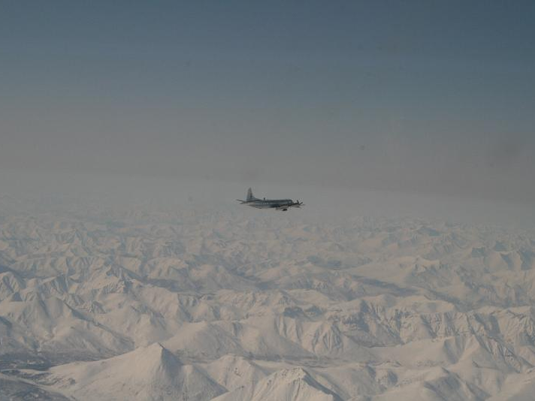
Long-range transport of pollution to the Arctic
Louisa Emmons - NCAR

Slide 2
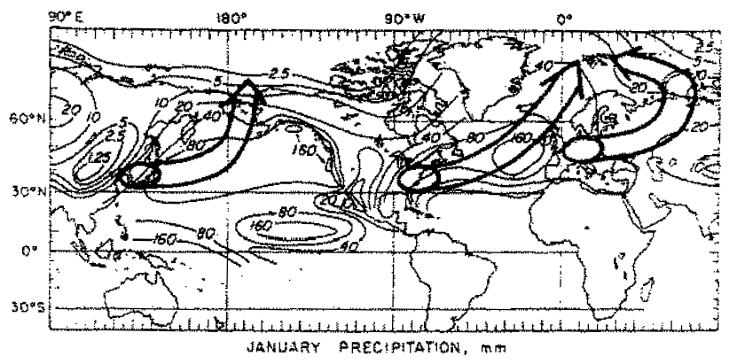
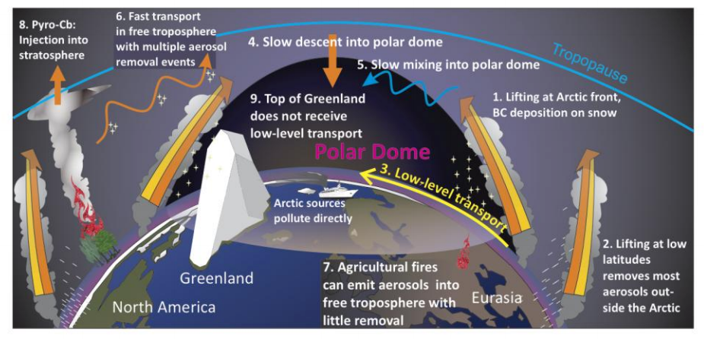
Transport pathways to the Arctic
Barrie
(Atmos. Env., 1986)
Law et al. (BAMS, 2014)

Slide 3
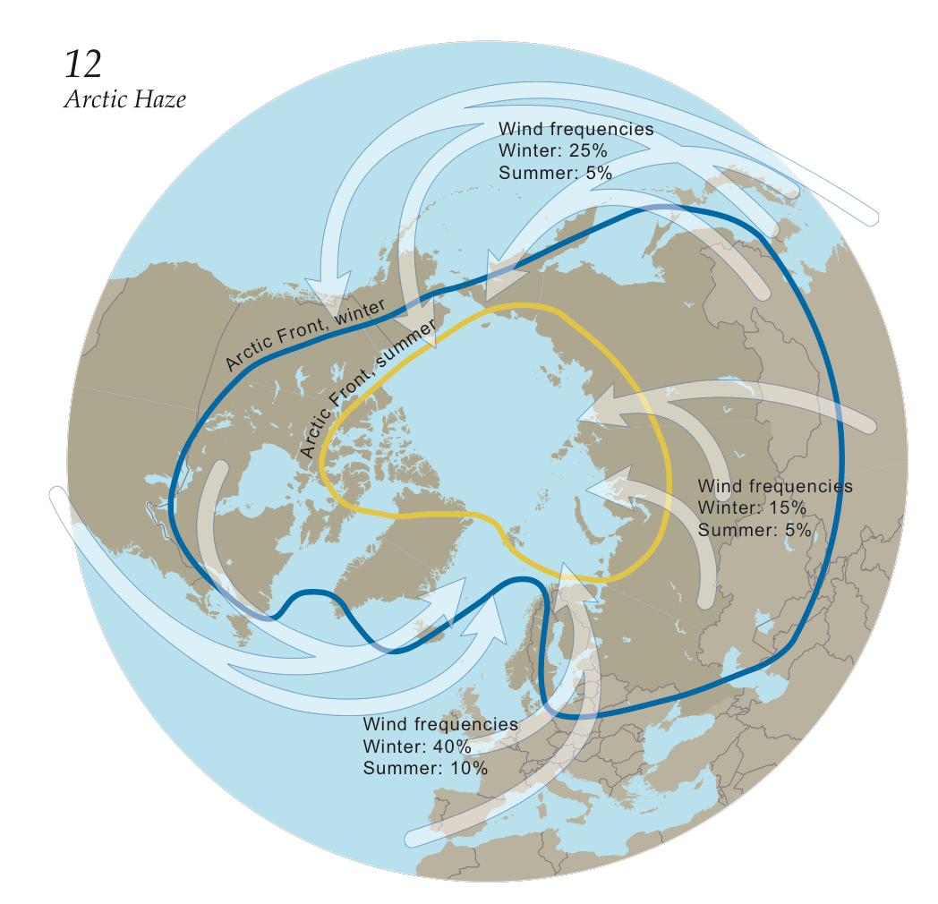
Long-range transport to the Arctic
Air masses transported from warmer lower latitudes enter Arctic at high altitude.
Implications for source sensitivities at different altitudes & radiative forcing.
Most existing (long-term) observations are at the surface.
AMAP, (2006)

Slide 4
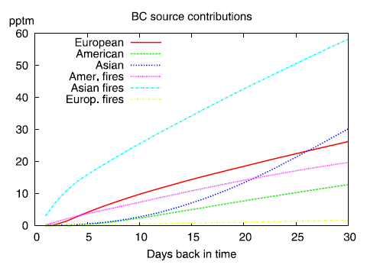
Transport efficiency from different regions
Summer:
Less efficient transport but seasonal shift in polar dome allows transport from more southerly/warmer regions (e.g. Asia).
Fires also become an important source
Winter:
Efficient transport into the Arctic from Europe (direct into Polar dome and shorter transport times)
Stohl (JGR, 2006)

Slide 5
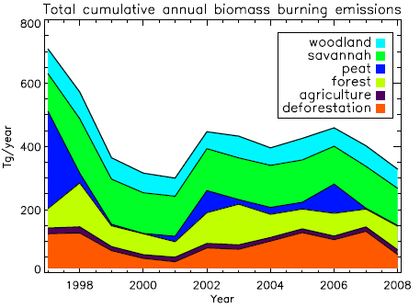
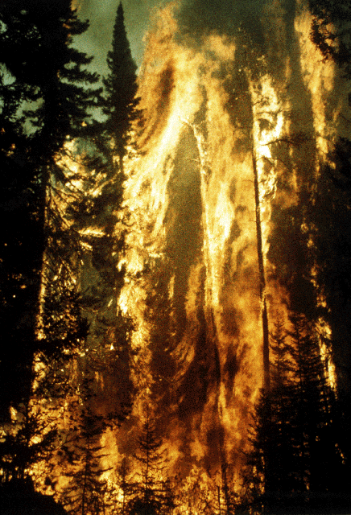
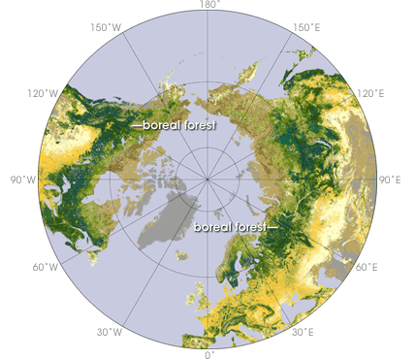
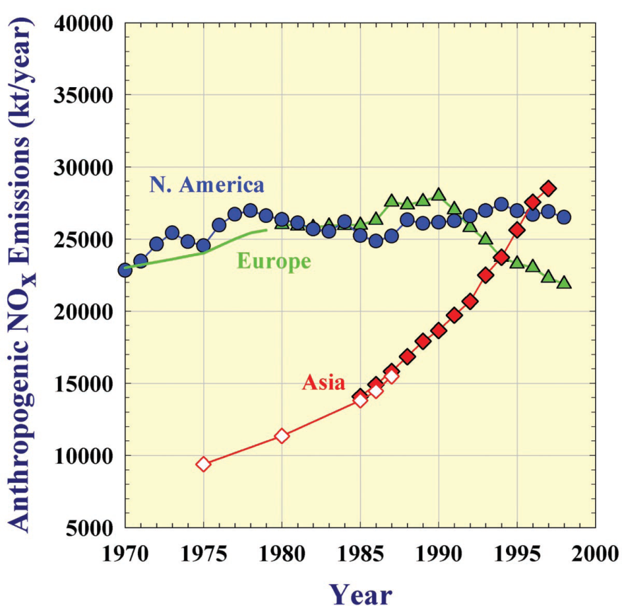
Natural versus Anthropogenic
Natural - Large interannual variability depending on climate variations:
Biomass burning
Biogenic
Anthropogenic:
Europe, Asia and North America ideally located for transport to the Arctic.
Shipping, oil/gas directly within the Arctic.
Anthropogenic emissions in Asia have rapidly increased

Slide 6
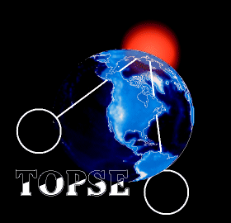
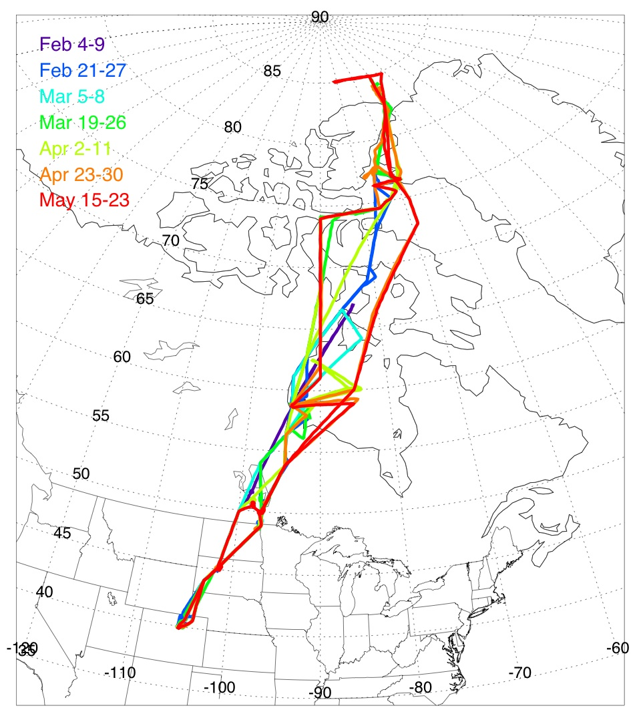
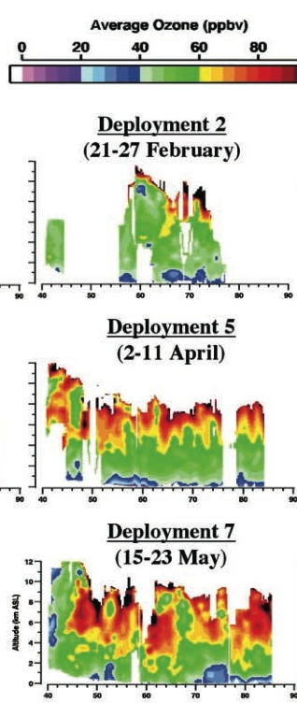
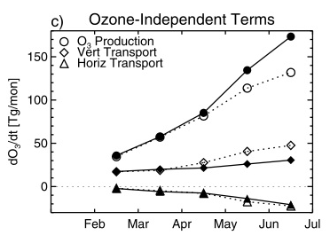
TOPSE
Tropospheric Ozone Production about the Spring Equinox
Thule
Winter-Spring 2000
C-130: 14 gas and aerosol instruments
7 missions between Colorado and Churchill or Thule
Churchill
NCAR
DIAL lidar documented ozone increase Feb to May
MOZART analysis showed photochemical production is more important than stratospheric flux
But questions remained about source contributions
Browell et al., JGR, 2003
Emmons et al., JGR, 2003

Slide 7
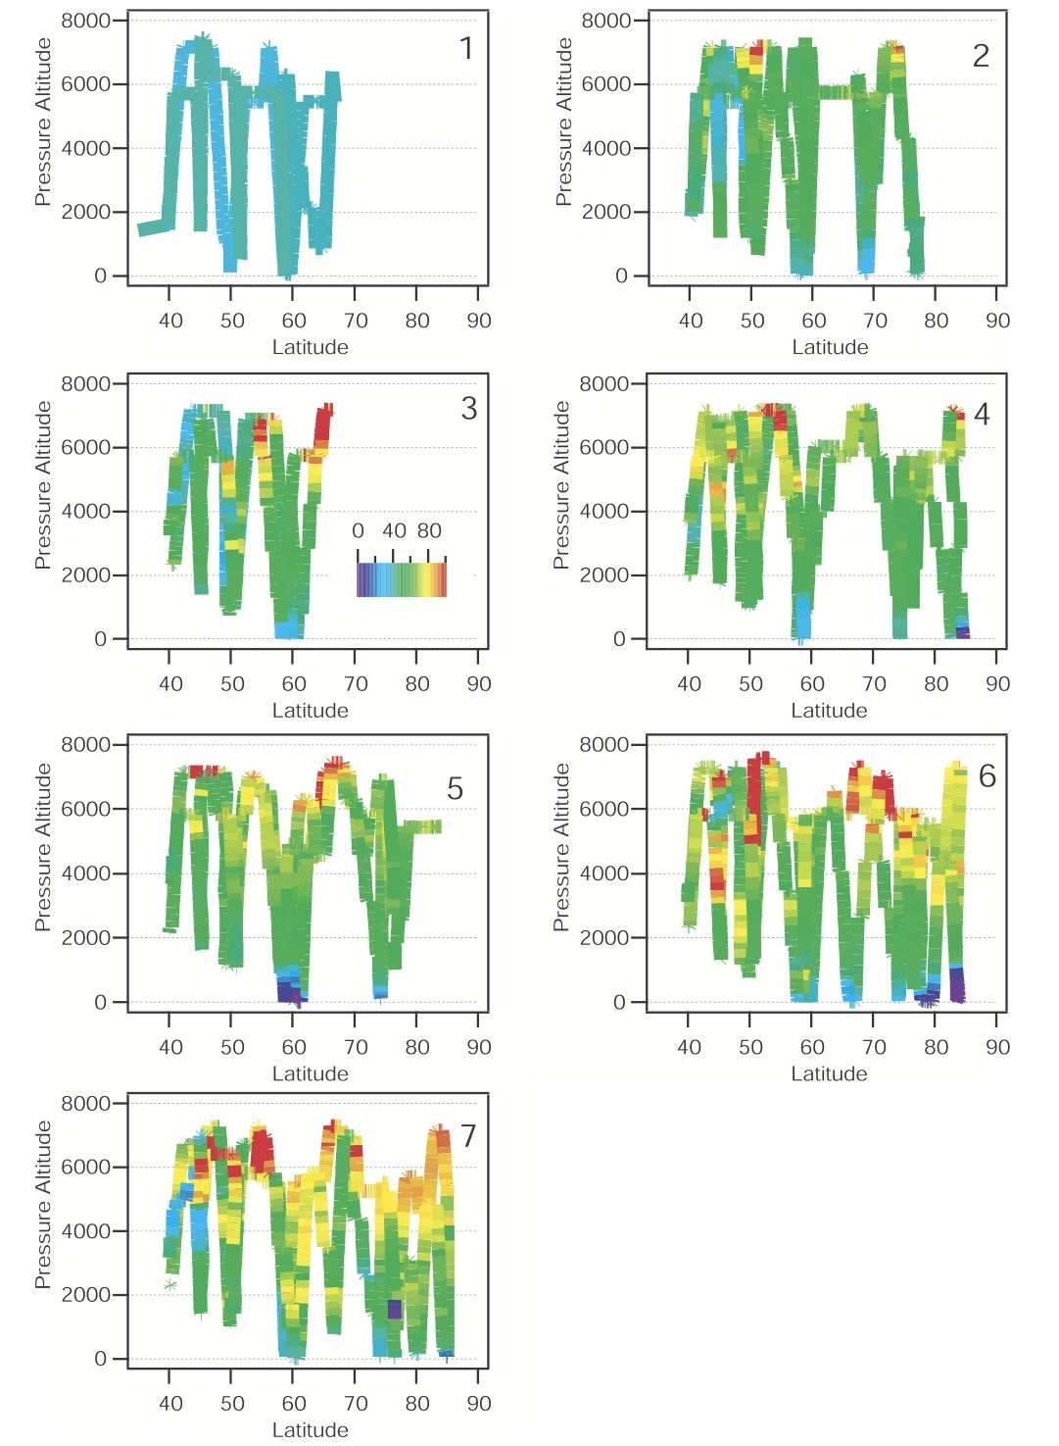
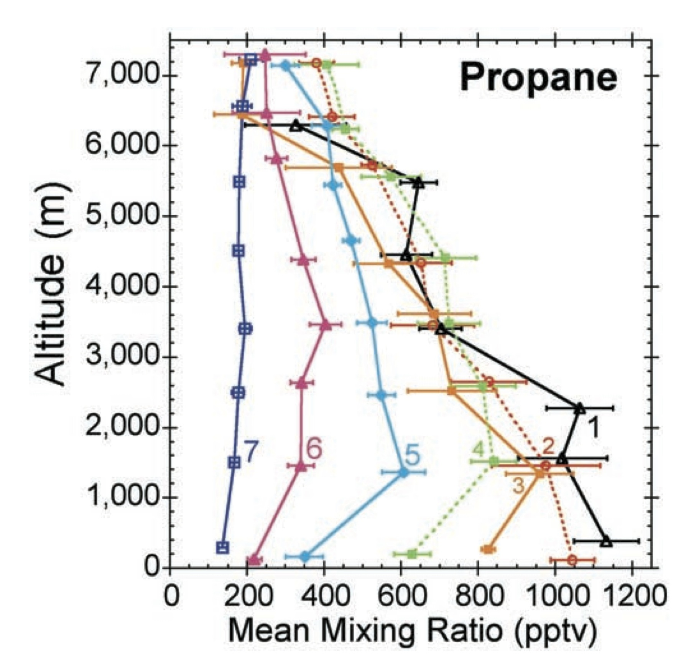
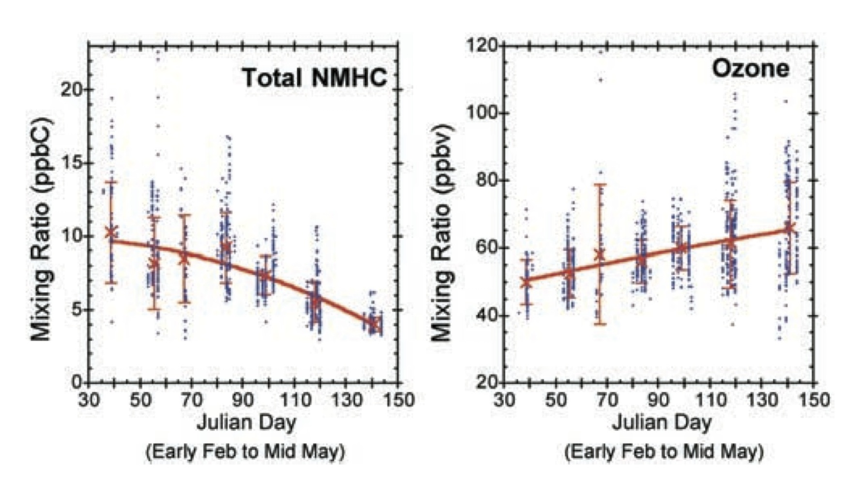
TOPSE provided lat-alt “curtains” of many species from late Winter thru Spring
In situ ozone for each TOPSE mission (Feb-May 2000)
Atlas et al., JGR, 2003
Blake et al., JGR, 2003

Slide 8

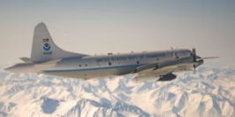
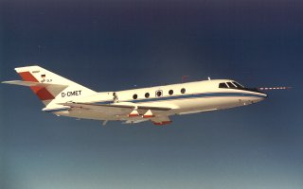

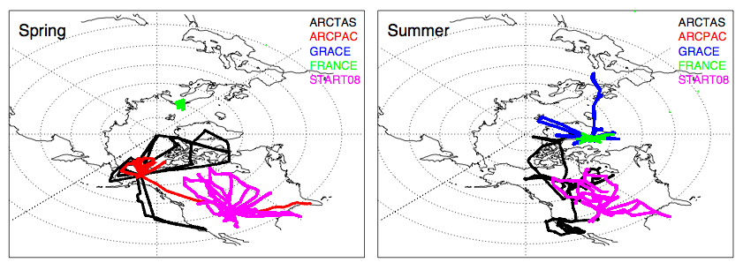
POLARCAT Experiments
April-July 2008
Spring:
NASA – ARCTAS (Alaska)
NOAA – ARCPAC (Alaska)
DOE – ISDAC (Alaska)
POLARCAT-France (Sweden)
{May-June: START08 (NCAR-GV, N.Amer.)}
Summer:
NASA – ARCTAS (Canada)
DLR – GRACE (Greenland)
POLARCAT-France (Greenland)
NASA DC-8
NOAA WP-3D
DLR Falcon
French ATR-42

Slide 9
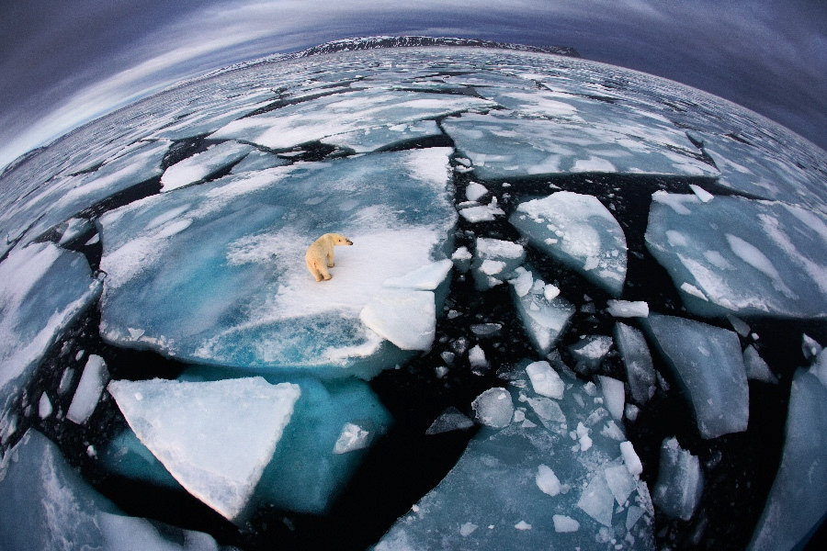
POLMIP: POLARCAT Model Intercomparison Project
POLMIP aims to exploit the large number of observations collected in the Arctic troposphere as part of International Polar Year in 2008, to evaluate 10 state-of-the-art atmospheric chemical transport models.
Louisa Emmons, Simone Tilmes (NCAR) – MOZART-4, CAM-chem
Steve Arnold, Sarah Monks (Univ. of Leeds) – TOMCAT
Kathy Law, Solene Turquety, Jennie Thomas, Idir Bouarar
(IPSL, Univ. Pierre et Marie Curie, Paris) – LMDZ, WRF-chem
Bryan Duncan, S. Steenrod, S. Strode (NASA Goddard) – GMI
Jingqiu Mao (GFDL) – GEOS-Chem
Vincent Huijnen (KNMI) – TM5
Johannes Flemming (ECMWF) – C-IFS

Slide 10
Model | Resolution | Meteorology | Chemistry
TOMCAT | 2.8°x2.8°, 31 levels | ECMWF ERA-oper. | trop: 82 species
MOZART-4 | 1.9°x2.5°, 56 levels | GEOS-5 | trop: 103 species, bulk aerosols; photolysis options: FTUV: online; LUT: lookup table
CAM4-chem | 1.9°x2.5°, 56 levels | GEOS-5 | MOZART-4, bulk aerosols
CAM5-chem | 1.9°x2.5°, 56 levels | GEOS-5 | MOZART-4, modal aerosols
LMDZ-INCA | 1.9°x3.75°, 19 levels | ECMWF | trop: 89 species
C-IFS | T159 (~1°), 60 levels | ECMWF | trop: CB05, strat: linear. O3 (Cariolle)
TM5 | 2°x3°, 60 levels | ECMWF | trop: CB05
NASA GMI | 2°x2.5°, 72 levels | GEOS-5 | strat&trop (154 species), GOCART aer.
GEOS-Chem | 2°x2.5°, 47 levels | GEOS-5 | trop: ~100 species
WRF-Chem | 100 or 50 km, 65 lev. | NCEP GFS | MOZART-GOCART
Emissions – Same for all models:
Anthropogenic: Streets’ ARCTAS-v1.2
Fires: FINN-v1
Biogenic, Ocean, etc: MACCity
*GEOS-chem used slightly different anthro emissions and includes increased HO₂ aerosol uptake [Mao et al., ACPD, 2012]
Output:
  Monthly for all of 2008
  Hourly for Spring & Summer for comparison with field campaigns
Focus on gas-phase chemistry
Artificial tracers – 25-day lifetime, based on CO anthro and fire emissions

Slide 11
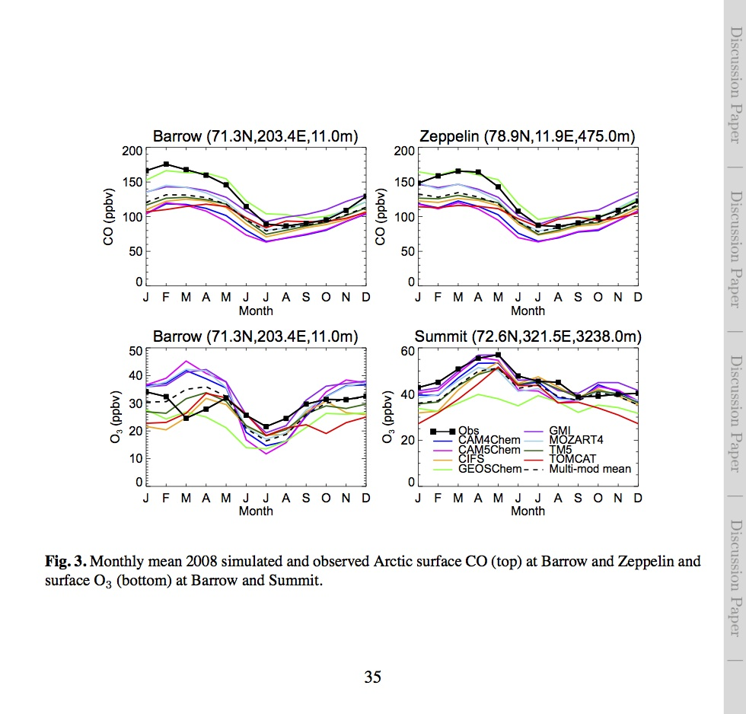
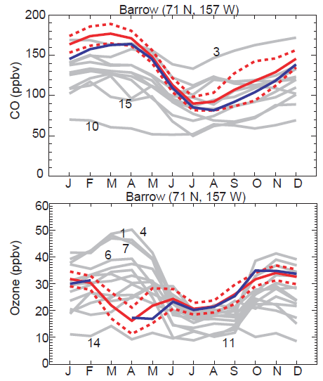
HTAP Models
[Shindell et al., 2008]
POLMIP Models
CO
O₃
The HTAP models, with various emissions, had difficulty reproducing Arctic observations; POLMIP models which all use the same emissions, show smaller differences, but still show deficiencies.

Slide 12
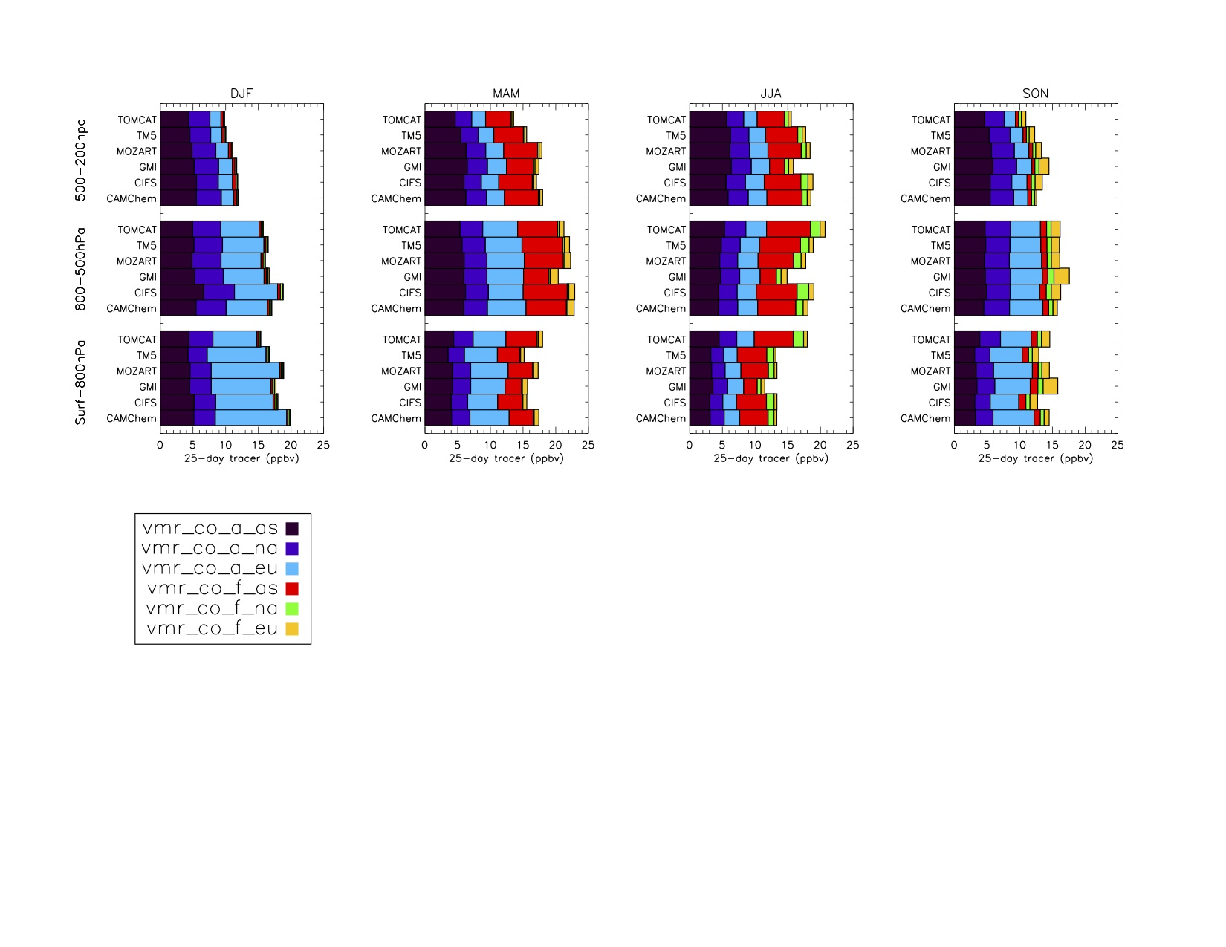

POLMIP: Artificial 25-day tracers with CO emissions from 3 regions
  Allow comparison of purely dynamics between the models, without chemistry
Averages over 66-90°N, for each season, over 3 altitude bands
All models show same general patterns:
Anthro emissions dominate in winter
Asia fires significant in spring and summer
Europe anthro is major source in DJF lower trop
In summer Asia is largest anthro source in UT
Largest differences between models in fire tracers
ANTHRO - Asia
N. America
Europe
FIRE - Asia
N. America
Europe
Sarah Monks, ACPD

Slide 13
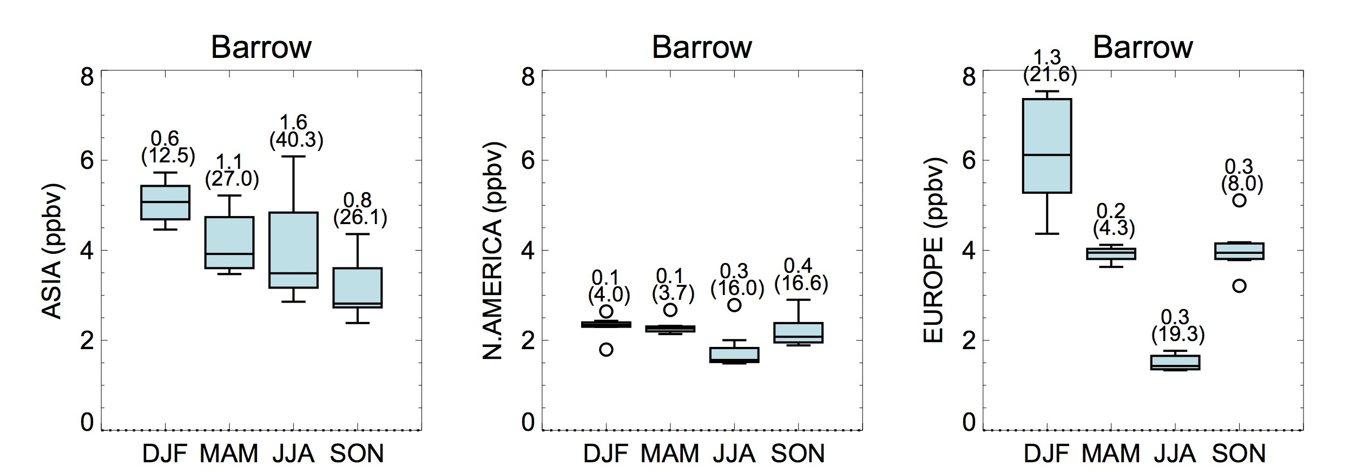
POLMIP models – 25-day tracers
Tracers with 25-day lifetime were emitted from each continent in 8 of the POLMIP models
Median & quartiles of models found for each season at Barrow
Contribution at Barrow from the regional tracers
Model spread:
40%
small
22%
Models all show similar contribution from N.America
Large ranges seen from Europe in DJF and Asia in all seasons

Slide 14
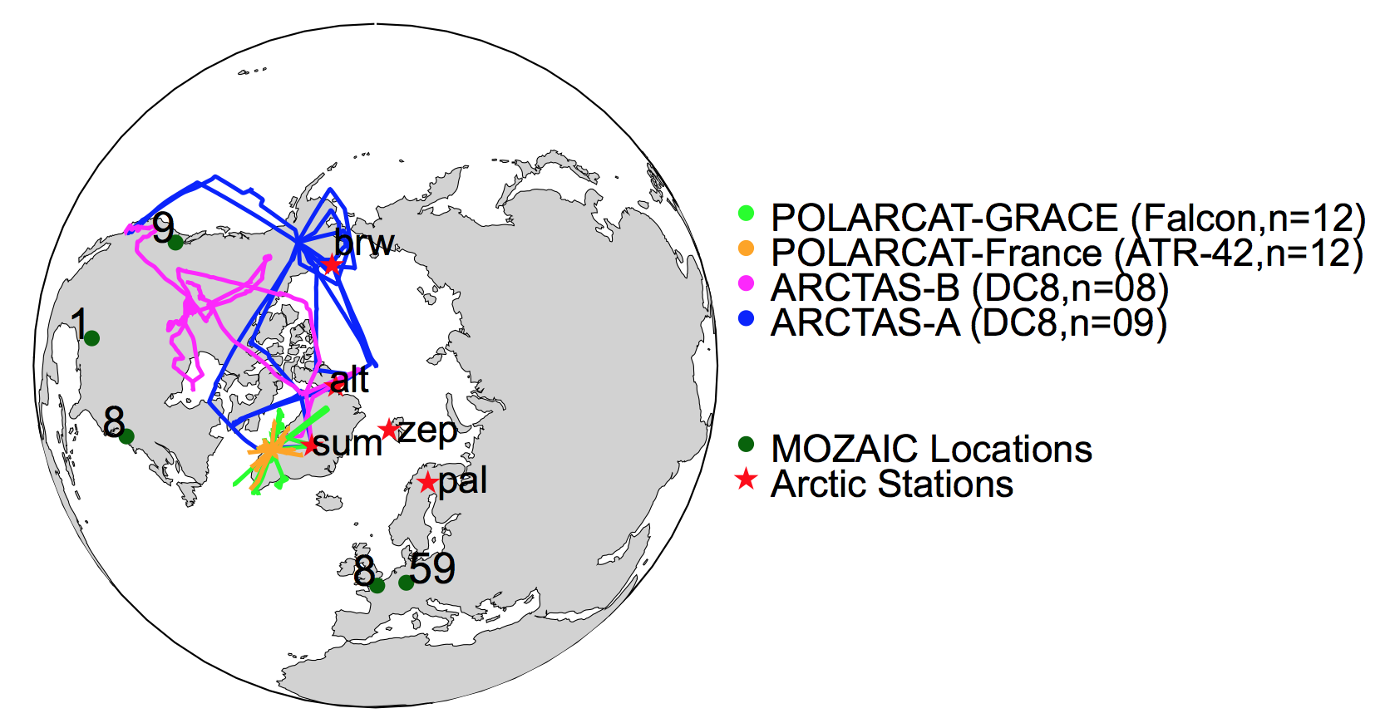
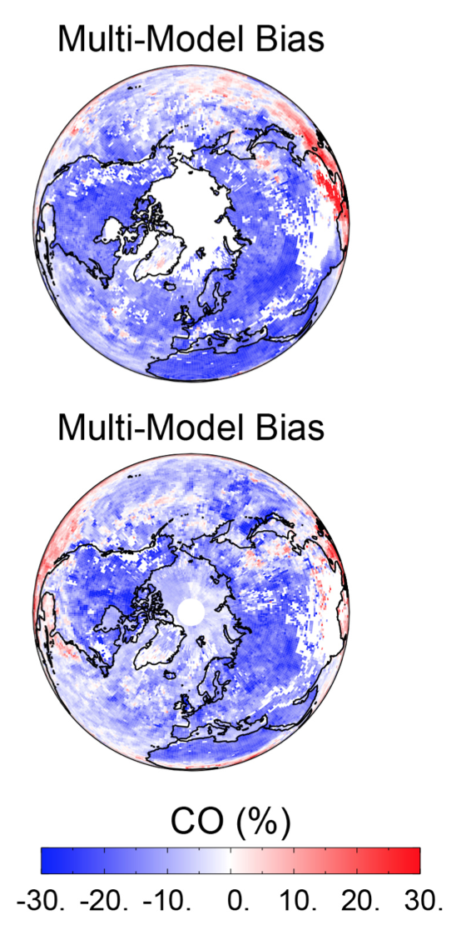
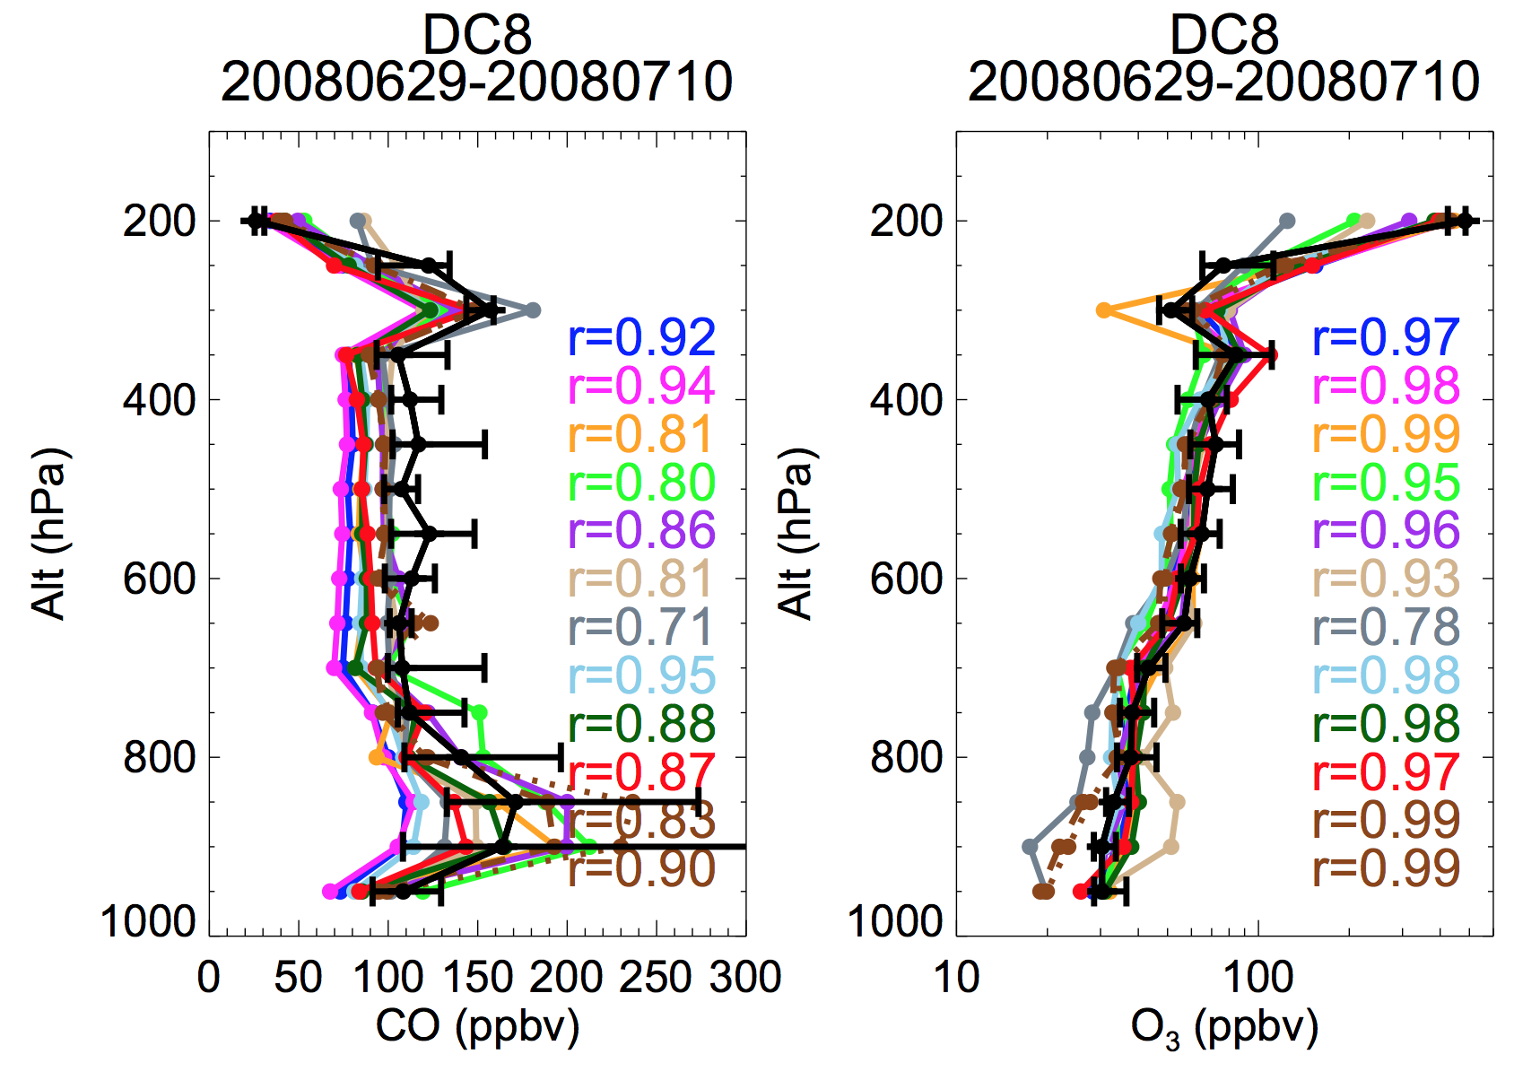
POLMIP evaluation in free troposphere (CO & O₃)
MOPITT CO
Monks et al., ACPD, (2014)
Aircraft + satellite comparisons
Spring
O₃ and CO model evaluation
MOPITT CO (300 & 700 hPa)
MOZAIC profiles (EU + NA)
ARCTAS DC8
POLARCAT French ATR
POLARCAT DLR Falcon
Surface stations
Summer
1. Negative CO bias persistent throughout troposphere.
2. Model ozone often overpredicted in upper troposphere.
Models highly variable.

Slide 15
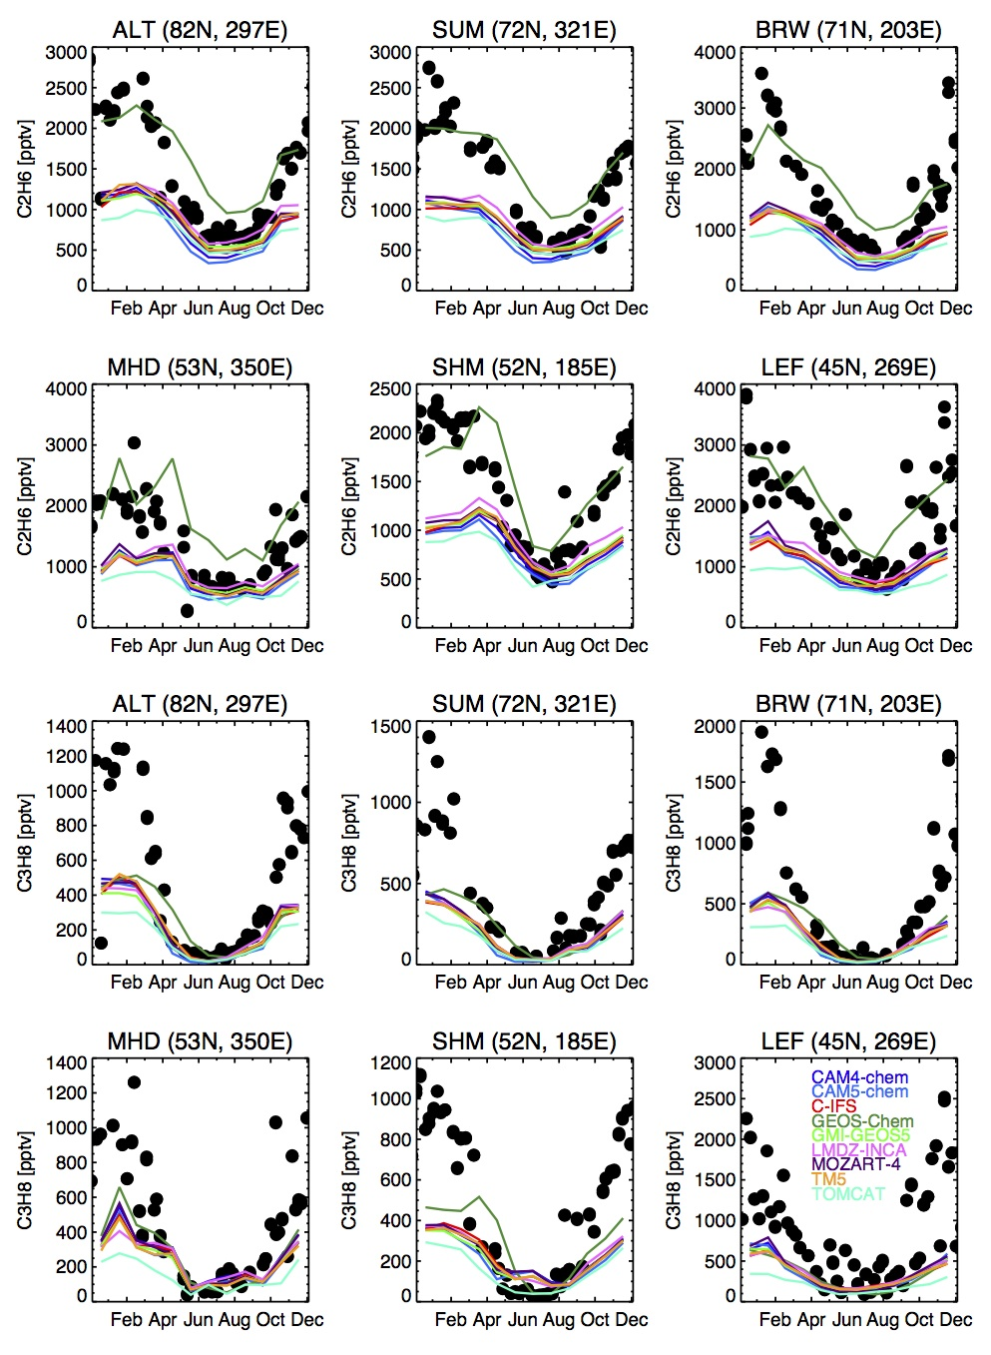
Ethane
POLMIP models and surface HCs
Models underestimate Ethane and Propane
at high and low latitudes
in Fall-Winter-Spring
Propane
Emissions must be too low
Implies all VOC emissions low
Differences between models due to OH
D.Helmig, NOAA GMD/INSTAAR

Slide 16
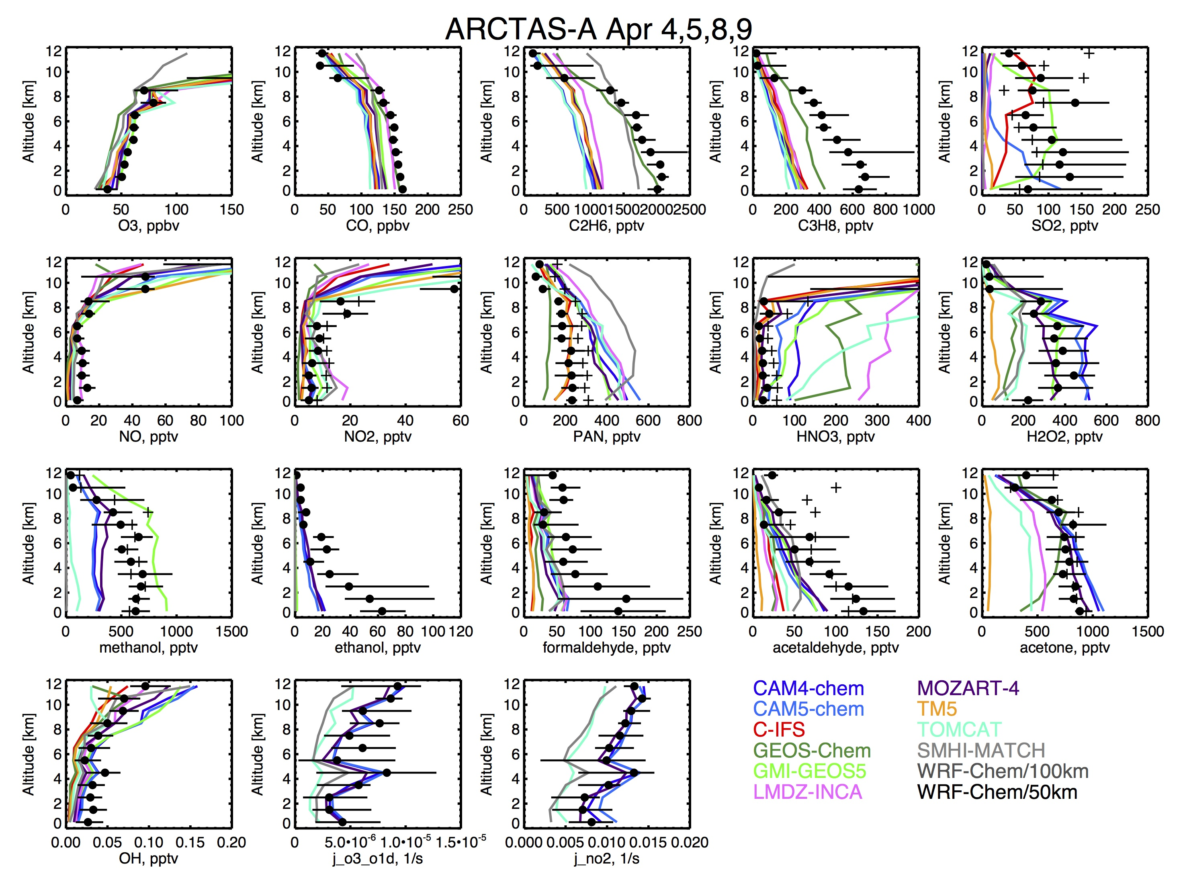
Comparison of POLMIP models to aircraft obs
Hourly output from models was interpolated to the flight tracks
Simultaneous measurements of numerous compounds helps evaluate model chemistry

Slide 17
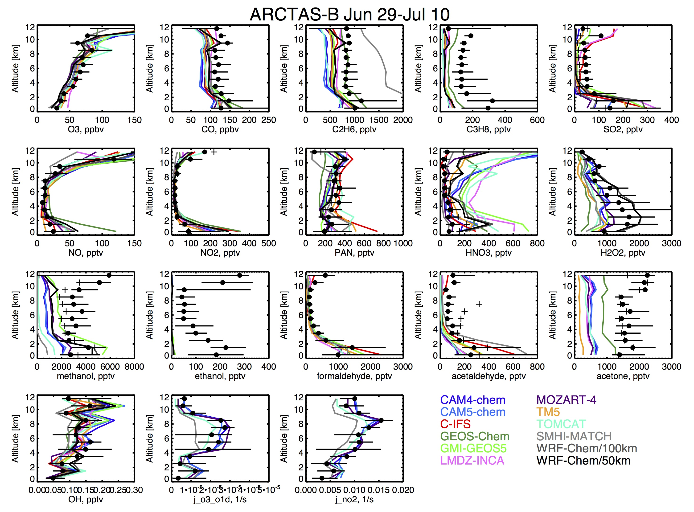
NOy partitioning
ARCTAS-A Apr 4-9
High HNO3 may be due to too little removal (washout, ice uptake, etc.)
But low PAN and high HNO3 may imply incorrect partitioning
ARCTAS-B Jun 29-Jul 10
During summer, with more active chemistry, models reproduce PAN better

Slide 18
Oxygenated VOCs
ARCTAS-A Apr 4-9
Important for OH reactivity, PAN formation and Ozone Production
ARCTAS-B Jun 29-Jul 10

Slide 19
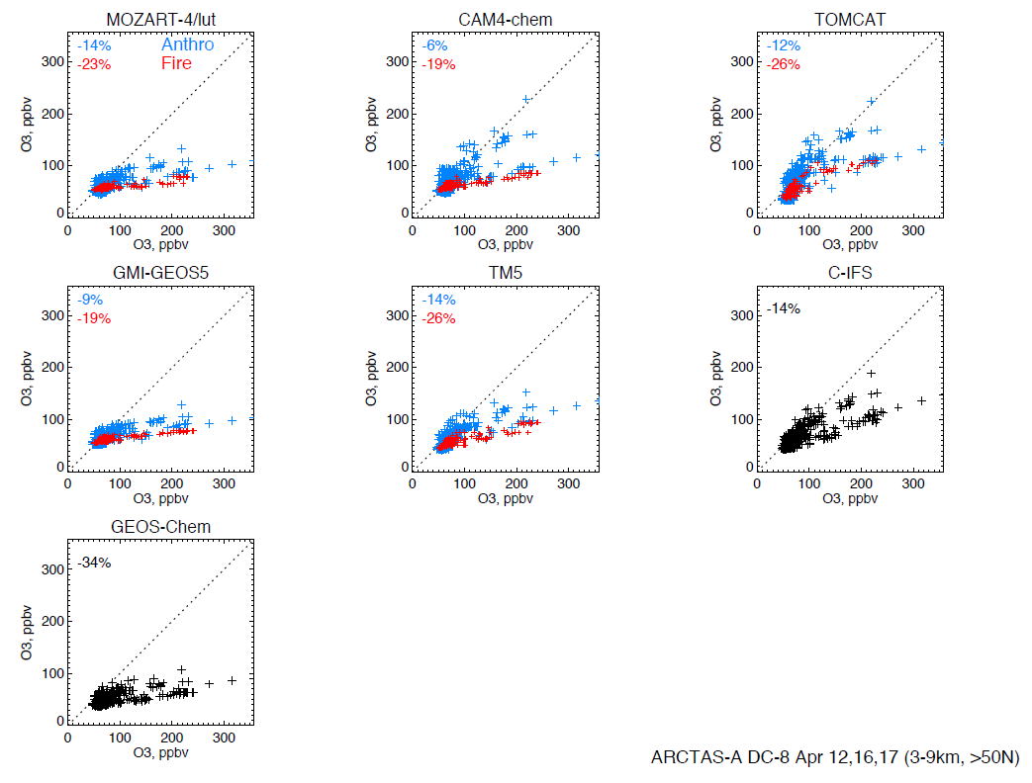
Model vs observed ozone for fire-dominated period
ARCTAS DC-8 observations over Alaska April 2008
Model O₃
Obs O₃
25-d lifetime model source tracers allow us to separately evaluate models in air most influenced by fires.

Slide 20
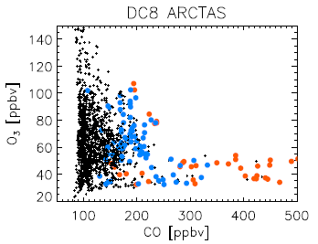
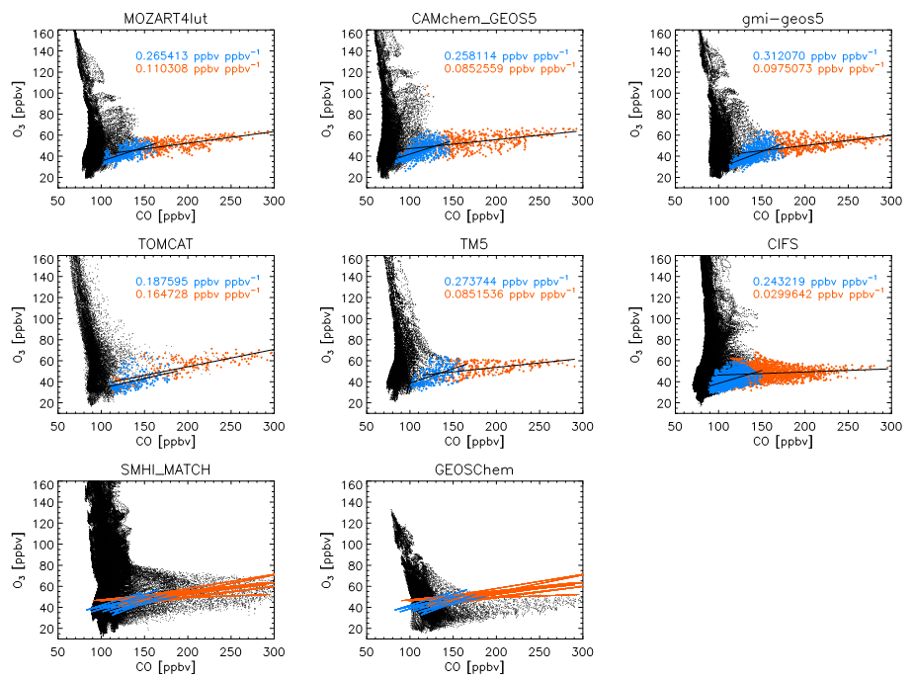
Model ΔO₃ / ΔCO relationships (July)
Summer
Lat > 50N
25-d lifetime model source tracers allow us to separately evaluate models in air most influenced by fires.
0.107 ppbv/ppbv
Models show positive ΔO₃ / ΔCO slopes in fire-dominated air, increasing with age since emission.
Lines show slopes from other models with tracers
- All model points north of 66N
Coloured points show fresh and aged air where fire tracer > 70% total tracer
Arnold et al., ACPD

Slide 21
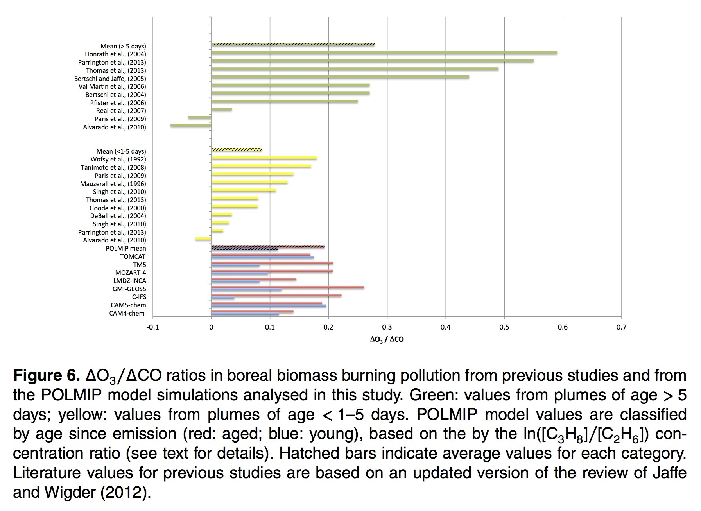
Aged plumes
Fresh plumes
POLMIP
aged
fresh
ΔO₃ / ΔCO
Arnold et al., ACPD

Slide 22
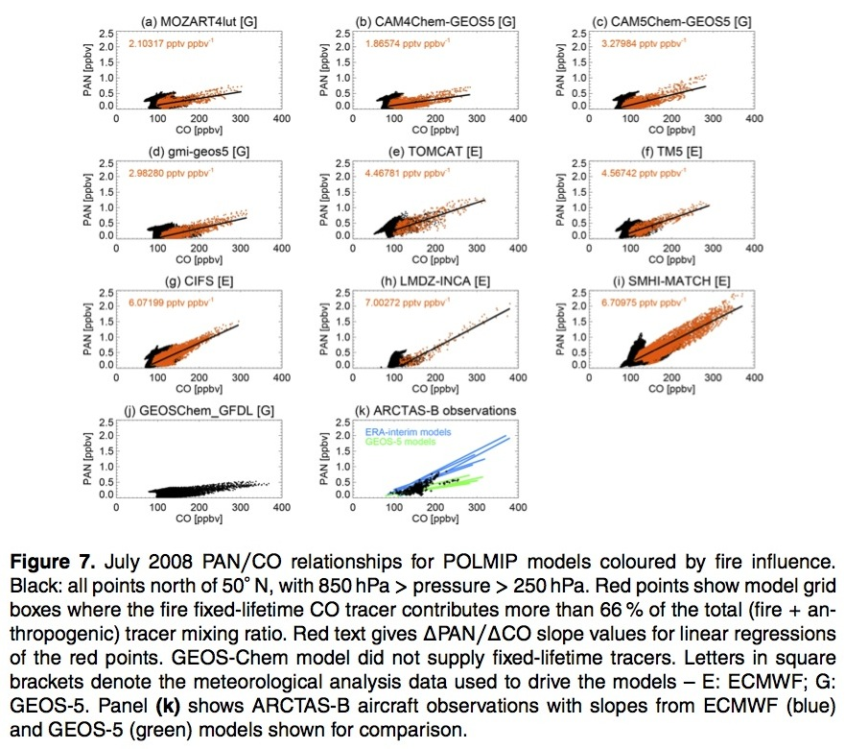
Arnold et al., ACPD

Slide 23
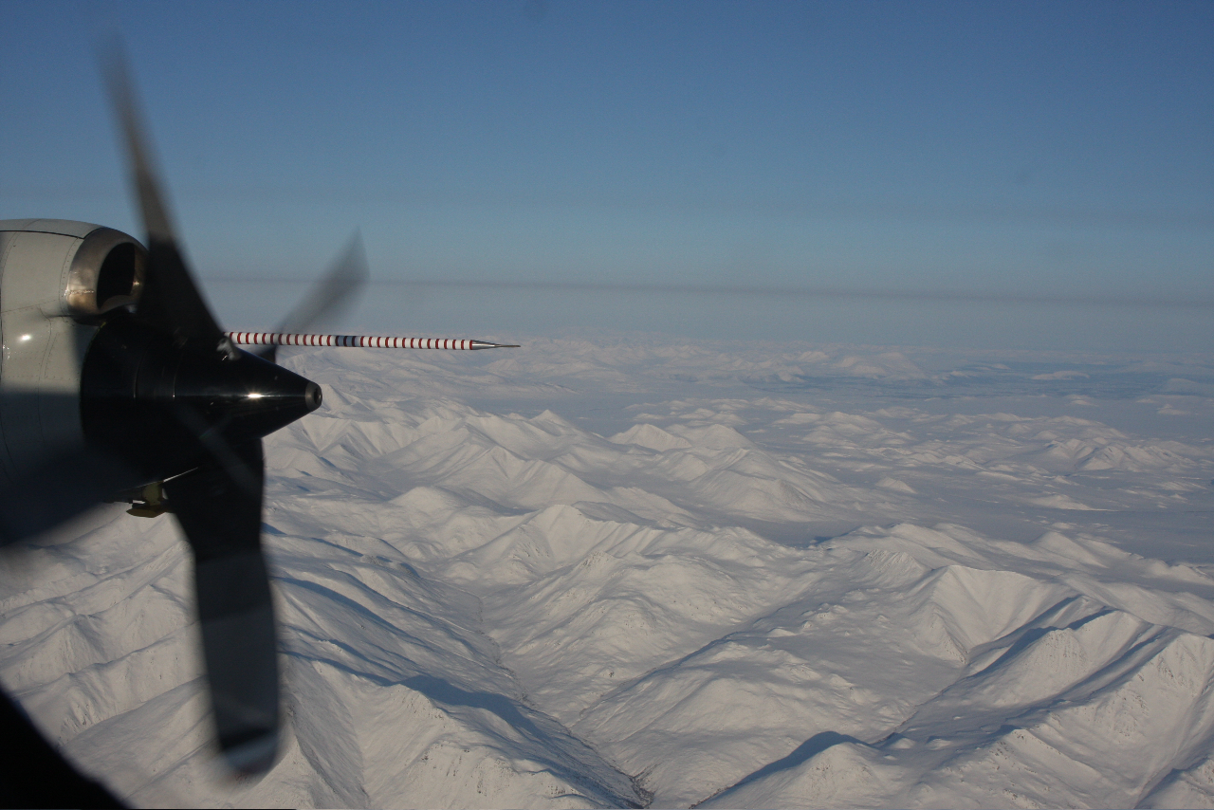
Aerosol layers over the Brooks Range; April 18th, 2008
from NOAA P-3
D. Lack, NOAA and CIRES, Univ. of Colorado

Slide 24
ARCPAC – NOAA P3 - Vertical profile measured at 73ºN on 2008/04/18
CO layers show biomass burning plumes
sulfate present throughout column
layers dominated by organic
<5% soot
acetonitrile layers show biomass burning plumes
extinction and absorption enhanced in layers
Middlebrook, Bahreini, Holloway, Schwarz, Spackman, Gao
de Gouw, Warneke, Lack

Slide 25
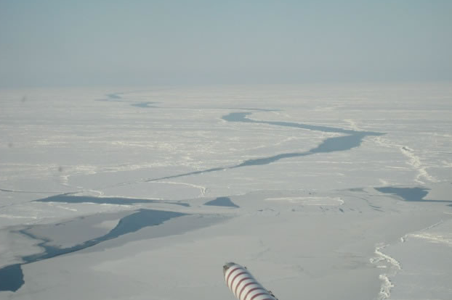
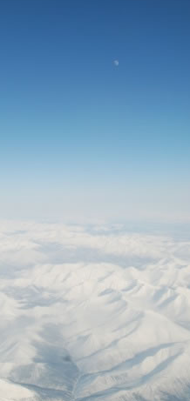
Airmass classification
Single scatter albedo
Acetonitrile
Arctic sea-ice boundary layer (ABL)
Hygroscopic parameter
CO
Polluted background
Anthropogenic (fossil fuel) and biomass burning layers
Aerosol mass
Organic fraction
Classification uses CO, acetonitrile, SO₂, and Br₂
McComiskey

Slide 26
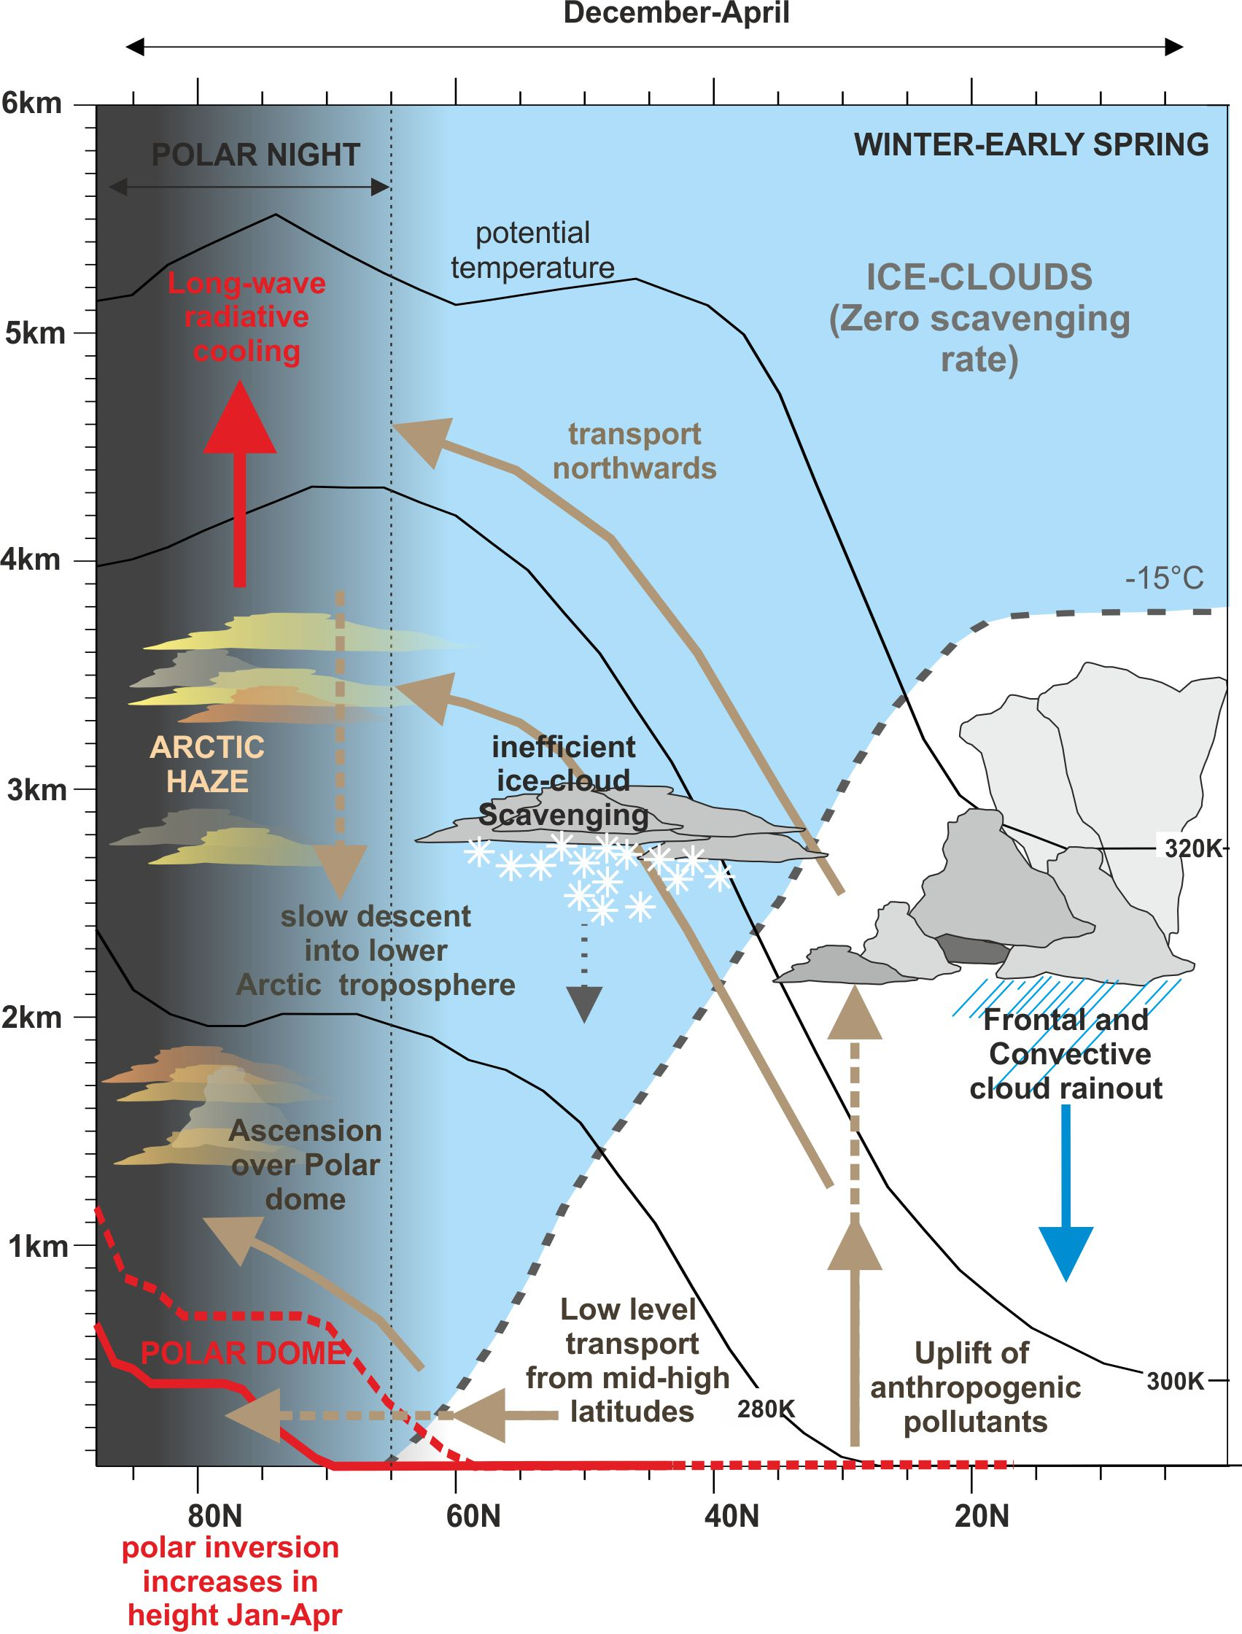
Why did these four aerosol classifications exist?
ABL: Long residence time circulating at low altitude over the Arctic Ocean interacting with surface
Background: Pollutants emitted directly into the "polar dome"; long residence time
BB and Anthropogenic layers: emissions from lower latitudes transported with good efficiency (minimal scavenging)
Browse et al., ACP, 2012

Slide 27
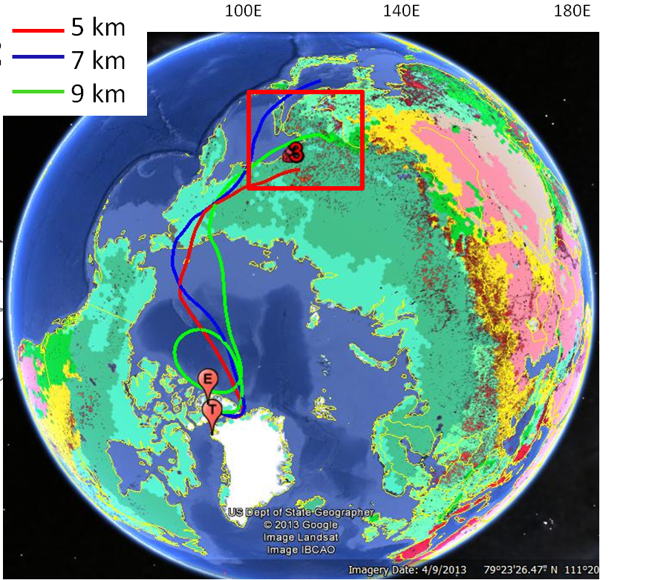
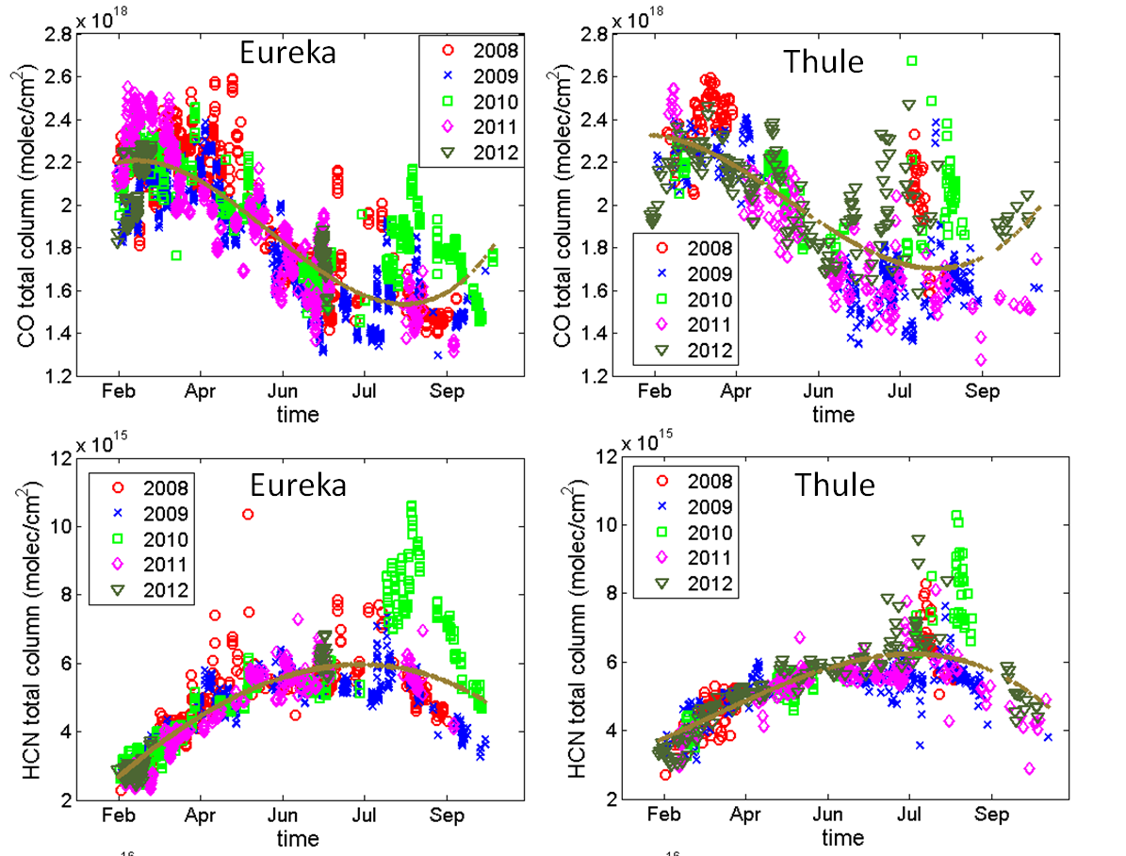
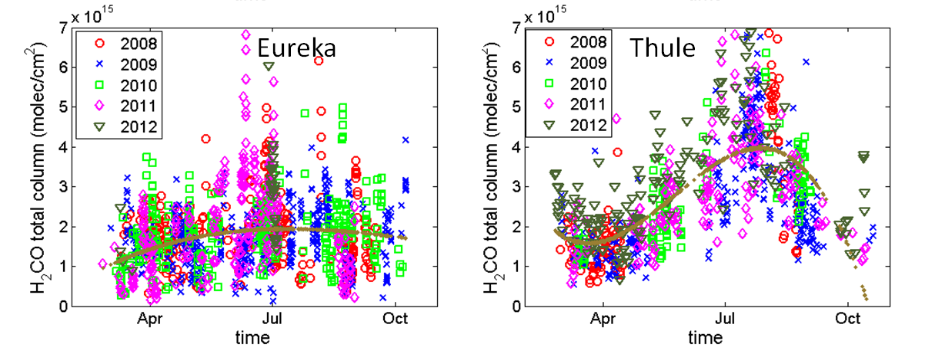
Analysis of fire plumes sampled by FTIR at Eureka and Thule
CO
July 10, 2008
HCN
Eureka
Thule
4-6 days transport from Siberian fires
CH₂O
FTIR measurements of numerous compounds simultaneously are valuable for source characterization
C. Viatte et al., ACPD, 2014

Slide 28
Long Range Transport Issues
Identification of measurements will lead to model improvement in transport and chemistry
Emissions (past, present and future)
  Asian anthropogenic
  Biomass burning
  Biogenic
Transport patterns in a future climate
  More convection?
Evaluation of model chemistry
  Ozone production
  Aerosol formation and scavenging
Impact of increased pollution on surface
  BC on ice
  Ozone damage to vegetation

