Slide 1
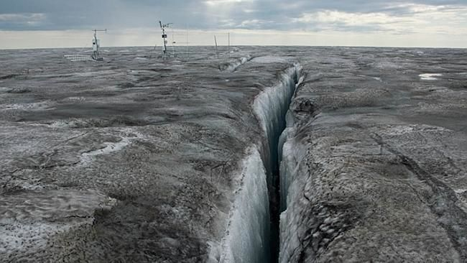
Arctic Aerosol Scavenging and Deposition
Jo Browse (University of Leeds)
Ken Carslaw, Graham Mann, Lindsay Lee, Leighton Regayre (university of Leeds)
Paul Field, Ben Boothe (UK met office)
IASC/IGAC Arctic air pollution workshop
Boulder 04/02/2015
Photo: South Greenland ice-sheet August 2014 (courtesy of Jason Box, the Dark snow project)

Slide 2
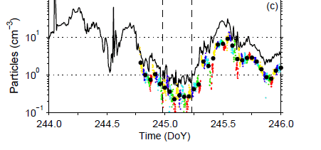
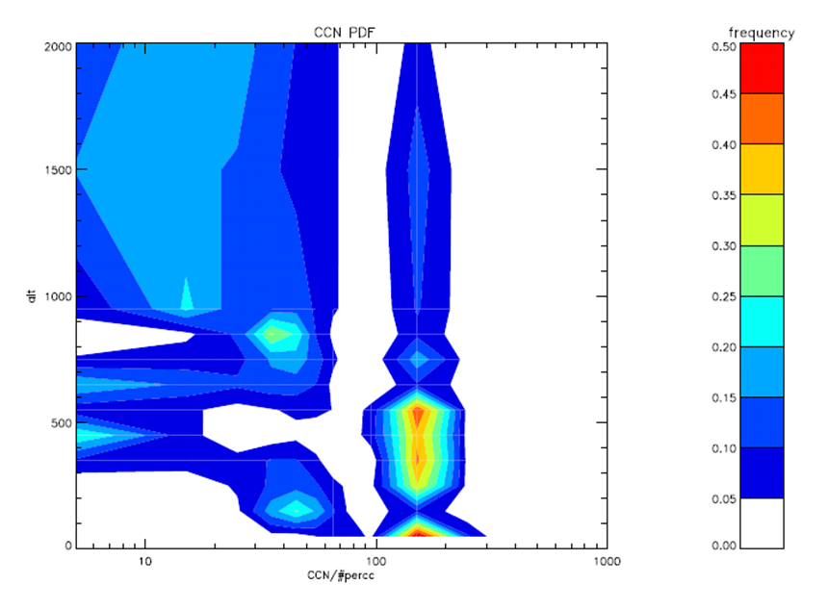
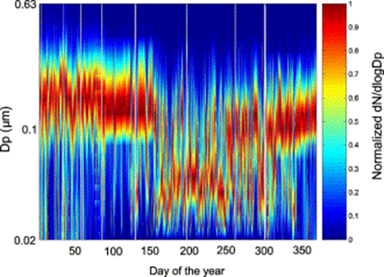

Arctic aerosol - seasonal extremes
1) Summertime low CCN regime
2) Arctic haze (mass, composition, size)
Accumulation mode particle concentration
During ASCOS campaign 2008, Birch et al., (2012)
3) Seasonal cycle (springtime transition)
CCN concentration PDF
(0-2km) 76N -ACCACIA 20/03/13
campaign
Arctic haze event (76N) 20/03/13
Observed size distribution
– Zeppelin Mountain, Svalbard,78N Strom et al., (2007)

Slide 3
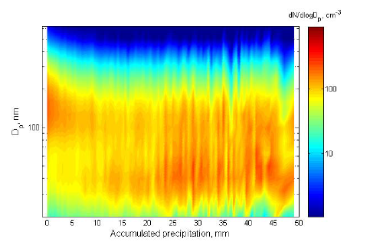
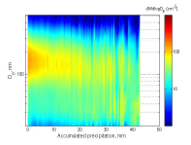
Spring to summer transition controlled by onset of local wet scavenging
seasonal cycle with springtime characterized by anthropogenic haze and summertime by ‘clean’ atmosphere
‘Clean’ summer linked to onset of liquid cloud scavenging in the marginal ice zone (Garrett et al., 2008: Tunved et al., 2013)
Mar-Sep
Zeppelin size distribution compared to accumulated precipitation encountered by air parcel in last 10 –days (Tunved et al., 2013)
Oct-Feb

Slide 4
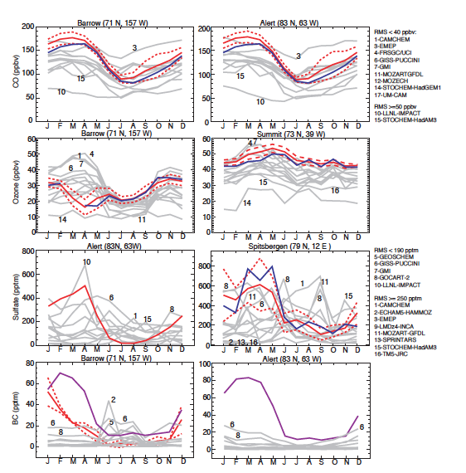
Scavenging and Arctic haze
Observational evidence suggests that transition in the spring is the result of local wet scavenging (drizzle)
Impact of global precipitation patterns on Arctic haze accumulation is more complex and must be decoupled from transport processes (Here we need global models)
However, majority of models diverge in the Arctic (compared to ozone or CO)
Multi-model Arctic aerosol evaluation (Shindell et al., 2008)

Slide 5
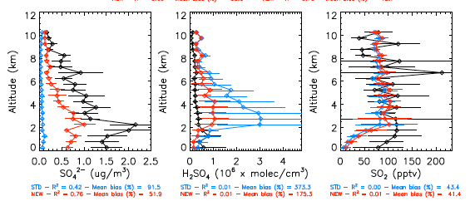
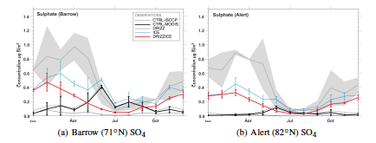
Aerosol Scavenging and the Arctic haze: The importance of ice processes
Decreasing (or suppressing) in-cloud scavenging in ice-phase clouds improves model representation of Arctic aerosol
Mechanism is plausible, representing the lack of collision and coalescence processes in ice-phase clouds
However, simulation of cloud phase in global models is heavily parameterized (generally using a temperature proxy)
Bourgeois & Bey (2011) response of Arctic sulphate concentrations to decreases in prescribed scavenging coefficients in ice-phase clouds
Browse et al., (2012) response of modelled sulphate concentrations at Barrow and Alert to suppression of ice-phase cloud scavenging

Slide 6
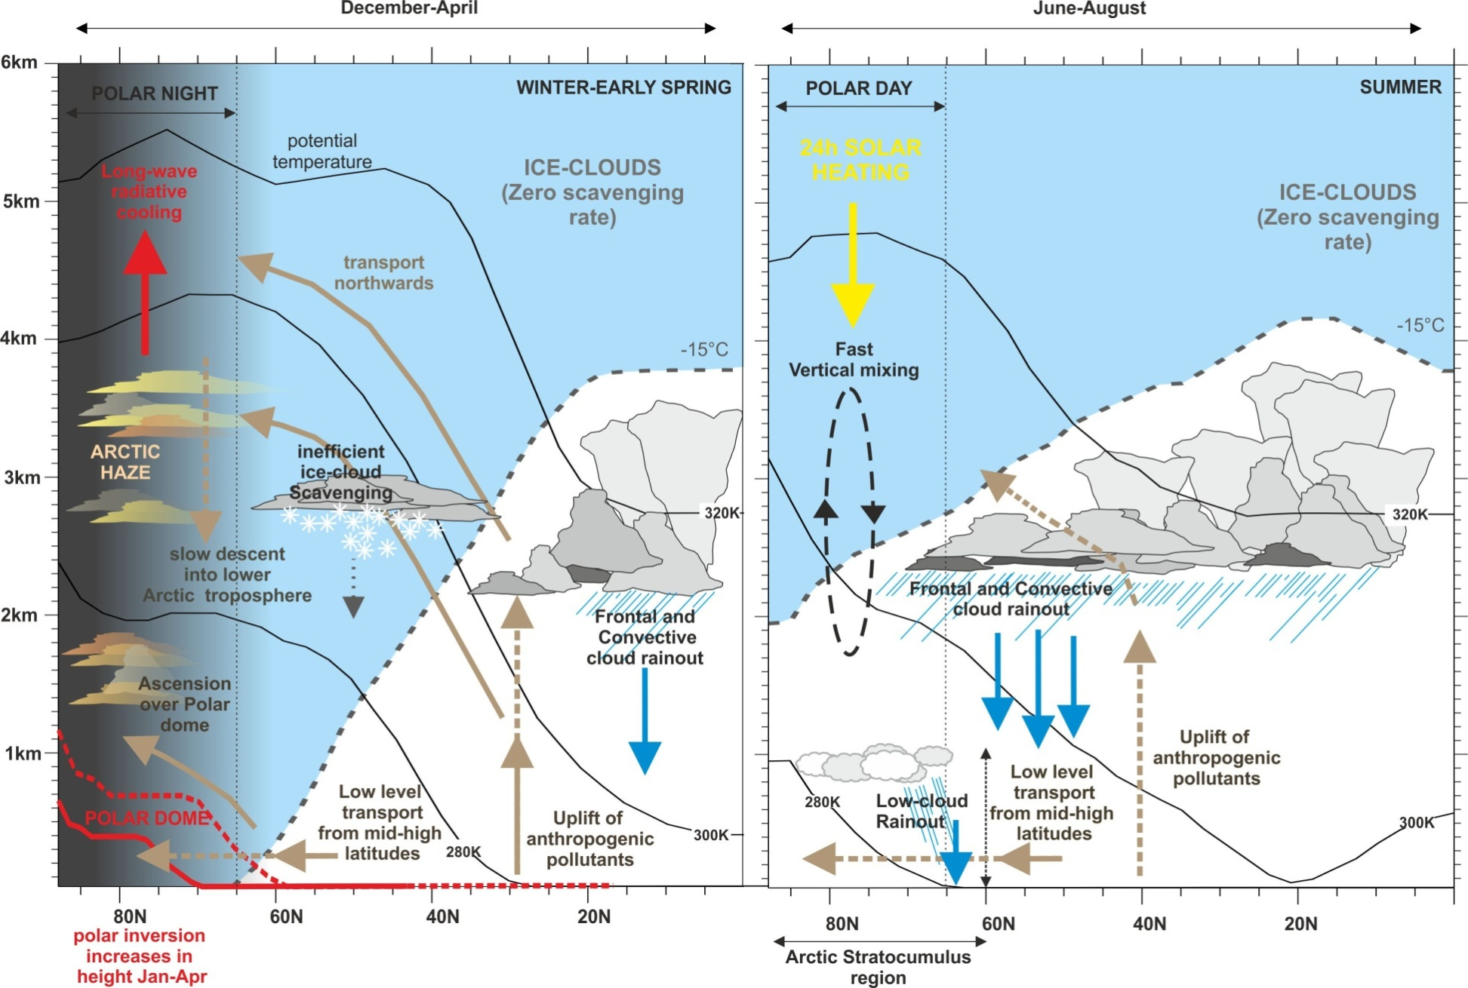
Arctic Aerosol Scavenging; present day understanding
Browse et al., (2012)

Slide 7
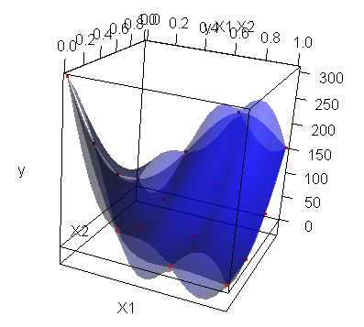
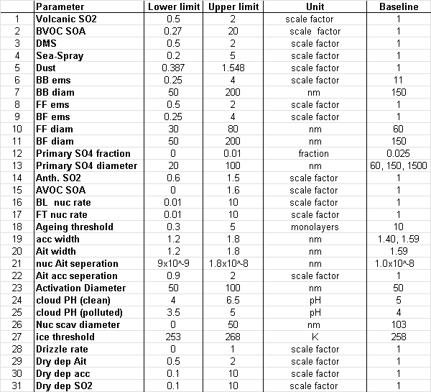
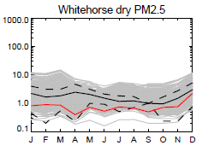
Improving on one at a time sensitivity studies
Emulation and the uncertainty ensemble
3D representation of Latin hyper-cube
sampling. Red dots indicate sampled
runs within the parametric uncertainty
observations
Model
Ensemble
Table: 31 parameters perturbed using Latin hyper-cube
sampling to yield 280 runs spanning the parametric range.
Experiment perturbs emissions and processes over
elicited ranges.
The 280 runs sampled do not represent
the entire uncertainty space.
Baseline run
PM2.5 mass from the model ensemble (grey) compared to observations at Whitehorse (US)

Slide 8
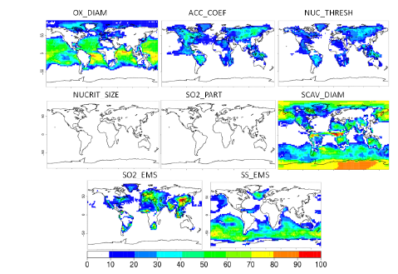
The role of scavenging parameters in modelled Arctic aerosol uncertainty
Scavenging diameter controls aerosol lifetime (greater SCAV_DIAM = longer lifetime)
Lee et al., (2012): % of uncertainty attributed to parametric uncertainty based o emulation techniques

Slide 9
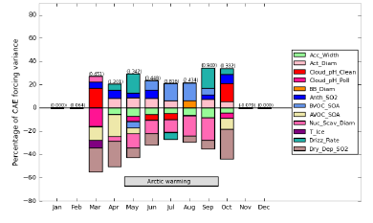
The role of scavenging parameters in modelled Arctic aerosol uncertainty
T-Ice = temperature clouds deemed ice-phase
Drizzle_rate=stratocumulus cloud scavenging rate
Nuc_scav_Diam = size threshold for in-cloud aerosol scavenging
Regarye. et al, (2014): % of uncertainty in indirect forcing attributed to parametric uncertainty in the Arctic

Slide 10
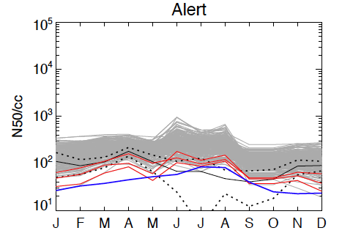
The right answer for the wrong reasons
Emission scaling
FF
BB
DMS
N50 concentrations at Alert
Dry Deposition
Emission and scavenging processes in three ‘best’ Arctic models
Drizzle
rate
Scavenging dry diameter

Slide 11
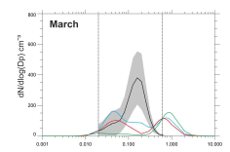
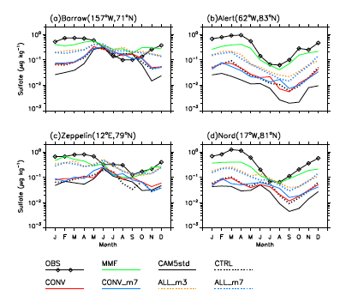
Do we need to parameterize scavenging should we include explicit cloud microphysics
UKCA-v8.4 ENDGAME
UKCA-v8.4 old dynamics
observations
Modelled size distribution in climate model with prognostic rain, and aerosol-cloud coupling
Wang et al., (2013) response of modelled Arcic sulphate to coupling of cloud microphysics model

Slide 12
Summary:
Local wet scavenging processes control the Arctic aerosol seasonal cycle and the transition from Arctic haze in the spring to the ‘clean’ summertime atmosphere
The scavenging efficiency and impact on high-latitude aerosol is dependent on cloud-phase
Likewise, Arctic haze concentrations are better represented in models which differentiate between ice-phase and mix-phased scavenging globally.
However, ensemble runs of CTM models which span the parametric range suggest that multiple parametric setups can result in similar model output
Thus, ‘tuned‘ models (with for example reduced global scavenging) while sufficient to calculate direct impacts from model output are likely insufficient to provide robust predictions

Slide 13
Options:
Conduct ensemble experiments, uncertainty remains but is quantified
Accept that current scavenging parameters are failing in the Arctic and focus on including cloud microphysics schemes within global models
Develop process based observations which could constrain model parameterizations ( deposition, transport)

Slide 14
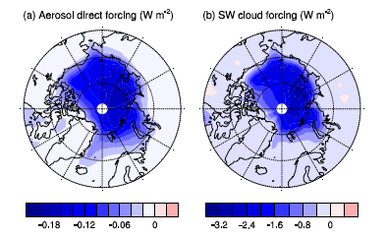
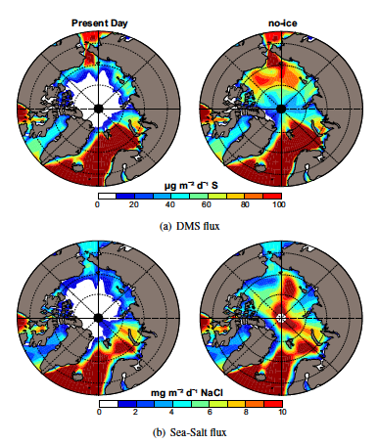
Arctic aerosol and sea-ice retreat
Direct and indirect forcing calculated from enhanced sea-salt emissions (Struthers et al.,2011)
Sea-ice retreat will change local natural aerosol emissions
Moderate direct forcing from sea-salt emissions (Struthers et al, 2011)
Indirect forcing significant (Struthers et al., 2011) However, forcing dependent on the response of Arctic clouds
Sea-salt and DMS flux increase in central Arctic after sea-ice loss (Browse et al., 2014)

Slide 15
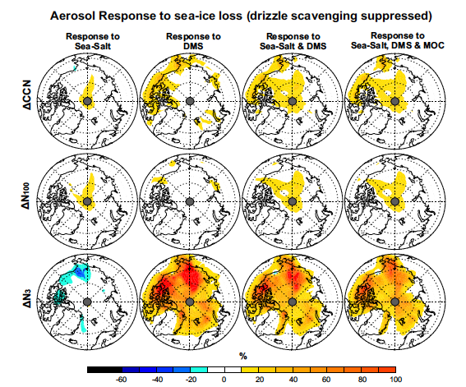
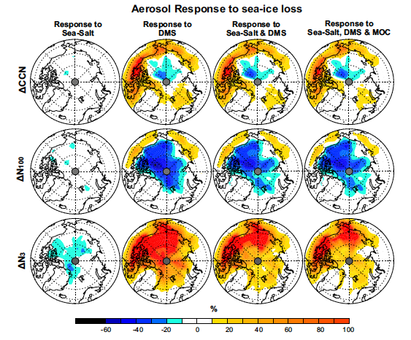
Arctic aerosol and sea-ice retreat (impact of scavenging)

Slide 16
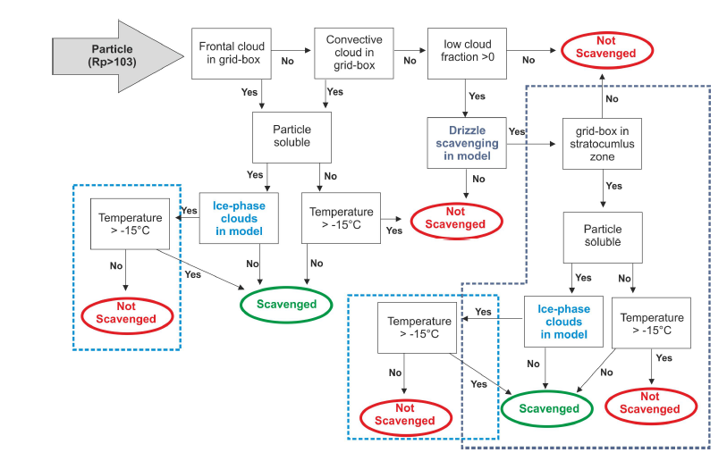
Aerosol Scavenging in global models
Typical aerosol scavenging parameterization in CTM

Slide 17
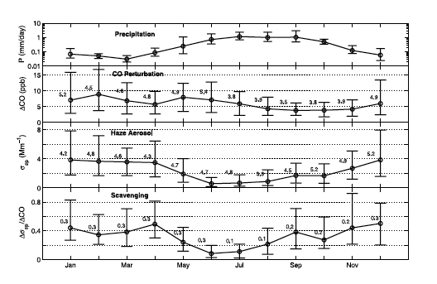
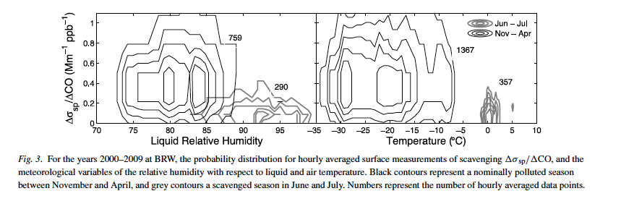
Scavenging controls the Spring-Summer aerosol transition
Garrett et al., (2008) linking ‘warm’ precipitation to low aerosol regimes
Change in precipitation (P), ΔCO (transport efficiency), aerosol (Δσ) and calculated scavenging efficiency S (Δσ/ΔCO) at Barrow (71°N)
PDF of derived S in Jun-Jul (grey) and Mar-Apr (black)

Slide 18
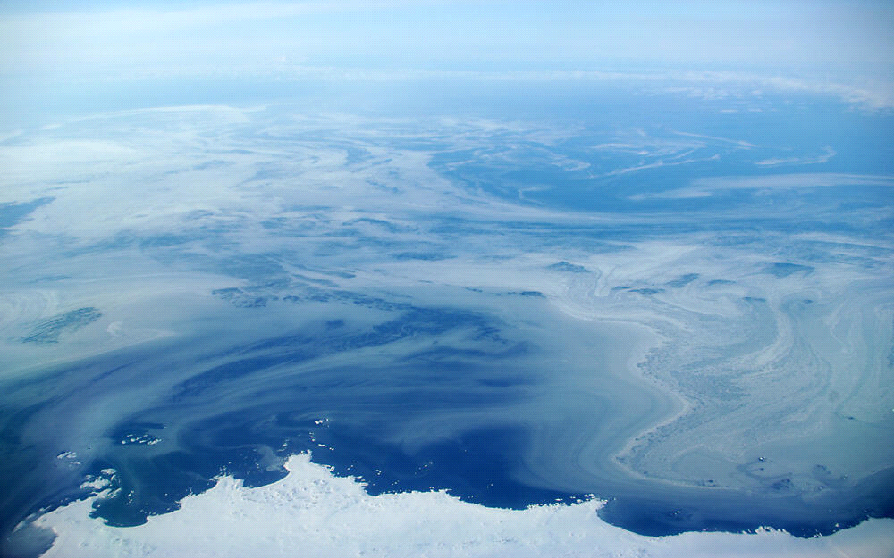
Size distribution at Arctic ground sites – Zeppelin (78N)
Spring
UKCA-v8.4 ENDGAME
UKCA-v8.4 old dynamics
observations
Summer
Missing sub-micron portion of the size distribution but runs do not include boundary layer nucleation

