Slide 1
Community observation opportunities
Maryann Fidel
Project Manager
Aleut International Association

Slide 2
Arctic Council Task force on short lived climate forcers
The most effective black carbon control strategies for Arctic climate benefits will vary by location and season
Reductions of Black Carbon will have both climatic and health benefits, it is a ‘no regrets’ measure
Short-lived climate forcers such as black carbon offer unique opportunities to slow Arctic warming in the near term.
Anthropogenic emissions of black carbon and methane in Arctic nations are significant for the Arctic climate relative to global emissions

Slide 3
Community BASED BLACK CARBON AND PUBLIC HEALTH ASSESSMENT PROJECT Goals:
Develop a pilot project in Arctic communities for reduction of black carbon emissions, mitigation of its health effects, raising community awareness and building local capacities
Assess local sources of black carbon emissions in partnership with a representative sampling of Alaskan, Russian, and Saami villages
Provide characterization of associated risks to public health
Black carbon emissions, mitigation, public health and institutional capacity information for communities.
An informational tool that communities will be able to use to assess black carbon exposures, risks and mitigation options.

Slide 4
The Bering Sea Sub-Network (BSSN) & Community based observation network for adaptation and security (CONAS)

Slide 5
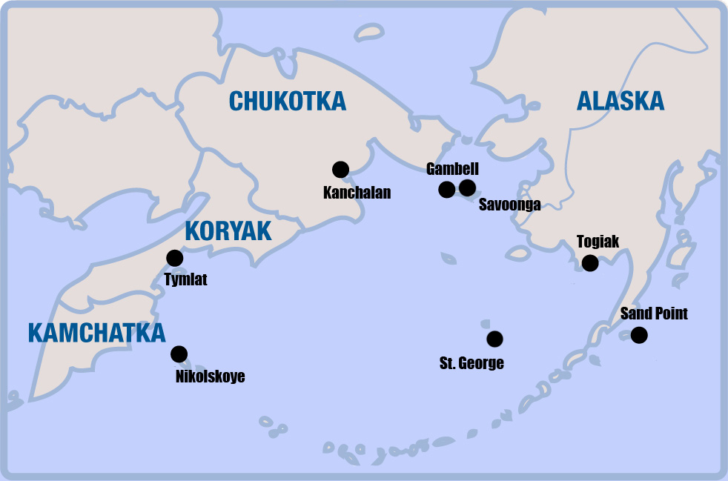
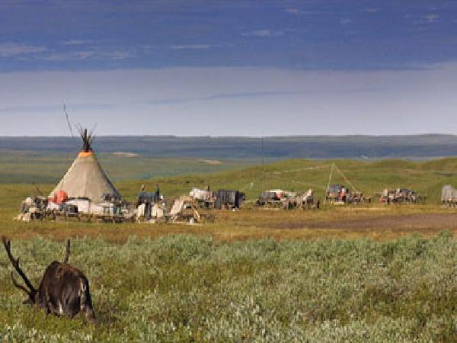
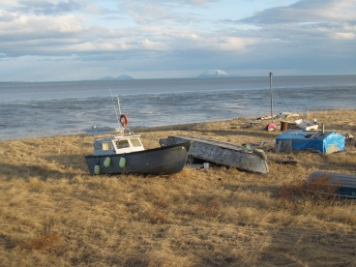
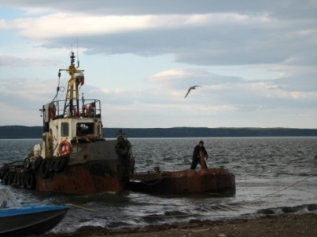
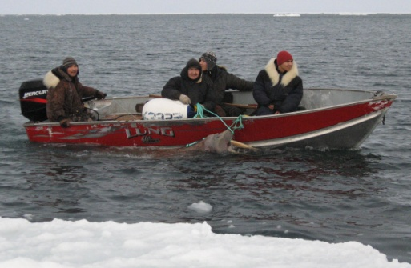
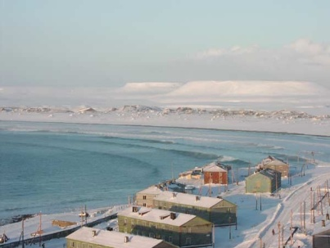
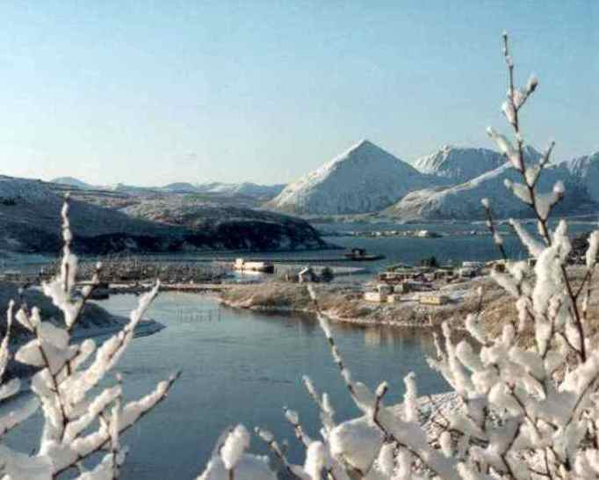
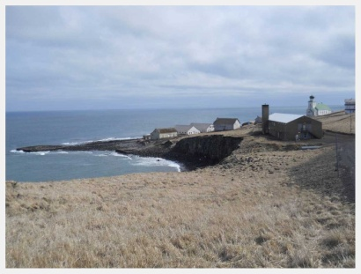

Slide 6
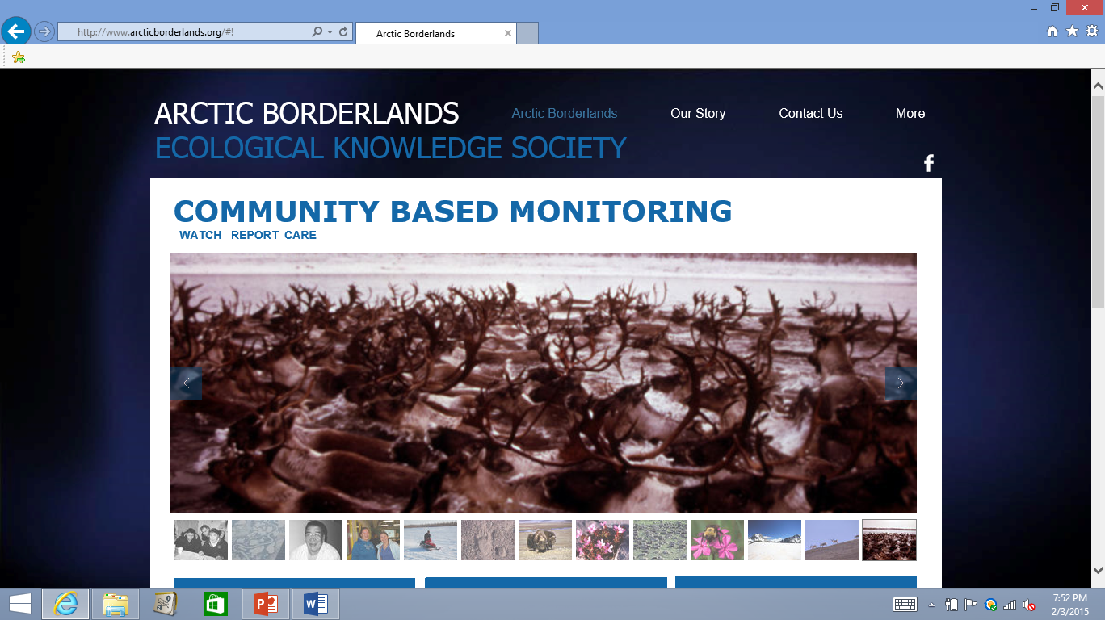

Slide 8
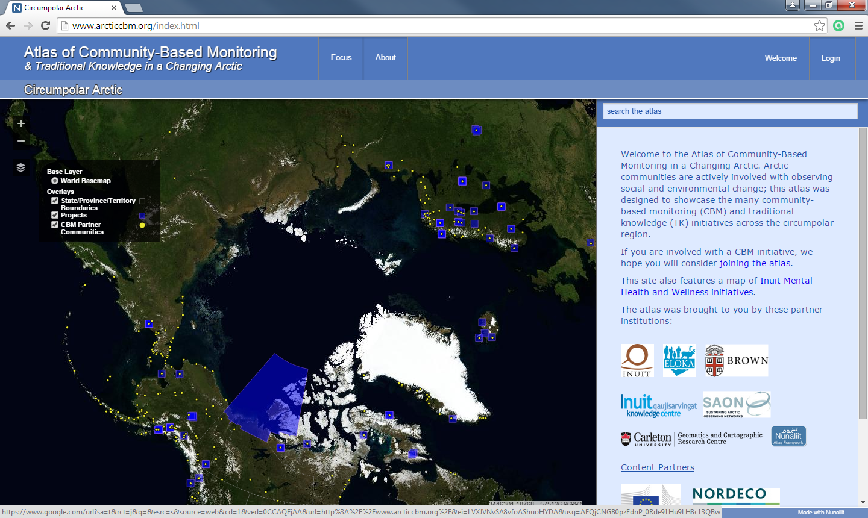
http://www.arcticcbm.org

Slide 9
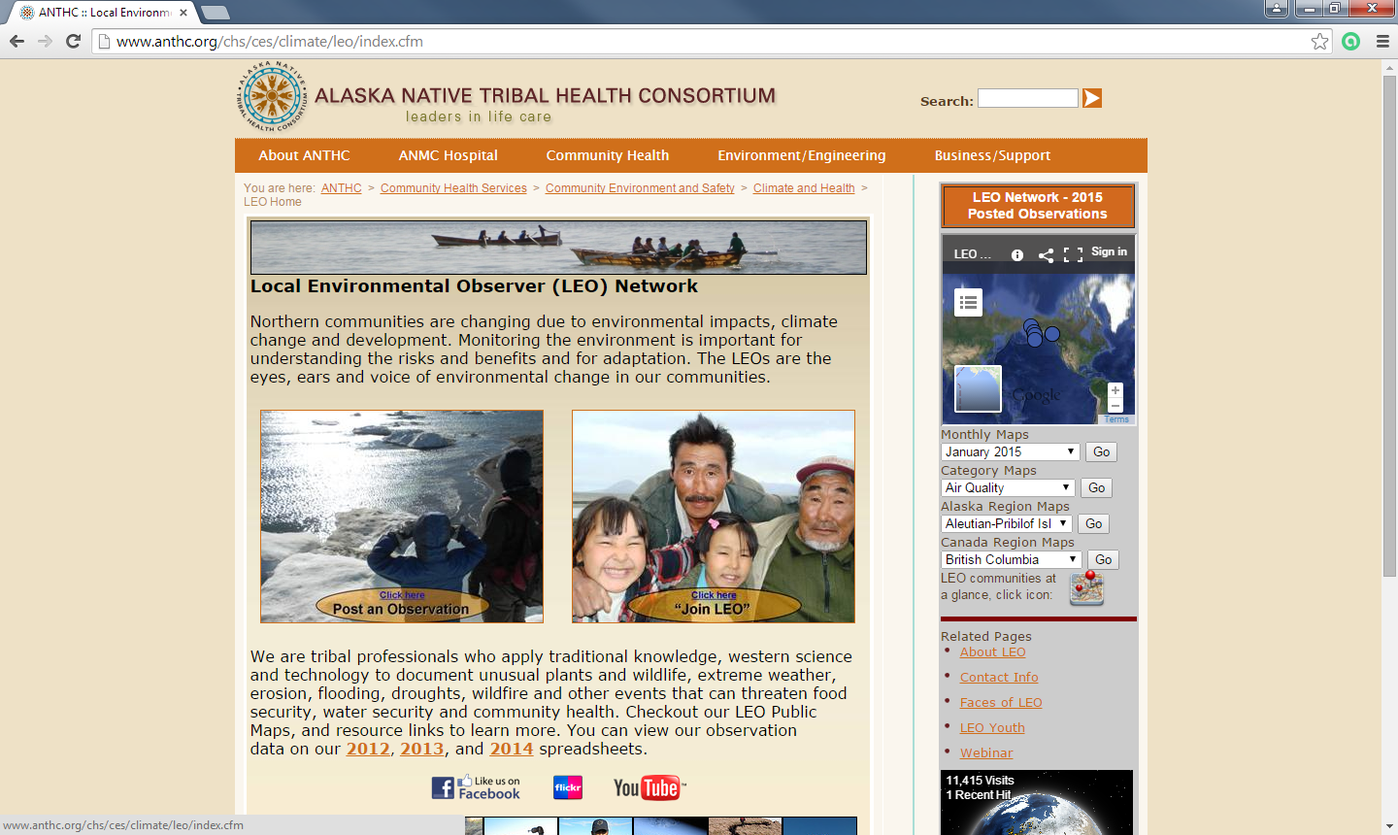
http://www.anthc.org/chs/ces/climate/leo/index.cfm

Slide 10
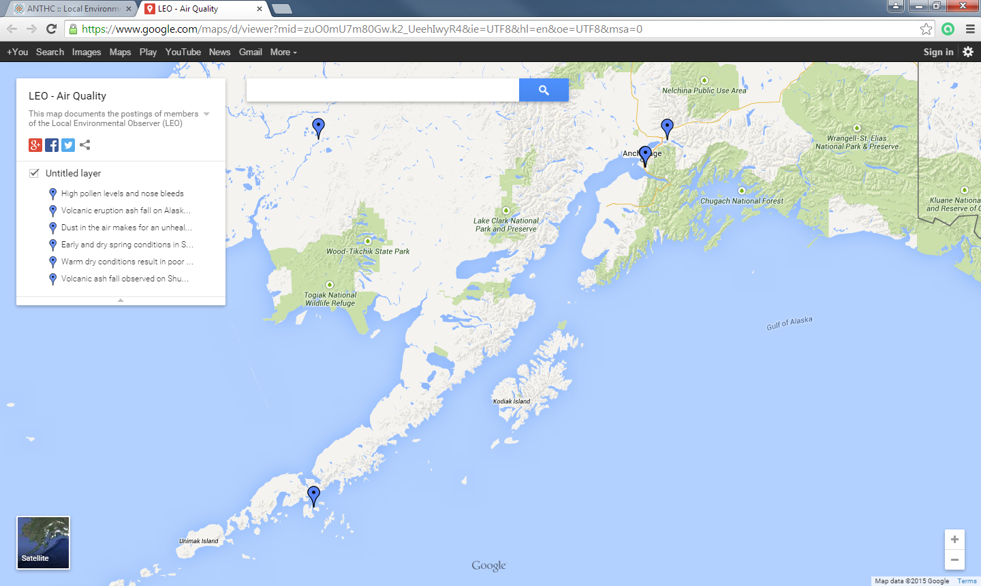

Slide 11
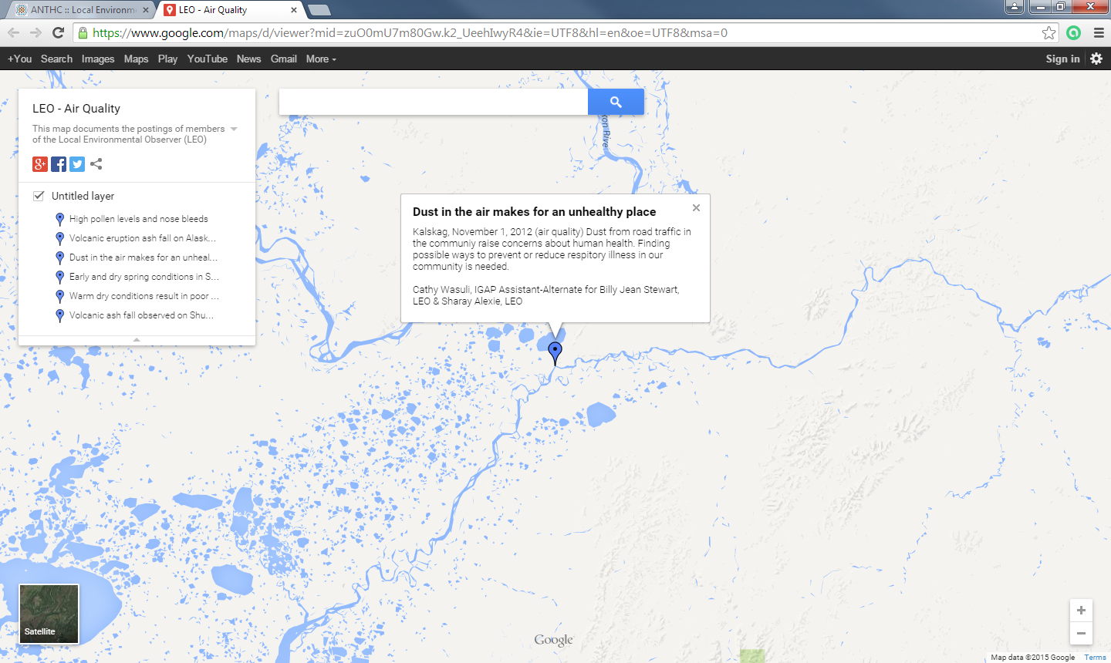

Slide 12
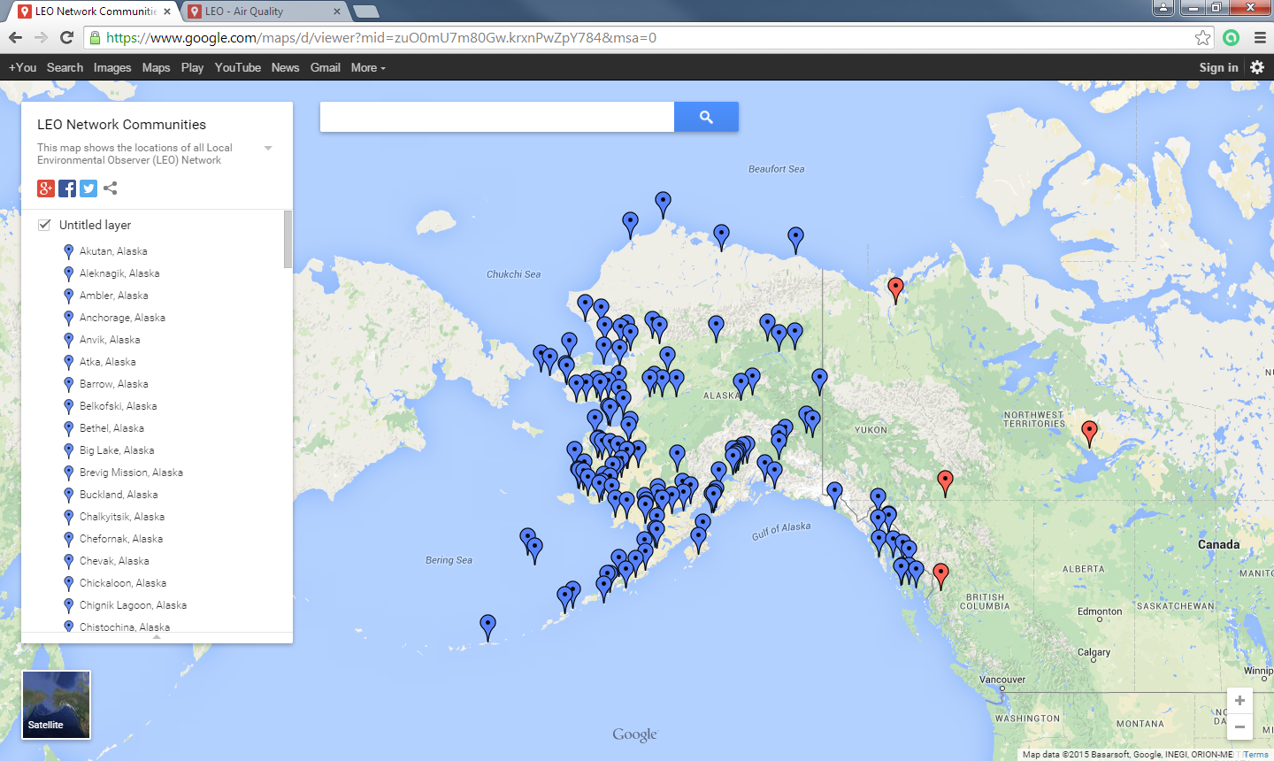

Slide 13
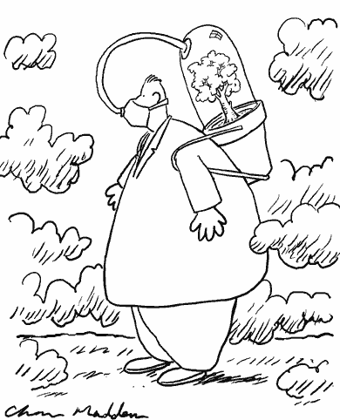
Take Home Messages
Partnerships with Arctic communities important to work toward sustainable future
Northern communities want to contribute to solutions and be involved in research (especially when the research will affect them)
Possibilities for working with rural Arctic communities in research are expanding due in part to advances in communication technology

Slide 14
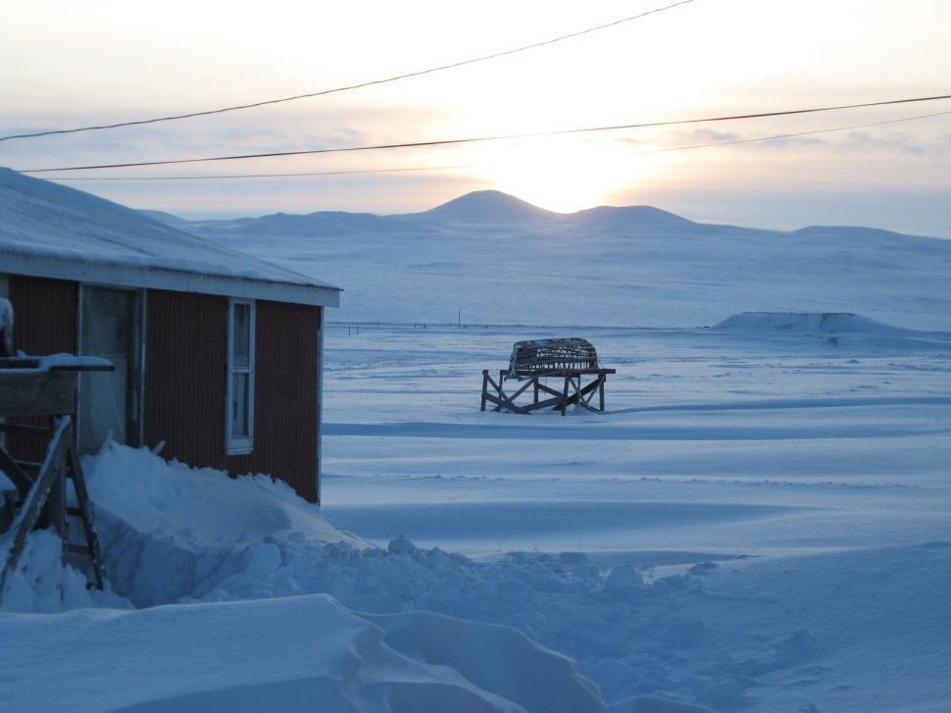
Thank you, Questions?
maryann_aia@alaska.net
Aleut-international.org
www.bssn.net

