Slide 1


Role for Observational Networks
Sandy Starkweather, T. Uttal, J. Drummon, A. Makshtas, J. Hannigan, M. Shupe, K. Strong and IASOA Aerosol WG
IASC-IGAC Arctic Air Pollution Workshop
Boulder, CO 3-5 FEB, 2015

Slide 2
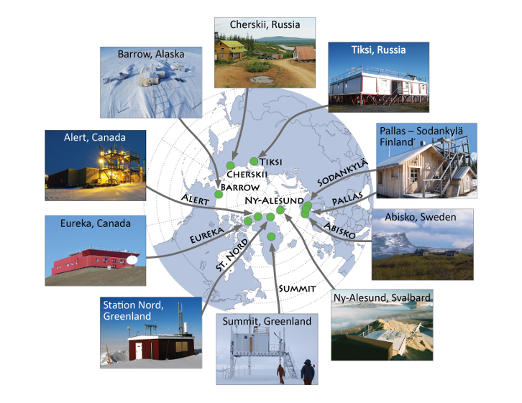
Major Long-Term Observatories –
Air pollution relevant since late 70’s
A Network of networks
LONG TERM TRENDS

Slide 3
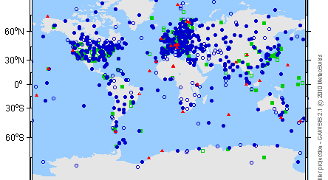
Example from GAW

Slide 4
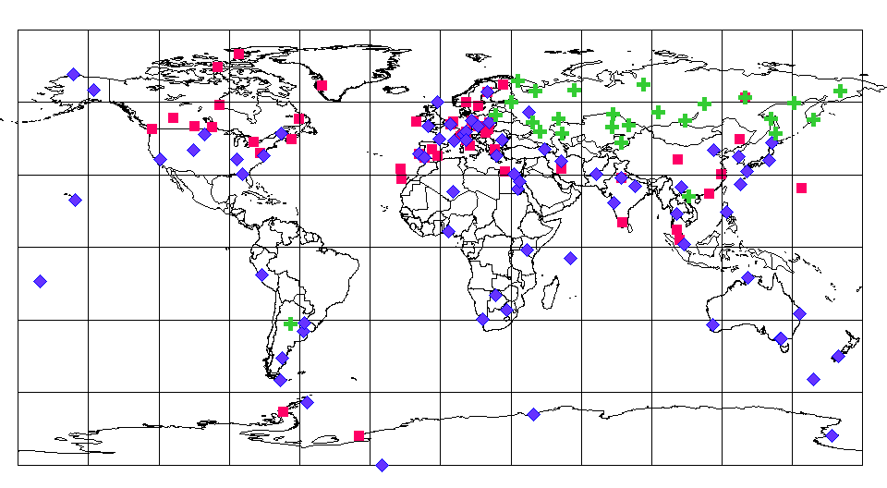
Example from WOUDC

Slide 5
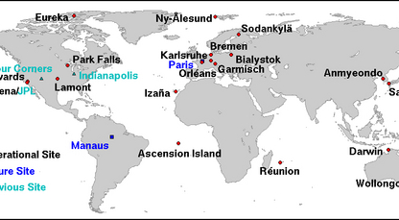
Example from TCCON

Slide 6
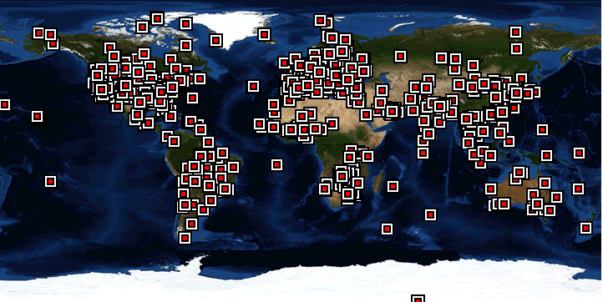
Example from AERONet

Slide 7
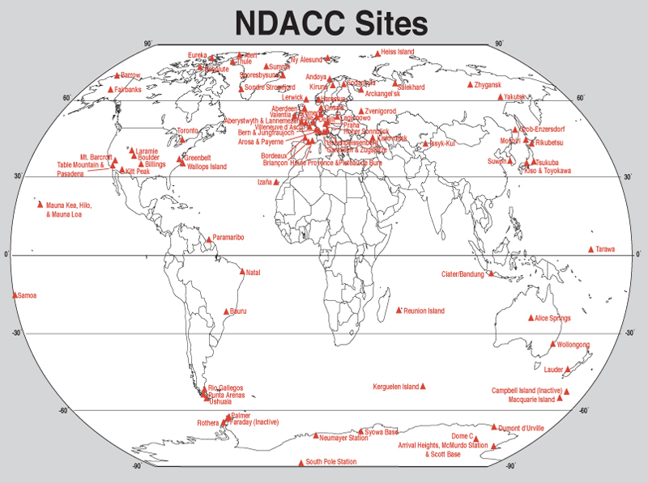
Example from Network for Detection of Atmospheric Composition Change

Slide 8
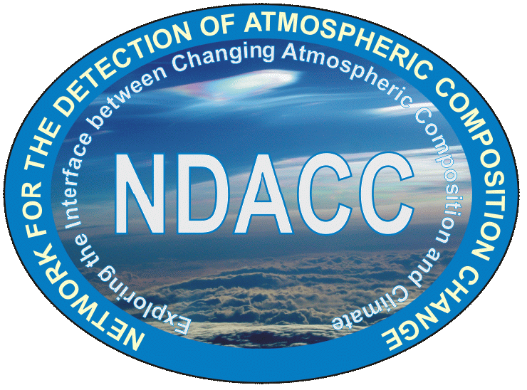



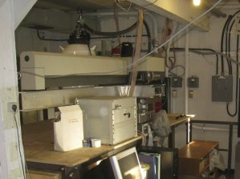
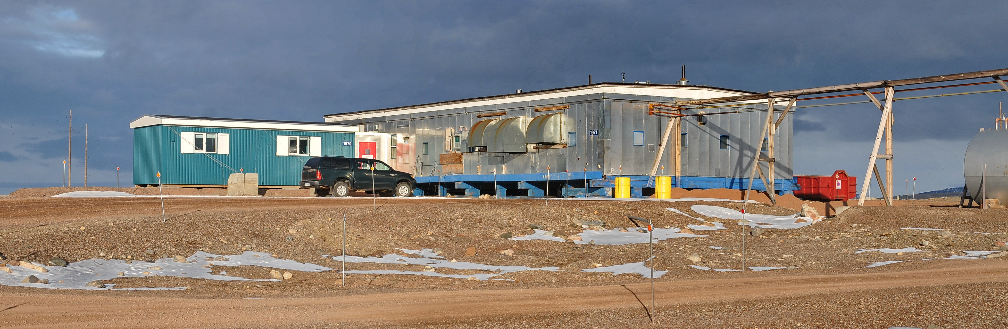
NCAR FTS Observation Program at Thule Greenland
Founding member of the NDACC (www.ndacc.org)
  NDACC is an organization of PI led observation programs
  Over 70 sites globally, 20 FTIR stations, 5 in the Arctic
  Data are archived and available at ndacc.org
This is a high spectral resolution, solar-viewing autonomously operational in mid-IR FTIR (2-15µm)
Off-base site is at 225masl (bldg 1971, South Mtn.)
Observations since Fall 1999
Retrieved profiles of O₃, HNO₃, HCl, HF, ClONO₂, NO₂, CH₄, CO₂, N₂O, CO, C₂H₆, C₂H₂, HCN + others.
New state of the art FTIR and solar tracking system will be installed spring 2015
There is space available for other research initiatives at this building
Contact James Hannigan, NCAR jamesw@ucar.edu

Slide 9
Surface Network Strengths
Maintaining consistent, quality-controlled and accessible data over LONG TERM
Serve as a single coordination point for cal-val community
Open data policies, usually supported by substantial cyberinfrastructure (e.g. WDC’s)
Some have cold regions working groups to address high latitude specific issues
Provide access to under-represented areas like Russia under umbrellas like WMO; through national monitoring agencies (mou’s, etc.)
Already MOBILIZED (e.g. Ozone hole)
IASC-IGAC Arctic Air Pollution Workshop
Boulder, CO 3-5 FEB, 2015

Slide 10
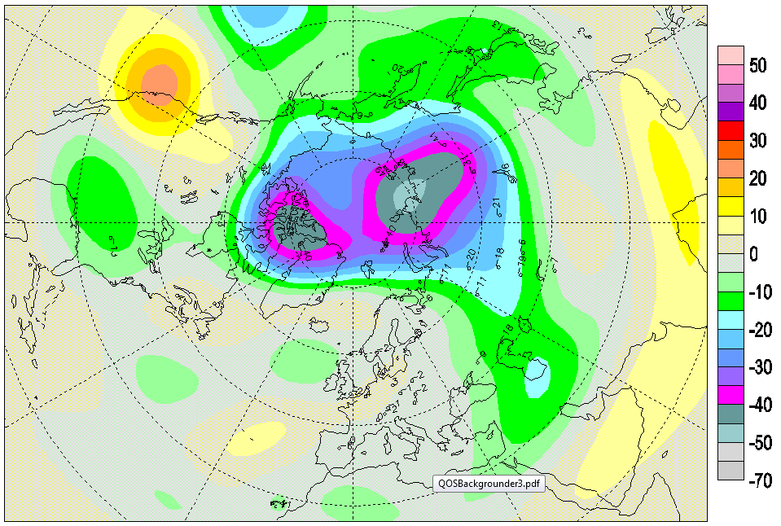
Ozone March 2011
PEARL

Slide 11
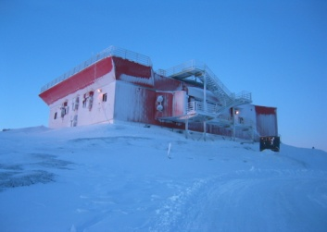
The Canadian Atmospheric Chemistry Experiment (ACE) Validation Project
K Walker
Ground-based measurements provide critical data for the validation of satellite retrievals of trace gases and for the assessment of long-term stability of these measurements
11 Canadian Arctic ACE Validation Campaigns have been held each spring (Feb-April) since 2004, with three more just funded
Take place at the Polar Environment Atmospheric Research Laboratory (PEARL) in Eureka, Nunavut (80N, 86W) and add campaign instruments to those already on site
Validating ongoing measurements by ACE-FTS and ACE-MAESTRO on ACE, OSIRIS on Odin, GOSAT, OCO-2
PEARL measurements by
  FTIR spectrometers: Total and partial columns of O₃, CH₄, H₂O, NO, NO₂, ClONO₂, HNO₃, N₂O, HCl, CCl₃F, CCl₂F₂, HF, CO
  UV-visible spectrometers: Total columns and (some) partial columns of O₃, NO₂, H₂O, OClO, BrO, SO₂
  Lidars: Profiles of O₃, H₂O, temperature, aerosols, clouds
  Ozonesondes and radiosondes: Profiles of O₃, H₂O and temperature

Slide 12
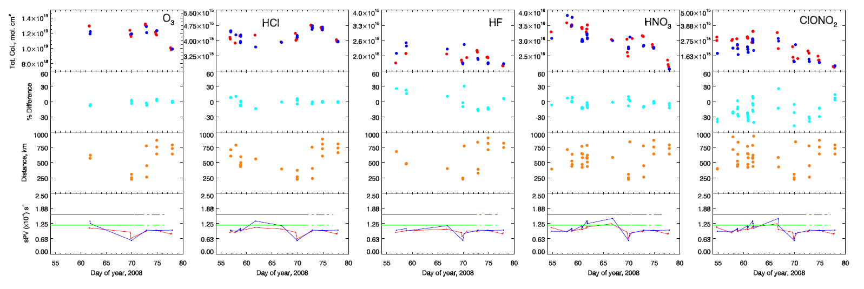
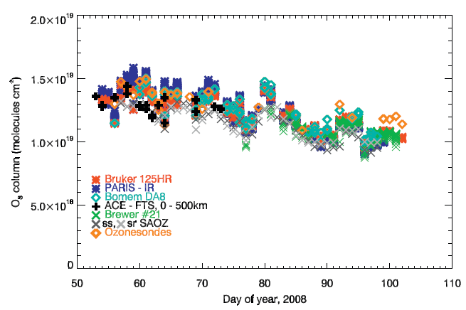

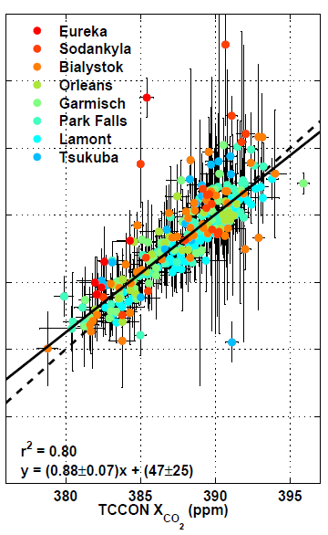
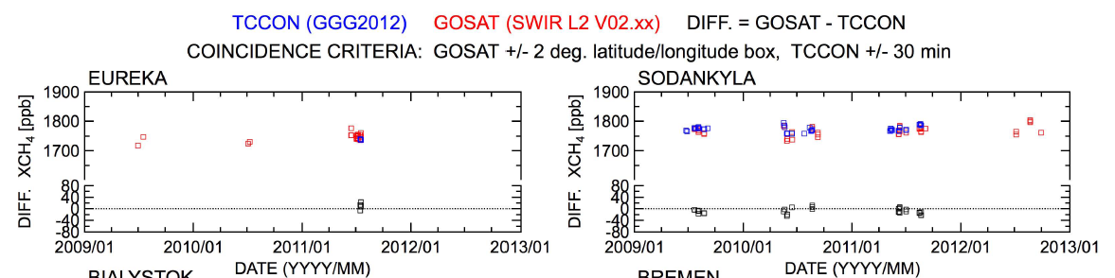
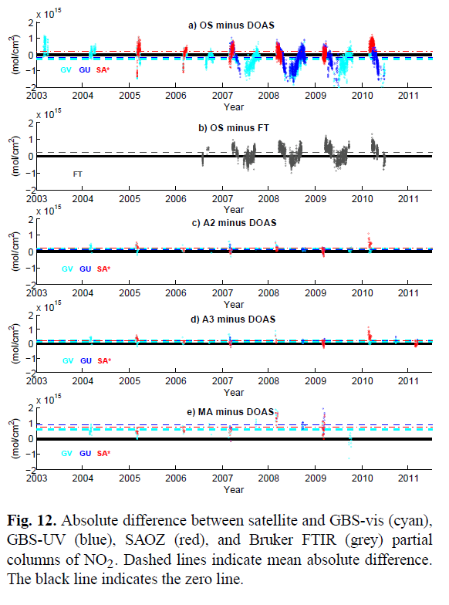
ACE-FTS O₃, HCl, HF, HNO₃, ClONO₂: Batchelor et al., AMT 2010
ACE-FTS O₃:
Lindenmaier et al.,
JQSRT 2010
GOSAT XCO₂: Wunch et al., AMT 2011
GOSAT XCH₄:
Yoshida et al., AMT 2013
OSIRIS NO₂: Adams et al., AMT 2012

Slide 13
Room for Improvements
Hard to integrate all offerings across sites
Network activities often stop short of full synthesis and assessment; still difficult for modelers to interpret
Networks often designed independent of modeling community needs
Surface site locations often dictated by logistics rather than science; calibration and correction schemes biased to mid-latitudes
TOO SPARSE IN THE ARCTIC, MOSTLY SAMPLING SURFACE
EXTREMELY EXPENSIVE
IASC-IGAC Arctic Air Pollution Workshop
Boulder, CO 3-5 FEB, 2015

Slide 14

IASOA Model

Slide 15
IASOA Model
Network of networks; brings data together through one portal (TAKE A LOOK)
Brings investigators together in working groups to “go the last mile” to develop higher-order data products of use to other communities
Serves as a unified collaboration point for Arctic cal-val needs and other collaborations
Multi-network perspective integrates across disciplines

Slide 16
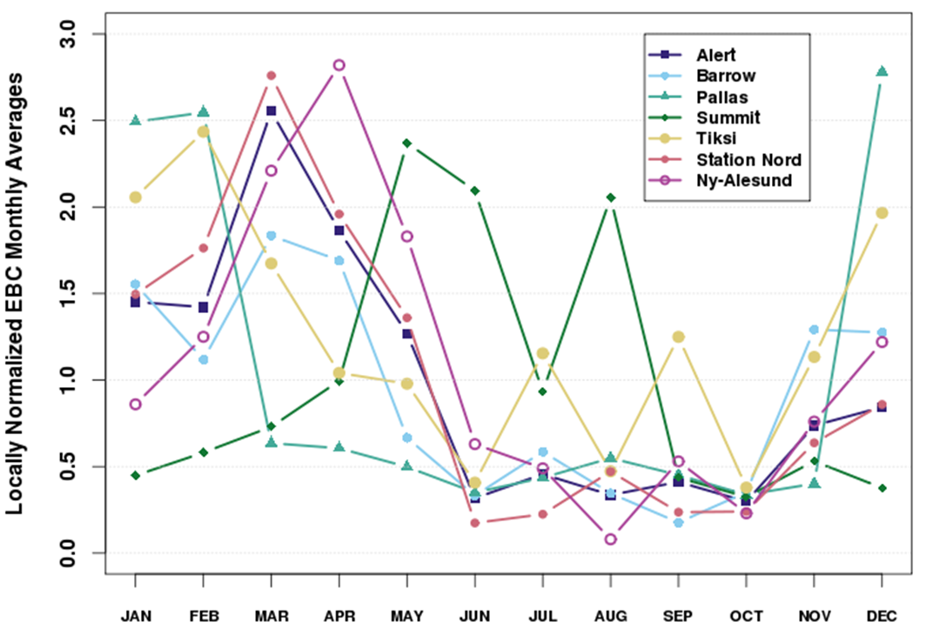
IASOA Aerosol WG – EBC Comparisons
Figure 1. EBC Monthly averages from the year 2012 normalized by the station’s local annual average of that same year, showing the annual variability in BC at 7 stations within the IASOA network.
UNPUBLISHED DRAFT INFORMATION

Slide 17
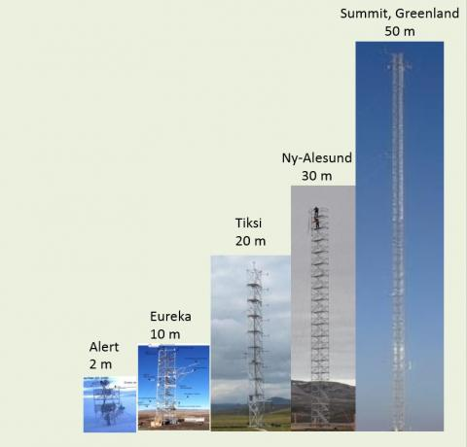
Flux Infrastructure
To what extent can IASOA Flux infrastructure be leveraged to improve understanding of dry deposition rates?

Slide 18
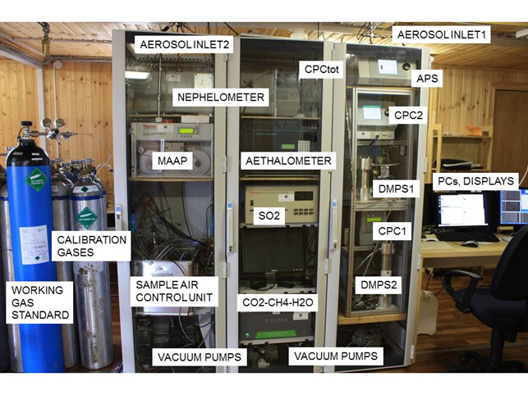
Current Russian Coverage, Tiksi

Slide 19
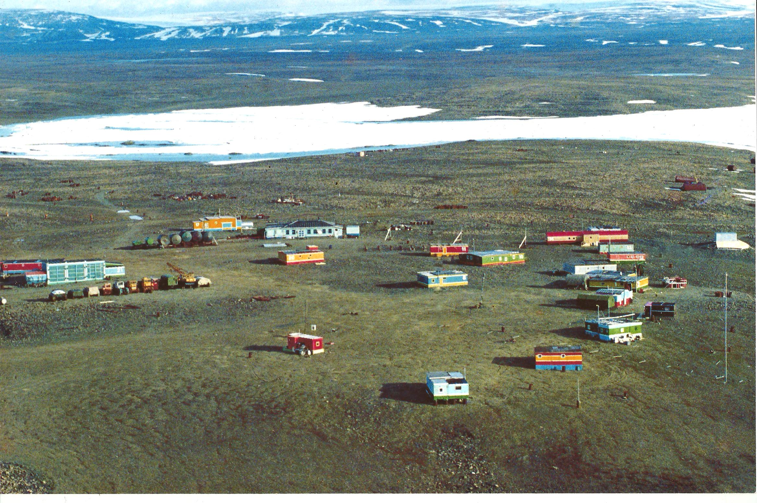
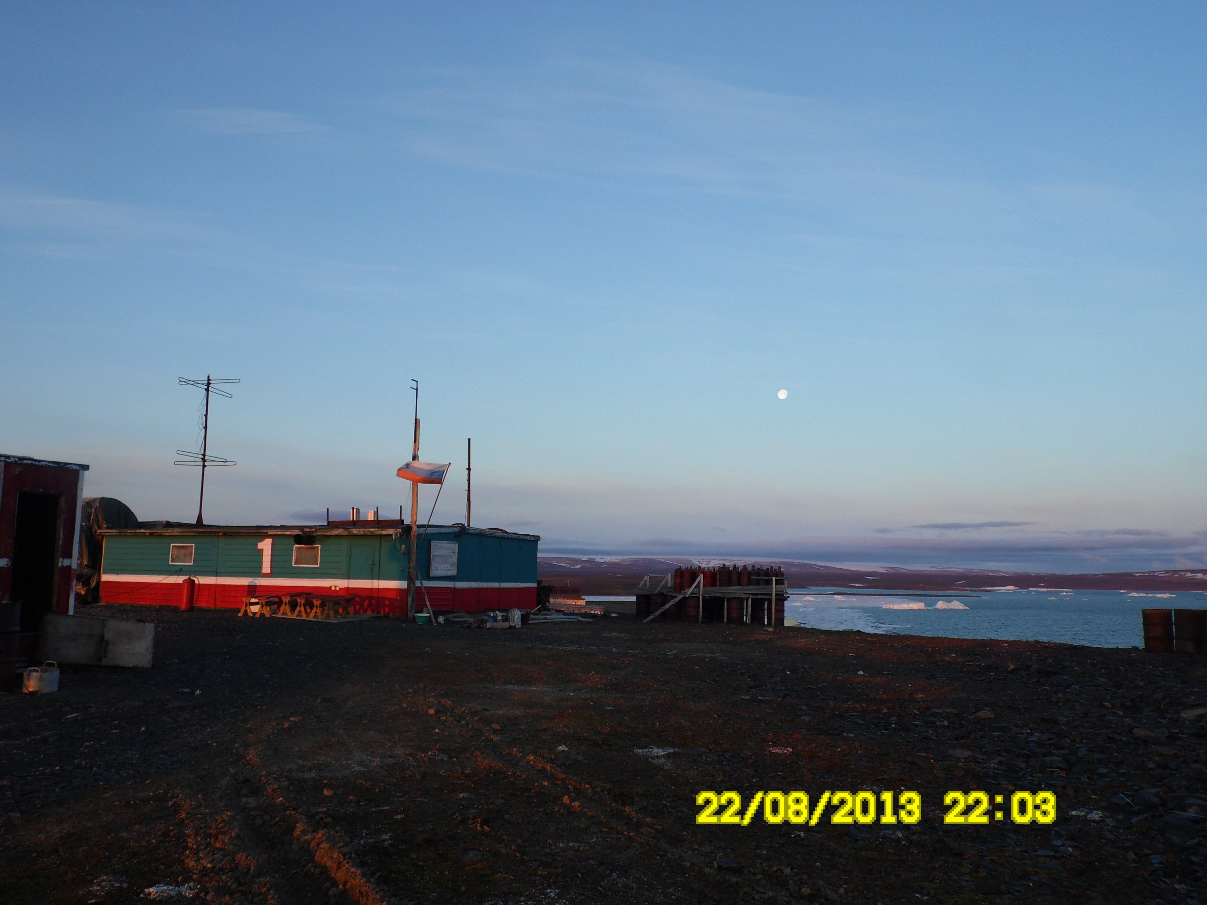
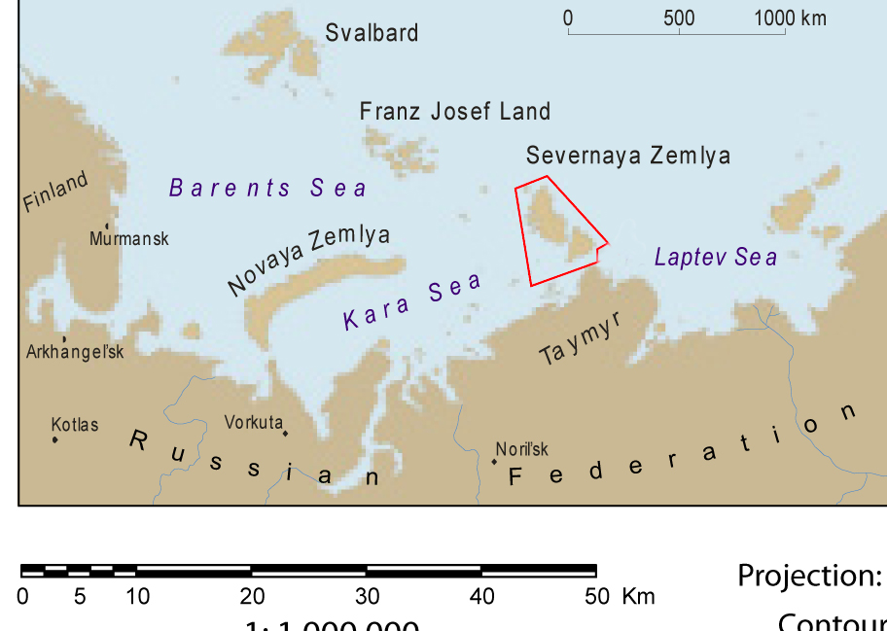
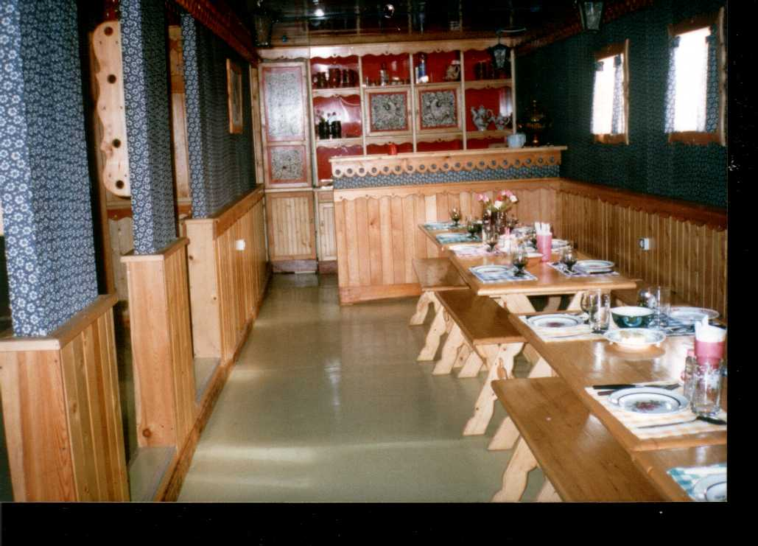
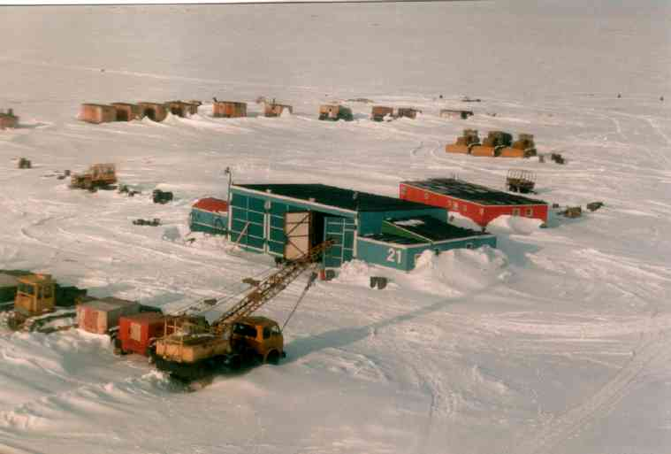
Future Russian Coverage?c
Severnaya Zemyla

Slide 20
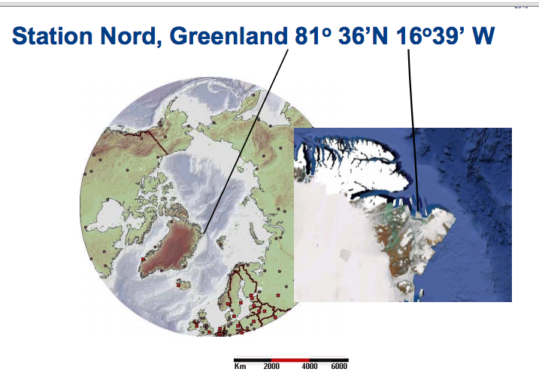
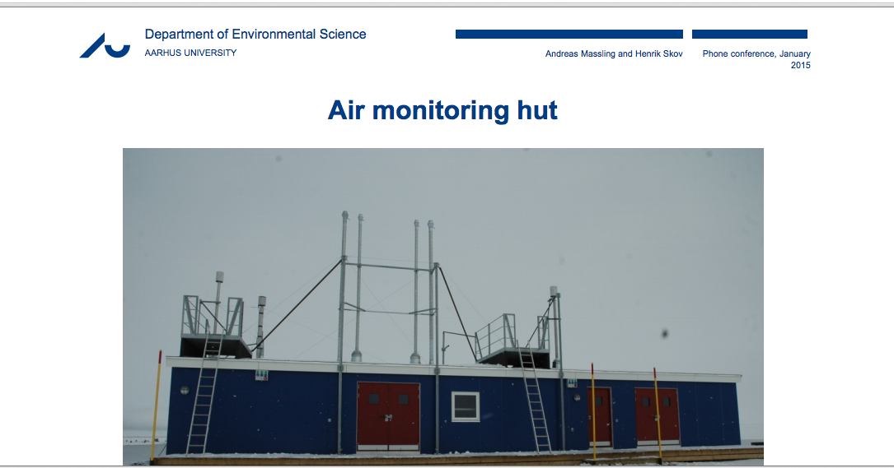
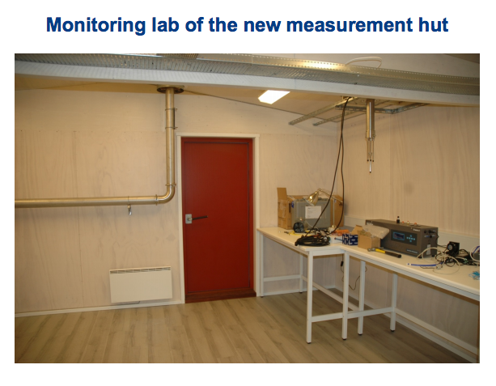
Extending coverage in Greenland at St. Nord.

Slide 21
Role for Networks
How will climate affect processes? You need to monitor processes over the long term.
Catching events as they evolve. You need to be deployed and watching.
Moving upward and outward. Hub infrastructure in place for extensive campaigns.
Building meta-collaboration infrastructure (e.g. IASOA) for data, data products and networking with other communities
IASC-IGAC Arctic Air Pollution Workshop
Boulder, CO 3-5 FEB, 2015

