Slide 1
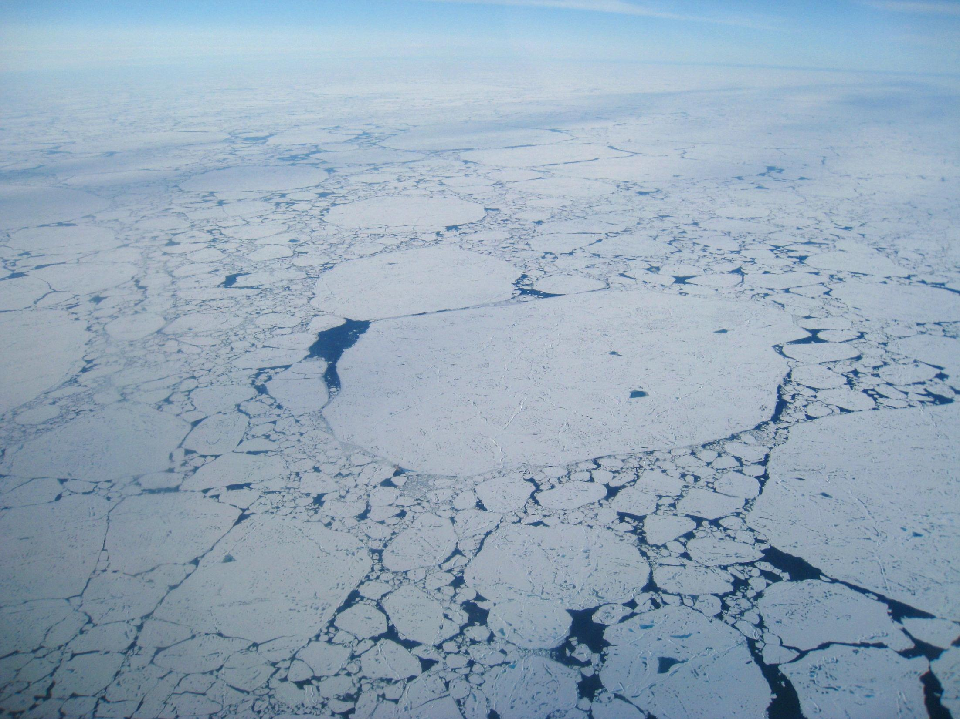
MOSAiC
Multidisciplinary drifting Observatory
for the Study of Arctic Climate
www.mosaicobservatory.org
Science Plan Writing Team
Matthew Shupe, David Barber,
Klaus Dethloff, Sebastian Gerland,
Jun Inoue, Craig Lee, Brice Loose,
Alexander Makshtas, Wieslaw Maslowski, Marcel Nicolaus, Dirk Notz, Ilka Peeken,
Don Perovich, Ola Persson, Julia Schmale, Michael Tjernström, Timo Vihma,
Jinping Zhao (w/ many other contributions)
Notes:
Introduce the organizing team and science plan writing team.

Slide 2
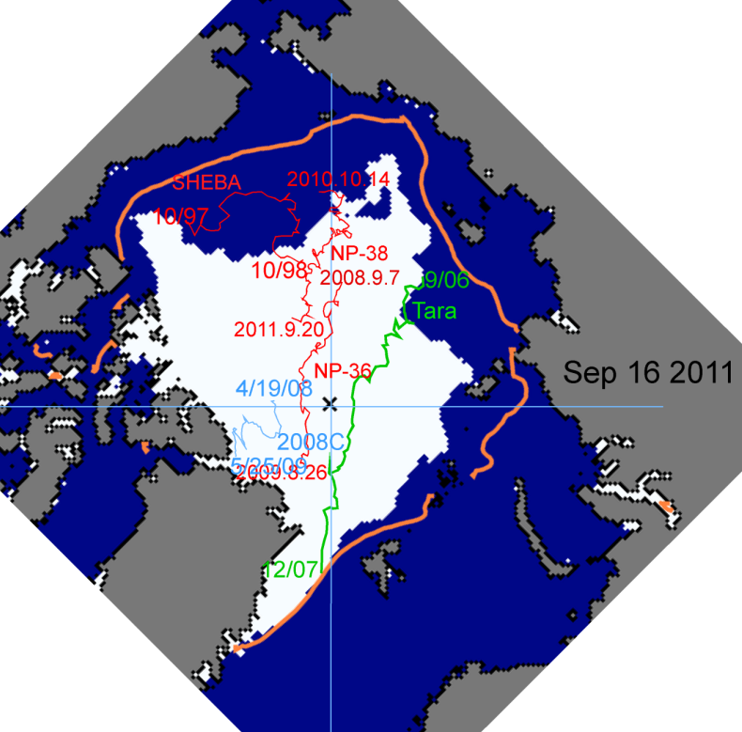
The MOSAiC Concept
NSIDC
Detailed process study to understand coupled central Arctic climate system
Central observatory on icebreaker – atmosphere-ice-ocean-BGC
Distributed observation network on “grid-box scale”
Coordinated multi-scale modeling activities
Timeframe: 2018-2019 annual cycle
Location: Central Arctic Basin ice pack
Targeting 1st-year sea ice
Who: International science team,
funding and infrastructure.
Coordination through IASC.
Notes:
US must play a critical role (likely lead role) if something like MOSAiC is to be successful.

Slide 3
Year of Polar Prediction
An initiative of the WWRP Polar Prediction Project
An extended period of coordinated intensive observational and modelling activities to improve polar prediction capabilities on a wide range of time scales.
www.polarprediction.net

Slide 4
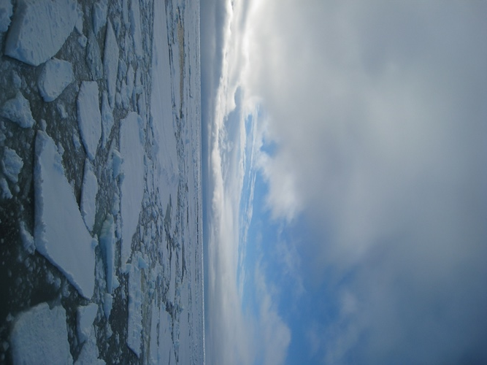
MOSAiC Science Plan
Interdisciplinary
Processes-study
Inter-seasonal
Sea-ice Life Cycle
Sea-ice Lagrangian
Ice as an Integrator
Broader Implications
What are the causes and consequences of an evolving and diminished Arctic sea-ice cover?
Draft available at www.mosaicobservatory.org
Notes:
These are the current specific science questions around which MOSAiC is being organized. They support the broader question related to sea-ice. These questions were developed via a workshop that was held in Boulder in summer 2012 and will serve as the basis for a science plan.

Slide 5
Sea-Ice Energy Budgets
Incoming solar radiation
Outgoing LW
Reflected solar
emitted by atmosphere
Energy Budgets
Radiation
Upper Ocean Heat Storage
Mixing Processes
Turbulence
Stratification
Boundary Layers
Momentum Fluxes
Absorbed by atmosphere
Atmosphere
back
radiation
Reflected surface
Turbulence
Large-scale advection
Sea ice
Absorbed by ice
Emitted-Absorbed by ice
Sea ice
Transmitted
Turbulence
Ocean

Slide 6
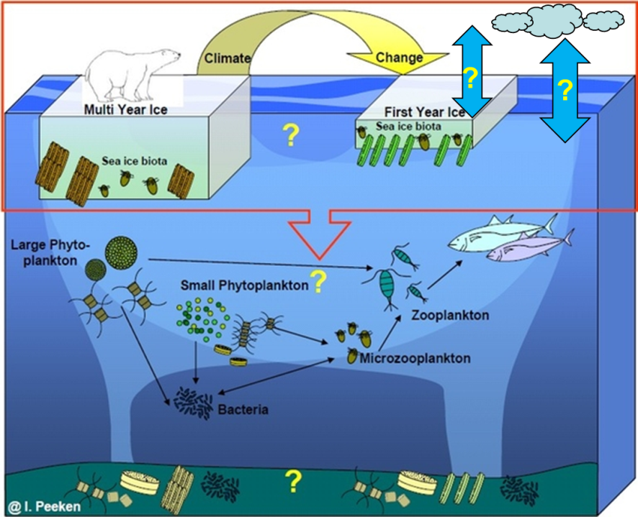
BioGeoChem Processes
Surface Gas Exchange
Carbon Cycle
Nutrient Transfer
Ice Algae / Biota
Sea Ice Ecosystems
Primary Productivity
Aerosol Precursors

Slide 7
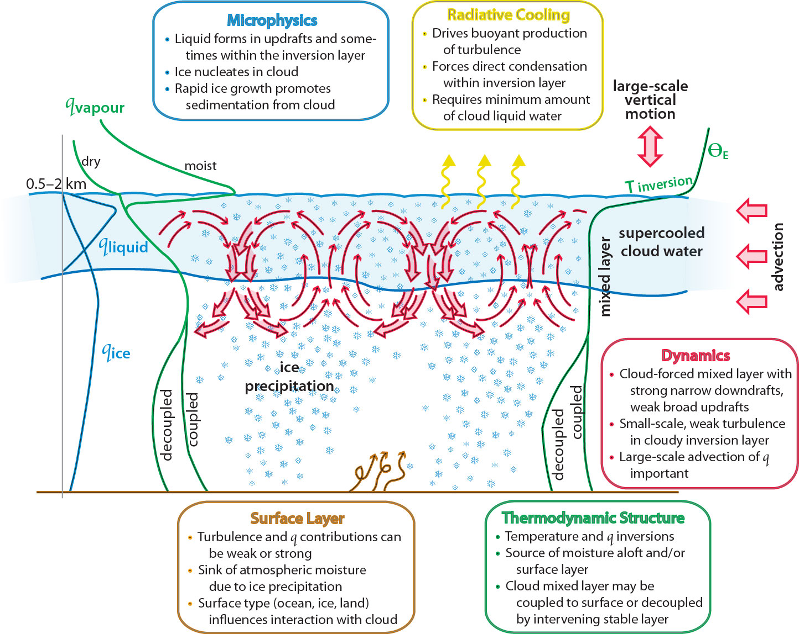
Clouds/Precip/Aerosols
Phase Partitioning / Mixed-phase
Radiative Processes
Cloud dynamics / Turbulence
Spatial Organization
Cyclogenesis
Aerosol Conc. / Source attribution
Precipitation
Morrison et al

Slide 8
Focusing on Aerosols
What do we know about central Arctic aerosols?
In winter? Annual variability? Composition?
Baseline properties – physical, chemical, optical, CCN & IN
Sources: local vs. advective
Aerosol evolution
Vertical dist’n/mixing
Impact on cloud formation, phase partitioning, microphysics
Black carbon’s role

Slide 9
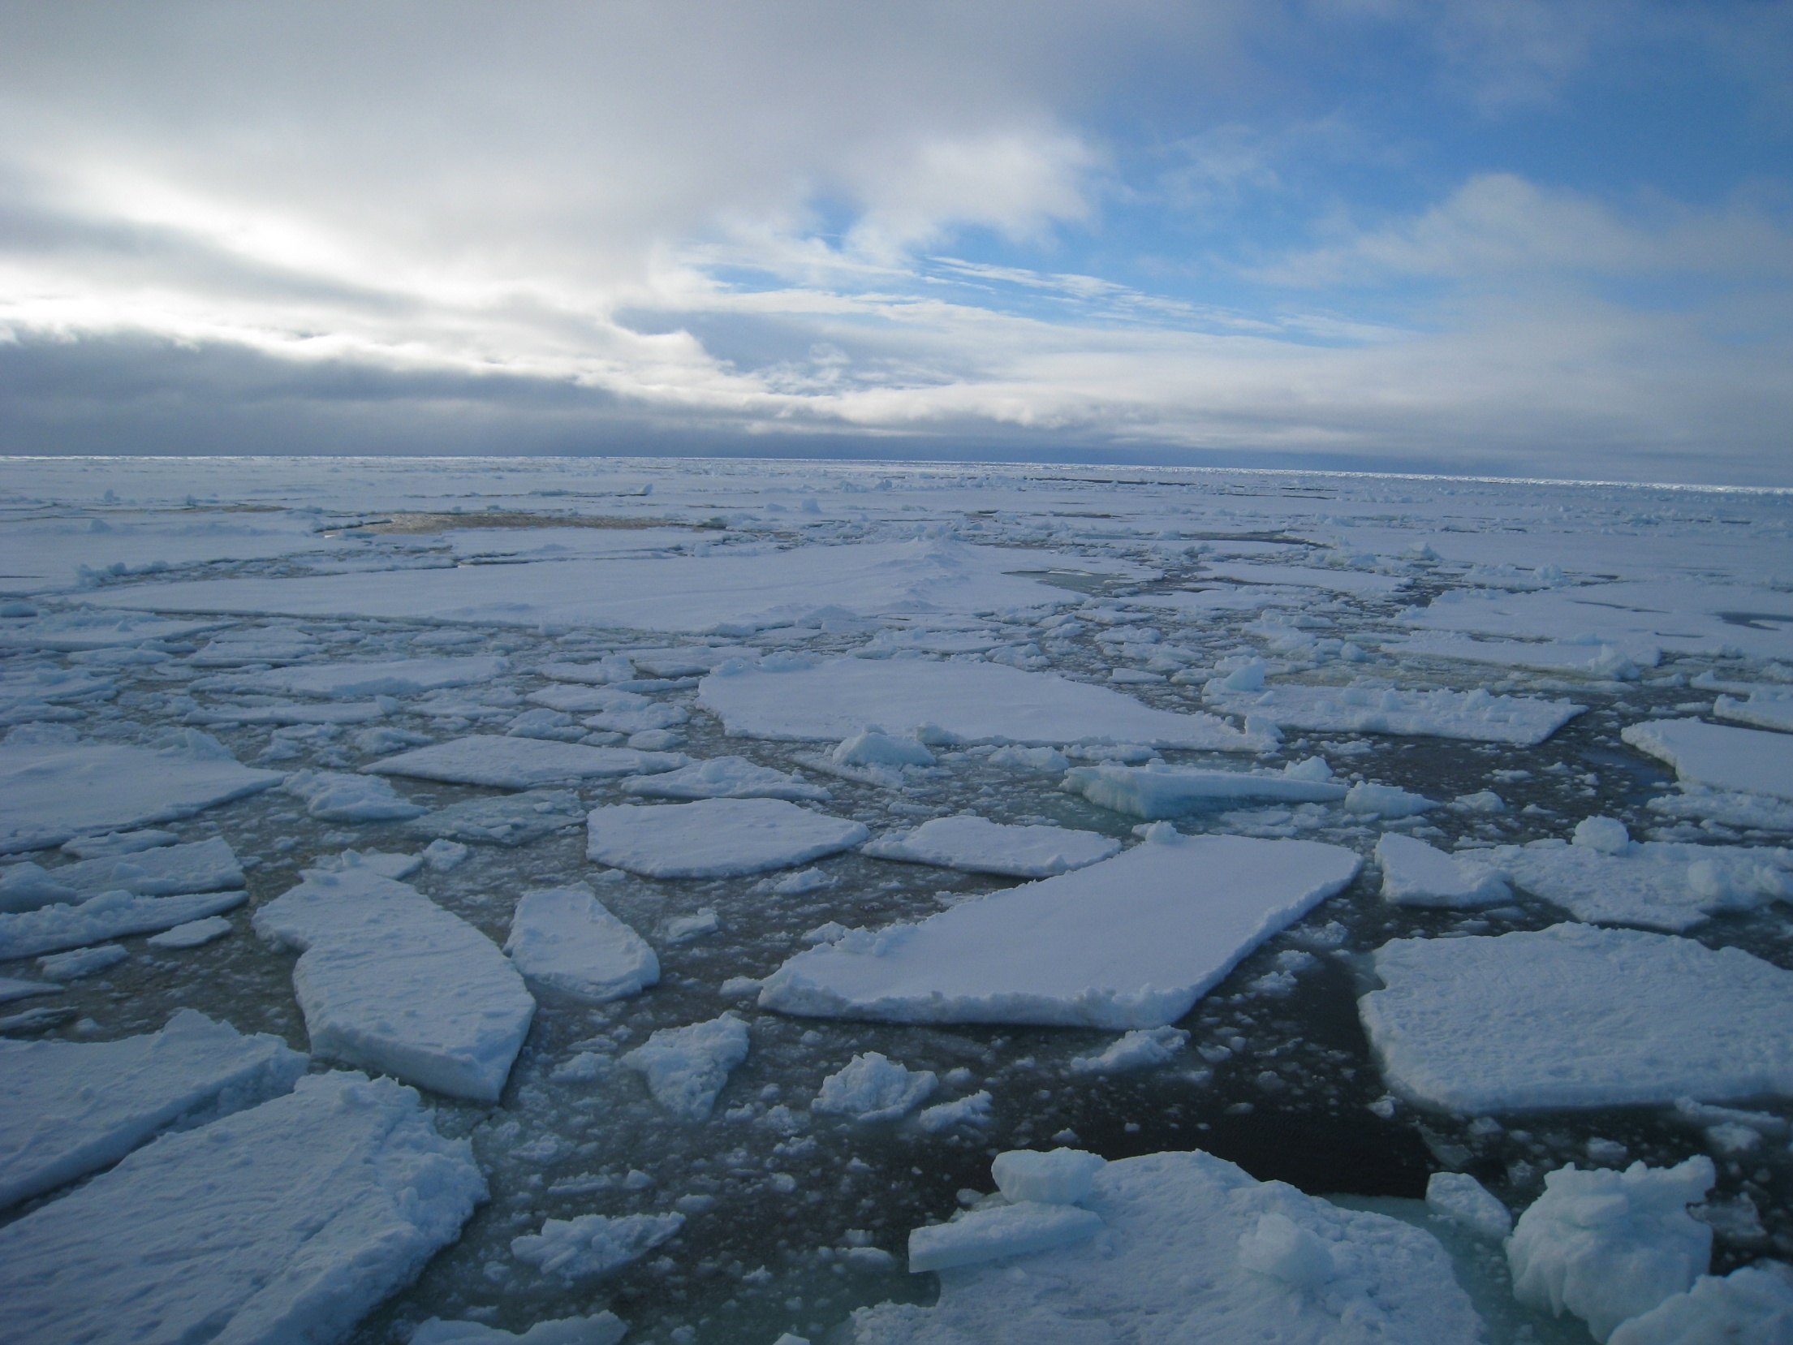
Opportunities
Engage with YOPP: Link and leverage planned and proposed observational activities
Coordinate with various national efforts related to MOSAiC
Propose targeted activities (NOAA aircraft missions…)
Promote MOSAiC and YOPP concepts
www.mosaicobservatory.org
www.polarprediction.net

