Slide 1
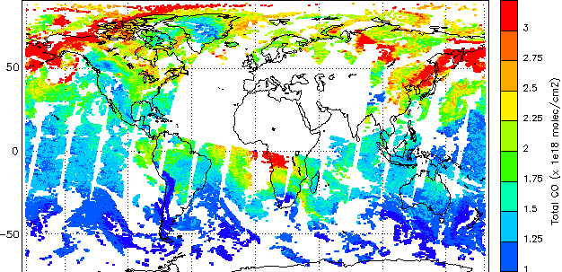
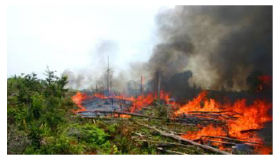
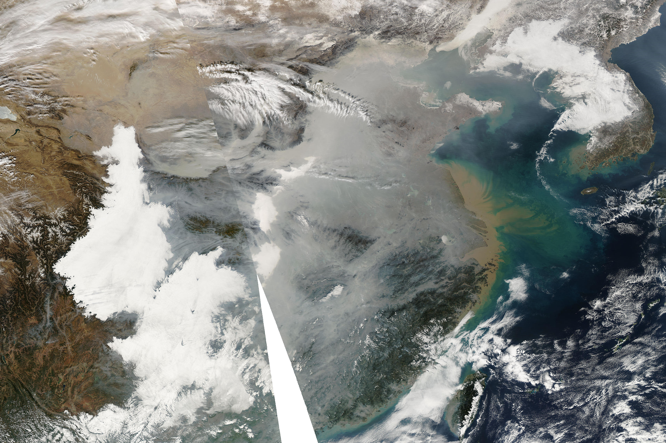
“Impacts of Asian air pollution on the Arctic climate and environment” -- a proposal submitted to the Ministry of Environment, Japan (2015-2017)
IASI Total CO, LATMOS
Does long-range transport of Asian pollution have impacts on Arctic climate & environment?
How much contribution is from anthropogenic/fire emissions, and where and which sectors?
What are relative contributions from European, North American and Asian emissions?
Notes:
Climatologically and episodically (BB in 2008, 2010; Chinese haze in 2012)

Slide 2
Links to policymakers / Collaboration within Asia
Yukari Takamura (co-I) will review/propose an international framework to reduce Arctic pollution and its climatic and environmental impacts
Yugo Kanaya (co-I) and Hiroshi Tanimoto (PI) are on gov’t committee on Japan’s strategy for Arctic issues (since Aug 2014), natural and social scientists, policy makers, and politicians
Science-policy dialogue toward co-benefit of global economic growth and Arctic environment protection
Personal-level collaborations exist but become tougher – environmental data is “national secrets (property)”
China
Institute of Atmospheric Physics, Beijing (Dr. Zifa Wang, others)
Russia
Institute of Atmospheric Physics, Moscow (Dr. Oleg Postylyakov)
Institute of Atmospheric Optics, Tomsk (Dr. Mikhail Arshinov)
Korea
KOPRI, Incheon (Dr. Jinyoung Jung) – joint work on ARAON icebreaker??
Effort to establish the IGAC Asia working group
With particular emphasis on Southeast Asia and South Asia
In future, a potential forum to discuss SLCP emissions in Asia
Notes:
International law, post-Kyoto protocol, COP, global warming

Slide 3
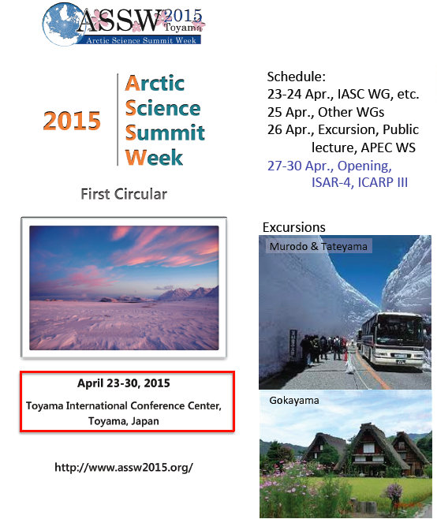
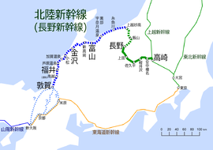
ASSW 2015 in Japan, April 23-30
Toyama
NIES
Haneda
Narita
Tokyo
New bullet train: March 14, 2015
Tokyo – Toyama: 2hrs

