Slide 1
Arctic Air Pollution – Report Backs
All sessions and questions

Slide 2
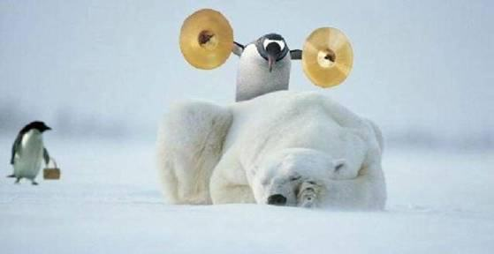
Rapporteur’s suggestions
Table #: 1
Theme #: 1
Question(s): Which within Arctic science areas require special attention?
List 10 points discussed:
Anthropogenic emissions – oil/gas, ships.
Natural Emissions – biogenic, fires, DMS, sea-salt
Aerosols – deposition, cloud-processing – present and future understanding.
Halogens – mercury deposition – ecosystems and society.
5. Sea-ice change – DMS emissions, sea-salt, dynamics (more cloud?) Less stratified BL)
6. Need more collaboration to get data in Russia/Siberia
7. Ocean acidification – biogenic emissions from oceans.
8. Emissions – need to get more estimates of EF, where are they emitted.
9. Gap in someone who is responsible for creating emission inventory.
10.

Slide 3
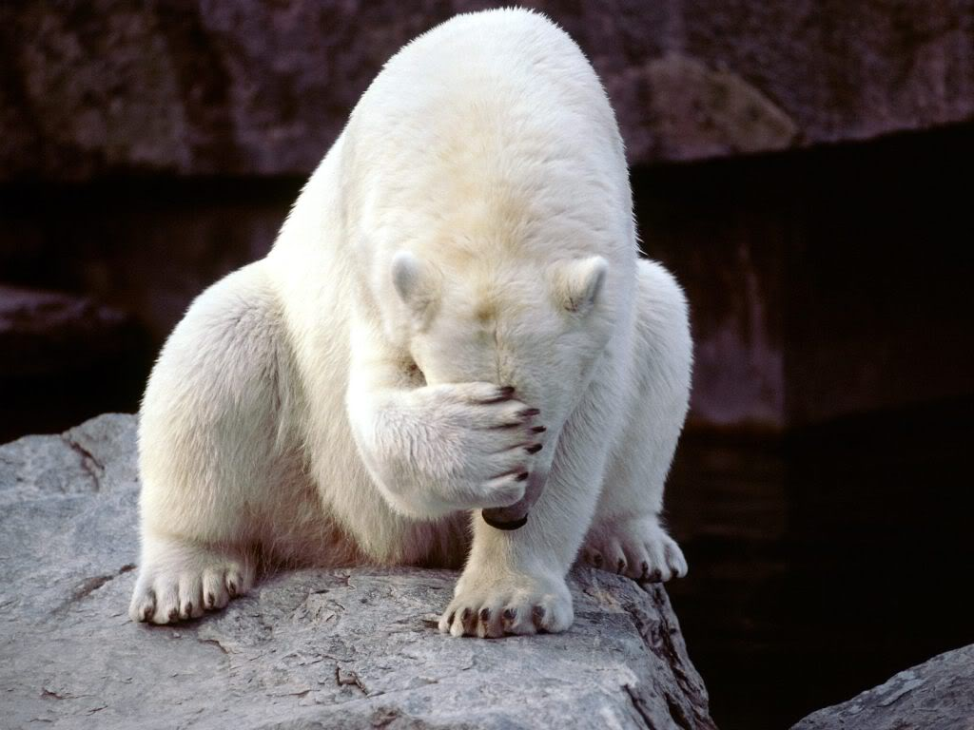
Recommendations by Table: at most 4 points.
1. Emissions – oil/gas, ships – EF validation, emission location, Russian/Siberian emissions – need collaboration, is there existing data – unfiltered long-term, aircraft with new emission estimation in models. Natural emissions.
2. Removal processes – aerosol/gas – dry deposition on snow (O3/BC), vegetation (O3/NOy), in-cloud scavenging.
3. Halogens – mercury deposition, future change in emissions with snow/ice, ecosystem impacts.
4. Sea-ice variability – DMS emissions & biogenic emissions, dynamics – more cloud/more vertical mixing.

Slide 4
Rapporteur’s suggestions
Table #: 2
Question(s):
Which Science areas related to long range transport require special attention?
List 10 points discussed:
1. Arctic rapidly changing – We are trying to understand a moving target.
2. Need for more integrated approach to transport, dynamics, chemistry, ocean/ice/atmosphere, sources, radiation, water vapor.
3. Emission inventories, natural versus anthropogenic sources.
4. Ageing within a plume during transport / changing oxidation capacity / heterogeneous reactions.
5. BVOC in warming northern forests : new species migrating north, changing emission patterns, increased shipping: pollution sources.
6. Understanding pathway variations in a changing vertical atmospheric structure/stability
7. Better understanding of scavenging and deposition processes
8. Snow pH modification with transport.
9. Aerosol / cloud interactions
10. Measurements for better metrics for model assessment.

Slide 5
Recommendations by Table: at most 4 points.
Continue to improve emission inventories. Considering evolution in time. Understand anthropogenic, ie flaring, mining, extraction, shipping urbanization; natural, forced changes ie DMS with less sea ice.
2. Contribution of small scale vs large scale on vertical distributions of pollutants. Metrics for model assessment/improvement. Observations to assess vertically resolved attributes of transport pathways.
3. More integrated approach in understanding processes to discern attribution of different components to transport and their modification with changing Arctic
4.

Slide 6
Rapporteur’s suggestions
Table #: 3
Theme #:
Question(s):
What issues are driven by societal issues/benefits?
List 10 points discussed:
1. Health (low level and local sources)
2. Impacts from climate change
3. Local sources of pollution (ship emissions, gas/oil extraction, garbage burning, forest fires)
4. Geopolitics: rules for shipping
5. Transport (also consider reemission of pollutants)
6. Mercury deposition → food chain
7. Increasing Arctic development
8. Need to know more about emissions in the Russian Arctic
9. Societal values regarding developments varies among groups
10. → social justice

Slide 7
Recommendations by Table: at most 4 points.
1. Better quantification of local pollution sources
2. Consider the effects of local emissions for health
3. Improve predictions and perform exposure studies
4. Clean fuel standard for shipping in the Arctic will be important

Slide 8
Rapporteur’s suggestions
Table #: 4
Theme #: 1
Question(s): Which issues would benefit from a collaborative approach?
List 10 points discussed:
More vertical profiling – spatial/temporal coverage, commercial aircraft for standardized vertical profiling
Data access/quality/corrections – aircraft archive by NASA, ground by ?
Modeling effort – measurement real-time analysis tools, model output of measurement locations, portal for communications, standardized data communication (MOZART, MACC), identify which/where/when meas. will constrain models? model diagnostics among diff. models
Integration of modeling + campaigns – retro-evaluation of past campaigns to guide experimental design
Russian Arctic – local new sources, BB, model comparison, data sharing, Pan-Eurasian program, currently personal-basis, WMO-Russia contacts?

Slide 9
Rapporteur’s suggestions
Table #: 4
Theme #: 1
Question(s): Which issues would benefit from a collaborative approach?
List 10 points discussed:
High (Central) Arctic – key area of CC, under-sampled by aircrafts/satellite, vertical profiles, Russia did lots of air/seawater but not shared with int’l community, (open access) Arctic treaty for research, observation by drifting stations, ship, aircraft, shipping routes
Local emissions – connect up by local sampling of emissions, exchange measurements/techniques,
Collaboration with oil/gas companies – EF, monitoring, Total, Statoil, NOAA
Coordinating meteorological measurements – identify gaps, radiosonde locations?
Social economic emission modeling for indigenous people - future development, transfer of knowledge of local impacts from local people to others

Slide 10
Recommendations by Table: at most 4 points.
Arctic treaty - high-level political treaty for open science access to high-Arctic and Russian Arctic
Data archive for model and measurements
Socioeconomic effects on indigenous people - emission changes
Better linking of modeling and measurements – science planning and analysis

Slide 11
Rapporteur’s suggestions
Table #: 1
Theme #: 2
Question(s):
What observations or instrument developments are needed (platforms, new instruments, sites, coordinated campaigns, Satellite data etc)? Which key advancements are top of the list?
List 10 points discussed:
1. Surface sites – provide sustained measurements in rapidly changing Arctic, existing sites and measurements, coastal bias, missing sites more inland and high arctic, missing radio sondes, quality assurance across sites
2. High arctic - missing measurements due to accessibilty with aircrafts and satellites, buoys with basic meteo, lidar backscatter (20 buoys planned)
3. Deposition measurements in the Arctic – few studies, not easy to measure (one is approach eddy covariance), importance for models, information from snow tables
4. Airborne measurements – coordinated lagrangian for plume studies, vertical regular profiling for model evaluation, long term monitoring, automated instruments on commercial/regular flying aircrafts, zeppelins for emission source characterisation
5. UAVs: - basic meteo on sites and emission sources (up to 12000ft); e.g. Ny Alesund, different payload on same UAV in regular operation on sites
6. Availability of satellite data, especially high arctic (CALIPSO to 82°N, IASI up to North Pole MOPITT for CO, GFAS as a fire database), cloud cover is a challenge
7. Missing measurements – tracer (gaseous mercury, N2O), VOCs on ground sites, PM2.5, brown carbon, refractory black carbon, particles < 100nm, uptake coefficients for the models
8. Polar night measurements gap - haze build up, deposition begins when sun comes up
9. Dust plumes – impacts on surface temps, uncertainty on frequency of occurrence
10 Low cost easy to use instrument for arctic communities (group at UC)

Slide 12
Recommendations by Table: at most 4 points.
1. Review of current existing measurement sites with respect to available data and the question of additional sites (high arctic, inland) and additional measurements (trace gases, VOCs). Perhaps IASOA could expand its data portal.
2. International coordinated airborne measurement campaigns based on process orientated questions and model needs (examples: lagrangian experiments, HIPPO type studies with vertical profiling)
3. Long Term Monitoring needed in rapidly changing arctic conditions to provide the baseline, trends, etc.
4.Filling the major measurement gaps over the arctic ocean and the Russian Arctic region

Slide 13
Rapporteur’s suggestions
Table 2:
Theme 2:
Question(s):
What types of modeling approaches/ developments are needed and within which types of frameworks?
Which key advances are on top of the list?
List 10 points discussed:
1. Scavenging (liquid and ice): Cloud micro physics not included in much of the models.
2. Deposition, both dry and wet
3. Emission inventories: spatial, temporal and quantity and injection height.
4. Modeling snow cover and land surface interactions correct.
5. Vertical resolution of models. Observational constraints. Are different layers represented good enough? Column numbers vs surface measurements and how to use them?
6. CO in winter and getting the chemistry right. CO/BC ratio.
7. Small scale processes to constrain models. What parameters are robust in models in comparison to other input parameters?
8. Modeling across scales and resolution
9. Long-range transport and aging processes PAN, HNO₃, NO_{Y} partitioning

Slide 14
Recommendations by Table: at most 4 points.
1. Improving the understanding of uncertainties in model parameters and processes using multiple approaches using adjoint modeling, uncertainty emulator and ensembles.
2. Polar winter observations are under represented and poorly modeled and should be a focus moving forward.
3. The big polar cloud on the ground: A massive reactive surface. It is not treated as an emission source.
4. New modeling tools are emerging (dynamical cores): how to utilize them in the Arctic region?

Slide 15
Rapporteur’s suggestions
Table #: 3
Theme #: 2
Question(s): How can models and observations be combined to improve our understanding of processes
List 10 points discussed:
Can we use models to decide what kind of observation are useful
Can we consistently compare model results with satellite data
What is the most important altitude range for model validation
Discrepancy between spatial and temporal resolution between model and measurements
Vertical model resolution is lower than measured resolution
Lagrangian studies are useful for validating processes
Need for Longtherm records and seasonal data information
Single column models can be used for direct comparison with measurements
9. Sensitivity runs to identify key processes in certain areas
10. Interaction communication between modellers and observer

Slide 16
Recommendations by Table: at most 4 points.
Vertical information is needed – Using of detailed aircraft measurements and new systems, like UAS
2. Joint language– Interaction communication between modellers and observer
3. Column models – These models can be used for direct comparison with measurements to understand processes
4. Data input – Need for Long-therm records and seasonal data information the validate different models

Slide 17
Rapporteur’s suggestions
Table #: 4
Theme #: 2
Question(s): What opportunities exist? Making use of existing or planned efforts
List 10 points discussed:
IASOA – Need vertical profiles over the long term sites, may need additional sites with long term observations, is there a way for campaign data to be included?
Measuring and modeling deposition processes – gases and aerosols, should this be a focus of a new activity
ATom – some data may be collected in the Arctic, chance for other measurements.
YOPP – driven by WMO - Year of polar prediction
MOSAIC/IAGOS – commercial aircraft, expansion or similar on Arctic aircraft
Korean icebreaker is equipped with chemical measurements – looking for collaborations
Buoy platforms – iAOOS and O-Buoy
MACC – now is called CAMS – useful for Arctic forecasts (campaign planning), may have a validation focus in the Arctic
Arctic Observing System – through the Arctic observing summit, mainly focused on the ocean historically
Single ozone measurements without anything else don’t add much

Slide 18
Recommendations by Table: at most 4 points.
Vertical profiles are needed (trace gases and aerosols)
2. Need integration / communication between ongoing projects and expanding ground based measurements coordinated at the international level (an IASOA like effort for campaigns?)
3. We have to focus on getting the atmosphere on the Arctic agenda internationally
Can we build on automation that is being built in large projects – buoys, UAVs, small sensors to get a much wider Arctic coverage (spatially and vertically)

Slide 19
Rapporteur’s suggestions
Table #: 1
Theme #:3
Question(s): How could themes recommended in session 1 and 2 benefit from an overarching conceptual framework? what might that look like?
List 10 points discussed:
1. Opportunities for collaboration from different science disciplines.
2. Overarching science question.
3. Not just the science but policy questions and regulations, political approaches to how climate is going to affect the community
4. What is the interest of countries members of the Arctic Council in changes in the Arctic, factors: energy development, security, arctic amplification.
5. Follow an approach as in CLRTAP (Convention on Long-range Transboundary Air Pollution - air polution is more accepted as a research topic than climate change.
6. Need for more connection with other groups: sea-ice, oceanographers
7. Cost of air pollution – integrated assessment models
8. Connecting to MOSAIC
9. Air Pollution from long range and local sources
10. Standardizing stations and measurments

Slide 20
Recommendations by Table: at most 4 points.
1. Ultimate goal of science activities was some framework for regulation of Arctic Air Pollution
2. Better connections with oceanographic, sea ice, and social science communities are important
3. What is the economic impact of air pollution
4. How does Air Pollution impact the Sustainability (and Resiliency) of the Arctic

Slide 21
Theme 3, Question 2 What collaborations are working well? How can we build off them?
AMAP – Assessments – but not data collection
Netcare – funded project that brings modellers and measurement people together
IGAC – could move for endorsement
IASOA – works well but does not yet include all Arctic Stations – Station pages should point back to IASOA
NDAC – brings together measurement people making common measurements
MOSAIC – the ball is rolling we could try to jump on the band wagon
Plumbing is broken in Arctic Networks

Slide 22
Theme 3, Question 2 What collaborations are working well? How can we build off them?
Personal interaction is important – need to increase opportunities for long term observation people to interact with modellers. Student participation important.
NDAC works because it is common people talking nuts and bolts
IASOA meeting would be good but who would it include?
IGAC – AICI model. Workshop every other year. AGU/EGU sessions. Special issue every 4 years.

Slide 23
Rapporteur’s suggestions
Table #: 3
Theme #: 3
Question(s): How can we best interface our science with social/regulatory issues that could help organize our approaches? (How and where will problem orientation help?)
List 10 points discussed:
1. Making our science relevant to local communities, policy makers and stakeholders
2. Identifying collaborative opportunities in the Arctic Council and with stakeholders, inviting stakeholders into the discussions, finding arenas for communication, more continuity. Increase interaction with Arctic Council.
3. Lobbying for funding, the science-policy interface is dialogue
4. Language, communication, make information available, framing of research questions, awareness of how policy making works
5. Communication with local communities e.g., during campaigns, establish support, outreach
6. Training/education in the Arctic, local technicians can keep long term measurements ongoing
7. Problem orientation may drive interdisciplinary research in a real way and help identifying where existing and new funding opportunities are

Slide 24
Rapporteur’s suggestions
Table #:
Theme #:
Question(s):
List 10 points discussed:
8. We are often encouraged to include policy/regulatory issues in applications, but the results lack clear advice/recommendations.
9. Arctic in a global perspective - Impact of Arctic changes on other latitudes, global equilibrium, changes potentially affecting a lot more people and nations
10. Arctic integrated in IPCC (Arctic report, specific scenarios, simulations, analysis for Arctic within CMIP6)

Slide 25
Recommendations by Table: at most 4 points.
1. More actively incorporating risk assessment in the framing of our science questions
2. Identify stakeholders, establish contact and actively work to maintain network, invite stakeholders into the process early on, being proactive
3. Maintaining and increasing training, education and outreach in local communities, e.g., when conducting a campaign
4. Explore opportunities for integrating Arctic in IPCC AR6 (sub-reports, CMIP6 Arctic specific simulations/analysis)

Slide 26
Rapporteur’s suggestions
Table #: 4
Theme #: 3
Question(s): How would a new initiative distinguish itself? How do we sell/fund a new initiative?
List 10 points discussed:
1. Address (mis)-perception of already too many projects taking place in the Arctic
2. Expanded spatial coverage or targeting of different regions
3. Expanded temporal coverage (all seasons including polar winter, interannual)
4. Inclusion of socio-economic components, community engagement
5. Full column concept (e.g. SHEBA) lends itself to 1D modelling and scavenging/dep
6. Emphasize cloud-aerosol science to distinguish from POLARCAT
7. Better integration between long-term and campaign-style activities
8. Increased involvement of modelling community in all stages of initiative
9. Emphasize recent observational/modelling advances (when these exist)
10. Build connection to POPs community – shared interests of LRT and health impacts

Slide 27
Recommendations by Table: at most 4 points.
1. Emphasize existing data strengths and weaknesses and identify gaps in surface monitoring strategies
2. Lagrangian sampling strategy from mid-latitude sources to the Arctic, require international collaboration on multiple platforms
3. Multiple scale strategy– local process scale (predictability for future impacts of development) vs long-range transport (climatology); sites along an impact gradient identified by Arctic Council
4. Pursue a funding source ‘Arctic Sustainability Fund’ that gets funding from industry stakeholders (shipping, resource extraction, insurance, defense)

