Slide 1
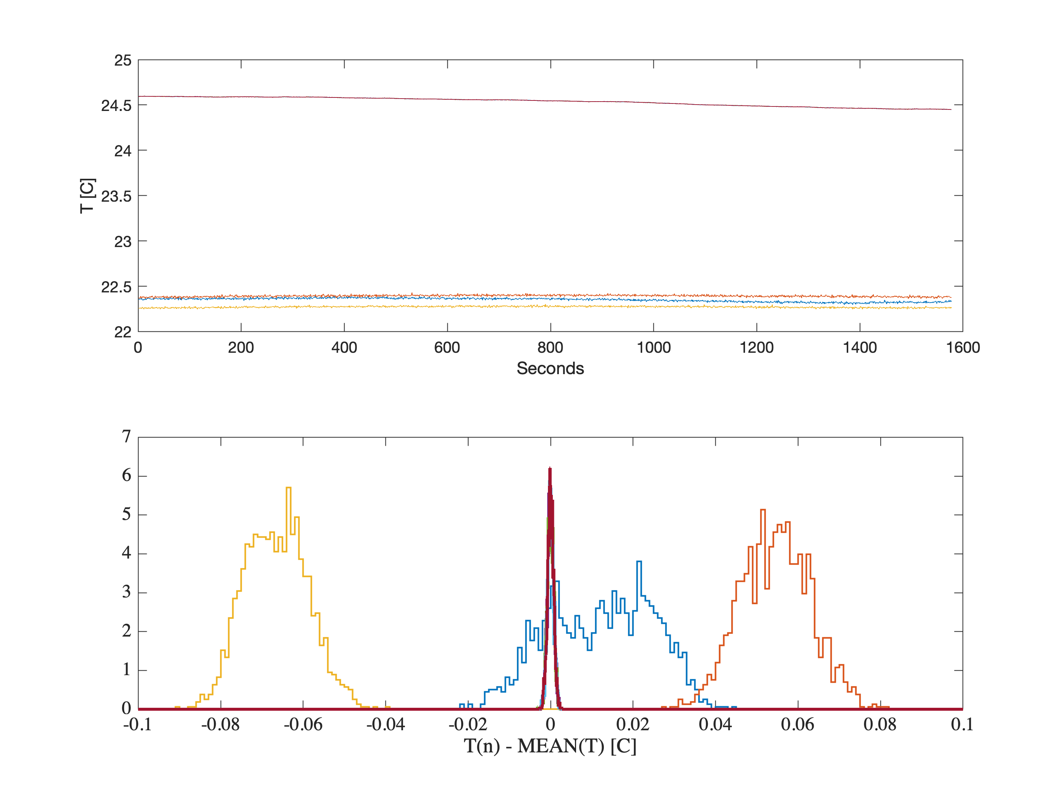
4x thermocouples
3x vaisala
TC1 – mean(all TC)
TC2 – mean(all TC)
TC3 – mean(all TC)
Vaisala1 – mean(all Vaisala)
TC4 – mean(all TC)
Vaisala3 – mean(all Vaisala)
Vaisala2 – mean(all Vaisala)

