Slide 1
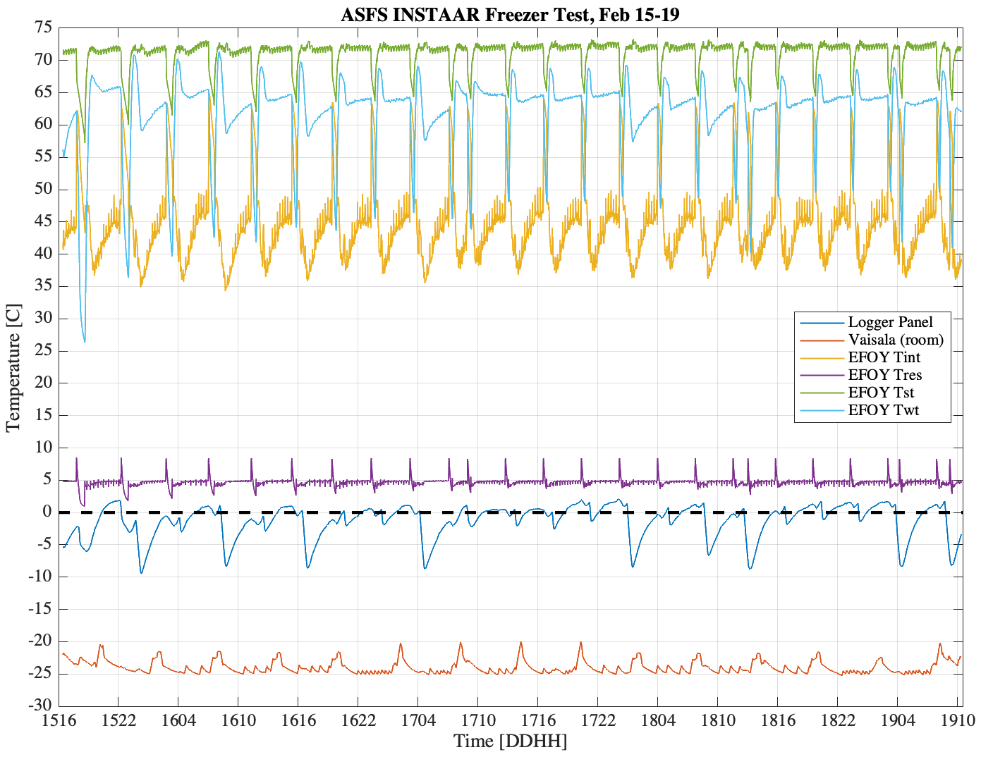
EFOY gets hot! The manual says the exhaust can be up to 140 F (60 C). Remember the thermostats for regulating the fan are in the box, not in the efoy. The 50 C limit for efoy is still a mystery…
Also recorded “Tpcb”, “Tdcdc”, ”Taux” but the data is nonsense. These are all “periphery temperatures” like Tres.
The efoy error flag, sampled 1x min, was 0 (no error) in all 5,396 minutes of the test.
Tint = “internal temperature”
Tres = “periphery temperature”
Tst = “stack temperature”
Twt = “heat exchanger temperature”

Slide 2
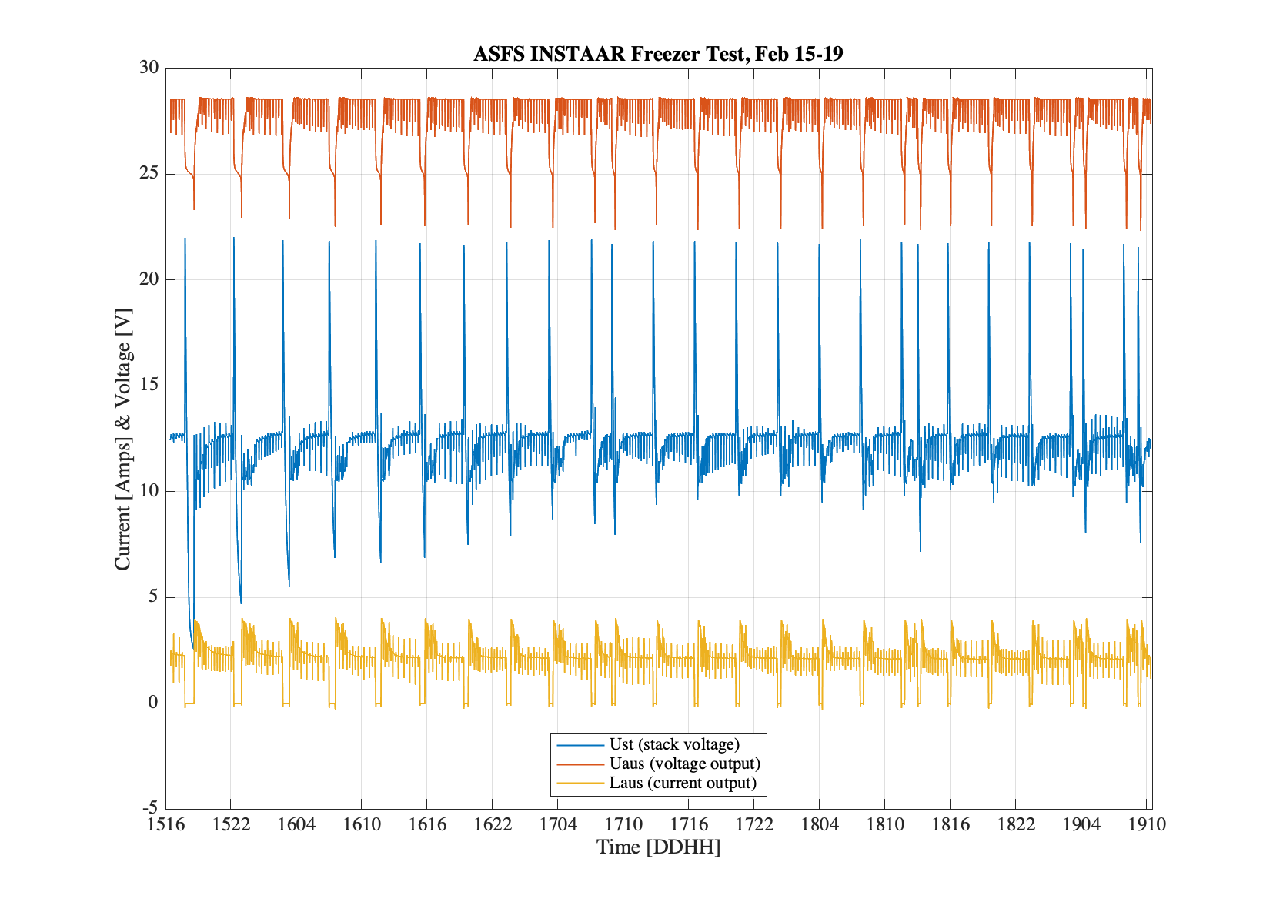
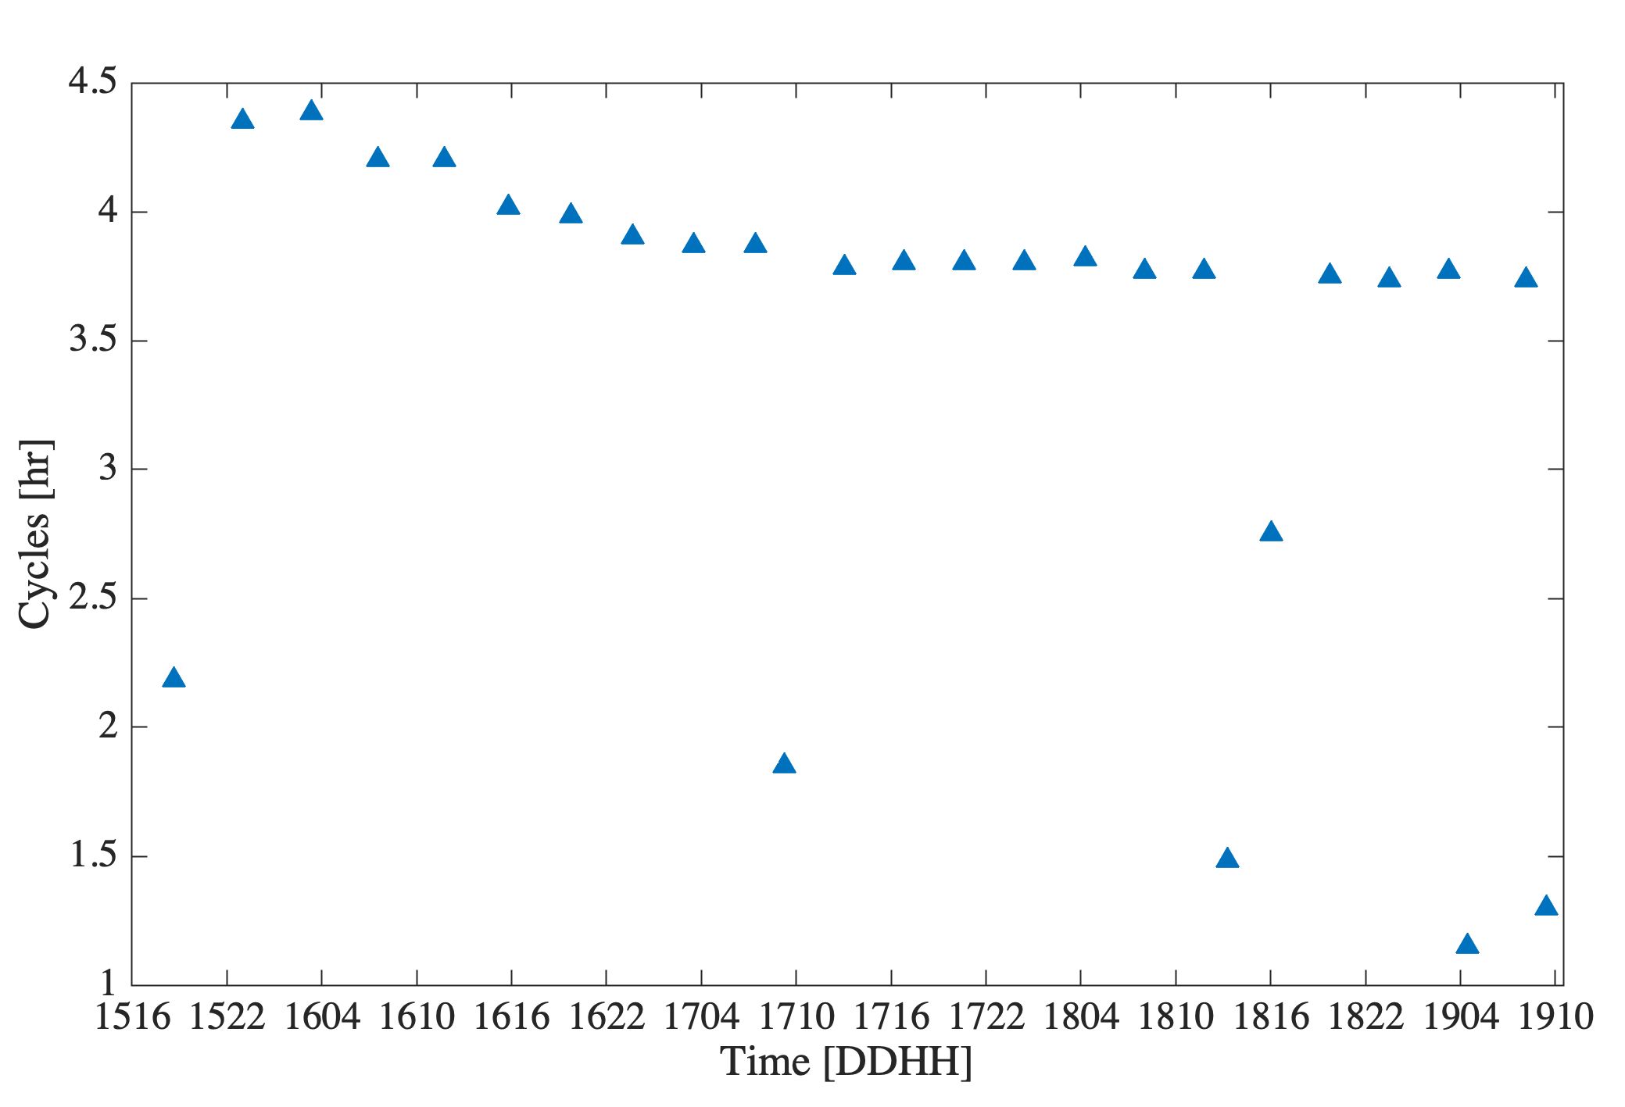
When EFOY turns off voltage drop from 28.5V to 25.5V happens in < 5 min. Uaus ~ Ubat
Duration of cycles
Assume output currents ~0 mean EFOY is off. If so, EFOY was on 88.9% of the time.

Slide 3
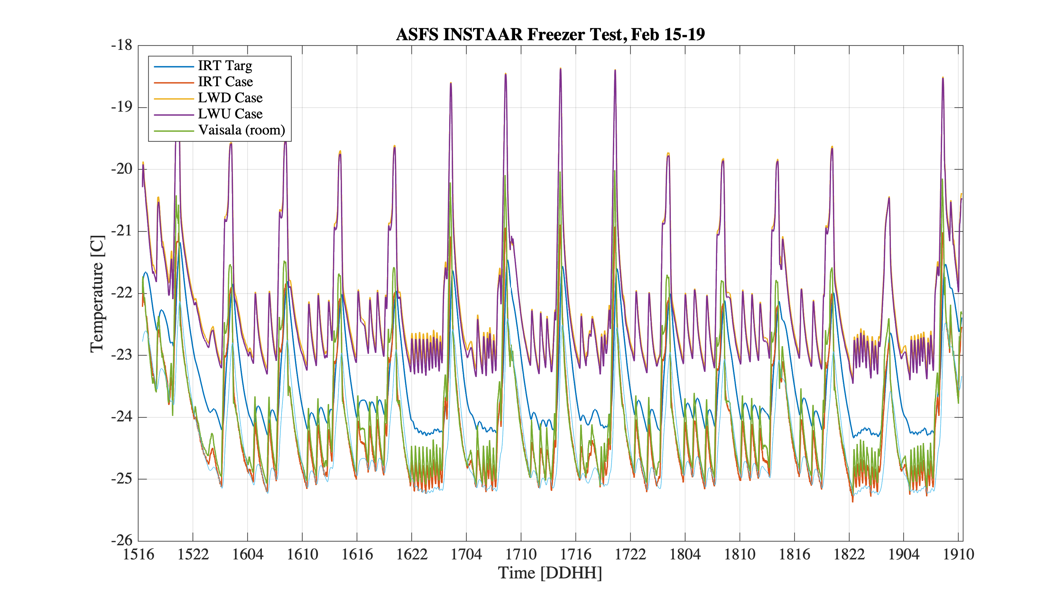
Both IR20 case temperatures are ~ +1.85 +/- 0.15 C over ambient. At -25 C this would lower an ambient RH_ice of 104% to 86.6%.
The difference between IRT Targ (here inside of IRT’s lens cap) and room air temp can roughly be explained if an emissivity of 0.98-0.99 is assumed.
IRT is not being heated and only uses ~1mA and so it is ambient. It will be icy!

Slide 4
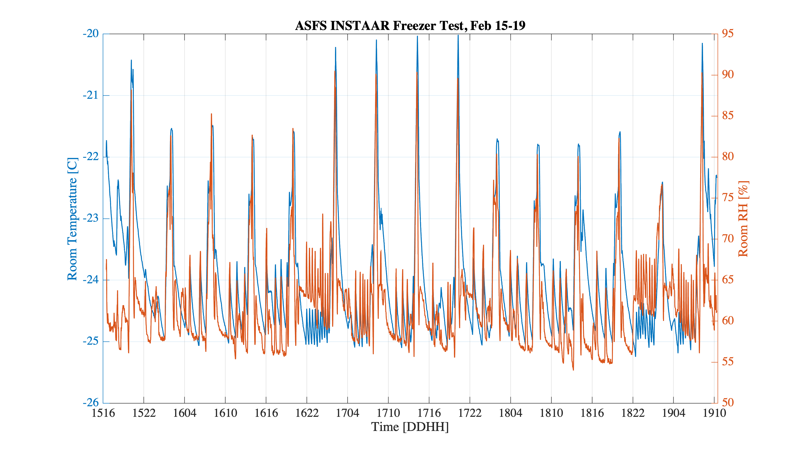
Freezer humidities are not very realistic relative to field conditions:
Room humidity was probably a little drier than we should expect in the field. The RH at Barrow when the ambient temperature is between -25 and -20 C is ~ 80% +/- 2%.
The RH increased with increasing air temperature! There must be an air intake to cycle outside air into the freezer despite what Bruce said. The spikes are too regular to be people entering the freezer.
Notice also that there was not a steady increase in humidity as EFOY exhausted vapor. But, since there is no frost in the freezer, the air exchanger must also somehow dry the air…

Slide 5
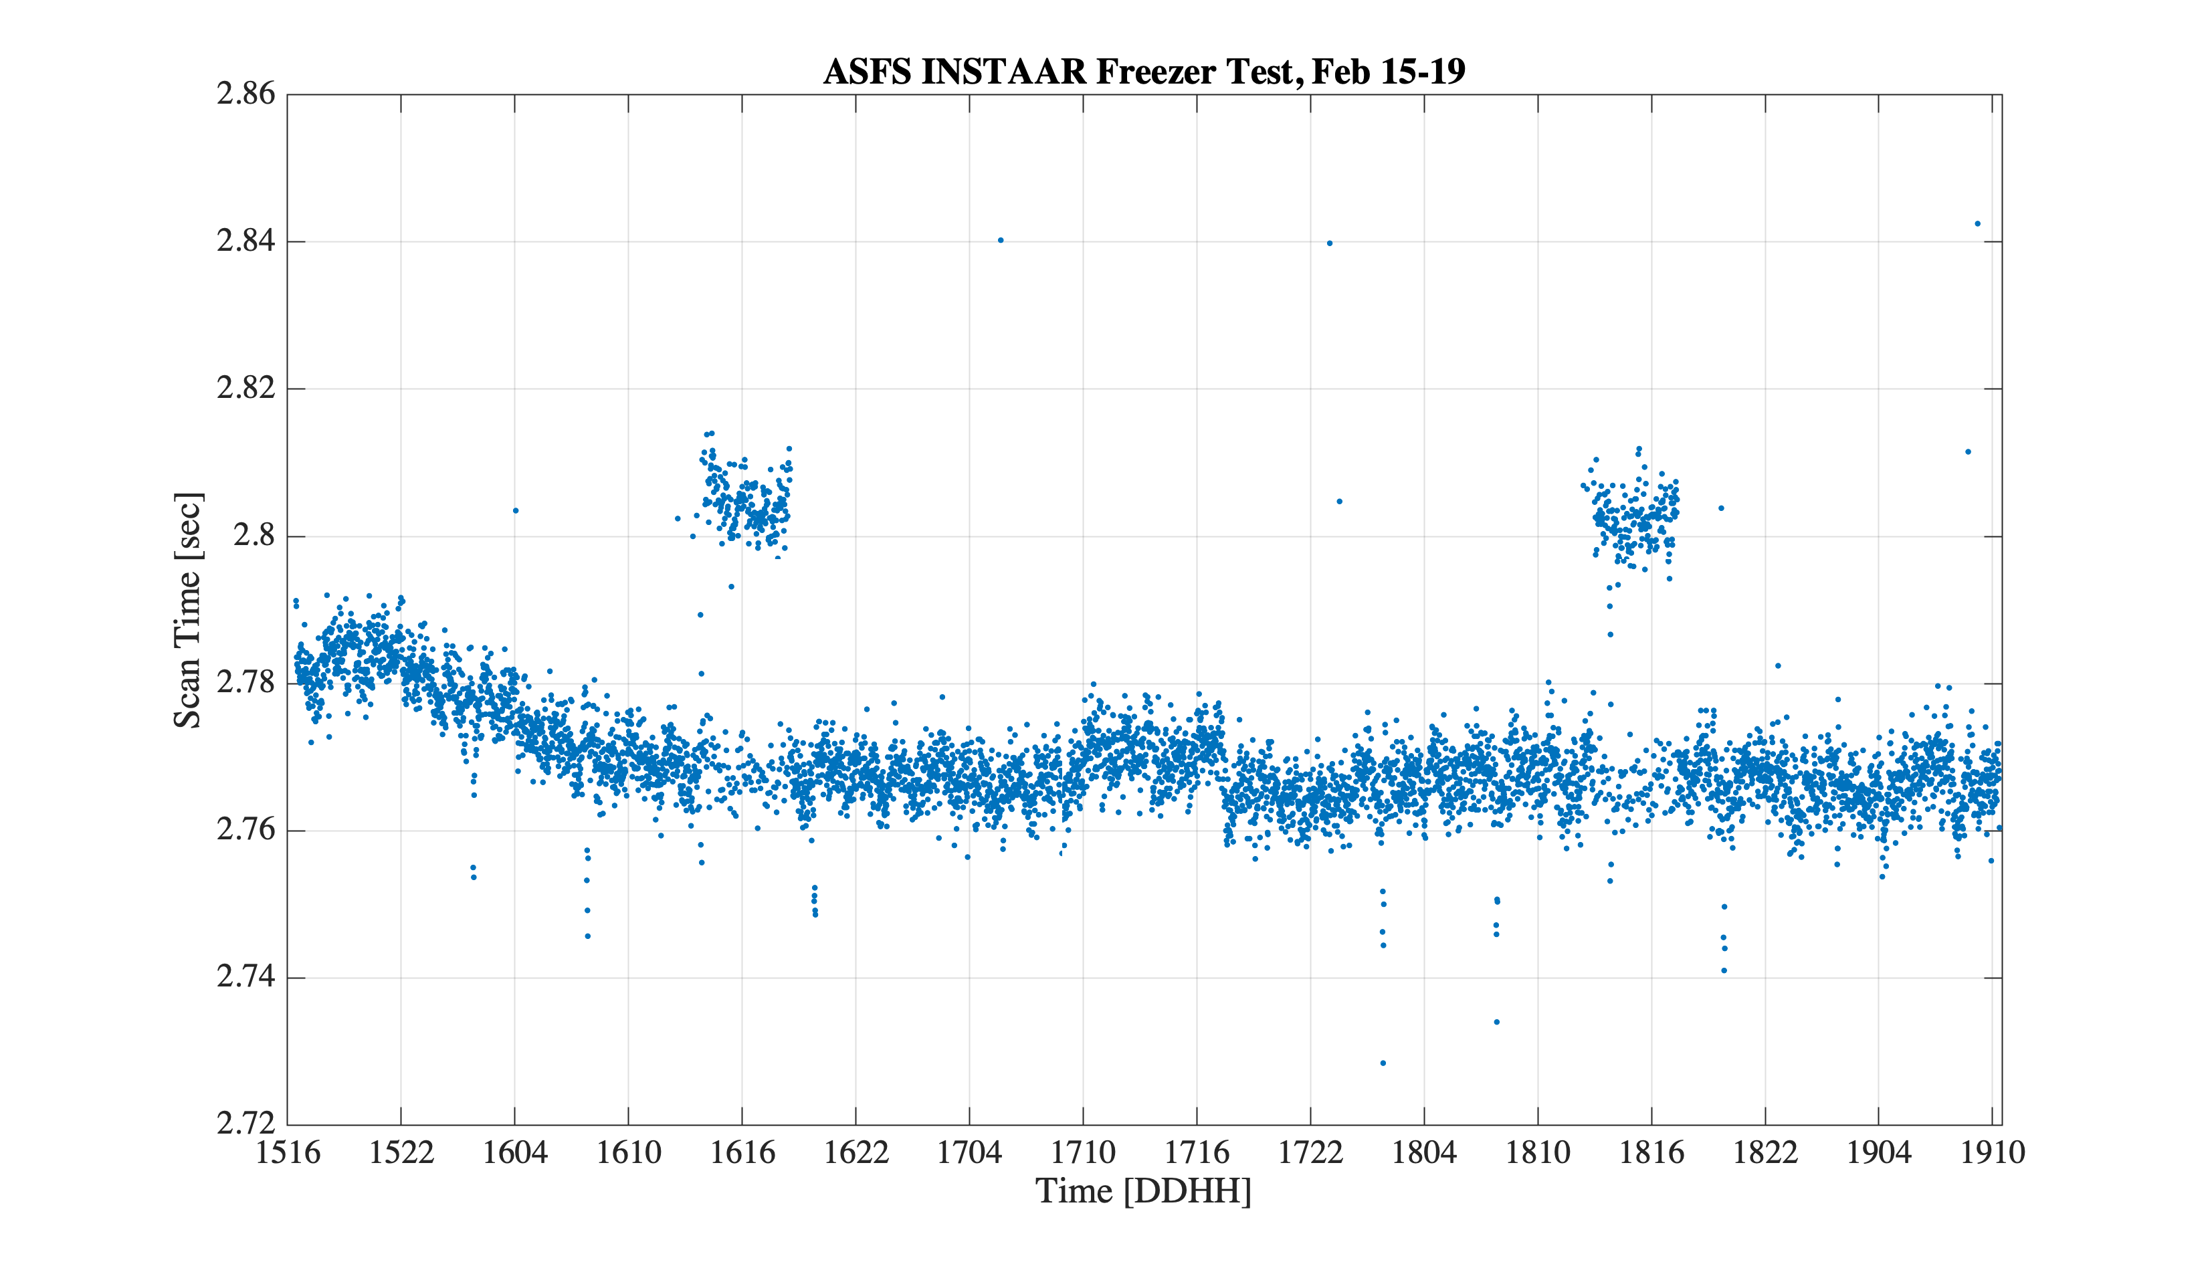
Time taken to execute instructions in the 5 sec scan loop is consistently about 2.8 s in freezer, which is similar to tests in the CIRES lab at +21 C. Good!
Two instances when abrupt changes were seen, each lasting several hours. Tracing the timers I placed throughout the code indicates that this was the result of the Vaisala taking an additional 0.036 s to respond (increase 5%). There is nothing noticeable in the met averages or standard deviations. No idea was happened, but does not seem concerning.
The reduction in scan time during fist 18 hours is associated with the SDI-12 sensors responding incrementally faster. No idea why.

Slide 6
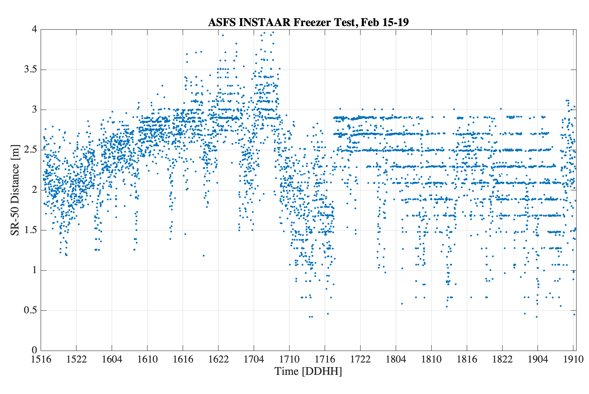
The SR-50 distance varied a lot and also became generally more discrete, tending to report at intervals close to 0.1 m. WTF? I don’t understand this.

Slide 7
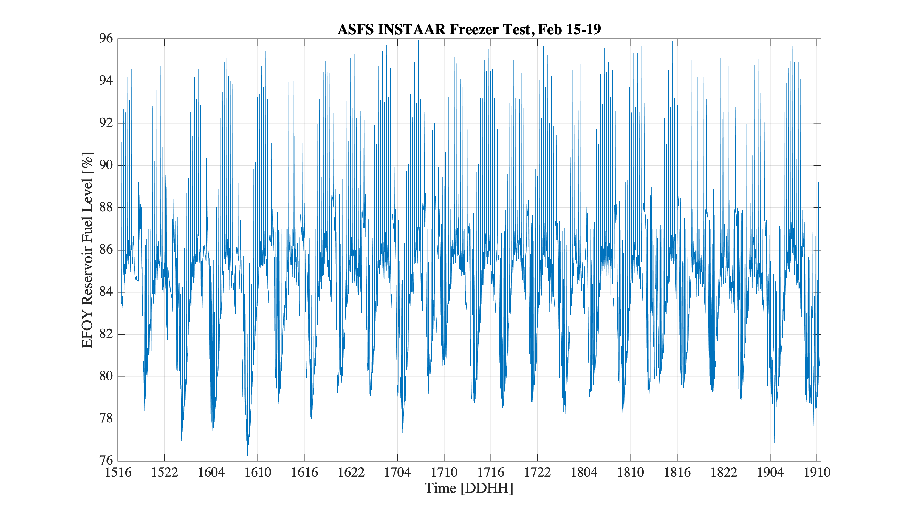
This variable appears to be mostly useless.
However…que next slide

Slide 8
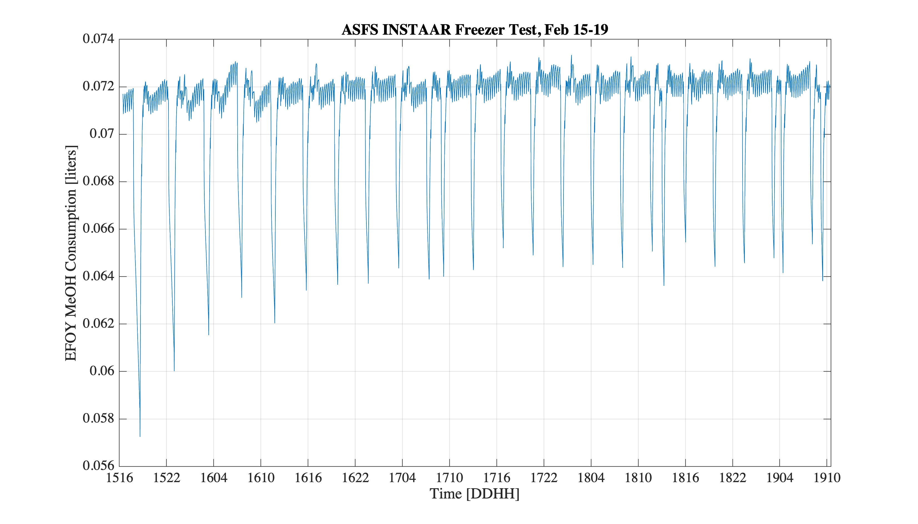
The consumption variable might be useful. The trouble is that its units are volume and not volume per time. Specifically, the time series is 1 min averages of 12 per min polled samples in liters consumed…whatever that means.

