Slide 1
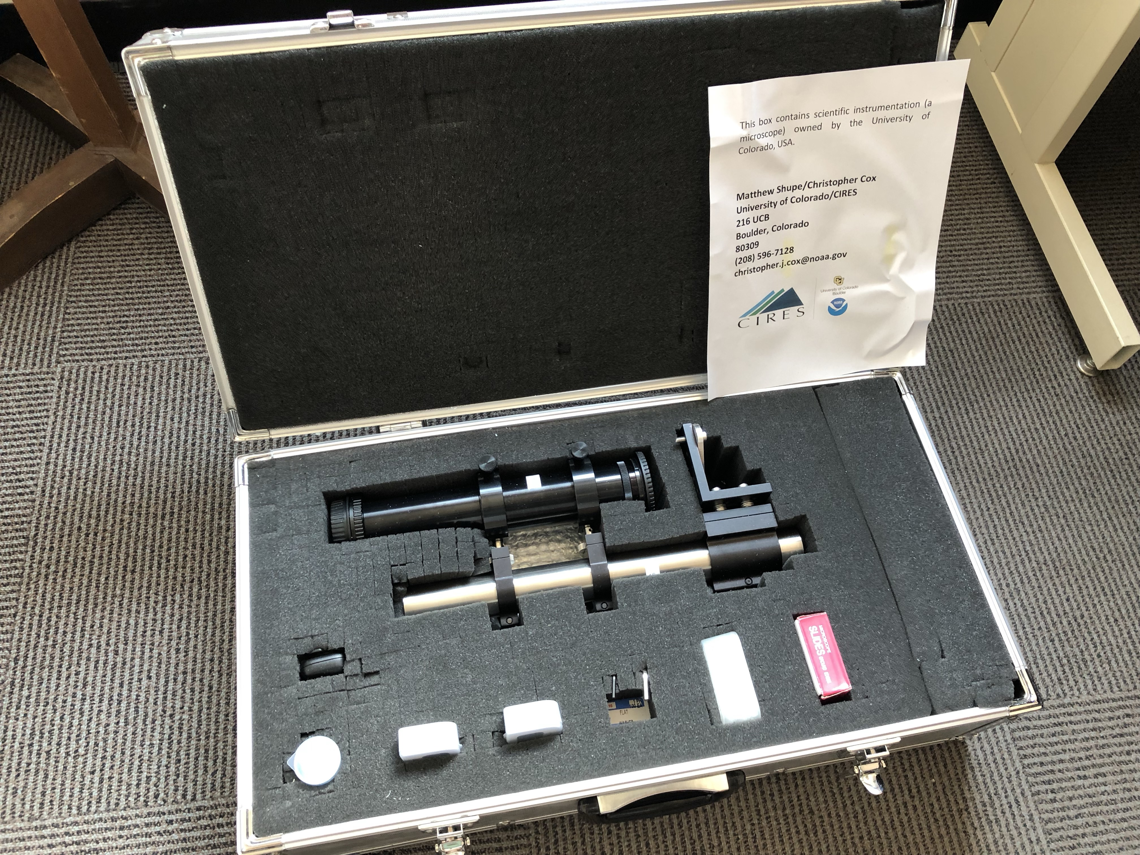
Breadboard base is located beneath the foam at the bottom of the box.
Camera equipment is not in this box. Use the CU Canon EOS.
Microscope assembly
Light source (headlamp)
Microscope objective
2 calibration slides
Spare parts and hex wrenches
Slides
Diffuser and spare

Slide 2
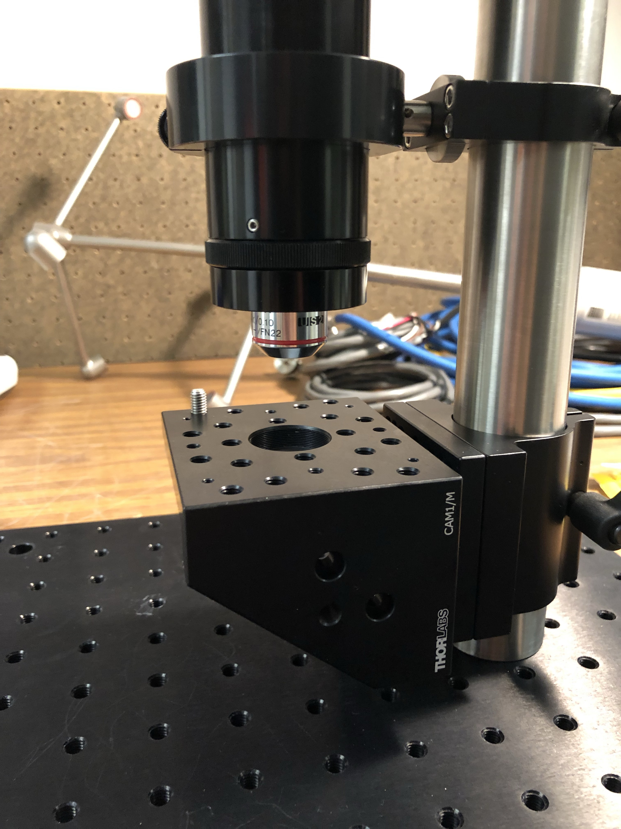
Microscope objective screws into the bellows here.
Assembly screws onto base here, or wherever is convenient.

Slide 3
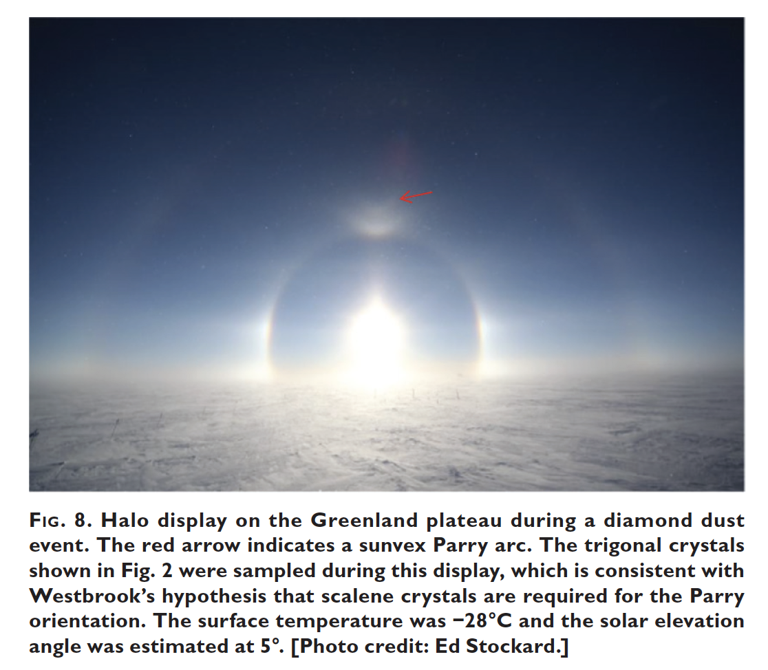
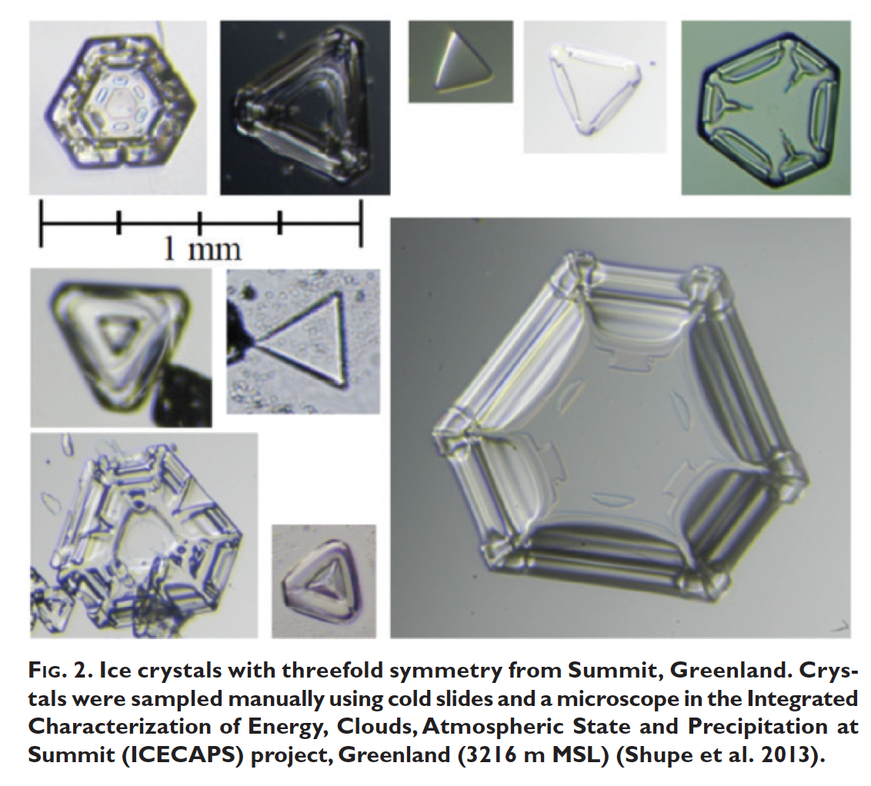
Murray et al. (2015)

Slide 4
Shupe et al. (2013)

Slide 5
Gladich et al. (2015)

