Slide 1
Hypothesis: Ventilation of ambient air without additional heating can be an effective method for ice mitigation.
  “yes” is the emerging conclusion
  Aims to quantify/explain the improvement and limits, and identify any negative consequences.
Some questions that have bubbled up:
  The hypothesis above is counter-intuitive. What is the physical explanation?
    Possibly, residual heat from the fan raises the temperature ~ 0.5-1 C and sub-saturates the air around the dome.
      The air must be directed properly.
      Direct heating is effective too, in particular for de-icing time.
      As with anything, there is an upper limit: What is it?
    How can we evaluate the characteristics of the airflow in successful systems? (fog machine!!??)
      Ok for a run at Barrow before system is taken down? Glycerin, a trihydroxy alcohol, C3H8O3
  (How/Does) ethanol induce icing?
  How about de-icing effectiveness?
  How does ventilator design obstruct the measurement, either directly or by encouraging accumulation around the dome?
    During (limited!) clear days with sunlight (DIR >> DIFF), we have seen large variance between pyranometers!
    PMOD ventilators impact FOV
    VENS collect snow/rime on radiation shield

Slide 2
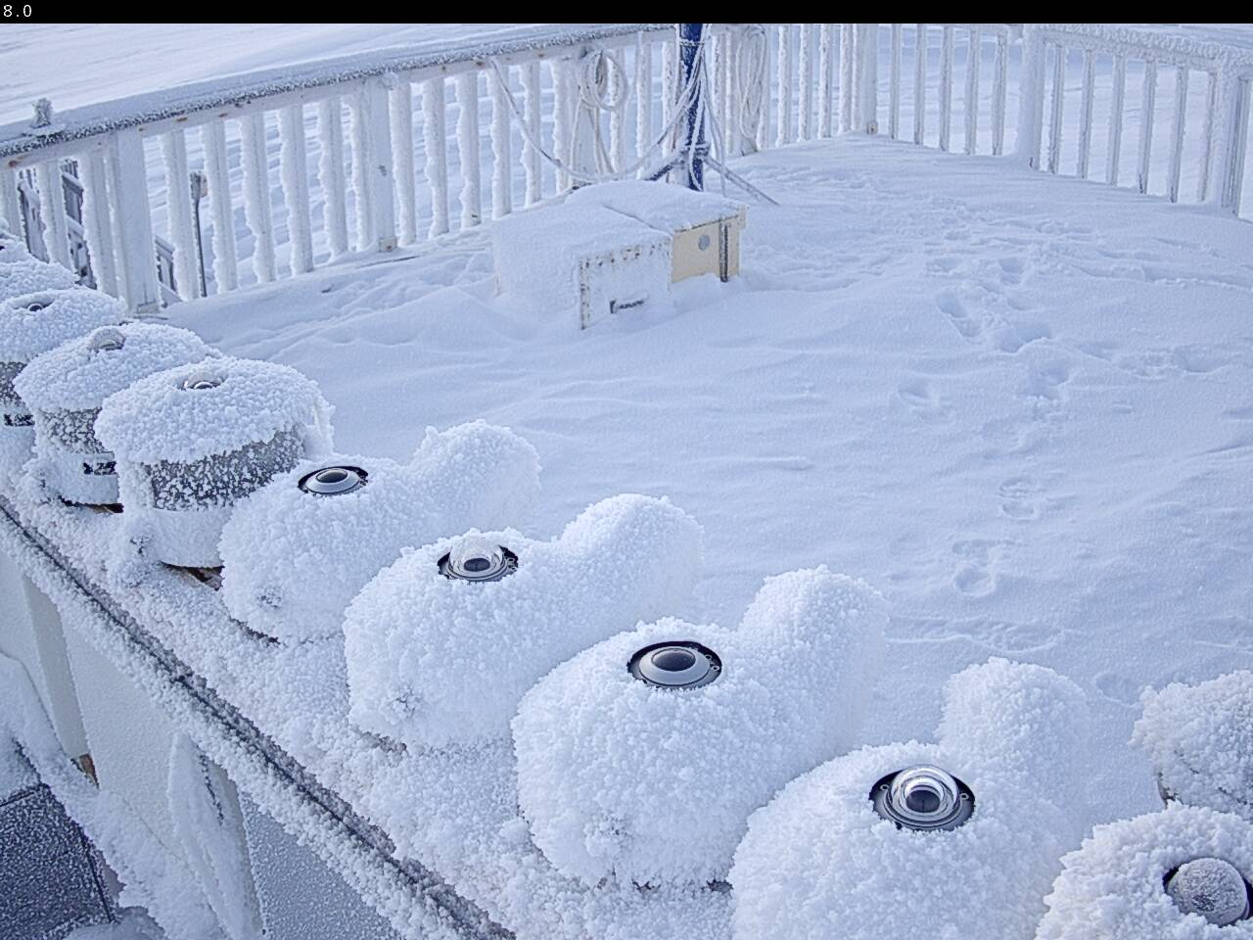
January 28, 12 UTC
Near the peak of an extended freezing fog event ~ -10 C, Rhi > 100%

Slide 3
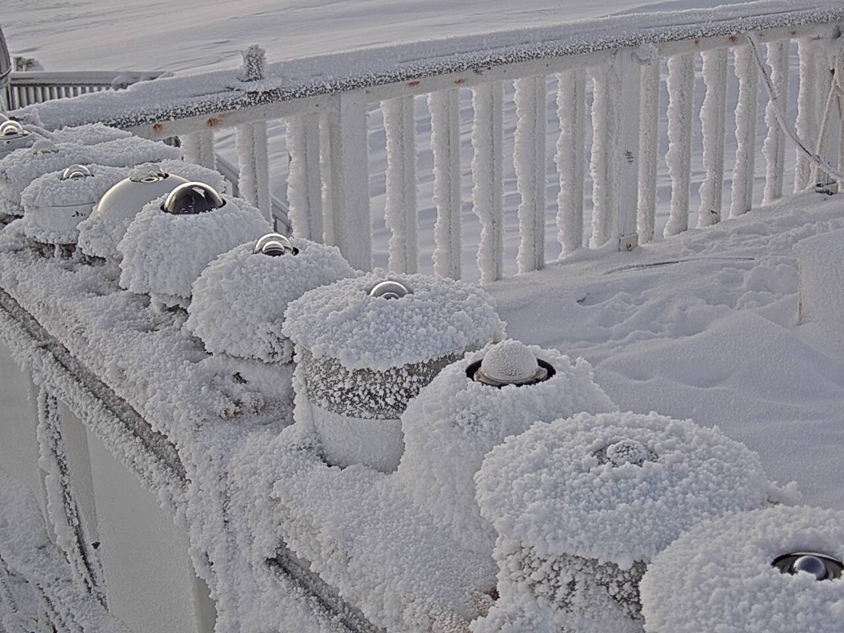
January 28, 12 UTC

Slide 4
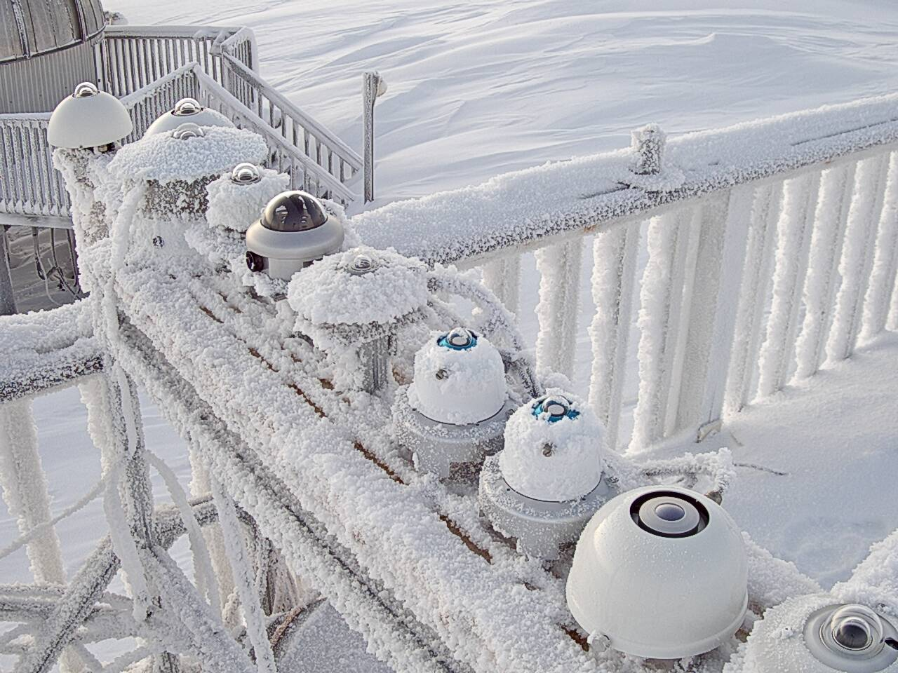
January 28, 12 UTC

Slide 5
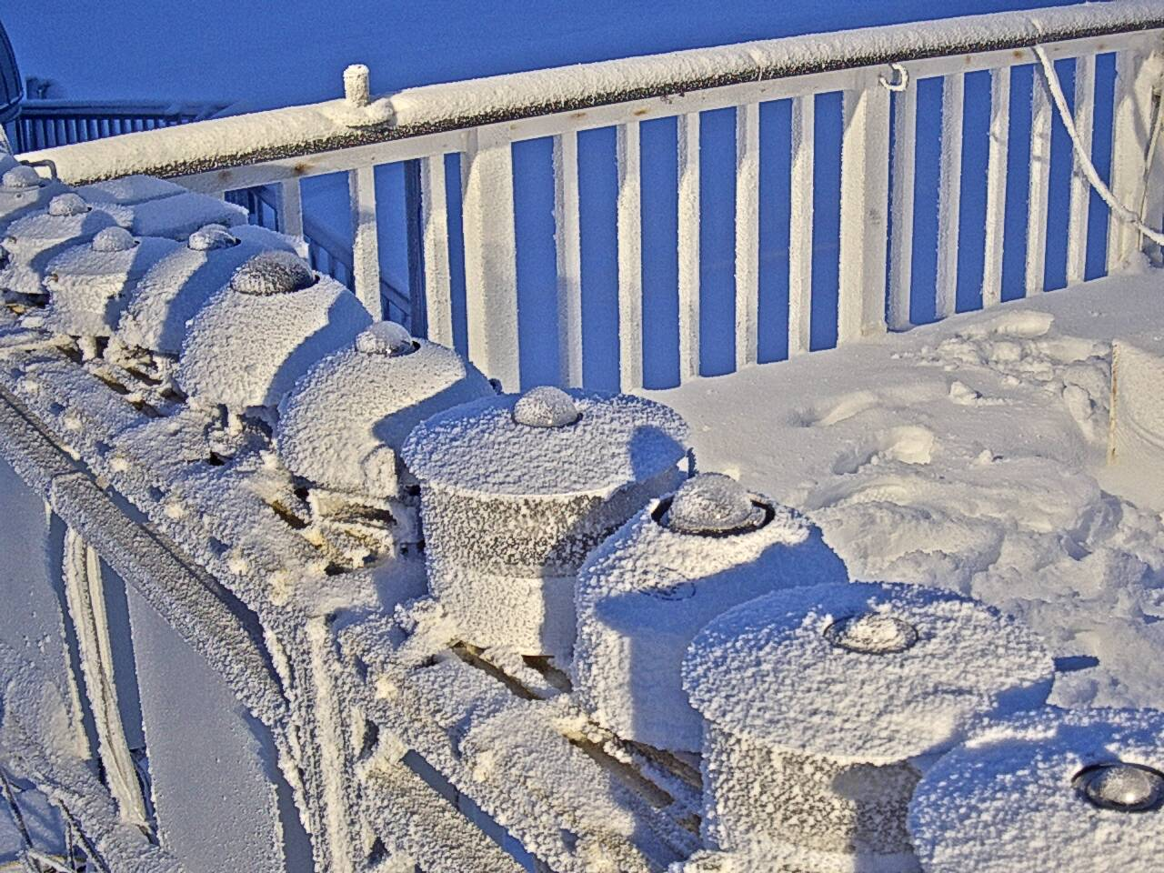
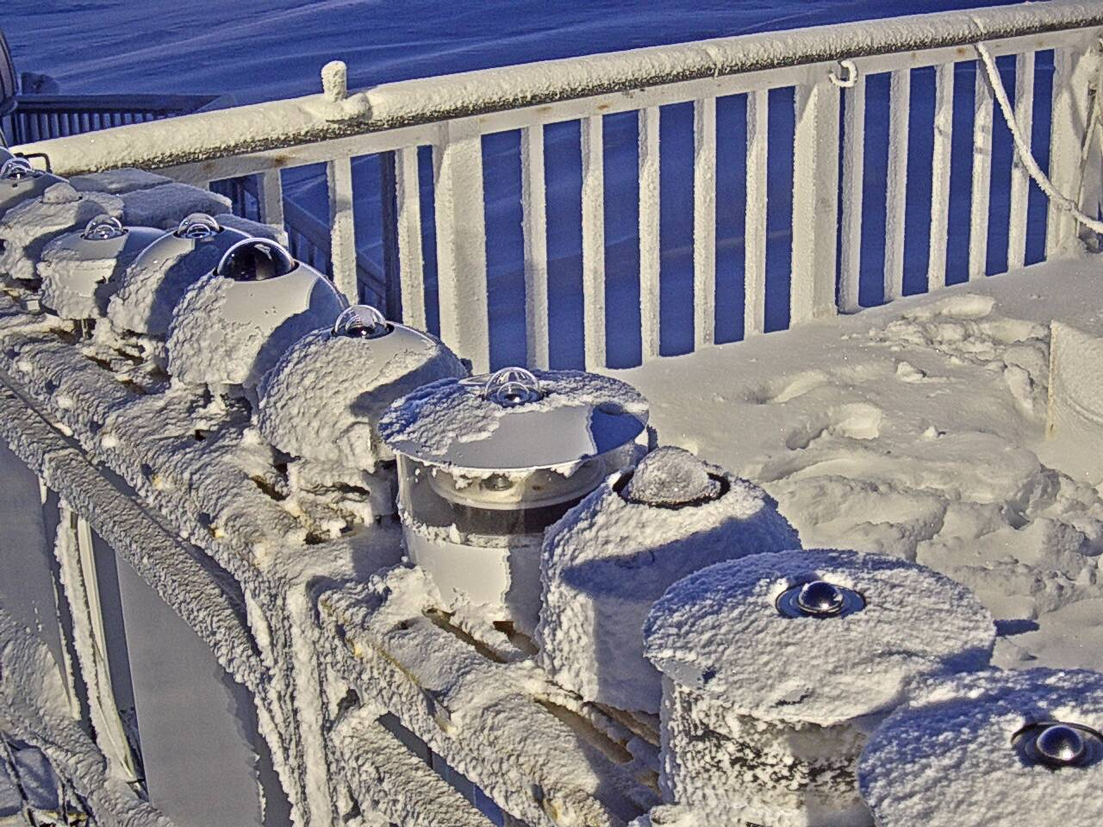
Ventilators turned off
Back on + 8 hours

Slide 6
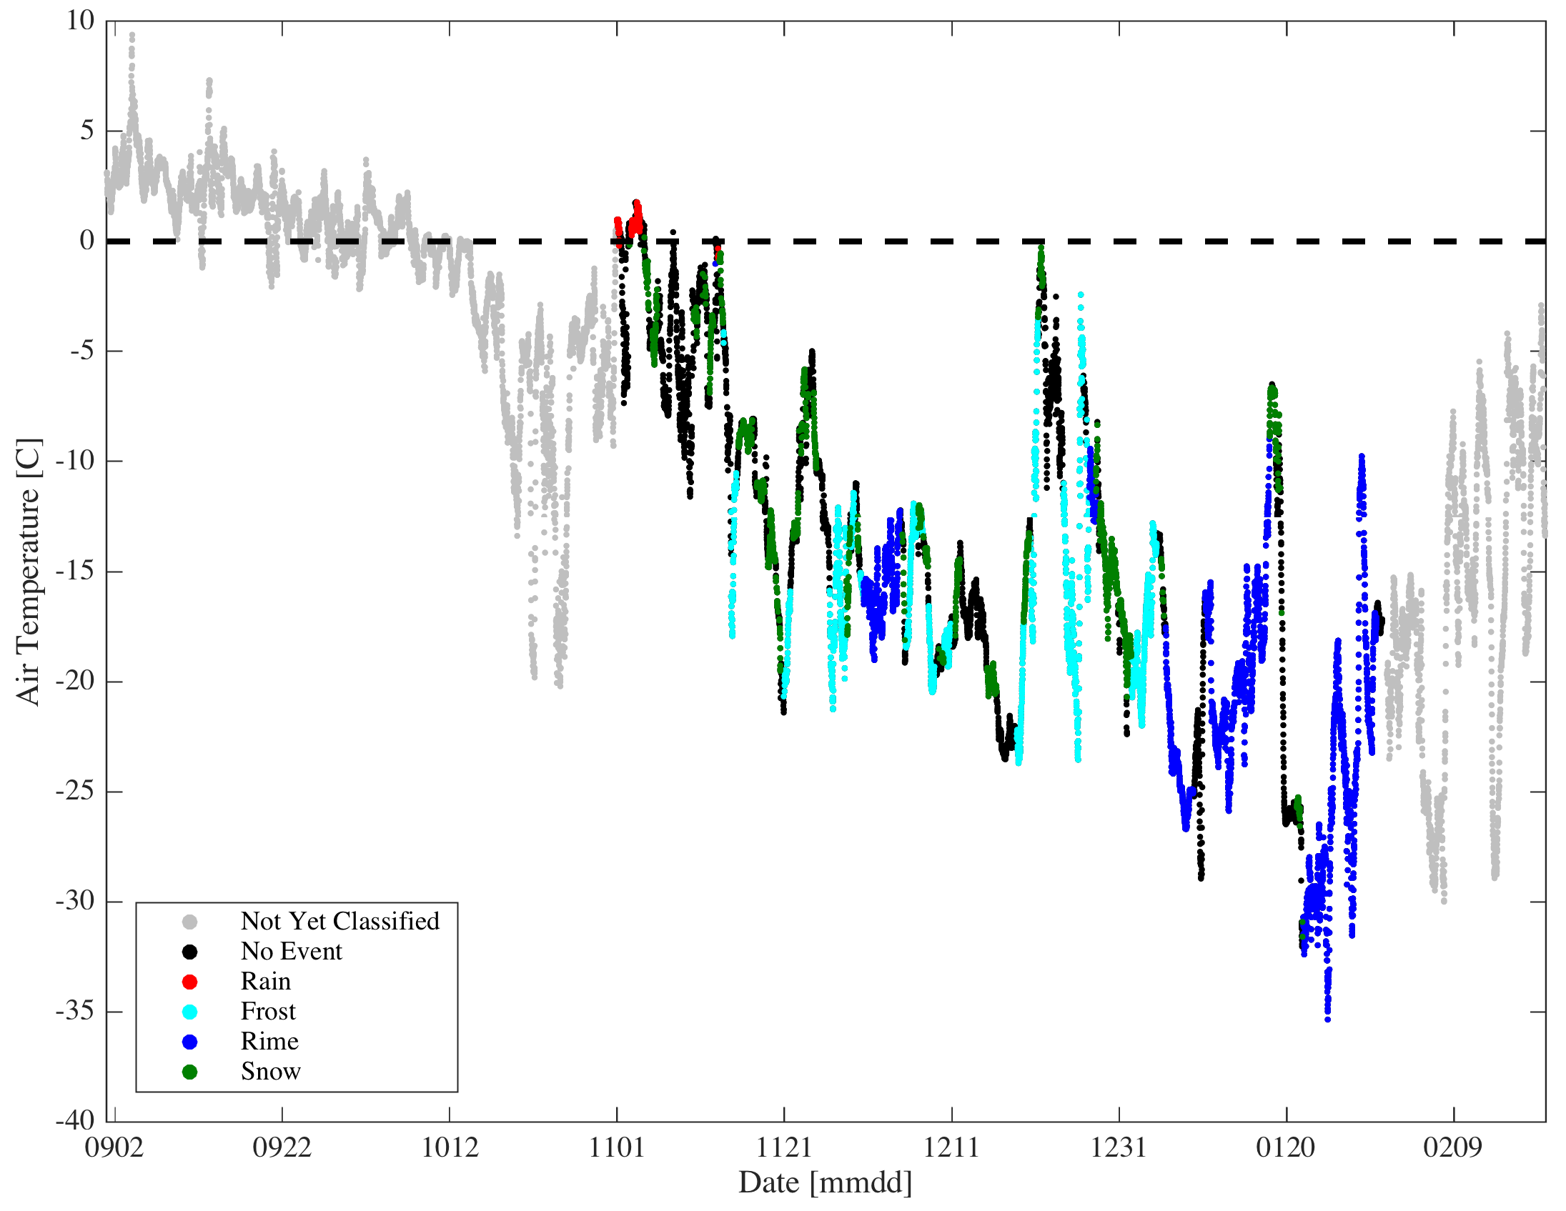
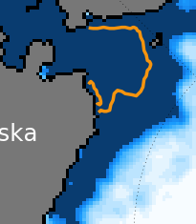
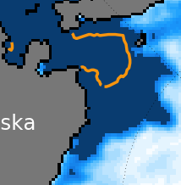
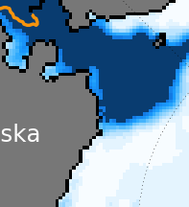
Aug 19, 2017 to Feb 20, 2018
~ 55,000 images
Image uptime (classified period) 96.4%
First ice event
October 10

Slide 7
Preliminary Classification of the D-ICE images
Only November, December and January analyzed thus far.
  Nov-Jan = 8832 15 min images of 26 radiometers = 229,632 total.
  The total length of tested time is 92 days tested of which 39.8 days (3820 15 min images) were taken during times classified as being impacted by frost or rime, including both development and ablation periods.
Made movies for each month stamped continuously with each frame’s filename. The image quality is the same as the original files. For each month, I step through the whole month for each radiometer individually. Can complete a month in 6-8 hours time.
The natural icing “condition” determined using CAM1 with CAMs as supplements. Identify events by looking at the table, railings, shields, logger boxes etc. Durations = full length of time ice is present: i.e., the end of the event is not the end of ice growth, but when the scene is naturally de-iced. Conversely, precipitation (generally, rain or snow) defined only during the period of active precipitation.
-99 = blackout or iced lens
-88 = cleaning
-77 = ethanol on the dome
-76 = ethanol-induced ice?
-60 = other/wtf? (rare)
0 = dome clear
10 = rain/wet/slush minimal
= rain/wet/slush
20 = frost light/side of dome
21 = frost heavy/top of dome
30 = rime light/side of dome
31 = rime heavy/top of dome
40 = snow: trace on dome
41 = snow accum on dome
42 = snow accum on shield

Slide 8
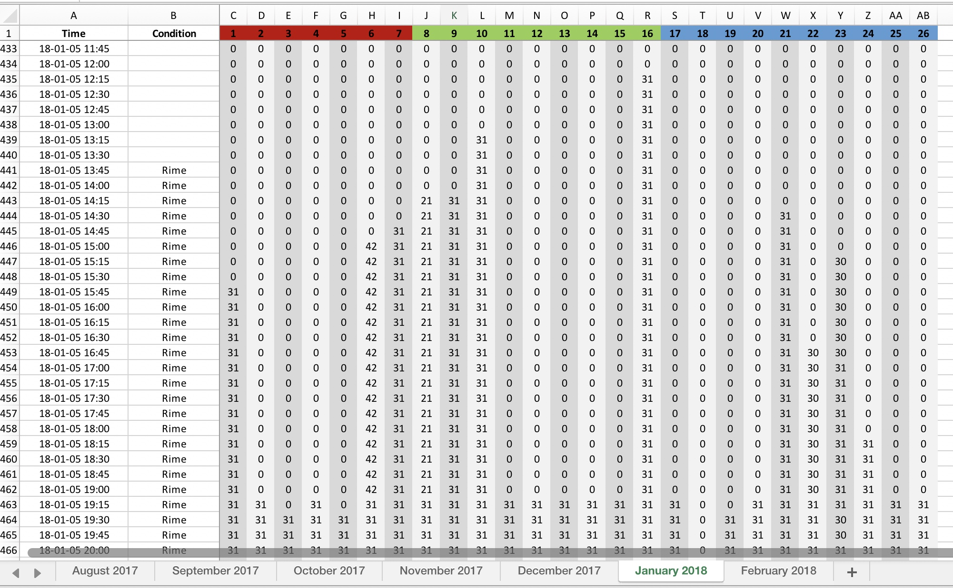
Preliminary Classification of the D-ICE images

Slide 9
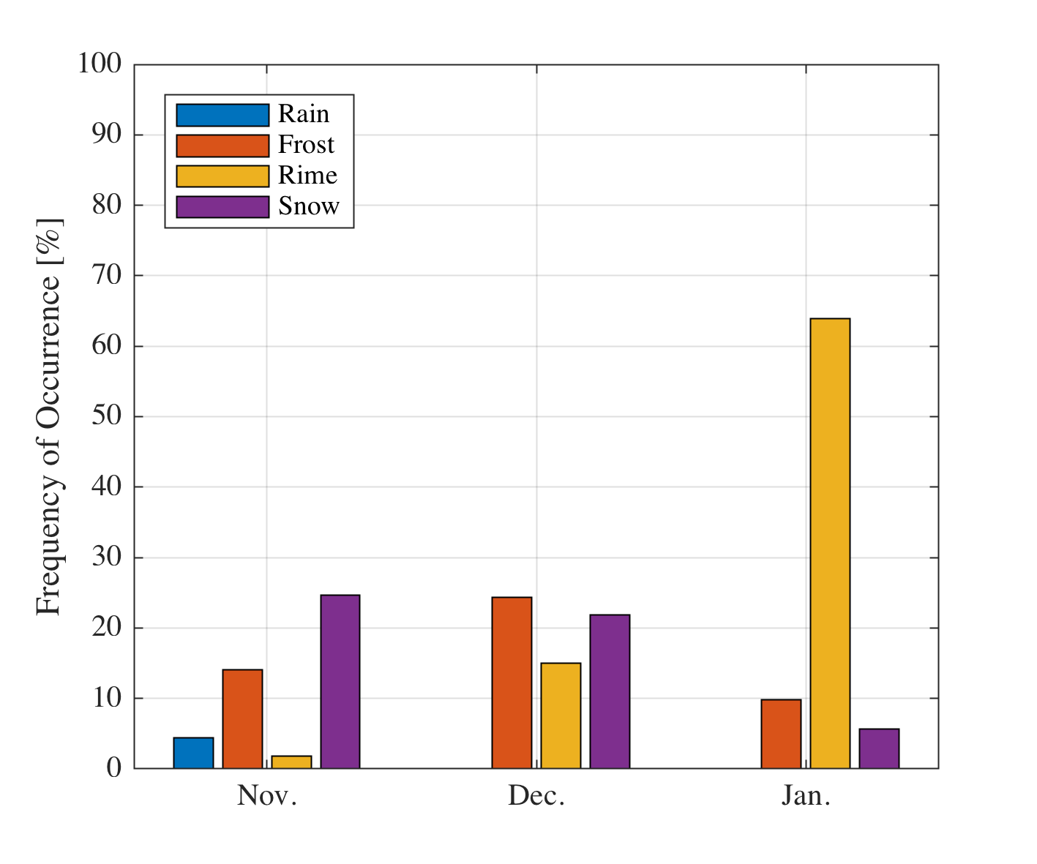
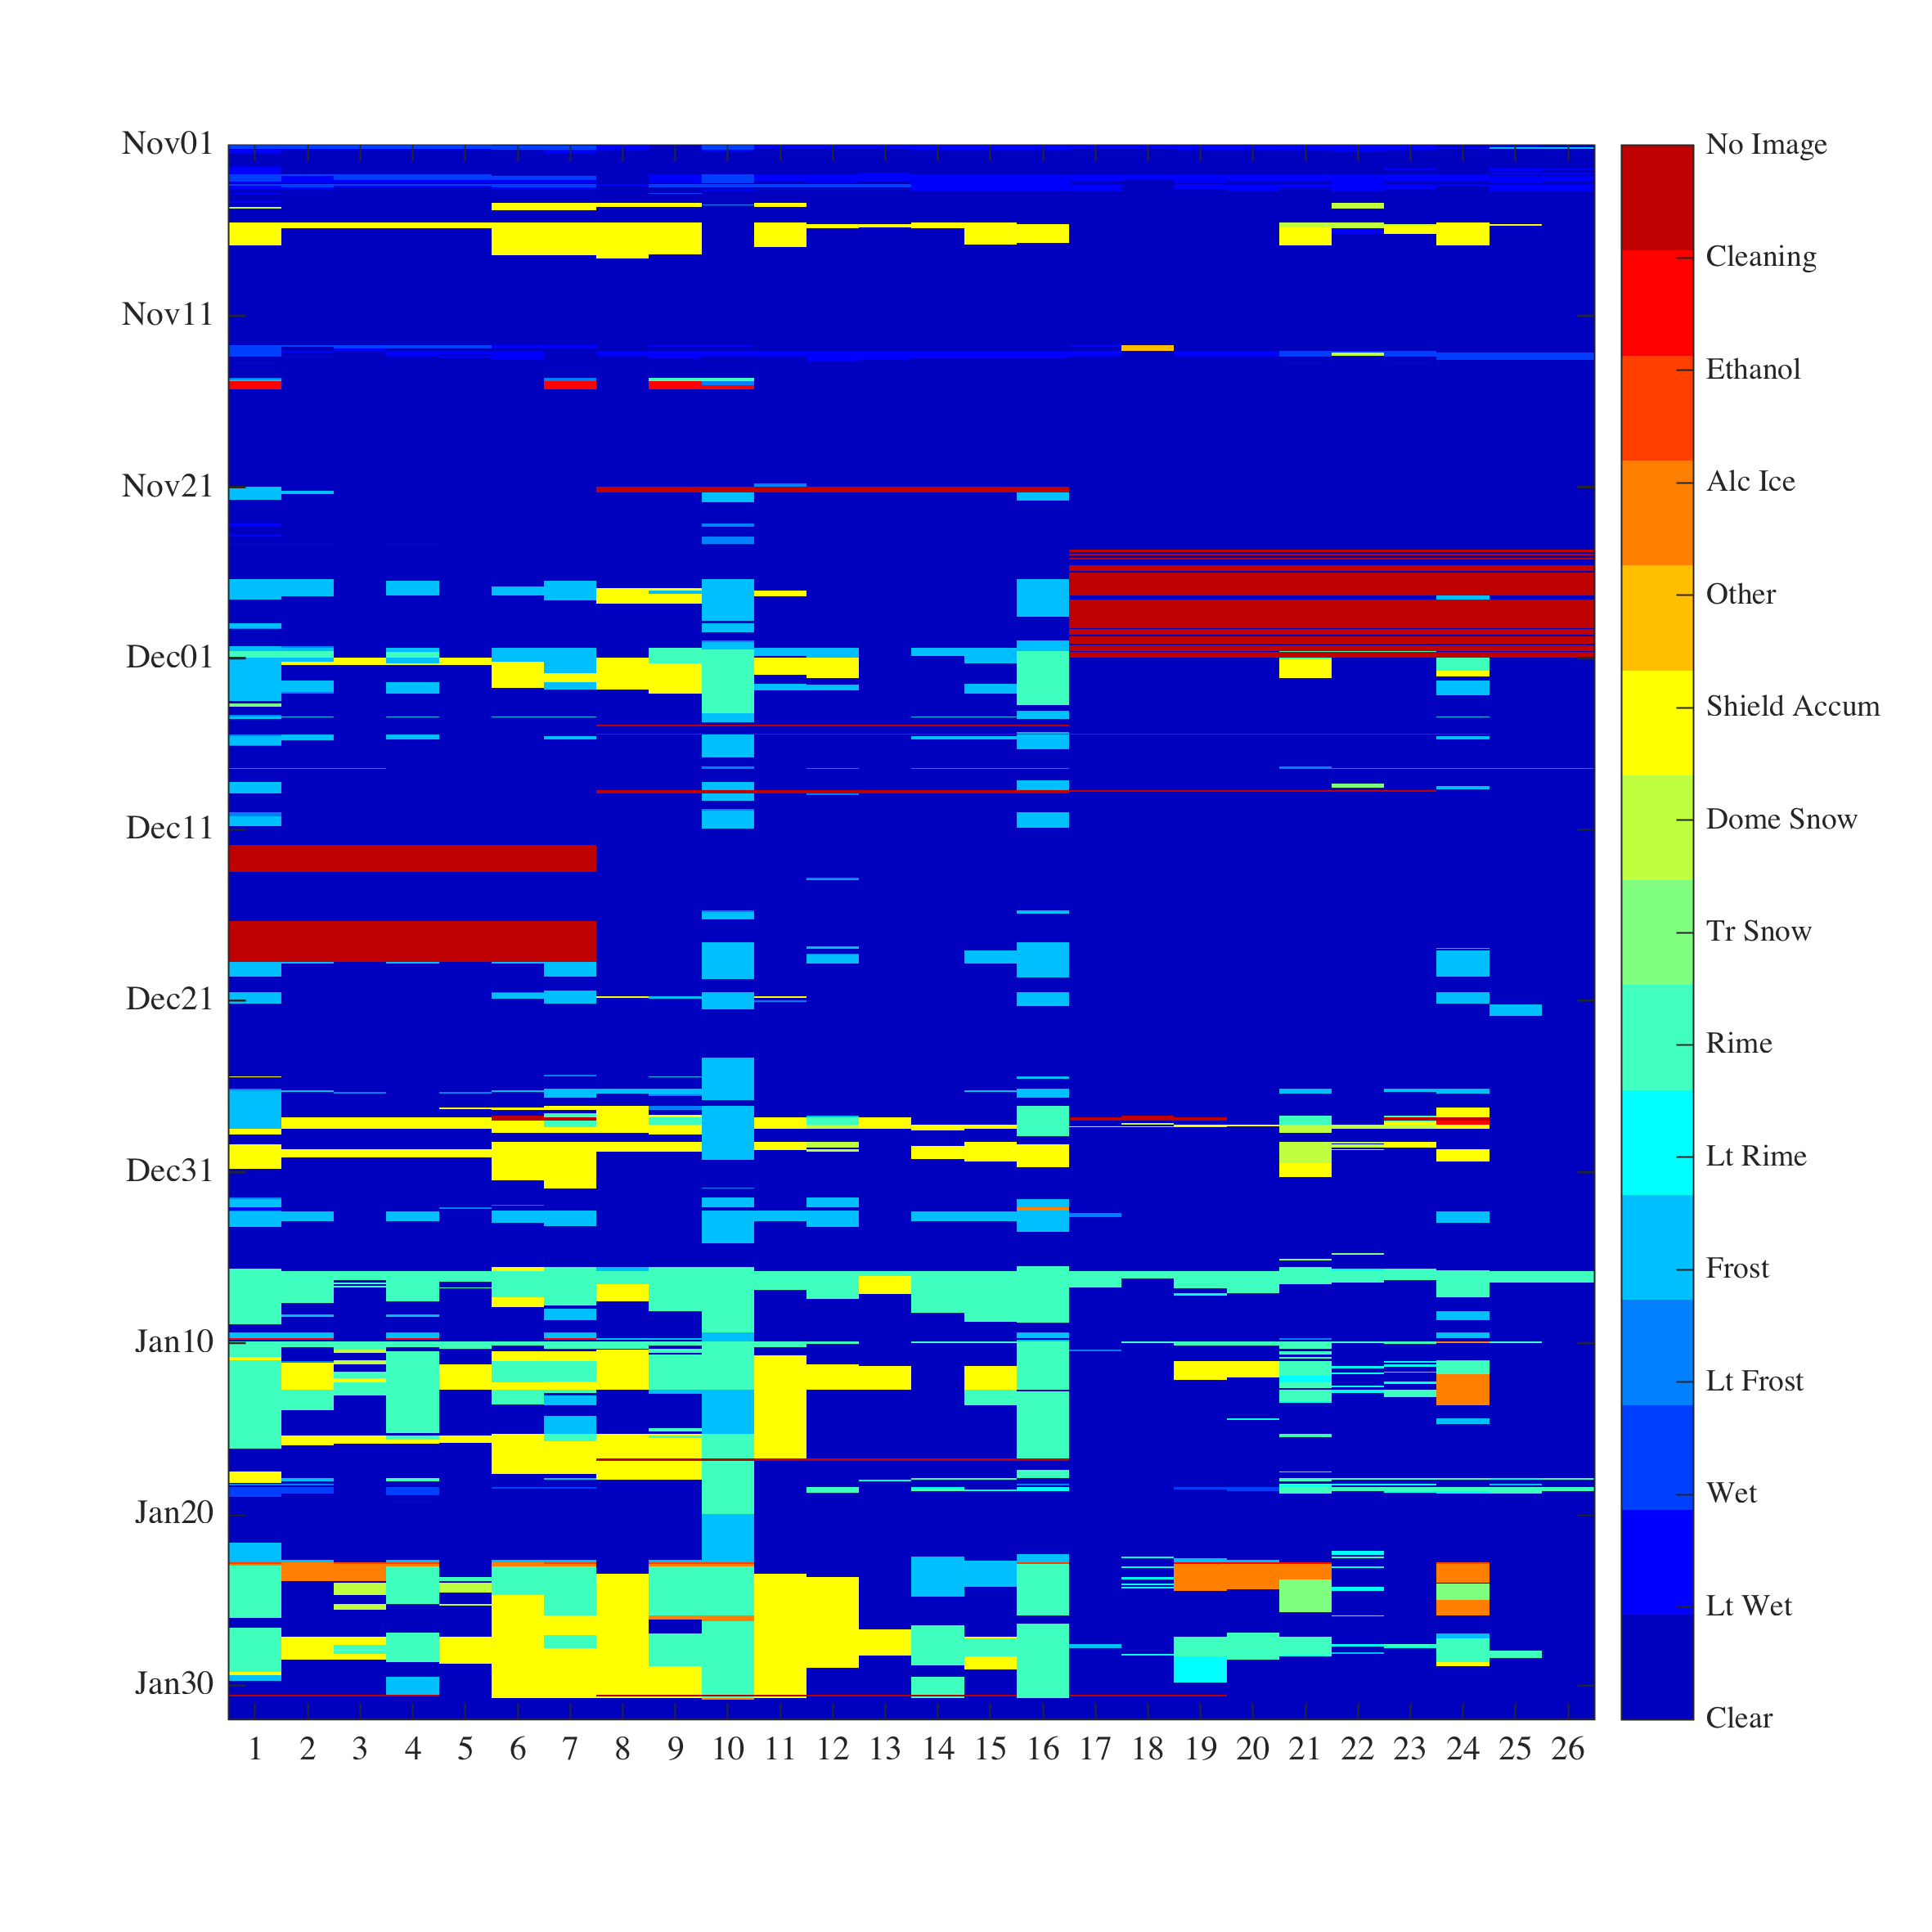
Preliminary Classification of the D-ICE images
Only November, December and January analyzed thus far.
  Nov-Jan = 8832 15 min images of 26 radiometers = 229,632 total.
  The total length of tested time is 92 days tested of which 39.8 days (3820 15 min images) were taken during times classified as being impacted by frost or rime, including both development and ablation periods.
Made movies for each month stamped continuously with each frame’s filename. The image quality is the same as the original files. For each month, I step through the whole month for each radiometer individually. Can complete a month in 6-8 hours time.
The natural icing “condition” determined using CAM1 with CAMs as supplements. Identify events by looking at the table, railings, shields, logger boxes etc. Durations = full length of time ice is present: i.e., the end of the event is not the end of ice growth, but when the scene is naturally de-iced. Conversely, precipitation (generally, rain or snow) defined only during the period of active precipitation.
-99 = blackout or iced lens
-88 = cleaning
-77 = ethanol on the dome
-76 = ethanol-induced ice?
-60 = other/wtf? (rare)
0 = dome clear
10 = rain/wet/slush minimal
= rain/wet/slush
20 = frost light/side of dome
21 = frost heavy/top of dome
30 = rime light/side of dome
31 = rime heavy/top of dome
40 = snow: trace on dome
41 = snow accum on dome
42 = snow accum on shield

Slide 10
Preliminary Classification of the D-ICE images
Things I do well
  Identify the presence of some type of contamination
    For LW, I have also gone back and rechecked points where there was disagreement, screening out another ~50 pts across a couple radiometers.
Things I do “okay”
  Identify what the contaminations is (e.g., frost vs rime)
    Can be difficult. Many cases where rime event underway and some radiometer domes show mostly clear and occasional/brief frost development
    Lots of cases of “rime” that is a combination of hoar frost and freezing fog
Things I do poorly
  Identify how much coverage is prohibitive (takes too long & too difficult)
  Distinguish light vs heavy: way too subjective and way too much variance within either category
  Assess the end time of the natural condition, especially for rime

Slide 11
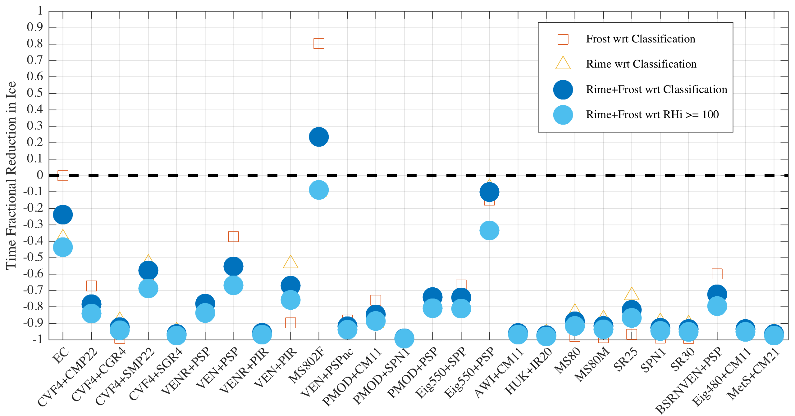
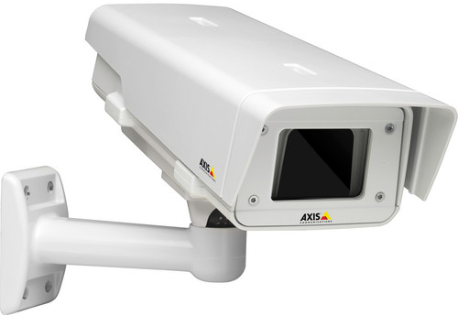
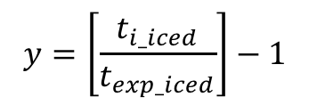

1 2 3 4 5 6 7 8 9 10 11 12 13 14 15 16 17 18 19 20 21 22 23 24 25 26
$$y=\left[\frac{t_{i_iced}}{t_{exp_iced}}\right]−1$$
$$i$$
t_{i_iced} is the time radiometer i was was iced.
t_{exp_iced} is the time the natural icing condition was was flagged either by classification or rhi.
This figure should be interpreted as the fractional change in icing caused by the use of the ventilator relative to natural de-icing. Generally, the value should be negative; i.e., -0.5 represents a 50% reduction in the presence of ice on the dome.
23/26 systems offer a 50%+ reduction in icing, 17/26 75%+ reduction. The mean is 75.4% and the distribution is log-normally distributed.
Positive values imply the system increases icing. This is seen on one unheated ventilator (MS802F), which may be the result of the airflow producing a low-pressure pocket around the dome and localized cooling that promotes deposition (the increased icing is seen in frost, not rime). Similarly, EC provides no defense against frost, but a 38% reduction in riming.
Wrt Classification more conservative than wrt Rhi because classification accounts for the sub-saturated period after an event during natural de-icing (sublimation): Avg. ~26% of the event.

Slide 12
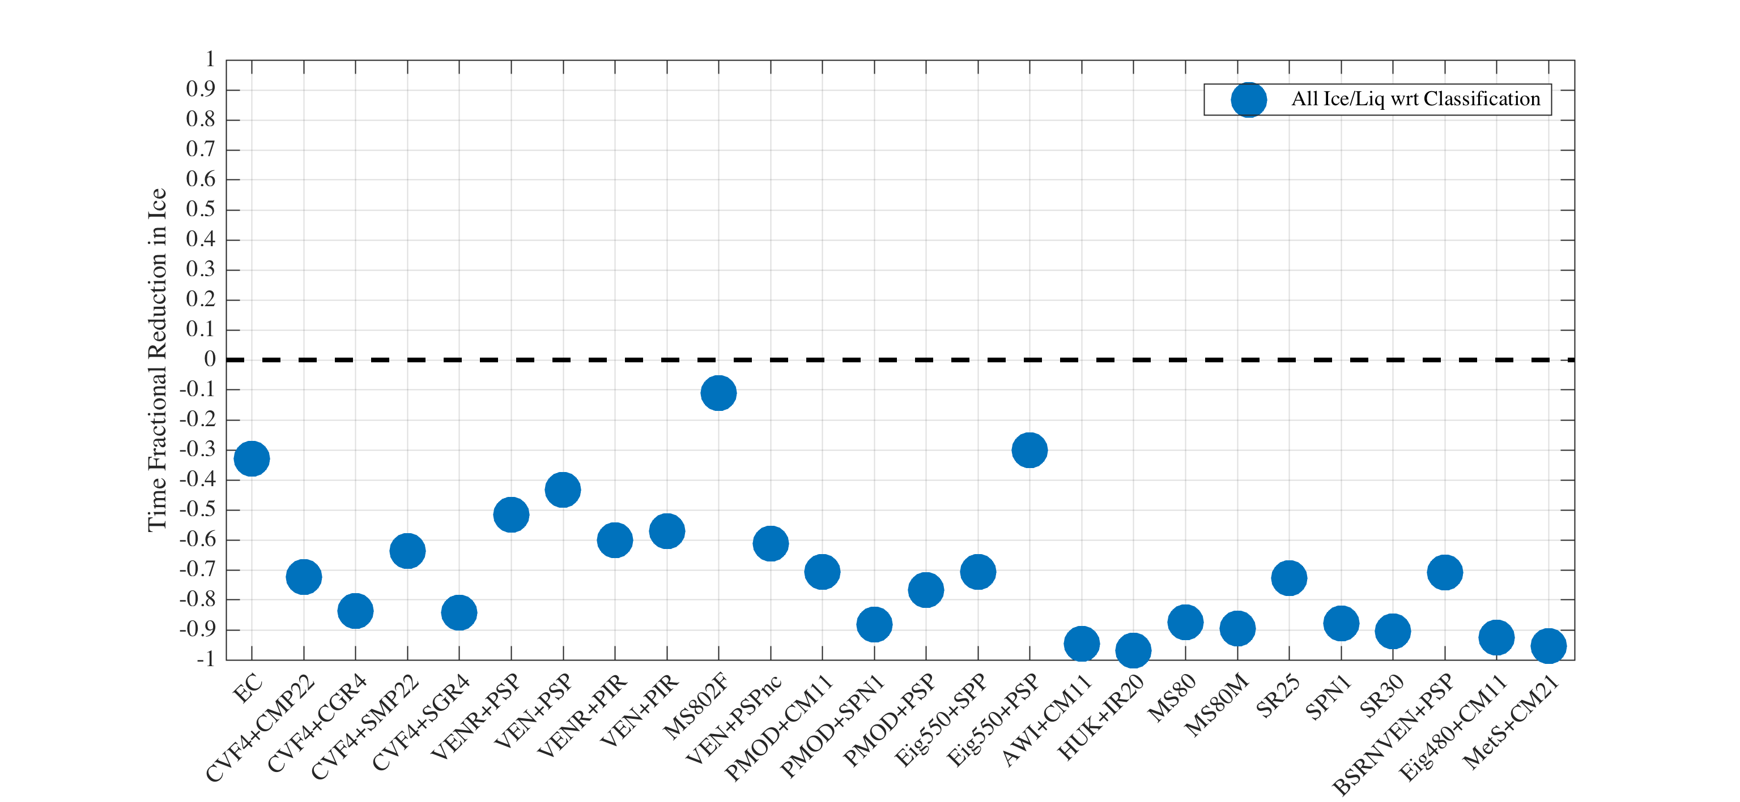

Slide 13
Preliminary Classification of the D-ICE images
I would like to…
  Get rid of “light” vs “heavy”
  Include development vs dissipation stages for natural condition and radiometers
  Set up a git-hub style version tracking for the spreadsheet and solicit input from others

Slide 14
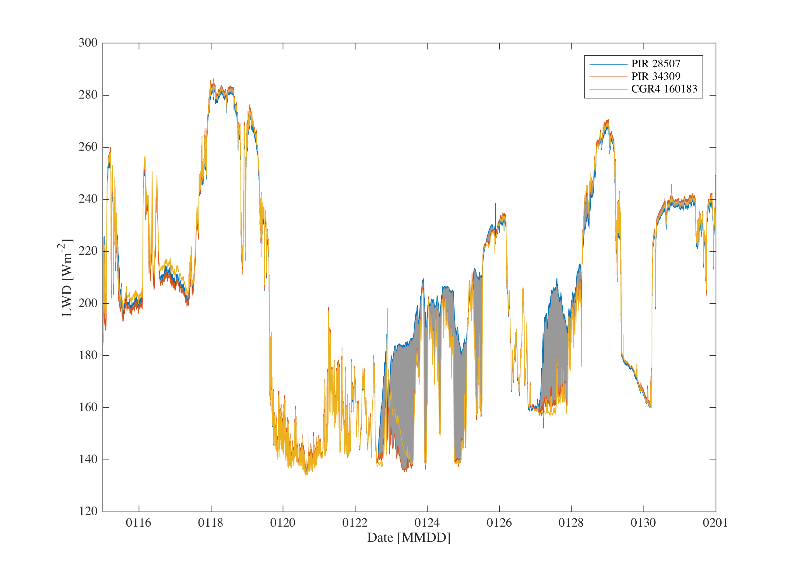
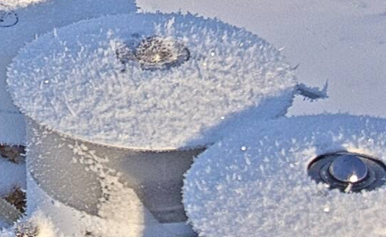
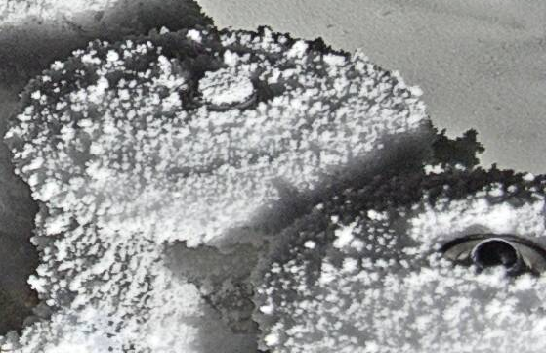
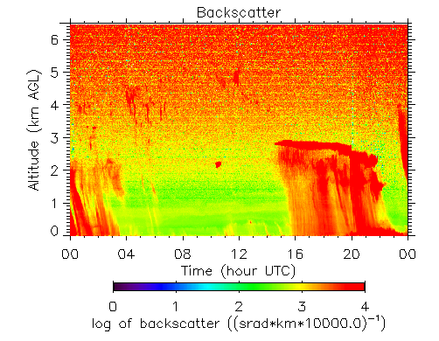
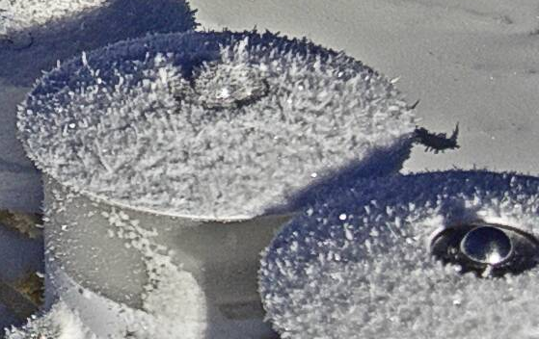
Diff: ~ 50 W m⁻²
Diff: up to 45 W m⁻²

Slide 15
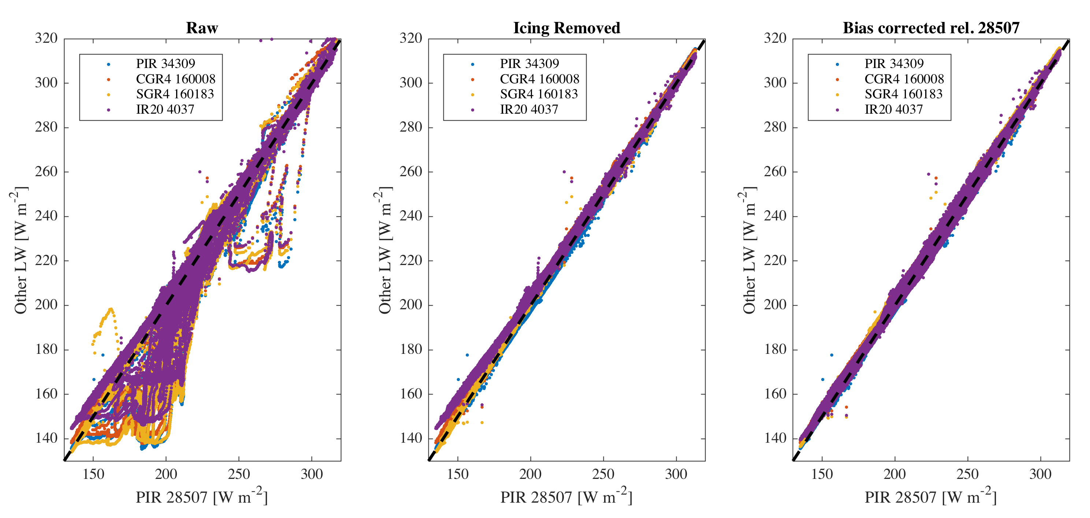

Slide 16
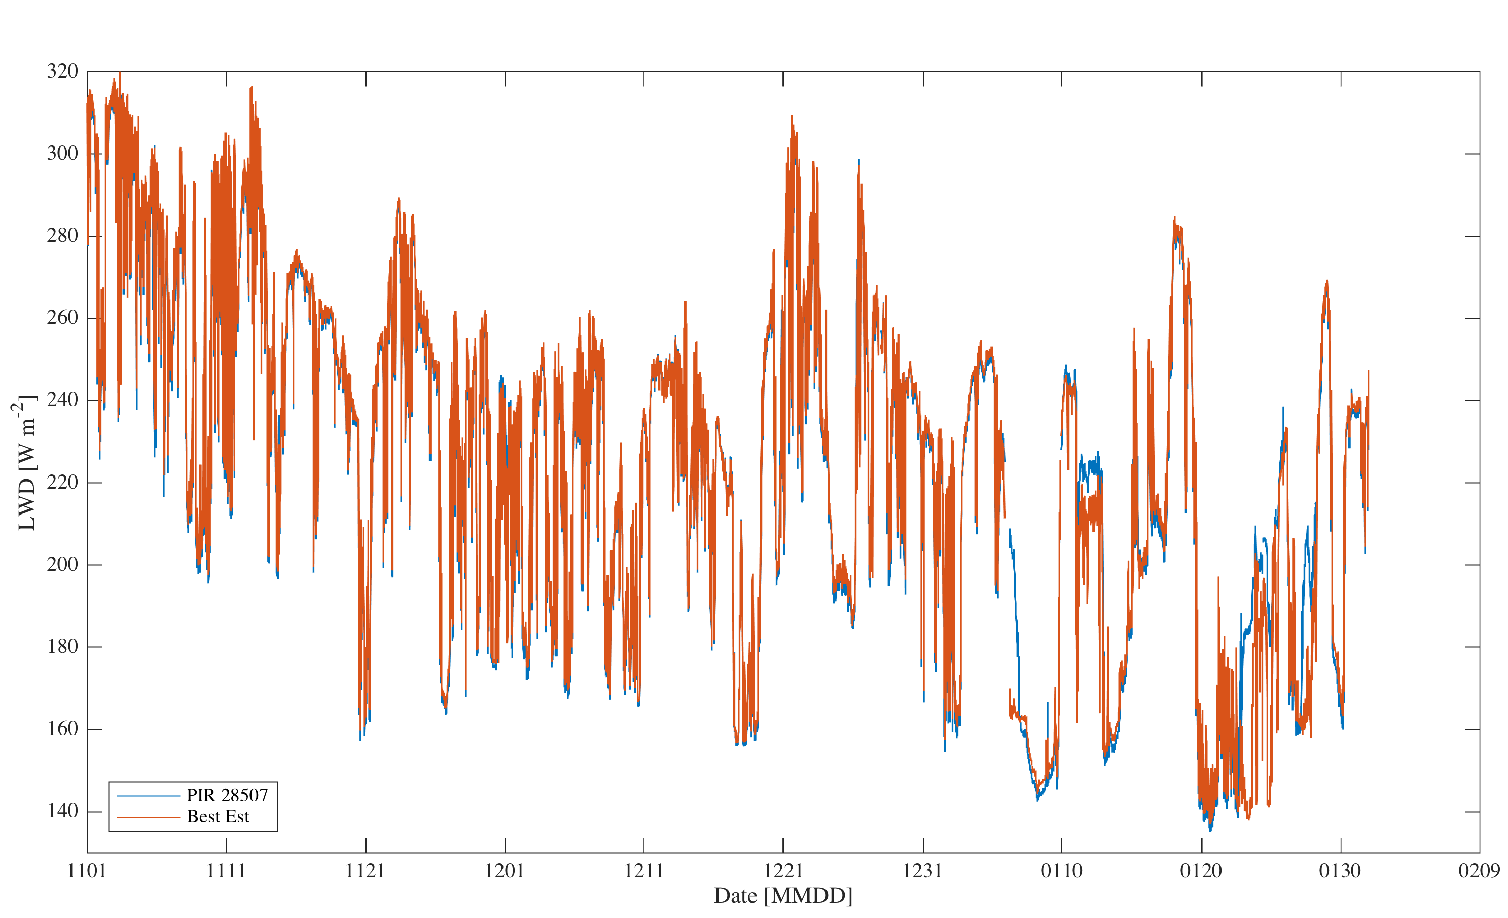
253.38 Wm⁻²
254.65 Wm⁻²
224.56 Wm⁻²
225.40 Wm⁻²
201.50 Wm⁻²
197.88 Wm⁻²
Diff = 3.63 Wm⁻²
Nov:
Δ = 1.27 Wm⁻²
Dec:
Δ = 0.84 Wm⁻²
Jan:
Record 98.6% Complete
(CAM2 down time 0.7% +
forced-ice experiment 1/9 +
no-vent experiment 1/5)
226.42 Wm⁻²
225.92 Wm⁻²
Diff = 0.5 Wm⁻²
Nov. 16% Iced
Nov. 16% Iced
Jan. 48% Iced

Slide 17
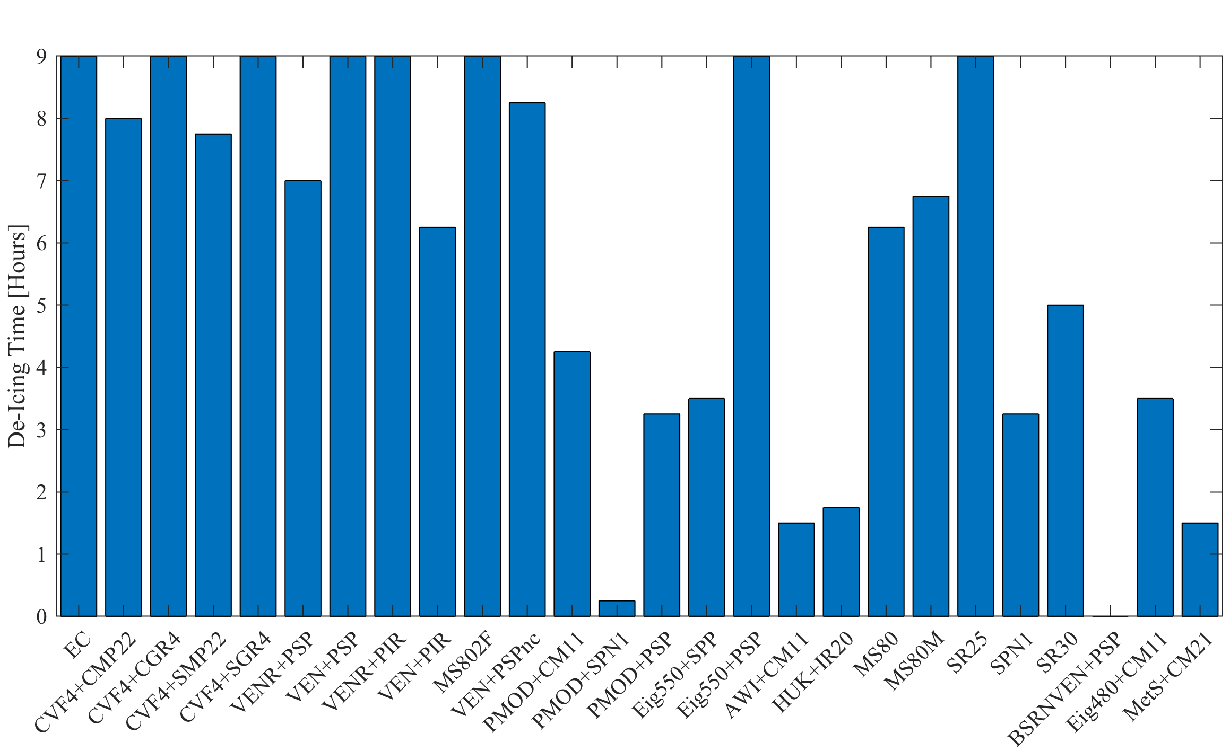
Forced Icing Experiment, 2018 Jan 9
Objective: Intentionally rime all domes with a consistent layer of ice and evaluated de-icing time.
Jan 9, 21:24-21:28 UTC, sprayed to “mists” of room-temperature snow meltwater to the east side of the dome and two more to the west side of the dome for all radiometers.
RHw = 84.9±1.8%, RHi = 102.5±0.6%, -26.7 to -16.2 C, SZA 92.9º to 118.8º.
While there was not an active icing event underway at the time of the spraying, unfortunately, freezing fog arrived with a few hours. Light natural riming began around 10 Jan at 9 UTC around 12 hours into the test and was briefly moderate-severe about 10 hours later. To avoid impacts of the fog, the experiment is cut off a +9 hours (6:30 UTC).
Mean = 5.9 hours
8/25 were not de-iced in 9 hours
BSRN was not included in the experiment, but was cleaned after the sprays. The ethanol appears to have induced some icing, which lasted 2.75 hours.

Slide 18
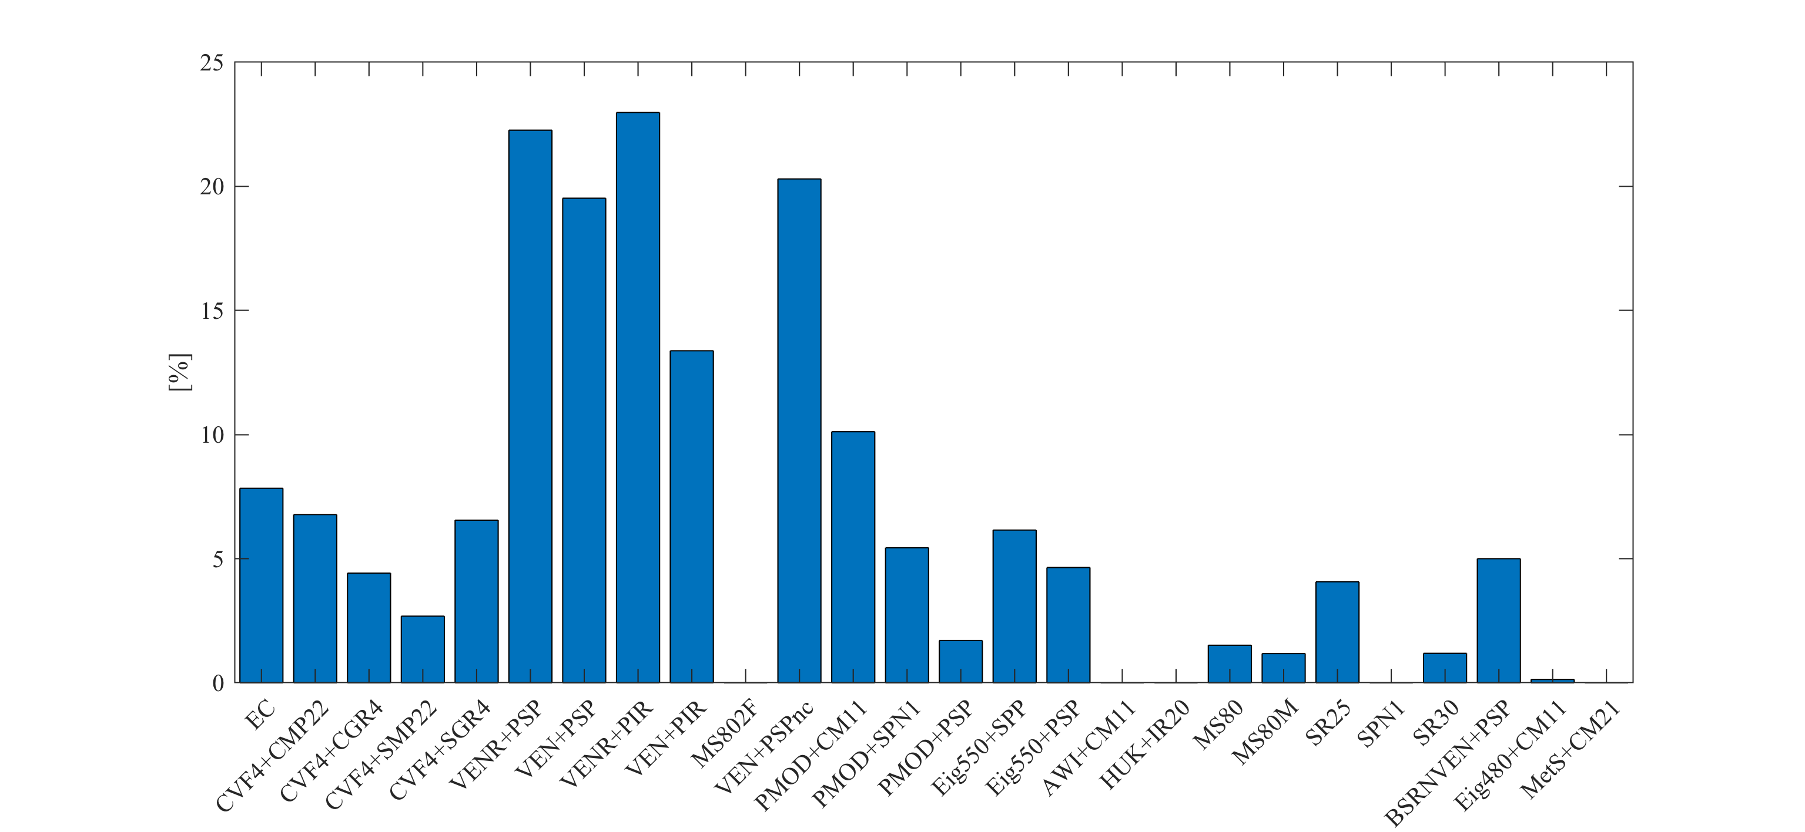
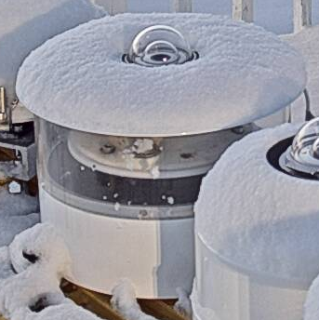
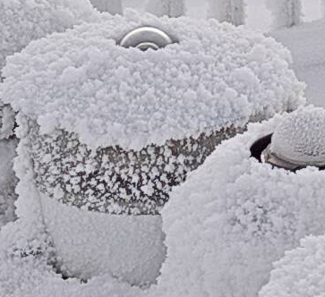
Snow/Rime on shield obstructing measurement (when otherwise clear dome)
Snow
Rime
This is mostly a problem with VENs because of their flat shield that collects snow. It also affects other systems too, but less so due to snow and more so due to rime (which also impacts the VEN). The BSRN VEN is minimally affected because of maintenance procedures.
Due to the design of the classification, which assigns only a single code to each radiometer image and gives priority to ice appearing on the dome, this analysis currently only includes times when the problem occurred, but the dome remained clear.

Slide 19
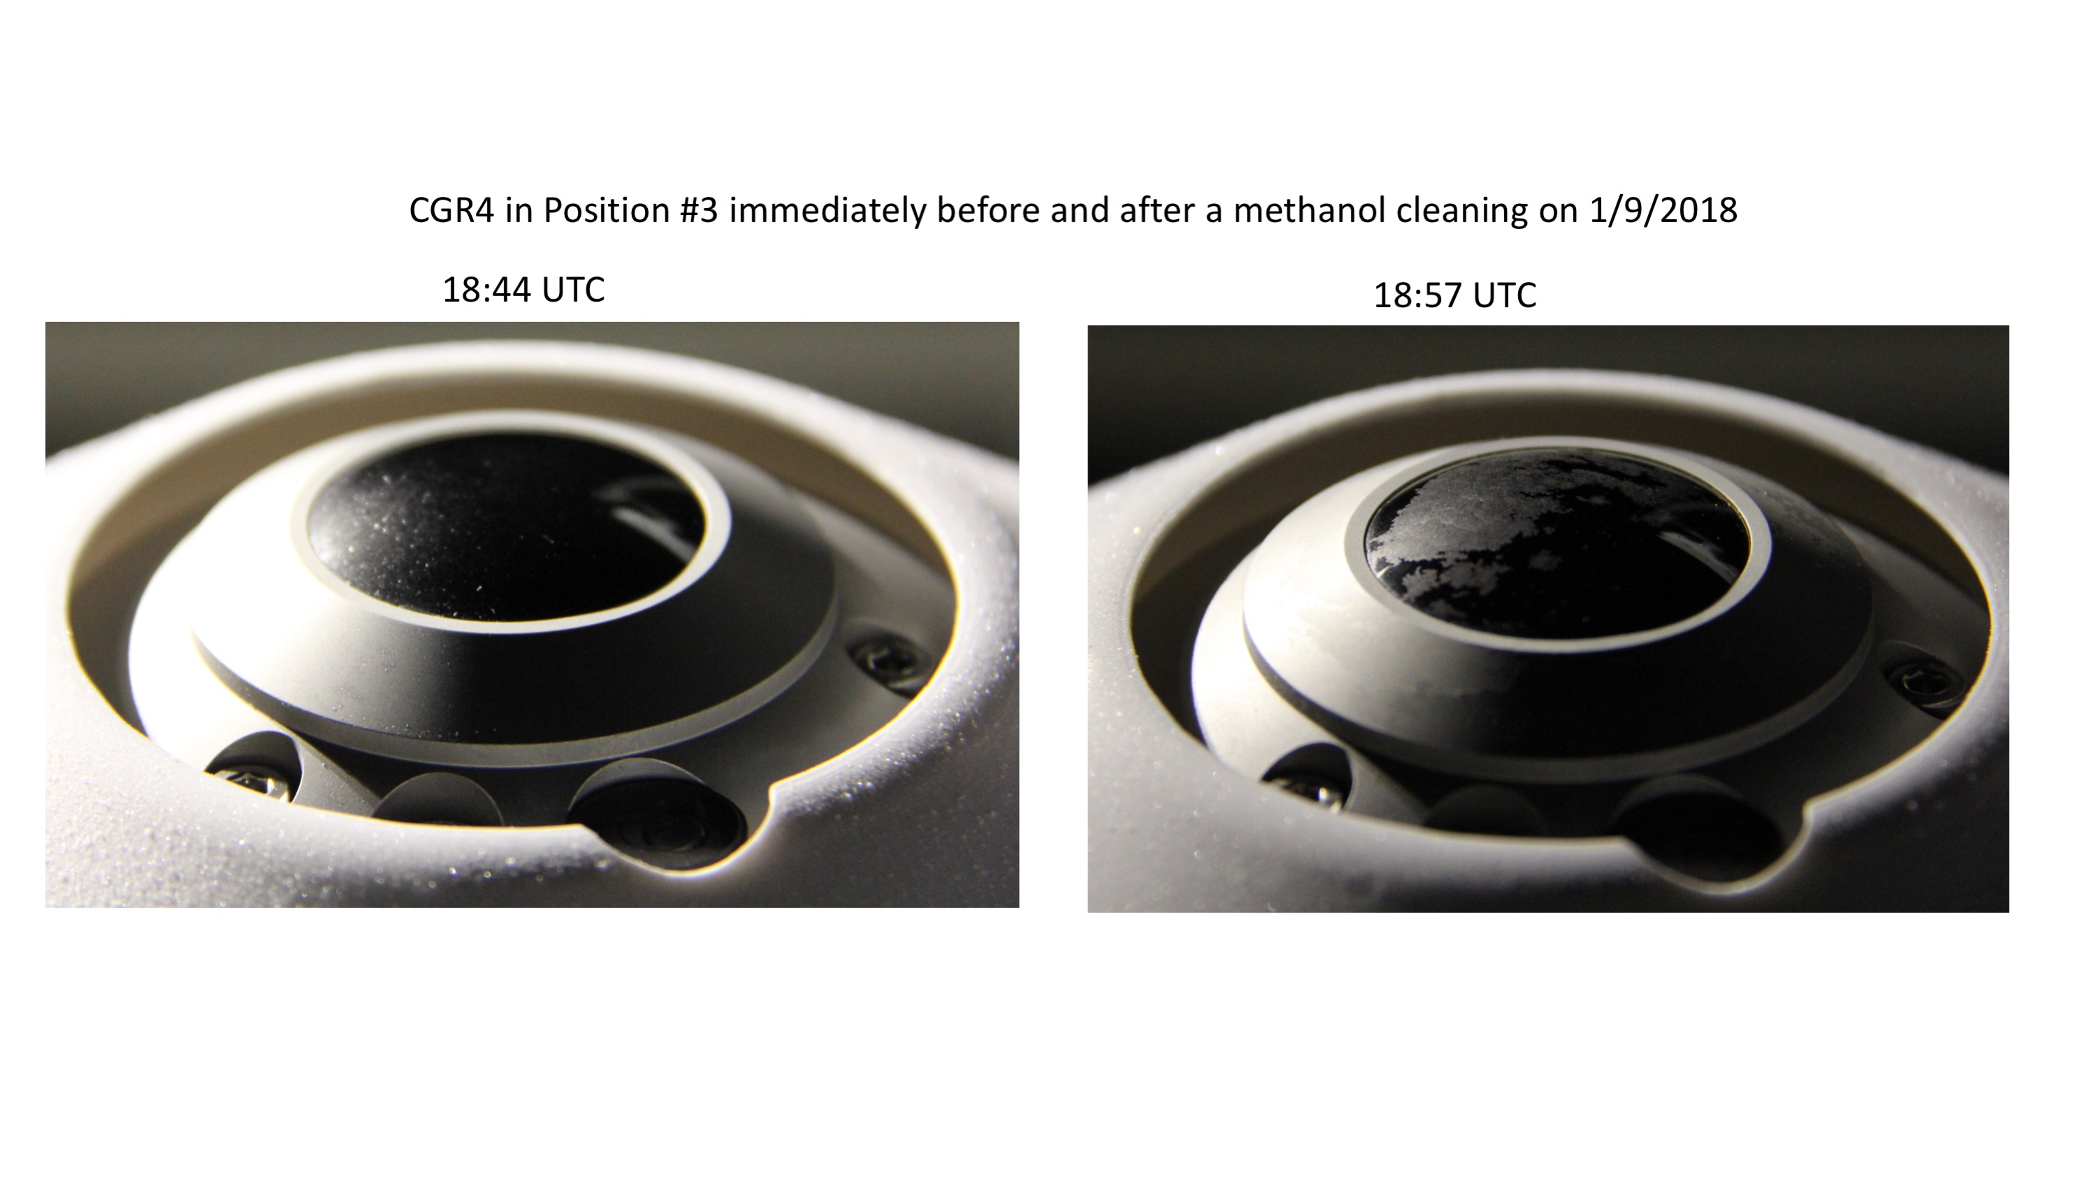
Ethanol => Ice?
You have all seen this...

Slide 20
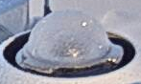
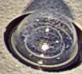
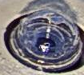
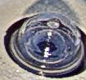
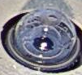
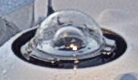
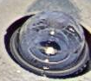
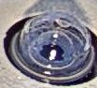
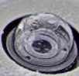
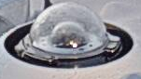
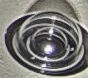
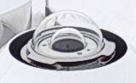
Maybe an even bigger problem…. ”Spray it and forget it” cleaning: 22 January 2018
20:45Z
+15 min, +15 min …
Rime
21:00Z
20:45Z
Ethanol
New Ice
Ethanol
Frost
21:15Z
New Ice
22:15Z
Clear Reference
(Different Day)
Clear Reference
(Different Day)

Slide 21
BRW uses “pure” ethanol:
  Hypothesis 1: There is some vapor contamination in storage that results in residual water to freeze.
  Hypothesis 2: Atmospheric vapor condenses into the alcohol and is then left as residual.
  Hypothesis 3: Evaporation cools the dome sufficiently to attract deposition of atmospheric vapor.
  Hypothesis 4: Ethanol melts ice => water/alc mixture => residual water refreezes
  Hypothesis 5: Kimwipe leaves particles behind that promote ice formation.
Ross’s experience taught him to manually dry it completely, implying that we can rule out hypothesis 5; i.e., more towels = better results.
Hypotheses 1-4 all likely have a role, but we do not know which are the big lever(s).
We are sending a DSLR to BRW and Ross/Bryan will attempt to document this problem.

Slide 22
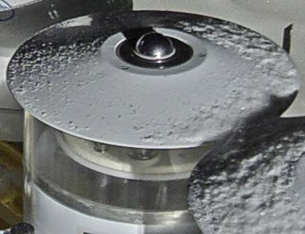
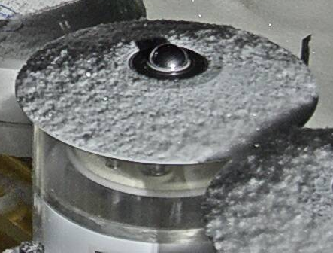
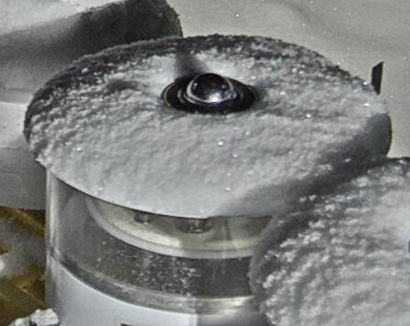
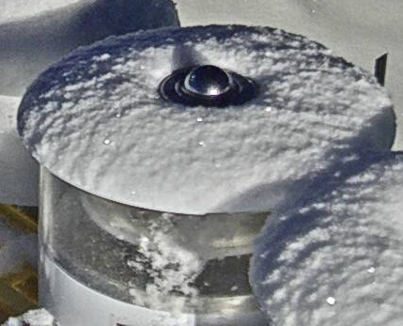
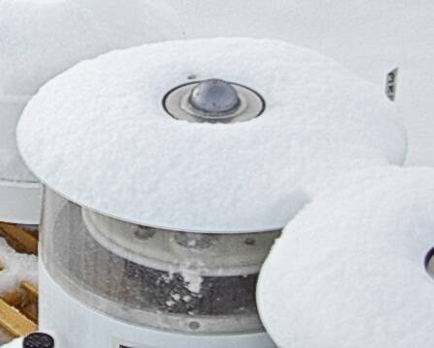
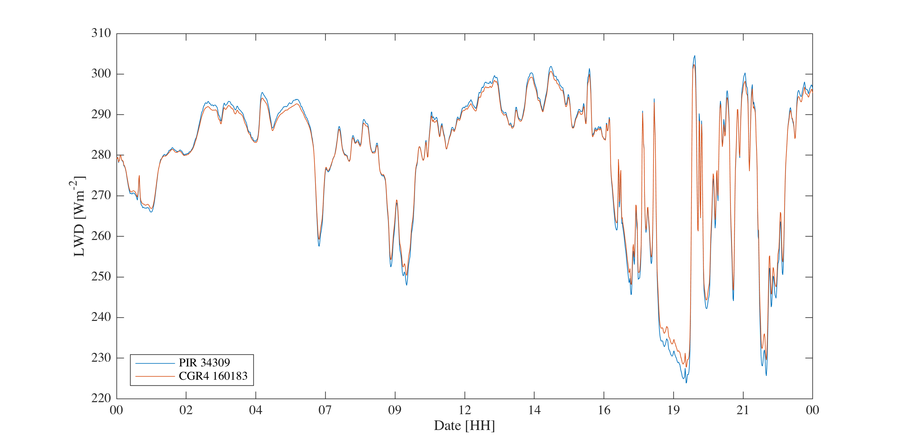

Slide 23
To dos…
Suggestions about image classification
When should we end D-ICE

