Slide 1
Building an Autonomous Surface Flux Observing Capacity for PSD
Applications to MOSAiC and Beyond
6 SEPT 2017

Slide 2
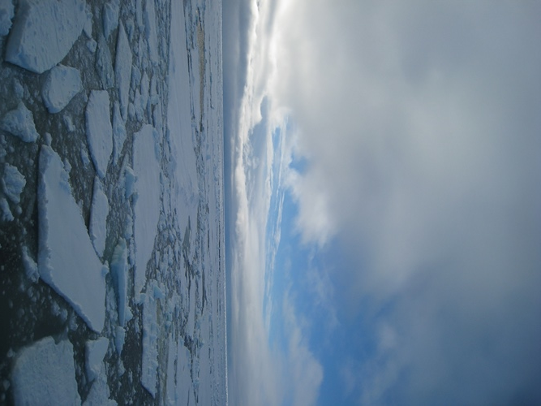
MOSAiC Concept
“What are the causes and consequences of an evolving and diminished Arctic sea ice cover?”
Sea-ice energy budget
Ice movement & deformation
Clouds / Precip / Aerosols
BioGeoChemistry and Ecosystems
Improved coupled modeling
Sea-ice forecasting
Assimilation Studies
Improved observing system

Slide 3

Science Focus Areas
Central Arctic Coupled System
Stratosphere
Vertical and meridional
dynamical coupling
Cloud, aerosol radiative properties
Cloud-aerosol interactions
Interactions with boundary layer
Precipitation
Dynamical coupling
Clouds
Radiation
Vertical fluxes through ocean, ice, atmosphere
Meridional fluxes in atmosphere and ocean
Aerosols
Ocean, ice & atmos chemistry, interactions w/ aerosols
Thermal structure
Small scale processes
Chemistry
Energy & momentum
fluxes
Boundary layers
Biogeochemical fluxes
Sea ice
Ecosystem
Formation
Drift
Deformation
Melting
Ocean structure
Mixing processes
Full seasonal cycle:
Ecosystem dynamics
Populations in ocean & sea ice

Slide 4
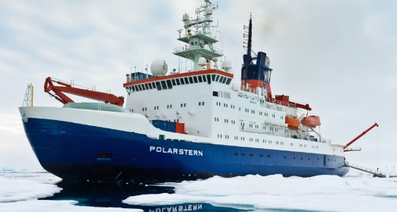
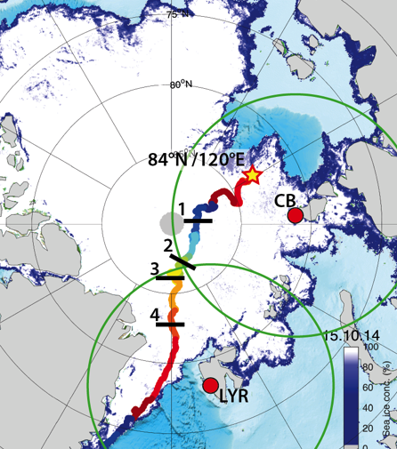
MOSAiC Concept
Drifting, interdisciplinary process study in central Arctic sea ice
Central Observatory: intensive atmos-ice-ocean-ecosystem observations
Distributed Network: Heterogeneity on model grid-box scales
Coordinated, multi-scale analysis and modeling activities
2019-2020, Full annual cycle

Slide 5
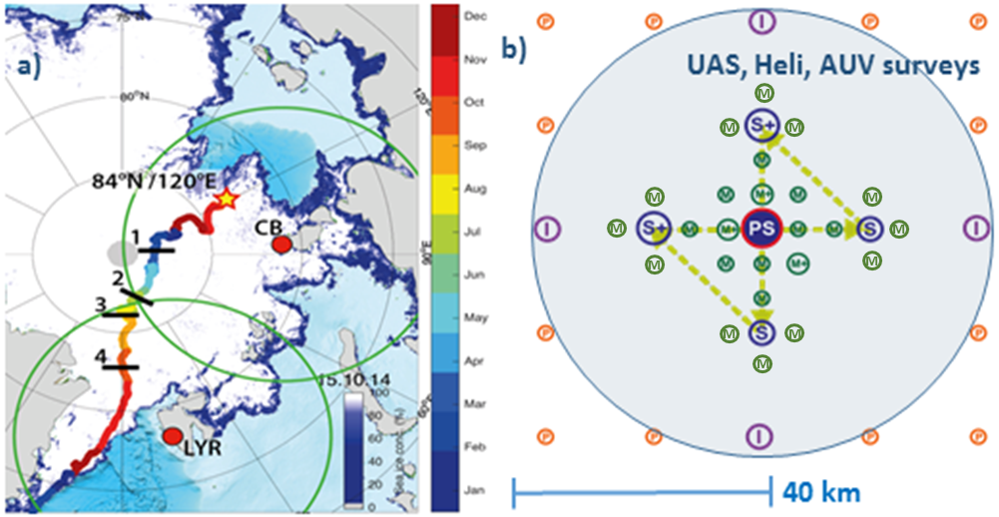
MOSAiC Concept
Polarstern = Central Observatory
Super-sites: IMB, Fluxes
Intermediate nodes
Intermediate nodes
Position buoys
MOSAiC Distributed Network

Slide 6
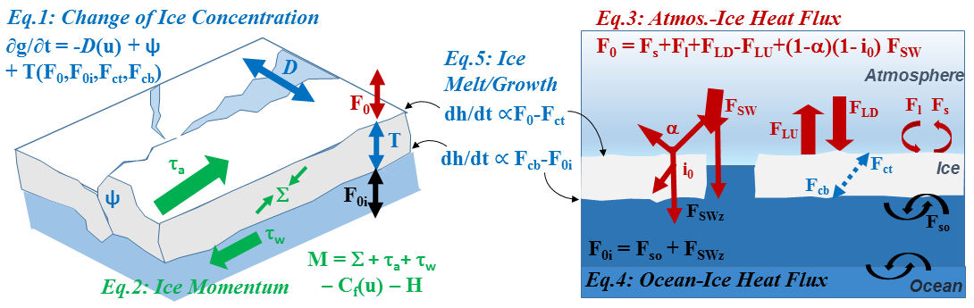
Thermodynamic and dynamic drivers of the Arctic sea-ice mass budget
An NSF/NOAA-funded MOSAiC activity
Matthew Shupe, Chris Fairall, Jenny Hutchings, Don Perovich, Ola Persson, Amy Solomon, Tim Stanton

Slide 7
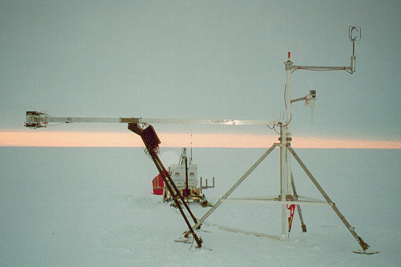
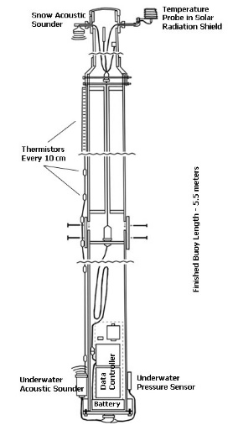
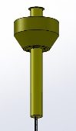
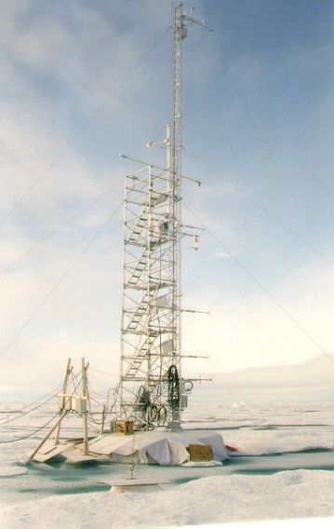
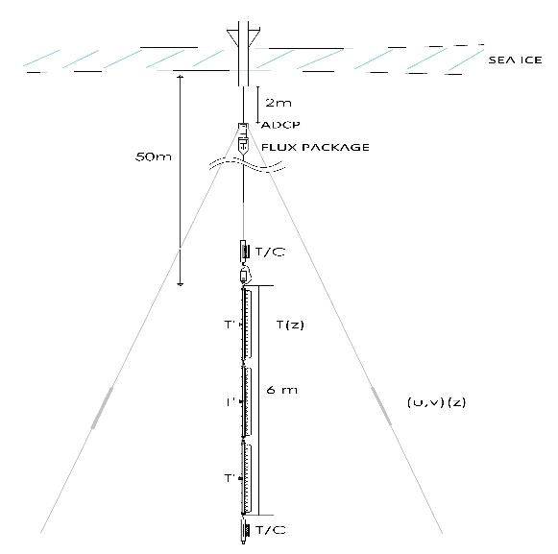
Installations
GPS buoy array (30-40)
Drift, deformation
4 x Flux Nodes
Atmospheric Surface Flux (ASF)
momentum, turbulent fluxes
Seasonal Ice Mass Balance (SIMB)
radiative fluxes
meteorology
precip rate
top height change
snow depth
ice thickness, temperature, conductive flux
Sea ice
bottom height change
heat, salt, momentum flux, optics
ADCP current profile
Autonomous Ocean Flux Buoy (AOFB)
pycnocline diffusivity, heat flux
Atmospheric Met Tower

Slide 8
Atmospheric Surface Flux Stations
Portable Automated Mesonet (PAM) Stations
Thermoelectric generators
20-30 W total
NCAR
Deployed at multiple locations during SHEBA with mixed success

Slide 9
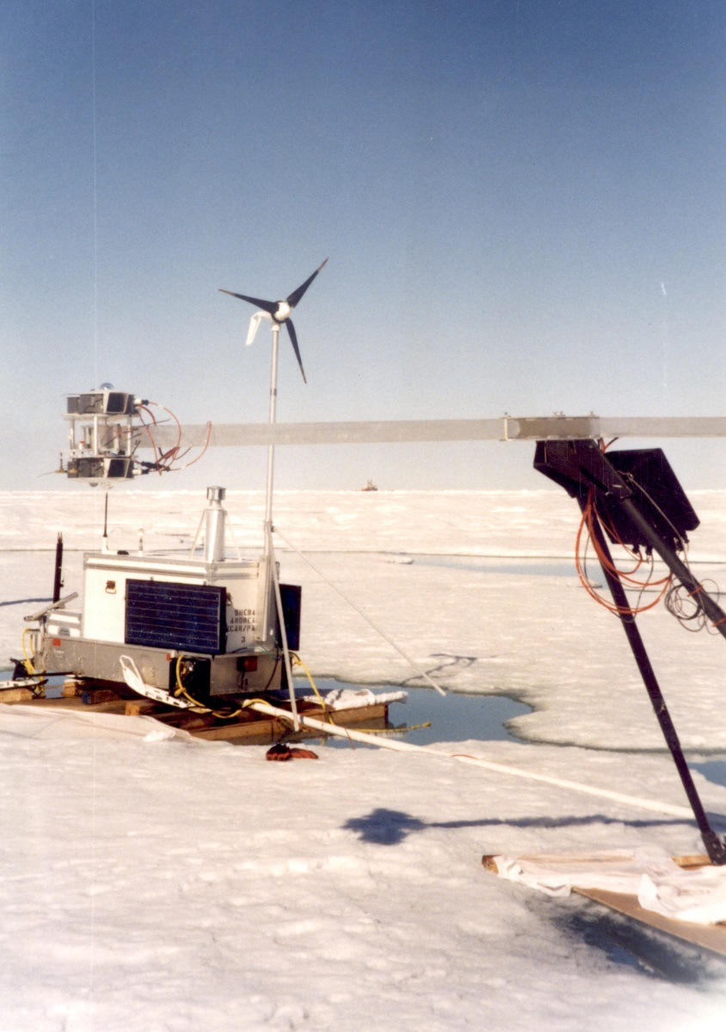
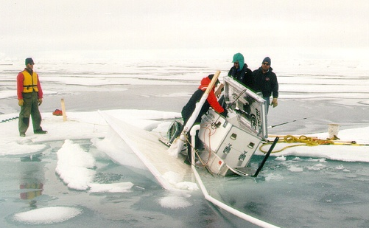
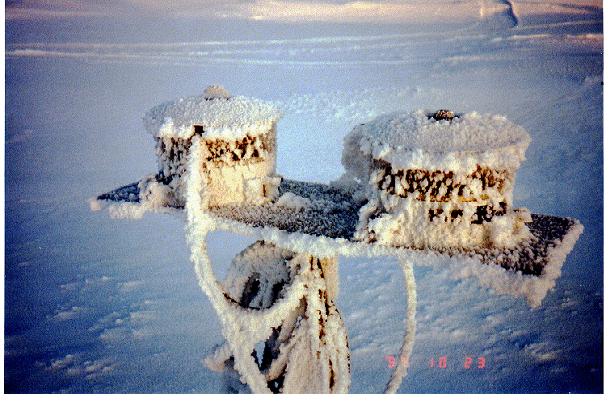
The Challenges
Power generation/management
Leveling / security
Rime mitigation (w/ low power)
Communications

Slide 10
Moving Forward
Establish overall plan, schedule, personnel (2017)
    Develop concept for PSD Front Office & Engineering team
Systems Design (2017-2018)
      Radiometer/sonic selection & strategy (>>>D-ICE, etc.)
      Power system: Energy audit, combined sources, operational logic
      Communications system: Direct over 15-30km LOS?, Irridium?
      System monitoring and on-board processing
      Integrated unit design
Field Tests (Steamboat, Niwot Ridge, Barrow….) (2018-2019)
Production (2019)
Deployment (2019-2020)
Future Development (buoy design, advanced power systems, fully autonomous)

Slide 11
wind generator
licor
sonic
camera
snow depth
radiation
antenna
irt
met
barometer
solar panel
main housing
sled

