Slide 1
Profile measurements of turbulent fluxes
Irina Repina
IAPh RAS

Slide 2
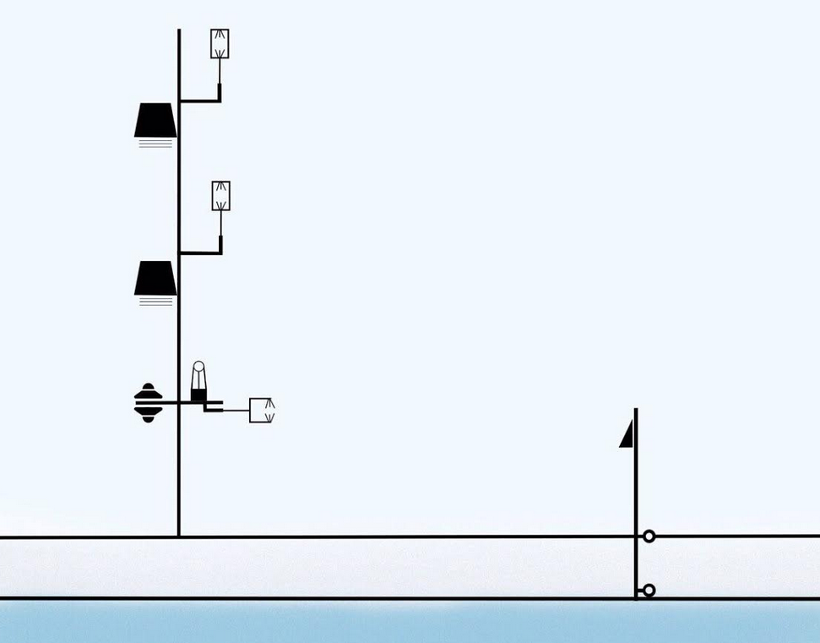
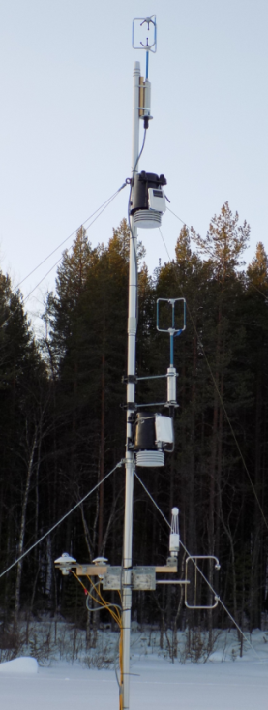
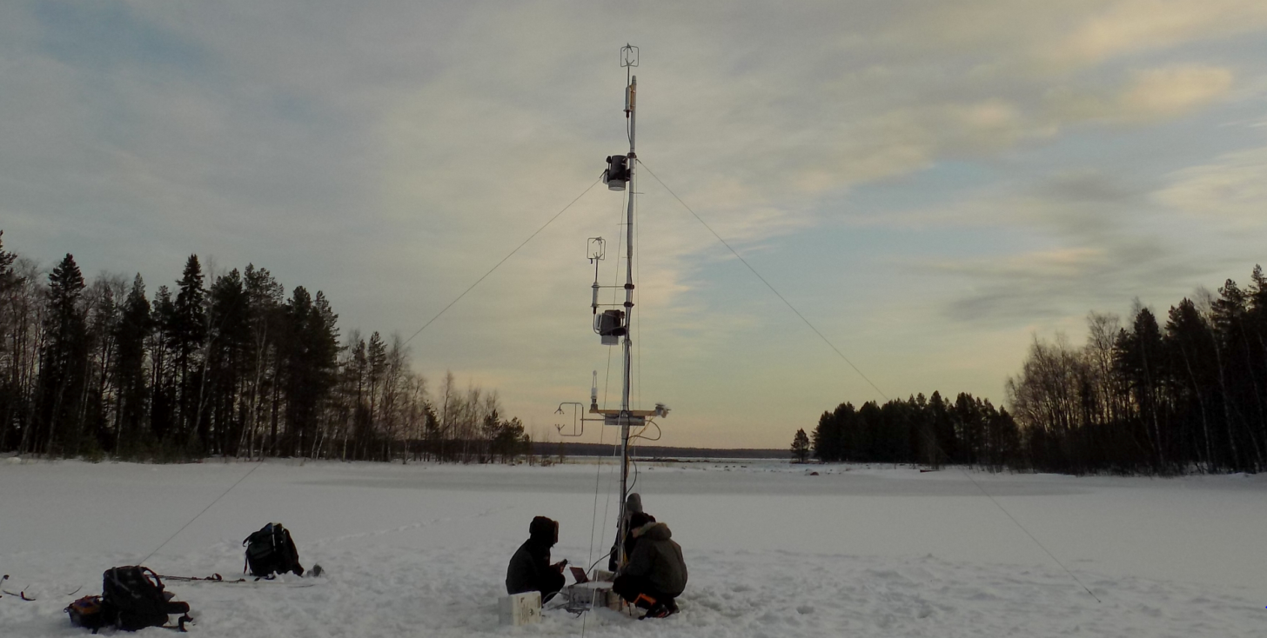
6-meter mast with instruments was installed in the center of the lake. There were 3 levels of ultrasonic three-component anemometers (2m, 4m and 6m) and two levels of standard meteorological measurement (3m and 5m). Temperature profile in the atmosphere was recorded with 50m step by microwave profiler MTP-5. Turbulent fluxes were calculated with Eddy-Covariance and gradient methods.

Slide 3
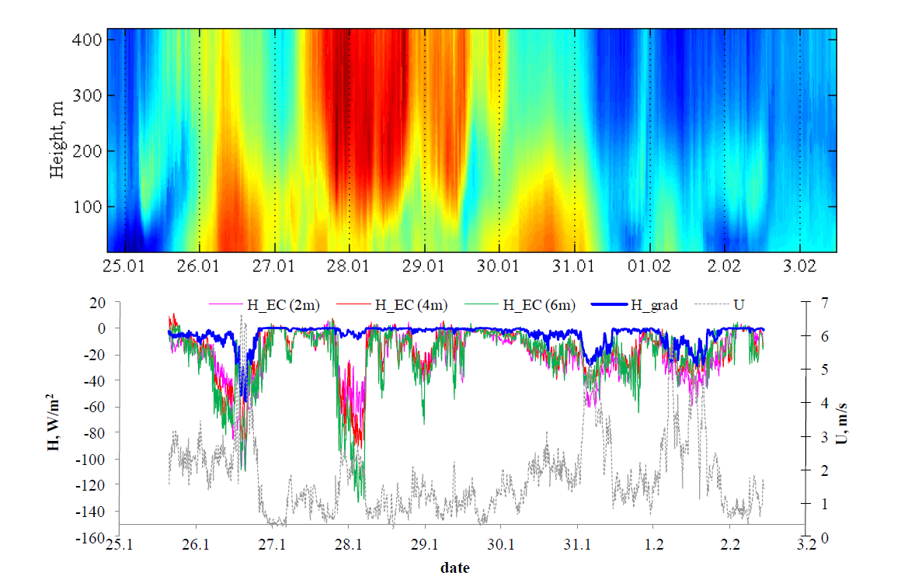
Temperature distribution in the boundary layer of the atmosphere (above) as measured by MTP-5 profiler, fluxes of sensible heat from EC measurements at different levels (H_EC), sensible heat flux by the gradient method (H_grad), and average wind velocity (U).
At some time intervals (for example, those around 26.01 12:00, 31.01 00:00, 01.02 12:00) the results of gradient method agree well direct measurements, albeit being smaller in absolute value. At the same time, the extrema of the heat flux observed during these periods well coincide with the increase in wind speed (up to 5-6 m/s) and with enhancing the difference in temperature between the surface and the atmosphere at the measurement level (not shown). The MOST demonstrates these heat flux extrema as well, since the flux is proportional to wind speed and temperature difference between the surface and atmosphere there. At the other time intervals (for example, those around 28.01 00:00 and 29.01 00:00) there are apparent spikes in EC-fluxes to which there are no corresponding extrema in MOST-calculated fluxes. Remarkably, in such cases, the wind speed remains small (< 2 m/s), so that MOST can’t provide significant increase in the H value. These periods coincide with a warm air advection in the middle and upper part of the boundary layer, so that negative heat flux should form at altitudes about 100 m, following the temperature gradient. We suggest, that there should be turbulent diffusion of the heat flux from heights of about 100 m to the surface layer, where the negative heat flux is lower in absolute value.

Slide 4
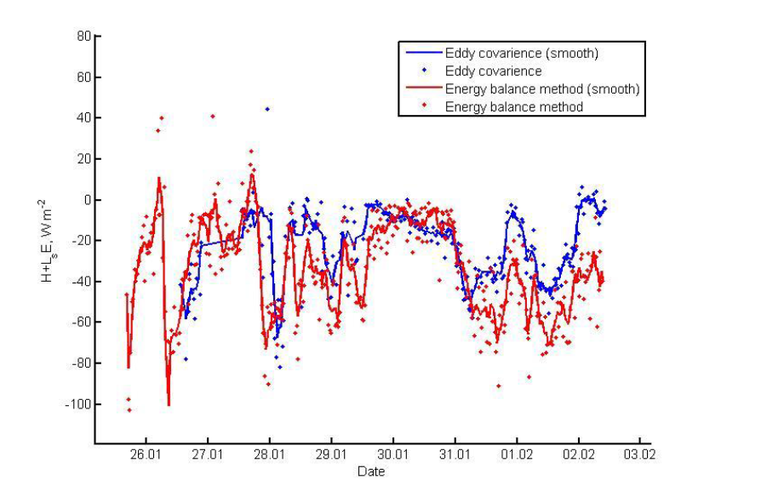
Total heat flux (sensible plus latent) according to direct measurements and calculations from surface energy balance. The span for the moving average is 5.
One can see, that time series are match well. The greatest difference between the two methods (62,8 W/m2) is observed on 28.01 during warm air advection above the surface layer. Significant discrepancies are also observed during last two days of the experiment. In both cases, the EC technique underestimates the absolute total heat flux, in-line with common experience (as mentioned in the introduction). This is likely the result of secondary circulations induced by the presence of the forest-lake boundary [11]. Mean difference between the two methods for all period is equal to 16,8 W/m2. Correlation coefficient of two time series is equal to 0,6.

Slide 5
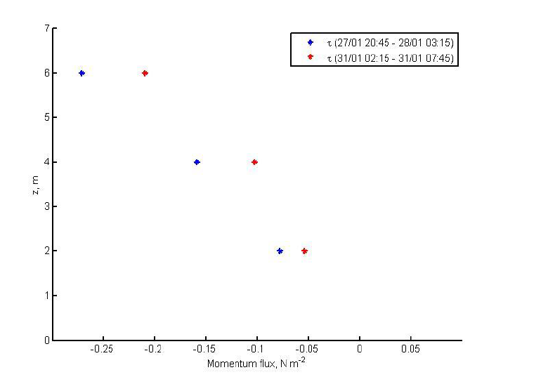
Profile of eddy covariance momentum flux
The momentum flux increases with height with approximately linearly dependence, and at the surface the momentum flux tends to 0. This agrees well with LES of inhomogeneous boundary layers. Thus, landscape inhomogeneity is very likely to significantly effect the momentum budget in the surface layer

Slide 6
Results
Turbulence measurements over a frozen lake surrounded by forest demonstrate that eddy covariance fluxes correlate well with those obtained by the surface energy balance method. A tendency of the EC technique to underestimate fluxes derived from the surface energy balance is in agreement with the energy balance closure problem. This might be attributed to secondary circulations developing near the forest-lake boundary. The presence of wind-shear effects at the height of trees demonstrated recently in LES was indirectly supported in our measurements by an increase of momentum flux with height in the surface layer, extrapolating to zero at the surface. However, contrary to LES, the sensible heat flux decreased with height most of the time. We suggest that this might be at least partially attributable to high magnitude negative heat fluxes above the surface layer formed when the warm advection occurs at altitudes of ~100 m. During warm advection events, MOST fails to reproduce the sharp increase of negative heat flux in the surface layer. This can be explained by a vertical transport of heat flux from above, not taking into account in the theory. Aside of the warm advection events, MOST corresponds well to EC fluxes, however, with some systematic underestimation of the flux magnitude. This is likely a consequence of omitting the surface inhomogeneity effects in MOST.

