Slide 1
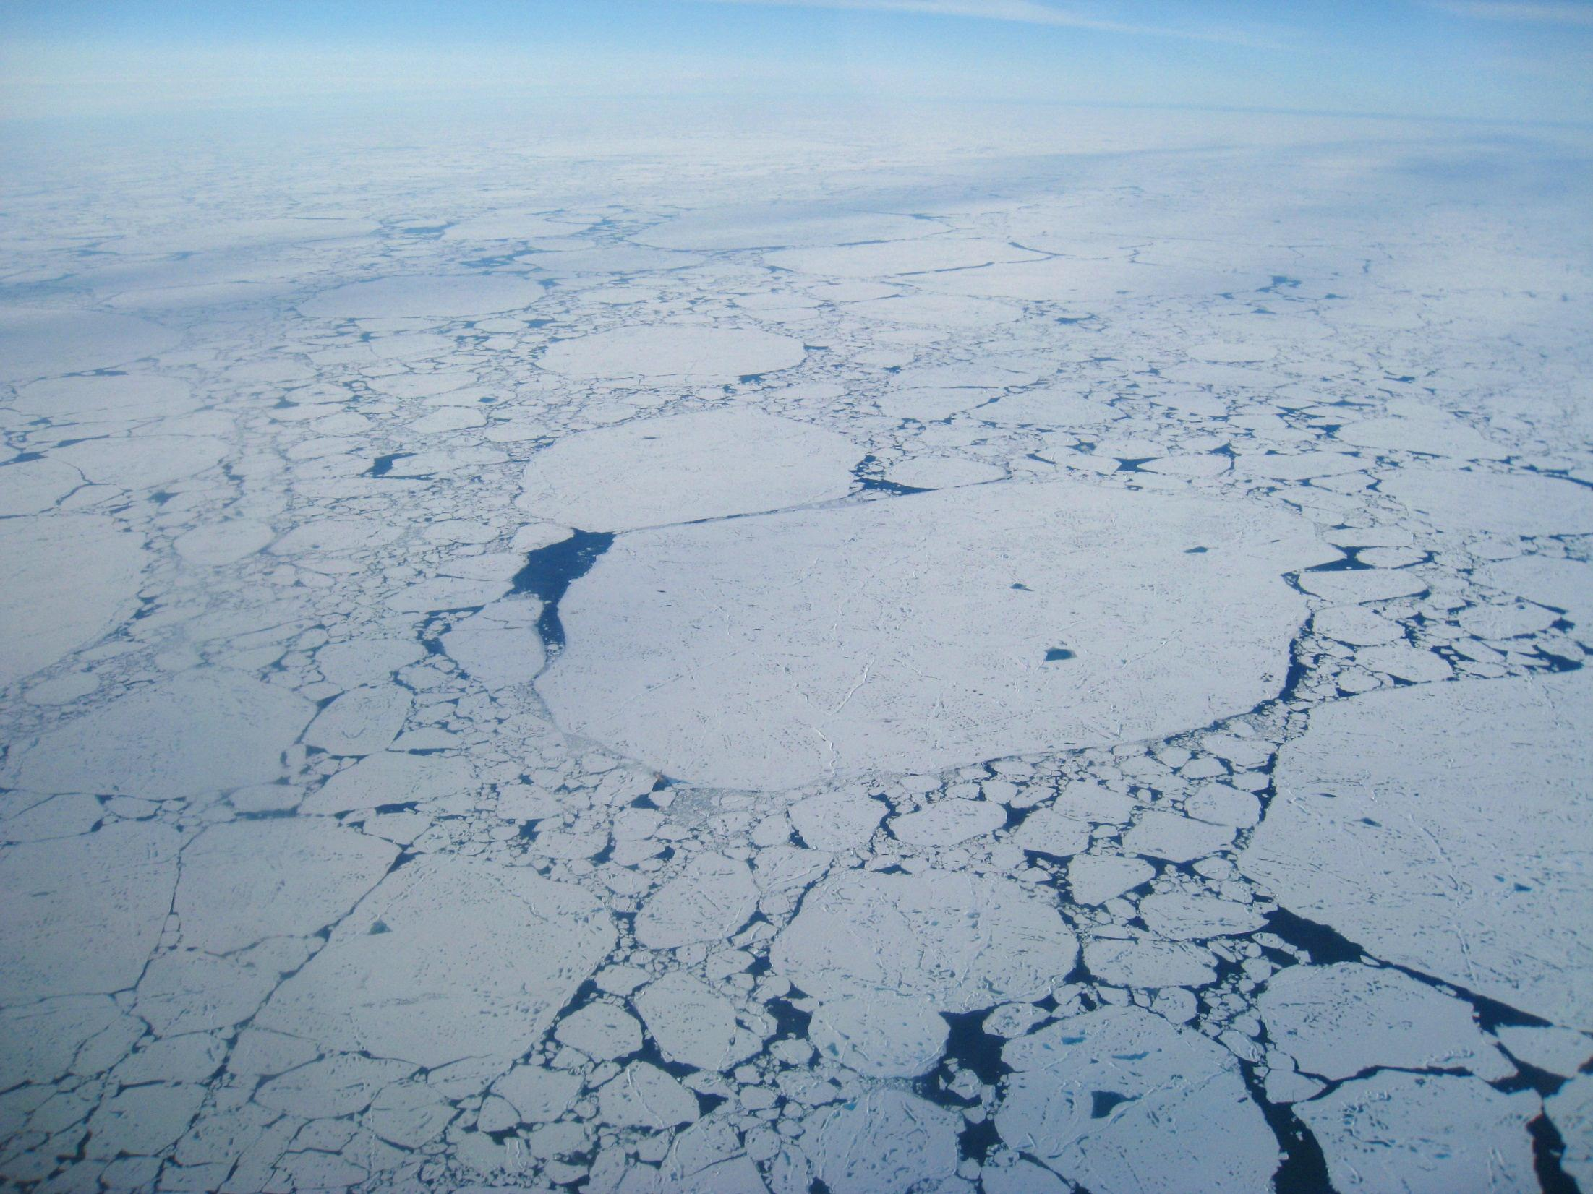
MOSAiC
Multidisciplinary drifting Observatory
for the Study of Arctic Climate
Remote Atmospheric Flux Station Planning
www.mosaicobservatory.org
Notes:
Introduce the organizing team and science plan writing team.

Slide 2
Remote Atmospheric Flux Stations (RAFS) - Structural Issues
measurement interactions/interference: - snow drift, turbulence generation, flow distortion, radiation impacts, melting/settling (out-of-level)
b) “sled”, box, or “jack stands” – shape, mobility, snow drift
c) box integrated with sonics & instruments, or separate box & tripod? – compactness, transportability, measurement interference
d) transportability, interactions with surface, safety as surface changes (melts) (flotation)
e) serviceability – height, step ladder, stakes/anchors, etc

Slide 3
wind generator
sonic
antenna
licor
snow depth
radiation
camera
met
irt
barometer
solar panel
Sled and/or flotation system
Atmospheric Surface Flux Station – Conceptual Design

Slide 4
sonic
wind generator
antenna
licor
camera
baro
snow depth
radiation
met
irt
solar panel
Sled and/or flotation system
Atmospheric Surface Flux Station – Conceptual Design

Slide 5
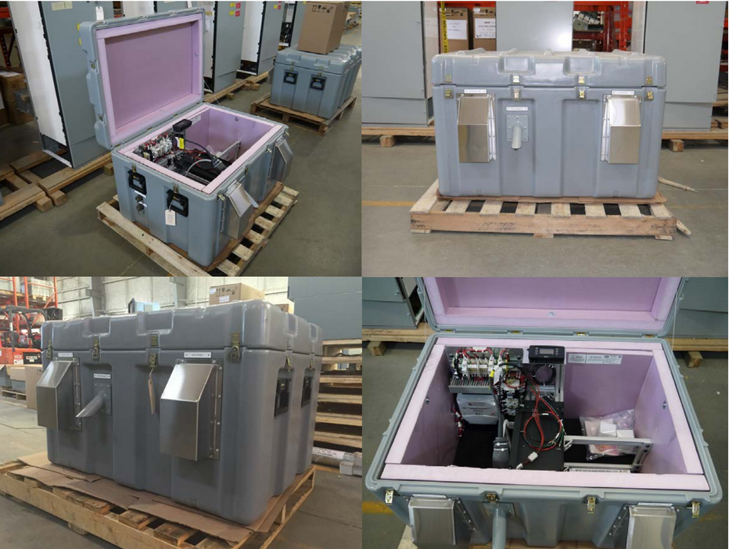
Box: E-FOY Fuel Cell power supply/data acquisition

Slide 6
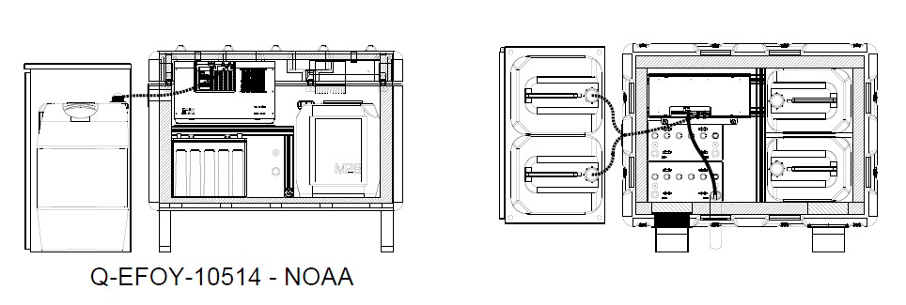
110 W, 24V.

Slide 7
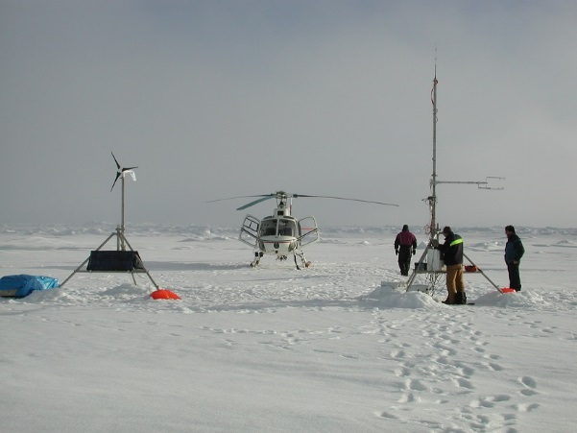
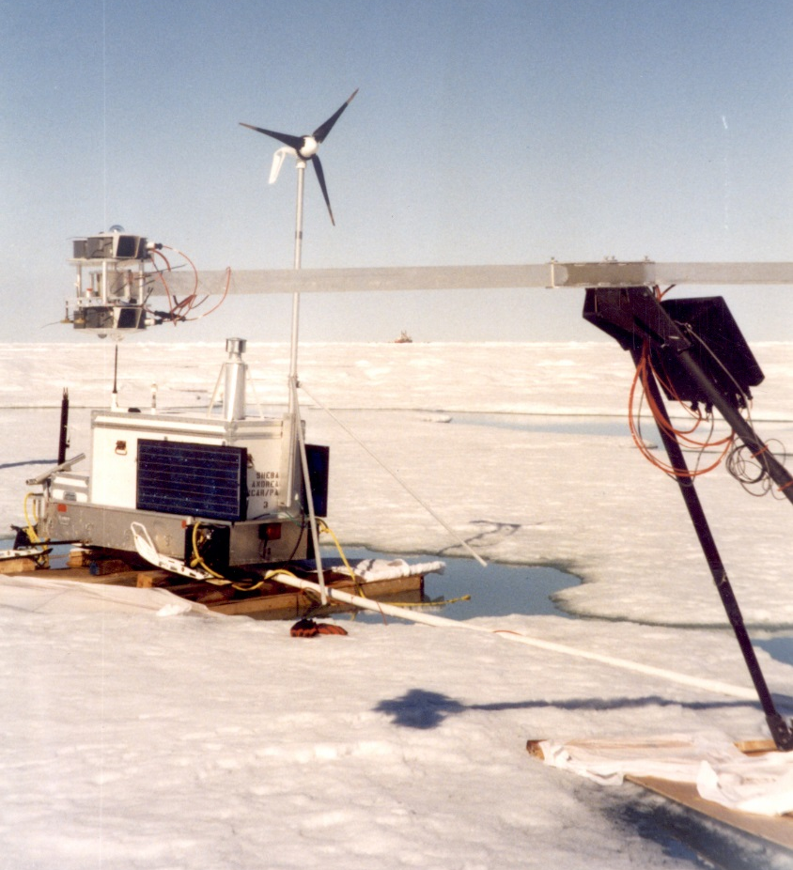
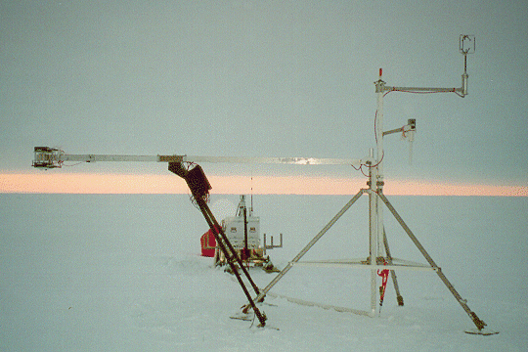
AOE-2001 –late August 2001 – helicopter deployments
NCAR PAM Stations
Criticisms from J. Militzer:
- individual sled runners too short, difficult to move
- radiometers/boom too heavy - need for wind turbine uncertain - box/footpads created own meltponds - snow drift around box
SHEBA
SHEBA

Slide 8
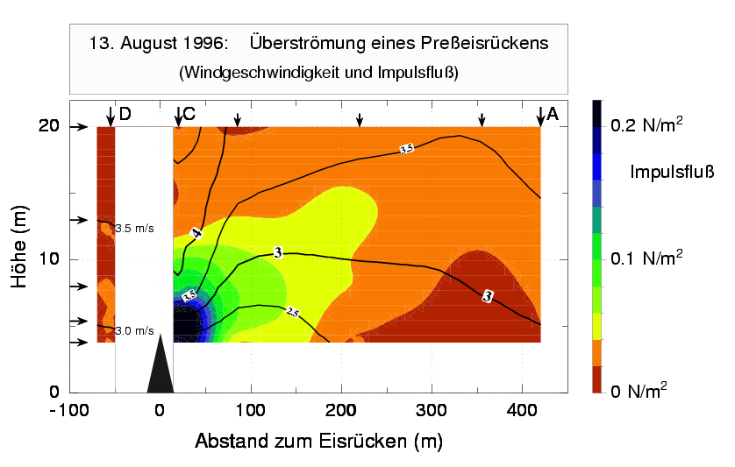
Impacts of Structure on Measurements
Small-Scale Spatial Variability: Ridge impact on the surface layer variables
Measured wind speed (contour lines) and momentum flux (color) downstream of a large (4m) pressure ridge (Garbrecht et al., 1999) – significant variability over a few 100 m
Measured wind speed and momentum flux
height (m)
distance to ice ridge (m)
Also small obstacles > 5-10 cm height strongly influence the atmospheric surface drag!
Important implications for upwind contamination of turbulence measurements!

Slide 9
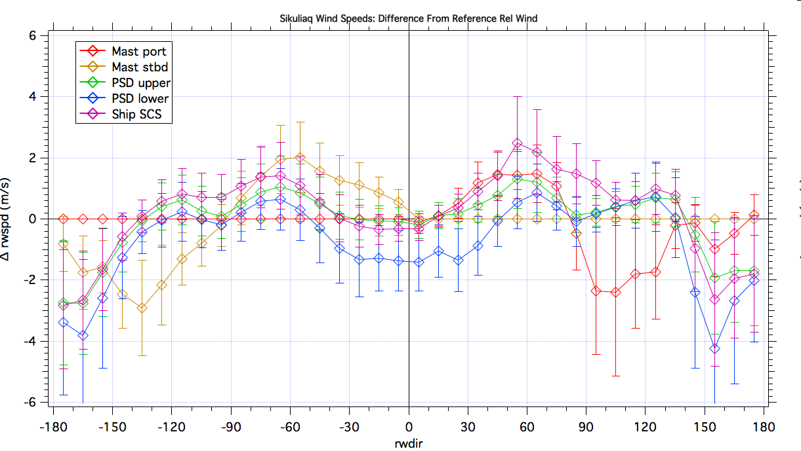
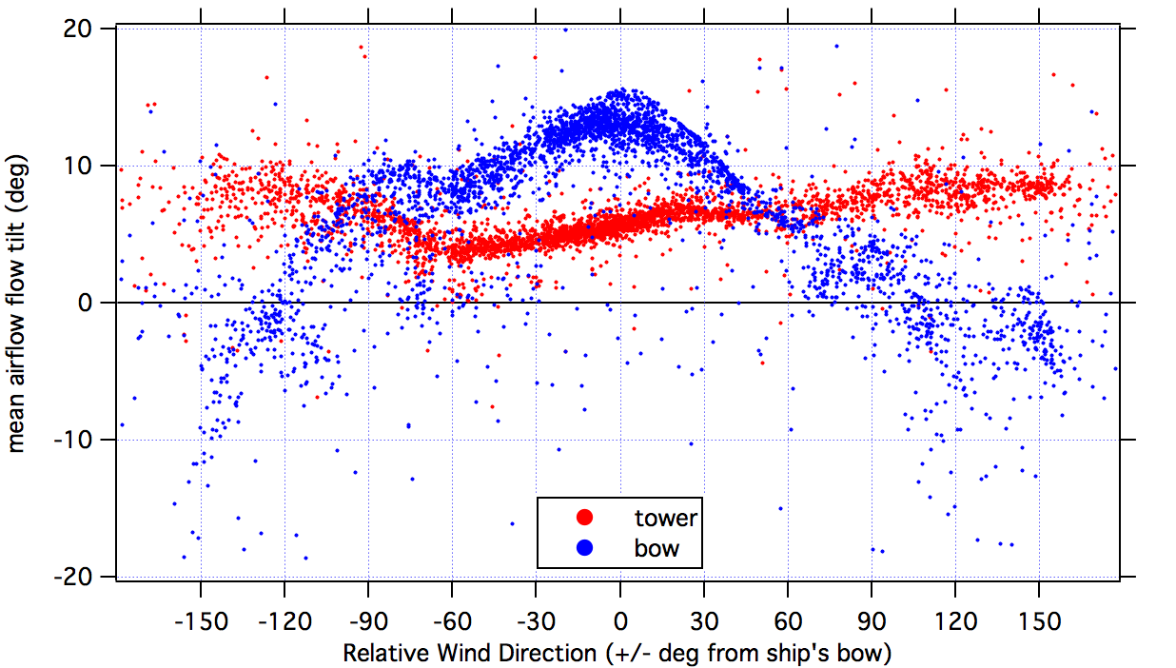
Ship Structure Impacts on Sampled Airflow - R/V Sikuliaq
- mast port/starboard sensor used as reference for ship-relative winds (SHR winds) from port/starboard - mast starboard/port sensor differs by -3 m/s to +2 m/s of port/starboard sensor for SHR winds from port/starboard - PSD upper bow winds between 0 to +1 m/s of reference wind for SHR winds between ±135° - PSD lower bow winds 0 – 1 m/s lower than PSD upper winds - 1-2 m/s acceleration near ±50-70° - 1-4 m/s deceleration with winds from stern - ship bow 2D sonic (“Ship SCS”) shows assymetric acceleration relative to PSD upper (which it is right next to)
Port winds
Bow-on winds
Starboard winds
Stern winds
Stern winds
Rel Wind – Rel Wind_{ref} (m/s)
Airflow tilt at PSD Sonics
Relative Wind Direction (deg)
Impacts also on a) turbulence/fluxes, b) air pressure

Slide 10
Impacts of Structure on Measurements – based on ship experience
sonic
~5° airflow tilt &
5% wind reduction
licor
snow depth
radiation
met
irt
barometer
2.5 m
1.0 m
solar panel
Sled or flotation system
From side:
~5° airflow tilt &
12%? wind acceleration
With this configuration, need airflow study, or pre-experiment field flow study (~ 2 months); post field-program corrections
Other possible issues: a) larger impact of box on outgoing radiation, b) solar heating of box (heat island) impacting Hs; c) proximity of H20 exhaust from fuel cells impacting humidity(?); d) heavier/more cumbersome to sling as integrated unit with helicopter.

Slide 11
Suggestion:
Instrument tripod separated from DA box/sled by ~ 5-8 m; minimize sled angle to sonic; remove affected angle from useful data.
Box on ~2-m Nansen sled with or without small duck boat attached on top (500 lbs of flotation max necessity?). Boat needs to be fastened without causing leak. Vendor for Nansen sled? Duck boat? Build Nansen sled?

Slide 12
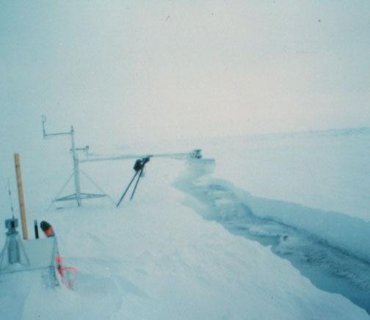
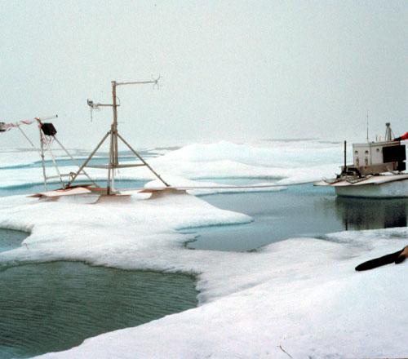
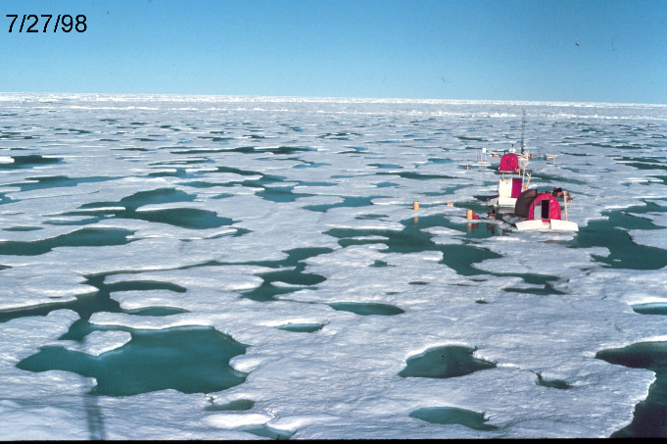
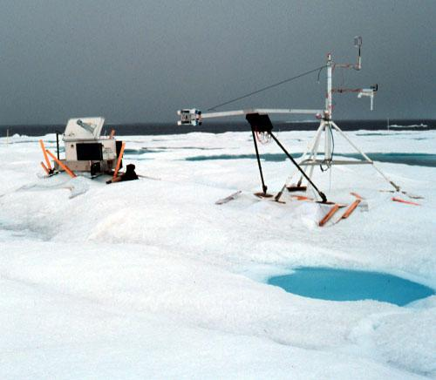
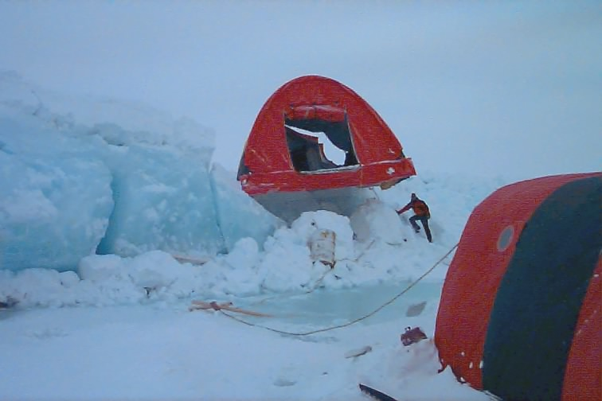
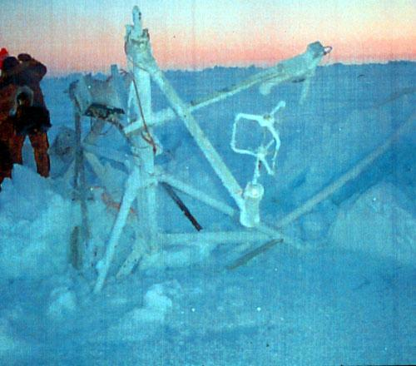
Dangers for RAF Stations
Need for mobility & flotation?
Wintertime lead opening (FLA)
Summer meltpond development (Maui) – note reduced melt under ablation shields
Summer meltponds - 26% (+?) areal coverage
Drastic ice movements (Ice tectonics)
Lead closing crushing Cleveland
Ice “disappearance” near Florida

Slide 13
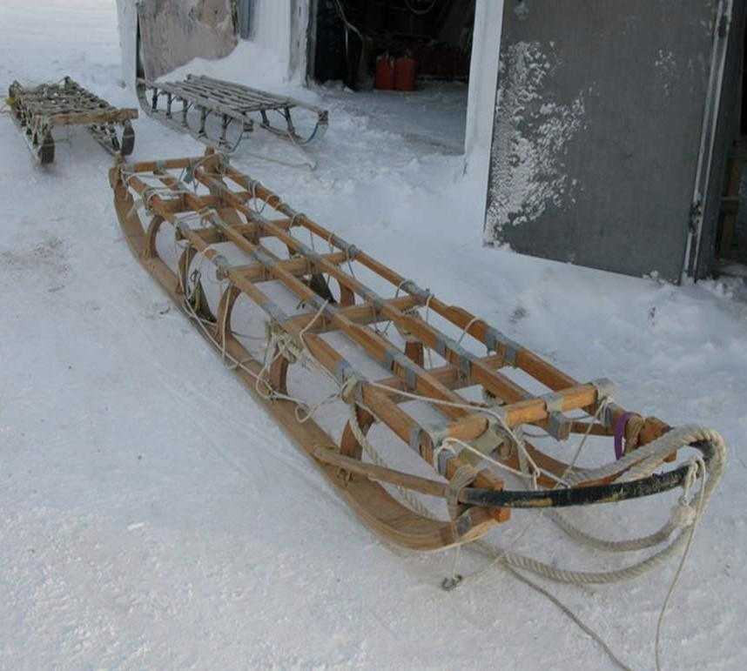
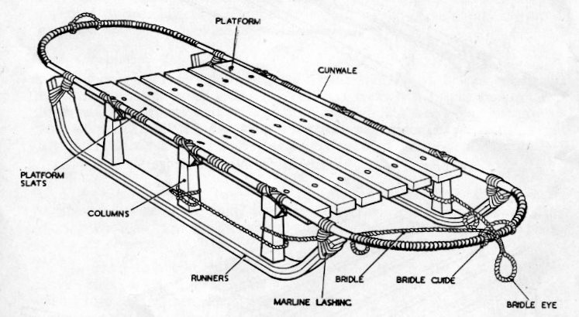
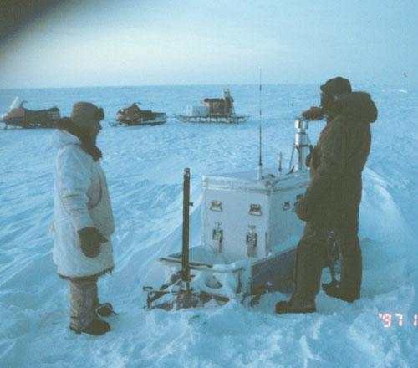
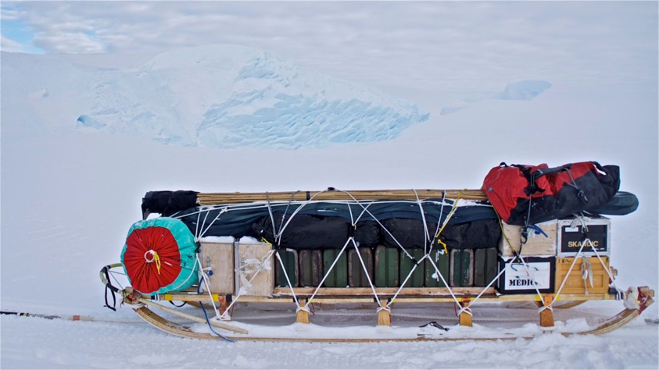
Nansen Sledge
- Strong for heavy loads
- Sufficiently long to ride easily over rough surface
- High enough and sufficiently sparse supports to reduce drift build-up (?)
SHEBA

Slide 14
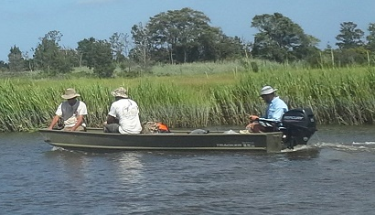
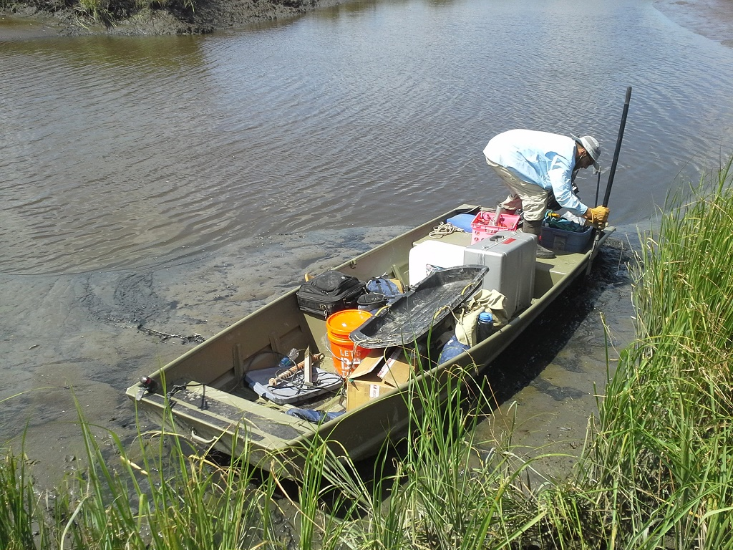
Duck boat with three 200-lb people plus gear & motor
Duck Boat
Flotation in case of melt pond development, lead opening
Duck boat help for this situation?

Slide 15
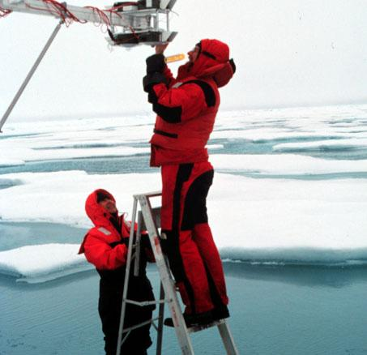
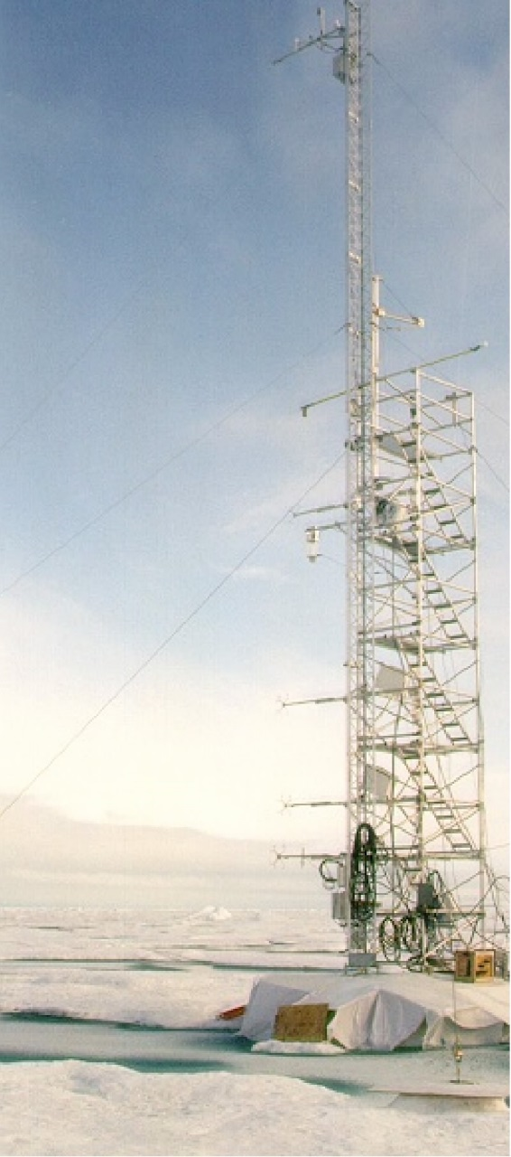
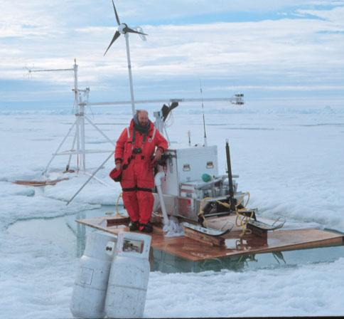
OTHER STRUCTURAL CONSIDERATIONS
Need for step ladder
Safe pedestal under main tower due to:
a) Wooden posts frozen in with fresh water
b) Plywood & white cloth ablation shields c) luck
SHEBA-late Aug
Meltpond formed by PAM box/sled
Note pedestal for guy anchor

Slide 16
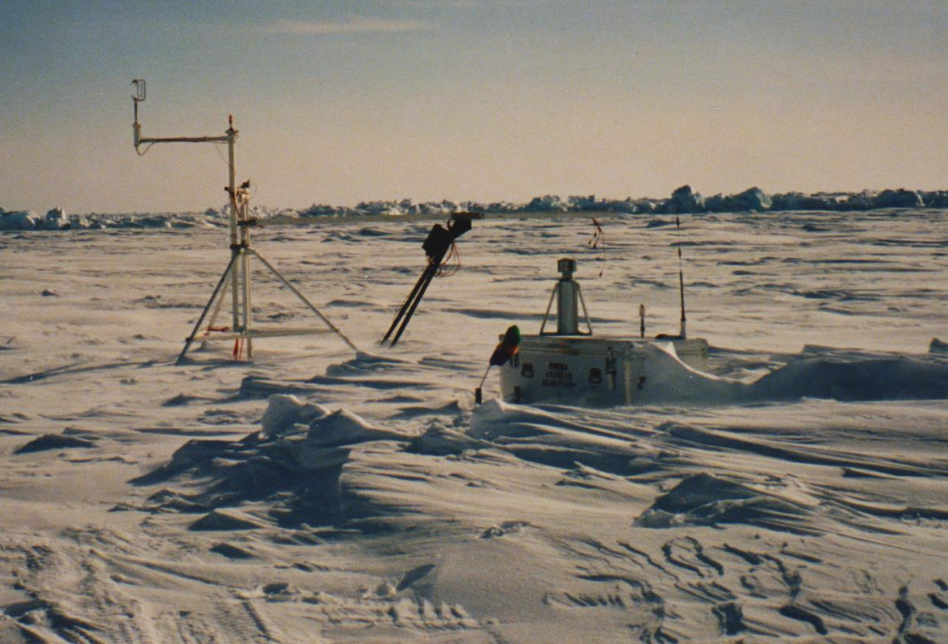
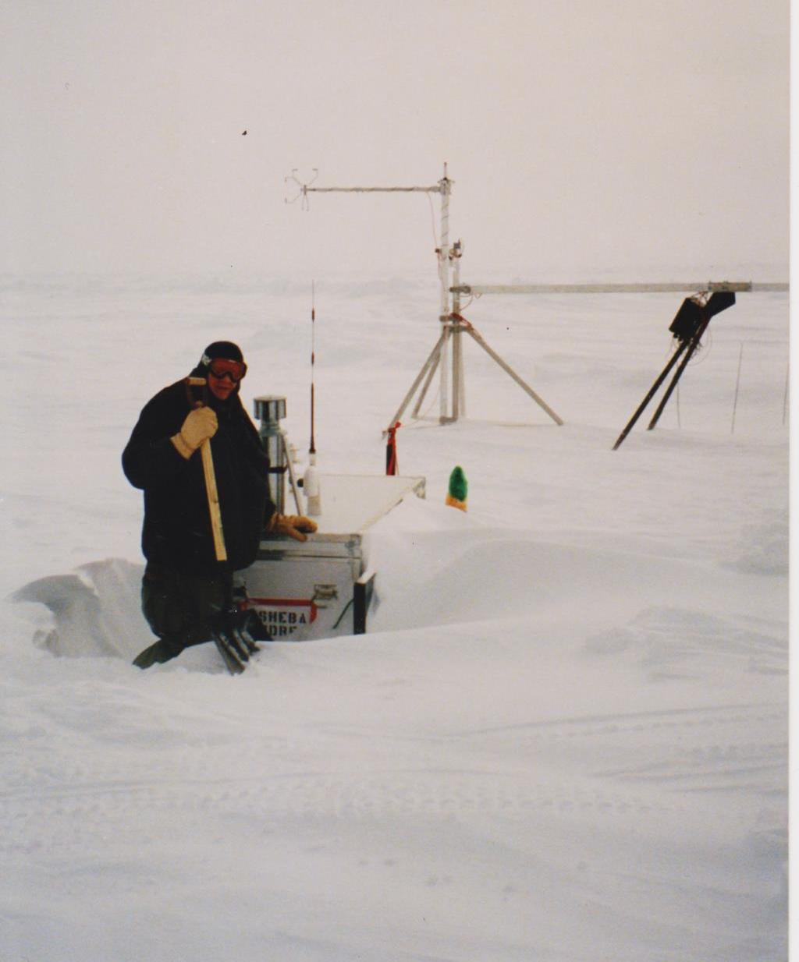
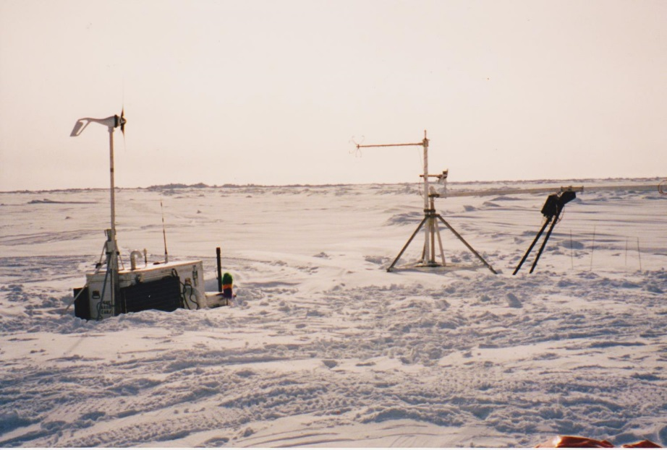
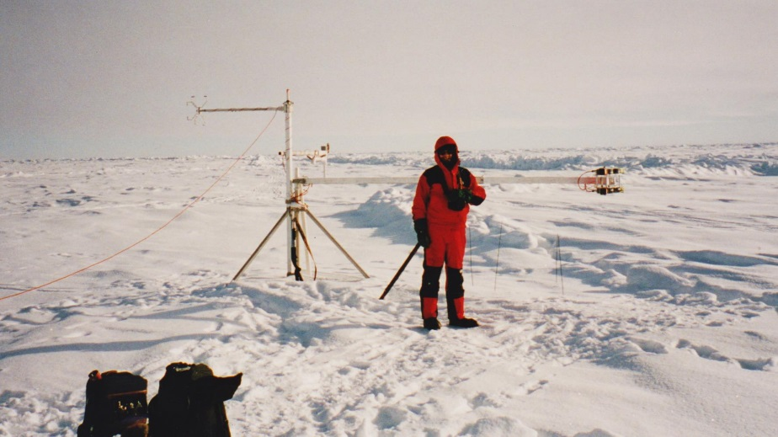
Snow Drifting SHEBA PAMs in March

Slide 17
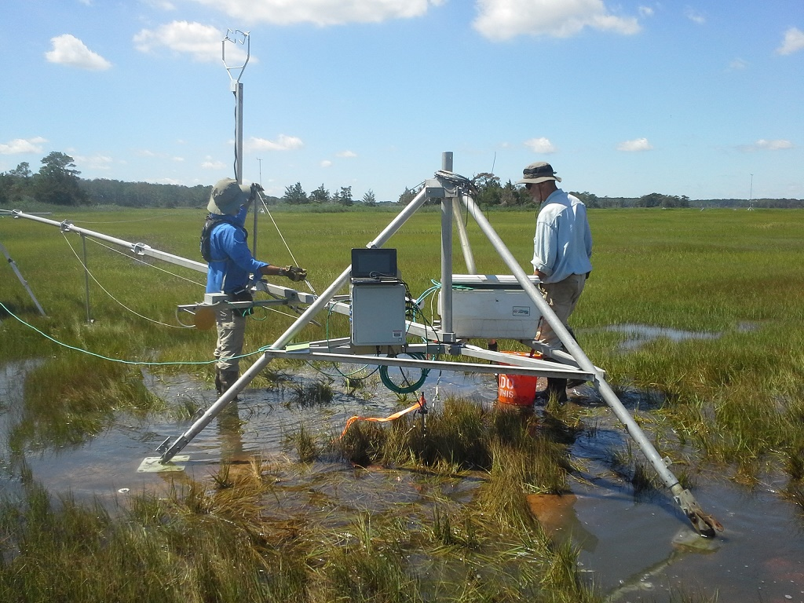
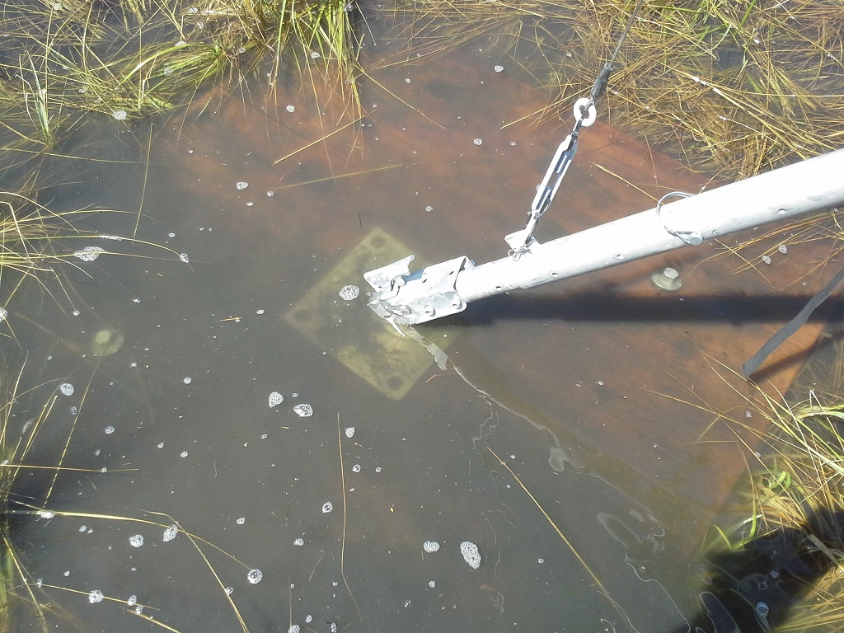
- tripods in shallow water - pad anchors

