Slide 1
MOSAiC Surface Flux Systems Schematics and Designs
2017

Slide 2
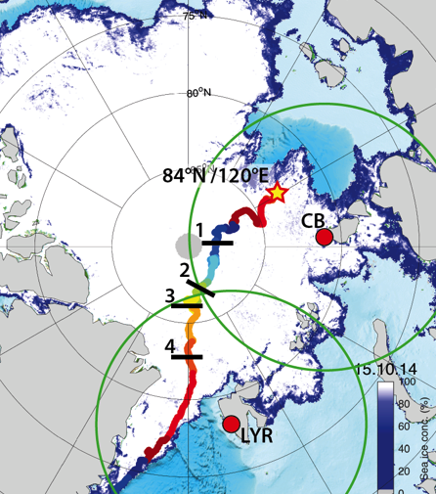
MOSAiC Concept
Drifting, interdisciplinary process study in central Arctic sea ice
Central Observatory: intensive atmos-ice-ocean-ecosystem observations
Distributed Network: Heterogeneity on model grid-box scales
Coordinated, multi-scale analysis and modeling activities
2019-2020, Full annual cycle

Slide 3
ASFS
10-20 km
Possible node
ASFS
? km
Met Tower
0.5 km
Ship
w/ Command Center
10-20 km
10-20 km
ASFS
ASFS
Spatial Distribution of Assets

Slide 4
Comms options
ASFS
Goals: 1) Health status file every 1-6 hours to command central; 2) Near-real-time plotting of key information; 3) Ability to upload configuration files/commands.
Iridium: Robust vs. high-cost/limited filesize
Radio: Unknown range limits vs. more flexible file sizes
Tower
Goals: 1) Ability to transfer all data in real-time to command central; 2) Robust time syncing; 3) Near-real-time plotting of data; 4) Ability to access data through camp wireless network.
Radio: Continuity vs. challenge with time syncing
Ethernet: Plenty of capacity vs. Potential down time

Slide 5
Tower
ASFS x3
instruments
Web site
quicklooks
NOAA NCEI
instruments
Logger/moxa
Logger/moxa
comms
instruments
comms
ant.
ant.
Local wireless user
preferred
monitor
data
Irridium
option
all data
manual transfer full data
FTP site
data host
ant.
ant.
PSD3data
ingest
process
NSF Arctic Data Center
email
quicklooks
RAID: full archive
PC1:
Data
Manager
PC2:
Work
quicklooks
Polarstern network
manual
transfer
PSD-Boulder
USB-HD
Command Center
MOSAiC central archive
PANGAEA
MOSAiC
Archive
manual transfer
by AWI
Polarstern
Arctic
External
Data Flow Schematic

Slide 6
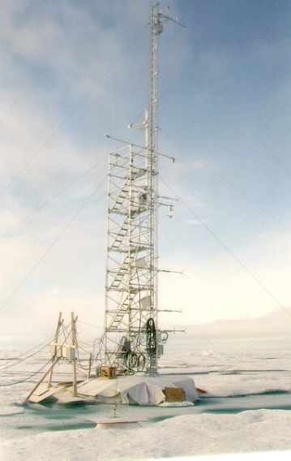
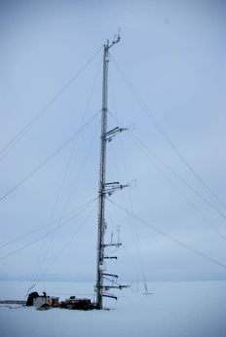
Tower
ASCOS: Triangular (10m)
SHEBA: Scaffold+triangular (20m)

Slide 7
sonic
sonic
Beacon
12m
Beacon
DT
T/RH
Top of 30m tower
T/RH
Antenna
sonic
6m
DT
T/RH
Sfc Ht
IRT
DT
licor
sonic
2m
Baro
T/RH
x4
Logger
outlet
Sub-surface base
c
10m
Flux Tower – Conceptual Design

Slide 8
30m
Sonic
T/RH
Beacon
Tower Signal Schematic
RS-232
RS-485
Ethernet
SDI-12/Modbus
analog
12m
Sonic
T/RH
Beacon
Command Center
6m
Sonic
T/RH
RS-485 converted to RS-233
All data
Computer
Storage
2m
Sonic
Licor
P/T/RH
DT1
DT2
SfcHt
IRT
Barometer
Flux plate1
Flux plate2
Data logger

Slide 9
Tower Tasks
Structural
Base/foundation design
Tipping method/design
Guy wire design
Setup on mesa
Instrument install
Booms/arms
Cabling
Interface/data log enclosure
Data logging
Sampling and time stamping
Syncing with central command

Slide 10
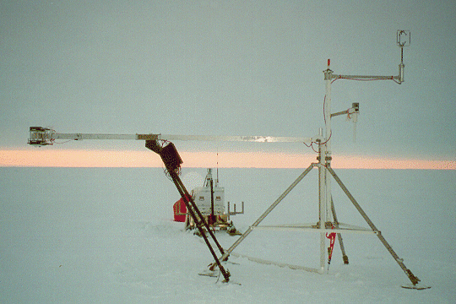
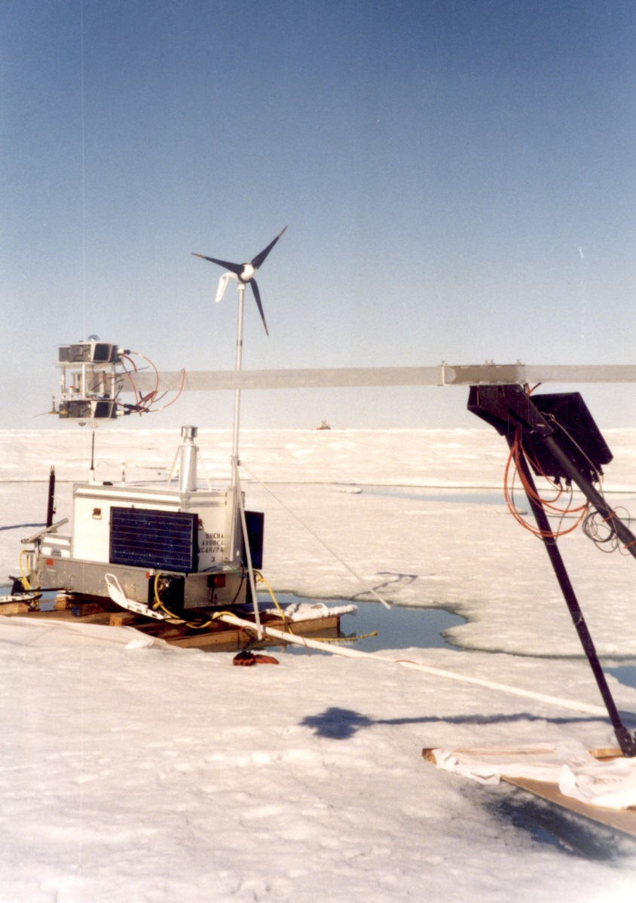
ASFS

Slide 11
wind generator
sonic
~3m
antenna
camera
snow depth
radiation
~2m
PTU
Power system
Data logging
irt
Interface panel
fuel
solar panels
Sled or floatation system
Atmospheric Surface Flux Station – Conceptual Design

Slide 12
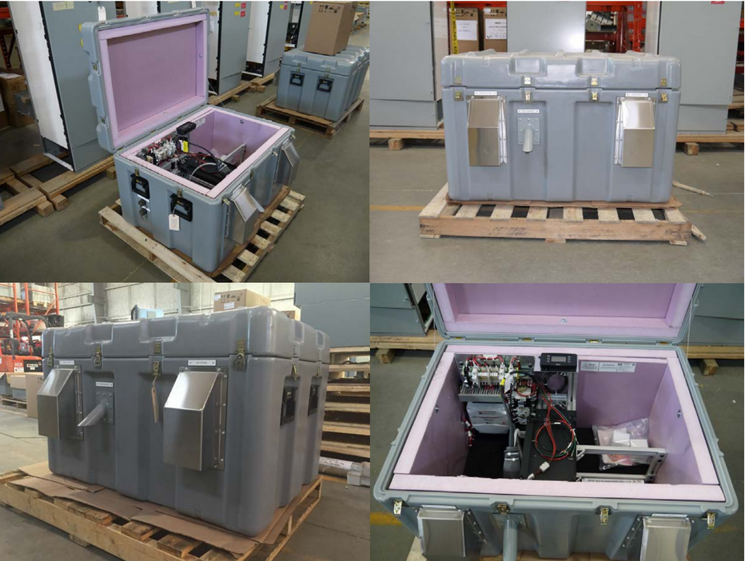
E-FOY fuel cell power system

Slide 13
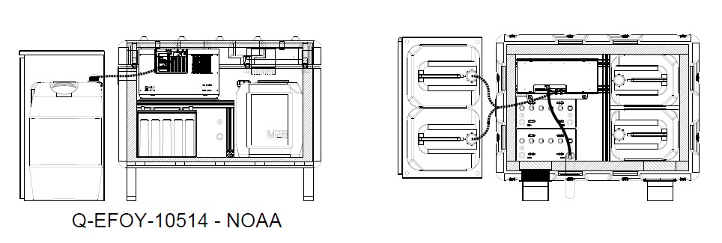
110 W, 24V.

Slide 14
ASFS Signal Schematic
RS-485
Ethernet
SDI-12/Modbus
analog
LWU
LWD
SWU
SWD
SPN1
Sonic
Licor
P/T/RH
SfcHt
IRT
Flux plate1
Flux plate2
GPS
Camera
System Health
Power System
CR1000X
Storage
??
Computer?
Option 1
RF451
Monthly Manual
Iridium 9522B
Command Central
Hourly Monitor

Slide 15
ASFS Tasks
Structural
Sled design/build
Mast design/build
Floatation?
Instrument install
Instrument mounts
Cabling
Interface panel
Power optimization
Data logging
Sampling and time stamping
Link with power system
Summary file creation
Communications system (p2p wireless or Iridium)
Testing and verification
Interface with data logging
Optimized/flexible communication strategy
Power system
Testing of EFOY
Design and integrate wind generator

Slide 16
Lab Container
Basic design: Insulated, HVAC, transformer, basic internal power runs (sockets, lights), integrated uni-strut for wall-mounted (moveable) structures, cable pass throughs.
Wall mount shelves
Wall mount bench top
Man door
Wall mount shelves
HVAC
Power management

