Slide 1
MOSAiC Flux Structural

Slide 2
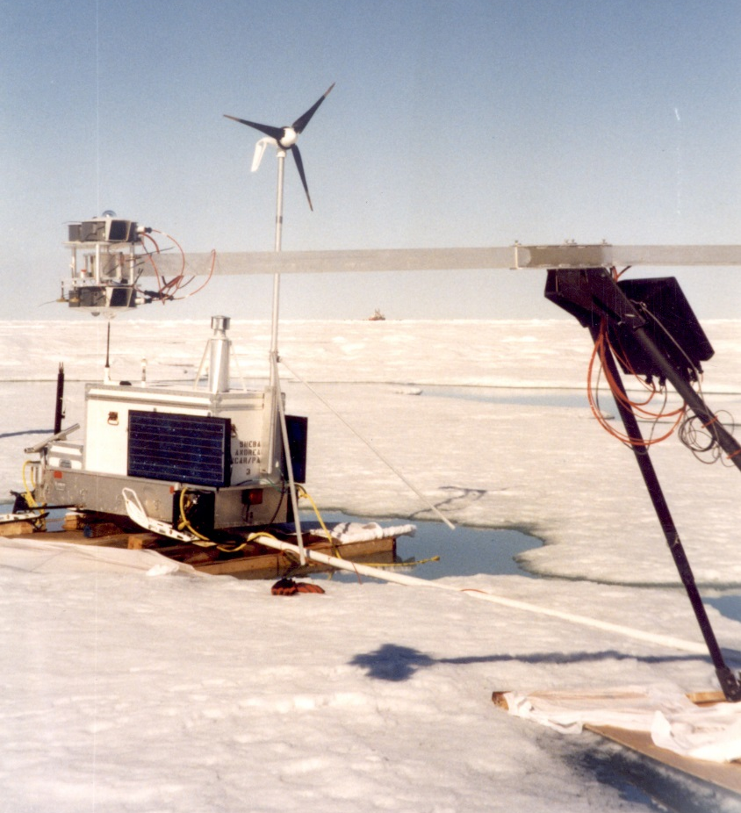
Remote Flux Stations

Slide 3
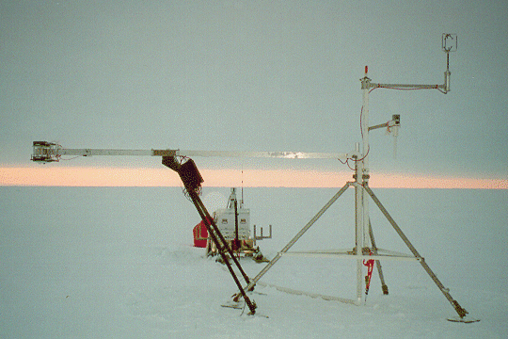

Slide 4
wind generator
sonic
antenna
licor
snow depth
radiation
camera
met
irt
barometer
solar panel
Sled or floatation system
Atmospheric Surface Flux Station – Conceptual Design

Slide 5
sonic
wind generator
antenna
licor
camera
baro
snow depth
radiation
met
irt
solar panel
Sled or floatation system
Atmospheric Surface Flux Station – Conceptual Design

Slide 6
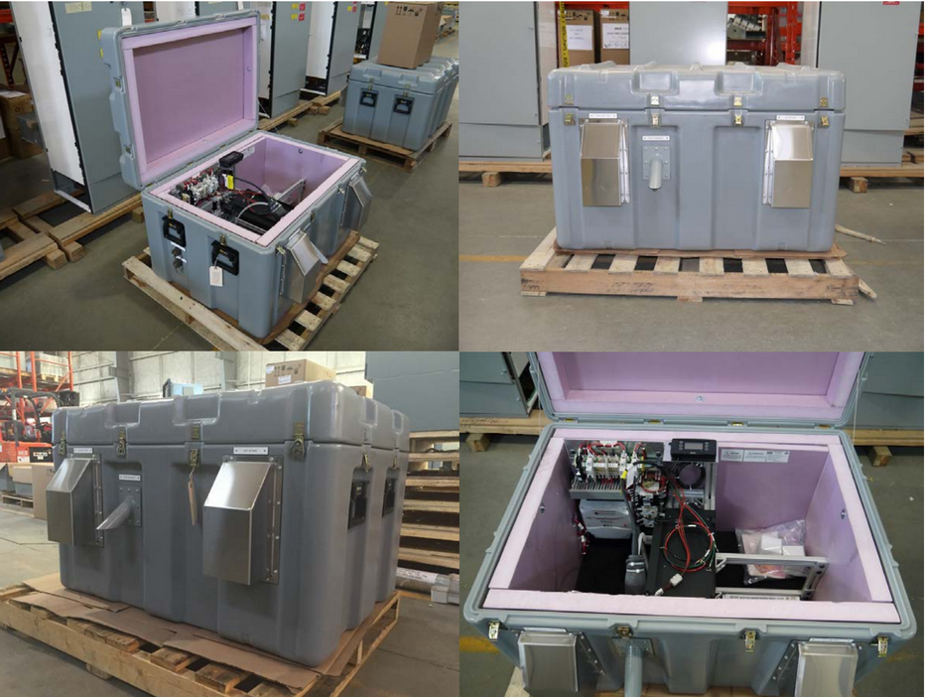

Slide 7
Decisions
General approach: Single unit? Multiple components?
Compartments / volume needed
Mobile structure, sled?
Floatation

Slide 8
sonic
sonic
Beacon
10m
Beacon
DT
T/RH
Top of 30m tower
T/RH
Antenna
licor
sonic
6m
DT
T/RH
Sfc Ht
IRT
DT
sonic
2m
Baro
T/RH
x4
Logger
outlet
Sub-surface base
c
8m
Flux Tower – Conceptual Design, 10-12m (33-40ft)

Slide 9
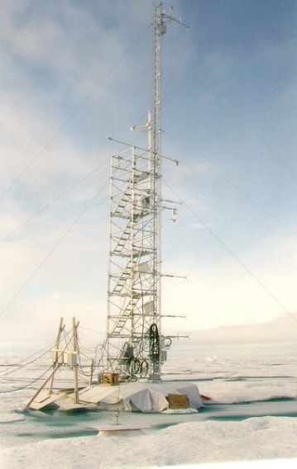
Options
ASCOS: Triangular (10m)
SHEBA: Scaffold+triangular (20m)

Slide 10
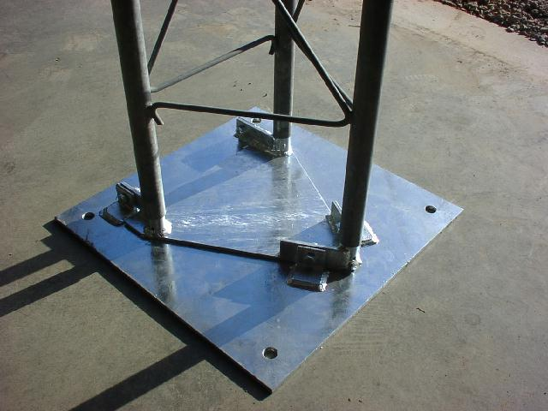
Options

Slide 11
Options

Slide 12
Decisions
How tall?
Approach to maintenance / Tower style
Foundation/base?

Slide 13
Lab Container
Basic design: Insulated, HVAC, transformer, basic internal power runs (sockets, lights), integrated uni-strut for wall-mounted (moveable) structures, cable pass throughs.
Wall mount shelves
Wall mount bench top
Man door
Wall mount shelves
HVAC
Power management

