Slide 1
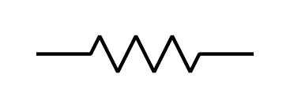
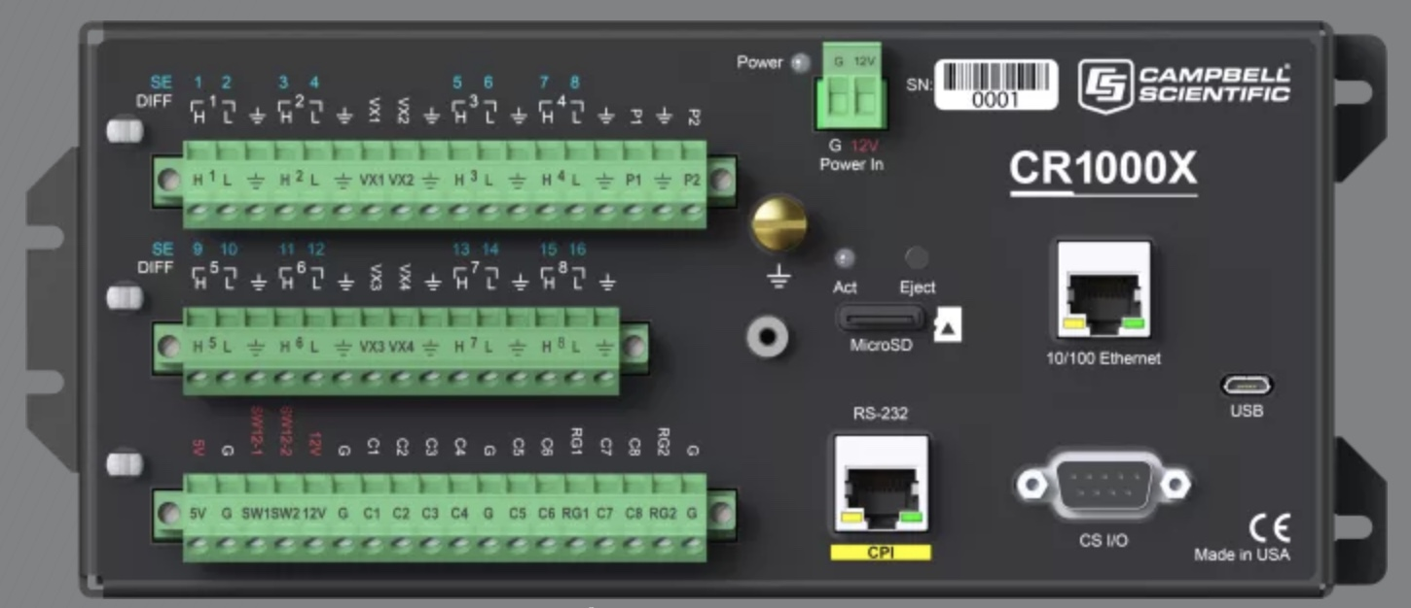
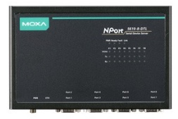
Slow Data
Fast Data
30 m
MOSAiC Flux Tower Comms
Sonic4
120R
120R
12 m
+
-
G
+
-
G
Sonic3
p/t/q
(slow)
DT3
p/t/q
+
-
G
6 m
Sonic2
DT2
p/t/q
Sonic1
Full duplex 4-Wire RS485
+
-
G
p/t/q
Analog
Licor
DT1
+
-
G
2 m
SDI-12
IRT
Ranger
Barometer
Analog
+
-
G
TCP/IP
PSP
FP1
FP2
PIR
Signals
Td, Tc
Fan tachs
RS485 Tx
120R
RS485 Rx
Switch
Half duplex 2-Wire RS485
SPN1
SC923A
Ship
This a serial device server, but could alternatively (better) be a DAS PC as Chris F suggests
I think as a practical matter we need the 30 m RS485 to be a separate line
Half duplex 2-Wire RS485
120R

