Slide 1

Arctic Halogen Cycles
Greg Huey
School of Earth and Atmospheric Sciences
Georgia Institute of Technology
Arctic Pollution Workshop – February 3, 2015

Slide 2
Outline
Halogens
  Arctic observations of Br, Cl, I
  Halogen interactions and pollutant impacts
HO_{x}
  Arctic Observations
  Halogen interactions and pollutant impacts
Arctic Pollution Workshop – February 3, 2015

Slide 3
Arctic Bromine
Ozone Depletion Events and Mercury loss
observed in polar boundary layer
ODEs
Mercury Depletion
Observations of BrO during surface ozone depletion
in spring at Alert by Hönninger, G. and U. Platt (2002).
Springtime depletion of mercury at Alert observed
by Schroeder,W. H et al. (1998)

Slide 4
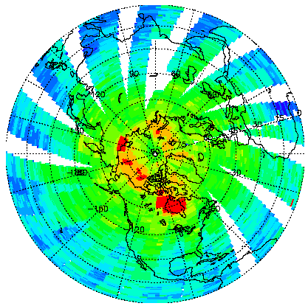

Satellite Observations of Total Column BrO
Data from April 30 - May 2, 1997
Chance, GRL, 1998
GOME satellite measurements of column BrO:
• BrO column >10 × 10¹³ cm² over Arctic ice shelf during spring
• BrO column ~ 5 × 10¹³ cm² at NH mid-latitudes year round, much larger
than in any model (at the time)
Variance in BrO is generally assumed to be tropospheric and mainly in boundary layer – correspond to tens of pptv. Note Hudson Bay

Slide 5
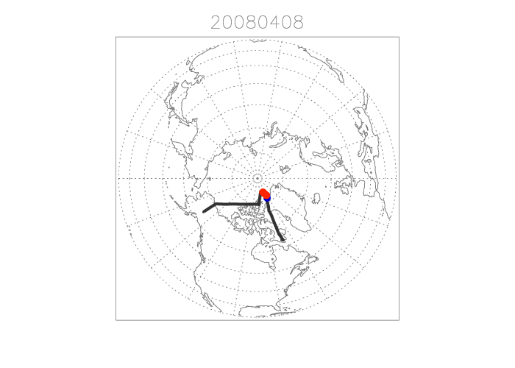
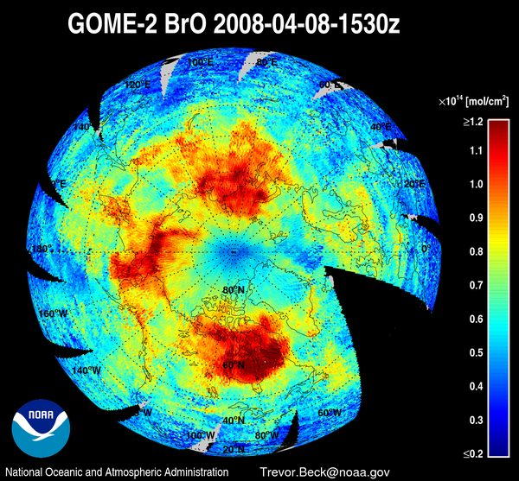
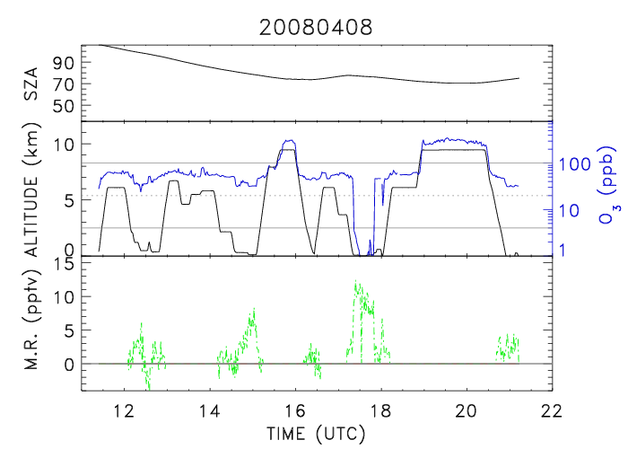
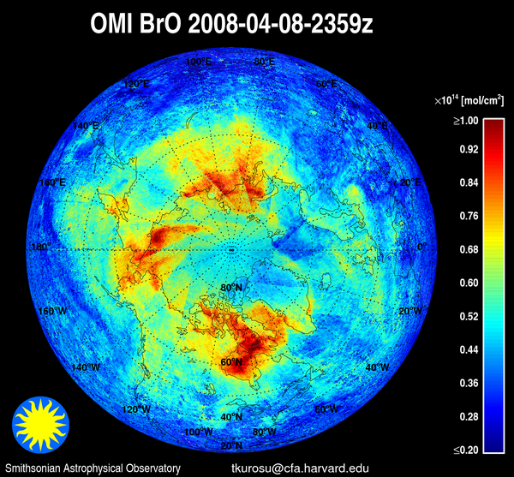
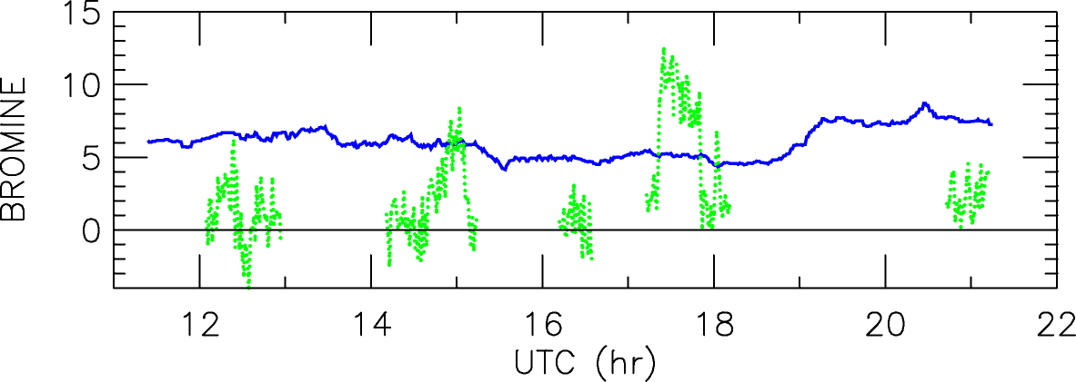
ARCTAS Flight 6: 4/8/08 (Fairbanks to Thule to Iqaluit)
DC8 ODE
×
Iqaluit
Flight Report:
Exploratory BL run north of Alert found O₃ < 0.5 ppb (Major ODE) with
significant levels of soluble Br⁻ and HOBr
Flew length of Frobisher Bay in the BL, just prior to landing, in a satellite
BrO “hotspot”. O₃ was not depleted, but no BrO or Br⁻ was detected.
↓O₃
Alt→
DC8 ODE
×
OMI Column (10¹³ mol/cm²)
↓
HOBr
Iqaluit

Slide 6

Natural Bromine Cycle in Arctic
HBr
Gas Phase
HO₂
HCHO
O₃
hv
Hg (GEM)
BrO
Br
RGM
Oxidized
Reactive
Mercury
BrO
HO₂
O₂
hv
HOBr
Br₂
hv
Deposit
OH
Br⁻ + H⁺
HOBr + Br⁻ + H⁺
Condensed Phase
BrO self reaction leads to ozone loss
Br reaction with CH₂O is a termination step
Br atoms oxidizes Hg lead to deposition
HOBr is key species in recycling of Br

Slide 7
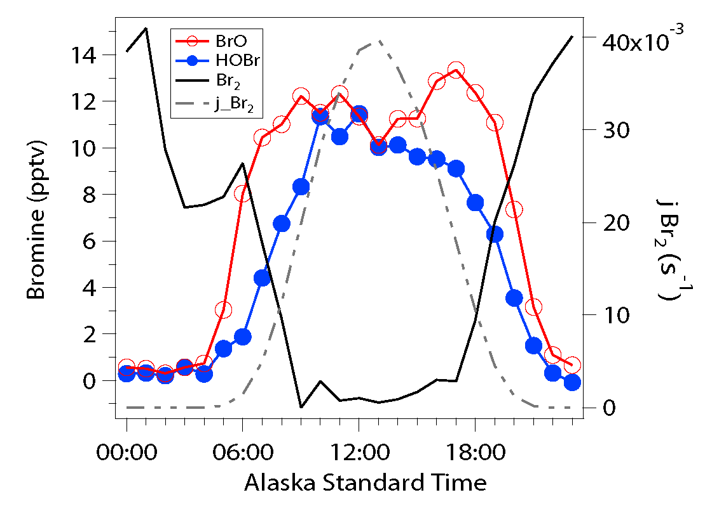
Br Speciation – Barrow, AK 2009
To support observed chemistry need HOBr recycling or Br₂ source
Average diurnal profile of bromine species in Barrow, AK spring 2009.
Br₂ photolyzes rapidly in the morning and converts primarily to BrO and HOBr

Slide 8
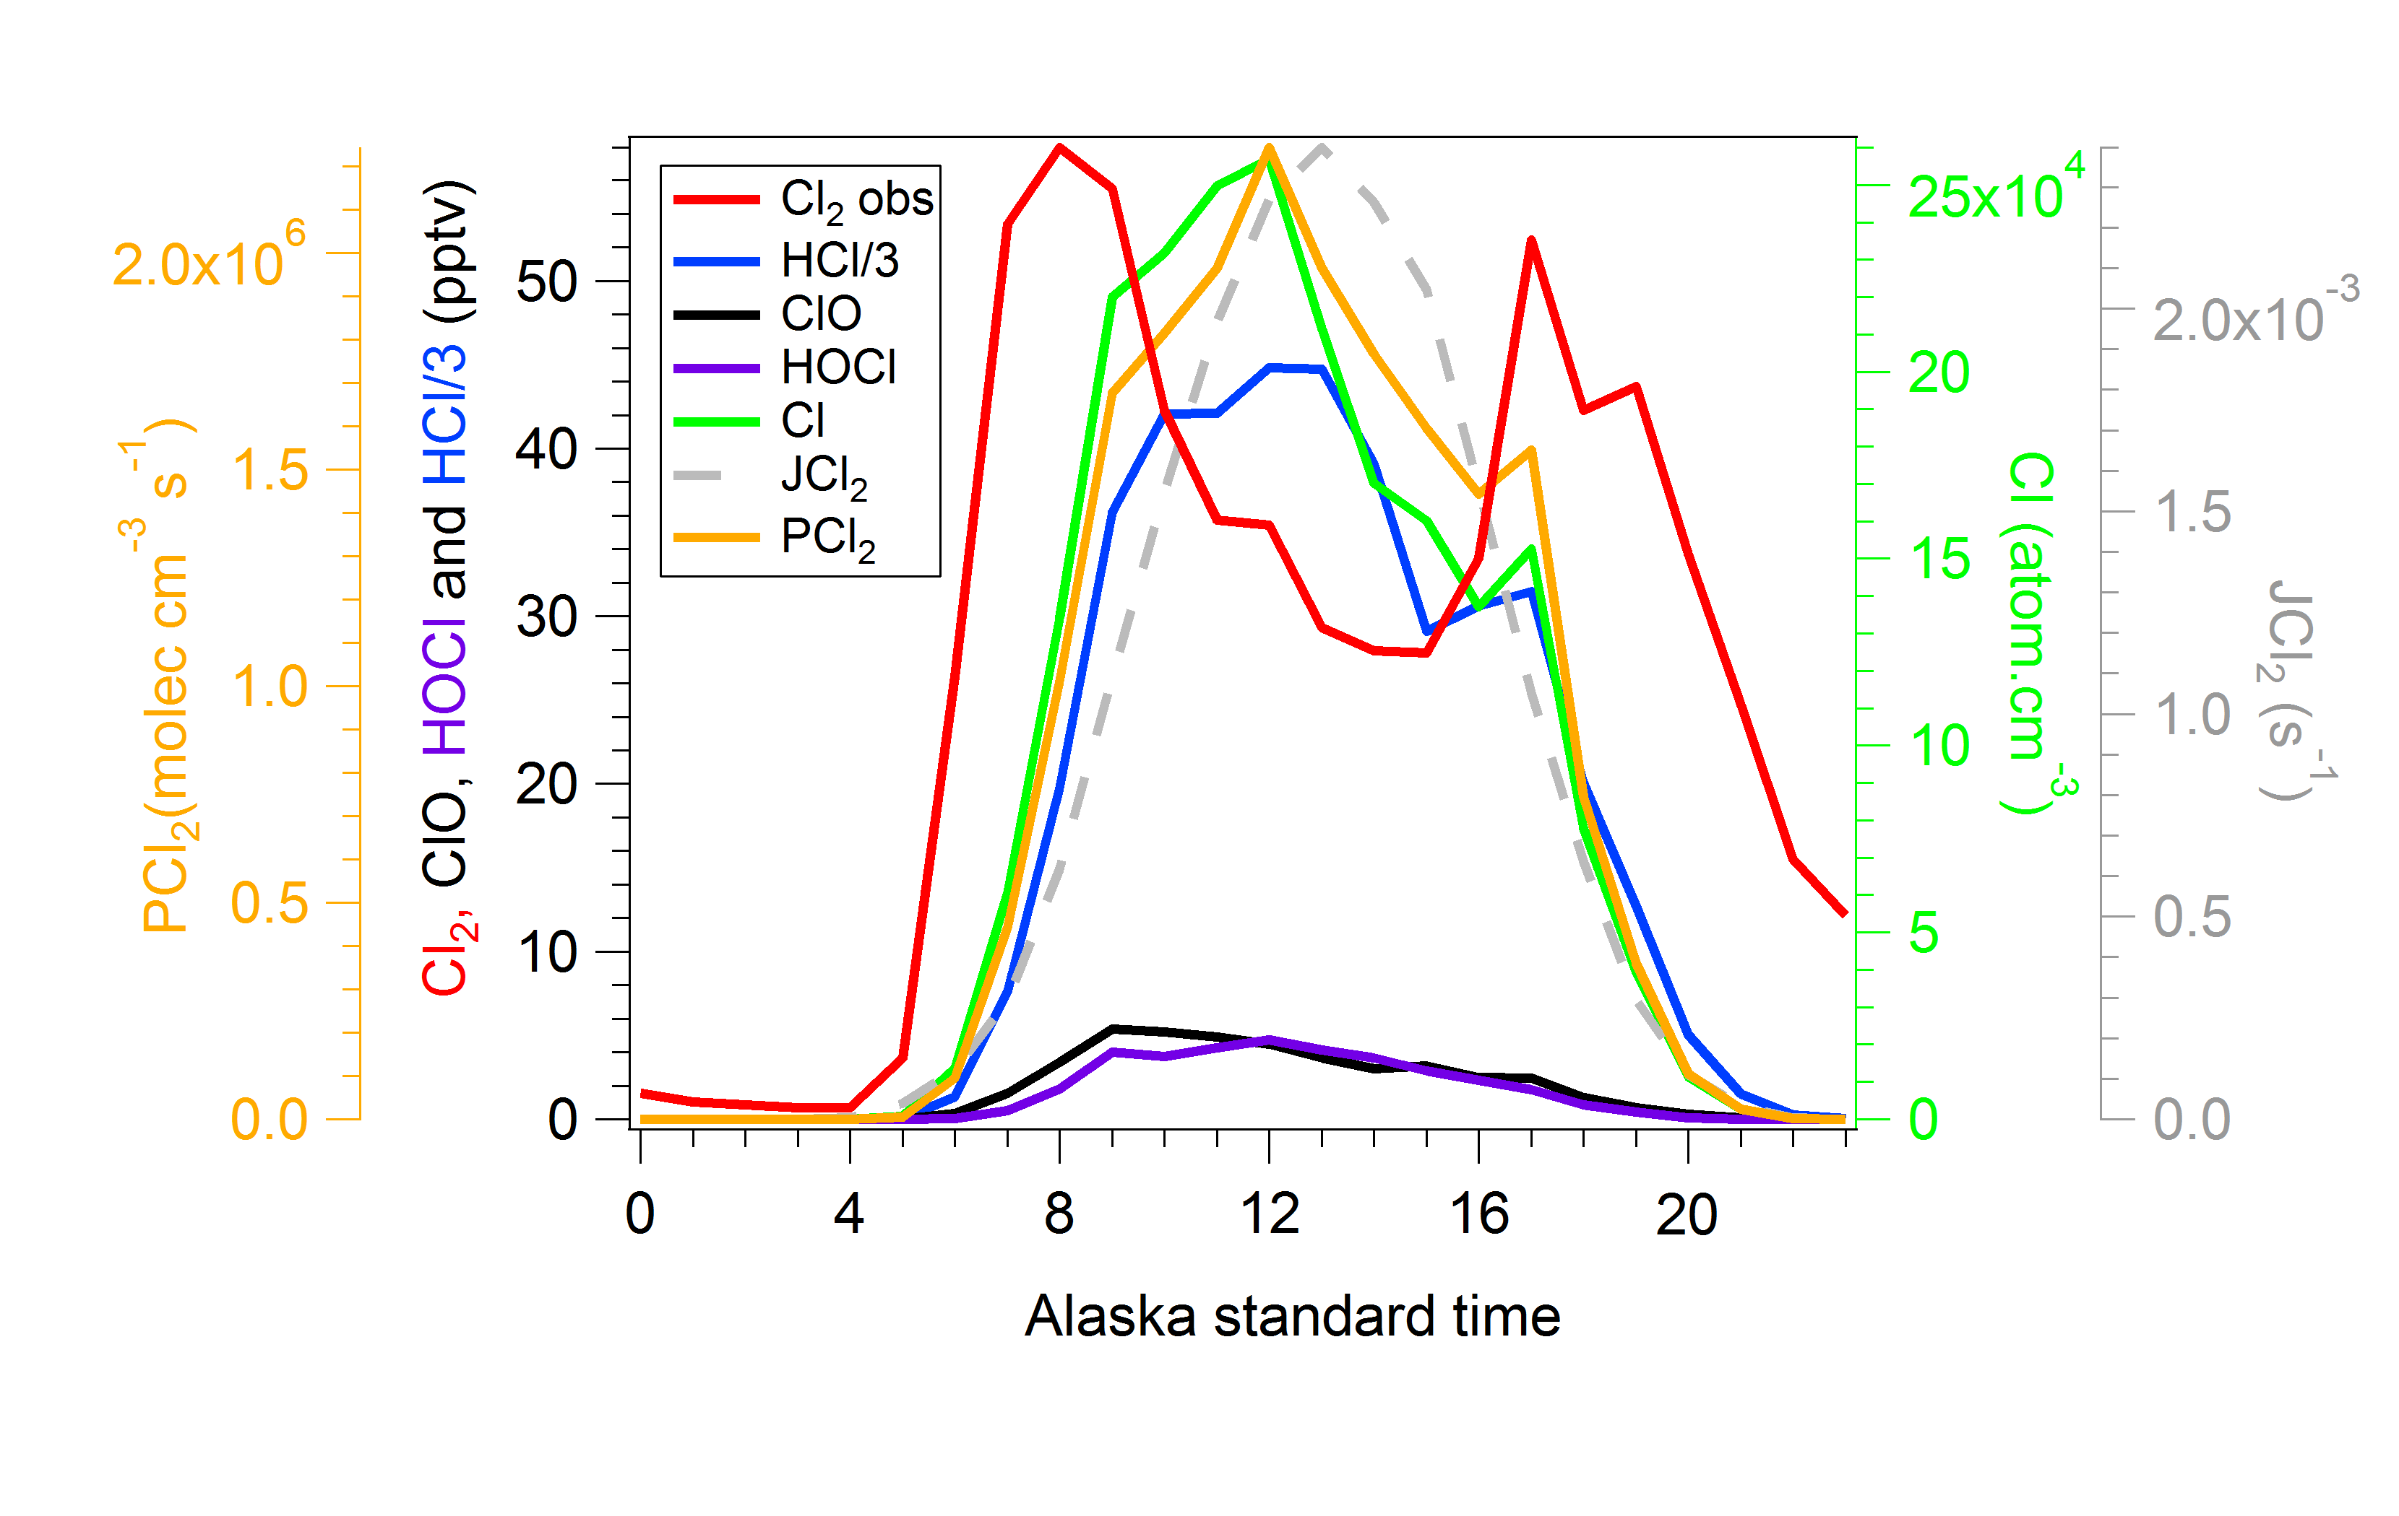
Arctic Chlorine
Very few measurements available but chlorine activity has been inferred from indirect measurements (e.g. Jobson et al., 1994; Impey et al., 1999)
High levels of Cl₂ and HCl ( up to 100’s pptv) observed in Barrow in Spring 2009 during OASIS. Chlorine often most important oxidant in this location, however, no idea of geographical distribution.
Average Cl₂ levels Spring 2009, Barrow, AK
Liao et al., 2014

Slide 9
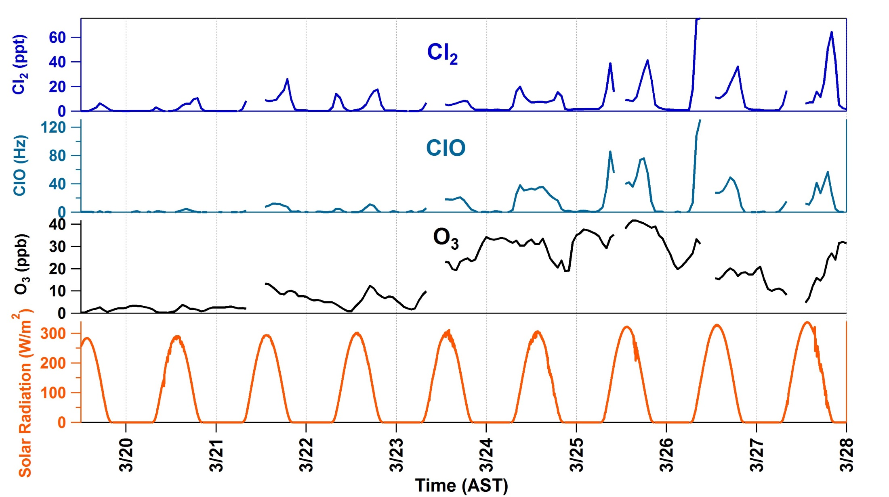
BRomine, Ozone, and Mercury EXperiment (BROMEX)
CIMS Deployment to Barrow, Alaska, March 2012
I(H₂O)_{n}⁻ as reagent ion
Monitored as ICl₂⁻ at masses 197 & 199, confirmed by isotope ratio; Field calibration with permeation source
Monitored as IClO⁻ at masses 178 & 180, confirmed by isotope ratio; currently conducting calibration experiment
Cl₂ correlated with solar radiation and ozone similar to Liao et al. observations
Kerri Pratt, Kyle Custard, & Paul Shepson, Purdue University

Slide 10
Real tundra snow illuminated in chamber
Barrow, AK 2012
Pratt et al., 2013

Slide 11
What is the Source of Br₂ and Cl₂?
Frost flowers, first year sea ice, and storm associated processes have been suggested to be ultimate source of bromine.
Most direct measurement is by Pratt et al., 2013 demonstrated that acidic, saline snowpack was best source of Br₂ – requires sunlight and ozone. Also showed that BrO could be present far inland.
Proposed condensed phase reactions (X=Br, Cl, I)
X⁻ + OH∙ + H⁺ → H₂O + X∙
X⁻ + X∙ ↔ X₂∙⁻
X₂∙⁻ + X₂∙⁻ → X₃⁻ + X⁻
X₃⁻ → X₂ + X⁻
Shepson group recently observed I₂ in snowpack in Barrow but couldn’t observe in atmosphere.
.

Slide 12
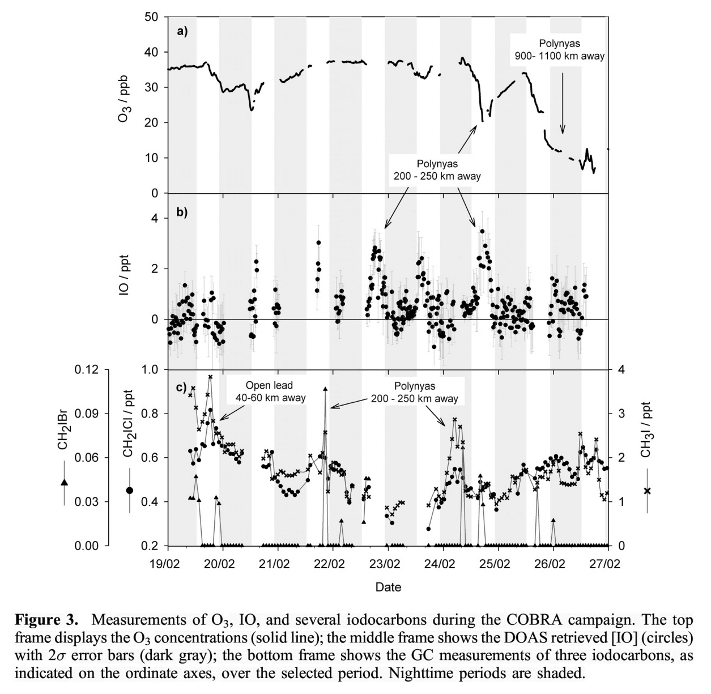
Arctic Iodine
IO commonly observed in Antarctica but only one instance in Arctic during COBRA in 2008
Eastern side of Hudson Bay.
IO ascribed to organic iodine emissions from open water –
Leeds and polynas
Mahajan, A. S. et al. Evidence of reactive iodine chemistry in the Arctic boundary layer. J. Geophys. Res. 115, D20303 (2010).

Slide 13
Natural Bromine Cycle in Arctic
HBr
Gas Phase
HO₂
HCHO
O₃
hv
Hg (GEM)
BrO
Br
RGM
Oxidized
Reactive
Mercury
BrO
HO₂
O₂
hv
HOBr
Br₂
hv
Deposit
OH
Br⁻ + H⁺
HOBr + Br⁻ + H⁺
Condensed Phase
BrO self reaction leads to ozone loss
Br reaction with CH₂O is a termination step
Br atoms oxidizes Hg
HOBr is key element in recycling

Slide 14
Chlorine Cycle
Chlorine cycle terminates much more easily as HCl is readily formed and HOCl is less reactive than HOBr. For example, in Barrow ~75% of Cl atoms are deactivated immediately.
  Cl + VOC → HCl
Chlorine impacts bromine cycle through several reactions and enhances ozone and mercury depletion
  ClO + BrO → Br + Cl + O₂ (ozone destruction)
  Cl enhances HO₂ → HOBr
.

Slide 15
Iodine Cycle
Inorganic Iodine does not terminate via gas phase reactions. IO oxidations leads to new particle production and uptake – Iodine Oxide Particles (IOP).
Iodine has efficient cross reactions with BrO and HO_{x} cycles. A little IO can have large impact.
  IO + BrO → Br + I + O₂ (ozone destruction)
  IO + HO₂ → OH + I + O₂ (OH enhancement)

Slide 16
Pollution Impacts on Halogens
CH₂O from VOC oxidation leads to Br termination step.
Br + CH₂O → HBr + CH₂O
NO₂ reacts with halogen oxides to form XONO₂
e.g. BrO + NO₂ → BrONO₂
This probably leads to bromine deactivation relative to HOBr formation. However, evidence at mid-latitude for fficient Br cycling at moderate NO_{x} levels.
ClONO₂ - could lead to enhanced chlorine cycling.
NO_{x} may also activate chlorine through ClNO2 production as well
pH is very important for both halogen recycling and snowpack halogen sources. Deposition of acidic gases and aerosol as well as oxidants to snowpack is likely to enhance halogen source to overlying atmosphere.

Slide 17
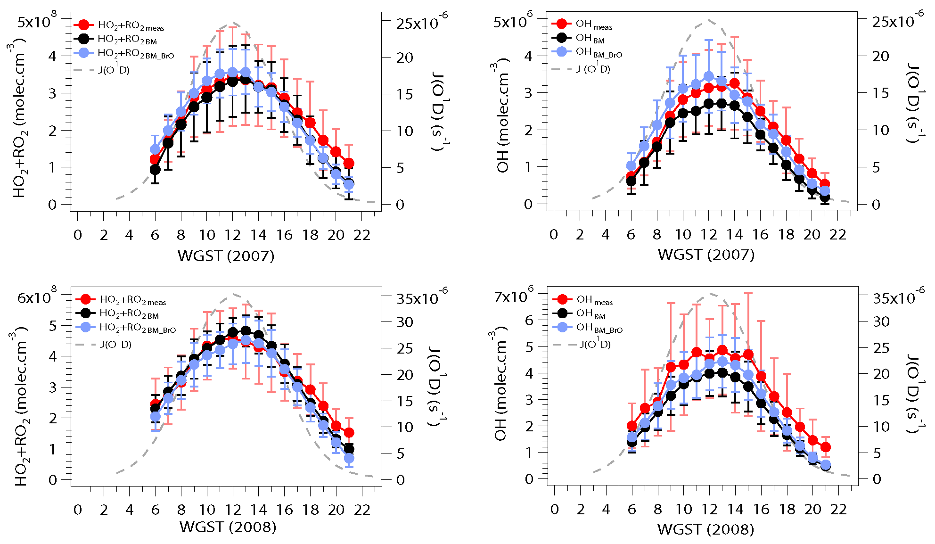
Arctic HO_{x}
A few measurements available Summit, Greenland (GSHOX), Hudson Bay (COBRA), Airborne (ARCTAS), Barrow (OASIS)
HO₂ well predicted by standard O₃ photolysis source and radical self reaction loss
OH harder to predict as impacted by halogen and other chemistry – even on top of ice sheet
Liao et al, 2011
Summit, Greenland

Slide 18
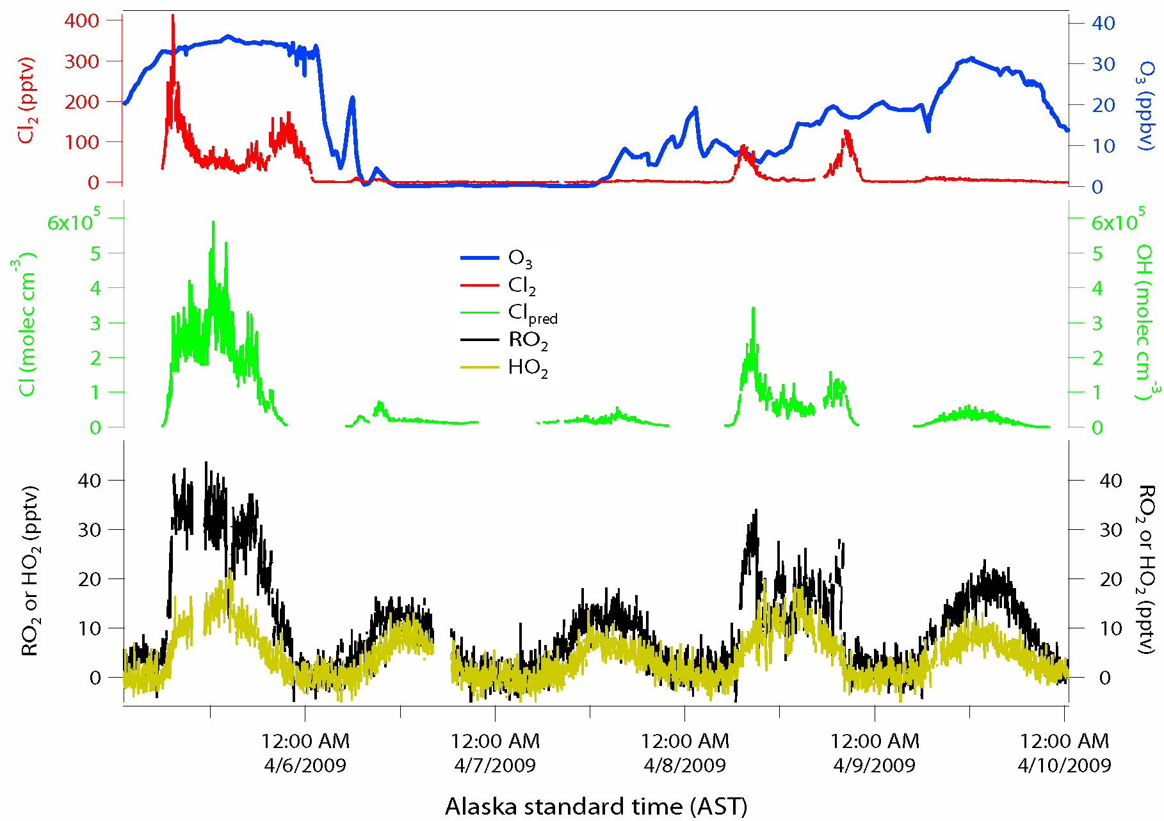
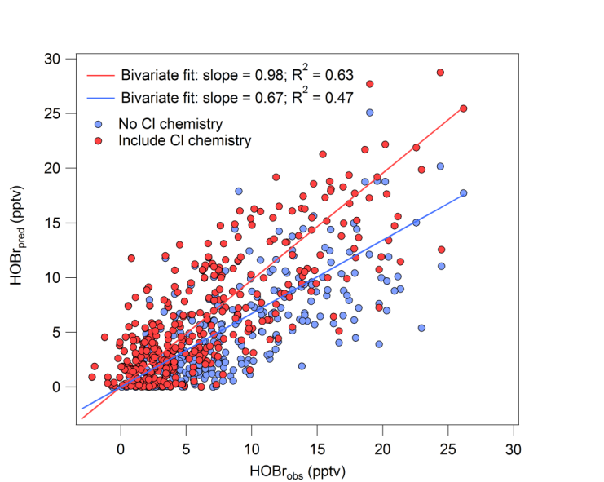
Barrow HO_{x}
Chlorine dominates RO₂ and impacts HO₂ production at Barrow, AK.
Ozone photolysis is not very important for HO₂ production in Barrow.
CH₂O and other radical sources dominate
Chlorine has large impact on HOBr
Through HO₂ – Can’t get bromine correct w/o chlorine and HO_{x} chemistry

Slide 19
Summary
We have made a lot of progress in Arctic halogen chemistry in last six years. However, combined impact of pollutants such as NO_{x} and acidic gases (snow pH) on halogen cycle are not settled issues.
HO_{x} chemistry in Arctic is very sensitive to pollutants as radical sources. NO_{x} and halogen levels have strong impact on HO_{x} partitioning and OH levels.
Understanding O₃ and Hg chemistry requires taking into account Br, Cl, I and HO_{x} interactions.
Changing see ice cover, precipation, etc. will also have a strong impact on Arctic halogens.

Slide 20
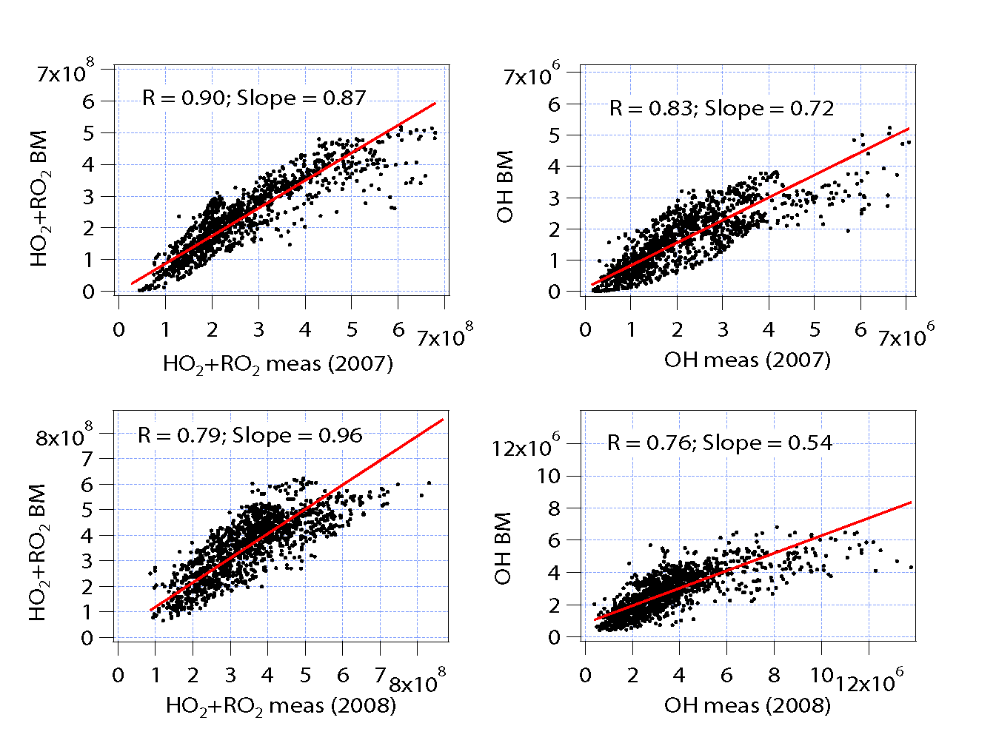

Slide 21
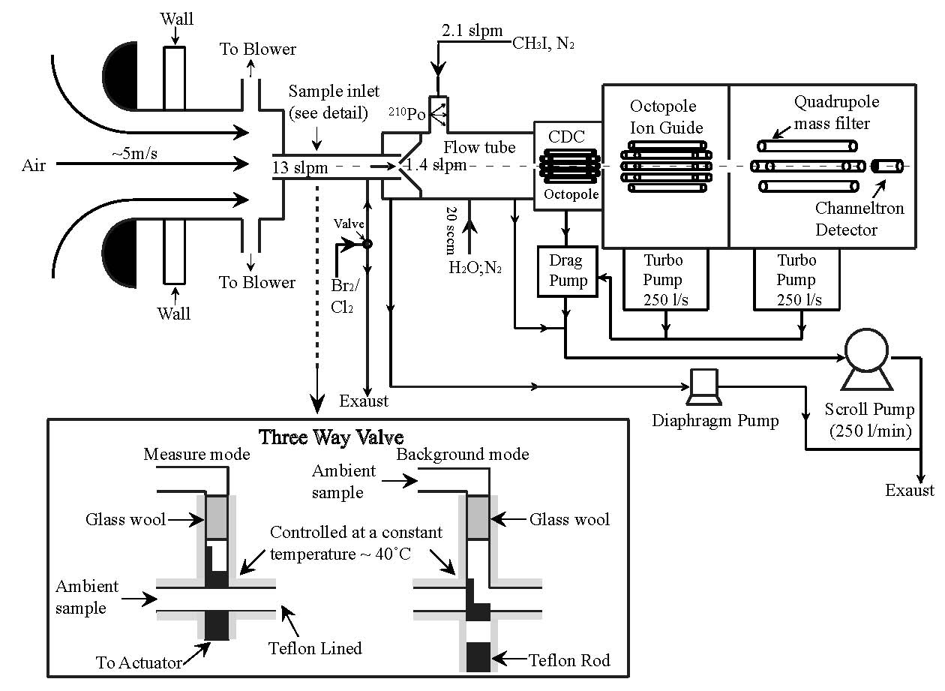
CIMS detection of halogens
Chemical
Ionization
Mass
Spectrometer

Slide 22
Ion Chemistry for Detection of Halogens
Tri-Halide “type” and/or association reactions
I⁻ + Cl₂ → ICl₂⁻
I⁻ + Br₂ → IBr₂⁻
I⁻ + BrCl → IBrCl⁻
I⁻ + ClO → IClO⁻
I⁻ + BrO → IBrO⁻
I⁻ + HOBr → I(HOBr)⁻
(Neuman et al., JGR, 2010, Liao et al., JGR, 2011, and 2012, Pratt and Shepson)
All reactions are more efficient at higher water levels.
e.g. dominant channel w/ Cl₂ at low water is Cl⁻.

Slide 23
Mass Spectra from Barrow
I⁻ + Cl₂ → ICl₂⁻⁻

Slide 24
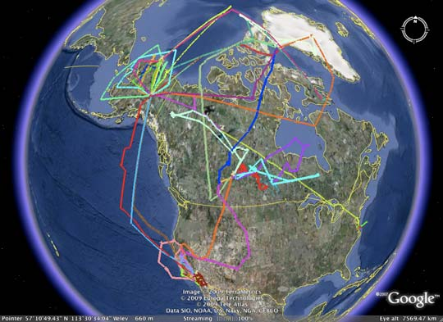
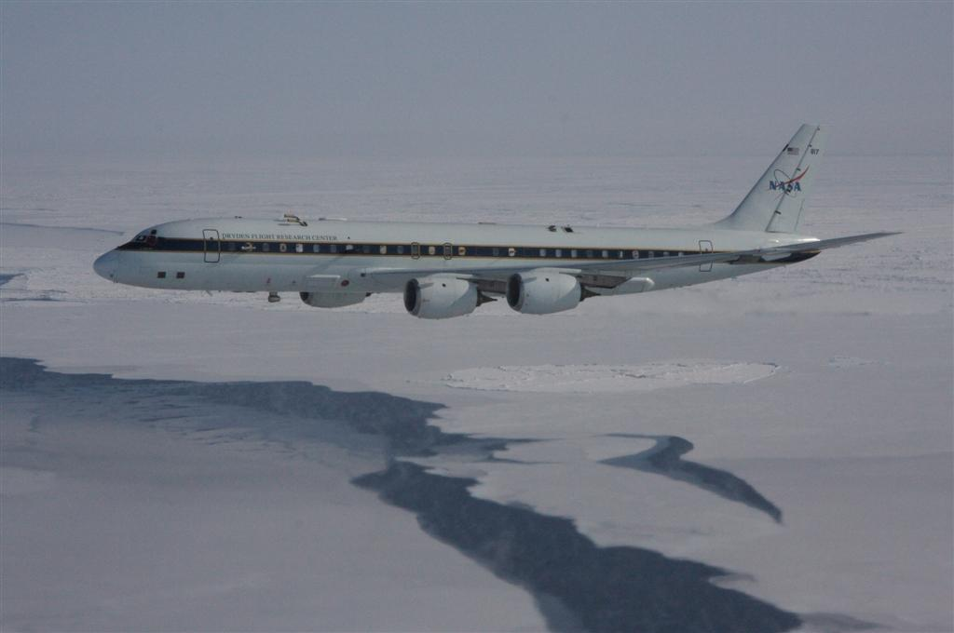
Arctic Research of the Composition of the Troposphere from Aircraft and Satellites (ARCTAS) - 2008
Large NASA mission aimed at quantifying pollution inputs to the Arctic – Boreal Fires,
Arctic Haze, etc. - Secondary aim to validate satellite BrO measurements
Photo of NASA DC-8 taken by Daniel Lack,
scientist on-board NOAA P3

Slide 25
ARCTAS Flight 6: 4/8/08 (Fairbanks to Thule to Iqaluit)
DC8 ODE
×
Iqaluit
Flight Report:
Exploratory BL run north of Alert found O₃ < 0.5 ppb (Major ODE) with
significant levels of soluble Br⁻ and HOBr
Flew length of Frobisher Bay in the BL, just prior to landing, in a satellite
BrO “hotspot”. O₃ was not depleted, but no BrO or Br⁻ was detected.
↓O₃
Alt→
DC8 ODE
×
OMI Column (10¹³ mol/cm²)
↓
HOBr
Iqaluit

Slide 26
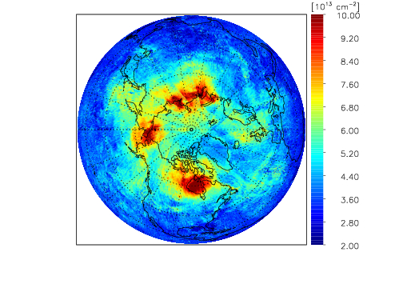
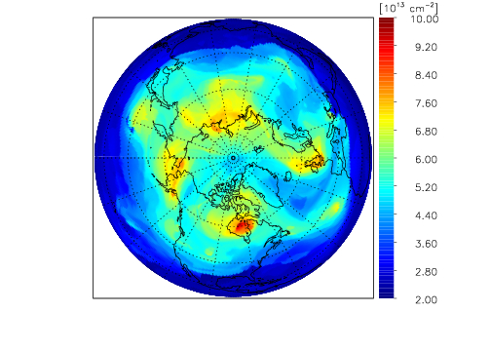
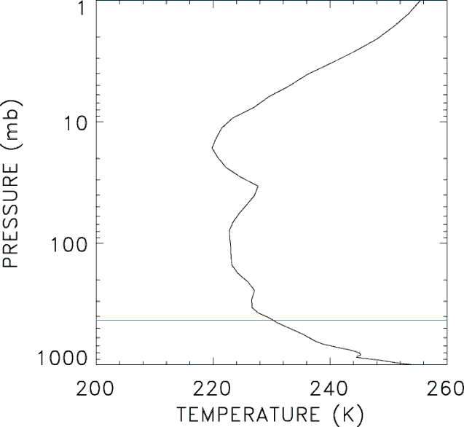
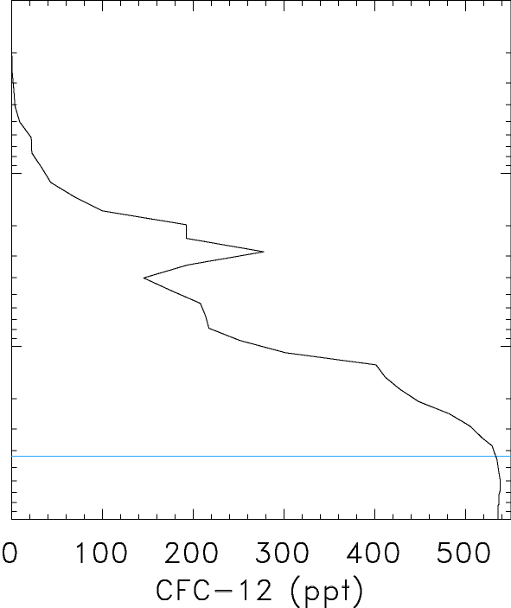
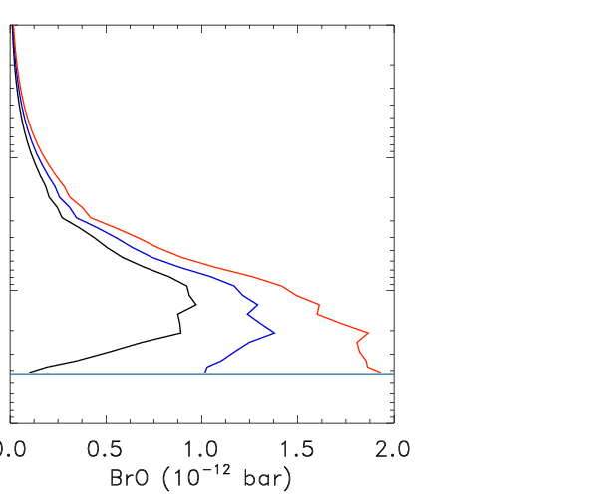
6 April 2008
OMI Total Column BrO
Model: VSL Br_{y} = 10 ppt
Model Profiles, Hudson Bay
Model by Ross Salawitch
VSL Br_{y} = 5 ppt
VSL Br_{y} = 10 ppt
VSL Br_{y} = 0
Tropopause 
VSL Br ~ CH₂Br₂ biogenically produced in tropical oceans

Slide 27
Conclusions from ARCTAS
There are issues in interpreting BrO satellite data in Arctic. There is some correspondence to in situ observations but in at least certain regions satellite does not correspond to tropospheric BrO.
One leading hypothesis is that the variance in satellite BrO is due to lower stratosphere BrO. For example, the persistent signal over Hudson Bay corresponds to consistent low point in the tropopause.
However, significant BrO in Arctic lower stratosphere requires a large input of very short live (VSL) bromine species to the tropical tropopause – Upcoming CONTRAST Mission
Overall results are disappointing four our group. Negative results don’t allow for measurement comparison or investigation of bromine chemistry.

Slide 28
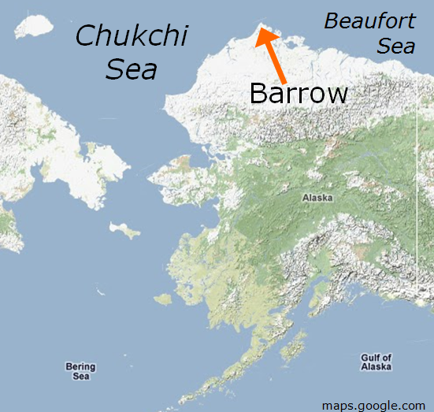
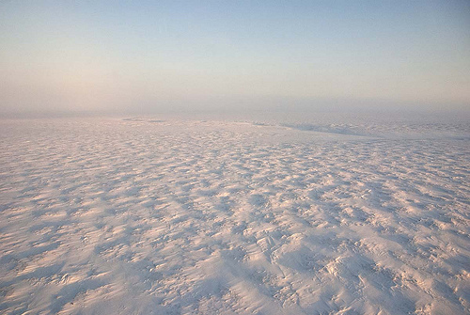
Ocean, Atmosphere, Sea Ice, and Snowpack (OASIS) Experiment - 2009
How do interactions between the sea ice and snow pack with the atmosphere influence ozone depletion and mercury deposition

Slide 29
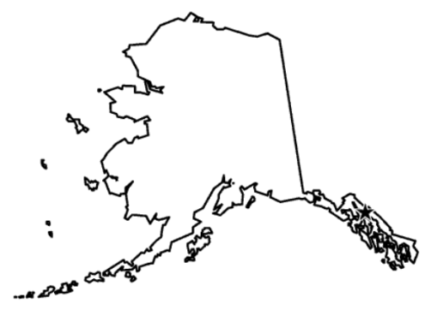
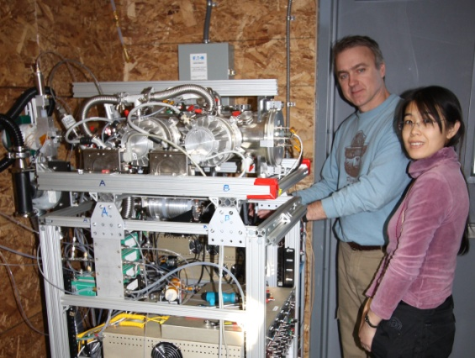
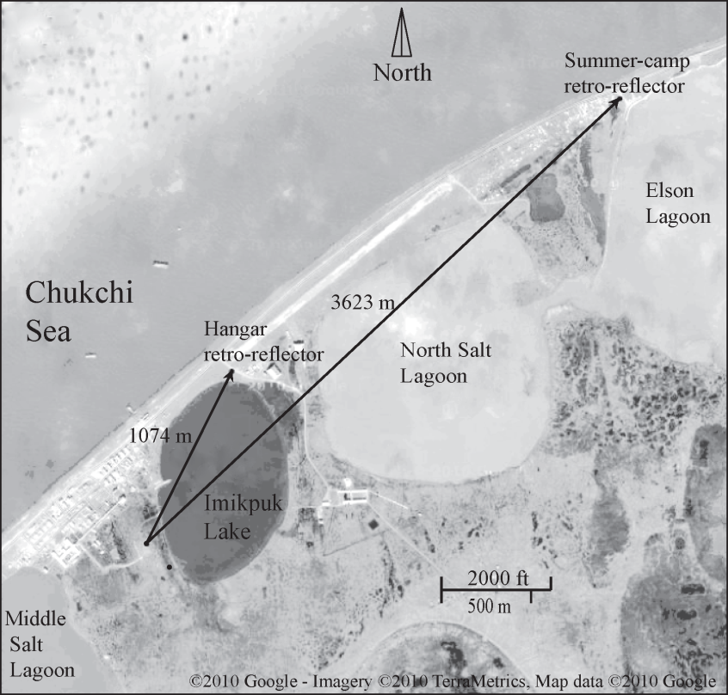
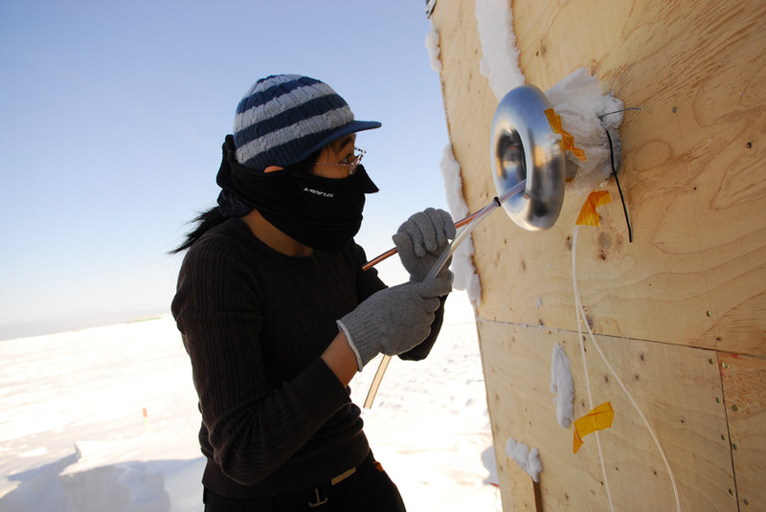
Barrow, AK (OASIS-09)
(71◦19′ N, 156◦ 39′ W )
Barrow
Chemical ionization mass spectrometer
Spring 2009
Alaska
Arctic Ocean
LP DOAS
CIMS

Slide 30
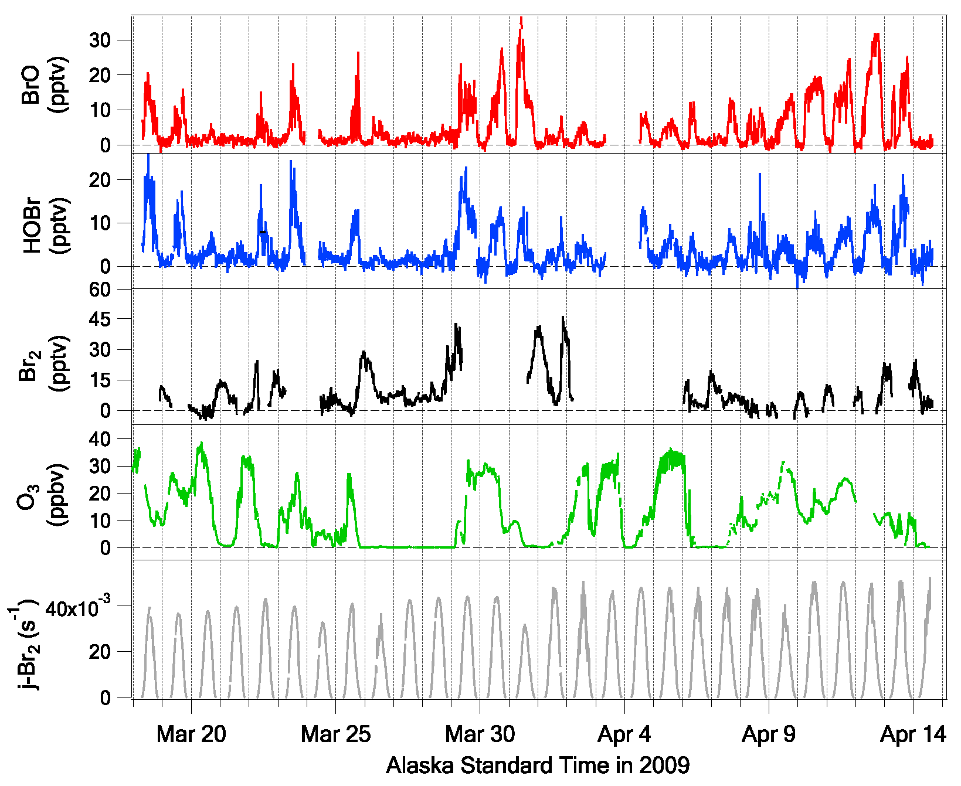
Observations of BrO, HOBr and Br₂ by CIMS
Compared to LPDOAS observations
First direct observations of HOBr
High levels of Br₂ at night

Slide 31
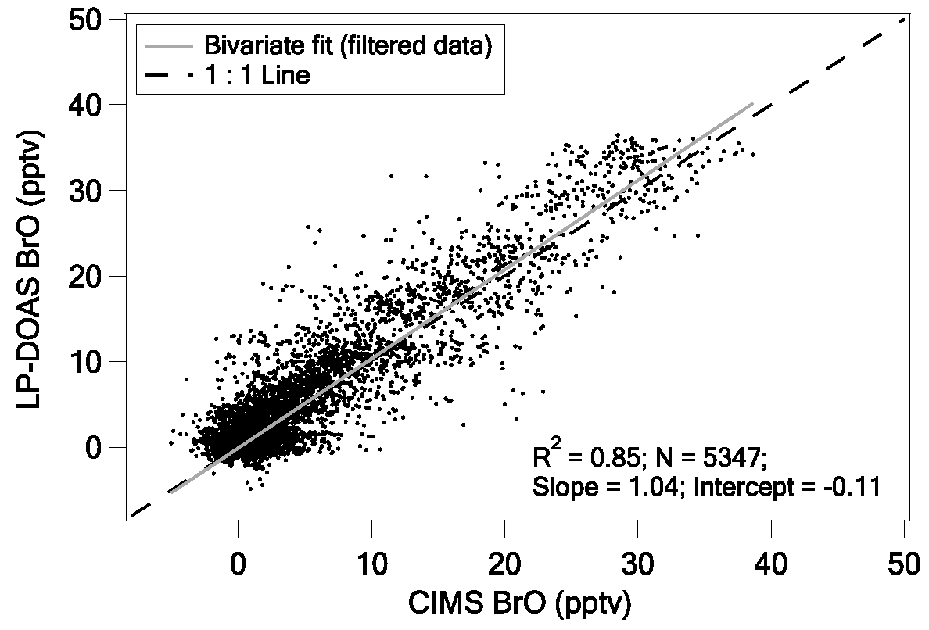
BrO measurement comparison
R² = 0.85
BrO measurements from the CIMS were in excellent agreement with a nearly
co-located LP-DOAS, especially at moderate wind speeds (3 m/s <ws < 8 m/s) and low NO (NO < 100 pptv) conditions. [Liao et al., 2011]

Slide 32
Average dirunal profile of bromine species in Barrow, AK spring 2009.
Br₂ photolyzes rapidly in the morning and converts primarily to BrO and HOBr

Slide 33
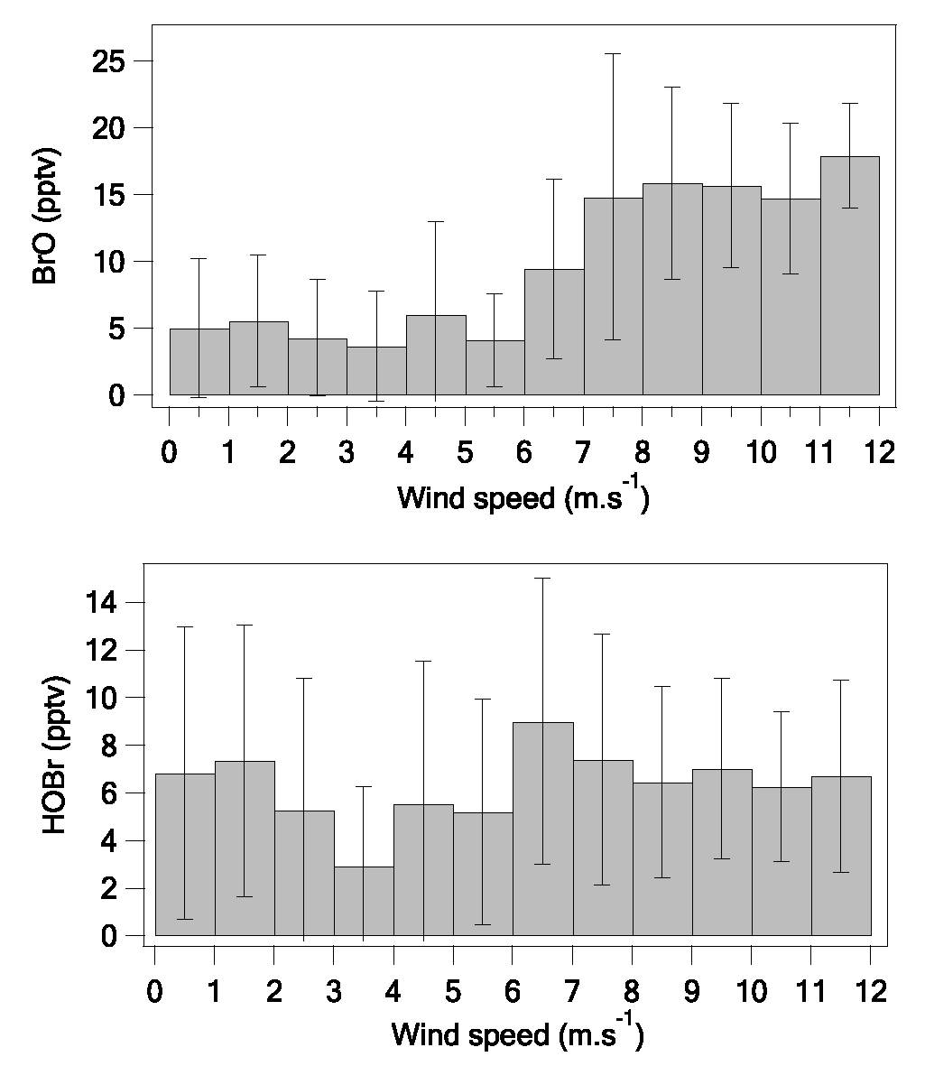
Bromine Activation and Wind Speed
Conditions favoring bromine activation
BrO v.s. WS
HOBr v.s. WS
Threshold for
blowing snow.
Indicates enhanced Br cycling on suspended snow.

Slide 34
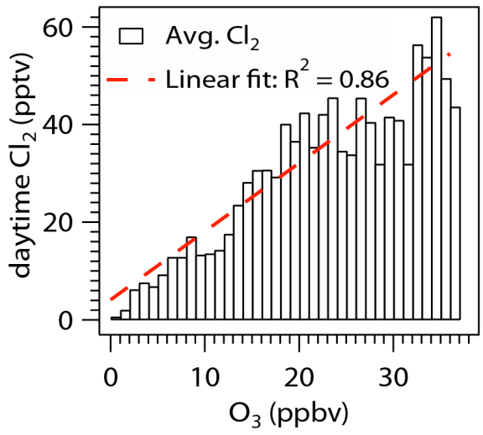
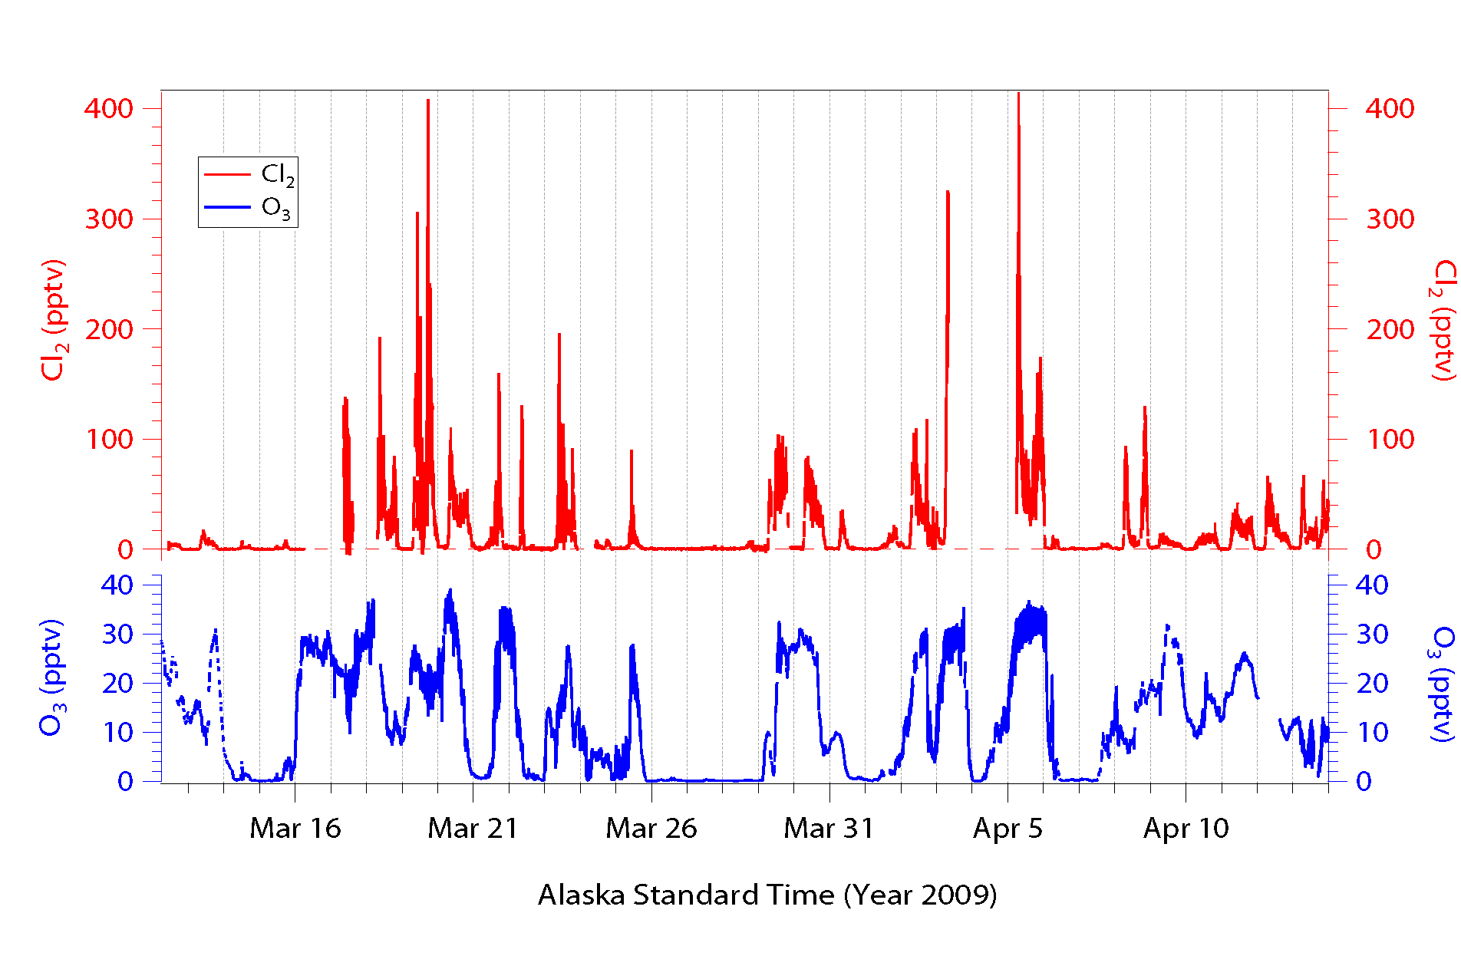
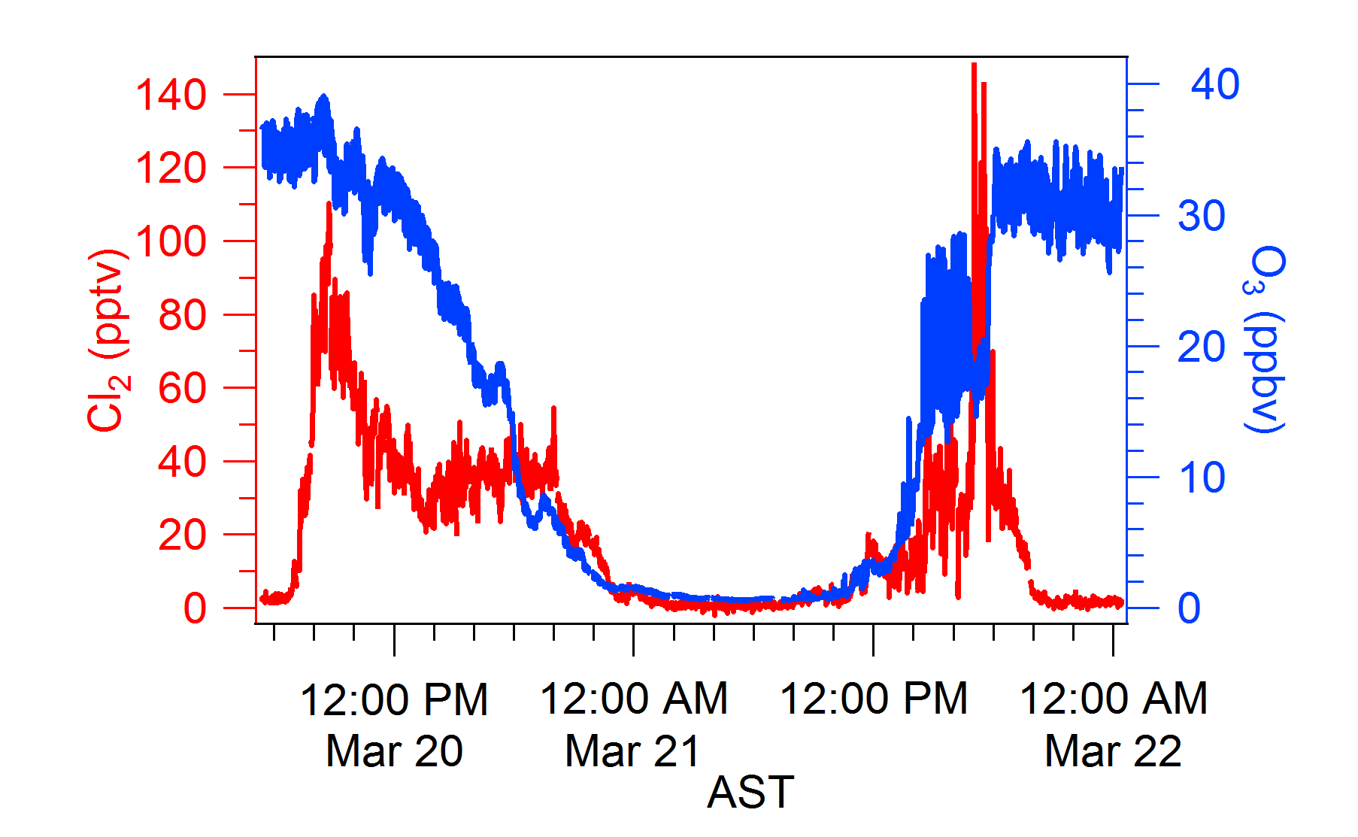
High levels of Cl₂ observed in presence of Ozone and Sunlight

Slide 35
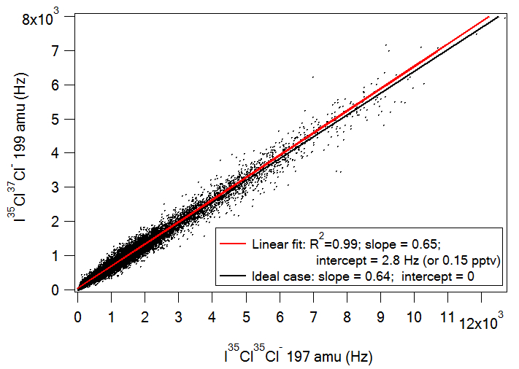
The quality of Cl₂ measurements
Comparison of ambient Cl₂ signals at different isotopes
Excellent correlation strongly indicates that Cl₂ was detected at these masses.

Slide 36
BRomine, Ozone, and Mercury EXperiment (BROMEX)
CIMS Deployment to Barrow, Alaska, March 2012
I(H₂O)_{n}⁻ as reagent ion
Monitored as ICl₂⁻ at masses 197 & 199, confirmed by isotope ratio; Field calibration with permeation source
Monitored as IClO⁻ at masses 178 & 180, confirmed by isotope ratio; currently conducting calibration experiment
Cl₂ correlated with solar radiation and ozone similar to Liao et al. observations
Kerri Pratt, Kyle Custard, & Paul Shepson, Purdue University

Slide 37
Average diurnal profiles of chlorine species
Cl
HCl
Data in the days with average daytime ( 8 am – 10 pm) Cl₂ >10 pptv were used to calculate the profiles.
Cl_{2 obs}
ClO
HOCl
A time dependent model constrained to Cl₂ measurements predicted chlorine species.
HOCl and ClO were ~5 times lower than Cl₂ concentrations; a large interference in Cl₂ measurements due to conversion of HOCl was unlikely.
The slow decline of Cl₂ after sunset indicates that Cl₂ has an extra loss (e.g. deposition) besides photolysis.
A large Cl₂ flux of 8 × 10¹⁰ molec cm⁻² s⁻¹ on average in the daytime is needed assuming a BLH of 400 m. Flux depends on ozone and sunlight.

Slide 38
Chlorine chemistry in the troposphere
Oxidize hydrocarbons (e.g. CH₄) and increase RO₂ levels
Oxidize CH₂O and H₂O₂ and enhance HO₂ levels
2. Intensify polar springtime surface ozone and mercury depletion
events (ODEs and MDEs)
Reactions | Rate coefficient@250K (cm³ molec⁻¹ s⁻¹)
OH + CH₄ | 2.0 × 10⁻¹⁵
Cl + CH₄ | 4.4 × 10⁻¹⁴
Concentrations (molec.cm⁻³)
OH (10⁵ -10⁶)
Cl (10⁴-10⁵?)
Reactions | Rate coefficient@250K (cm³ molec⁻¹ s⁻¹)
BrO + BrO | 3.8 × 10⁻¹²
ClO + BrO | 1.6 × 10⁻¹¹
BrO + HO₂ | 2.8 × 10⁻¹¹
Br + Hg | 9.2 × 10⁻¹⁴
Cl + Hg | 1.0× 10⁻¹²
Concentrations
BrO (0−40 pptv)
ClO (1-10 pptv?)
Br (10⁶-10⁸)
HO₂ (10⁷ -10⁸)

Slide 39
Cl₂ Impacts
Chlorine dominates RO₂ and impacts HO₂ production at Barrow, AK.
Chlorine has large impact on HOBr
Through HO₂ – Can’t get bromine correct w/o chlorine chemistry

Slide 40
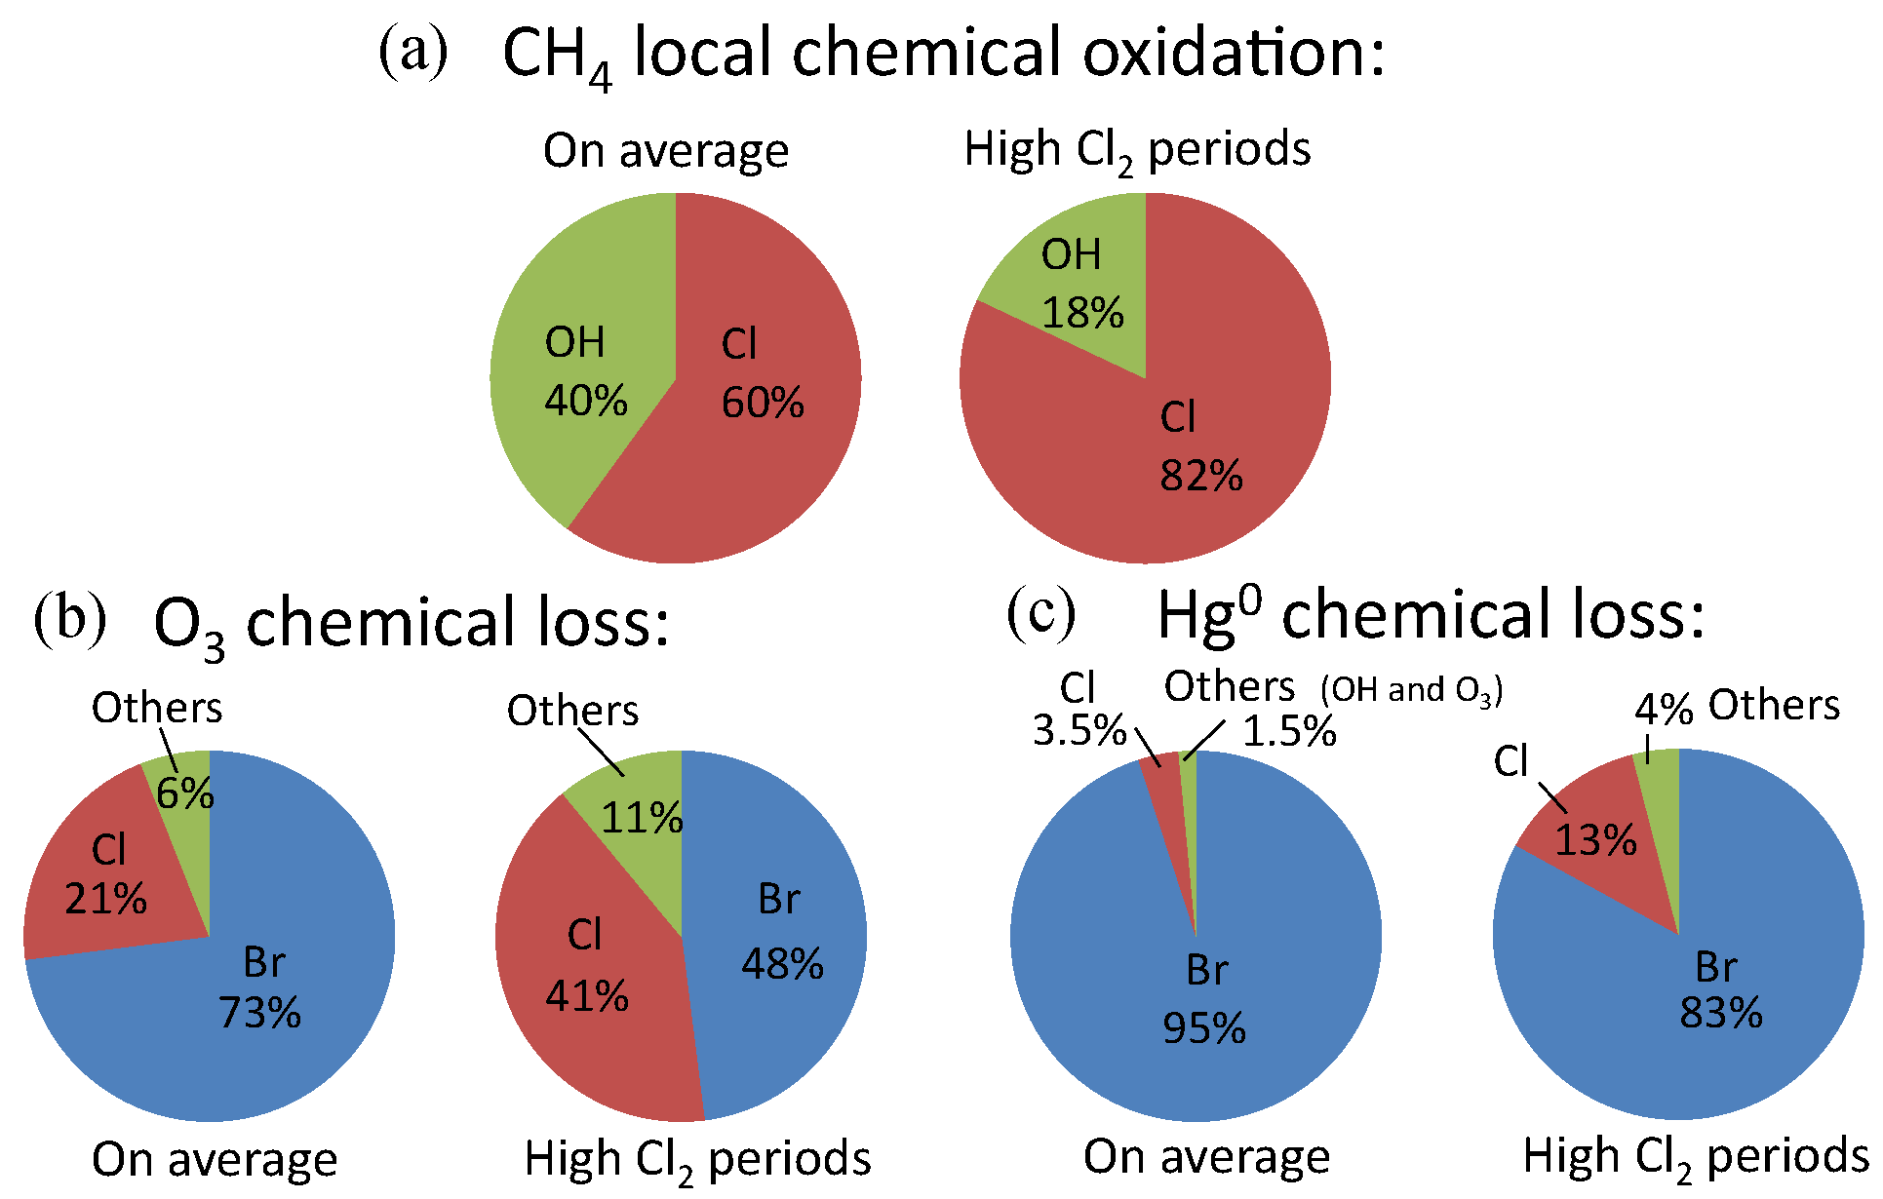
Impact of chlorine chemistry

Slide 41
Arctic Halogen Chemistry in 2013
Halogen chemistry is interesting but not really not very well pinned down at all.
The spatial (horizontal and vertical) distribution of inorganic bromine and chlorine is not well understood.
Chlorine chemistry is much more important in the Arctic than previously thought if it is not isolated to Barrow.
Chlorine will impact methane oxidations, ozone depletion, and mercury depletion both directly and indirectly via interaction with HOx and bromine chemistry
We need new airborne missions to address these issues
January 2014 (Guam) – CONvective TRansport of Active Species in the Tropics (CONTRAST) – address the tropical inputs impacting the LS
Proposed – Polar HAlogen and Mercury Experiment (PHAME)

Slide 42
Acknowledgements
Jin Liao and David Tanner - Tech
John Nowak and Andy Neuman -NOAA
Kerri Pratt and Paul Shepson - Purdue
Funding – NSF-ATM, NASA-TCP

Slide 43
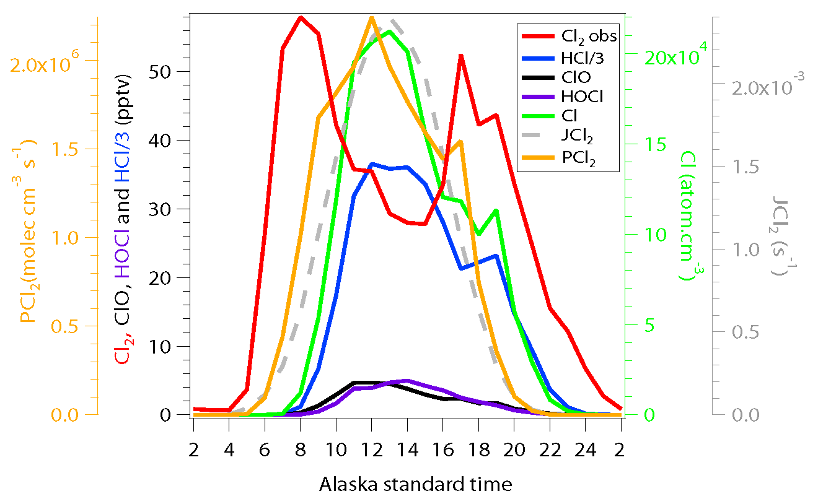
Cl₂ Diurnal Profile

Slide 44
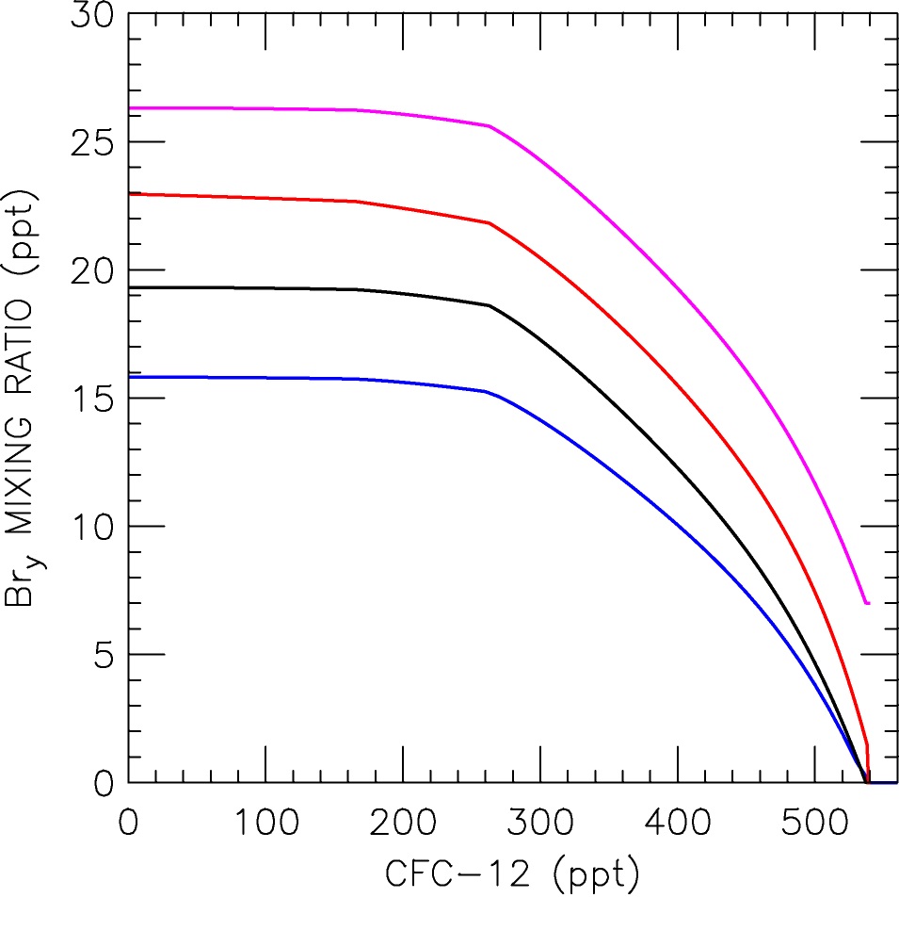
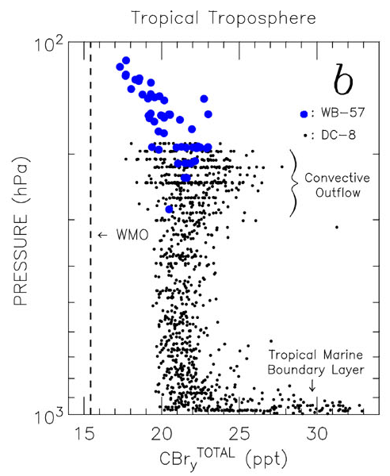
Bromine from VSL (very short lived) Sources
Sala : PGI= 7 ppt
on top of TC⁴
Theys: SGI = 5 ppt
PGI= 1 ppt
TC⁴ CH₃Br, Halons, CH₂Br₂
WMO CCMVal2
CH₃Br & Halons
TC⁴ tropospheric data indicate significant potential
for VSL species to supply Br_{y} to stratosphere
Salawitch et al., GRL, 2010 & Theys et al., ACP, 2009
Theys et al., ACP, 2011
Salawitch et al., GRL, 2010

