Slide 1
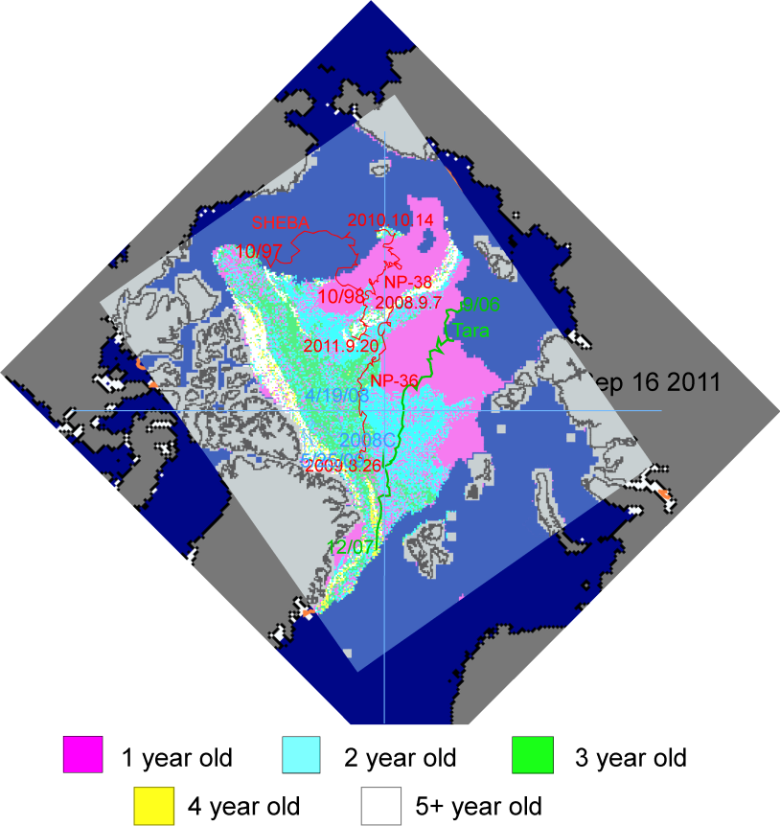
International Arctic Science Committee
The proposed Multidisciplinary drifting Observatory for Studies of Arctic Climate (MOSAiC)
O. Persson, M. Shupe, M. Tjernström, K. Dethloff, D. Perovich (& many others)
What: Deployment of a heavily instrumented, manned, Arctic Ocean observatory to provide observations addressing key science questions associated with the Arctic atmosphere, cryosphere, and ocean along with their interactions
When: Approximate timeline: start 2016-2017, covering several annual cycles
Where: Central Arctic basin drift will allow measurements in regions with limited instrumentation, include different ice and weather regimes, and provide a multi-year data set
Who: International participation (e.g. US, Germany, Sweden, Canada, Finland, United Kingdom, Russia, China, Japan, France,…) through IASC coordination, synchronized international funding, and use of international infrastructure
Outcomes: Improved process level understanding of Arctic system components and their interactions; Improved GCM parameterizations; Improved satellite remote sensing techniques; Arctic Ocean observational impact test bed; expand terrestrial climate observations
September 2011 sea ice extent and ice age (courtesy NSIDC and J. Maslanik). Drift tracks of stations installed in autumn of 2006-2010 with at least 1-year longevity are shown to suggest possible observatory put-in locations and tracks

Slide 2
Why ?
”New Arctic”
- large regions of first-year ice and seasonally open water instead of primarily multi-year ice – regional and global impacts
- commercial interests increasing
Lack of understanding of many disciplinary processes
Atmosphere
Cryosphere
Oceans
Biosphere
3) Lack of understanding of interdisciplinary interactions/processes

Slide 3
MOSAiC Science Planning Workshop, June 27-29, 2012, Boulder, Colorado USA
Overarching Science Question
“What are the causes and consequences of an evolving and diminished sea ice cover?”
Broad Sub-questions
● How do ongoing changes in the Arctic ice-ocean-atmosphere system drive heat and mass transfers of importance to climate and ecosystems?
● What are the processes and feedbacks affecting sea-ice cover, atmosphere-ocean stratification and energy budgets in the Arctic?
● Will an ice-reduced Arctic become more biologically productive and what are the consequences of this to other components of the system?
● How do the different scales of spatial and temporal heterogeneity within the atmosphere, ice and ocean interact to impact the linkages or feedbacks within the system?
● How do interfacial exchange rates, biology and chemistry couple to regulate the major elemental cycles?

Slide 4
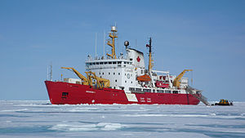
How are MOSAiC science questions to be addressed?
Deploy manned, international drifting observatory in the central Arctic for at least one full annual cycle, preferably longer
- base for sophisticated local measurements of atmosphere, cryosphere, ocean, and biosphere (e.g., radars, lidars, towers, radiometers, soundings, ice/snow surveys, CTDs, …)
- center of distributed array of spatial measurements using automated observing stations (automated towers, ice buoys, floats), unmanned aerial and underwater vehicles (UAVs, AUVs, gliders), remotely operated vehicles (ROVs), and episodic aircraft campaigns (e.g., AWI Polar-5)
- during episodic intensive observing periods, coordinate measurements with larger array of ships (e.g., Russian drifting station; Japanese R/V Mirai; German R/V Polarstern; Swedish R/V Oden; Chinese; others?) and research aircraft (German Polar-5, U.S. aircraft?, British aircraft?)
b) Time deployment and design innovative logistical techniques to allow measurements of autumn freeze-up, heat loss from upper ocean to atmosphere, and formation of first-year ice
c) Engage modeling community to define/refine needed observations and coordinate planning [ e.g., Year of Polar Prediction (YOPP) – 2017]
CCGS Amundsen

Slide 5
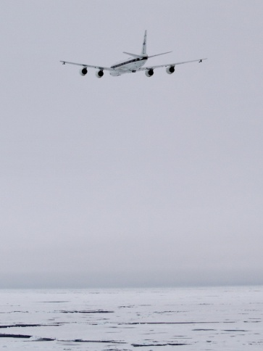
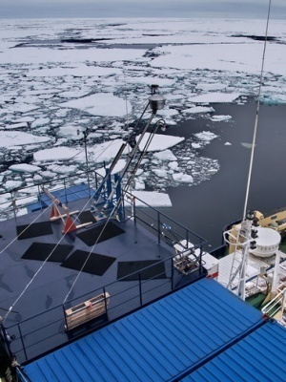
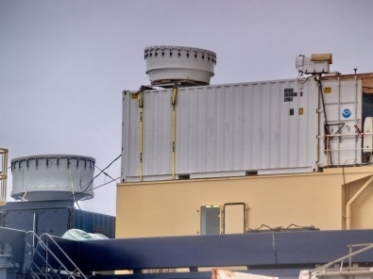
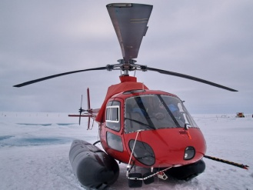
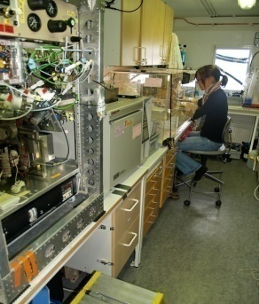
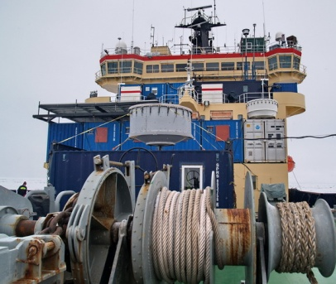
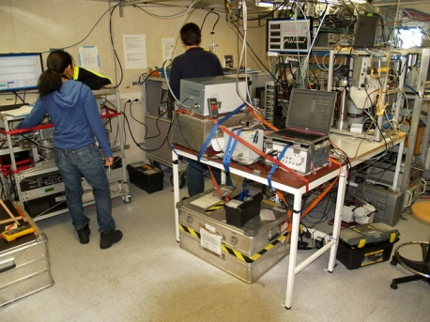
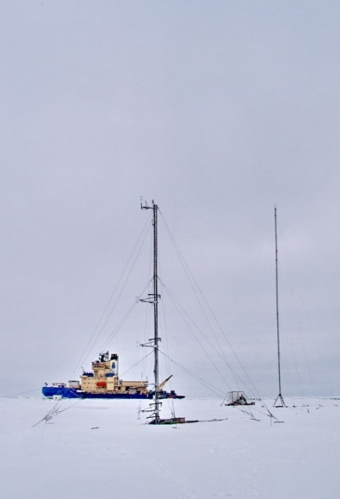
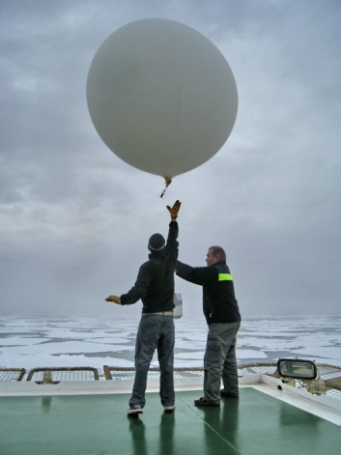
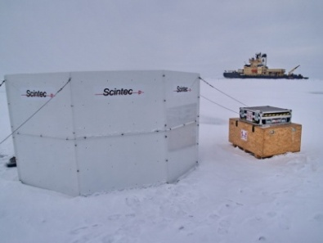
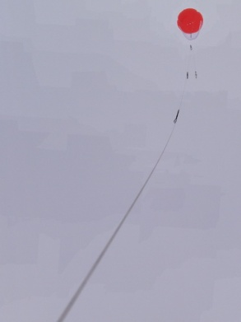
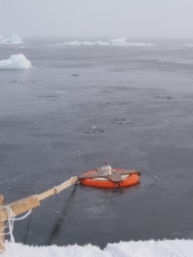
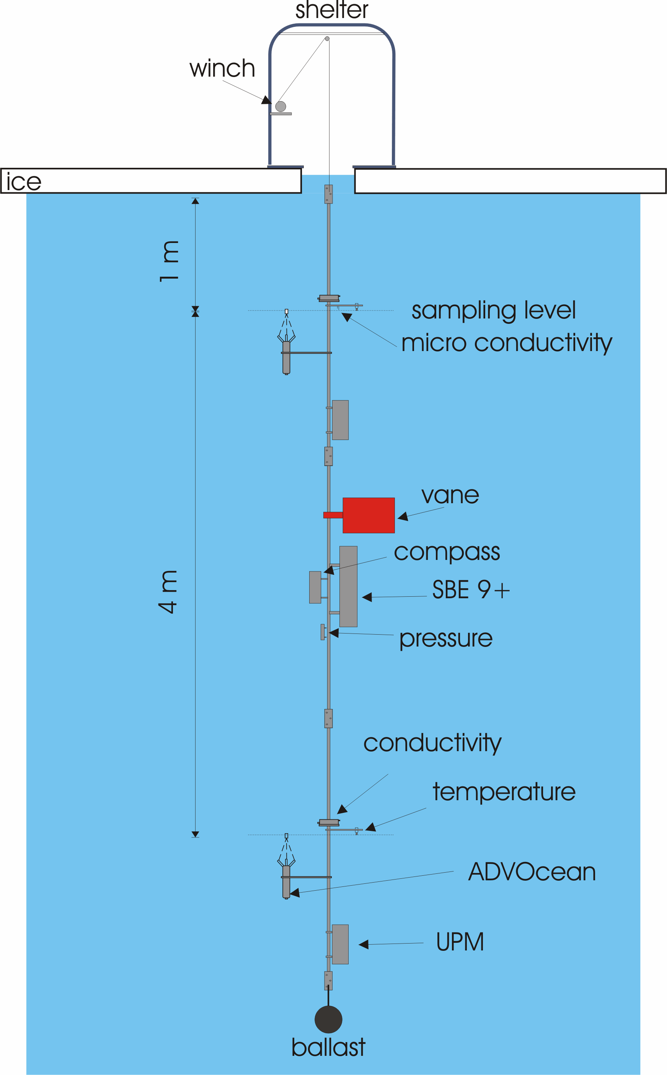
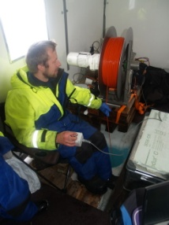
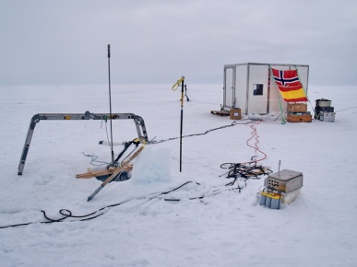
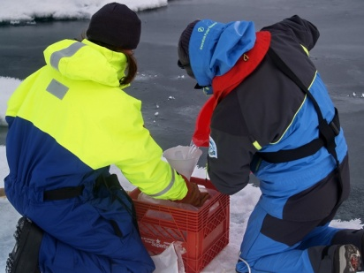
Remote sensing
observations
Airborne
observations
Atmospheric gas phase and aerosol lab
8 km
Atmospheric
profiling
500 m - 1 km
Micro-
meteorology
Ice
Lead
Under-ice & upper ocean physics
Marine biology and chemistry
c:a 400 m
Bubble
formation

Slide 6
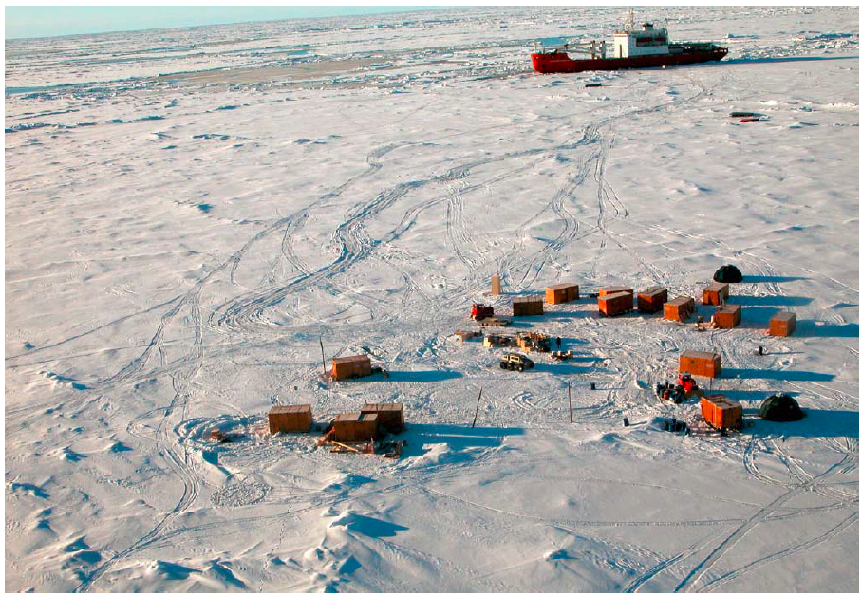
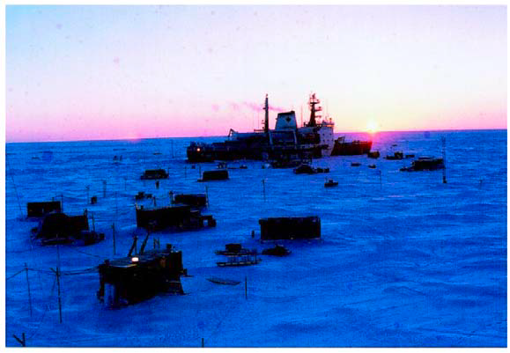
Previous experience
Russian Drifting Station – ice islands
Deployed by icebreaker
• Soviet/Russian drifting stations:
Annual deployments provide unique long-term time series of basic meteorological and some cryospheric parameters. Lack important instruments/measurements for understanding processes related to clouds, aerosols, boundary layer, snow, sea-ice, ocean, biology interactions. Parameters increased for recent deployments.
• SHEBA:
Sampled full annual cycle with some sophisticated instrumentation, including cloud measurements and solid ice, mass, & energy
budgets. Some oceanographic measurements also made. Failed to characterize aerosols, trace gases, boundary layer structure, cloud dynamics, and broader dynamical context for local measurements.
• Short-term deployments (LEADEX, AOE-2001, ASCOS, …):
e.g., ASCOS: Sophisticated gas, aerosol, cloud, boundary layer, and energy budget observations. Lacked sufficient observations of the ice mass budget and ocean energy flux contributions. Lasted for only 3‐5 weeks.
Surface Heat Budget of the Arctic Ocean (SHEBA; 10/1997-10/1998)
Continuous icebreaker facility and on-ice deployment

Slide 7
Previous experience – why insufficient?
Not comprehensive enough: Must observe many important systems together, ultimately process interactions and feedbacks are important (and more difficult to understand!)
Not long enough: Important processes often vary with season AND the system has memory that impacts future responses. Short campaigns will miss many of the important contextual details
Not representative: Observations at a single location or time of year may not characterize other times or locations. Spatial and temporal variability are likely important. Some processes likely to have different significance in the “New Arctic”

Slide 8
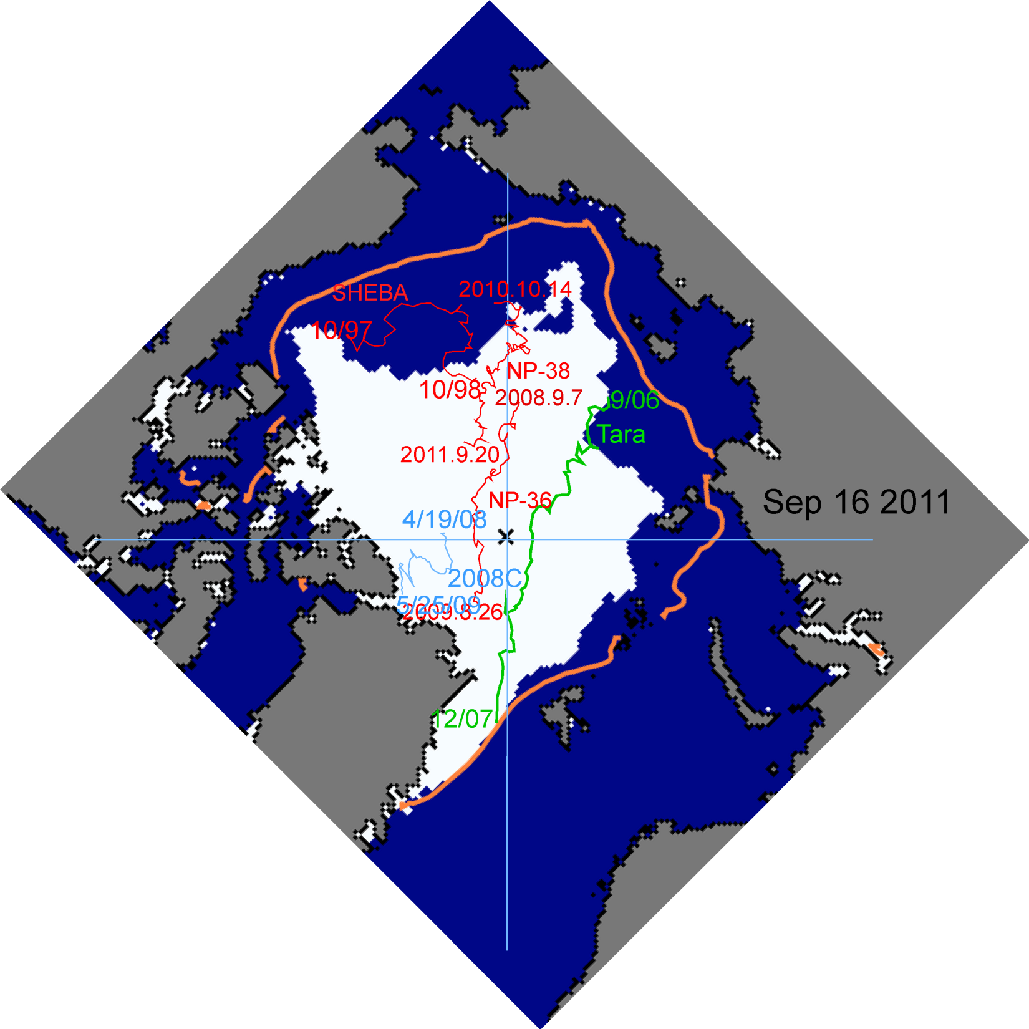
Where? – Transpolar Drift
- only option that can provide a) length of sampling and b) sampling of Central Arctic
x
Tiksi
Locations of recent drifts
NP-36, 38 and Tara tracks would meet MOSAiC needs

Slide 9
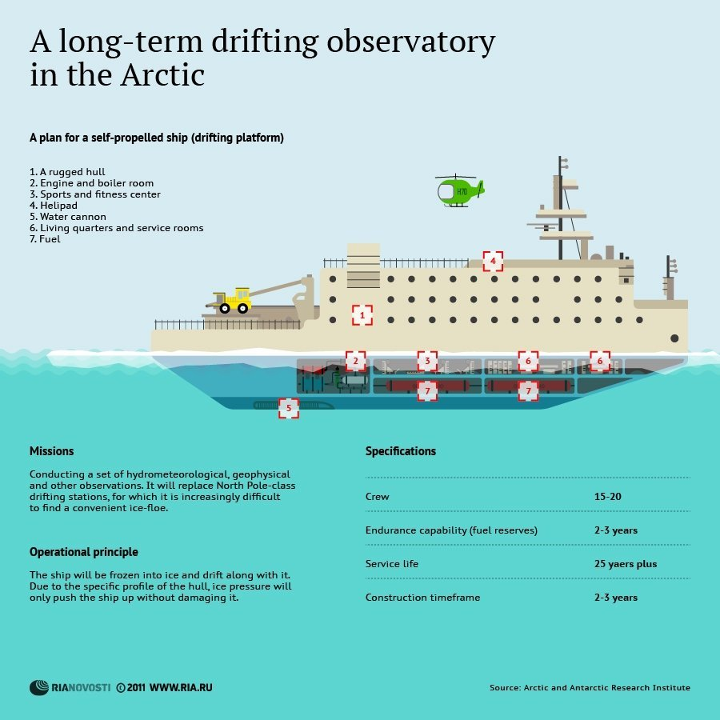
Proposed MOSAiC Observatory – Russian Drifting Station (NP Station) Collaboration
Scientific Collaboration – benefit to both because of similar science objectives - Russian participation in MOSAiC planning
- coordinate observatory deployment locations – optimize scientific benefit - coordinate measurement parameters/instrumentation – personnel exchanges(?) - coordinate measurement times - simultaneous measurements - communicate/support each other during Intensive Observation Periods
Logistical Collaboration – benefit to both because of similar logistical needs
- MIZ deployment logistics – share: experience, satellite information, deployment vessels(?); facilitate permissions - coordinate/share resupply, ship/science crew rotations, emergency evacuation plans
New Barge for Russian NP Stations
Possible Ship for MOSAiC International Observatory
CCGS Amundsen

Slide 10
MOSAiC Development Plans
Key milestones :
1) the Boulder Workshop - June 27-30, 2012 -coordinate MOSAiC science research topics, with a science plan ideas/draft as an output.
2) Coordinate AODS (Arctic Ocean Drift Study) with MOSAiC – Workshop, Winnipeg, 9/16-17/2012
3) the establishment of a Scientific Steering Group for MOSAiC
4) develop MOSAiC Science Plan - autumn, 2012
5) Winter 2012-2013: MOSAiC SSG meeting to finalize science plan and begin draft of MOSAiC Implementation Plan. (in Finland?)
6) February-March 2013: Summarize Science and Implementation Plans for Arctic Observing Summit
7) MOSAiC Implementation Plan - draft by Feb. 1; final version by June 30, 2013
8) Open MOSAiC Science and Implementation Workshop – Spring (April, May) 2013?
9) Summer 2013: Submit MOSAiC Science and Implementation Plans to appropriate funding agencies and international organizations with interest. Identify and propose/begin necessary preparatory instrument development/modeling .
10) Further planning and logistics meetings 2014-2015; proposal submissions late 2014 or 2015.
11) Begin deployment, October 2016? October 2017?

Slide 11
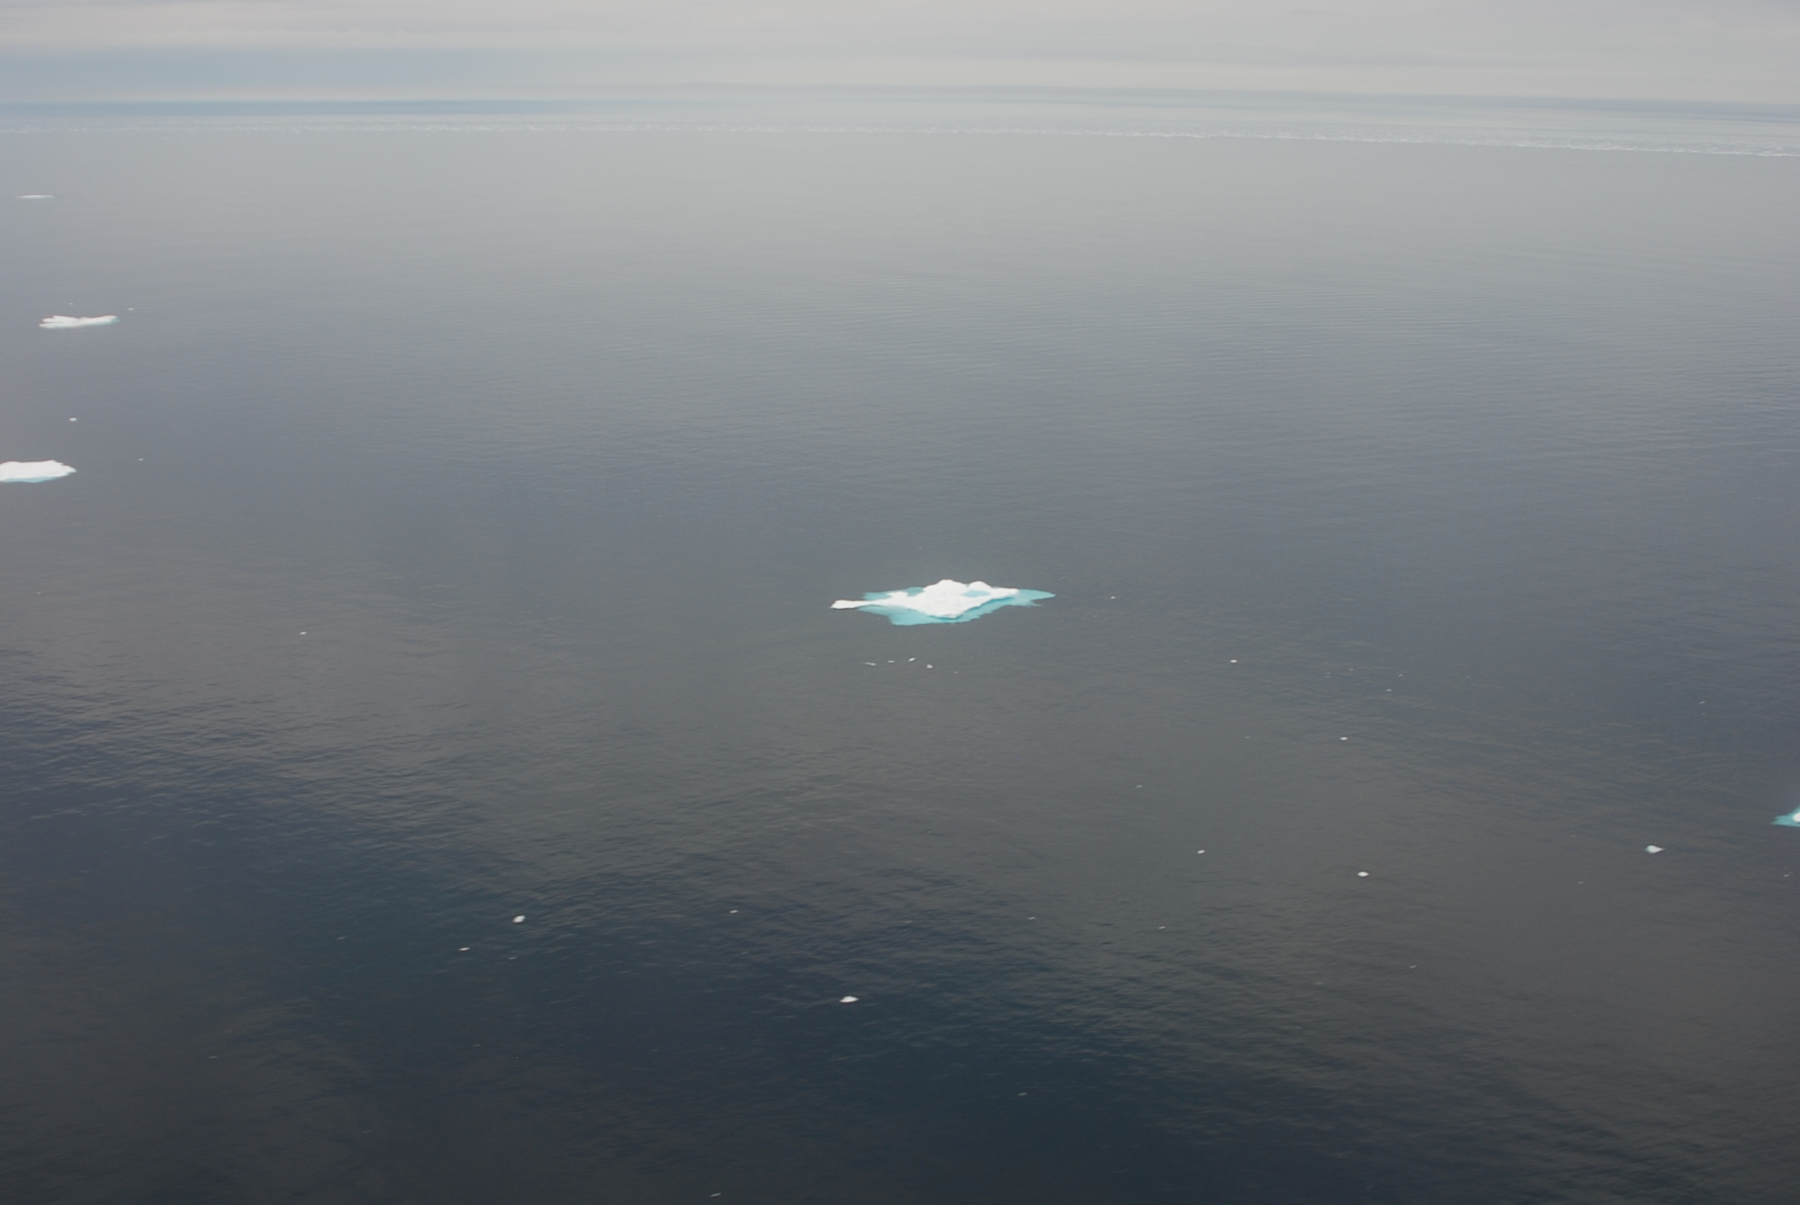
End Fin Ende Slut

Slide 12
Key Science Questions
● What are the processes and feedbacks producing the recent loss of sea-ice cover?
a) enhanced energy fluxes from ocean or atmosphere? If so, what is the relative contribution from atmosphere and ocean? Which processes are changing? Why? Where are these process changes occurring? What are the primary energy fluxes, and what is their spatial and temporal variability?
b) advective ice losses from changes in atmospheric circulation/ocean currents? If so, what changes? Where? When? Are these circulation changes linked to changes at lower latitudes?
c) combination of above: imbalance between formation, melt, advective export? If so, all processes need to be quantified and above questions addressed.
● What are key consequences of recent sea-ice loss?
a) how does sea-ice loss produce local, regional, and/or global atmospheric circulation changes
b) what processes produce changes in the oceanographic structure and circulation
c) what processes produce changes in the biosphere
Numerous related (and some unrelated) disciplinary science questions

