Slide 1
CalWater2 Gulfstream-IV Dropsonde Measurements
Chris Fairall, Byron Blomquist, and Janet Intrieri
NOAA/Earth System Research Laboratory
April 23, 2014

Slide 2
G-IV The Gulfstream IV-SP (G-IV) is a high altitude, high speed, twin turbofan jet aircraft acquired by NOAA AOC in 1996. The G-IV is currently configured for operational support of the National Hurricane Center synoptic surveillance mission. This mission is designed to collect, process and transmit vertical atmospheric soundings in the environment of the hurricane.
Platform | Altitude Range | Proposed Base | Ops Areas | Standard Payload
NOAA G-IV | 1,000 to 45,000 | Travis AFB or Honolulu, HI | Offshore Coastal CA-HI Coast Range | Dropwindsonde Tail Doppler Radar (TDR)

Slide 3
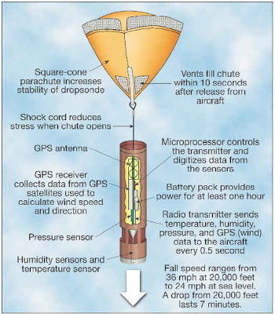
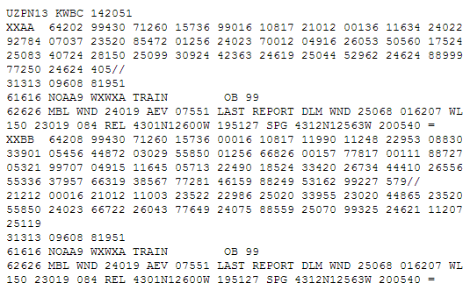
Dropwindsondes
The dropsonde is released from the G-IV measuring and transmitting back the pressure, temperature, humidity, and GPS Doppler frequency shifts to the aircraft as it descends to earth. The Doppler shifts are used to compute the horizontal and vertical wind components.
After analysis and processing of the dropsonde data the information is formatted into a TEMP-DROP message using the standard WMO format. The TEMP-DROP message is then transmitted to the NCEP and the NHC for inclusion into the global and hurricane model runs. The TEMP-DROP message is also provided to the hurricane forecaster providing real-time observations depicting the synoptic patterns surrounding the hurricane.

Slide 4
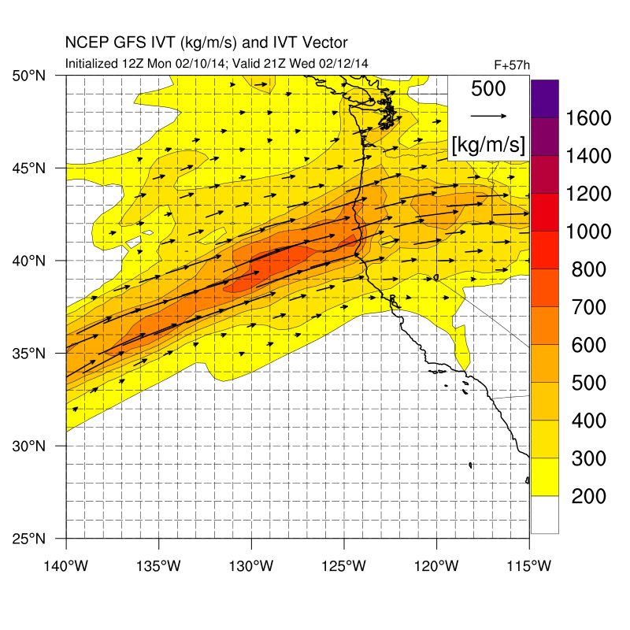
IOP-4 Concept: TO 1000 AM Wednesday 12 Feb; 17 drops
NOTAM Pt | Lat | Lon
NW | 46 | 127
NE | 46 | 125
E Center | 42 | 125
SE | 38 | 126
W Center | 42 | 127
SW | 36 | 125
Pt 3
Pts 2, 4
Pt 5
IVT track | Flight level | Lat | Lon
Pt 1 | 410-450 | 37.0 | 124.0
Pt 2 | 410-450 | 42.0 | 126.0
Pt 3 | Descend 410 to YYY* | 45.0 | 126.0
Pt 4 = Pt 2 | YYY | 42.0 | 126.0
Pt 5 | Ascend YYY to 450 | 38.0 | 124.5
Pt 6 = Pt 1 | 450 | 37.0 | 124.0
*Flight level YYY is determined from dropsondes between pts 1-2. FL YYY is set to be such that T < -12 C. along entire legs 3-4 and 4-5.
Pts 1, 6
Chief Scientist: Ryan Spackman
Observer: NPS person
Dropsonde spacing: 30 nm
Avoid 4000-14000 ft on return where T= +2 C to -12 C

Slide 5
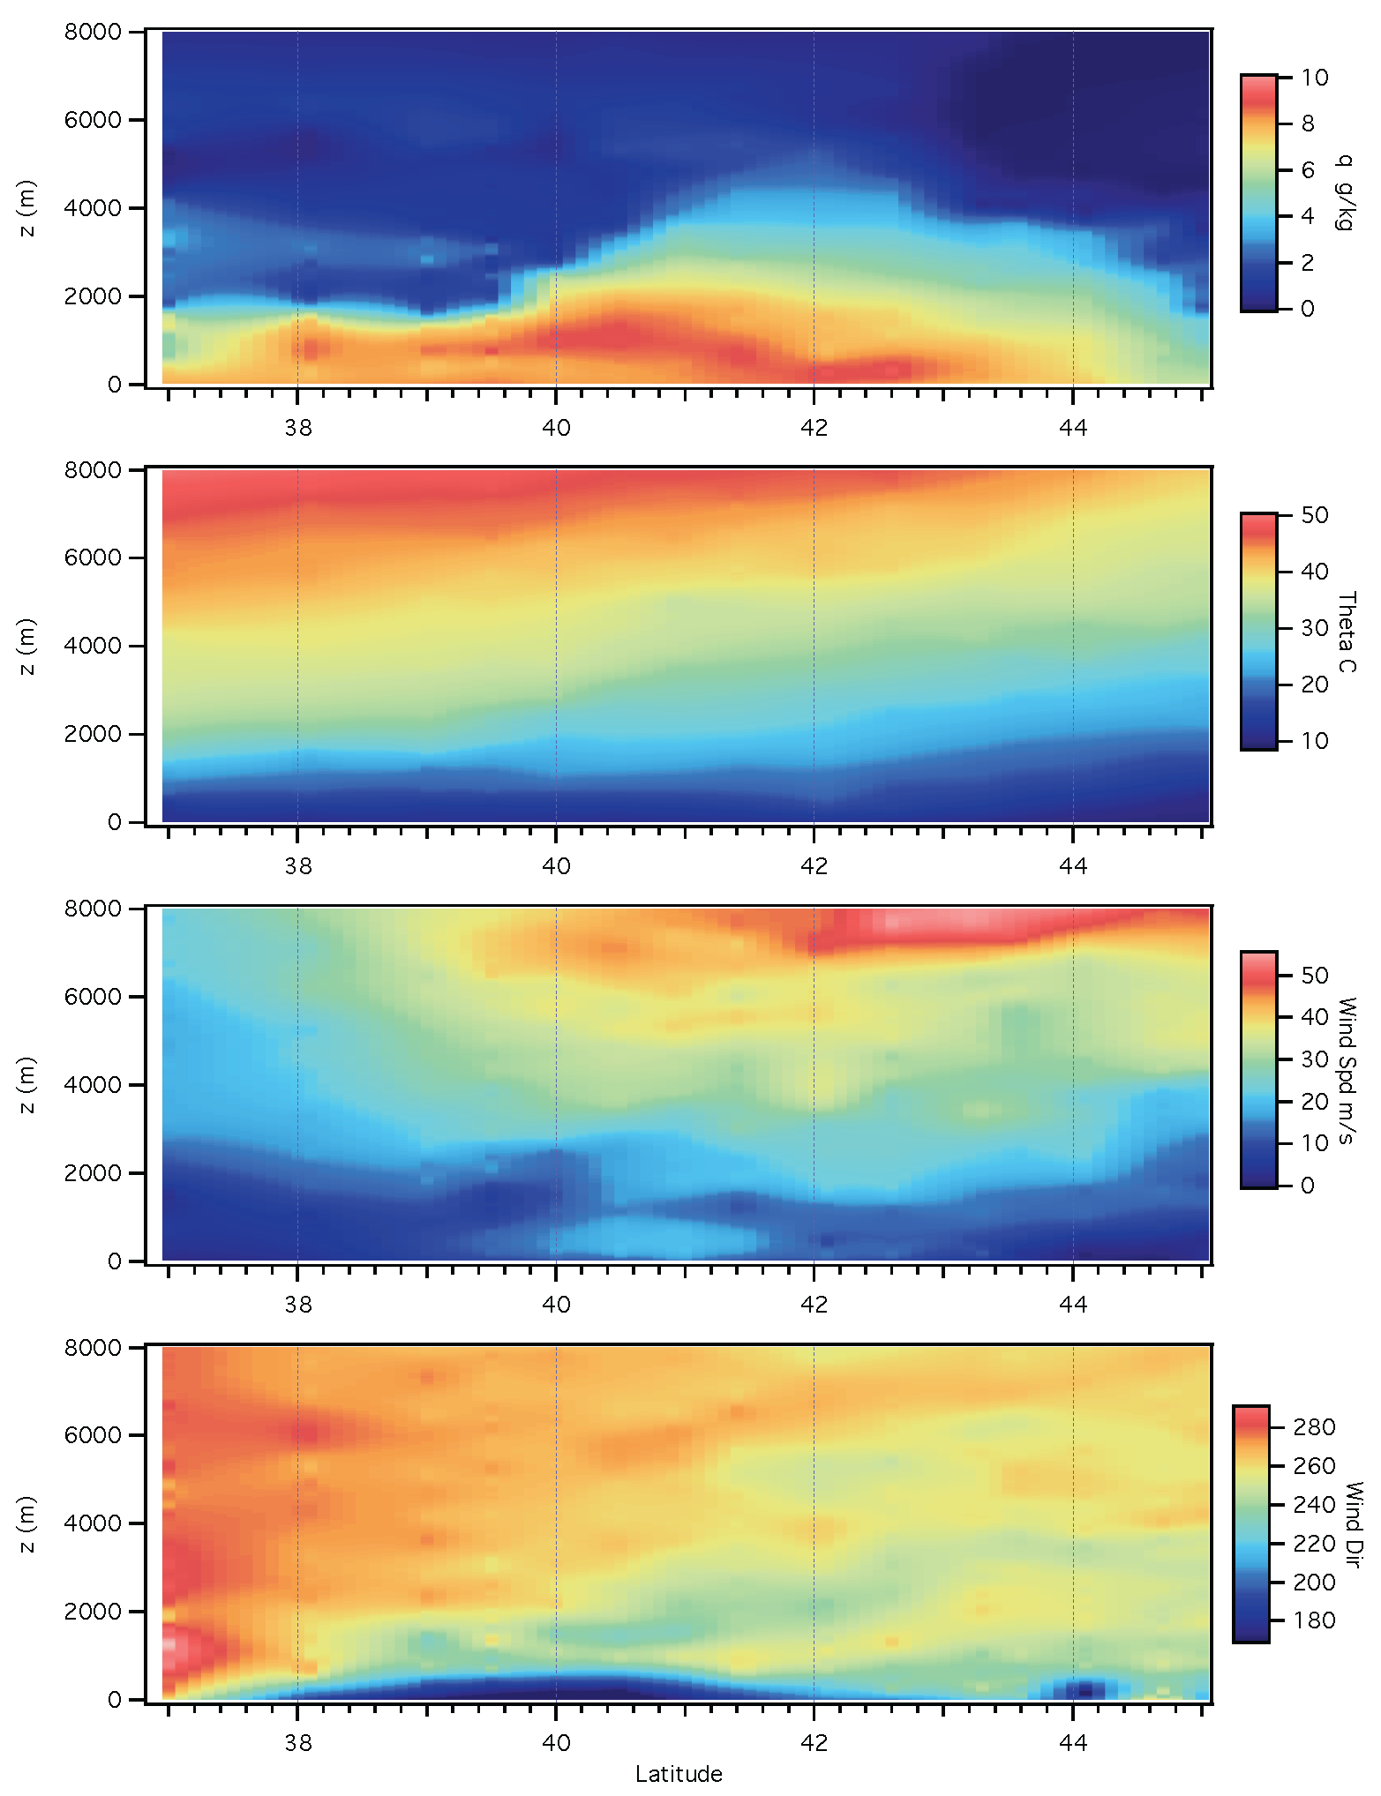
February 12 Line of 15 sondes

Slide 6
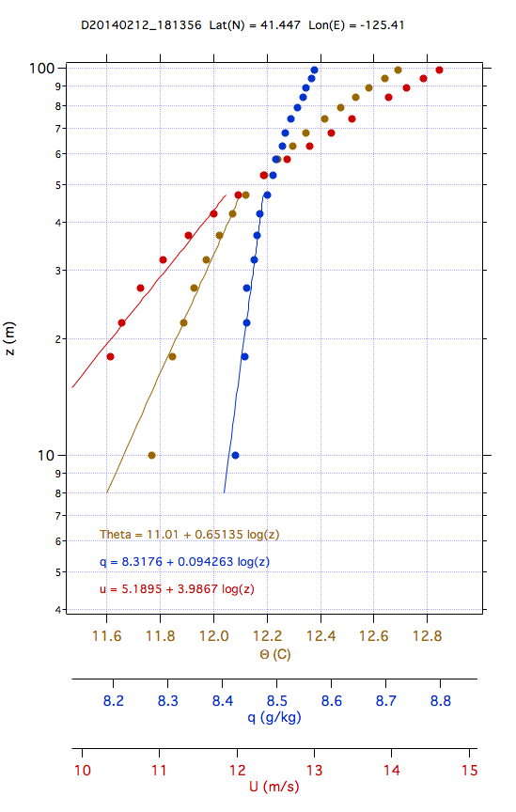
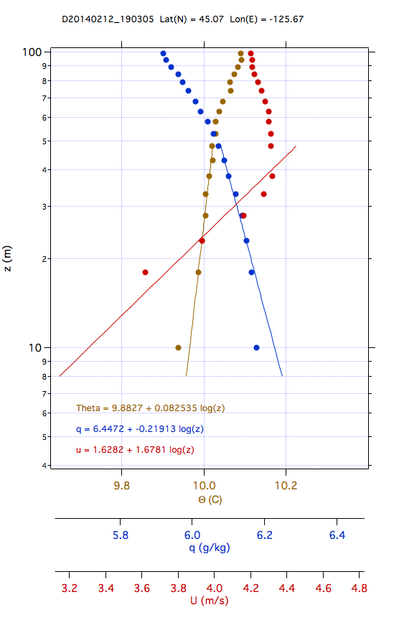
Log(z) fits to Near-Surface Profiles

Slide 7
Synthesize log-linear fits
thg=[.39 .29 .2 .4 .38 .35 .35 .65 .7 .94 .97 1.1 .35 .15 .08];%th gradient
ath=[11.2 11 11.7 11.3 11.1 10.9 11.2 11 11.3 10.3 9.5 8.7 9.6 9.7 9.9];%theta constant
qg=[-.19 -.14 -.15 -.09 -.1 -.08 -.08 .09 .09 .21 .23 .31 -.1 -.14 -.21];%q gradient
aq=[8.2 8.2 8.5 8.5 8.3 8.3 8.4 8.3 8.6 8.1 7.4 7.1 7.7 6.3 6.4];%q constant
ug=[3.7 2.2 .14 .29 4.8 10.4 .25 3.9 5.8 2.2 6.4 3.6 .37 1.3 1.7];%u gradient
au=[-3.1 1.1 8.3 9.1 3.9 -2.2 15.4 5.1 2.6 6.7 -2.4 0 1.1 -1.5 1.6];%u constant
th100=[12 11.7 12.2 12.3 12.1 11.8 12.1 12.7 13.1 12.6 11.9 11.3 10.4 10.1 10];%th at 100 m
q100=[7.8 7.9 8.1 8.3 8.1 8.05 8.1 8.6 8.7 8.5 8.0 7.8 7.3 6 5.9 ];
th0=[9.67 9.84 10.88 9.7 9.63 9.5 9.8 8.4 8.55 6.63 5.62 4.3 8.3 9.2 9.6];
q0=[9 8.7 9.1 8.9 8.7 8.6 8.7 8 8.2 7.2 6.5 5.7 8 6.9 7.3];
lat=[36.985 38.068 39.032 39.514 39.998 40.487 40.972 41.447 42.078 42.624 43.278 43.587 44.095 44.685 45.07];%latitude sounding

Slide 8
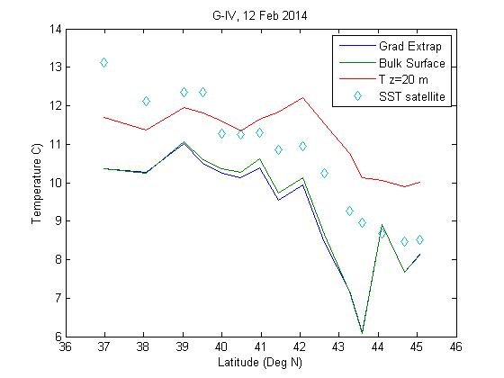
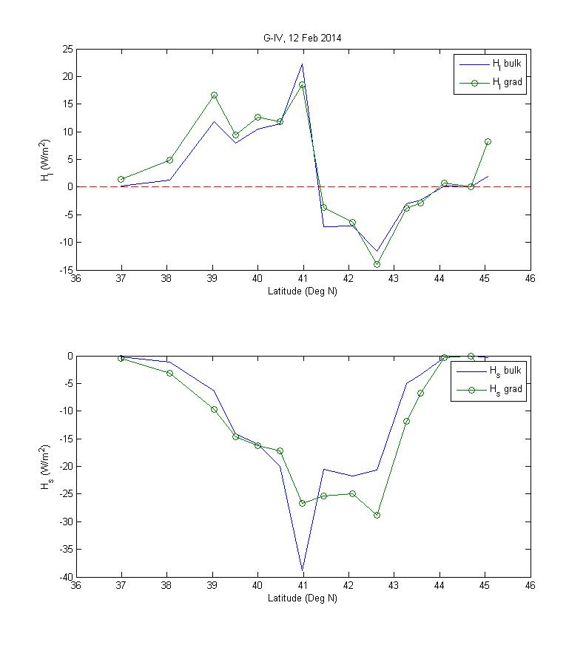
Estimate Surface Value
Moisture – Temperature compatibility
Or, RH(z0)=98%
Bulk Flux Computation
Gradient Flux Computation

Slide 9
Profiles of RH after q correction of 1 g/kg

Slide 10
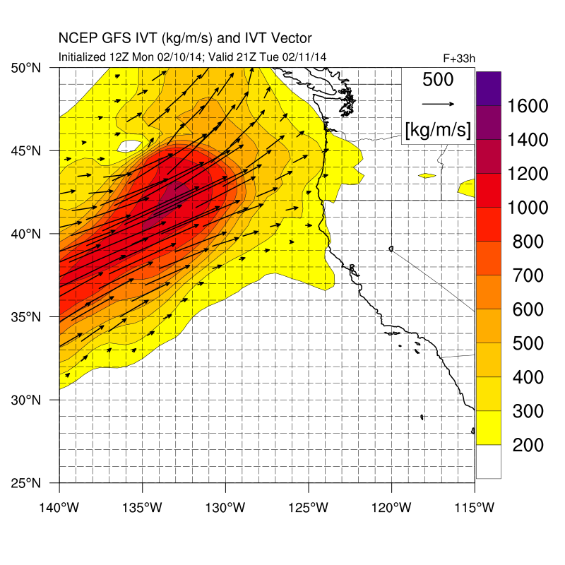
IOP-3 Plan: TO 930 AM – 430 PM Tuesday 11 Feb; 27 drops
Budget box | Lat | Lon
1 NE | 39.2 | 131.7
1 SE | 37.7 | 130.9
1SW | 37.3 | 131.8
1 NW | 38.8 | 132.5
2 SW | 40.6 | 133.5
2 NW | 42.9 | 134.7
2 N center | 43.3 | 133.8
2 S center | 41.0 | 132.6
2 SE | 41.4 | 131.7
2 NE | 43.7 | 132.9
3 SW | 45.4 | 133.7
3 NW | 46.9 | 134.3
3 NE | 47.4 | 133.5
3 SE | 45.9 | 132.8
NOTAM Pt | Lat | Lon
NW | 45 | 140
NE | 49 | 132
SW | 32 | 133
SE | 36 | 125
Box 3
Box 2
Box 1
Onboard:
- Ryan Spackman (Chief Scientist)
TBD (Meteorologist)
TBD (Observer)
Ops Center:
- Marty Ralph
Dropsonde spacing: 50 nm, plus one between box 1 and 2, and one between box 2 and 3.
50 nm X 100 nm box
100 nm X 100 nm box
100 nm X 150 nm box

Slide 11
