Slide 1
ODM data processing results: SPURS-2 2016-2017 TGT 2017-2018 PISTON 2018
Elizabeth Thompson
July 2020

Slide 2
for rain rate P, liquid water content W, and reflectivity z and Z (linear, logarithmic), I calculated a time dependent variable (P, W, z, Z) and also a variable discretized in time X bin. The resulting Pd, Wd, zd, and Zd 2-D variables are the field per time step per bin. With these 2D variables, one can analyze the contributions of drops in each diameter range to the total rain observables.

Slide 3
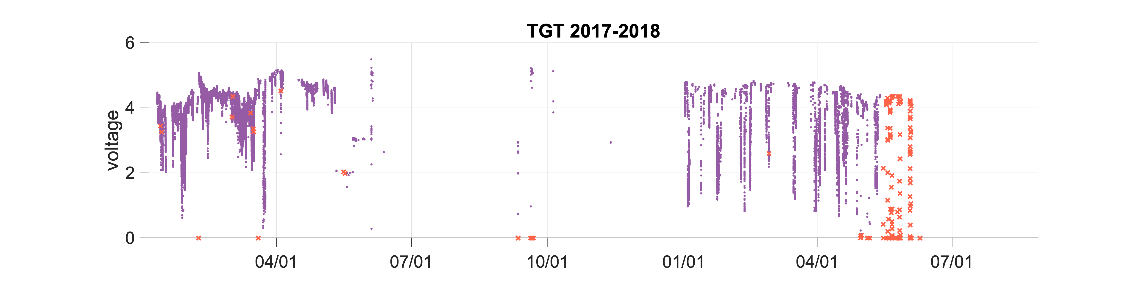
Voltage is used to identify bad data (orange points, saved in files)
V has a diurnal cycle?
RF interference?
When V goes to zero, we were cleaning/wiping the optical sensors -> bad data
TGT data went bad (or just worse than before) on May 15, 2018. The data were not good before then either (outrageous rain rates). In August 2018, we found the unit had an extremely tangled cord, which appeared to have strangled the instrument and caused the worsening data quality.
For PISTON 2018 leg 3 (Sept-Oct), ET uninstalled Christian’s ODM on TGT and replaced it with Kyla’s ODM. This worked well.

Slide 4
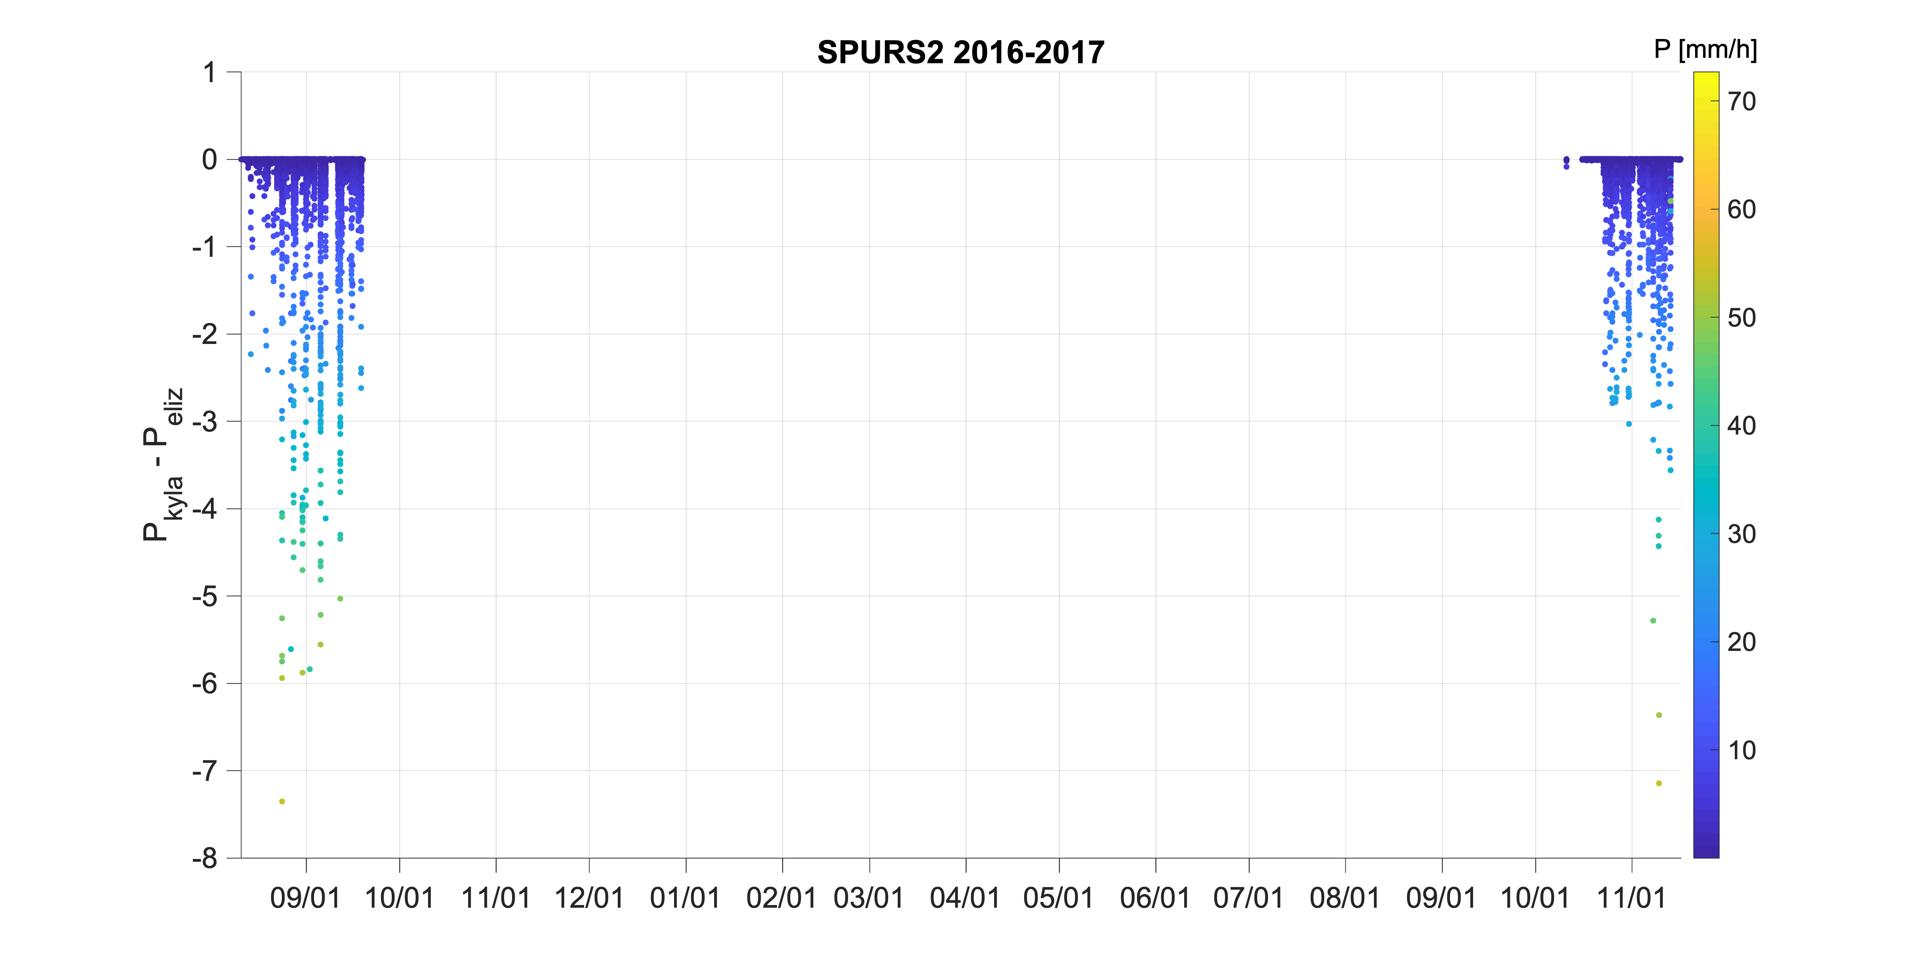
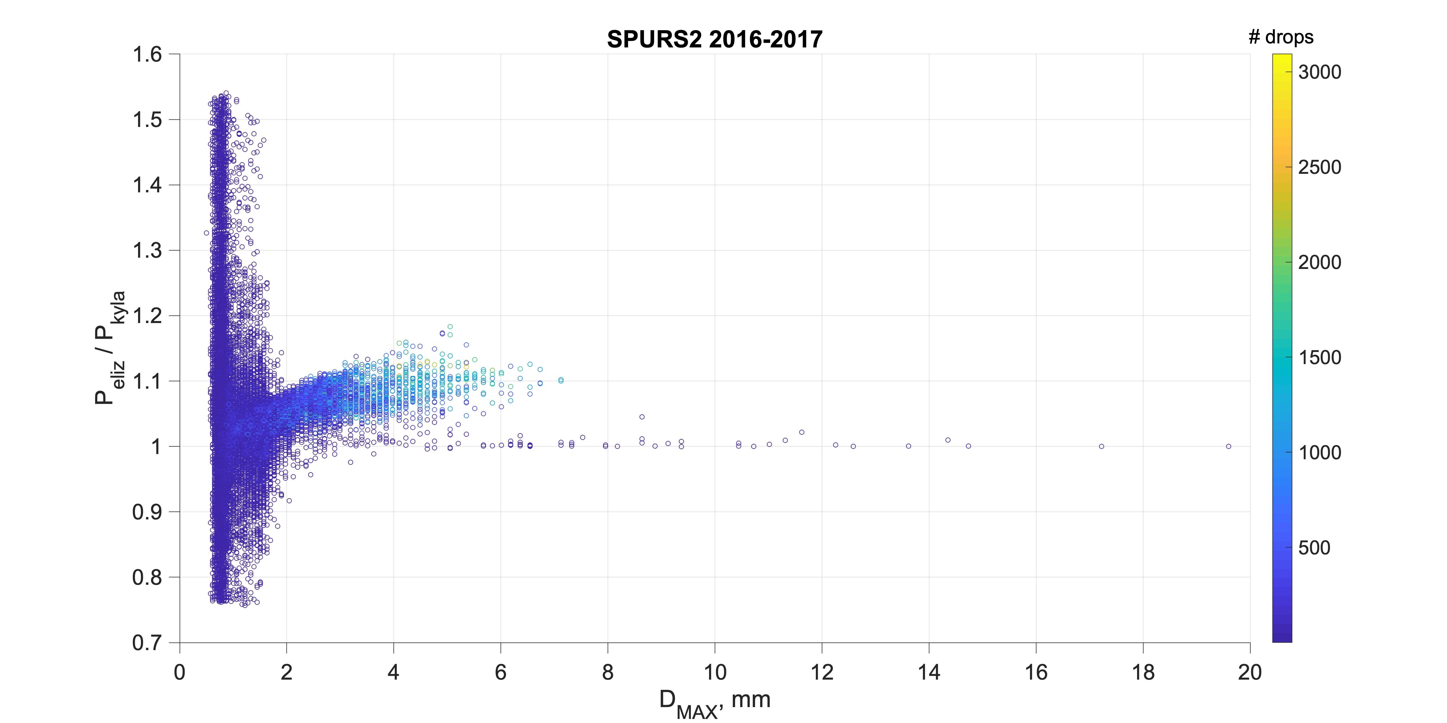
bad data =
when voltage < 0.12 V
and when Dmax > 15 mm
-> matlab ET
-> fortran Kyla
-> matlab ET
Fortran code (in black) produces lower rain rates than matlab code (purple).
The P differences increases with increasing drop size, up to 10%.
Using same equations from Klepp 2015….
P_{eliz} = calculated by ET using matlab code
P_{kyla} = calculated by Kyla using Christian’s fortran code

Slide 5
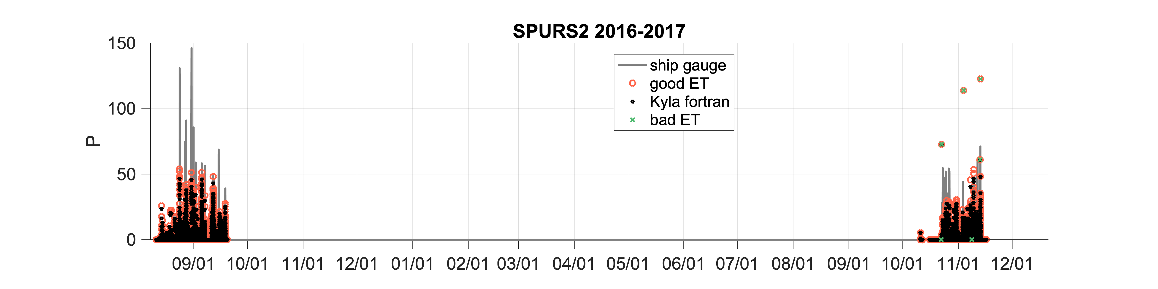
(sorry for the color scheme changes)
matlab Peliz is higher than fortran Pkyla…. by up to 10% at higher D
so matlab Peliz is closer to ship gauge rain rates
neither P are as high as optical gauge;
likely due to missing drops of D < 0.44 mm
ODM was mounted on the bow foremast in 2017 -- less flow distortion. collocated with optical gauge
ODM was mounted on a forward O2 deck van -- potentially more flow distortion
Please use caution combining ODM data from SPURS-2 between 2016 and 2017… they were mounted in different locations each year:

Slide 6
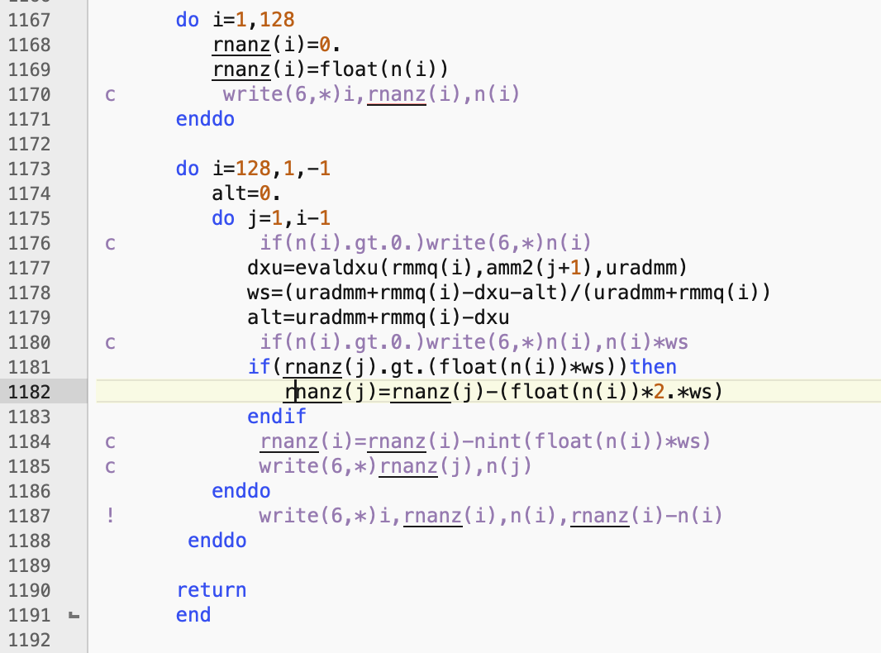
The fortran code and matlab code are identical except for one small section related to n(D). The fortran code given to Kyla by Christian Klepp has a mysterious extra term that reduces drop counts per bin, n(D), by some unexplained function related to drop geometry. This step is not mentioned in the Klepp 2015 or 2018 papers or equations. I suspect it’s erroneous and causing the disagreement between matlab (ET) and fortran (Kyla) rain rates.
Reducing drop counts would reduce liquid water content and rain rate: P and W ~ n_{i} D_{i}³.
This source of disagreement in n(D) would have less impact on reflectivity since that is more heavily weighted by D: z = $Σ$n_{i} D_{i}⁶. In fact, the reflectivitiy calculated from fortran and matlab codes are nearly identical, which supports this hypothesis regarding the source of error.
rnanz is the drop count per bin per time step. It’s modified by n*2*ws in a way that is unexplained and seemingly unjustified. The result is to reduce drop counts and therefore P, W. This does not match rain measurements from gauges or my calculations using Klepp 2015 equations and raw ODM data.
There are also very very very small differences in the way drop bin widths are calculated in fortran and matlab. Both are justified. This results in a very very small difference in Z (up to 0.25 dBZ difference). The only other variable affected is N(D), the latter of which is used to calculate mu, Nw, D0, and cantman electromagnetic scattering simulations.

Slide 7
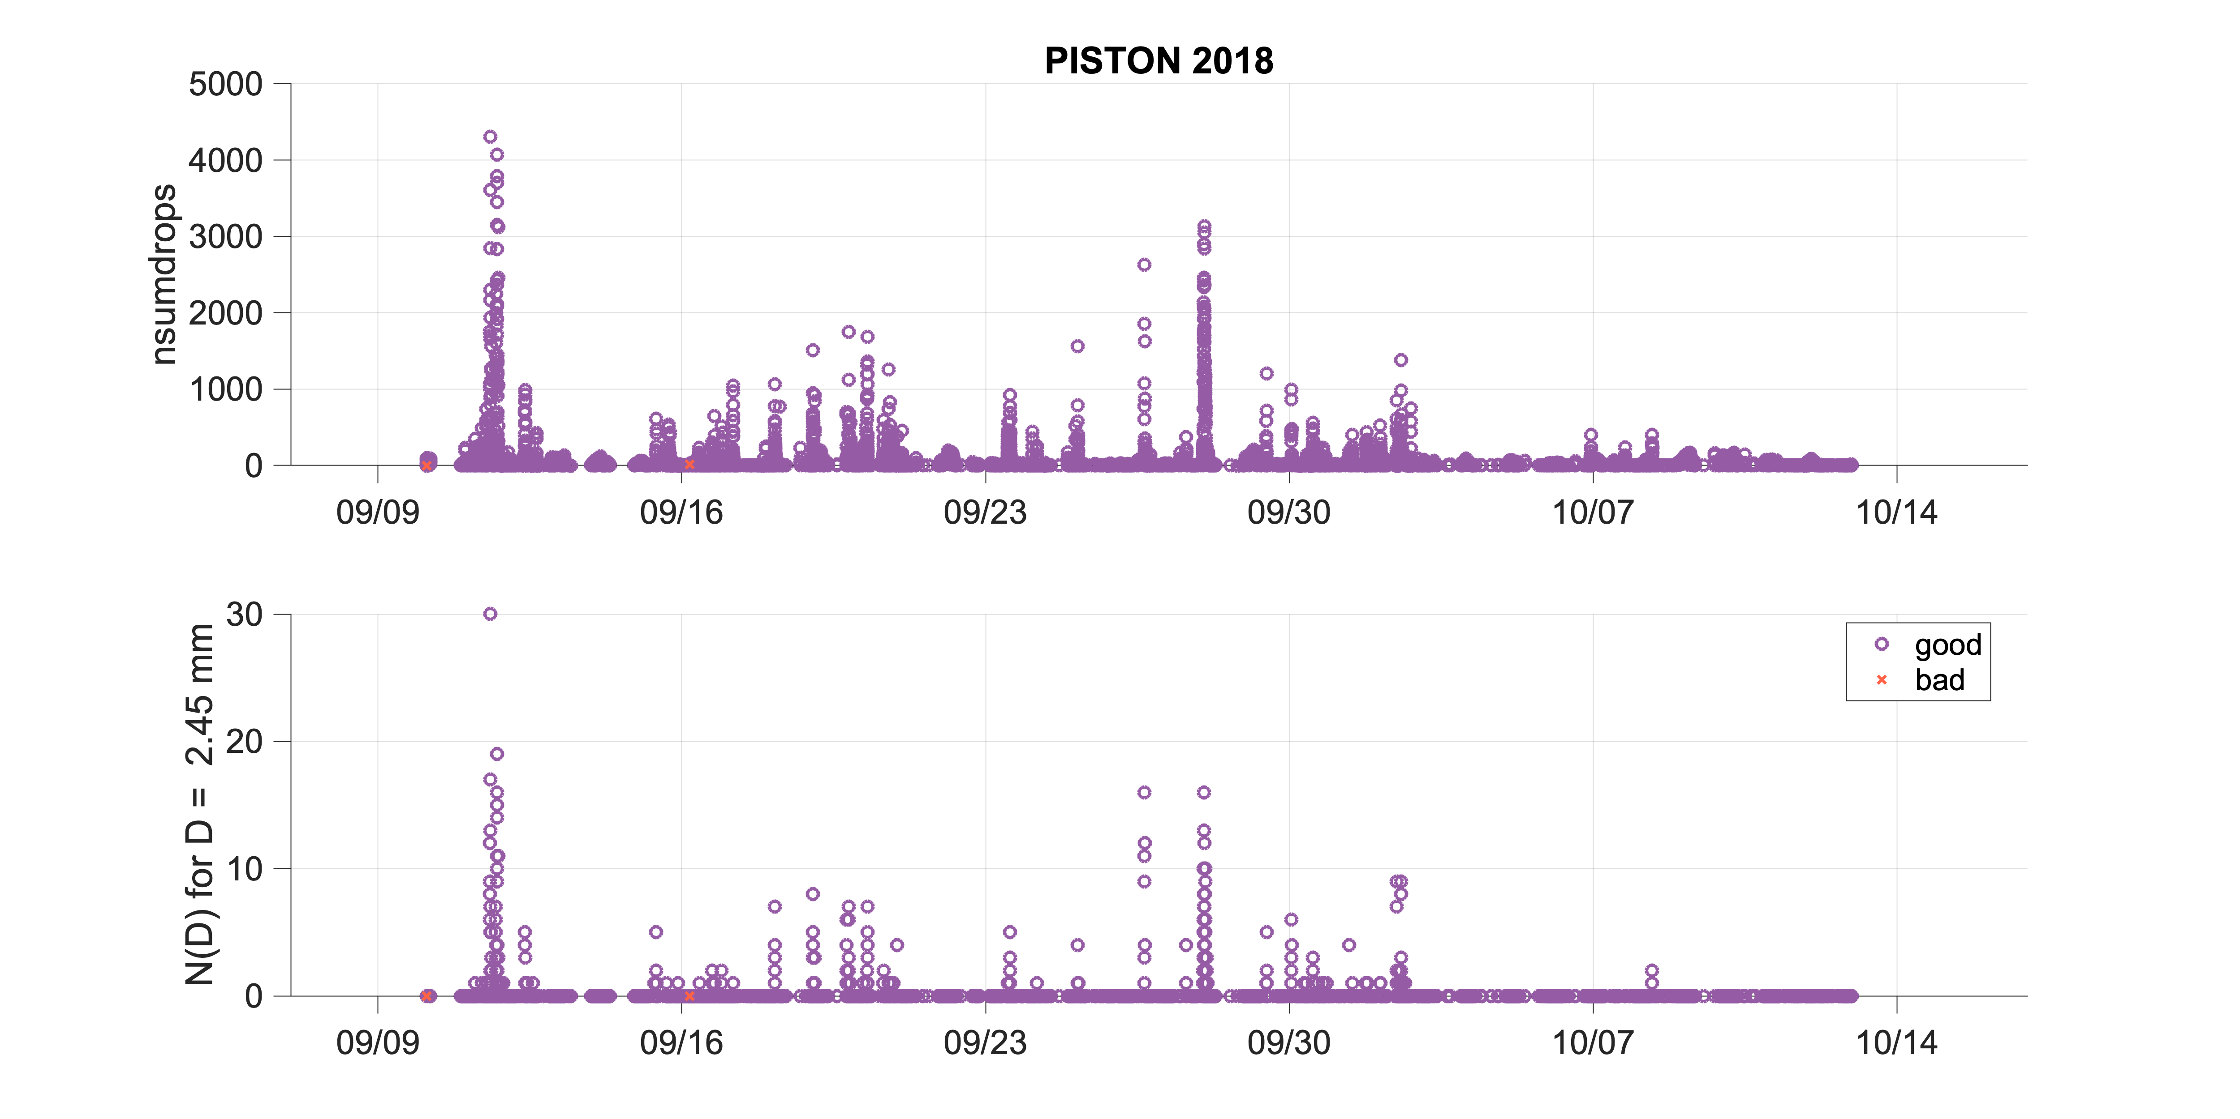
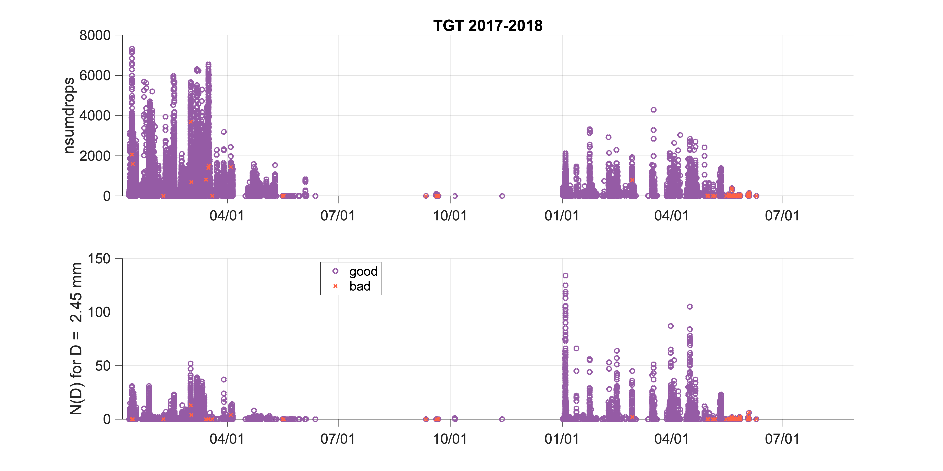
TGT ODM data prior to PISTON look outrageous and unphysical
Voltage (and therefore diameters) look noisy but not outrageous.
nsumdrops(t) and ndrops(D,t) look way to high -> main issue most likely causing P > 300 mm/hr

