Slide 1
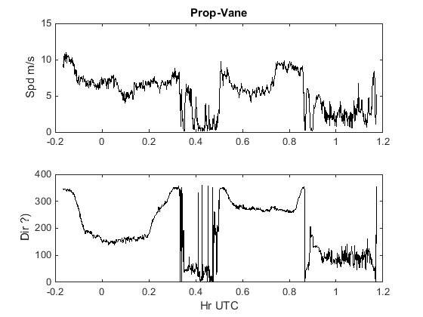
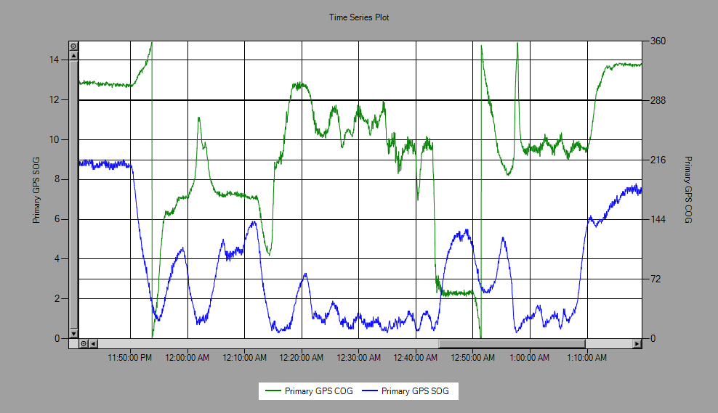
COM 47 output
Rel SPD and DIR
20160310-11
2350-0150 UTC

