Slide 1
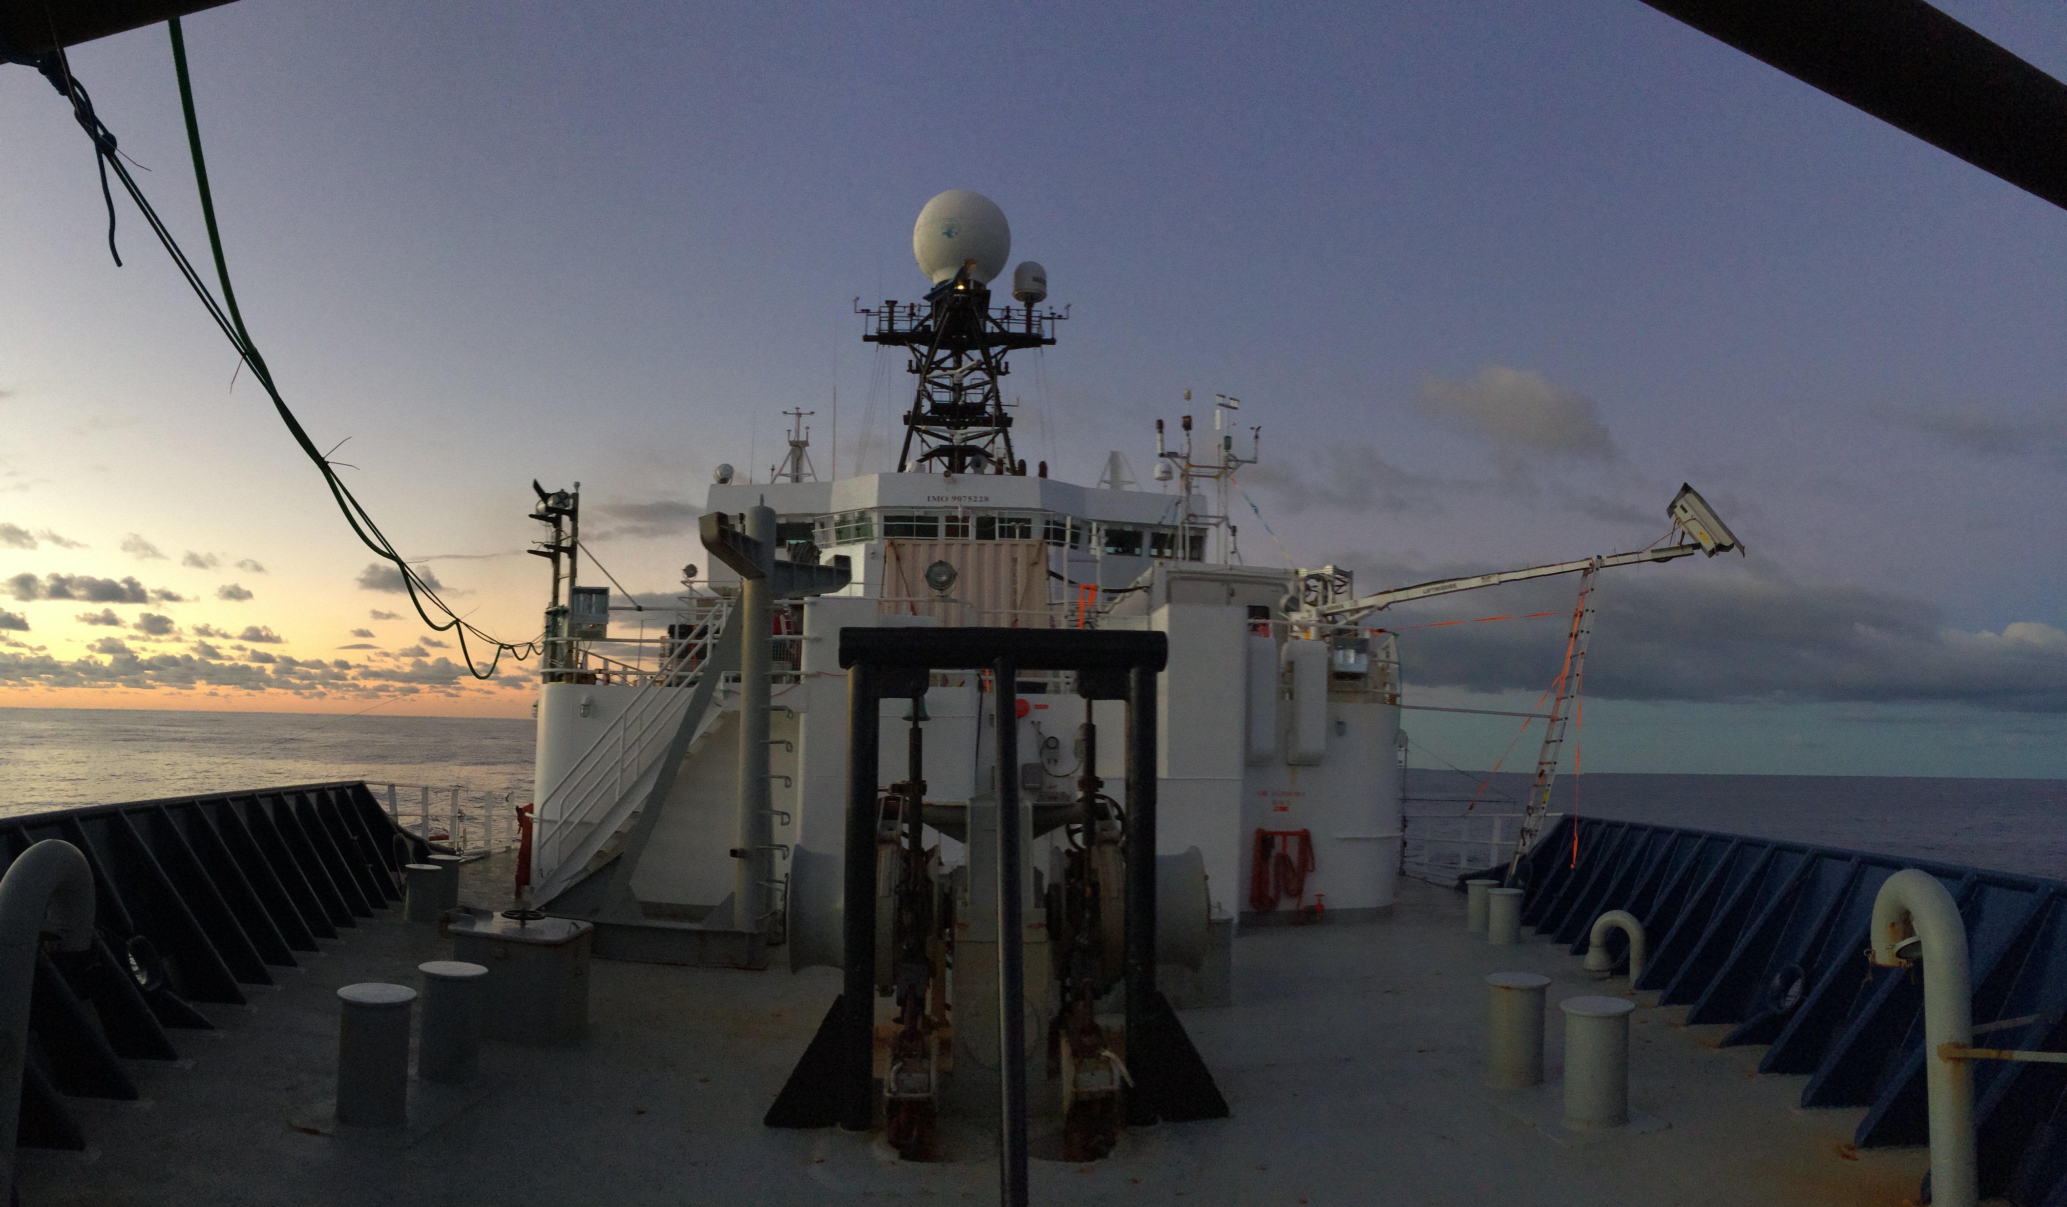
Utility of shipborne disdrometer and marine navigation radar observations during convective and stratiform rain
ELIZABETH J. THOMPSON, KYLA DRUSHKA, WILLIAM E. ASHER
Applied Physics Lab at Univ. of Washington
CHRISTIAN KLEPP
Univ. of Hamburg

Slide 2
SMAP
SSS
30-40
psu
Surface Salinity or soil moisture
Interest in precipitation impacts on ocean renewed because of:
global climate projections, SST impacts, and satellite salinity measurements
NASA SMAP L-band radiometer: 40 km, 9 day resolution
April – July 2015 NASA Hyperwall: https://svs.gsfc.nasa.gov/30698
IMERG
Rain
0-160
mm h⁻¹
Rain
E. J. Thompson AMS Radar 2017
Notes:
Soil Moisture, Sea Surface Salinity, and Rainfall
This visualization compares weekly soil moisture and sea surface salinity data (over land and water, respectively) from NASA’s Soil Moisture Active Passive Satellite (SMAP) mission [<i>top map</i>] with a precipitation product called Integrated Multi-satellite Retrievals for GPM, or IMERG [<i>bottom map</i>], from April 17 to August 2, 2015. IMERG is derived using data from the Global Precipitation Measurement (GPM) international constellation of satellites.
These maps reveal how precipitation amounts influence soil moisture conditions and sea surface salinity. For example, high amounts of precipitation along the equator coincide with relatively moist soil conditions on land (blue shades) and low salinity values in the ocean (green and blue shades). Conversely, areas that receive little or no precipitation, such as the Sahara Desert in northern Africa, coincide with dry soils (dark yellow shades). Scientists can use data from SMAP and IMERG to develop improved flood prediction and drought monitoring capabilities. Societal benefits include improved water-resource management, agricultural productivity, and wildfire and landslide predictions. Data from SMAP also allow us to extend the data record of the highly successful 3-year Aquarius sea surface salinity mission into the future.
For more information, visit:
svs.gsfc.nasa.gov/goto?30698

Slide 3
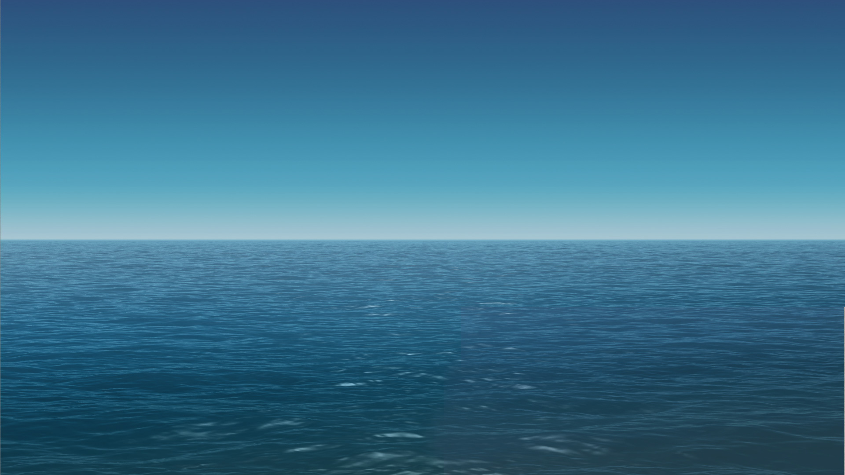
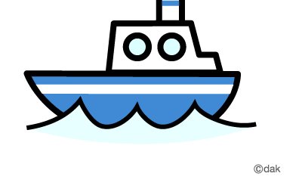
Radars and disdrometers are needed to better understand several coupled climate and weather processes over oceans
Need ways to contextualize ship point measurements to synoptic and satellite-observable scales
Upstream rainfall is important for understanding local salinity and temperature structure in the ocean, but to an unknown degree.
Drop size impacts ocean turbulent mixing, which is parameterized in ocean models
Local
Data
?
?
?
?
?
?
?
?
?
?
?
?
Advected freshwater by ocean current
E. J. Thompson AMS Radar 2017
Notes:
Representativeness problem:
Research ships struggle with “representativeness” problem
research ship is just one point in the ocean
research ship is actually in the cone of silence
disdrometer in center of radar might actually be a way to bridge that gap; gauge can do quantitative work but disdrometer can explain morphology
Similarly over land, disdrometers and aircraft probes help verify physics we think we see in radar variables. It’s symbiotic because radars also help remotely broaden the field of view compared to several gauges or disdrometers.
We think upstream precipitation matters for underlying ocean variability; radars can help.
We always need a way to justify high costs of ship measurements and a way to connect them to larger scales of satellites - a ship board disdrometer can help describe larger scale features or place us within the large scale feature that might actually be visible from satellite scale. This could be a really great tool. It’s compact too - easy to delpoy on a ship.
Develop the capability for shipborne disdrometers and radars to quantify spatial and temporal variability of local and upstream rainfall, which will help contextualize local atmospheric and ocean measurements, and connect them to the satellite-scale… so that we can learn how to remotely quantify these sub grid scale processes.
Supports ground validation of satellite rain retrievals over ocean, which are usually underestimated or missed due to partial beam filling, prevalence of shallow warm rain processes, and lack of gauges.
Convective vs. stratiform hypotheses
Upstream rainfall must be quantified to understand in situ ocean processes
While intense convective rainfall has been hypothesized to impact the ocean mixed layer depth more, stratiform rain possesses a longer and larger window of opportunity to alter ocean physics.
Because these processes have not yet been measured until recently, It is still unknown how the spatial and temporal variability of rain impacts ocean variability.
SSS will be assimilated into global models… need to understand the physics associated with rain impacts on the ocean surface.

Slide 4
Radars and disdrometers are needed to better understand several coupled climate and weather processes over oceans
Need ways to contextualize ship point measurements to synoptic and satellite-observable scales
Upstream rainfall is important for understanding ocean salinity and temperature structure, but to an unknown degree.
Drop size impacts ocean turbulent mixing, which is parameterized in ocean models
Local
Data
Central Indian Ocean Shipborne Radar
Zh
?
?
?
?
?
?
?
?
?
?
?
?
Advected freshwater by ocean current
E. J. Thompson AMS Radar 2017
Notes:
Representativeness problem:
Research ships struggle with “representativeness” problem
research ship is just one point in the ocean
research ship is actually in the cone of silence
disdrometer in center of radar might actually be a way to bridge that gap; gauge can do quantitative work but disdrometer can explain morphology
Similarly over land, disdrometers and aircraft probes help verify physics we think we see in radar variables. It’s symbiotic because radars also help remotely broaden the field of view compared to several gauges or disdrometers.
We think upstream precipitation matters for underlying ocean variability; radars can help.
We always need a way to justify high costs of ship measurements and a way to connect them to larger scales of satellites - a ship board disdrometer can help describe larger scale features or place us within the large scale feature that might actually be visible from satellite scale. This could be a really great tool. It’s compact too - easy to delpoy on a ship.
Develop the capability for shipborne disdrometers and radars to quantify spatial and temporal variability of local and upstream rainfall, which will help contextualize local atmospheric and ocean measurements, and connect them to the satellite-scale… so that we can learn how to remotely quantify these sub grid scale processes.
Supports ground validation of satellite rain retrievals over ocean, which are usually underestimated or missed due to partial beam filling, prevalence of shallow warm rain processes, and lack of gauges.
Convective vs. stratiform hypotheses
Upstream rainfall must be quantified to understand in situ ocean processes
While intense convective rainfall has been hypothesized to impact the ocean mixed layer depth more, stratiform rain possesses a longer and larger window of opportunity to alter ocean physics.
Because these processes have not yet been measured until recently, It is still unknown how the spatial and temporal variability of rain impacts ocean variability.
SSS will be assimilated into global models… need to understand the physics associated with rain impacts on the ocean surface.

Slide 5
Radars and disdrometers are needed to better understand several coupled climate and weather processes over oceans
Need ways to contextualize ship point measurements to synoptic and satellite-observable scales
Upstream rainfall is important for understanding ocean salinity and temperature structure, but to an unknown degree.
Drop size distributions provide clues about surrounding rain variability
Local
Data
Central Indian Ocean Shipborne Radar
Zh
?
?
?
?
?
?
?
?
?
?
?
?
Advected freshwater by ocean current
E. J. Thompson AMS Radar 2017
Notes:
Representativeness problem:
Research ships struggle with “representativeness” problem
research ship is just one point in the ocean
research ship is actually in the cone of silence
disdrometer in center of radar might actually be a way to bridge that gap; gauge can do quantitative work but disdrometer can explain morphology
Similarly over land, disdrometers and aircraft probes help verify physics we think we see in radar variables. It’s symbiotic because radars also help remotely broaden the field of view compared to several gauges or disdrometers.
We think upstream precipitation matters for underlying ocean variability; radars can help.
We always need a way to justify high costs of ship measurements and a way to connect them to larger scales of satellites - a ship board disdrometer can help describe larger scale features or place us within the large scale feature that might actually be visible from satellite scale. This could be a really great tool. It’s compact too - easy to delpoy on a ship.
Develop the capability for shipborne disdrometers and radars to quantify spatial and temporal variability of local and upstream rainfall, which will help contextualize local atmospheric and ocean measurements, and connect them to the satellite-scale… so that we can learn how to remotely quantify these sub grid scale processes.
Supports ground validation of satellite rain retrievals over ocean, which are usually underestimated or missed due to partial beam filling, prevalence of shallow warm rain processes, and lack of gauges.
Convective vs. stratiform hypotheses
Upstream rainfall must be quantified to understand in situ ocean processes
While intense convective rainfall has been hypothesized to impact the ocean mixed layer depth more, stratiform rain possesses a longer and larger window of opportunity to alter ocean physics.
Because these processes have not yet been measured until recently, It is still unknown how the spatial and temporal variability of rain impacts ocean variability.
SSS will be assimilated into global models… need to understand the physics associated with rain impacts on the ocean surface.

Slide 6
Motivation
Optical Disdrometer
Attached to anemometer;
rotates into wind to minimize flow distortion
Understand the capabilities of a shipborne optical disdrometer and X-band marine navigation radar for sensing stratiform and convective rain
Marine navigation radars are different than weather radars, but are standard equipment on research vessels
OceanRAIN project has deployed ODM470 optical disdrometers on several long term cruises (Klepp 2015, Atm. Res.)
E. J. Thompson AMS Radar 2017

Slide 7
X-band Marine Navigation Radar
48 km range
7 hours of tropical E. Pacific rain
3 stable freshwater lenses
3 updates per minute
1º horizontal beam width
Rain gauge indicated rain when echoes were overhead
Adjustable signal gain ~ “relative reflectivity” output
E. J. Thompson AMS Radar 2017

Slide 8
Marine radar qualitatively revealed stratiform and convective rain morphology on 1-min time scales
Isolated convection
Stratiform
Could use data to motivate intensive field campaigns with research quality radar
48 km range = 25 IMERG pixels… plenty of satellite validation opportunities
48 km range = 2.5-6 hr ship steaming; 15 hr advective time scale
48 km range
Organized Convection
Stratiform with embedded convection
E. J. Thompson AMS Radar 2017

Slide 9
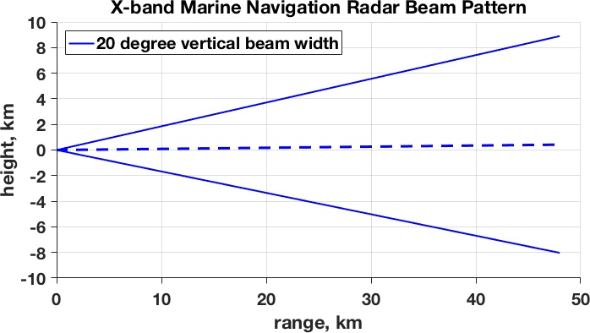
Marine Radar Problem: 20º vertical beam width
Designed to see targets on sea surface regardless of sea state
Cannot distinguish: Rain aloft or rain at surface?
Tropical 0ºC Layer
Beam hits melting layer at 25 km range
Beam is 6 km tall at
40 km range
E. J. Thompson AMS Radar 2017

Slide 10
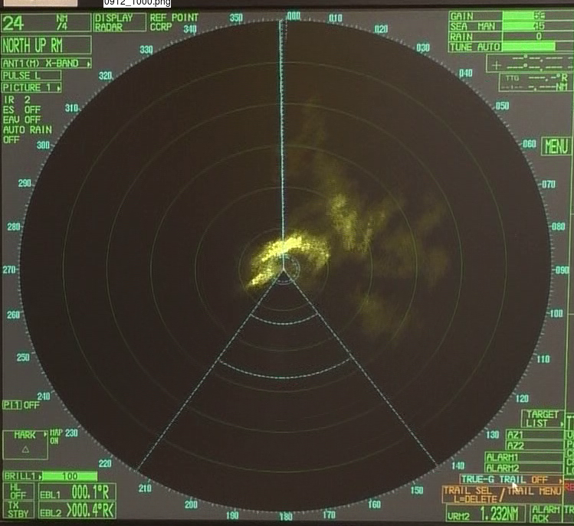
Marine Radar Problem: Attenuation and artificial (?) echo brightening ~8 km range ~2 km high
48 km range
E. J. Thompson AMS Radar 2017
Notes:
Maybe its okay for stratiform rain to attenuate… we know its more homogeneous. But we would miss embedded convection

Slide 11
ODM disdrometer performance at sea
Sea spray not a terrible problem if mounted high enough (20 m)
Small log-scale size bins
Flow distortion minimized but fall speed still parameterized
Ship vibrations prevent drop detection below 0.43 mm
Lempio et al. (2007 Adv. Geosci.);
Klepp et al. (2010 Tellus);
Klepp (2015 Atm. Res.)
E. J. Thompson AMS Radar 2017

Slide 12
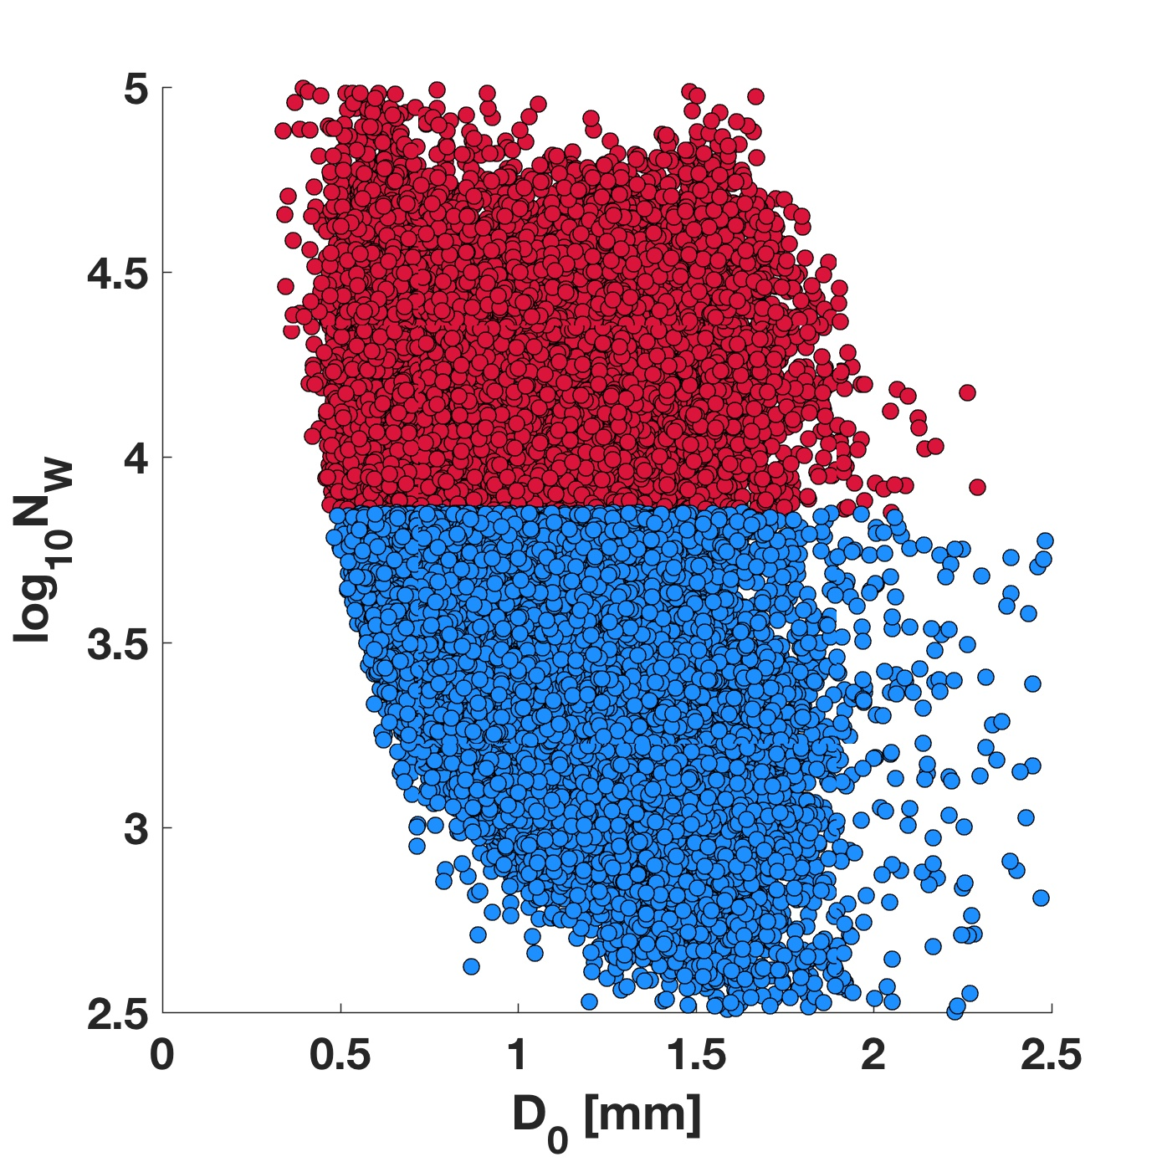
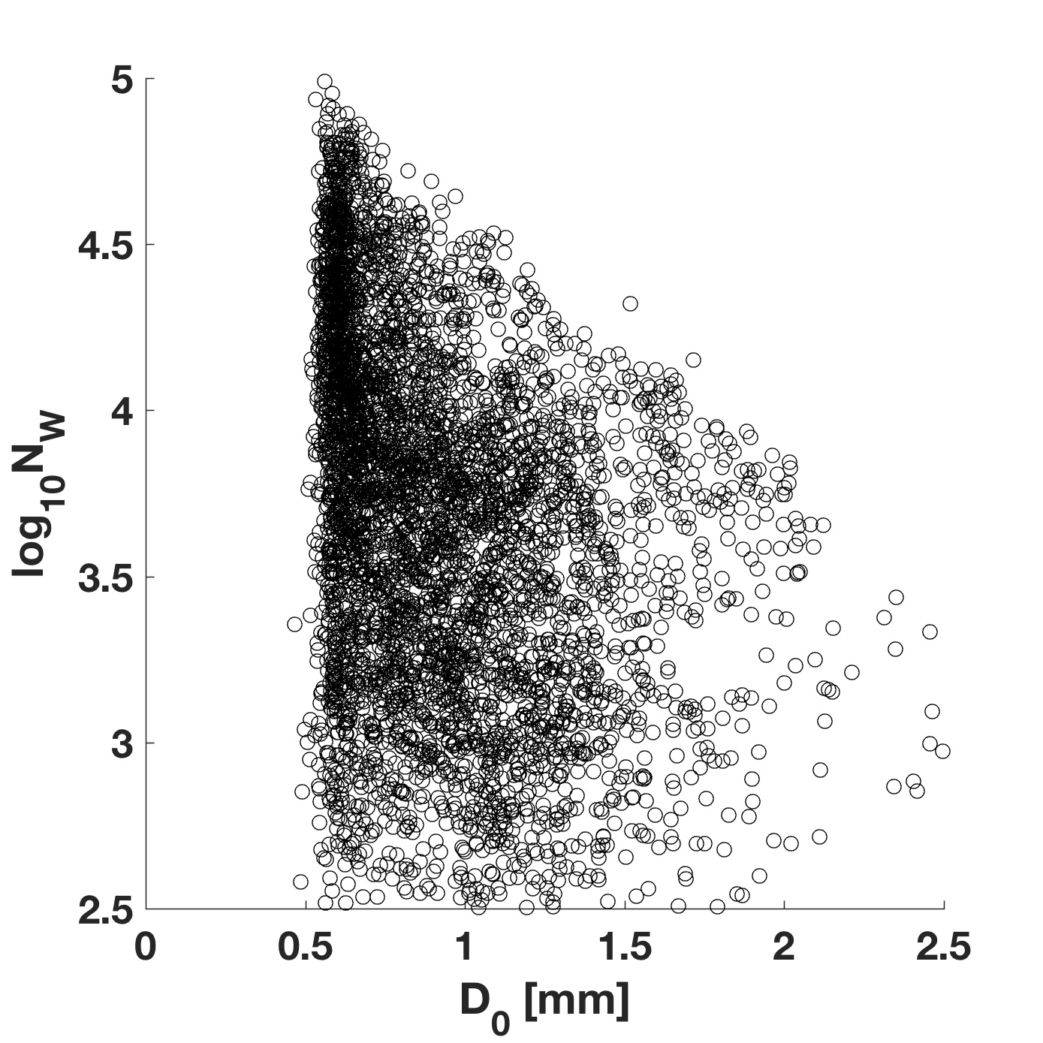
Shipboard disdrometer: produces DSD parameters, …but 0.43 mm drop diameter detection limit complicates convection vs. stratiform separation. Solution: use rain duration
W. Pacific DSD: 2DVD
E. Pacific DSD: ODM 470
W. Pacific DSD: 2DVD
Thompson et al.
2015 JAS
?
Should conduct more side-by-side disdrometer tests on land
Convective
Stratiform
E. J. Thompson
AMS Radar 2017

Slide 13
Summary: shipborne marine radar and disdrometer
2010-2014 ship disdrometer opportunities, including North Pole crossing
X-band Furuno marine navigation radar:
Very high spatial and temporal resolution; very qualitative
Great resource for detecting spatial patterns and relative intensity of rain
ODM 470 optical disdrometer:
Fine bin size resolution; sea spray not a problem in most cases
Future: minimize ship vibration impact
Future: need side-by-side comparison
E. J. Thompson AMS Radar 2017

Slide 14
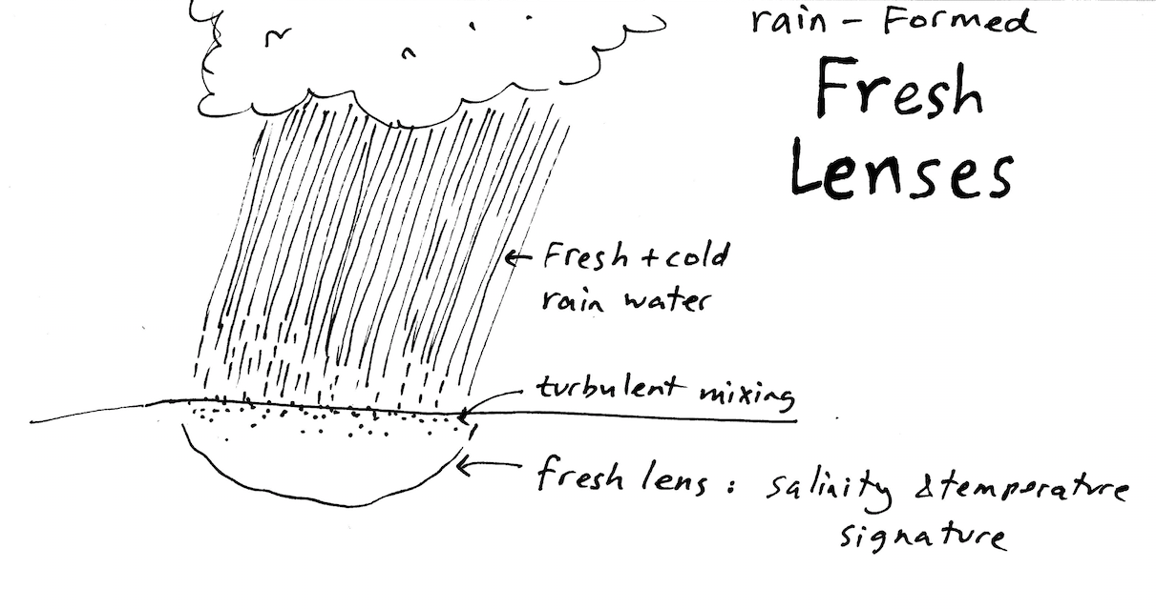
Impacts:
Ocean turbulence
SST --> Rain
Hydrologic and energy budgets
Illustration c/o
Kyla Drushka
Fresh water
Salt water
Miller et al. 1976, Anderson et al. 1996, Soloviev and Lukas 2006, Drushka et al, 2014a,b, 2016, Asher et al. 2014, Boutin et al. 2014, Thompson et al. in prep
E. J. Thompson AMS Radar 2017

