Slide 1
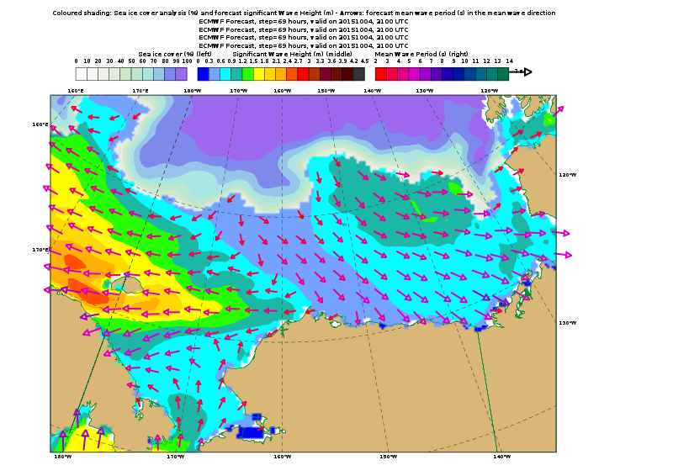
ECMWF Model
Oct 4, 1PM LT

Slide 2
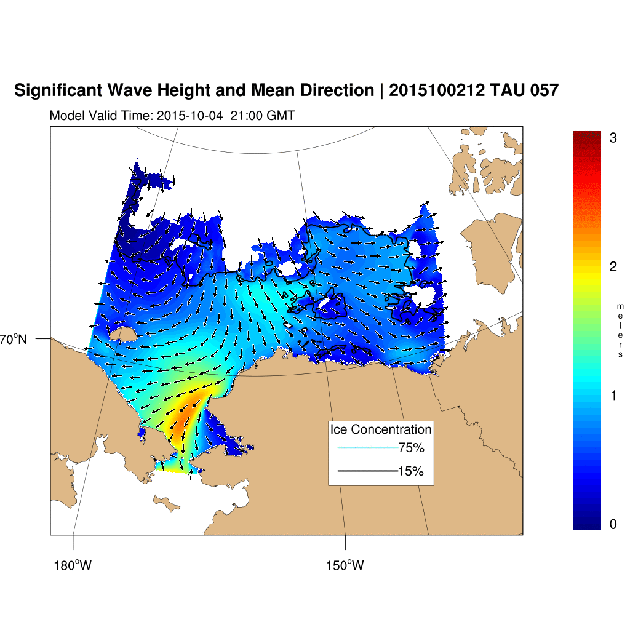
NRL wave model
Run Shore-side
*Good ice*
Oct 4, 1PM LT

Slide 3
NRL wave model
Run Ship-side
Oct 4, 1PM LT

Slide 4
NRL wave model
Run Ship-side
Oct 5, 1PM LT

Slide 5
NRL wave model
Run Ship-side
Oct 6, 1PM LT

